Slide 1
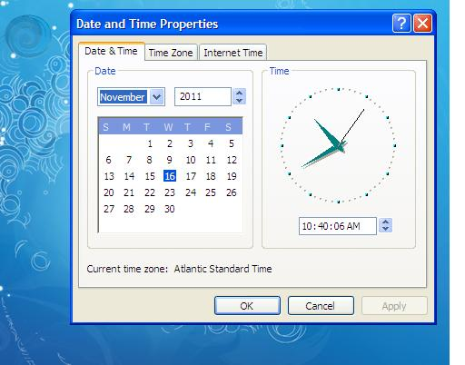
Double click on laptop clock to get the “analog” clock and the current time showing in hh:mm:ss format in upper right corner of laptop desktop.

Slide 2
Laptop clock should always be set to Eastern Daylight Time (EDT), corresponding to the time of summer.

Slide 3
Check that the laptop time is very close (within one minute) to the GPS (atomic clock) time at the beginning of a day of rain gauge data collection.

Slide 4
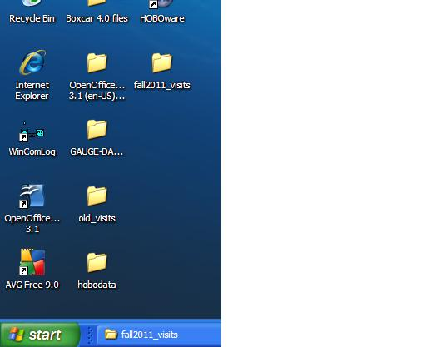
WinComLog shortcut icon is found on desktop (lower left corner)

Slide 5
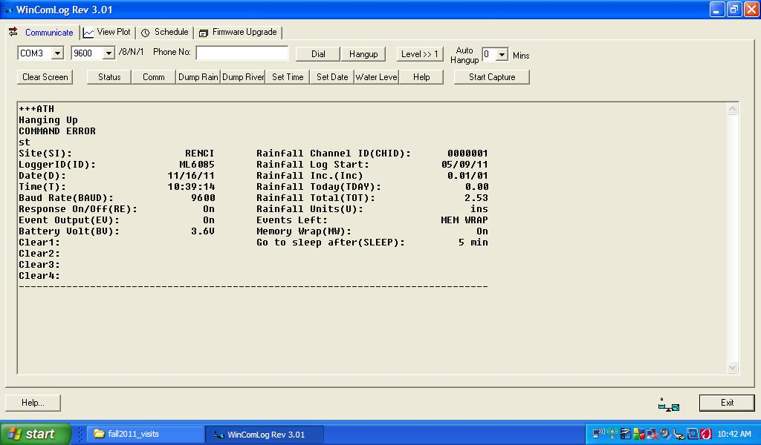
Click on the WinComLog desktop icon to get this window. Type “st” to get the status of the ML1 data logger after connecting the serial port cables to the laptop.

Slide 6
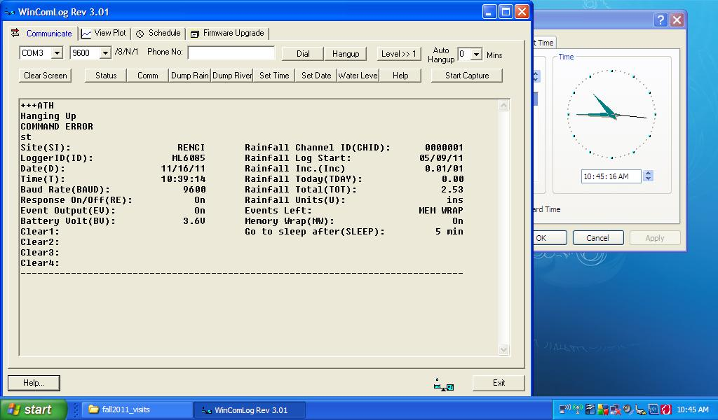
Shrink the WinComLog window so that it and the clock window can be seen at the same time. Prepare to do a Raw (*.txt) data capture to document the status of the ML1 logger into a permanent file. Click “Start Capture.”

Slide 7
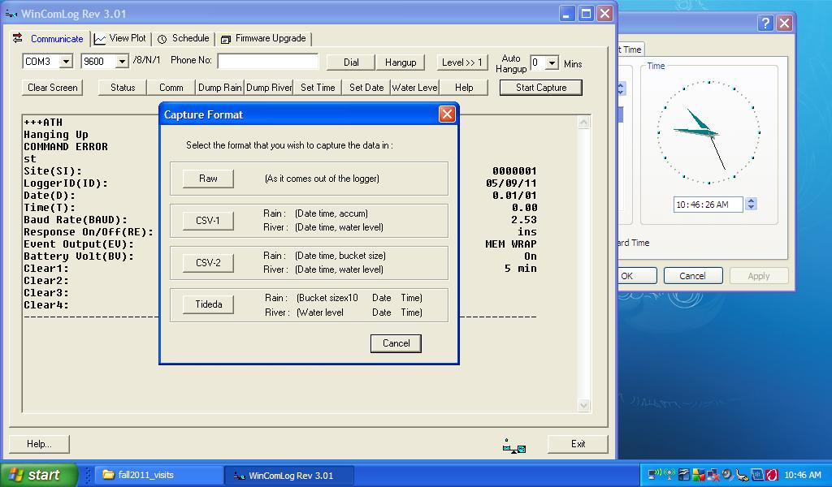
Select “Raw” to document the ML1 logger status.

Slide 8
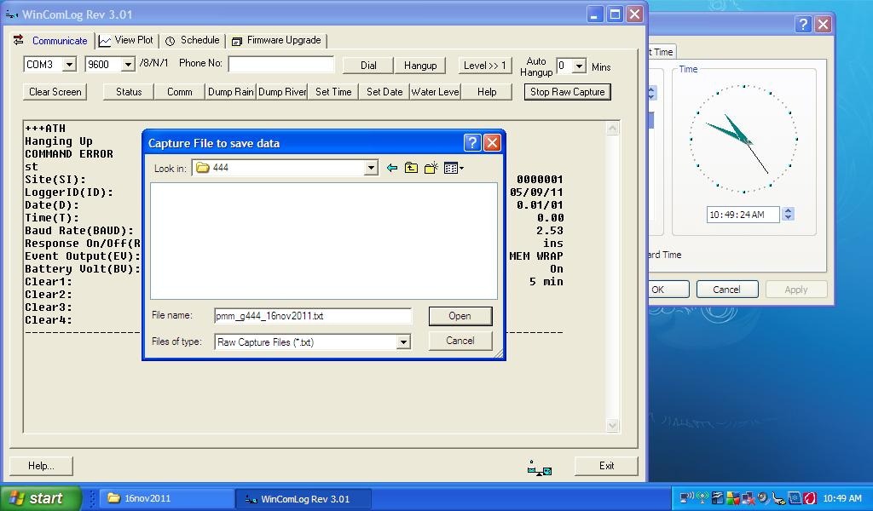
Save to a file having the naming convention “pmm_g###_16nov2011.txt” where “###” is the three digit gauge number ( gauge #3 would be “003” ) into the appropriate desktop folder. Use the appropriate date rather than “16nov2011”.

Slide 9
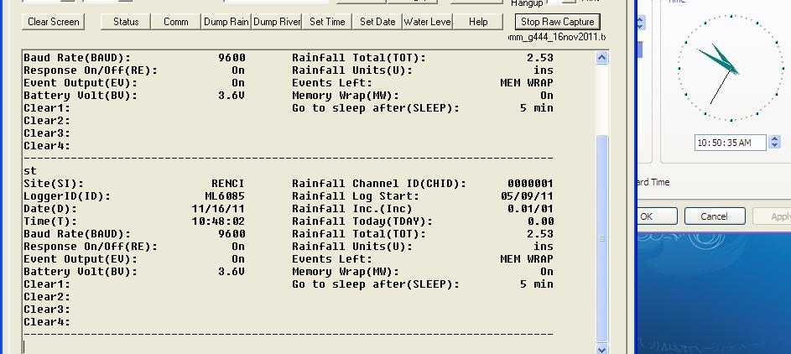
You should see “Stop Raw Capture” if you have successfully opened an output file.

Slide 10
Enter the “st” command again to get the ML1 status information dumped into the output file.

Slide 11
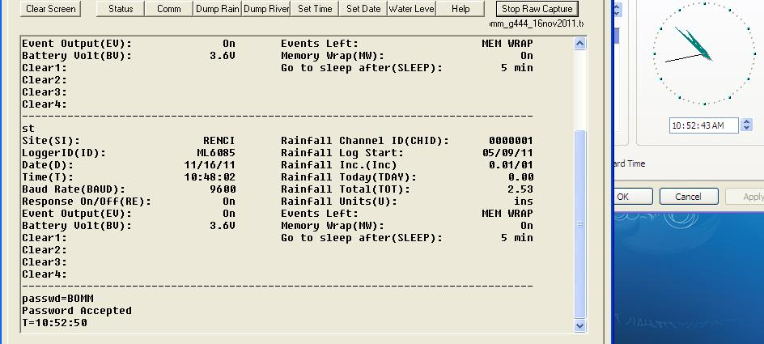
You notice that the ML1 time and the laptop (GPS atomic clock) time are different by more than one minute. To change the time, you’ll need to enter the ML1 password using the “passwd” command.

Slide 12
You’ll enter a FUTURE time using the “T=hh:mm:ss” command so that you have enough time to hit the laptop “enter” key to within one second of what the laptop clock window indicates
seven seconds future time…hit “enter” when laptop clock indicates “10:52:50”

Slide 13
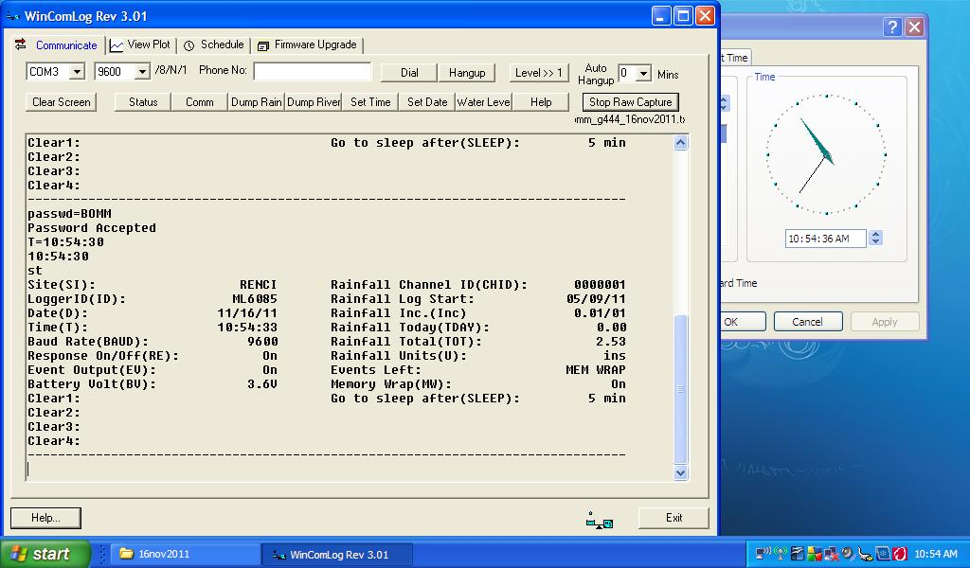
Type the status (“st”) command again to document in the output file that the time was changed. Be certain to note in the field logbook the time that the logger was changed FROM and the time that it was changed TO (very important!!).

Slide 14
Also check that the ML1 logger has the proper date. This particular logger has the format “mo/da/yr”, however, many loggers have the format “da/mo/yr”.

Slide 15
If the ML1 logger has the incorrect date. Use the “D=dd/mm/yy” or “D=mm/dd/yy” command and format that is appropriate for this particular logger. You might have to re-enter the password if you wait too long to make this correction.

Slide 16
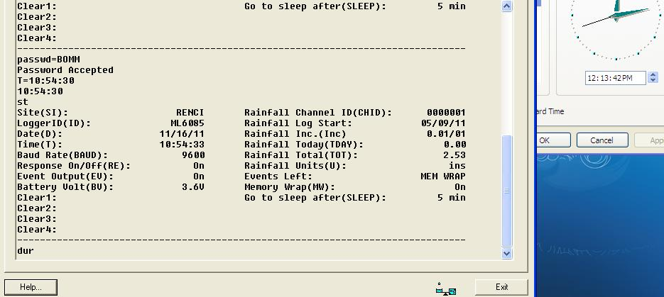
Now dump the rain gauge data into the same “Raw” output file using the “dur” command.

Slide 17
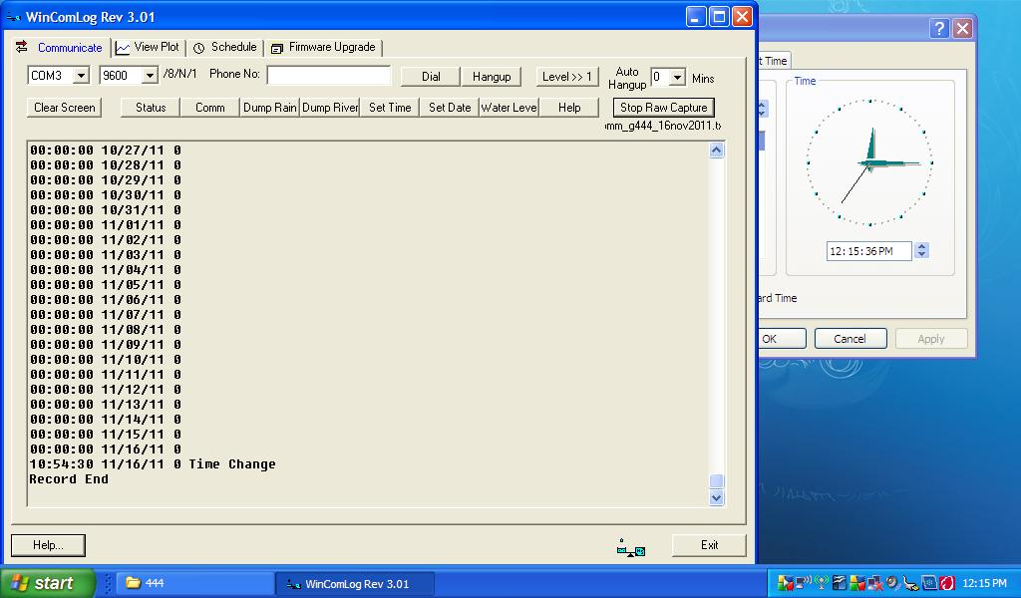
At the end of the gauge data dump, make sure that the most recent date showing is correct to insure that the record was somehow not terminated prematurely. Examining this data record will also help you know the ML1 date format for this logger.

Slide 18
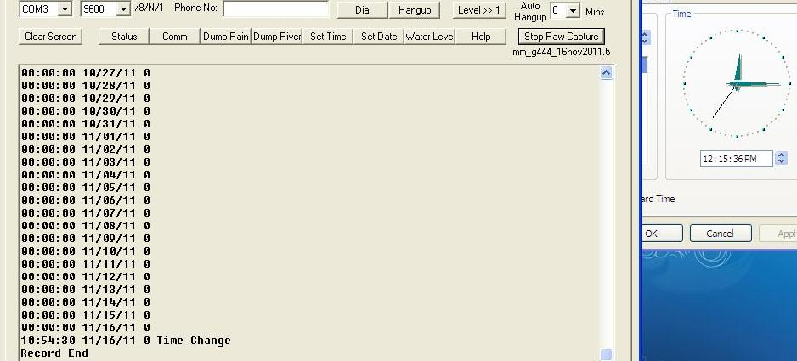
Now you can stop the “Raw” output file data capture by pressing the “Stop Raw Capture” button.

Slide 19
Select “CSV-1” to dump the rain gauge data to an Excel-compatible format file using the naming convention “pmm_g###_16nov2011.csv”.

Slide 20
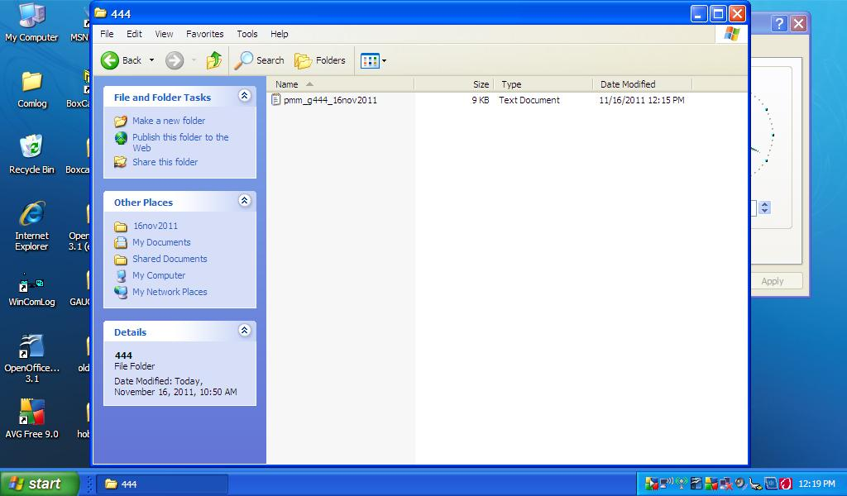
Check that downloaded *.txt and *.csv files have non-zero content (open them up with Wordpad and Excel, respectively).

Slide 21
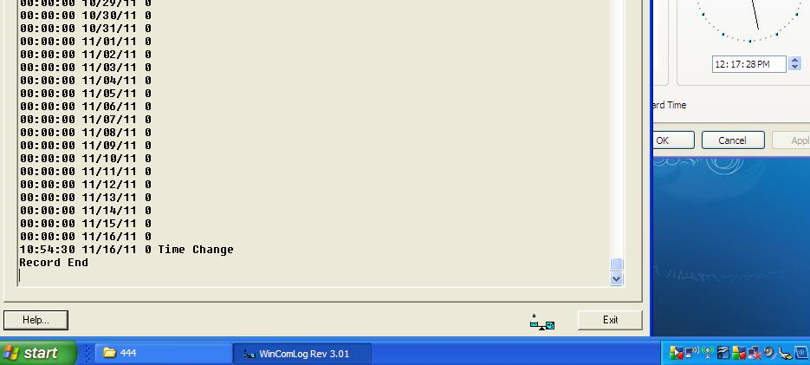
After completing both the “Raw” and “CSV-1” rain gauge data capture steps and checking that the file contents are NOT empty, click “Exit” to end the WinComLog session.

