Slide 1
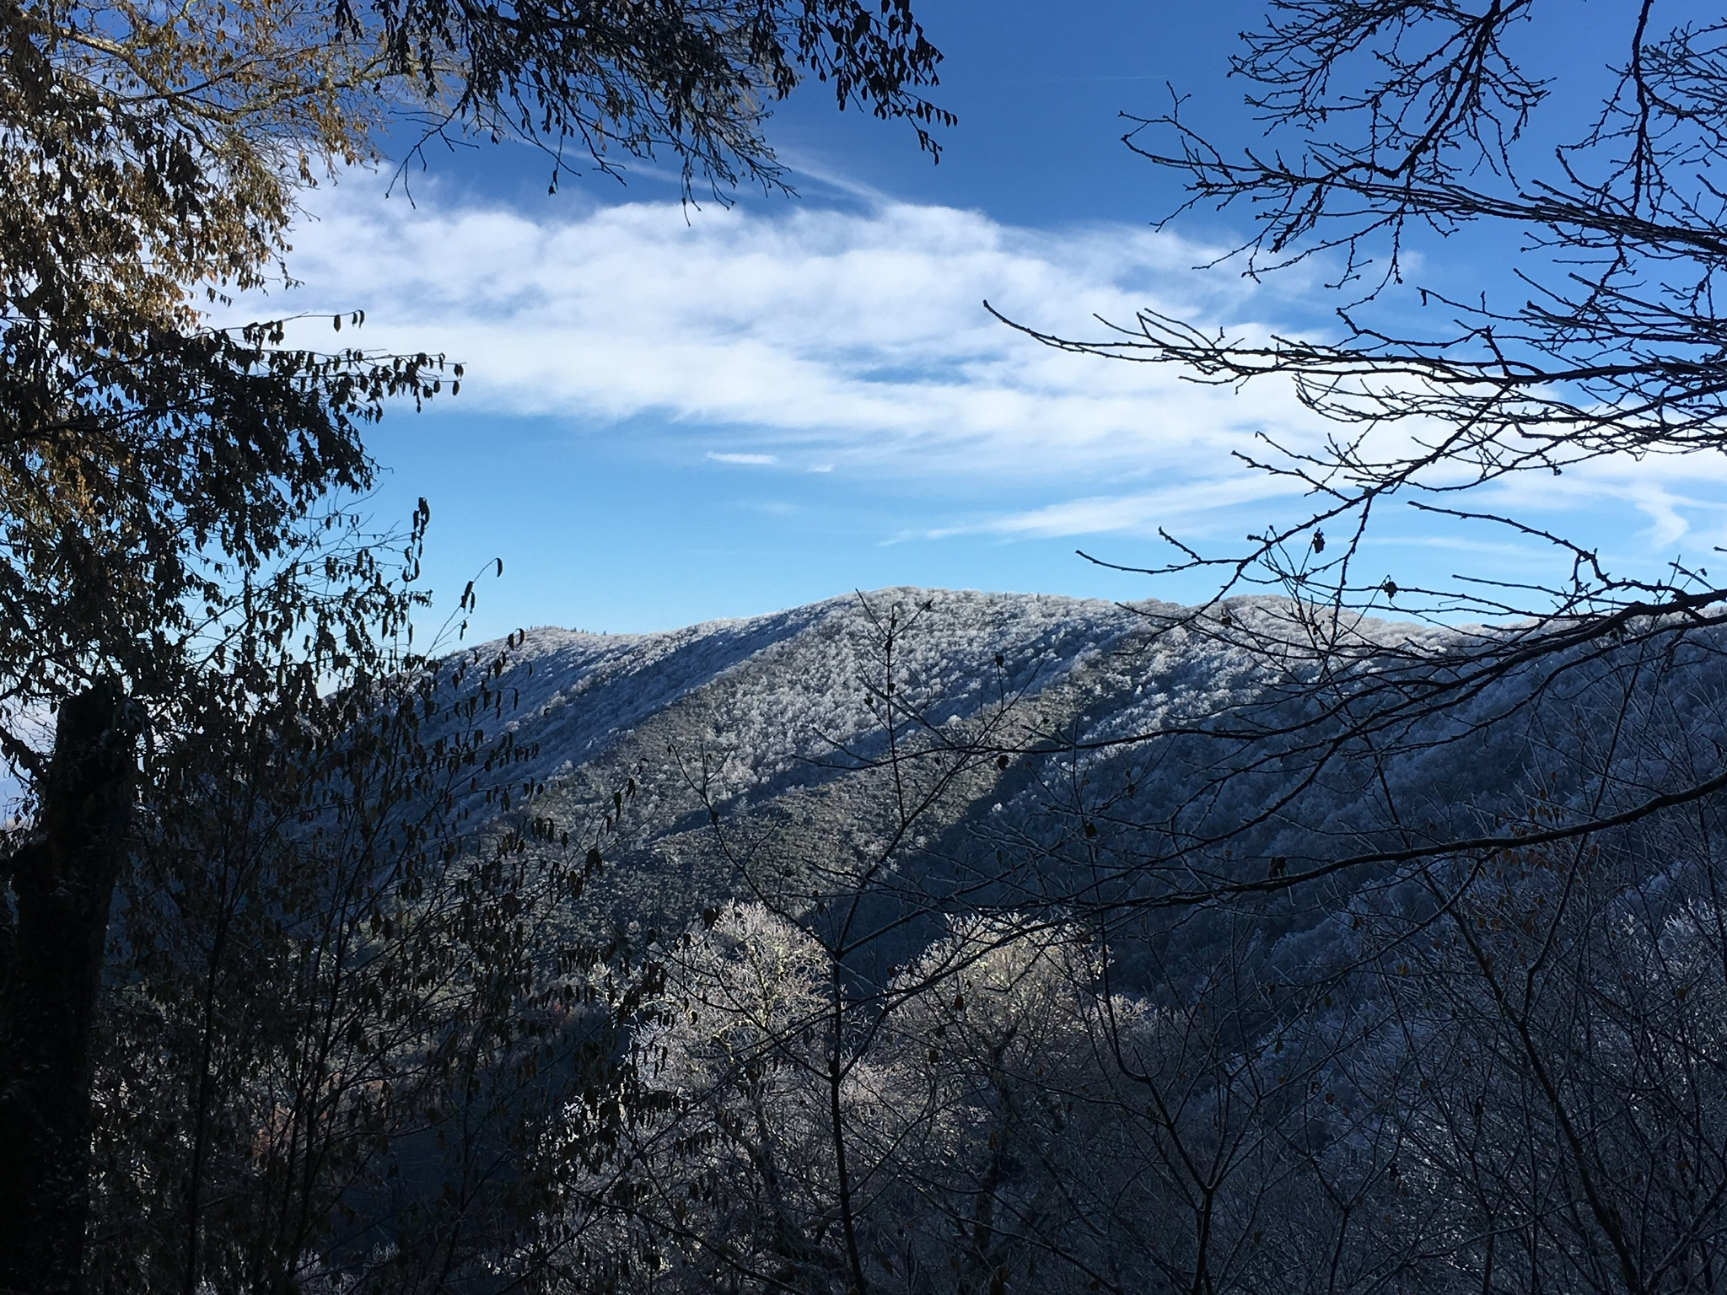
Salamanders of Sunup Knob

Slide 2
Motivation
Talking about climate change can seem very distant and abstract
Change in temperature
Change in precipitation
Rising sea levels

Slide 3
Motivation
Talking about climate change can seem very distant and abstract
Change in temperature
Change in precipitation
Rising sea levels
What impact will a changing climate have on something closer to home?

Slide 4
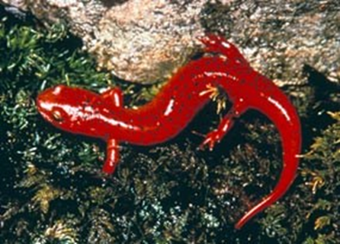
Motivation
Climate change impact on something closer to home…
https://www.nps.gov/grsm/learn/nature/amphibians.htm

Slide 5
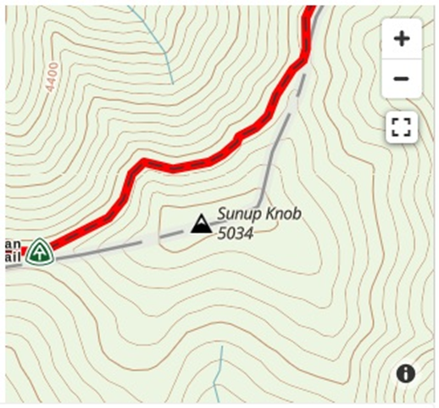
Motivation
Climate change impact on something closer to home…
35°44.7’N 83°10.2’W
https://www.gaiagps.com/hike/6957/sunup-knob-via-appalachian-trail/

Slide 6
Our Model
Salamanders (amphibians) rely on moist soil (23-30%) to remain healthy
Soil M [%] = Const [% yr/mm]*(Precip – Evap)[mm/yr]
precipitation
temperature

Slide 7
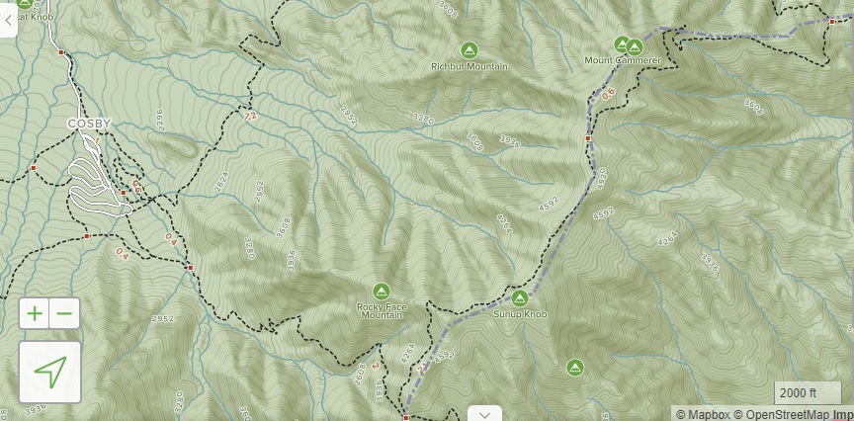
Our Model
Domain – Sunup Knob [5034 foot peak]
https://www.alltrails.com/explore/trail/us/north-carolina/big-creek?ref=sidebar-static-map
Annual mean (today)
Precipitation = 1900 mm/yr (74.8”)
Ground temperature = 12.0 ºC
Evaporation = 1330 mm/yr
Soil M = 27 %

Slide 8
Our Model
Salamanders (amphibians) rely on moist soil (23-30%) to remain healthy
Soil M [%] = 0.04737 [% yr/mm]*(1900 – Evap)[mm/yr]
precipitation
temperature

Slide 9
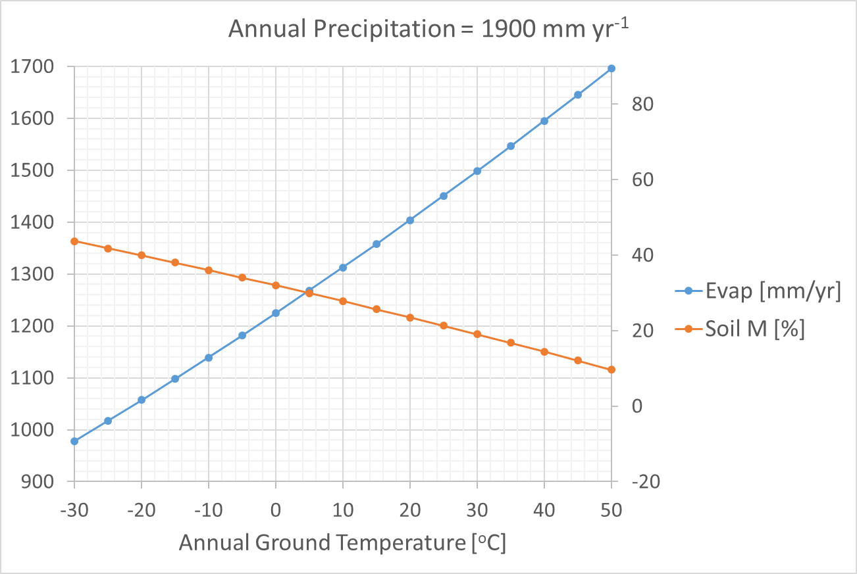

Slide 10
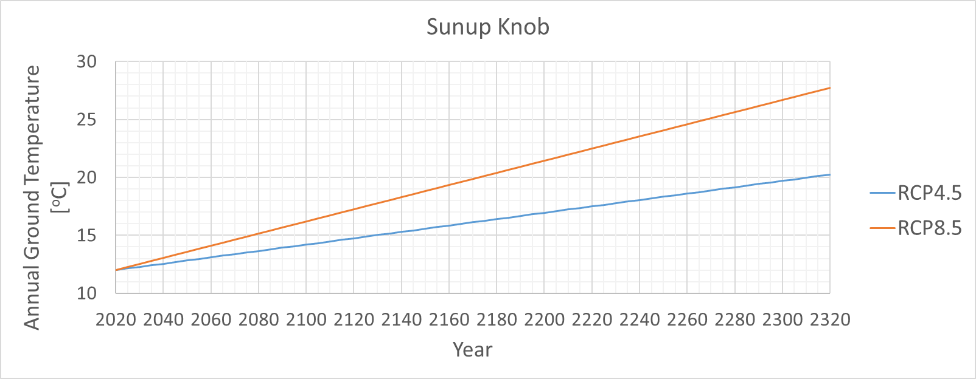
2170
2310
Spread of GCM predictions of annual ground temperature is shown at 2100

Slide 11
Motivation
How might the salamander adapt if the soil is becoming too dry?
https://www.nps.gov/grsm/learn/nature/amphibians.htm

Slide 12
Motivation
Hint:
ground temperature decreases 6.5ºC for every kilometer of ascent
evaporation of soil moisture decreases when ground temperature decreases
https://www.nps.gov/grsm/learn/nature/amphibians.htm

Slide 13
A.G.T. = 14.1ºC
1524 meters
610 meters
A.G.T. = 20.0ºC
Sunup Knob

Slide 15
2170
2310
Spread of GCM predictions of annual ground temperature is shown at 2100

Slide 16
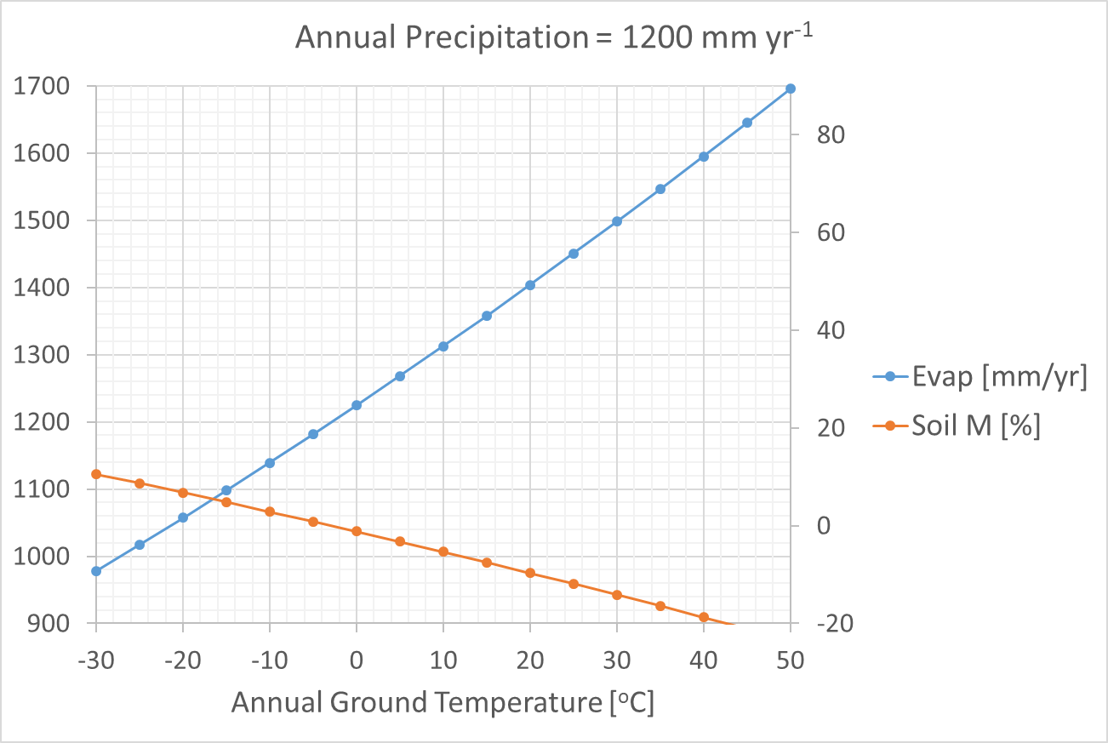

Slide 17
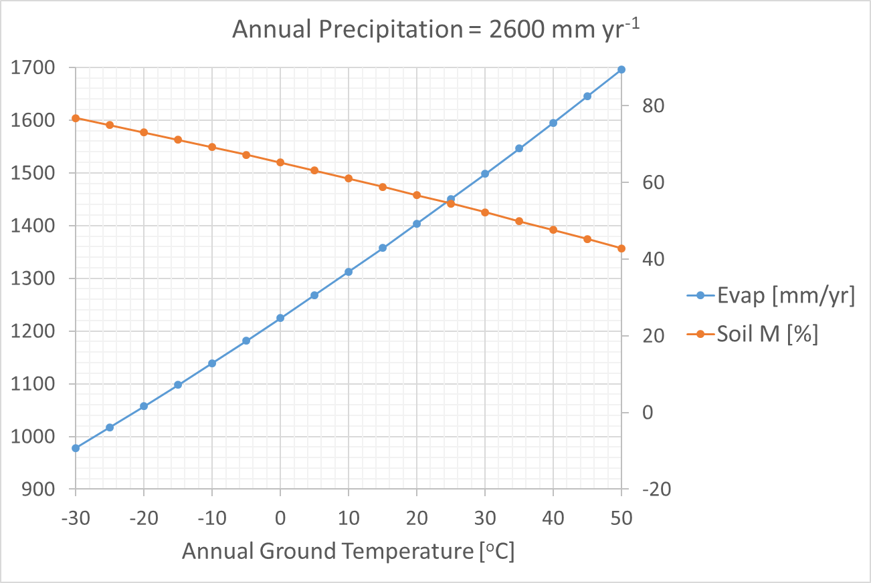

Slide 18
Extras…

Slide 19
https://www.nps.gov/grsm/learn/nature/amphibians.htm
https://www.gaiagps.com/hike/6957/sunup-knob-via-appalachian-trail/

Slide 20
Our Model
Domain – Sunup Knob [5034 foot peak]
Annual (today)
Precipitation = 1900 mm/yr (74.8”)
Ground temperature = 12.0 ºC
Evaporation = 1330 mm/yr
Soil M = 30 %

Slide 21
Our Model
Salamanders (amphibians) rely on moist soil (23-30%) to remain healthy
Soil M [%] = 0.05263 [% yr/mm]*(1900 – Evap)[mm/yr]
precipitation
temperature

Slide 22
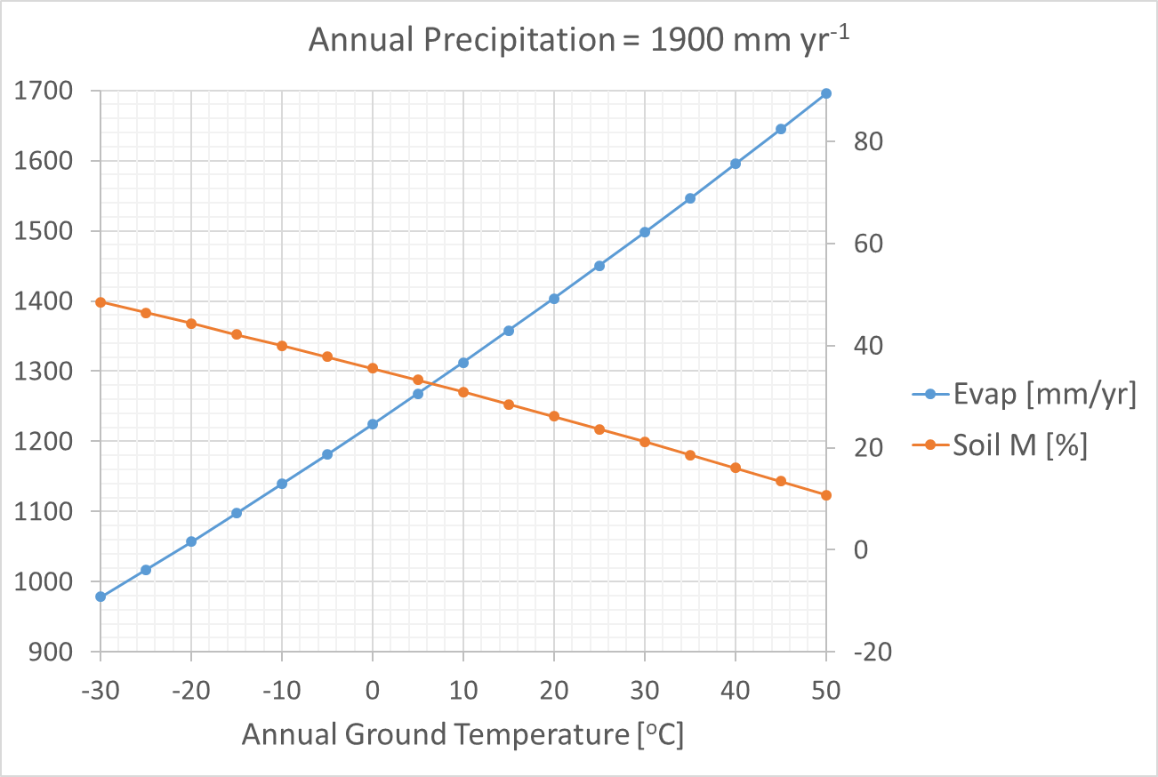

Slide 23
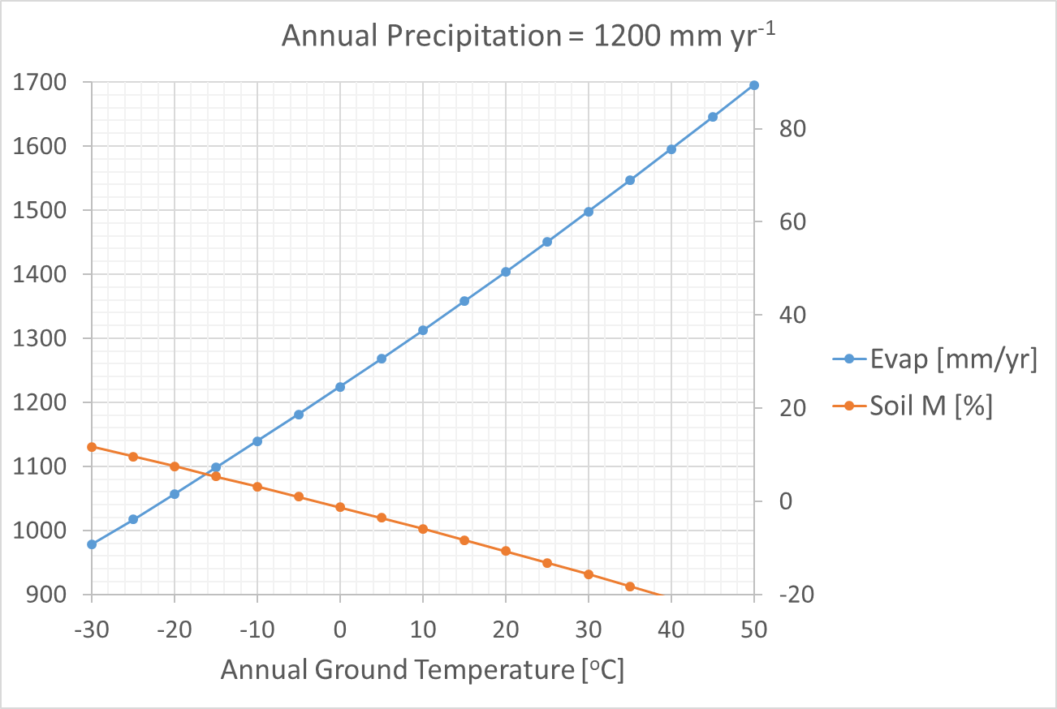

Slide 24
