Slide 1
Weather-related Professional Learning Experience
Session 2
Douglas K. Miller
Professor, Atmospheric Sciences Department
UNC Asheville
dmiller@unca.edu

Slide 2
Outline
A tale of two cities (air pressure continued)
Fronts
Jet streams
El Niño/La Niña
Activities (outside and KH, Rooms 036 and 037)
(Karpen Hall, Room 038)

Slide 3
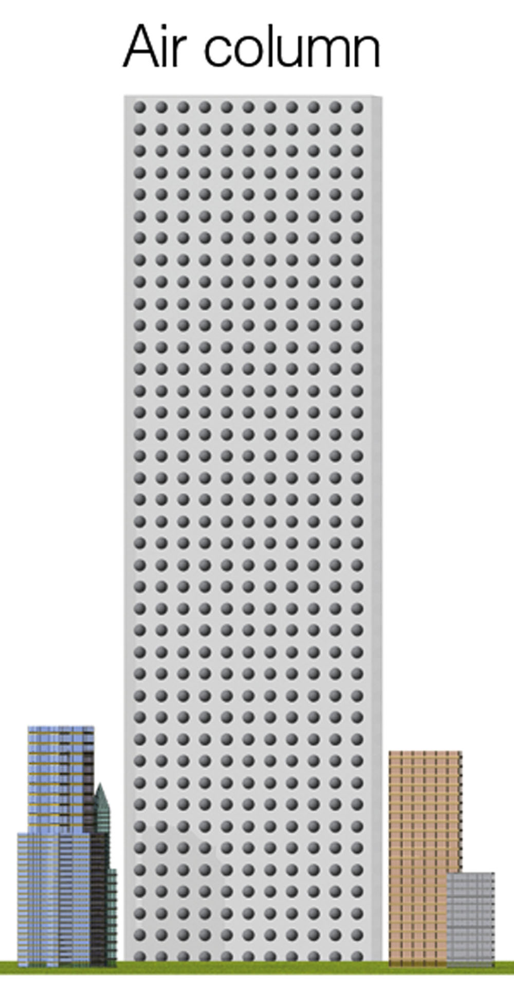
A tale of two cities
First, a closer look at air pressure…
  I go swimming
Lecture Packet #6

Slide 4
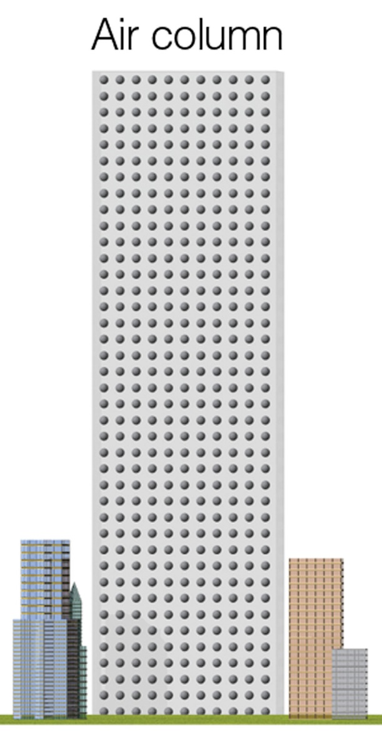
A tale of two cities
Warm air over City A
Cool air over City B
Two columns of air, initially equal temperature and height
Same air pressure
p ~ T x ρ
p is pressure
T is temperature
ρ (rho) is density
Lecture Packet #6

Slide 5
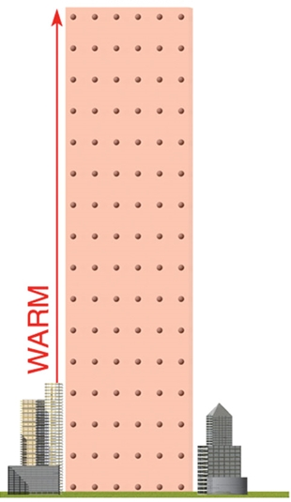
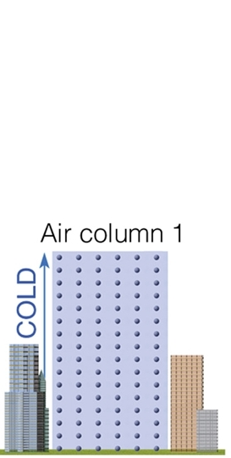
A tale of two cities
Warm air over City A
Cool air over City B
Lecture Packet #6

Slide 6
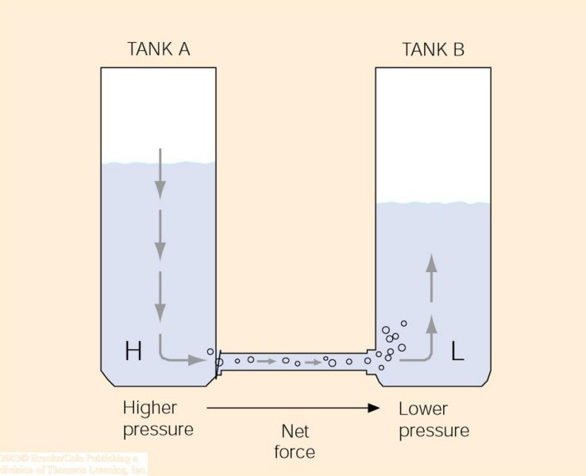
A tale of two cities
The higher water level creates higher fluid pressure at the bottom of tank A and a net force directed toward the lower fluid pressure at the bottom of tank B. This net force causes water to move from higher pressure toward lower pressure.
Since it is easier to visualize a tank of water than a tank of air…
Lecture Packet #6

Slide 7
Fronts
Air masses
Source Regions – are regions where air masses originate. In order for a huge air mass to develop uniform characteristics, its source region should be generally flat and of uniform composition with light surface winds.
  The longer air remains stagnant over its source region, the more likely it will acquire properties of the surface below.
  Best source regions are usually dominated by High Pressure [e.g. ice and snow covered arctic plains and subtropical oceans and desert regions.]
Lecture Packet #8

Slide 8
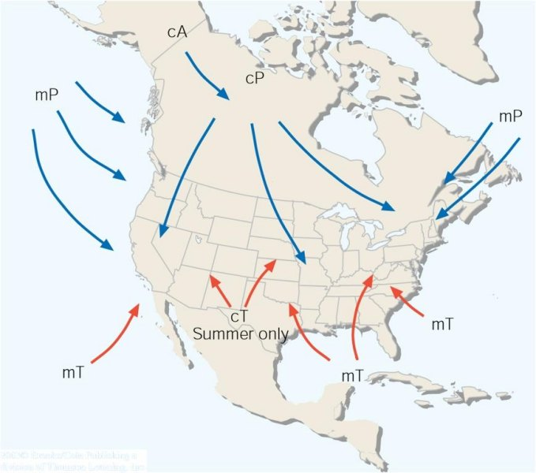
Air mass source regions and their paths.
Lecture Packet #8

Slide 9
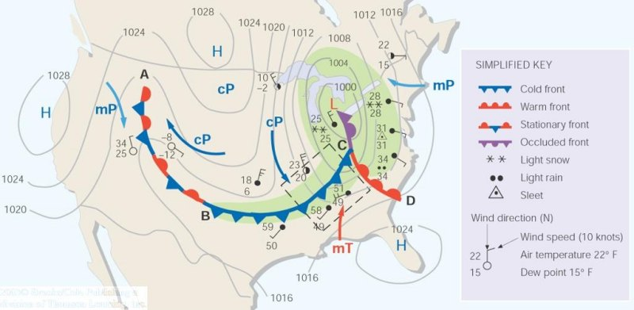
A weather map showing surface-pressure systems, air masses, fronts, and isobars (in millibars) as solid gray lines. Large arrows in color show air flow. (Green-shaded area represents precipitation.)
Lecture Packet #8

Slide 10
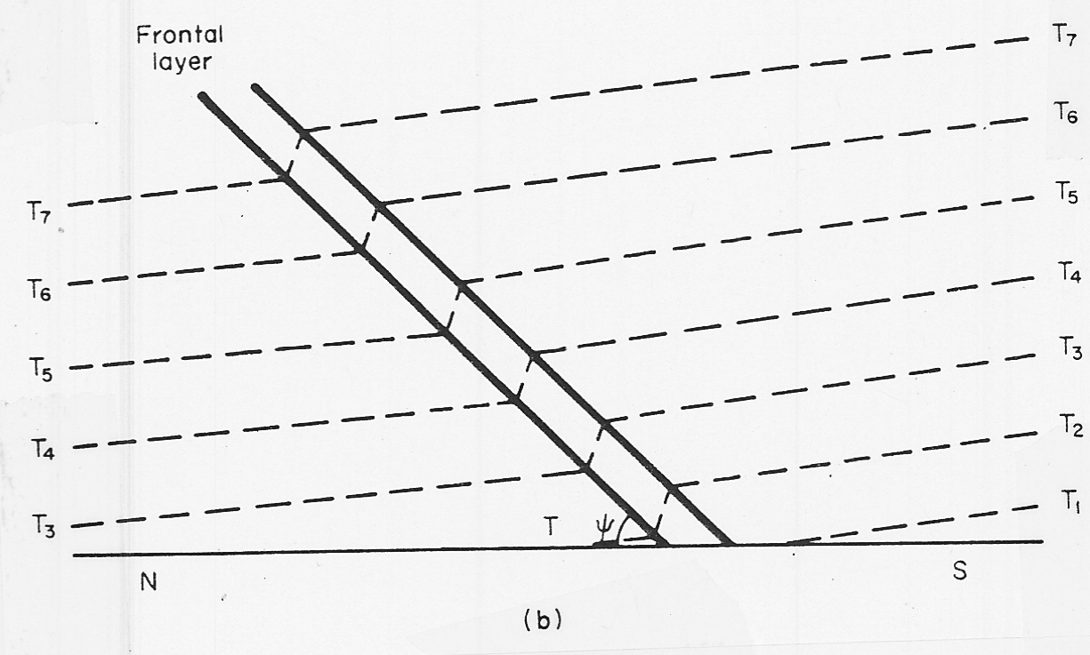
Fronts
[ aka frontal zone ]
cold air
warm air
T₇ < T₆ < T₅ < T₄ < T₃ < T₂ < T₁
T = air temperature

Slide 11
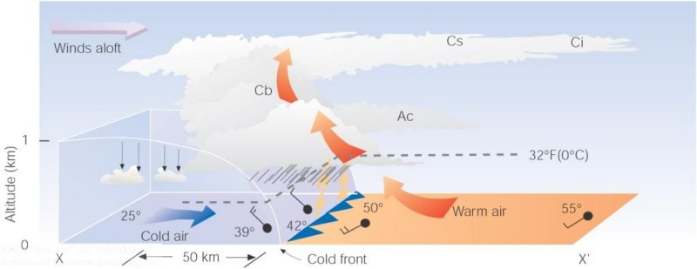
A vertical view of the weather across a cold front
Lecture Packet #8

Slide 12
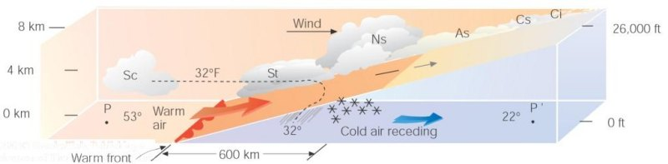
A vertical view of the weather across a warm front
Lecture Packet #8

Slide 13
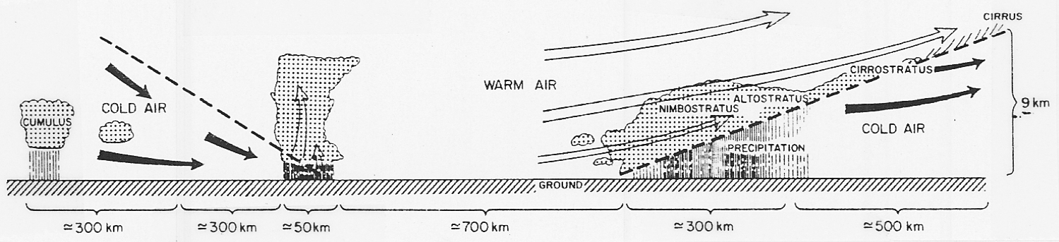
Fronts
Observed Structure of Fronts
  Associated cloud structure
    Norwegian school (Bjerknes and Solberg 1922)

Slide 14
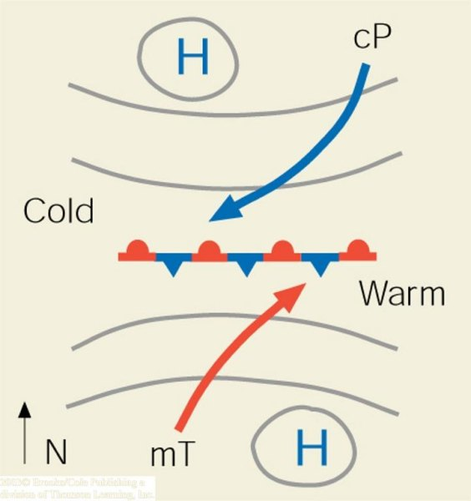
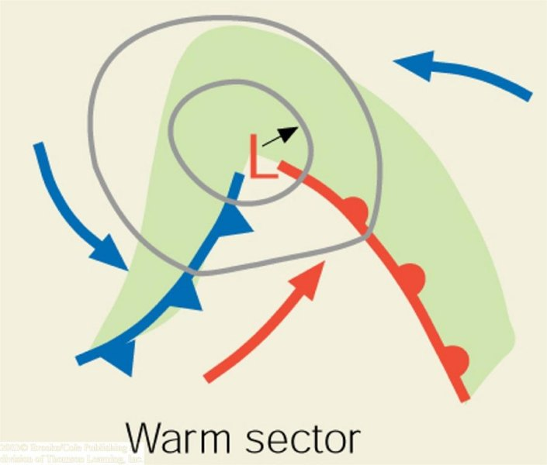
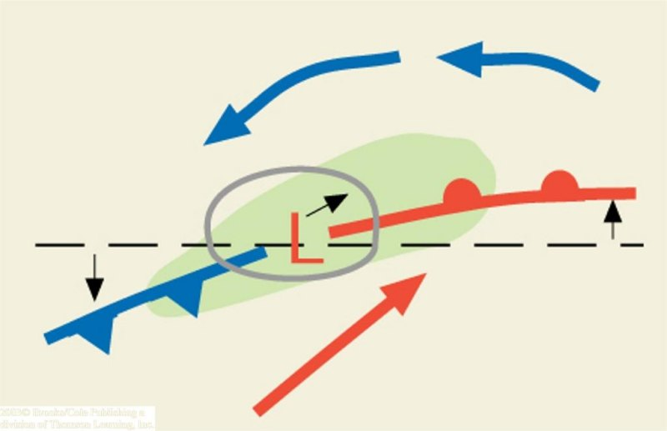
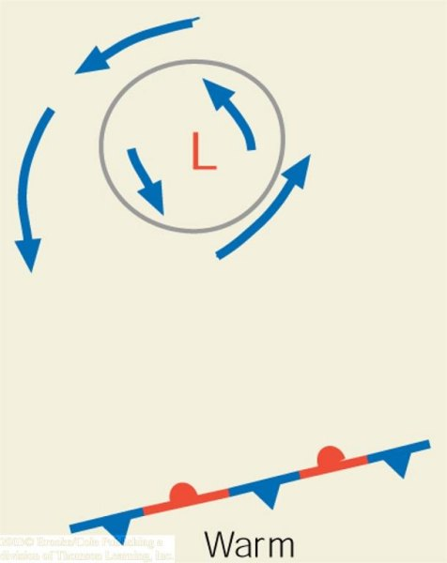
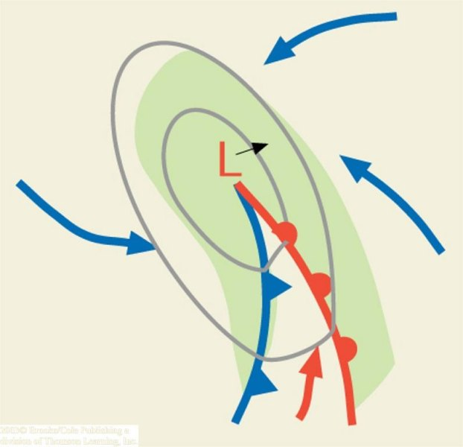
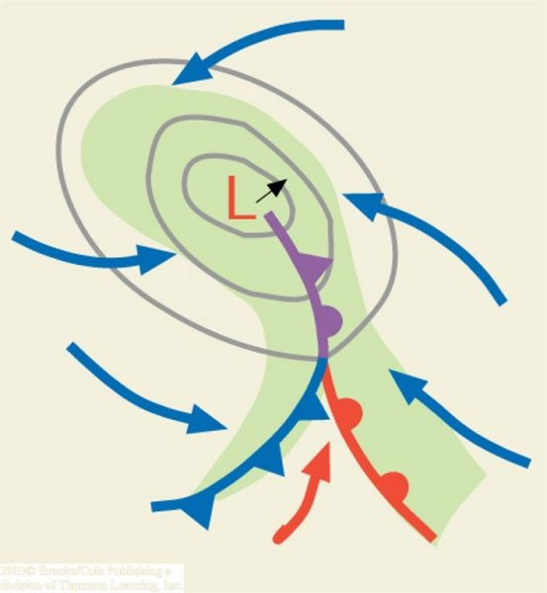
‘trigger’
cyclogenesis
(a)
(b)
(c)
N.H.
(d)
(e)
(f)
Lecture Packet #8

Slide 15
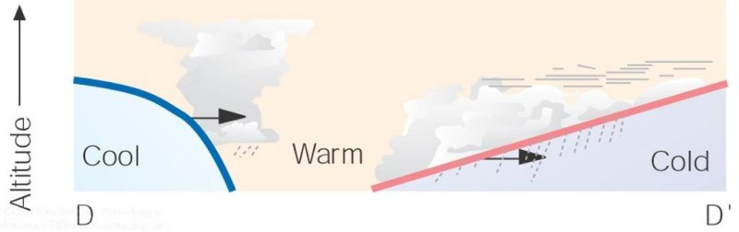
Fronts
Lecture Packet #8

Slide 16
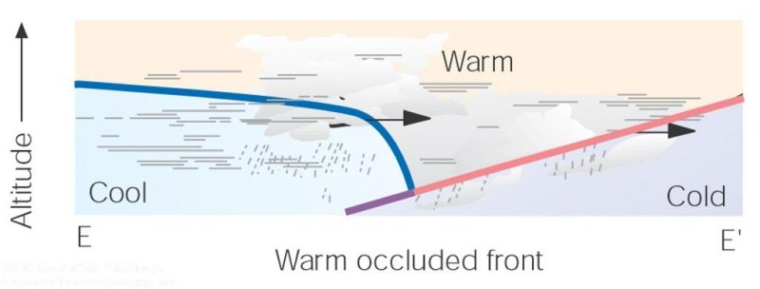
Fronts
Lecture Packet #8

Slide 17
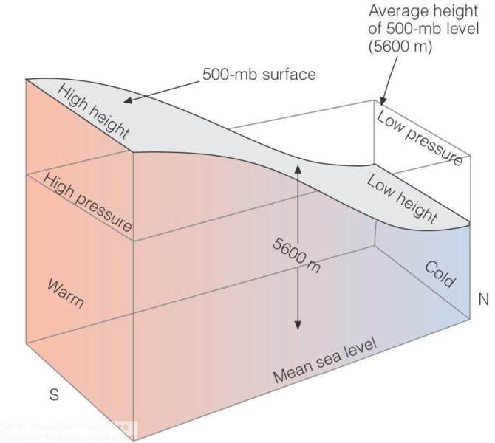
Jet streams
Lecture Packet #6

Slide 18
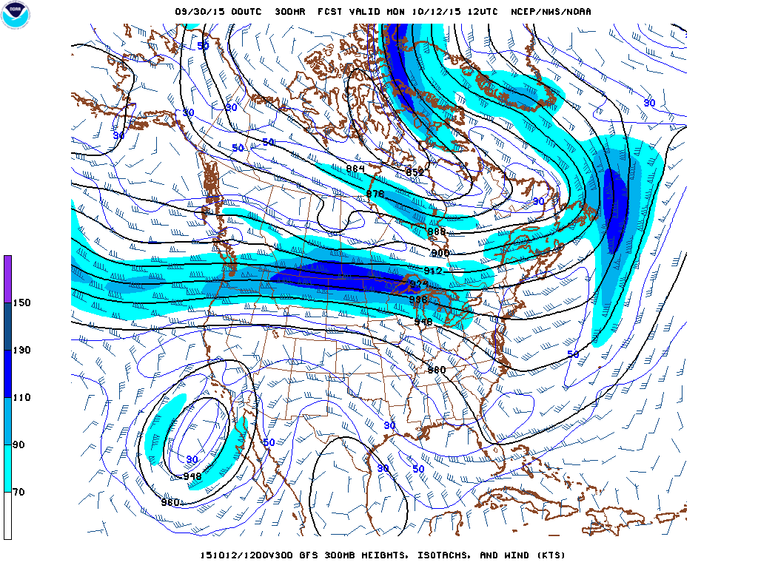
Jet streams
127 mph
http://mag.ncep.noaa.gov/model-guidance-model-area.php#

Slide 19
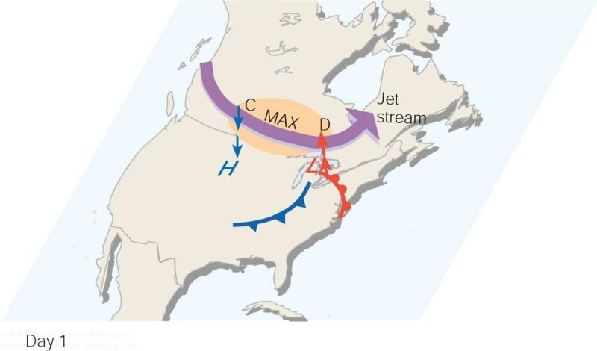
As the polar jet stream and its area of maximum winds (the jet streak, or MAX). Swings over a developing mid-latitude cyclone, an area of divergence (D) draws warm surface air upward, and an area of convergence (C) allows cold air to sink. The jet stream removes air above the surface storm, which causes surface pressures to drop and the storm to intensify.
Lecture Packet #8

Slide 20
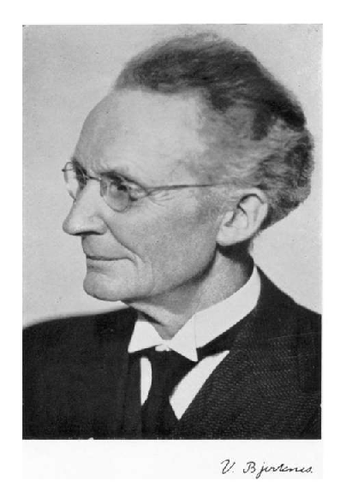
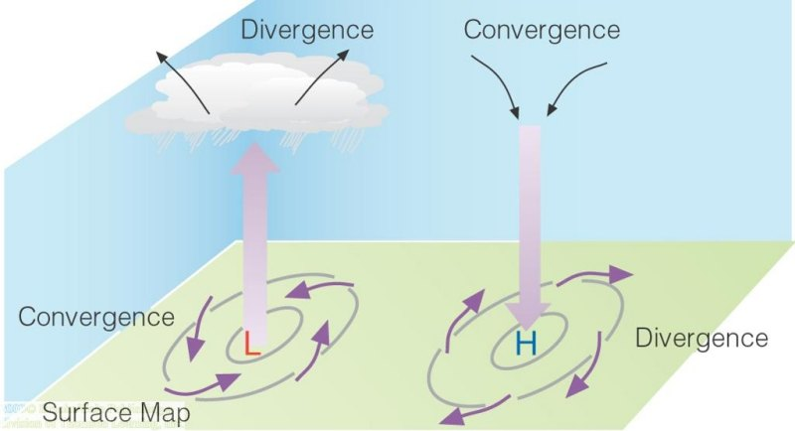
Pressure systems
Some challenges (1908)…
  ‘Strassburg Low’
  Surface convergence over the center of an intensifying cyclone
Vilhelm Bjerknes
Lecture Packet #6

Slide 21
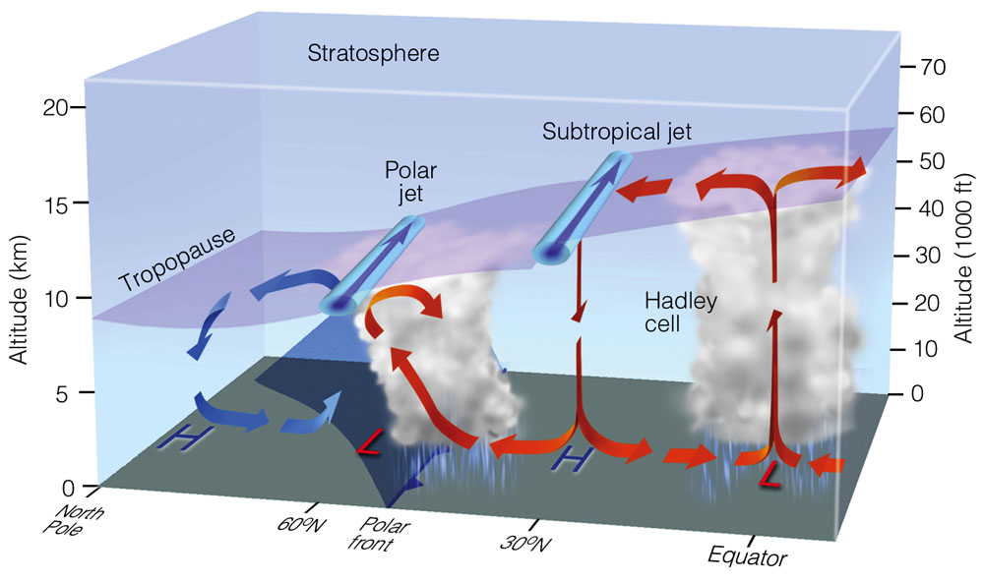
Lecture Packet #7
Notes:
Figure 7.31: Average position of the polar jet stream and the subtropical jet stream, with respect to a model of the general circulation in winter. Both jet streams are flowing from west to east.

Slide 22
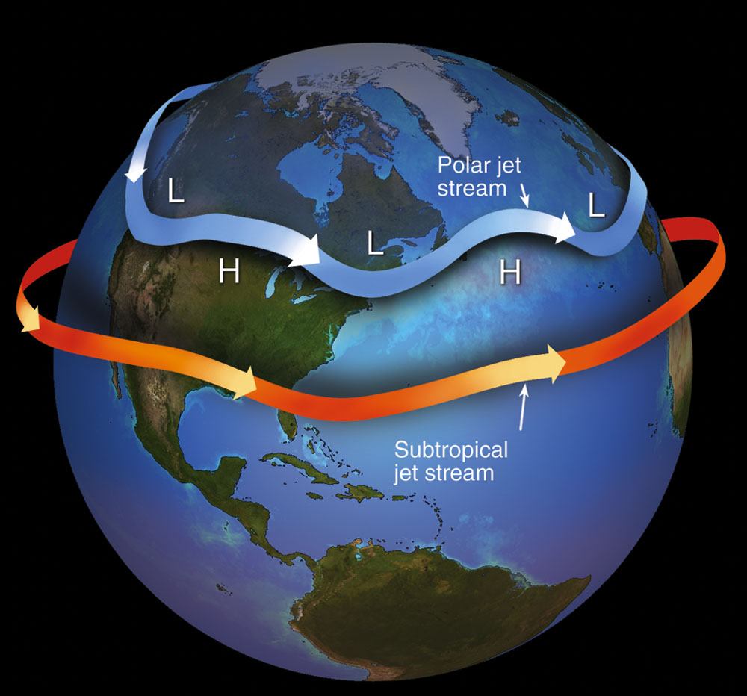
Lecture Packet #7
Notes:
Figure 7.32: Jet streams are swiftly flowing currents of air that move in a wavy west-to-east direction. The figure shows the position of the polar jet stream and subtropical jet stream in winter. Although jet streams are shown as one continuous river of air, in reality they are discontinuous, with their position varying from one day to the next.

Slide 23
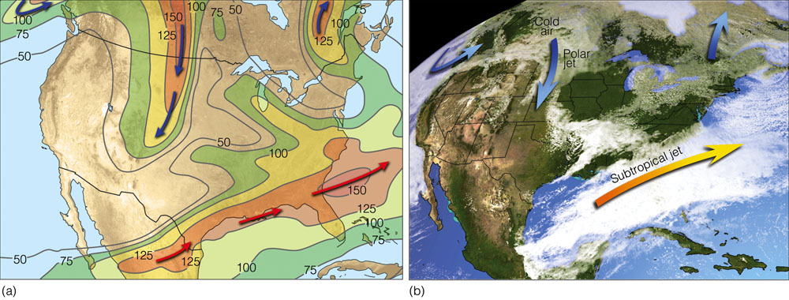
Lecture Packet #7
Notes:
Figure 7.33: (a) Position of the polar jet stream (blue arrows) and the subtropical jet stream (orange arrows) at the 300-mb level (about 9 km or 30,000 ft above sea level) on March 9, 2005. Solid lines are lines of equal wind speed (isotachs) in knots. (b) Satellite image showing clouds and positions of the jet streams for the same day.

Slide 24
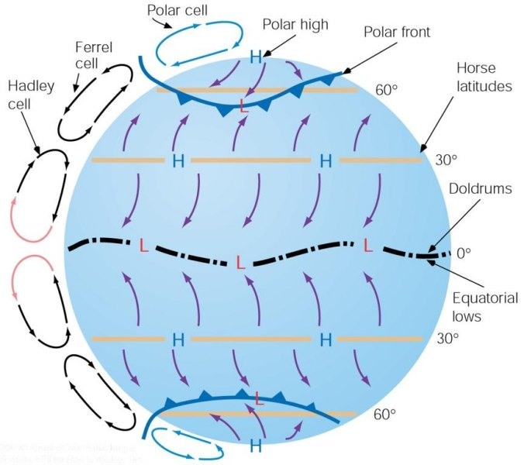
El Niño/La Niña
Trade winds – blow from northeast in N. Hemi and southeast in S. Hemi
Intertropical Convergence Zone – Surface region of convergence between trades
Subtropical Highs – semipermanent high in the subtropical high pressure belt centered near 30° latitude. Bermuda high, Pacific Ridge.
Westerlies – prevailing westerly flow
Lecture Packet #7

Slide 25
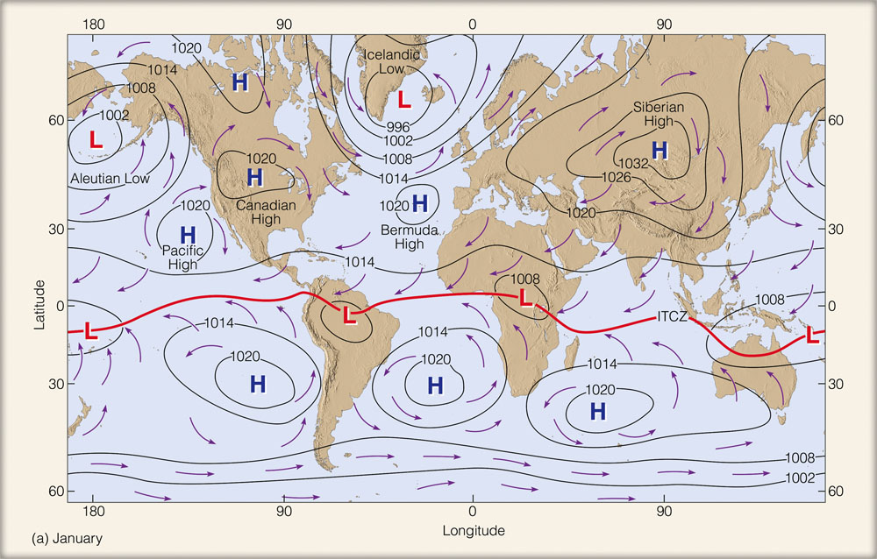
January
Lecture Packet #7
Notes:
Figure 7.27: Average sea-level pressure distribution and surface wind-flow patterns for January (a) and for July (b). The solid red line represents the position of the ITCZ.

Slide 26
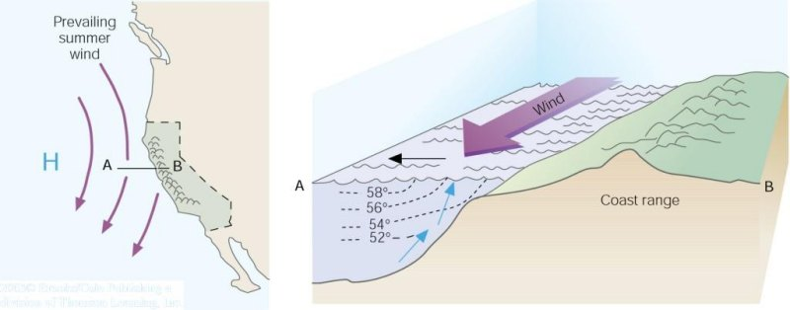
Upwelling
As winds blow parallel to the west coast of North America, surface water is transported to the right (out to sea). Cold water moves up from below (upwells) to replace the surface water.
Lecture Packet #7

Slide 27
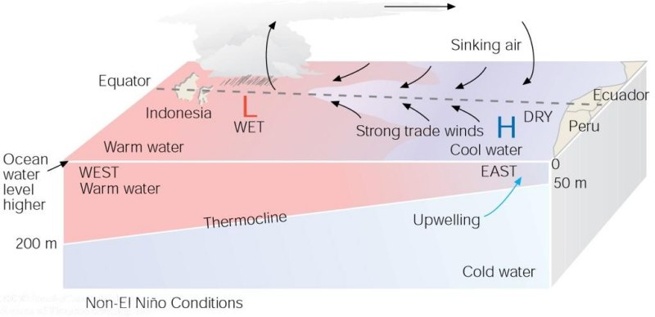
Under ordinary conditions, higher pressure over the southeastern Pacific and lower pressure near Indonesia produce easterly trade winds along the equator. These winds promote upwelling and cooler ocean water in the eastern Pacific, while warmer water prevails in the western Pacific. When the trades are exceptionally strong, water along the equator in the eastern Pacific becomes quite cool. This cool event is called La Niña.
Lecture Packet #7

Slide 28
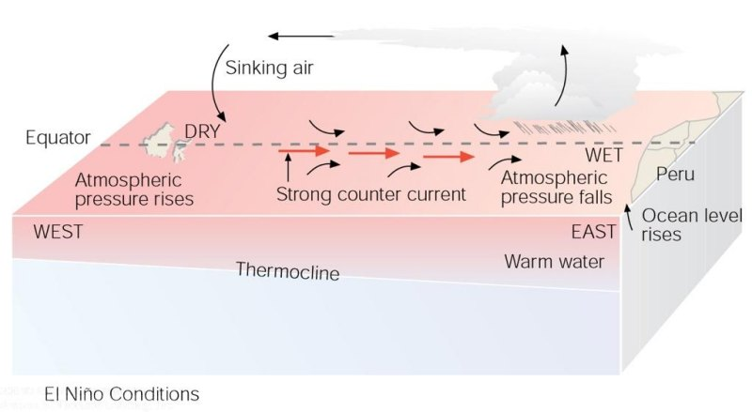
During El Niño conditions, atmospheric pressure decreases over the eastern Pacific and rises over the western Pacific. This change in pressure causes the trades to weaken or reverse direction. This situation enhances the countercurrent that carries warm water from the west over a vast region of the eastern tropical Pacific. The thermocline, which separates the warm water of the upper ocean from the cold water below, changes as the ocean conditions change from non-El Niño to El Niño.
Lecture Packet #7

Slide 29
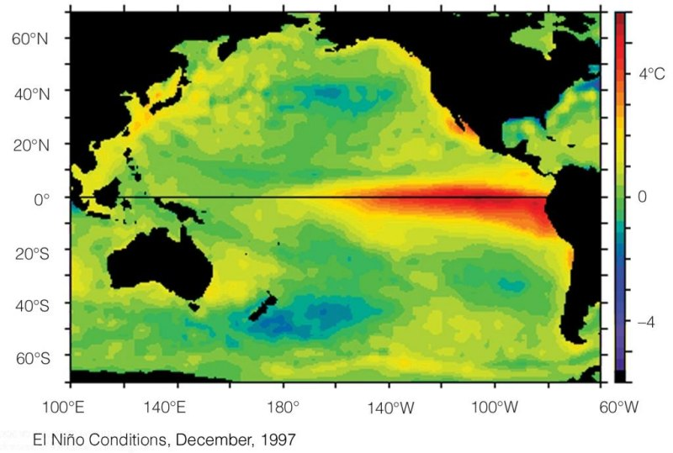
Average sea surface temperature departures from normal as measured by satellite.
(a) During El Niño conditions, upwelling is greatly diminished and warmer than normal water (deep red color), extends from the coast of South America westward, across the Pacific.
Lecture Packet #7

Slide 30
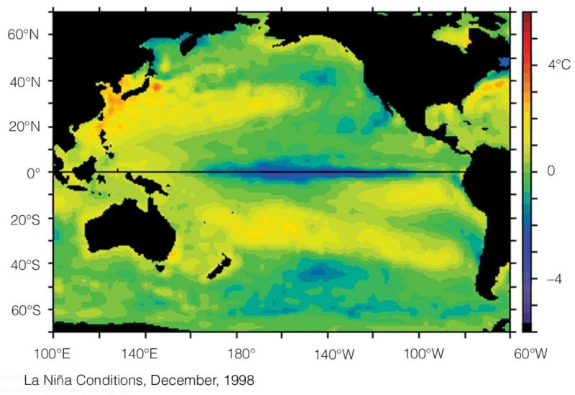
During La Niña conditions, strong trade winds promote upwelling, and cooler than normal water (dark blue color) extends over the eastern and central Pacific.

Slide 31
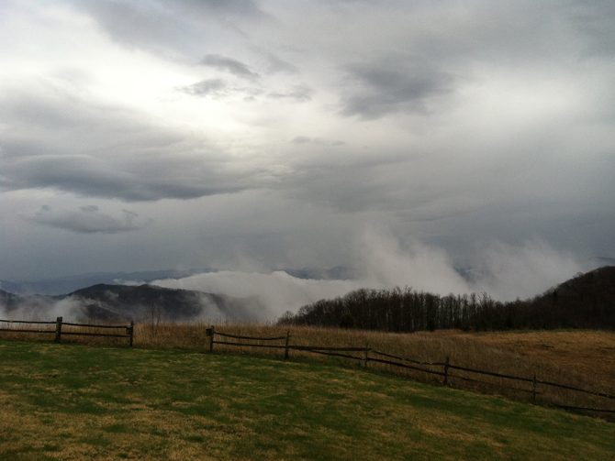
Outdoor activity {weather permitting}
Using our senses to nowcast the weather (0-6 hours into the future)
http://www.nasa.gov/topics/earth/features/smokies.html

Slide 32
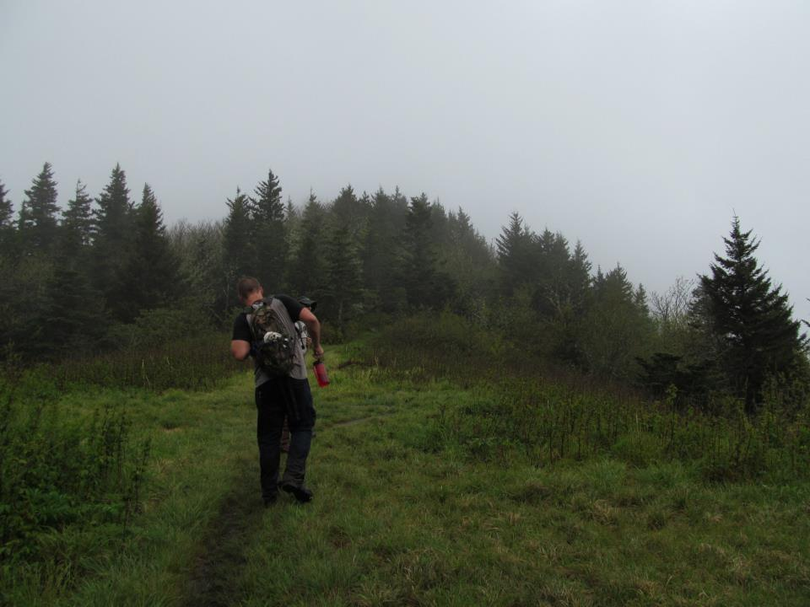
Weather-related safety issues
Hypothermia
  strong winds, cold air, damp clothing
Electrocution
  thunderstorms
Drowning
  persistent or sudden intense rainfall
Blunt force trauma
  wind-throw, slipping and falling, rock slides/ debris flows
Courtesy: Daniel Martin

Slide 33
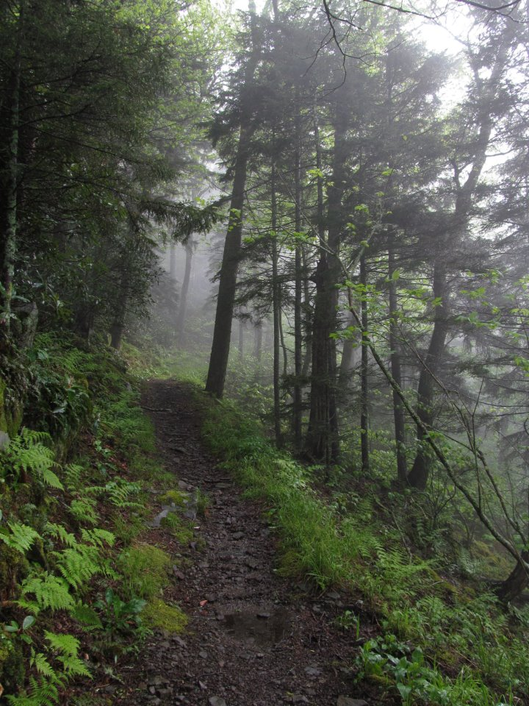
Weather-related safety issues
Nowcasting (0 – 6 h weather forecast) to avoid or anticipate weather hazards
  Sights
  Sounds
  Smells
  Sensations
Courtesy: Daniel Martin

Slide 34
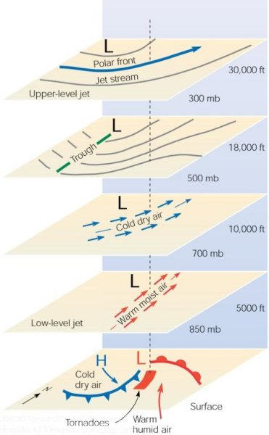
Mid-latitude cool season storm
Note: LLJ at 850 mb, cold air at
700 mb, trough at 500 mb, PFJ at
300 mb.
At the ground
(sea level)

Slide 35
Synoptic-scale cyclone
North
At the ground
(sea level)
1243 miles
Open wave stage of the cyclone. Arrows represent general wind direction, concentric circles are isopleths of mean sea level pressure, and the green shaded region represents the precipitation region. The cold and warm fronts are indicated by the blue and red “arms”, respectively, extending from the cyclone center (designated by the red “L”).

Slide 36
Ci = cirrus
Approaching warm front

Slide 37
Cb = Cumulonimbus
Approaching cold front

Slide 38
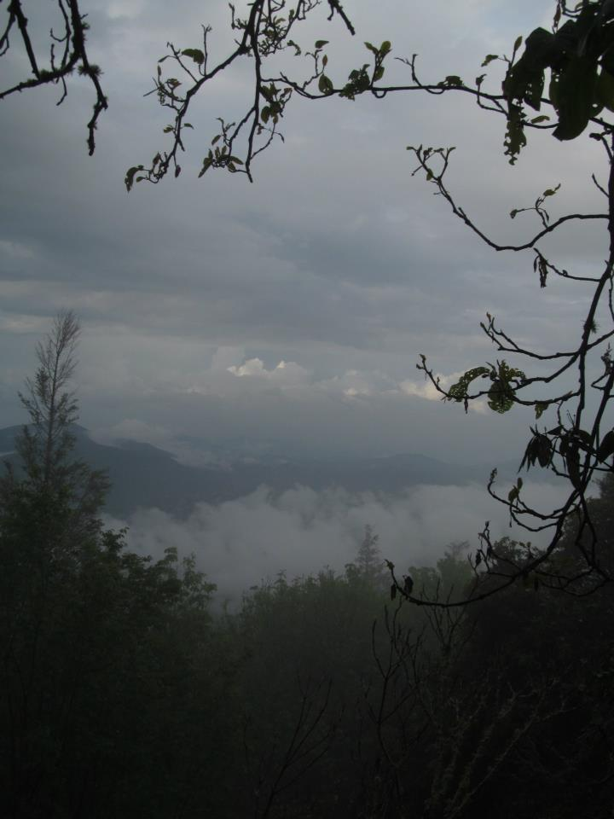
Weather-related safety issues
Nowcasting to avoid or anticipate weather hazards; sights
  Cool season
    Clouds thickening (can’t see sun) → storm approaching
    Winds and/or clouds moving toward north → storm approaching
    Winds and/or clouds shift to moving toward east or south → clearing and cool weather approaching
Courtesy: Daniel Martin

Slide 39
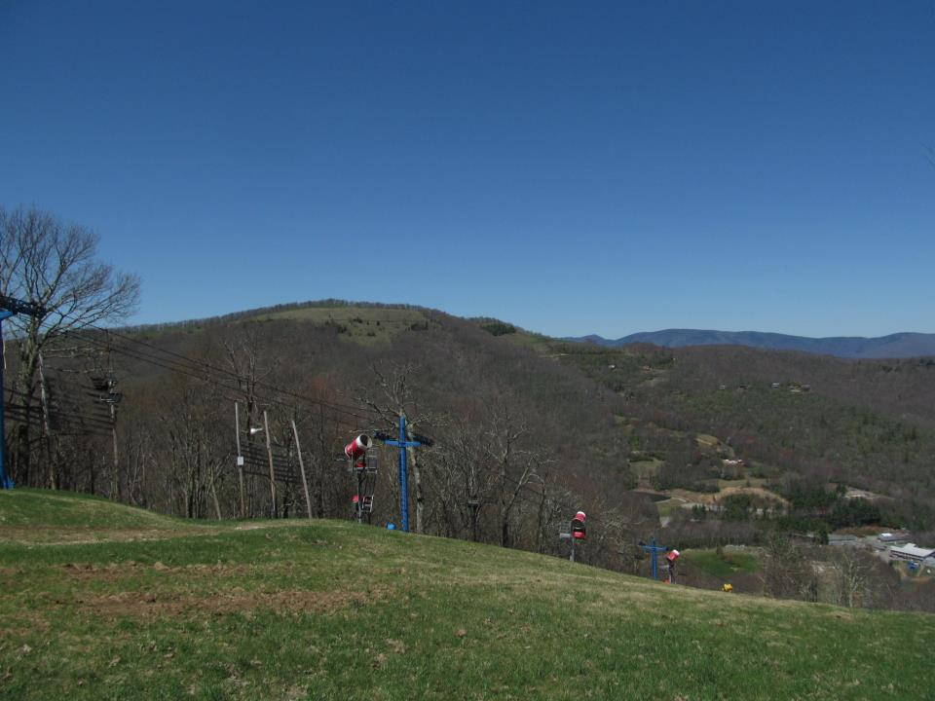
Weather-related safety issues
Nowcasting to avoid or anticipate weather hazards; sights
  Cool season
    Calm winds with…
      clouds and precipitation; in middle of storm (low pressure center)
      clear sky; in the middle of high pressure, winds may shift to blowing from the south (warming on the horizon)
Courtesy: Daniel Martin

Slide 40
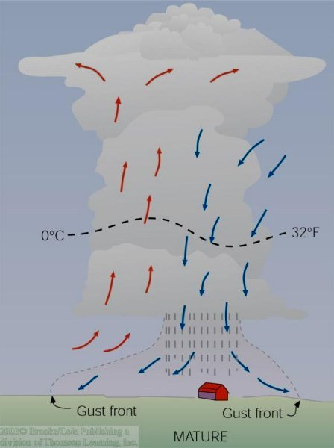
Ordinary Thunderstorm Mature Stage
The downdraft and updraft within the mature thunderstorm constitute a cell
This is the most intense stage of an ordinary thunderstorm
Lightning & thunder, hail, heavy rain possible
Often a cold downrush of air associated with the onset of precipitation – gust front

Slide 41
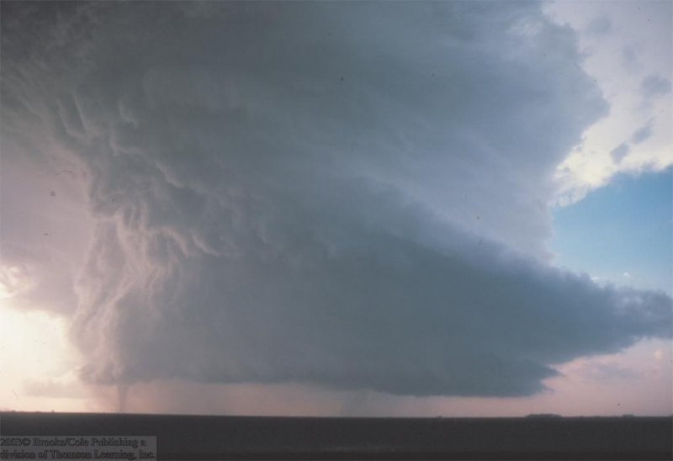
A Supercell T-storm with a tornado extending downward from its base.

Slide 42
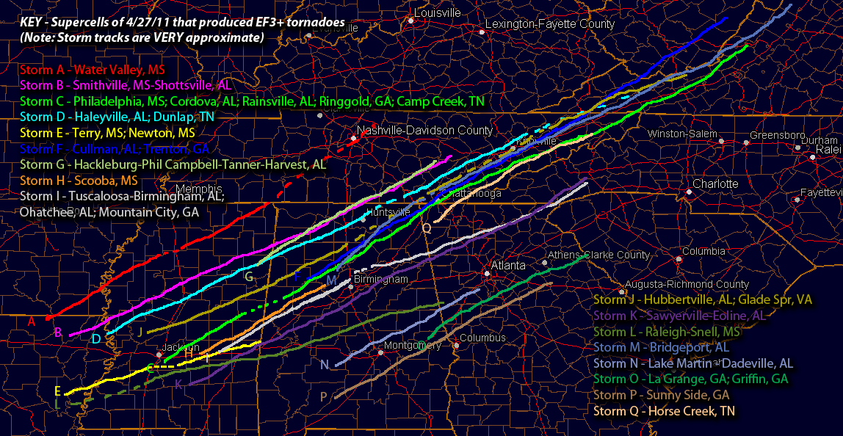
Supercell Tracks – 27 April 2011
http://www.talkweather.com/forums/index.php?/topic/56530-supercell-tracks-from-april-27-2011/

Slide 43
April 27, 2011
http://www.srh.noaa.gov/srh/ssd/mapping/

Slide 44
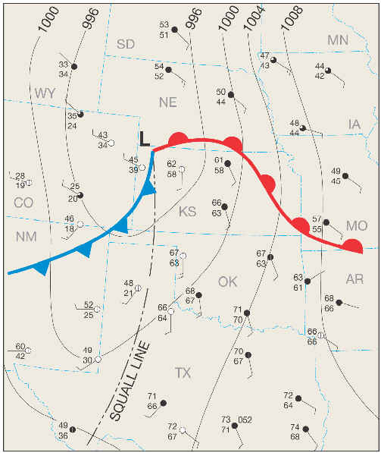
Squall Line Thunderstorm
A line of thunderstorms that often form along or ahead of a cold front associated with a synoptic-scale cyclone (2000 km or 1243 mile horizontal scale)
Most persistent and damaging squall lines occur in the spring
Can also have a long lifespan (~6 hours)
Recent studies suggest that most nighttime tornadoes are produced by squall lines
http://www.geography.hunter.cuny.edu/~tbw/wc.notes/10.thunderstorms.tornadoes/squalls_tornadoes.htm

Slide 45
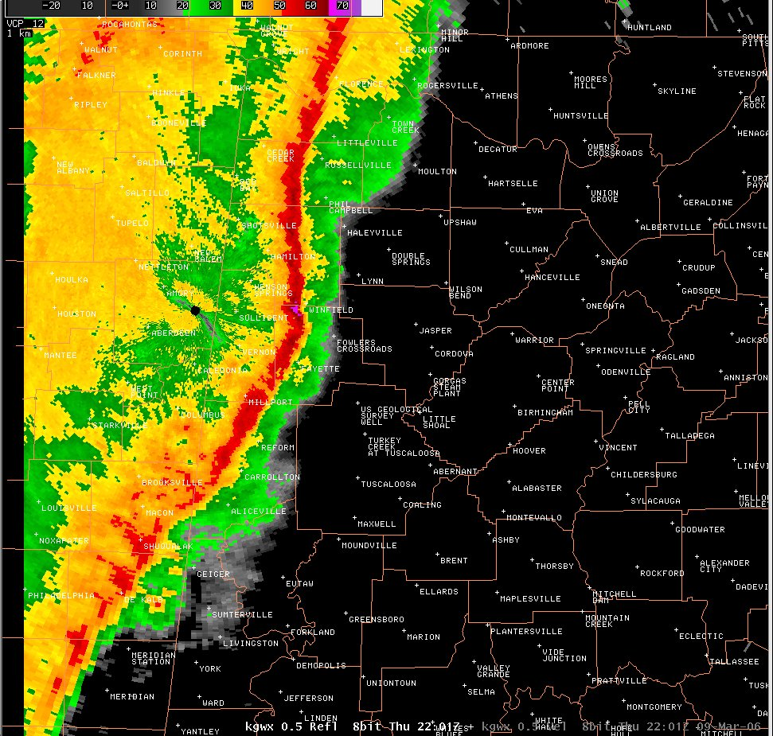
Squall Line Thunderstorm
Alabama, 9 March 2006
Tornadoes can form at the far northern and southern ends of a “bowing” squall line
http://www.srh.noaa.gov/bmx/?n=event_03092006

Slide 46
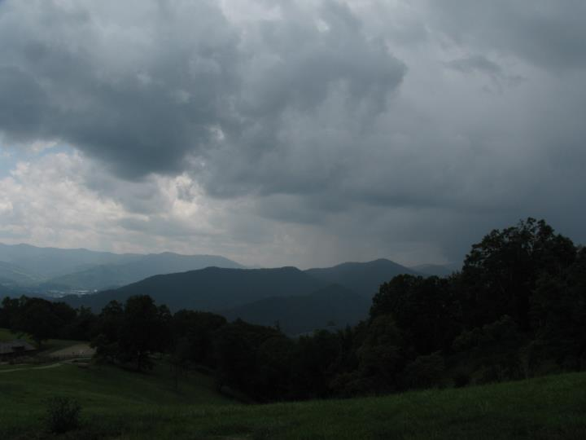
Weather-related safety issues
Nowcasting to avoid or anticipate weather hazards; sights
  Warm season
    Clouds thickening (can’t see sun) → storm approaching
    Wind speeds pick up (approaching gust front)
    Wind direction can indicate T-storm center location, but mountains & valleys complicate its interpretation
Courtesy: Daniel Martin

Slide 47
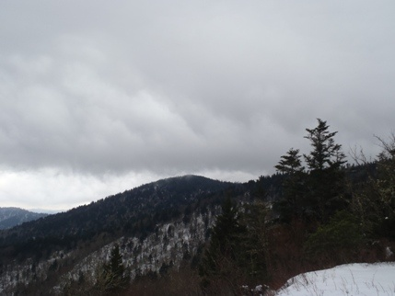
Weather-related safety issues
Nowcasting to avoid or anticipate weather hazards; sounds
  Cool season & Warm season
    Gusts (indicated by tree movement) can warn of potential wind-throw
    “Roar” warns of sustained windy period and strong gusts

Slide 48
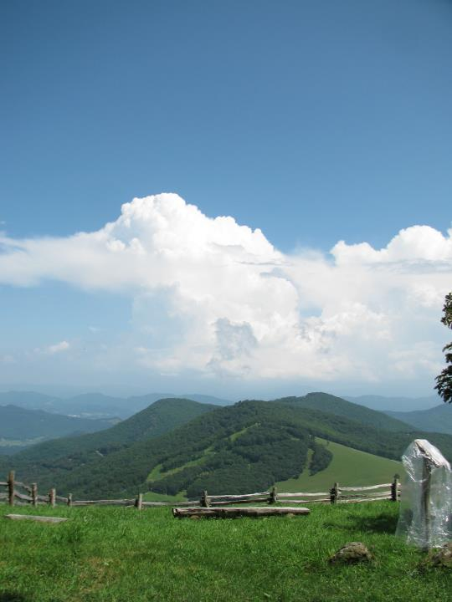
Weather-related safety issues
Nowcasting to avoid or anticipate weather hazards; sounds
  Warm season
    Thunder – indicates proximity of lightning-generating T-storm cell
Courtesy: Daniel Martin

Slide 49

T-storm Warning Signs
Watch & Listen for
  Time between
    seeing lightning flash
    hearing thunder
  [time (sec) / five = distance of T-storm in miles]

Slide 50
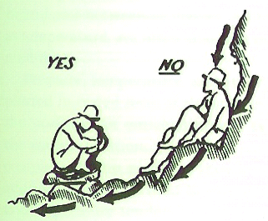
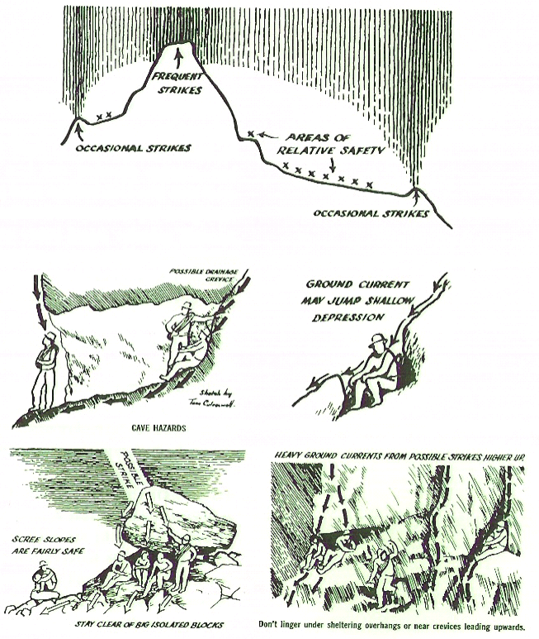
Lightning Safety, in the Mountains
Lightning safety, when caught outdoors
    Avoid peaks and ridges
    Do squat on an insulating material
    Do not lean back against rock walls
    Do not take shelter under tall isolated trees
    Do not take shelter in caves, shallow depressions, under large boulders, or under overhangs
“Mountain Meteorology, Fundamentals and Applications” by C. David Whiteman

Slide 51

Weather-related safety issues
Nowcasting to avoid or anticipate weather hazards; smells
  Cool season and Warm season
    Air pockets in the soil collect gases from decaying matter
    Rain fills the air pockets, expelling the gases which are then carried by the winds of the storm
Courtesy: Daniel Martin

Slide 52
Weather-related safety issues
Nowcasting to avoid or anticipate weather hazards; sensations
  Cool season and Warm season
    Creaky knee?
    Achy breaky elbow?
    might be indicating a significant change in atmospheric pressure that can forewarn the approach of a storm

Slide 53
Weather-related safety issues
Nowcasting to avoid or anticipate weather hazards; undetected hazard

Slide 54

Gunter Fork Debris Flow
KMRX
  Loop period; 7:17 pm EDT 14 July – 12:03 am EDT 15 July 2011

Slide 55

Weather-related safety issues
Nowcasting to avoid or anticipate weather hazards; undetected hazard
  Gunter Fork example
Courtesy: Rick Wooten

Slide 56

Spotter field activity
Cloud thickness trend
Cloud movement
Wind speed/ direction
Weather-related sounds?
Weather-related smells?
Weather-related aches and pains?

Slide 57
Activities (Outside, KH Rooms 036 and 037)
Observe (using the five senses)
Hypothesize where we might be (in Asheville) relative to low pressure and high pressure systems in the United States
Confirm your hypothesis by returning to look at the weather maps in Karpen Hall, Rooms 036 and 037

Slide 58

Useful, extra slides…
N.H.
Lecture Packet #8

Slide 59

Useful, extra slides…
N.H.
Lecture Packet #6

Slide 60

It’s all about balance
Example
microscale
mesoscale
synoptic scale
annual scale
seconds
hours
days
one year
Lecture Packet #2

Slide 61

Pressure systems
Some challenges (1908)…
  ‘Strassburg Low’
  Surface convergence over the center of an intensifying cyclone
N.H.
Lecture Packet #8

