Slide 1
Weather-related Professional Learning Experience
Session 1
Douglas K. Miller
Professor, Atmospheric Sciences Department
UNC Asheville
dmiller@unca.edu

Slide 2
Outline
Pre-session assessment review – selected questions
It’s all about balance
Weather tools
Pressure systems
Activities (Karpen Hall, Rooms 036 and 037)
(Karpen Hall, Room 038)

Slide 3
Pre-session assessment review – selected questions
Multiple choice, true/false, short answer
(** in-depth questions saved for ‘activities’)
Google search via smartphone ‘socrative student’
Room code for answering assessment will be written on white board…

Slide 4
It’s all about balance
At all scales, circulations in the atmosphere are attempting to restore balance to an imbalanced situation forced by uneven heating and/or cooling at the earth’s surface.
microscale
mesoscale
synoptic scale
planetary scale
seconds
hours
days
weeks

Slide 5
It’s all about balance
Uneven heating and/or cooling at the earth’s surface creates atmospheric environments having potential energy that, in the presence of a ‘trigger’, releases the energy (instability) for conversion to kinetic energy (energy of motion)
microscale
mesoscale
synoptic scale
planetary scale
seconds
hours
days
weeks

Slide 6
It’s all about balance
Storm development (increasing kinetic energy) continues until balance has been restored locally…however, uneven heating and/or cooling at the earth’s surface is continuous elsewhere…so the pursuit of balance is endless!
microscale
mesoscale
synoptic scale
planetary scale
seconds
hours
days
weeks

Slide 7
It’s all about balance
Example
microscale
mesoscale
synoptic scale
annual scale
seconds
hours
days
one year

Slide 8
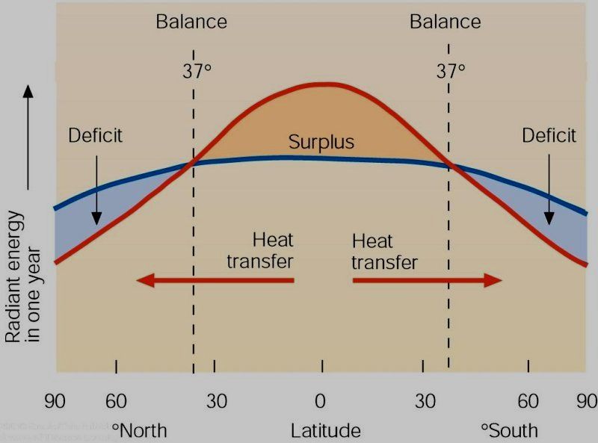
It’s all about balance
Example
microscale
mesoscale
synoptic scale
annual scale
seconds
hours
days
one year
Lecture Packet #2

Slide 9
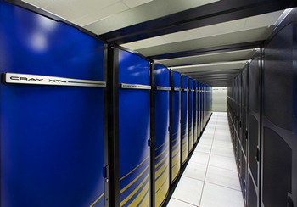
Weather tools
Computer-based weather analysis
Computer-based weather forecast
Computer weather model
http://cs.lbl.gov/news-media/news/2009/berkeley-lab-checkpoint-restart-improves-productivity/

Slide 10
Weather tools
Weather sensors
in situ
thermometer
barometer
hygrometer
wind vane and anemometer
rain gauge
rawinsonde (weather balloon)
remote
radar
satellites
Computer-based weather analysis
Many of today’s weather sensors have been designed for automation and are difficult for ‘hands-on’ demonstrations…
thermometers → electronic resistance is a function of air temperature

Slide 11
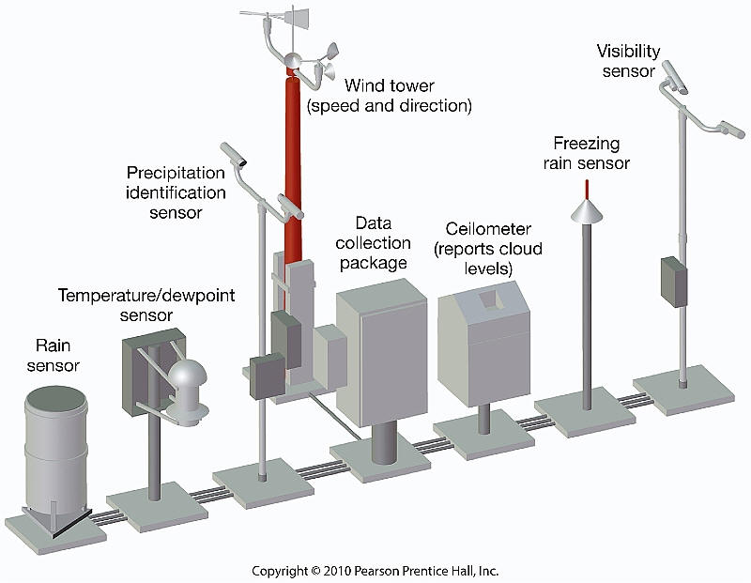
Weather tools
Automated Surface Observing System (ASOS)
http://www.geography.hunter.cuny.edu/tbw/wc.notes/12.weather.forecasting/automated_surface_observing_syst.htm

Slide 12
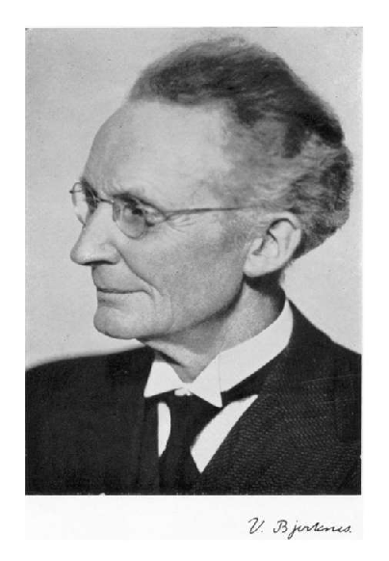
Weather tools
Some challenges (1908)…
‘Strassburg Low’
Surface convergence over the center of an intensifying cyclone
Vilhelm Bjerknes

Slide 13
Weather tools
Some challenges (1908)…
‘Strassburg Low’
Surface convergence over the center of an intensifying cyclone
Vilhelm Bjerknes

Slide 14
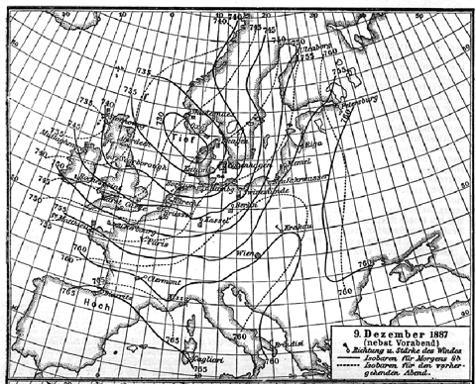
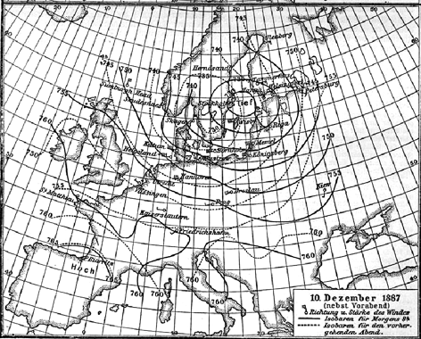
Weather tools
Some challenges (1908)…
‘Strassburg Low’
Surface convergence over the center of an intensifying cyclone
http://www-history.mcs.st-andrews.ac.uk/HistTopics/Weather_forecasts.html

Slide 15
Weather tools
Some challenges (1908)…
‘Strassburg Low’ – predicting storms was made difficult when bad data was included in the weather analysis alongside the good data
Vilhelm Bjerknes

Slide 16
Weather tools
Weather sensors
in situ
thermometer
barometer
hygrometer
wind vane and anemometer
rain gauge
rawinsonde (weather balloon)
remote
radar
satellites
Computer-based weather analysis
Quality Control of observations is an essential part of the weather analysis step

Slide 17
Weather tools
Computer-based weather analysis
Computer-based weather forecast
Computer weather model – incorporates the governing equations that define the conservation of momentum, mass, heat, and moisture.
ALWAYS a compromise between physical realism and timeliness of the computer-generated weather prediction (limited by compute power).
http://cs.lbl.gov/news-media/news/2009/berkeley-lab-checkpoint-restart-improves-productivity/

Slide 18
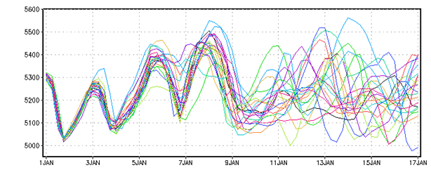
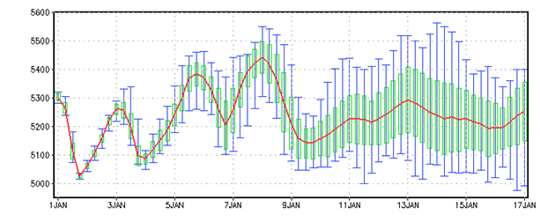
Weather tools
Weather is chaotic (forecast sensitive to initial conditions)
Initialize computer weather model with multiple scenarios only differing slightly from each other in the prescribed initial conditions.
Computer-based weather forecast
http://www.iges.org/grads/gadoc/ensembles.html

Slide 19
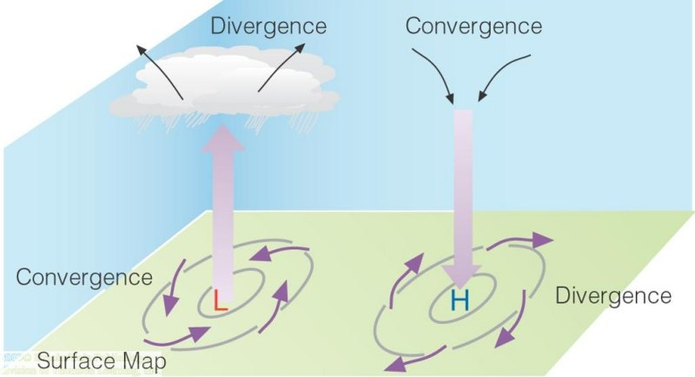
Pressure systems
Some challenges (1908)…
‘Strassburg Low’
Surface convergence over the center of an intensifying cyclone
Vilhelm Bjerknes
Lecture Packet #6

Slide 20
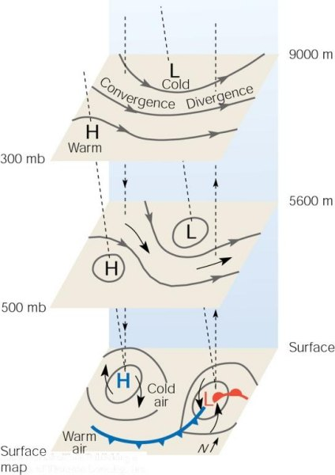
Pressure systems
Some challenges (1908)…
‘Strassburg Low’
Surface convergence over the center of an intensifying cyclone
N.H.
Lecture Packet #8

Slide 21
Pressure systems
microscale
mesoscale
synoptic scale
planetary scale
seconds
hours
days
weeks

Slide 22
Pressure systems
Uneven heating and/or cooling at the earth’s surface creates atmospheric environments having potential energy that, in the presence of a ‘trigger’, releases the energy (instability) for conversion to kinetic energy (energy of motion)
microscale
mesoscale
synoptic scale
planetary scale
seconds
hours
days
weeks

Slide 23
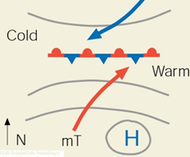
Pressure systems
Synoptic scale low pressure system (cyclone) ‘trigger’
N.H.

Slide 24
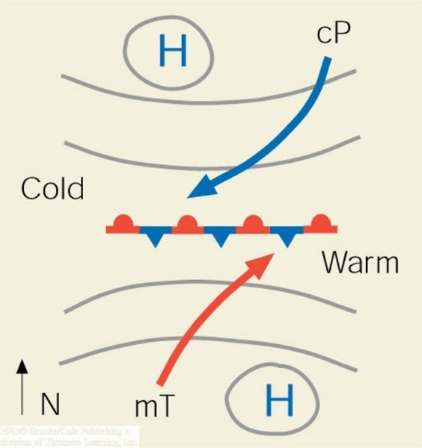
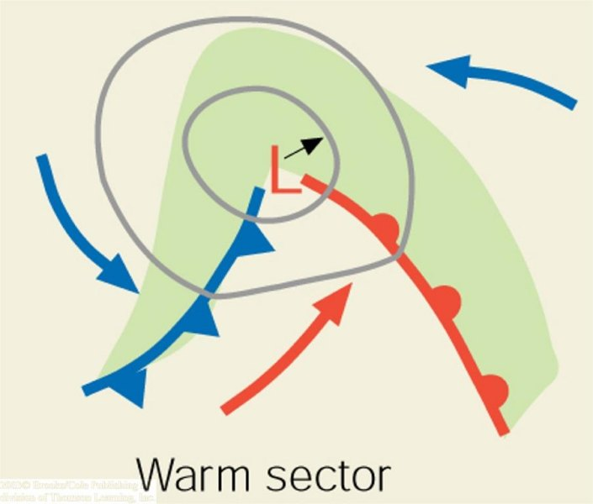
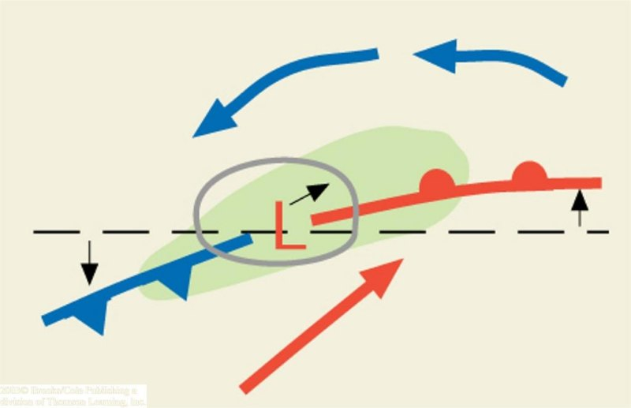
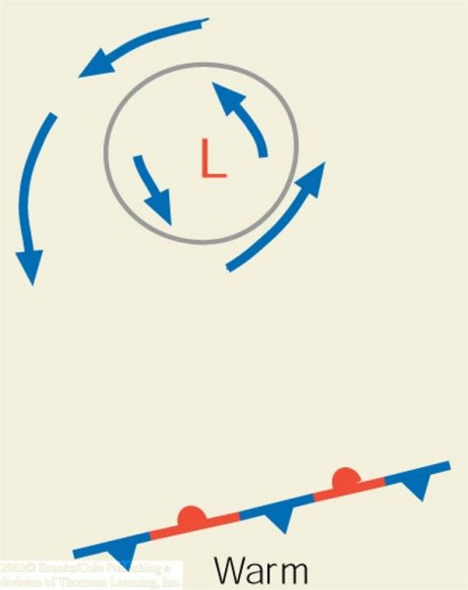
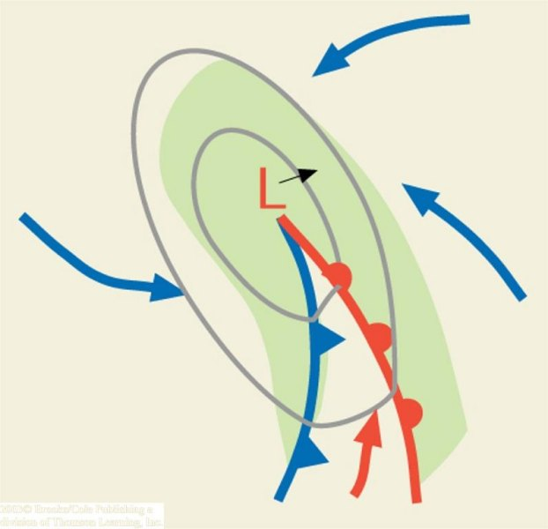
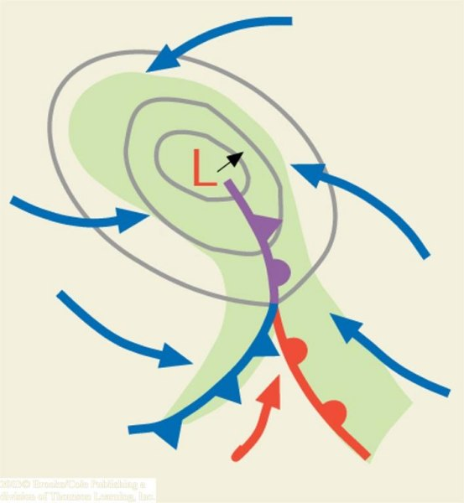
‘trigger’
cyclogenesis
(a)
(b)
(c)
N.H.
(d)
(e)
(f)
Lecture Packet #8

Slide 25
Pressure systems
Anticyclone (high pressure system)
N.H.
Lecture Packet #8

Slide 26
Activities (Karpen Hall, Rooms 036 and 037)
Work together to
complete final responses the (**) questions on the pre-session assessment document
We’ll go over your final responses at the beginning of Session #2
complete the ‘Weather and Climate Treasure Hunt’ activity to help familiarize yourself with where to find web-based resources for tracking current weather and making 24-72 h and seasonal weather forecasts

Slide 27
Useful, extra slides…
N.H.
Lecture Packet #8

Slide 28
Useful, extra slides…
Two columns of air, at equal temperature and height.
p ~T x ρ
p is pressure
T is temperature
ρ (rho) is density
Lecture Packet #6

Slide 29
Useful, extra slides…
Lecture Packet #6

Slide 30
Useful, extra slides…
N.H.
Lecture Packet #6

Slide 31
Three Cell Model
Trade winds – blow from northeast in N. Hemi and southeast in S. Hemi
Intertropical Convergence Zone – Surface region of convergence between trades
Subtropical Highs – semipermanent high in the subtropical high pressure belt centered near 30° latitude. Bermuda high, Pacific Ridge.
Westerlies – prevailing westerly flow
Lecture Packet #7

Slide 32
Upwelling
As winds blow parallel to the west coast of North America, surface water is transported to the right (out to sea). Cold water moves up from below (upwells) to replace the surface water.
Lecture Packet #7

Slide 33
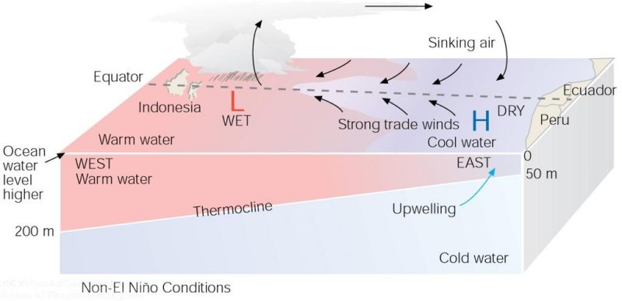
Under ordinary conditions, higher pressure over the southeastern Pacific and lower pressure near Indonesia produce easterly trade winds along the equator. These winds promote upwelling and cooler ocean water in the eastern Pacific, while warmer water prevails in the western Pacific. When the trades are exceptionally strong, water along the equator in the eastern Pacific becomes quite cool. This cool event is called La Niña.
Lecture Packet #7

Slide 34
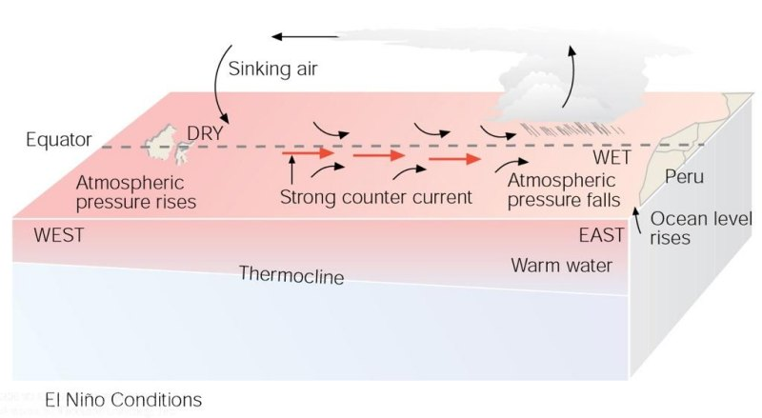
During El Niño conditions, atmospheric pressure decreases over the eastern Pacific and rises over the western Pacific. This change in pressure causes the trades to weaken or reverse direction. This situation enhances the countercurrent that carries warm water from the west over a vast region of the eastern tropical Pacific. The thermocline, which separates the warm water of the upper ocean from the cold water below, changes as the ocean conditions change from non-El Niño to El Niño.
Lecture Packet #7

Slide 35
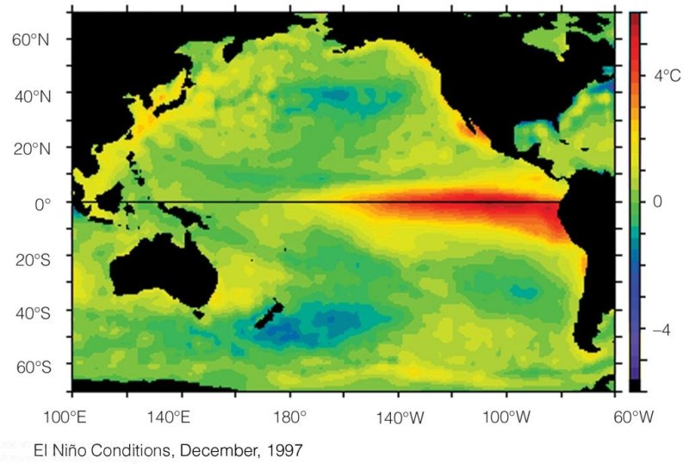
Average sea surface temperature departures from normal as measured by satellite. (a) During El Niño conditions, upwelling is greatly diminished and warmer than normal water (deep red color), extends from the coast of South America westward, across the Pacific.
Lecture Packet #7

