Slide 1
Meteorology – A Forecast Fascination
Session 2
Douglas K. Miller
Professor, Atmospheric Sciences Department
UNC Asheville
dmiller@unca.edu

Slide 2
Outline
Review - Restoring balance (global scale)
A tale of two cities (air pressure, continued)
Fronts
Jet streams
Outdoor activities

Slide 3
It’s all about balance
Storm development (increasing kinetic energy) continues until balance has been restored locally…however, uneven heating and/or cooling at the earth’s surface is continuous elsewhere…so the pursuit of balance is endless!
microscale
mesoscale
synoptic scale
planetary scale
seconds
hours
days
weeks

Slide 4
It’s all about balance
Example
microscale
mesoscale
synoptic scale
annual scale
seconds
hours
days
one year

Slide 5
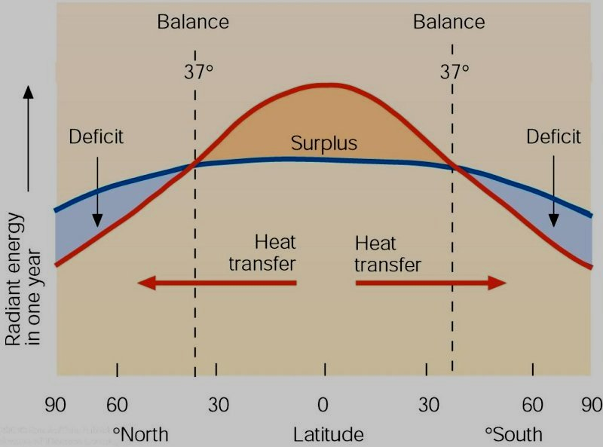
It’s all about balance
Example
microscale
mesoscale
synoptic scale
annual scale
seconds
hours
days
one year
Lecture Packet #2

Slide 6
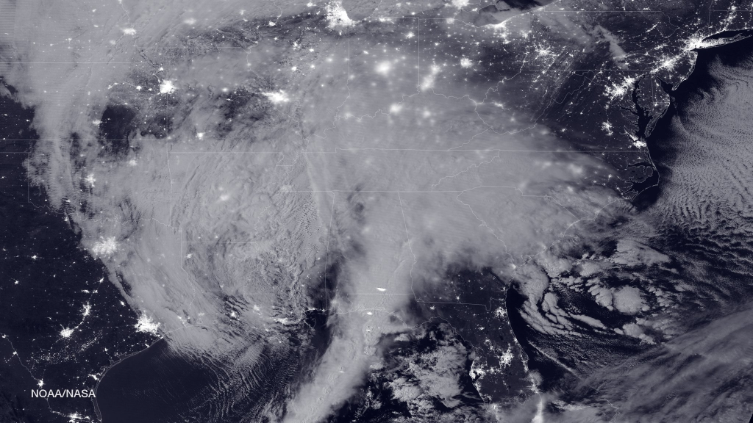
The BIG climate picture
https://www.nasa.gov/image-feature/2016-blizzard-by-moonlight

Slide 7
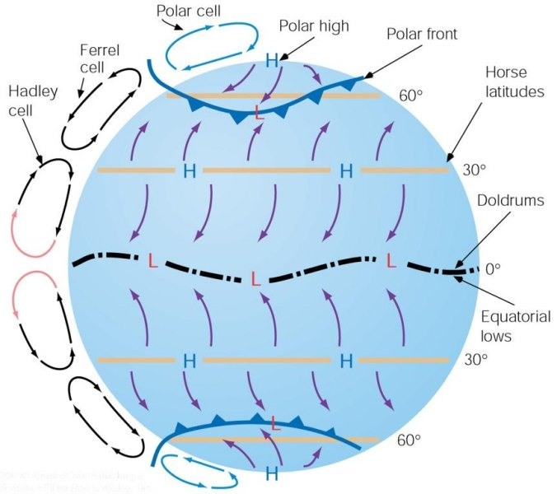
The BIG climate picture
Global circulation – the long-term atmospheric response to the uneven global energy distribution
Ahrens (2005)

Slide 8
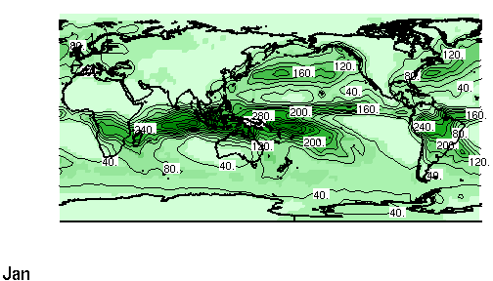

The BIG climate picture
Tropical low pressure (Intertropical convergence zone, ITCZ)
http://iri.ldeo.columbia.edu/~bgordon/ITCZ.html

Slide 9
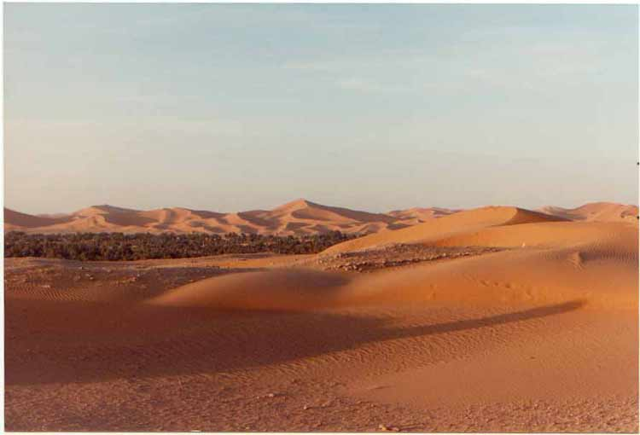
The BIG climate picture
Sub-tropical high pressure (Pacific High, Bermuda High)
http://www.martinreeds-page.co.uk/afrpics/pic10.jpg

Slide 10
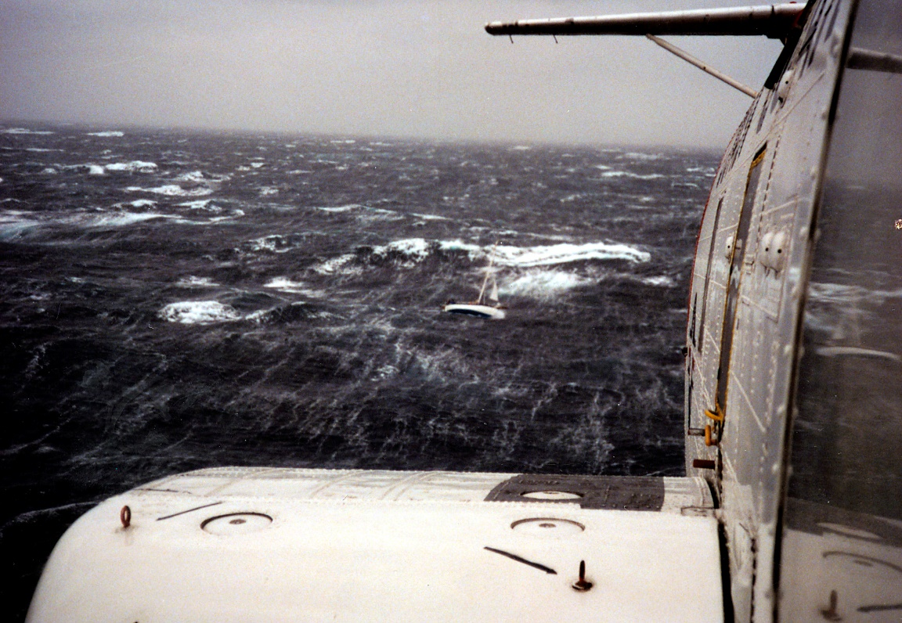
The BIG climate picture
Mid-latitude low pressure- our winter cyclones (Aleutian Low, Icelandic Low)
http://www.uscg.mil/news/PerfectStorm/Image14.jpg

Slide 11
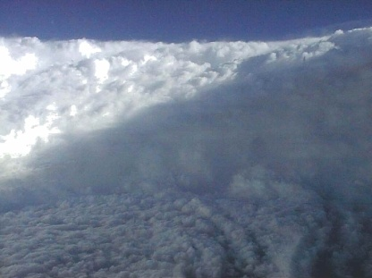
The BIG climate picture
Mid-latitude low pressure- our summer tropical cyclones
http://earthsci.org/processes/weather/cyclone/cyclone.html

Slide 12
The BIG climate picture
All global circulations are acting to move
  Warm, moist air poleward
  Cold, dry air equatorward
to even out the inequity of the global energy distribution
Ahrens (2005)

Slide 13
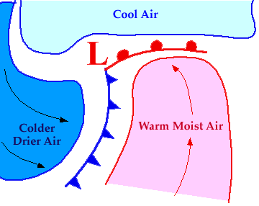
The BIG climate picture
But the global circulations are not the only atmospheric circulations acting to even out the inequity of the global energy distribution
http://ww2010.atmos.uiuc.edu/(Gh)/wwhlpr/cyclone.rxml?hret=/guides/rs/sat/home.rxml&prv=1

Slide 14
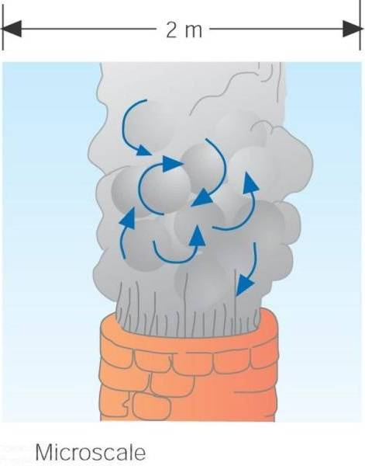
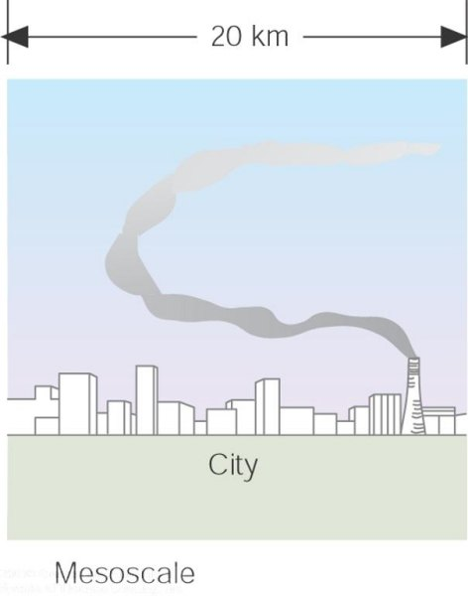
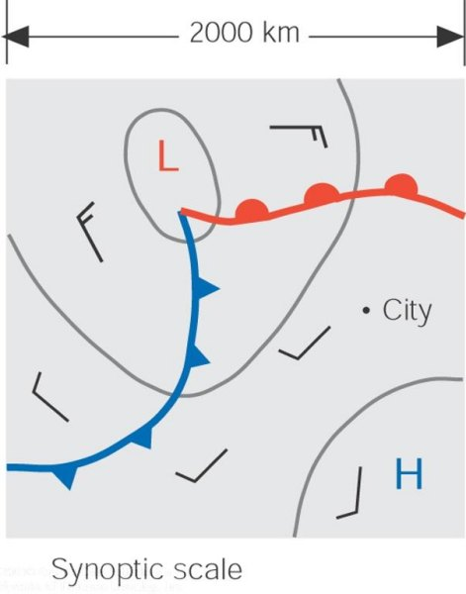
The BIG climate picture
Ahrens (2005)
Atmospheric Circulation Scales:
molecular → microscale → mesoscale → synoptic scale → planetary scale → intraseasonal → interseasonal → BIG (global) climate

Slide 15
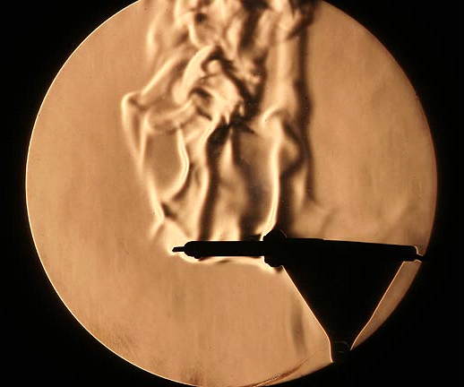
The BIG climate picture
Molecular circulations (turbulence)
http://www.rit.edu/~andpph/photofile-c/schlieren-3659.jpg

Slide 16
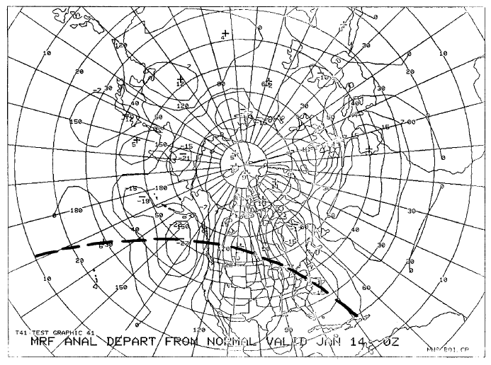
The BIG climate picture
Planetary-scale circulations (Rossby Waves)
http://www.nws.noaa.gov/im/pub/wrta8604.pdf

Slide 17
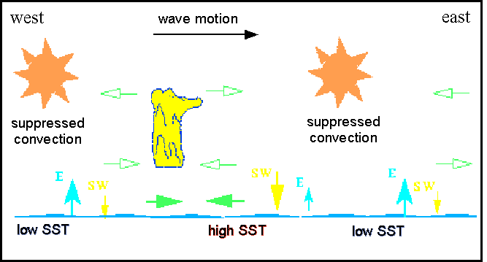
The BIG climate picture
Intraseasonal circulations (e.g. Madden-Julian Oscillation, MJO)
  40-50 day oscillation over the tropical Pacific Ocean
http://www-das.uwyo.edu/~geerts/cwx/notes/chap12/mjo1.gif

Slide 18
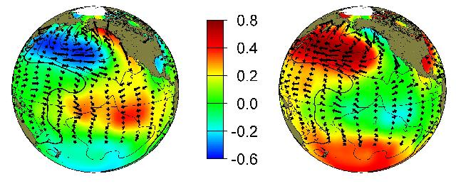
The BIG climate picture
Interseasonal circulations (e.g. El Niño, La Niña, Pacific Decadal Oscillation [PDO])…
warm
cool
http://tao.atmos.washington.edu/pdo/

Slide 19
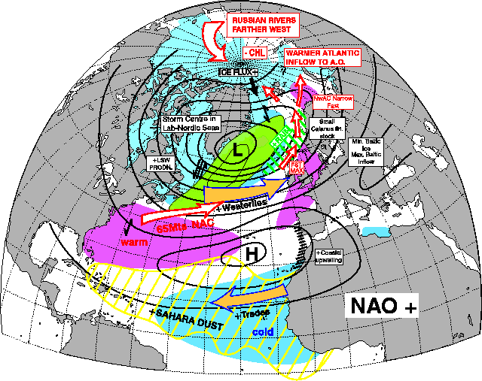
The BIG climate picture
Interseasonal circulations (e.g. El Niño, La Niña, PDO, North Atlantic Oscillation [NAO])…
http://www.met.rdg.ac.uk/cag/Images/naoplus.gif

Slide 20
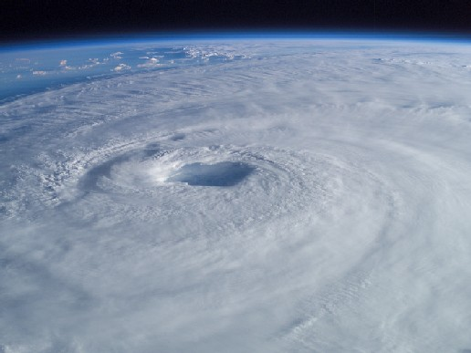
The BIG climate picture
The net effect of ALL atmospheric motions is to move
  Warm, moist air poleward
  Cold, dry air equatorward
to even out the inequity of the global energy distribution
http://www.nasa.gov/images/content/51677main_isabel_new_4.jpg

Slide 21
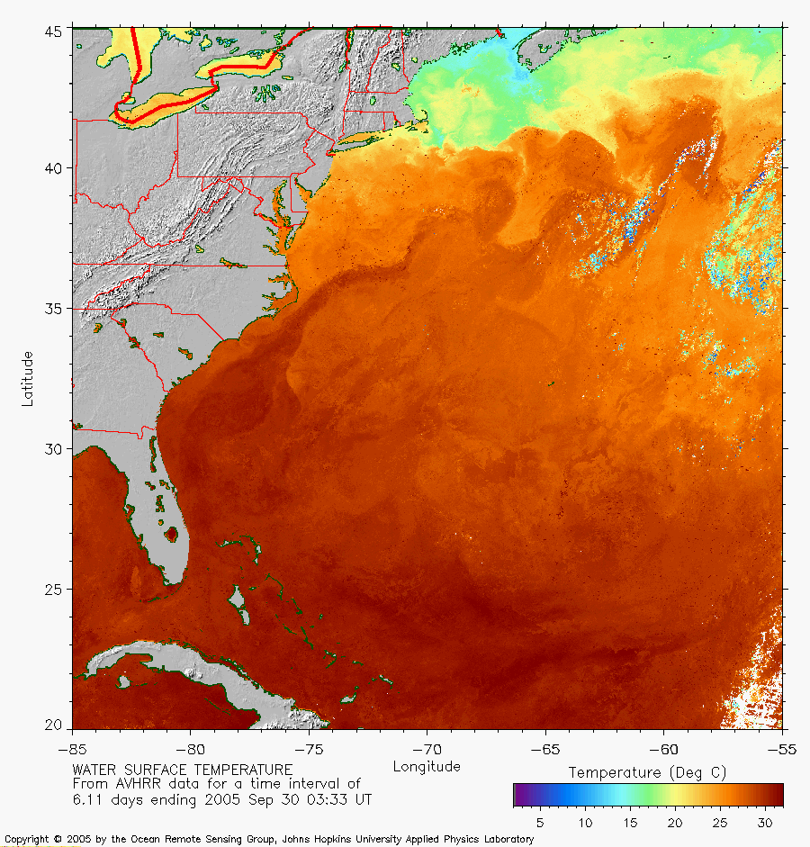
The BIG climate picture
And don’t forget about the ocean circulations!
http://fermi.jhuapl.edu/avhrr/gs/averages/05sep/gs_05sep30_0333_mult.png

Slide 22
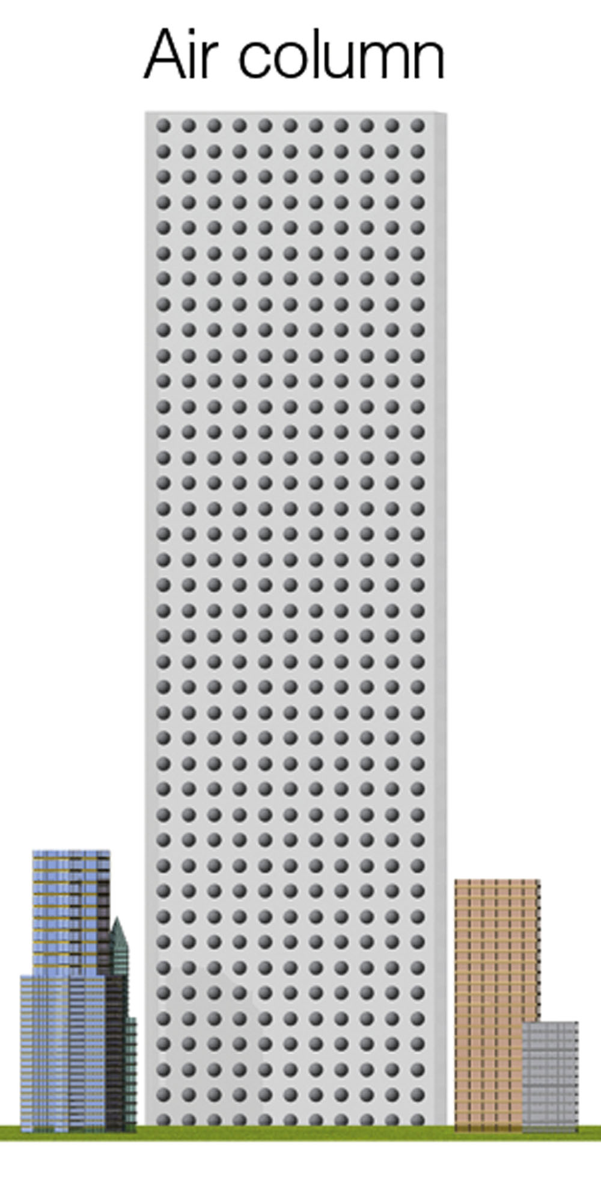
A tale of two cities
First, a closer look at air pressure…
  (or how we convert energy of horizontal
  thermal variations into kinetic energy)
Lecture Packet #6

Slide 23
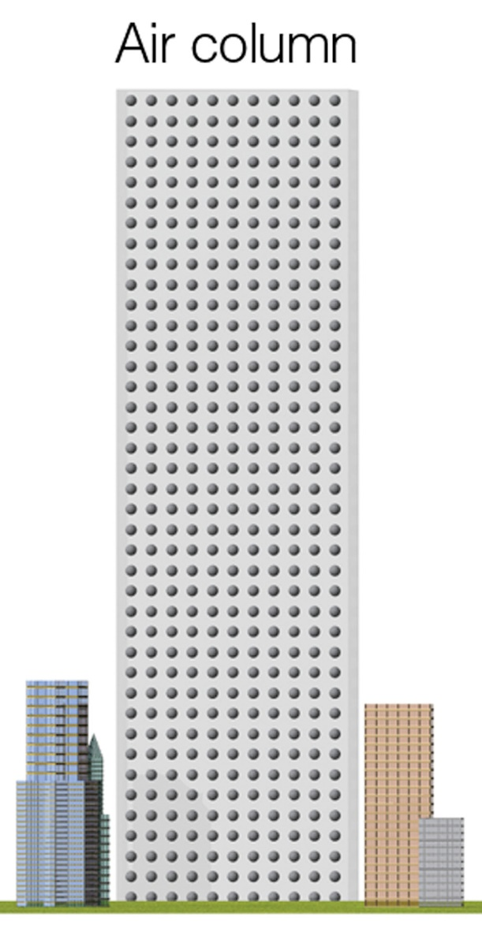
A tale of two cities
Warm air over City A
Cool air over City B
Two columns of air, initially equal temperature and height
Same air pressure
p ~ T x ρ
p is pressure
T is temperature
ρ (rho) is density
Lecture Packet #6

Slide 24
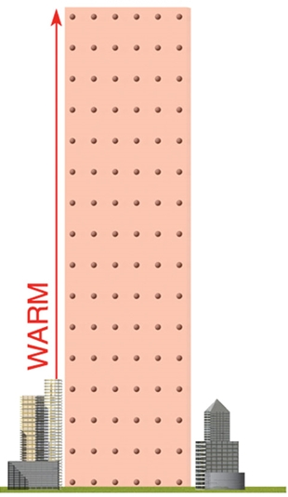
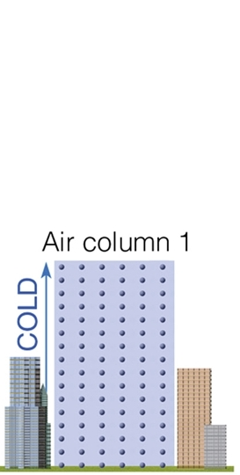
A tale of two cities
Warm air over City A
Cool air over City B
Lecture Packet #6

Slide 25
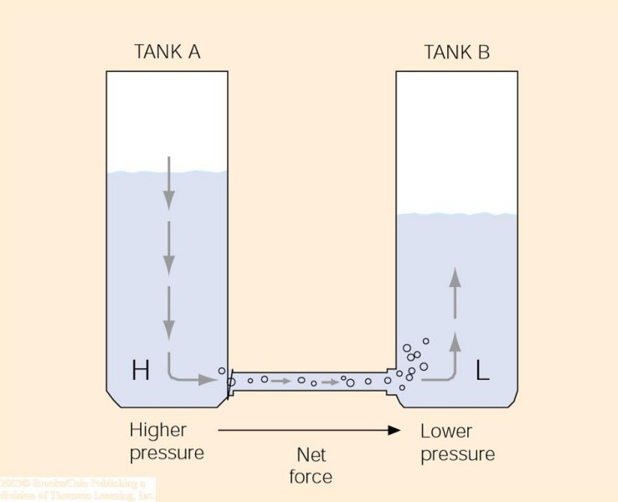
A tale of two cities
The higher water level creates higher fluid pressure at the bottom of tank A and a net force directed toward the lower fluid pressure at the bottom of tank B. This net force causes water to move from higher pressure toward lower pressure.
Since it is easier to visualize a tank of water than a tank of air…
Lecture Packet #6

Slide 26
Fronts
Air masses
Source Regions – are regions where air masses originate. In order for a huge air mass to develop uniform characteristics, its source region should be generally flat and of uniform composition with light surface winds.
  The longer air remains stagnant over its source region, the more likely it will acquire properties of the surface below.
  Best source regions are usually dominated by High Pressure [e.g. ice and snow covered arctic plains and subtropical oceans and desert regions.]
Lecture Packet #8

Slide 27
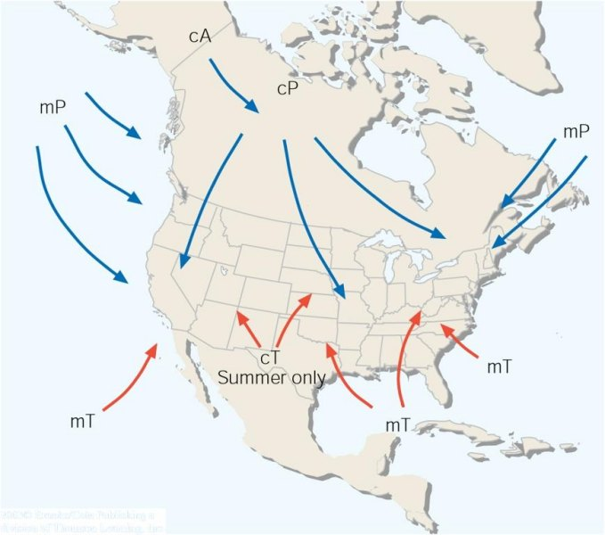
Air mass source regions and their paths.
Lecture Packet #8

Slide 28
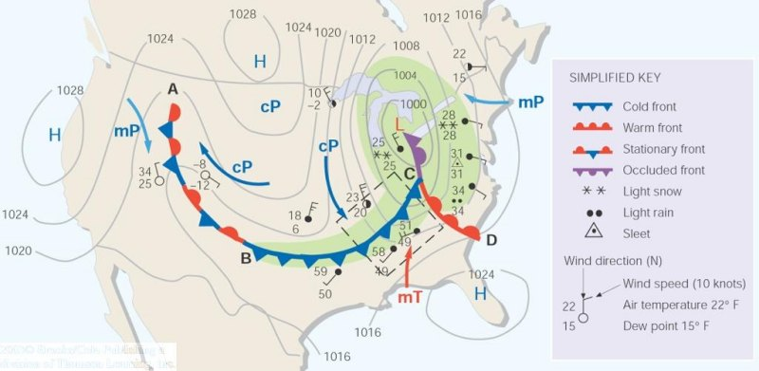
A weather map showing surface-pressure systems, air masses, fronts, and isobars (in millibars) as solid gray lines. Large arrows in color show air flow. (Green-shaded area represents precipitation.)
Lecture Packet #8

Slide 29
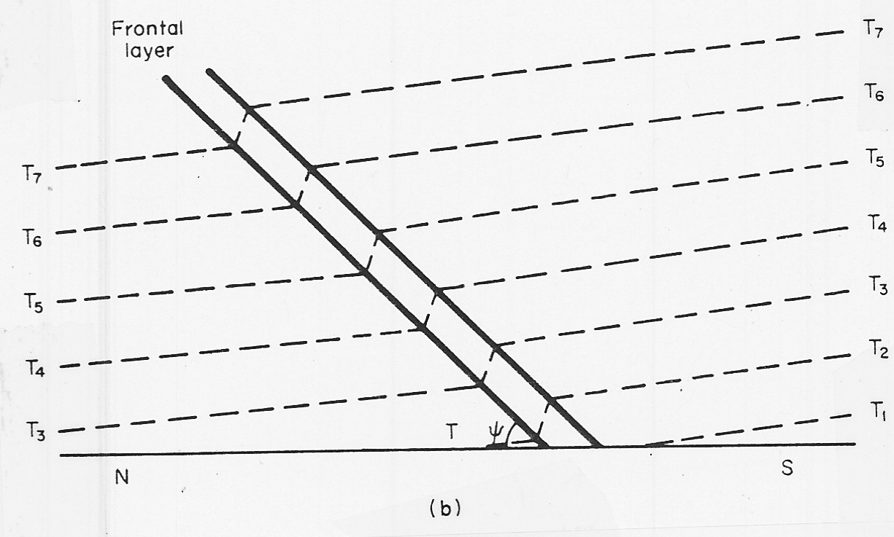
Fronts
[ aka frontal zone ]
cold air
warm air
T₇ < T₆ < T₅ < T₄ < T₃ < T₂ < T₁
T = air temperature

Slide 30
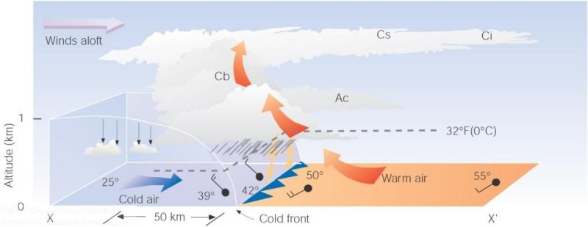
A vertical view of the weather across a cold front
Lecture Packet #8

Slide 31
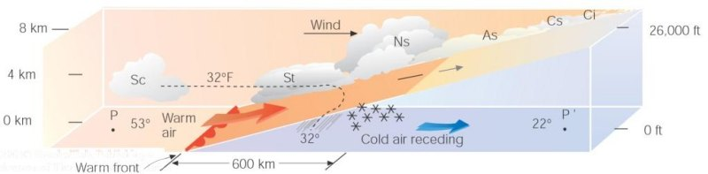
A vertical view of the weather across a warm front
Lecture Packet #8

Slide 32
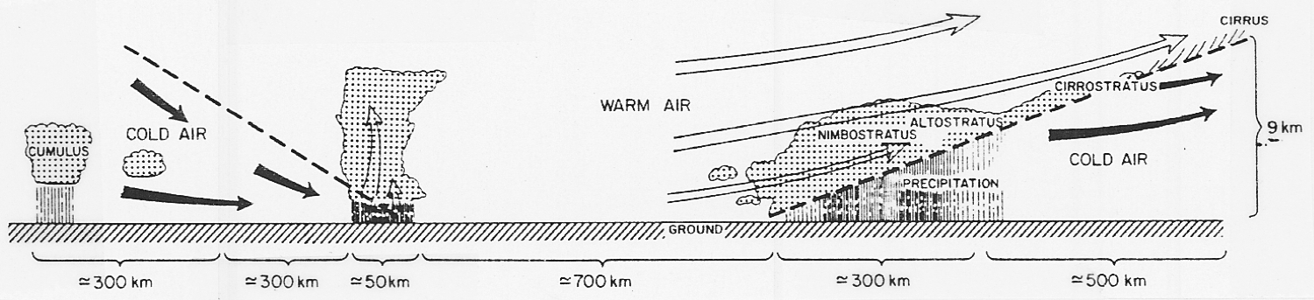
Fronts
Observed Structure of Fronts
  Associated cloud structure
    Norwegian school (Bjerknes and Solberg 1922)

Slide 33
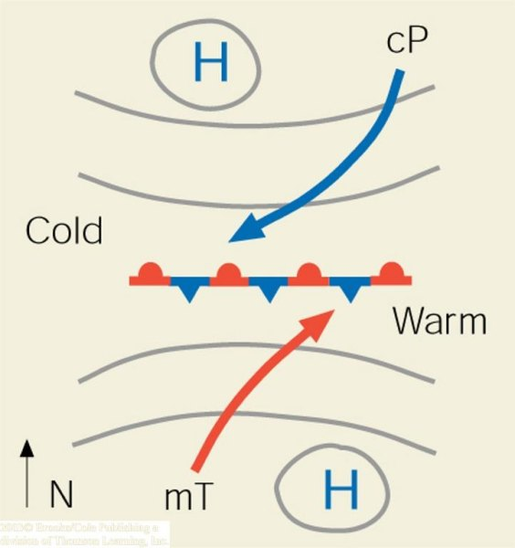
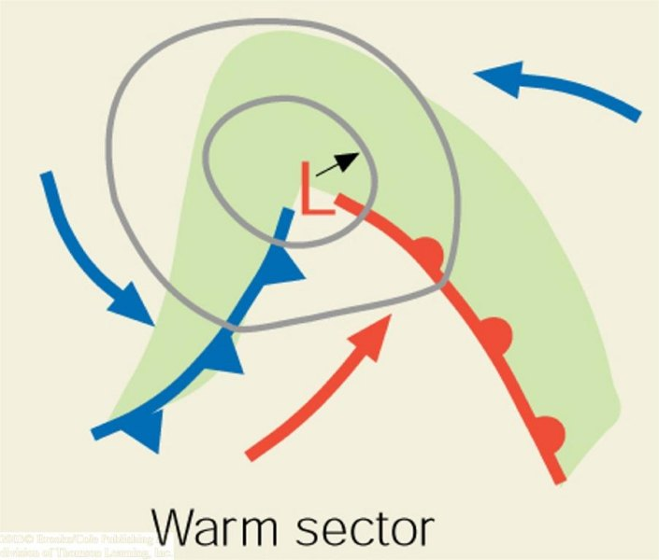
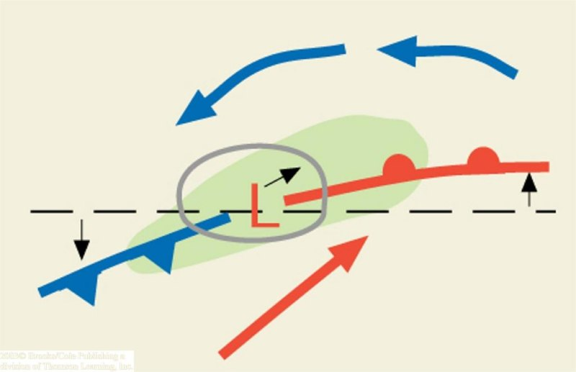
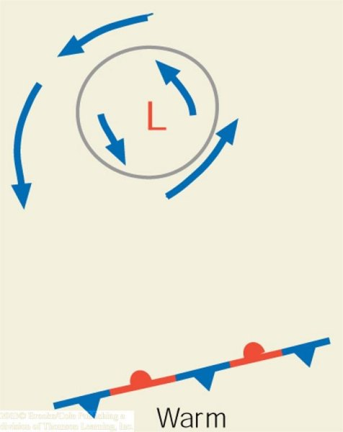
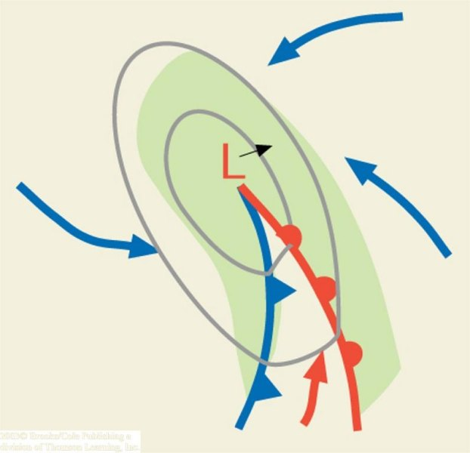
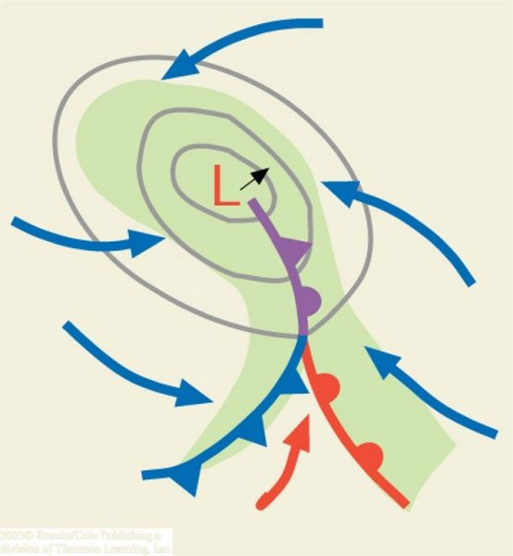
‘trigger’
cyclogenesis
(a)
(b)
(c)
N.H.
(d)
(e)
(f)
Lecture Packet #8

Slide 34
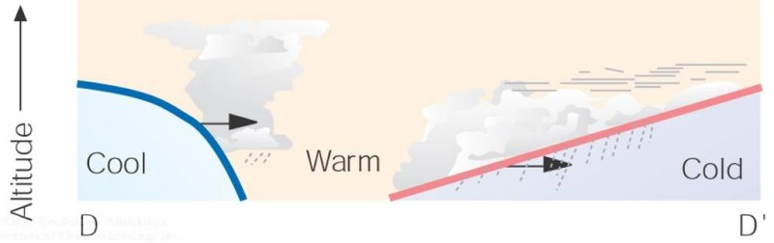
Fronts
Lecture Packet #8

Slide 35
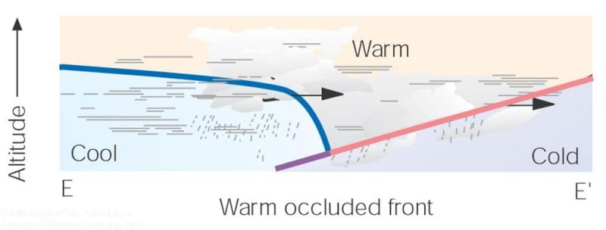
Fronts
Lecture Packet #8

Slide 36
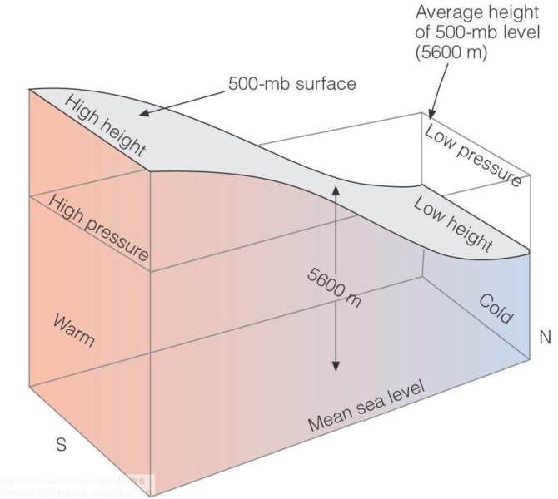
Jet streams
Lecture Packet #6

Slide 37
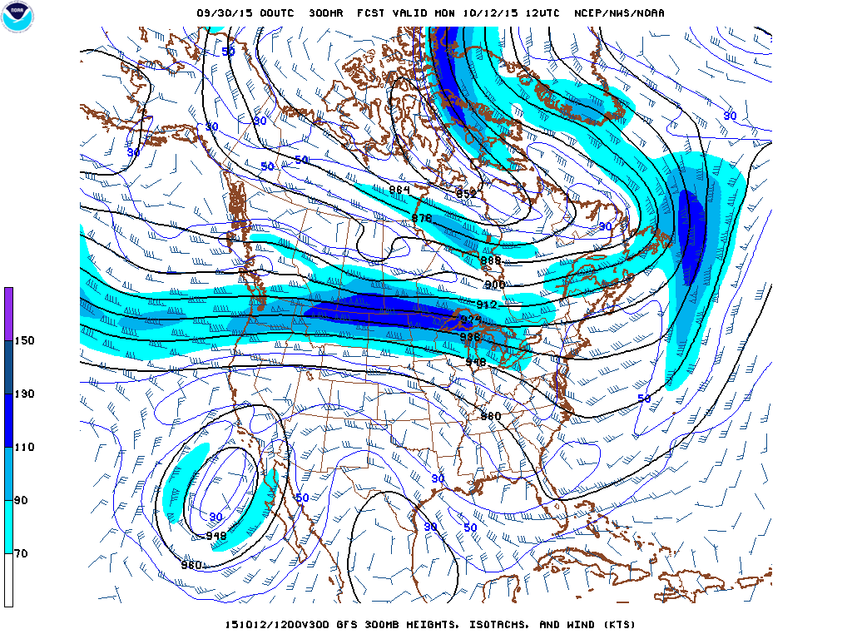
Jet streams
127 mph
http://mag.ncep.noaa.gov/model-guidance-model-area.php#

Slide 38
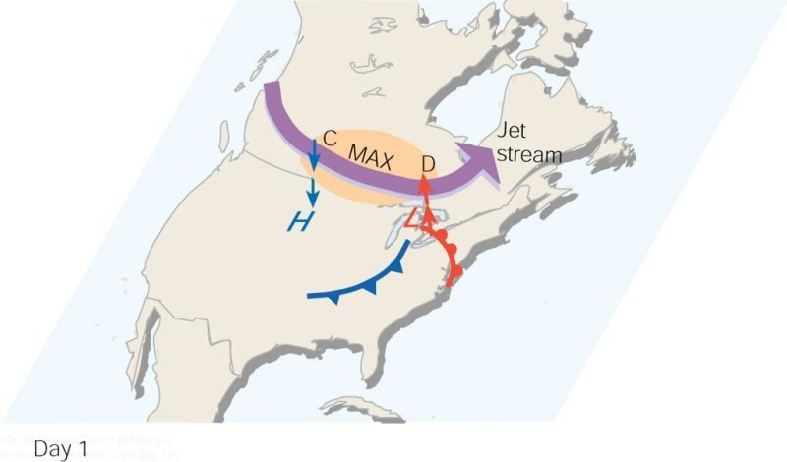
As the polar jet stream and its area of maximum winds (the jet streak, or MAX). Swings over a developing mid-latitude cyclone, an area of divergence (D) draws warm surface air upward, and an area of convergence (C) allows cold air to sink. The jet stream removes air above the surface storm, which causes surface pressures to drop and the storm to intensify.
Lecture Packet #8

Slide 39
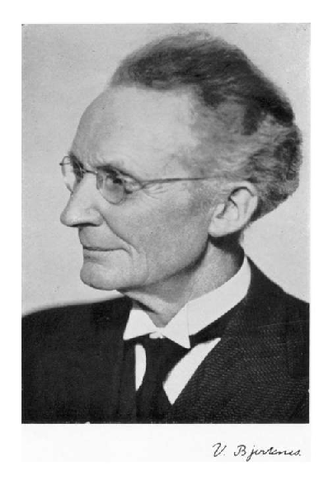
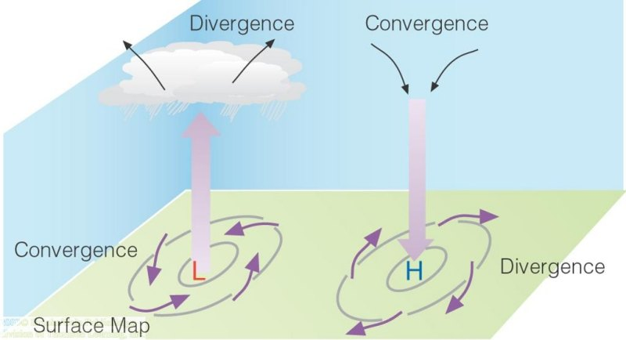
Pressure systems
Some challenges (1908)…
  ‘Strassburg Low’
  Surface convergence over the center of an intensifying cyclone
Vilhelm Bjerknes
Lecture Packet #6

Slide 40
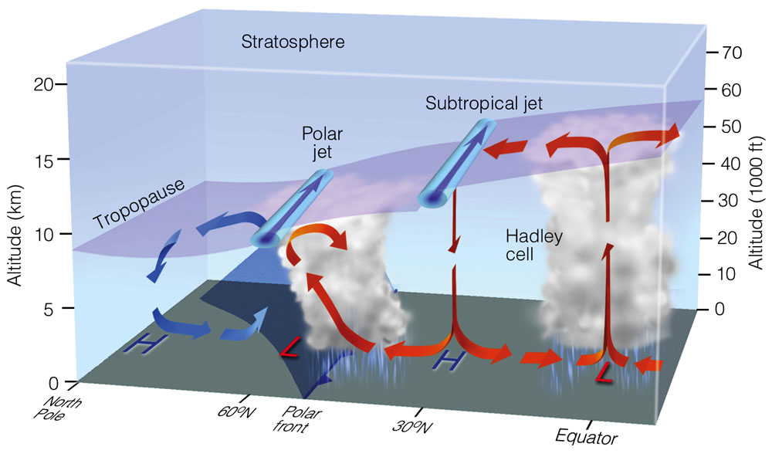
Lecture Packet #7
Notes:
Figure 7.31: Average position of the polar jet stream and the subtropical jet stream, with respect to a model of the general circulation in winter. Both jet streams are flowing from west to east.

Slide 41
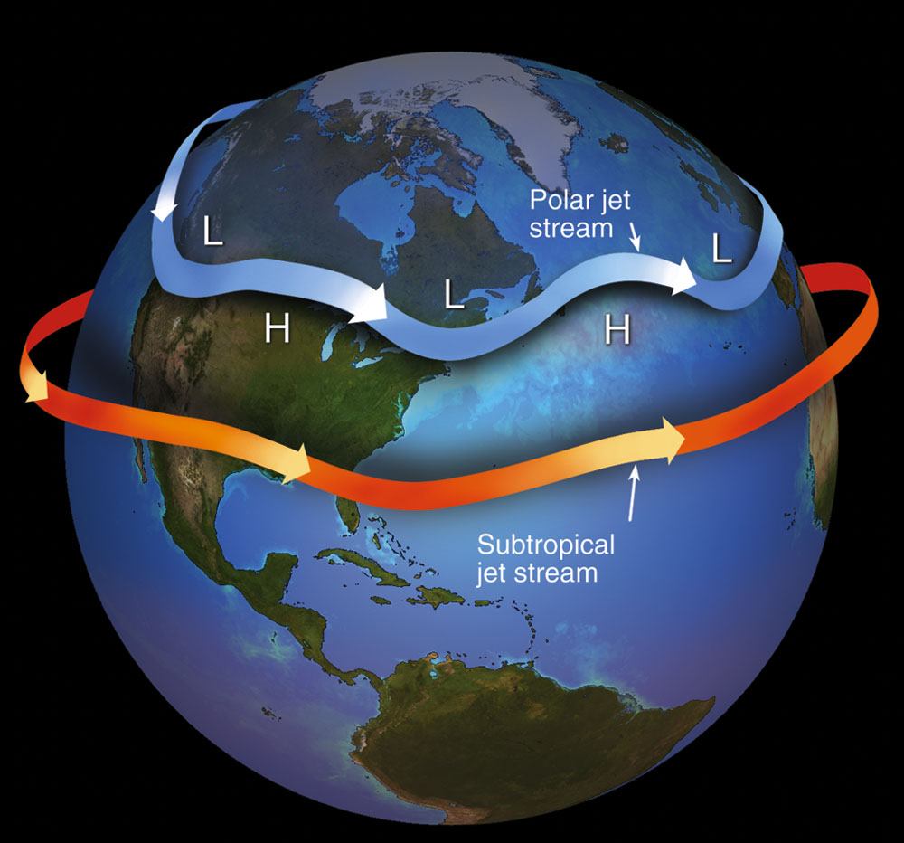
Lecture Packet #7
Notes:
Figure 7.32: Jet streams are swiftly flowing currents of air that move in a wavy west-to-east direction. The figure shows the position of the polar jet stream and subtropical jet stream in winter. Although jet streams are shown as one continuous river of air, in reality they are discontinuous, with their position varying from one day to the next.

Slide 42
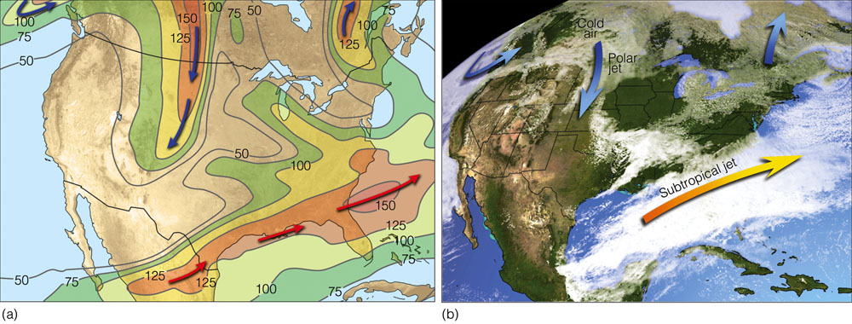
Lecture Packet #7
Notes:
Figure 7.33: (a) Position of the polar jet stream (blue arrows) and the subtropical jet stream (orange arrows) at the 300-mb level (about 9 km or 30,000 ft above sea level) on March 9, 2005. Solid lines are lines of equal wind speed (isotachs) in knots. (b) Satellite image showing clouds and positions of the jet streams for the same day.

Slide 43
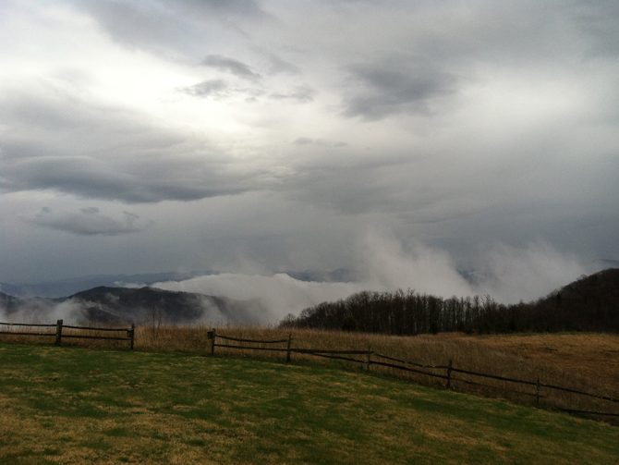
Outdoor activity
Using our senses to nowcast the weather (0-6 hours into the future)
http://www.nasa.gov/topics/earth/features/smokies.html

Slide 44
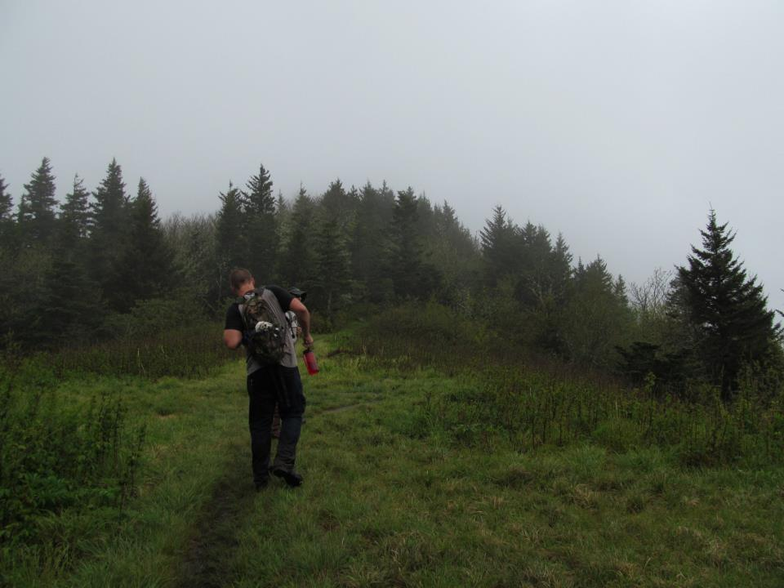
Weather-related safety issues
Hypothermia
  strong winds, cold air, damp clothing
Electrocution
  thunderstorms
Drowning
  persistent or sudden intense rainfall
Blunt force trauma
  wind-throw, slipping and falling, rock slides/ debris flows
Courtesy: Daniel Martin

Slide 45
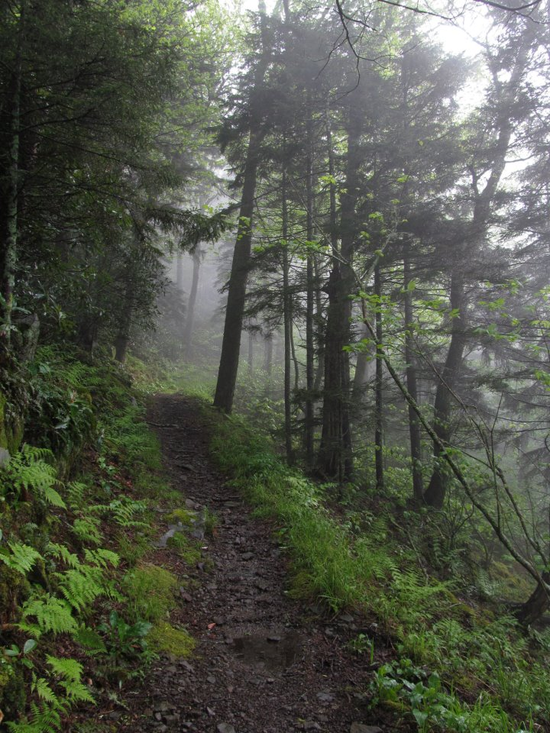
Weather-related safety issues
Nowcasting (0 – 6 h weather forecast) to avoid or anticipate weather hazards
  Sights
  Sounds
  Smells
  Sensations
Courtesy: Daniel Martin

Slide 46
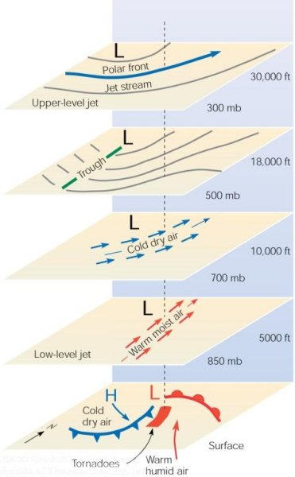
Mid-latitude cool season storm
Note: LLJ at 850 mb, cold air at
700 mb, trough at 500 mb, PFJ at
300 mb.
At the ground
(sea level)

Slide 47
Synoptic-scale cyclone
North
At the ground
(sea level)
1243 miles
Open wave stage of the cyclone. Arrows represent general wind direction, concentric circles are isopleths of mean sea level pressure, and the green shaded region represents the precipitation region. The cold and warm fronts are indicated by the blue and red “arms”, respectively, extending from the cyclone center (designated by the red “L”).

Slide 48
Ci = cirrus
Approaching warm front

Slide 49
Cb = Cumulonimbus
Approaching cold front

Slide 50
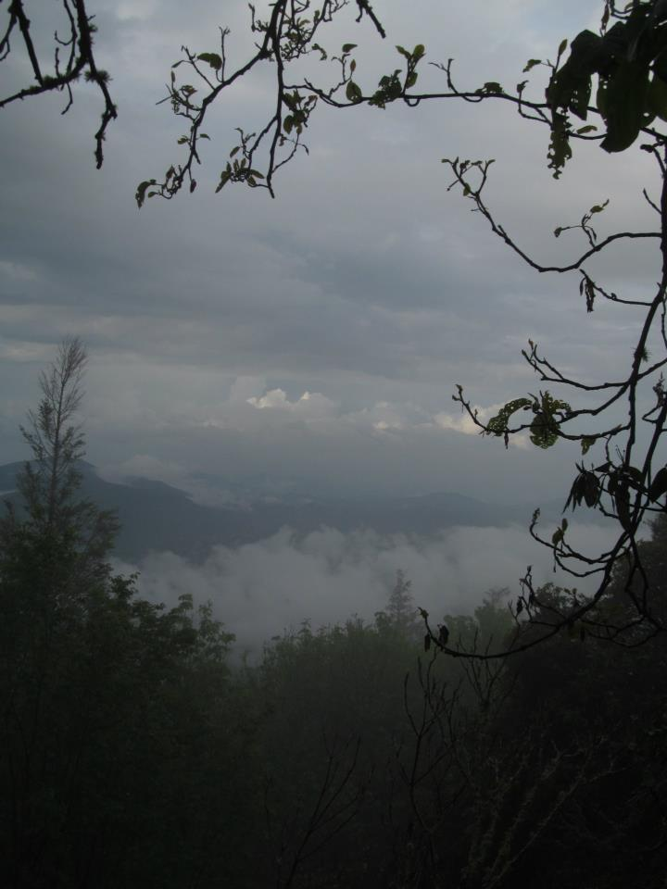
Weather-related safety issues
Nowcasting to avoid or anticipate weather hazards; sights
  Cool season
    Clouds thickening (can’t see sun) → storm approaching
    Winds and/or clouds moving toward north → storm approaching
    Winds and/or clouds shift to moving toward east or south → clearing and cool weather approaching
Courtesy: Daniel Martin

Slide 51

Weather-related safety issues
Nowcasting to avoid or anticipate weather hazards; sights
  Cool season
    Calm winds with…
      clouds and precipitation; in middle of storm (low pressure center)
      clear sky; in the middle of high pressure, winds may shift to blowing from the south (warming on the horizon)
Courtesy: Daniel Martin

Slide 52

Ordinary Thunderstorm Mature Stage
The downdraft and updraft within the mature thunderstorm constitute a cell
This is the most intense stage of an ordinary thunderstorm
Lightning & thunder, hail, heavy rain possible
Often a cold downrush of air associated with the onset of precipitation – gust front

Slide 53

A Supercell T-storm with a tornado extending downward from its base.

Slide 54

Supercell Tracks – 27 April 2011
http://www.talkweather.com/forums/index.php?/topic/56530-supercell-tracks-from-april-27-2011/

Slide 55
April 27, 2011
http://www.srh.noaa.gov/srh/ssd/mapping/

Slide 56

Squall Line Thunderstorm
A line of thunderstorms that often form along or ahead of a cold front associated with a synoptic-scale cyclone (2000 km or 1243 mile horizontal scale)
Most persistent and damaging squall lines occur in the spring
Can also have a long lifespan (~6 hours)
Recent studies suggest that most nighttime tornadoes are produced by squall lines
http://www.geography.hunter.cuny.edu/~tbw/wc.notes/10.thunderstorms.tornadoes/squalls_tornadoes.htm

Slide 57

Squall Line Thunderstorm
Alabama, 9 March 2006
Tornadoes can form at the far northern and southern ends of a “bowing” squall line
http://www.srh.noaa.gov/bmx/?n=event_03092006

Slide 58

Weather-related safety issues
Nowcasting to avoid or anticipate weather hazards; sights
  Warm season
    Clouds thickening (can’t see sun) → storm approaching
    Wind speeds pick up (approaching gust front)
    Wind direction can indicate T-storm center location, but mountains & valleys complicate its interpretation
Courtesy: Daniel Martin

Slide 59

Weather-related safety issues
Nowcasting to avoid or anticipate weather hazards; sounds
  Cool season & Warm season
    Gusts (indicated by tree movement) can warn of potential wind-throw
    “Roar” warns of sustained windy period and strong gusts

Slide 60

Weather-related safety issues
Nowcasting to avoid or anticipate weather hazards; sounds
  Warm season
    Thunder – indicates proximity of lightning-generating T-storm cell
Courtesy: Daniel Martin

Slide 61

T-storm Warning Signs
Watch & Listen for
  Time between
    seeing lightning flash
    hearing thunder
  [time (sec) / five = distance of T-storm in miles]

Slide 62


Lightning Safety, in the Mountains
Lightning safety, when caught outdoors
    Avoid peaks and ridges
    Do squat on an insulating material
    Do not lean back against rock walls
    Do not take shelter under tall isolated trees
    Do not take shelter in caves, shallow depressions, under large boulders, or under overhangs
“Mountain Meteorology, Fundamentals and Applications” by C. David Whiteman

Slide 63

Weather-related safety issues
Nowcasting to avoid or anticipate weather hazards; smells
  Cool season and Warm season
    Air pockets in the soil collect gases from decaying matter
    Rain fills the air pockets, expelling the gases which are then carried by the winds of the storm
Courtesy: Daniel Martin

Slide 64
Weather-related safety issues
Nowcasting to avoid or anticipate weather hazards; sensations
  Cool season and Warm season
    Creaky knee?
    Achy breaky elbow?
    might be indicating a significant change in atmospheric pressure that can forewarn the approach of a storm

Slide 65
Weather-related safety issues
Nowcasting to avoid or anticipate weather hazards; undetected hazard

Slide 66

Gunter Fork Debris Flow
KMRX
  Loop period; 7:17 pm EDT 14 July – 12:03 am EDT 15 July 2011

Slide 67

Weather-related safety issues
Nowcasting to avoid or anticipate weather hazards; undetected hazard
  Gunter Fork example
Courtesy: Rick Wooten

Slide 68

Spotter field activity
Cloud thickness trend
Cloud movement
Wind speed/ direction
Weather-related sounds?
Weather-related smells?
Weather-related aches and pains?

