Slide 1
Meteorology – A Forecast Fascination
Session 1
Douglas K. Miller
Professor, Atmospheric Sciences Department
UNC Asheville
dmiller@unca.edu

Slide 2
Outline
It’s all about balance
Weather tools
Pressure systems
What drives our global climate?

Slide 3
It’s all about balance
At all scales, circulations in the atmosphere are attempting to restore balance to an imbalanced situation forced by uneven heating and/or cooling at the earth’s surface.
microscale
mesoscale
synoptic scale
planetary scale
seconds
hours
days
weeks

Slide 4
It’s all about balance
Uneven heating and/or cooling at the earth’s surface creates atmospheric environments having potential energy that, in the presence of a ‘trigger’, releases the energy (instability) for conversion to kinetic energy (energy of motion)
microscale
mesoscale
synoptic scale
planetary scale
seconds
hours
days
weeks

Slide 5
It’s all about balance
Storm development (increasing kinetic energy) continues until balance has been restored locally…however, uneven heating and/or cooling at the earth’s surface is continuous elsewhere…so the pursuit of balance is endless!
microscale
mesoscale
synoptic scale
planetary scale
seconds
hours
days
weeks

Slide 6
It’s all about balance
Example
microscale
mesoscale
synoptic scale
annual scale
seconds
hours
days
one year

Slide 7
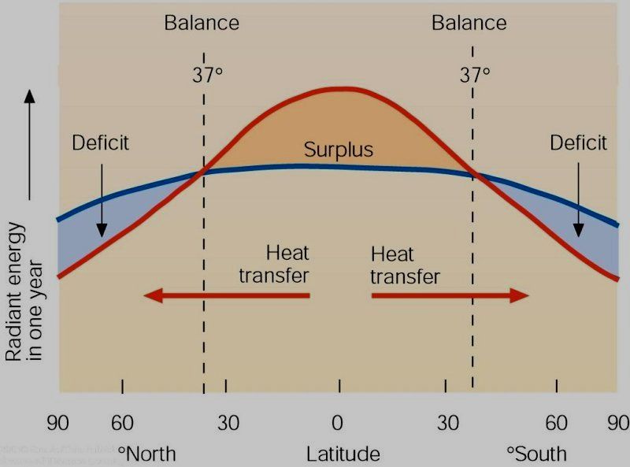
It’s all about balance
Example
microscale
mesoscale
synoptic scale
annual scale
seconds
hours
days
one year
Lecture Packet #2

Slide 8
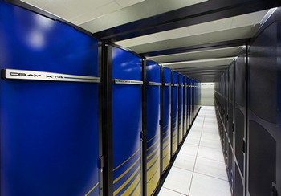
Weather tools
Computer-based weather analysis
Computer-based weather forecast
Computer weather model
http://cs.lbl.gov/news-media/news/2009/berkeley-lab-checkpoint-restart-improves-productivity/

Slide 9
Weather tools
Weather sensors
in situ
thermometer
barometer
hygrometer
wind vane and anemometer
rain gauge
rawinsonde (weather balloon)
remote
radar
satellites
Computer-based weather analysis
Many of today’s weather sensors have been designed for automation and are difficult for ‘hands-on’ demonstrations…
thermometers → electronic resistance is a function of air temperature

Slide 10
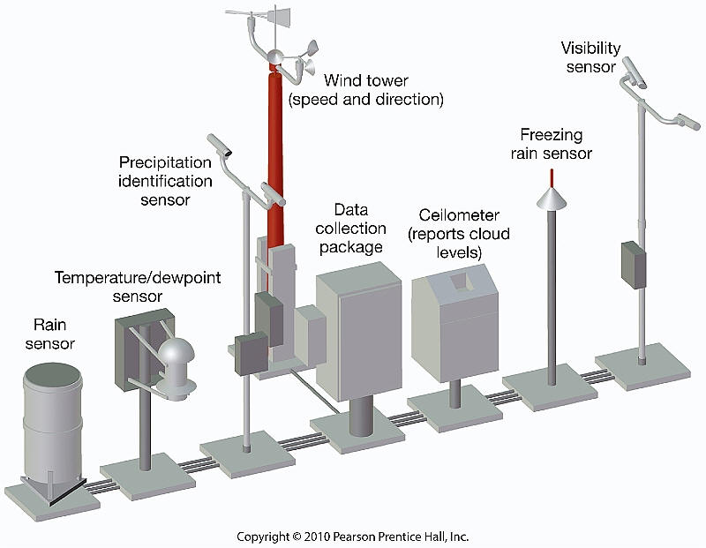
Weather tools
Automated Surface Observing System (ASOS)
http://www.geography.hunter.cuny.edu/tbw/wc.notes/12.weather.forecasting/automated_surface_observing_syst.htm

Slide 11
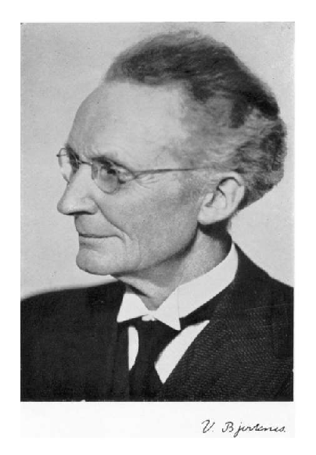
Weather tools
Some challenges (1908)…
‘Strassburg Low’
Surface convergence over the center of an intensifying cyclone
Vilhelm Bjerknes

Slide 12
Weather tools
Some challenges (1908)…
‘Strassburg Low’
Surface convergence over the center of an intensifying cyclone
Vilhelm Bjerknes

Slide 13
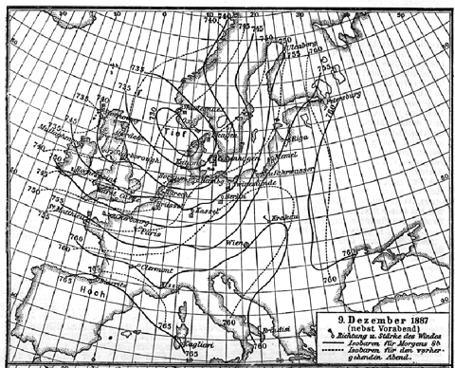
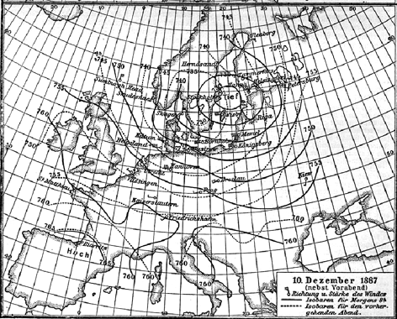
Weather tools
Some challenges (1908)…
‘Strassburg Low’
Surface convergence over the center of an intensifying cyclone
http://www-history.mcs.st-andrews.ac.uk/HistTopics/Weather_forecasts.html

Slide 14
Weather tools
Some challenges (1908)…
‘Strassburg Low’ – predicting storms was made difficult when bad data was included in the weather analysis alongside the good data
Vilhelm Bjerknes

Slide 15
Weather tools
Weather sensors
in situ
thermometer
barometer
hygrometer
wind vane and anemometer
rain gauge
rawinsonde (weather balloon)
remote
radar
satellites
Computer-based weather analysis
Quality Control of observations is an essential part of the weather analysis step

Slide 16
Weather tools
Computer-based weather analysis
Computer-based weather forecast
Computer weather model – incorporates the governing equations that define the conservation of momentum, mass, heat, and moisture.
ALWAYS a compromise between physical realism and timeliness of the computer-generated weather prediction (limited by compute power).
http://cs.lbl.gov/news-media/news/2009/berkeley-lab-checkpoint-restart-improves-productivity/

Slide 17
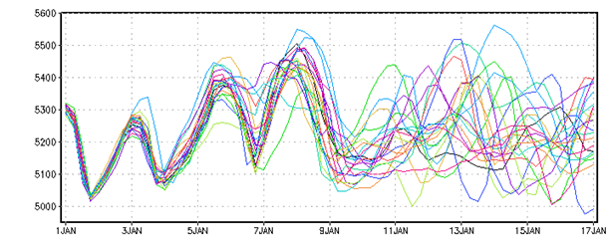
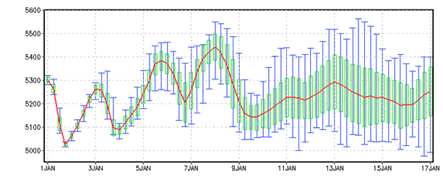
Weather tools
Weather is chaotic (forecast sensitive to initial conditions)
Initialize computer weather model with multiple scenarios only differing slightly from each other in the prescribed initial conditions.
Computer-based weather forecast
http://www.iges.org/grads/gadoc/ensembles.html

Slide 18
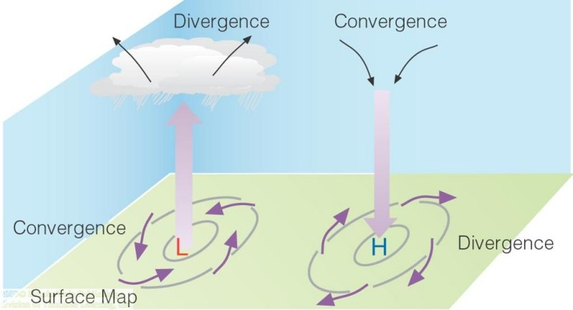
Pressure systems
Some challenges (1908)…
‘Strassburg Low’
Surface convergence over the center of an intensifying cyclone
Vilhelm Bjerknes
Lecture Packet #6

Slide 19
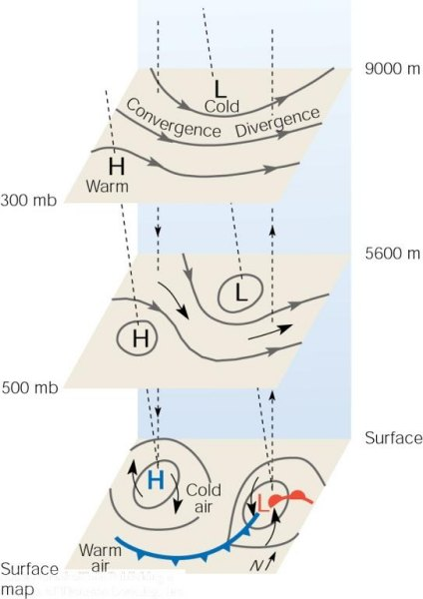
Pressure systems
Some challenges (1908)…
‘Strassburg Low’
Surface convergence over the center of an intensifying cyclone
N.H.
Lecture Packet #8

Slide 20
Pressure systems
microscale
mesoscale
synoptic scale
planetary scale
seconds
hours
days
weeks

Slide 21
Pressure systems
Uneven heating and/or cooling at the earth’s surface creates atmospheric environments having potential energy that, in the presence of a ‘trigger’, releases the energy (instability) for conversion to kinetic energy (energy of motion)
microscale
mesoscale
synoptic scale
planetary scale
seconds
hours
days
weeks

Slide 22
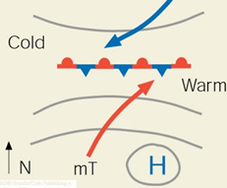
Pressure systems
Synoptic scale low pressure system (cyclone) ‘trigger’
N.H.

Slide 23
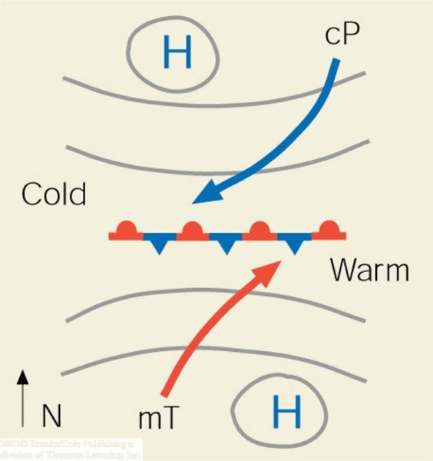
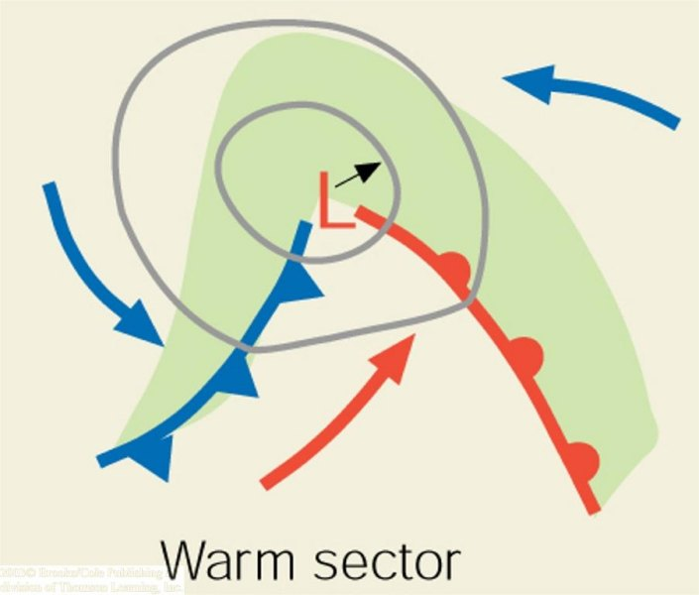
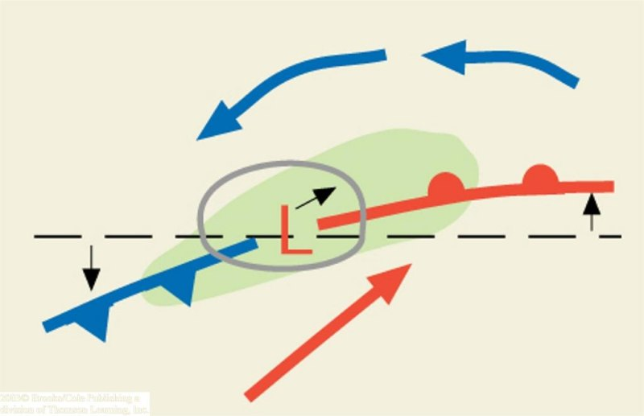
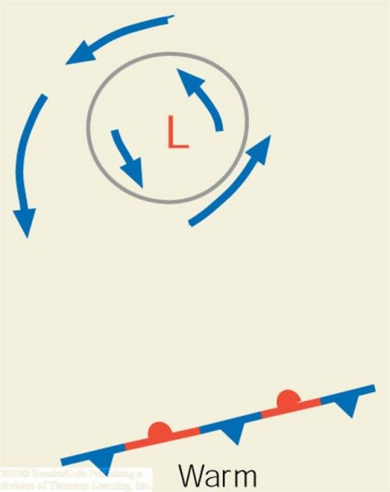
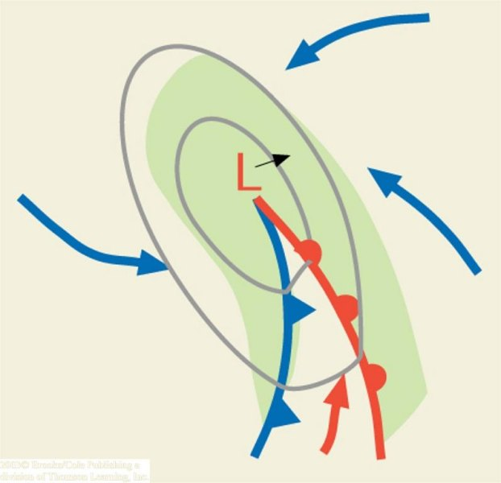
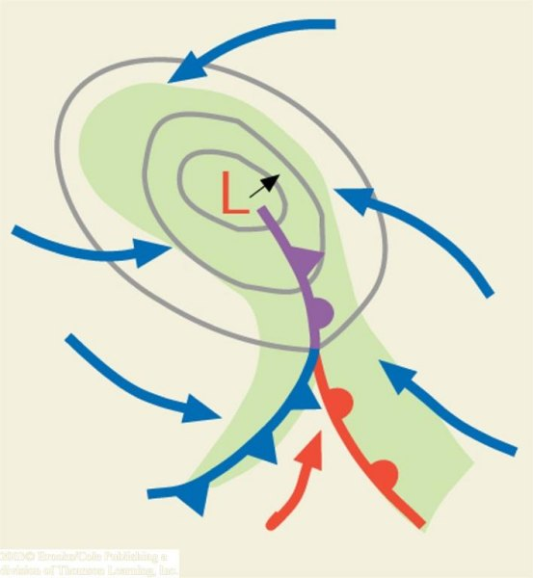
‘trigger’
cyclogenesis
(a)
(b)
(c)
N.H.
(d)
(e)
(f)
Lecture Packet #8

Slide 24
Pressure systems
Anticyclone (high pressure system)
N.H.
Lecture Packet #8

Slide 25
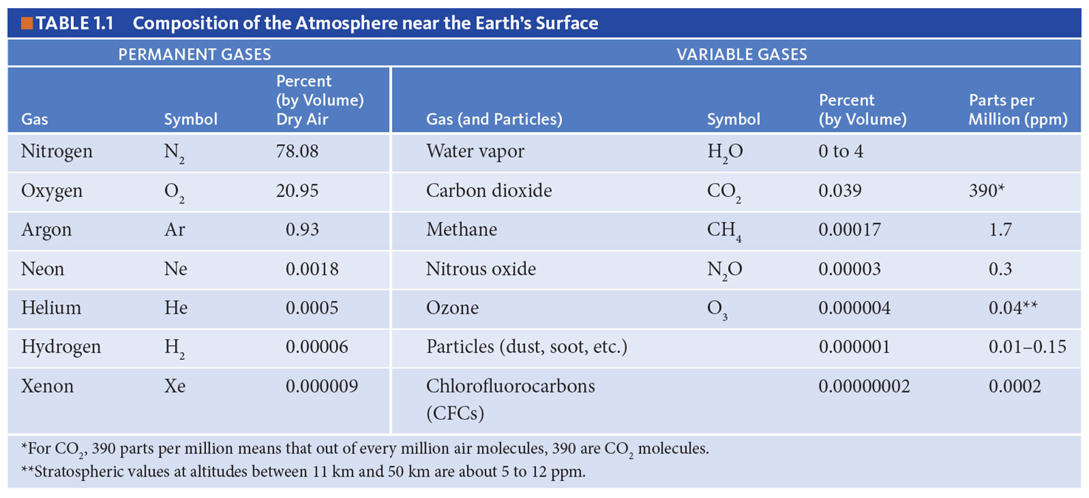
What drives our global climate?

Slide 26
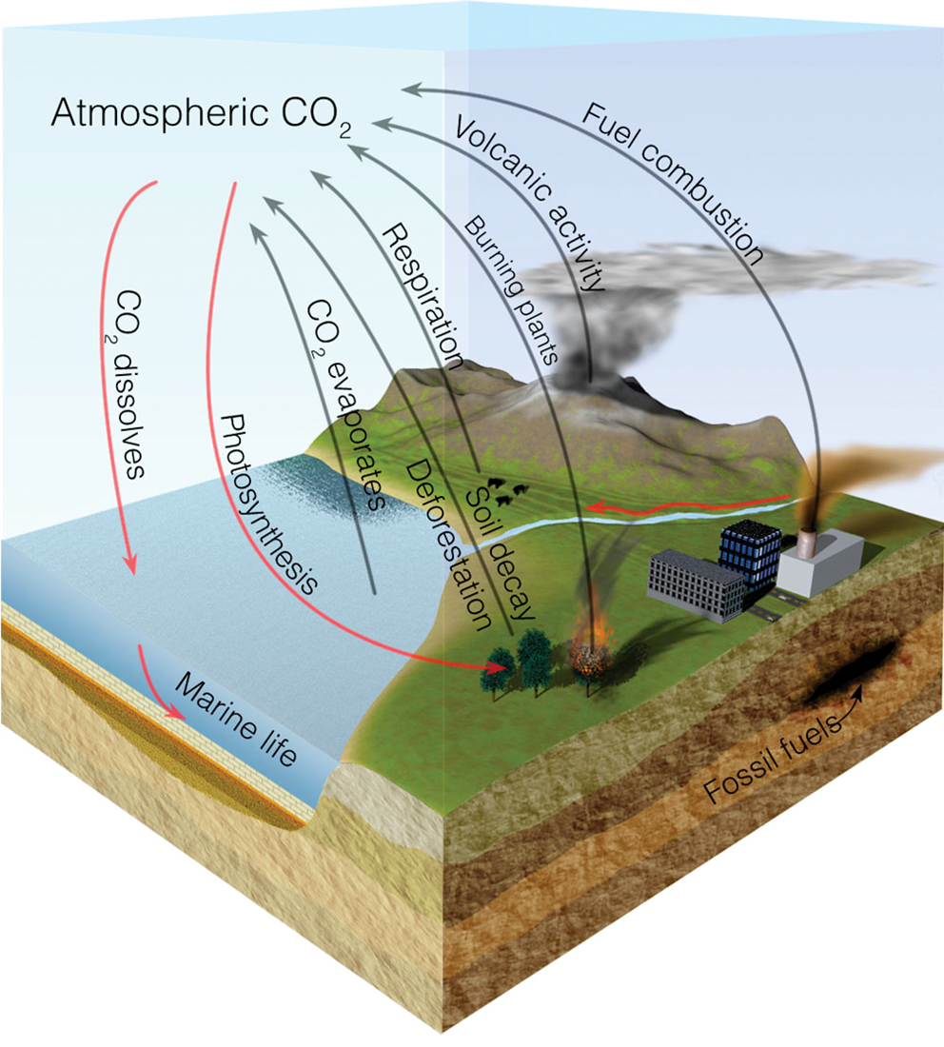
All gaseous molecules are part of a cycle
Sources
Sinks
Storage

Slide 27
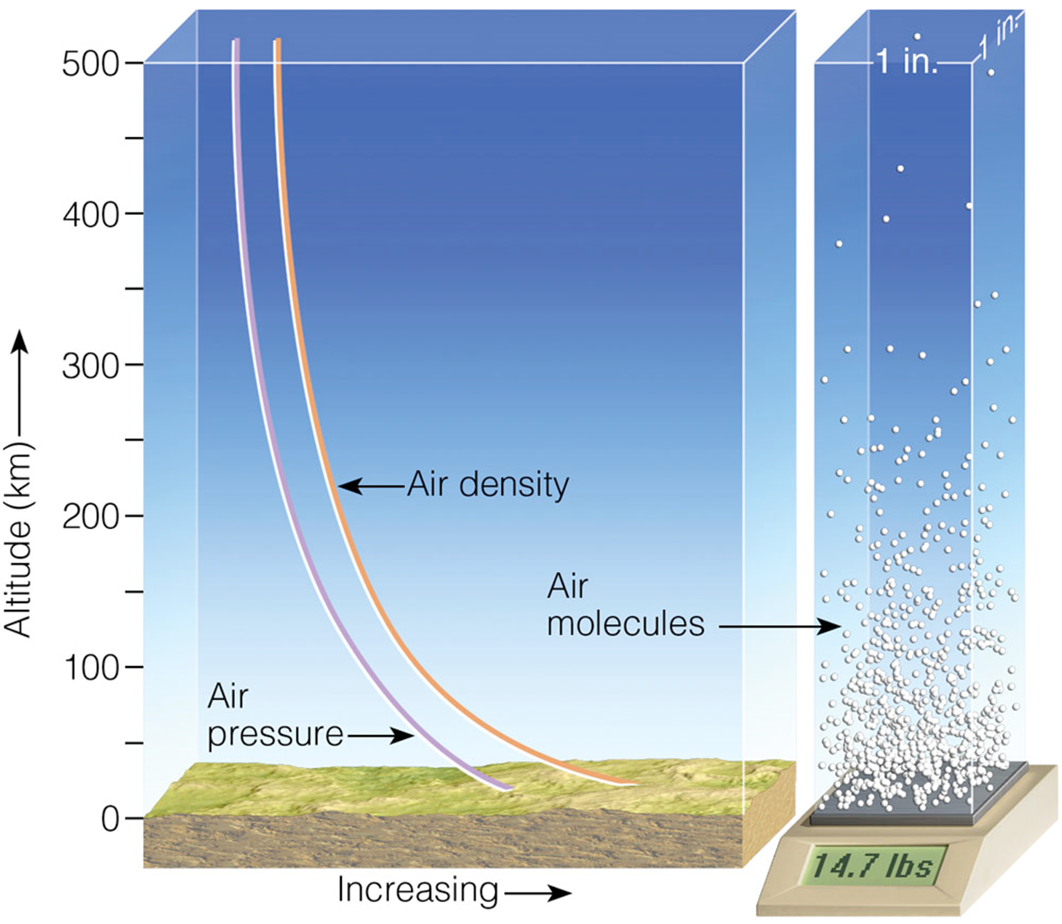
All gaseous molecules have mass
Well-mixed in lowest atmosphere
Highest density near the earth’s surface
Decreases exponentially above the earth’s surface

Slide 28
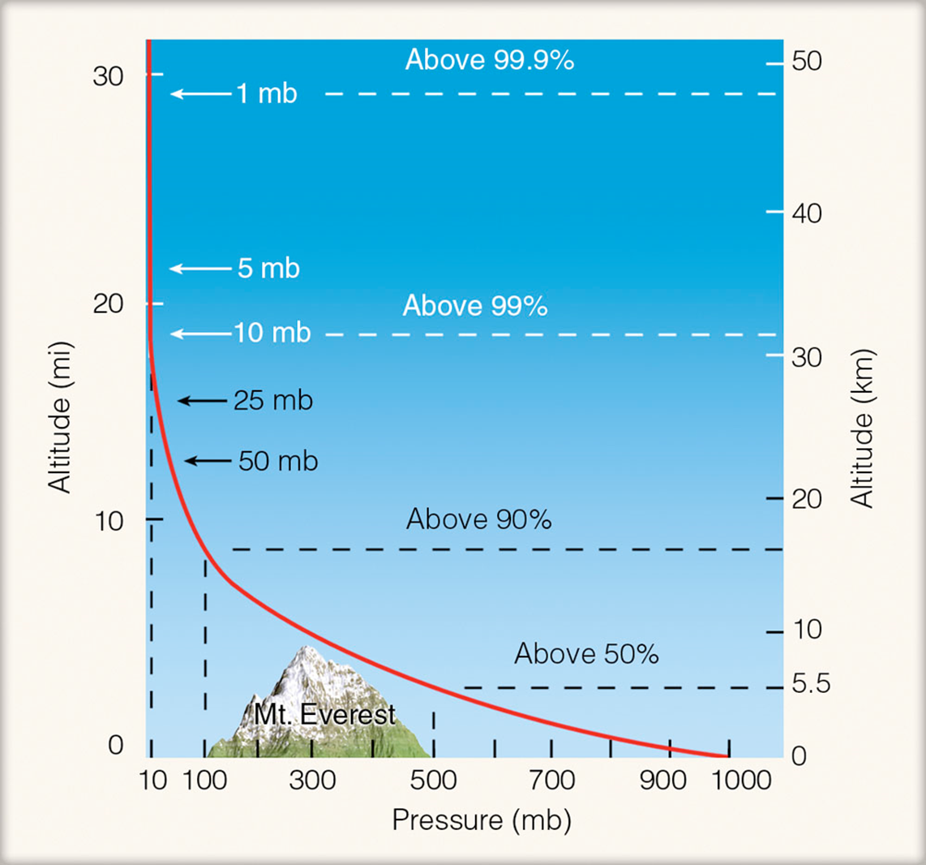
Atmospheric pressure is a measure of the number of air molecules in the overhead column
On top of Mt Everest you would be at an elevation above more than half of the air molecules

Slide 29
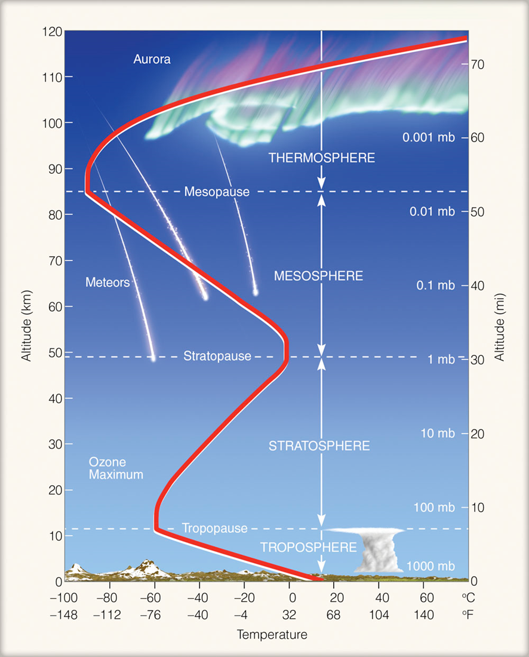
Atmospheric layers are primarily categorized according to the vertical temperature profile
Troposphere
Stratosphere
Mesosphere
Thermosphere

Slide 30
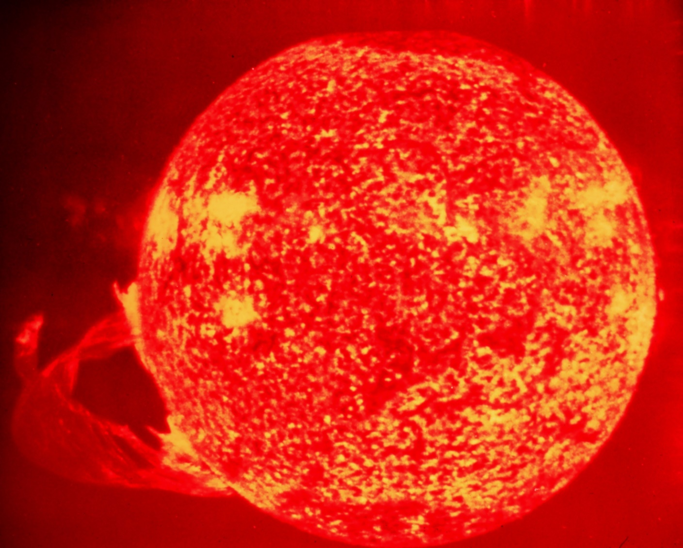
What drives our global climate?
http://www.noaanews.noaa.gov/stories2005/images/solar-flare.jpg

Slide 31
Primary heat transfer mechanisms - Radiation
http://www.noaanews.noaa.gov/stories2005/images/solar-flare.jpg

Slide 32
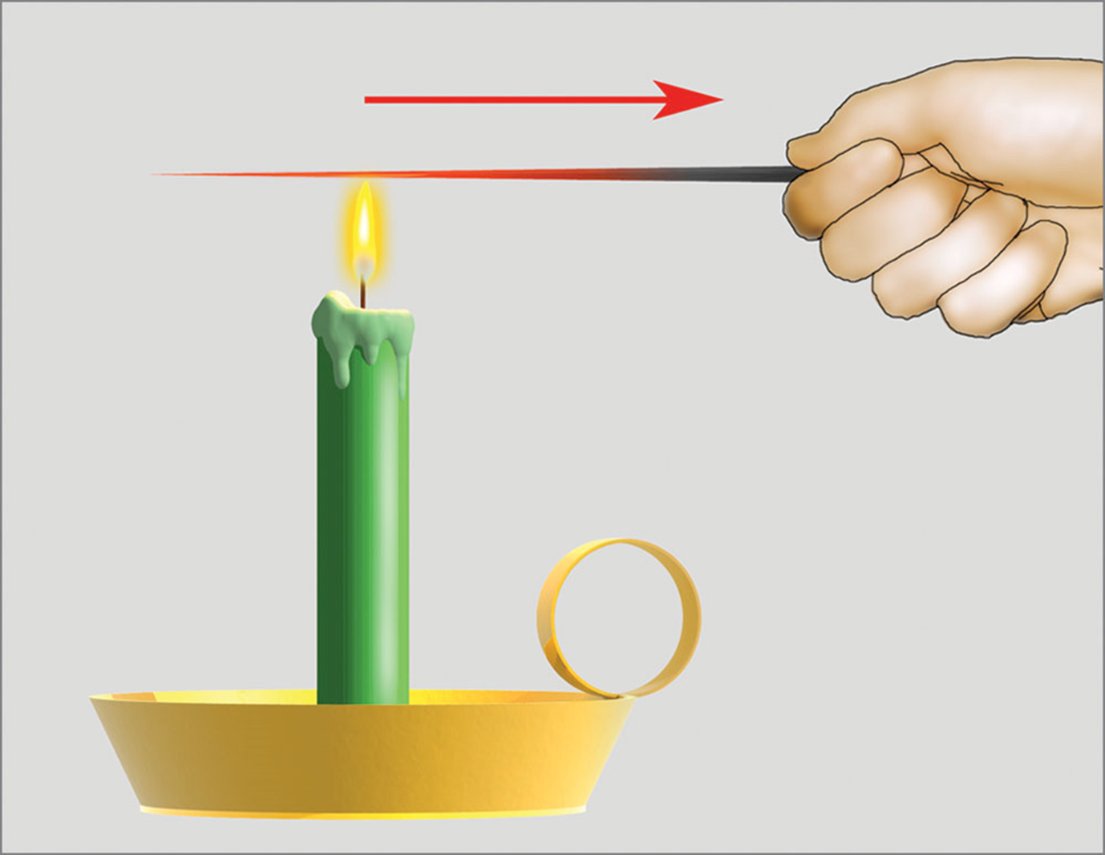
Primary heat transfer mechanisms - Conduction

Slide 33
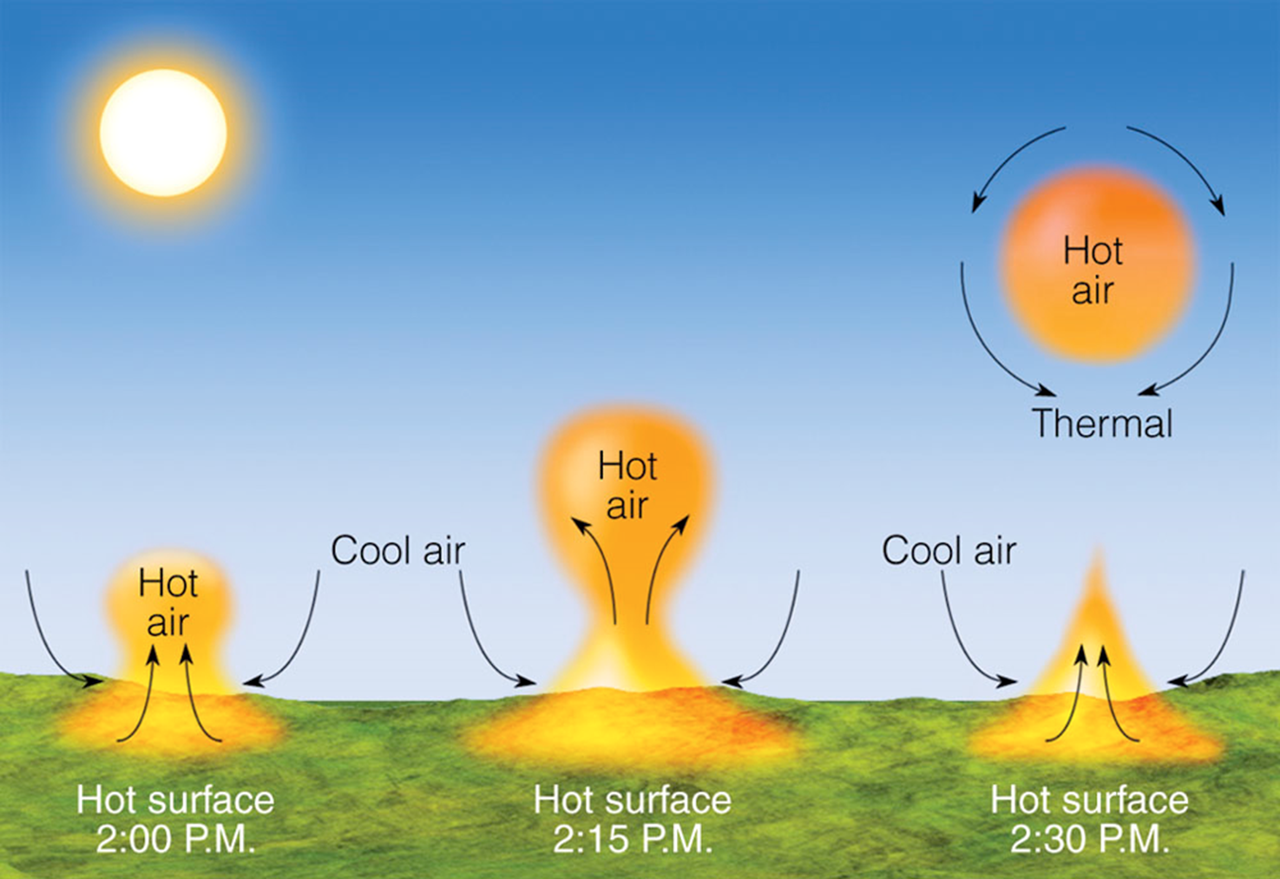
Primary heat transfer mechanisms - Convection

Slide 34
Driver of our weather and climate…
http://www.noaanews.noaa.gov/stories2005/images/solar-flare.jpg

Slide 35
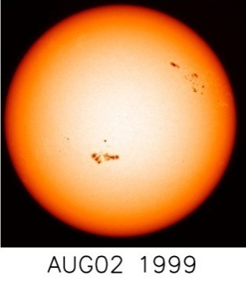
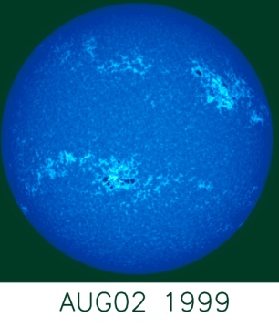
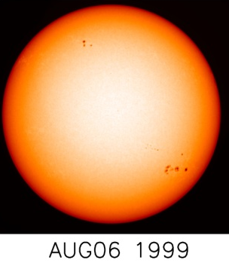
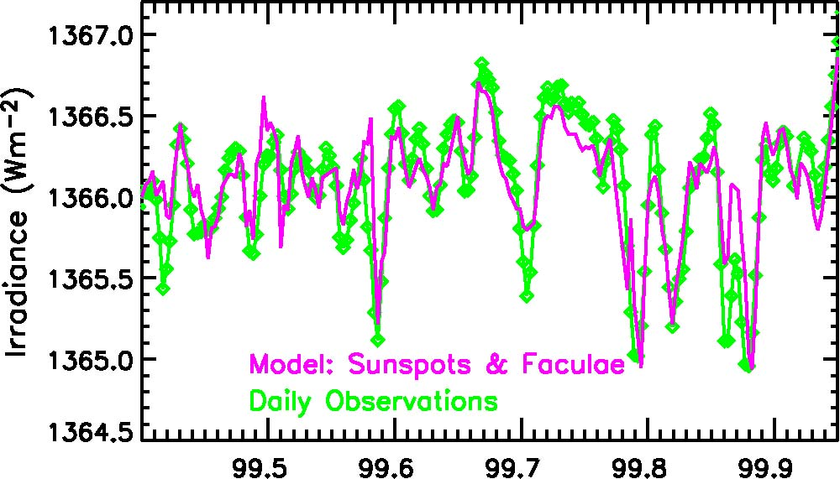
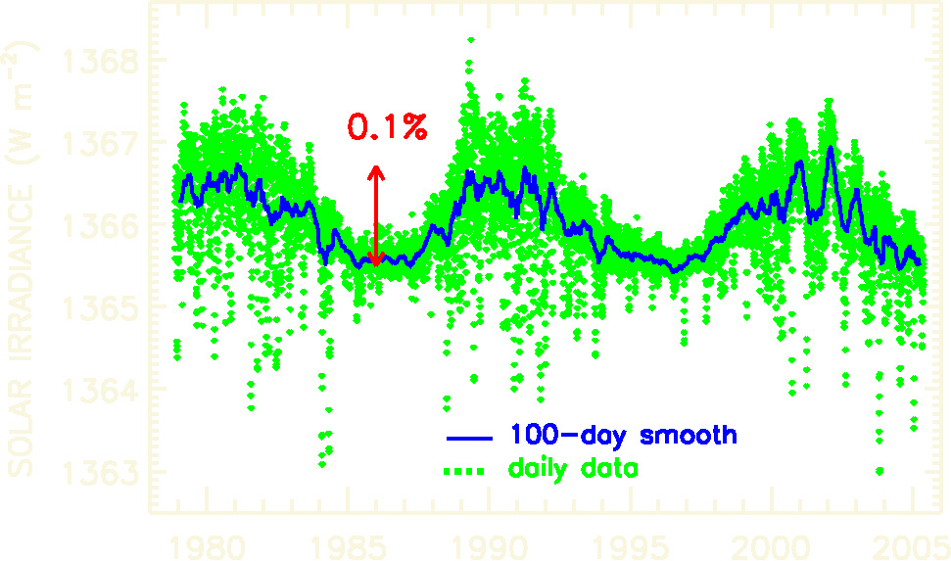
Total Solar Irradiance
5-min oscillation ~ 0.003%
27-day solar rotation ~ 0.2%
11-year solar cycle ~ 0.1%
longer-term variations not yet detectable
cycle 21
max
cycle 22
max
solar photosphere
near UV,VIS,IR
radiation
1366 Wm⁻²
climate
data: Fröhlich & Lean,GRL,1998
http://www.pmodwrc.ch

Slide 36
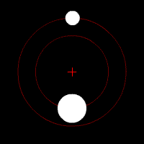
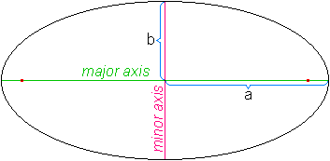
What drives our global climate?
Mean earth-sun distance is 92,955,807 miles
http://en.wikipedia.org/wiki/Orbit
http://en.wikipedia.org/wiki/Ellipse
http://www.windows.ucar.edu/tour/link=/the_universe/uts/log_jpg.html

Slide 37
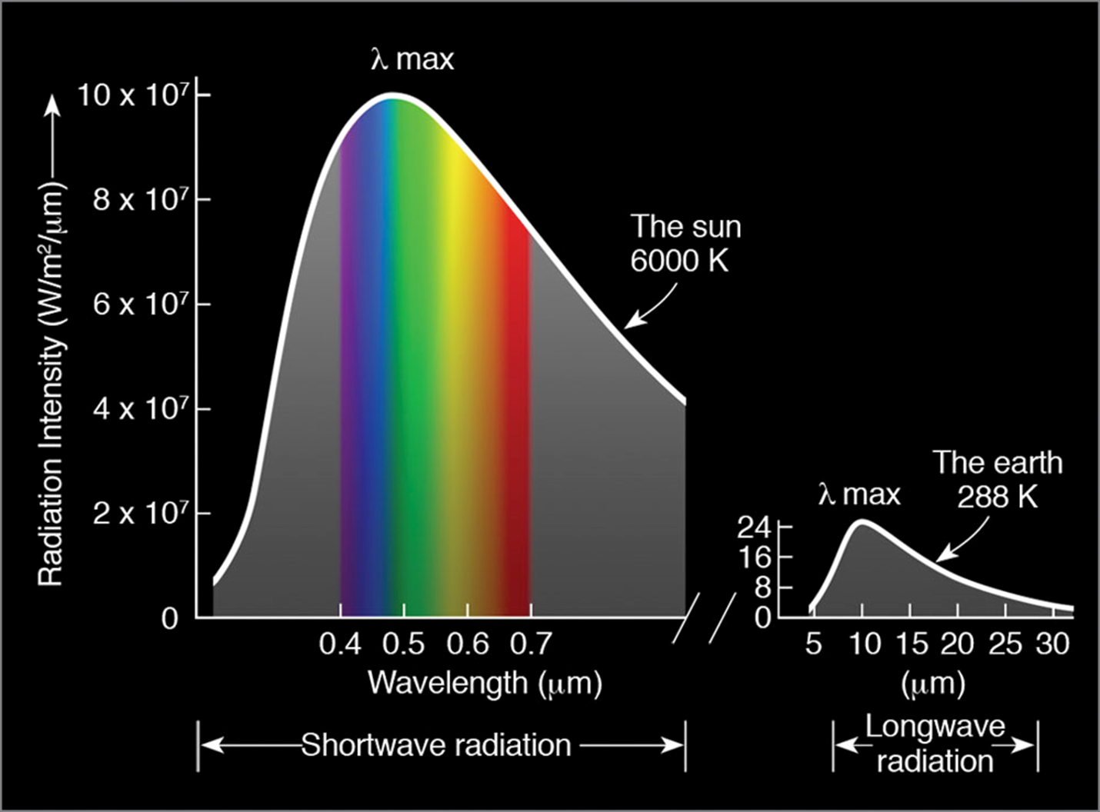

Slide 38
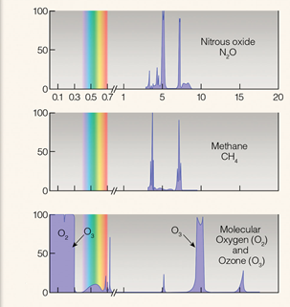
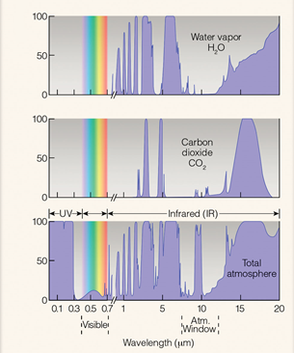
What drives our global climate?
Absorption (%)
Ahrens (2005)

Slide 39
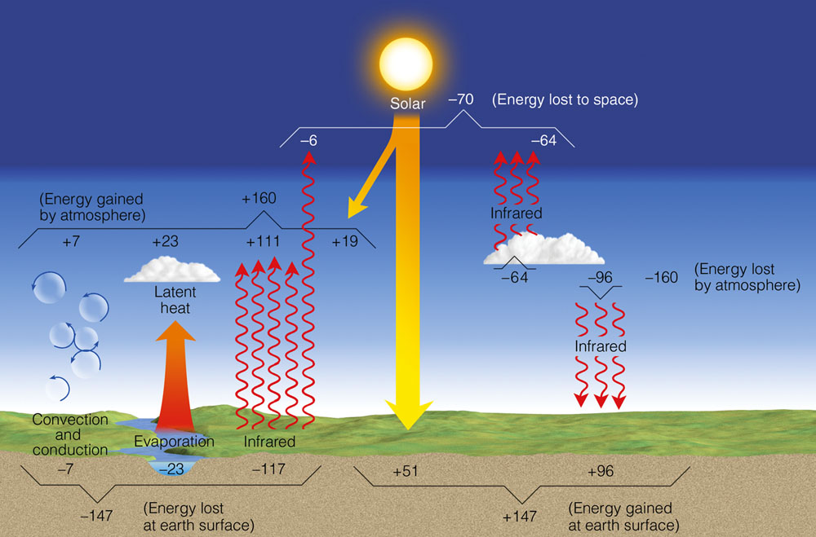
What drives our global climate?
global and
annual average
Ahrens (2005)

Slide 40
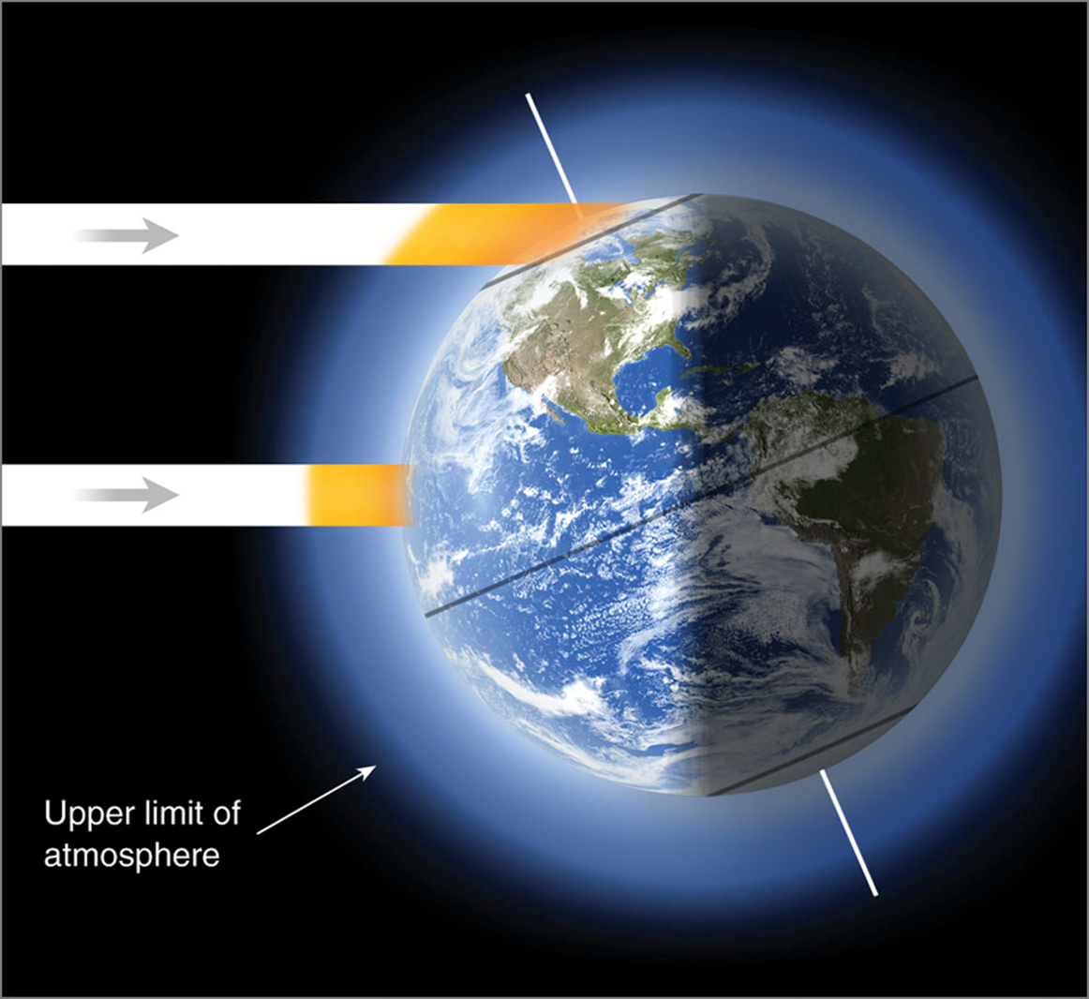
What drives our global climate?
Mean earth-sun distance is 92,955,807 miles
At a moment in time…
[example is showing NH summer]

Slide 41
What drives our global climate?
annual average
Ahrens (2005)

Slide 42
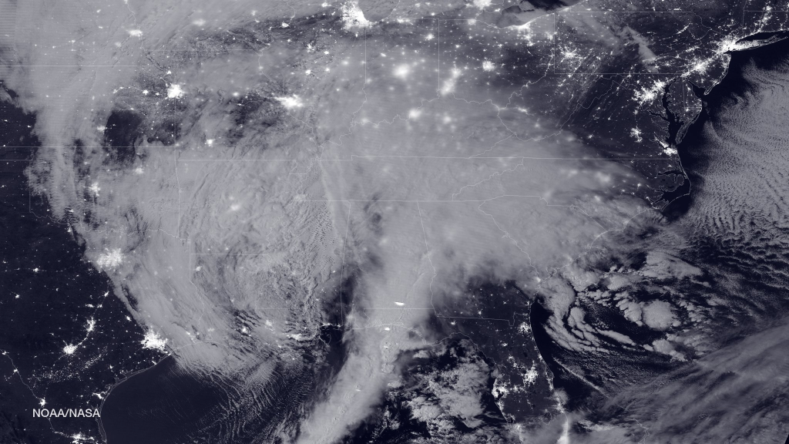
The BIG climate picture – Session 2 sneak peek
23 Jan 2016
https://www.nasa.gov/image-feature/2016-blizzard-by-moonlight

Slide 43
The BIG climate picture – Session 2 sneak peek
Trade winds – blow from northeast in N. Hemi and southeast in S. Hemi
Intertropical Convergence Zone – Surface region of convergence between trades
Subtropical Highs – semipermanent high in the subtropical high pressure belt centered near 30° latitude. Bermuda high, Pacific Ridge.
Westerlies – prevailing westerly flow
Lecture Packet #7

