Slide 1
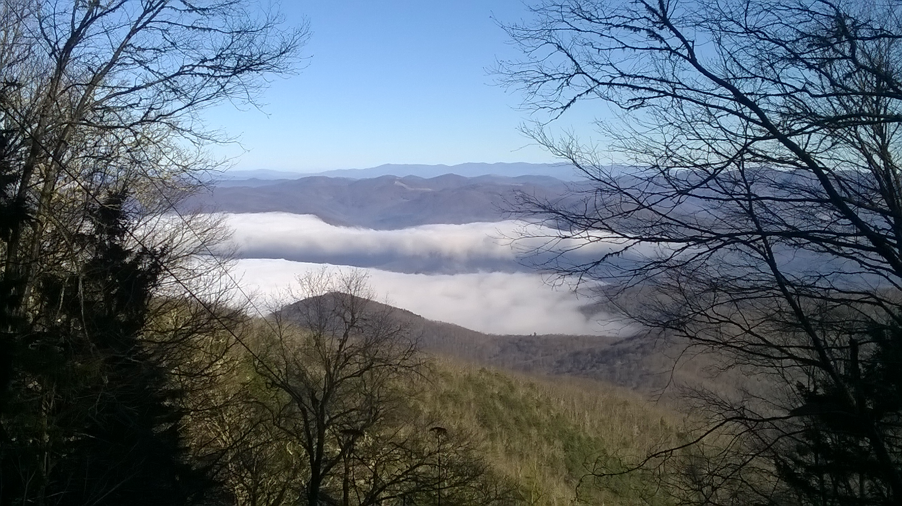


Eight Years of Catching Hydrometeors in the Great Smoky Mountains National Park and Pigeon River Basin
Douglas K. Miller
Professor and Chair
Atmospheric Sciences Department
UNC Asheville
Dr. Ana Barros and Anna Wilson, Duke University
credit: E. Wright

Slide 2
Purpose
Seek partnerships and collaborations that can expand the usefulness of high-elevation precipitation measurements in the Pigeon River Basin and Great Smoky Mountains National Park

Slide 3
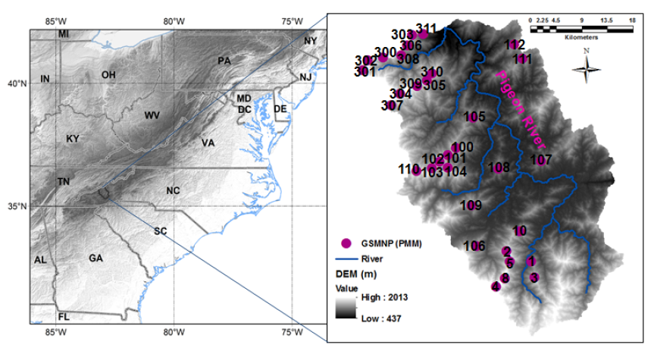
Duan, Wilson, and Barros (2015)
Notes:
3

Slide 4
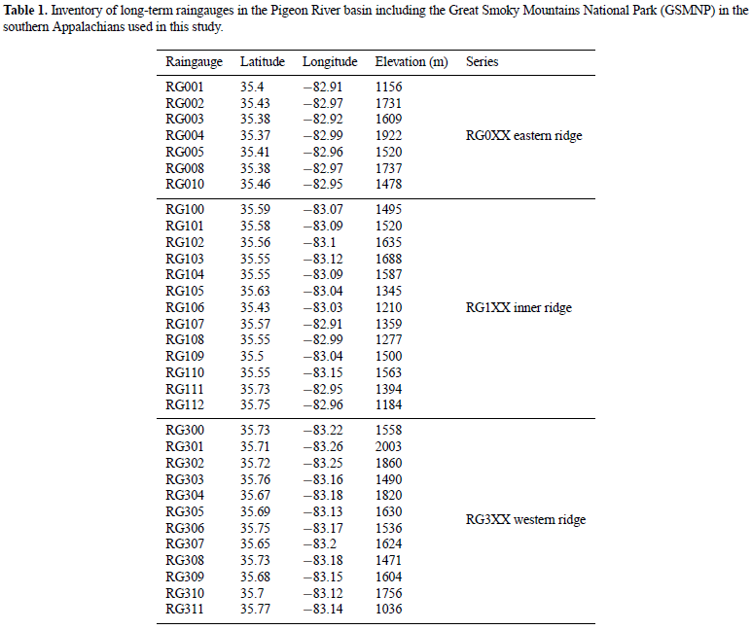
Duan, Wilson, and Barros (2015)
Notes:
4

Slide 5
Outline
High elevation rain gauge network in the Pigeon River Basin and Great Smoky Mountains National Park
  Original purpose
  What have we learned?
    Based on field observations
    IPHEx
  How do we continue the hydrological record?

Slide 6
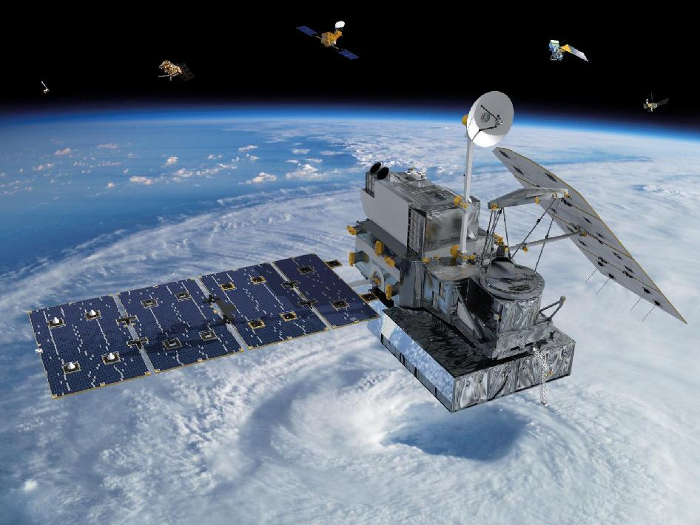
Original purpose
funded by NASA
  Provide ground validation (GV) at high elevation locations in the mid-latitudes for NASA’s Global Precipitation Mission (GPM)

Slide 7

GPM LAUNCH: 27 FEBRUARY 2014, 1:37 PM EST, TANEGASHIMA SPACE CENTER, JAPAN
Improves upon the capabilities of the Tropical Rainfall Measurement Mission (TRMM), a joint NASA-JAXA mission launched in 1997 and still in operation.
Expands coverage area from 40°N to 40°S (TRMM) to from the Arctic Circle to the Antarctic Circle.
Detect light rain and snowfall, a major source of available fresh water in some regions.
Collect information that unifies and improves data from an international constellation of existing and future satellites by mapping global precipitation every three hours.
http://www.nasa.gov/mission_pages/GPM/main/#.Ux9ynM65Hws
Wilson et al. (2014)
Notes:
TRMM stands for Tropical Rainfall Measurement Mission
TRMM revisits area on average once a day
7

Slide 8
GPM Ground Validation Program
Objectives
Provide ground and airborne precipitation datasets supporting physical validation of satellite-based precipitation retrieval algorithms
Determine the measurement uncertainty for GPM measurements to allow users of GPM data to interpret observations
Improve the retrieval algorithms used by GPM and future space-based precipitation measurement missions
Improve understanding of precipitation processes and the ground-based GV measurements themselves, which have historically been beset with difficulties
seek to advance our physical understanding of precipitation processes and assure consistency between this understanding and the representation of those physical processes in NASA GPM retrieval algorithms
Wilson et al. (2014)

Slide 9
What have we learned?
Based on field observations (summary)
    Extreme rainfall at high elevations for warm season convective precipitation events
    Considerable inhomogeneity in precipitation forcing and precipitation
      Significant valley and ridgeline variability
      Diurnal differences
      Significant water gained from light rainfall events
        Suggest unique drop size distributions (DSDs)
        Importance of seeder-feeder mechanism
    Effective for calibration of remotely-sensed precipitation estimates
      Modeling applications

Slide 10
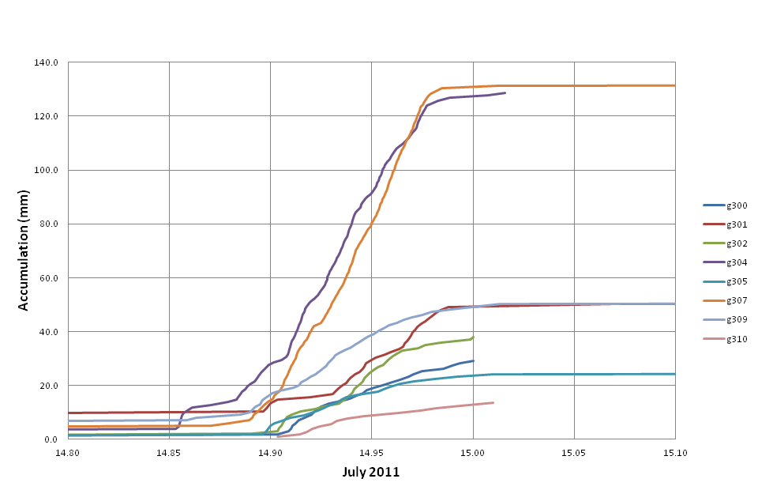
Introduction
Duke University Great Smoky Mountains National Park Rain Gauge Network
Balsam Mtn; 4.97 inches
What happened?
14-15 July 2011
14, 15 July 2011 from 8:30 pm – half past midnight
Big Cataloochee Mtn; 4.87 inches
Midnight EDT
10:00 pm EDT
8:00 pm EDT
14 July
15 July

Slide 11
What have we learned?
Lee et al. (2011)
KGSP WSR-88D storm total rainfall estimate between approximately 2330 UTC
on 14 July 2011 until 0430 UTC on 15 July 2011. Arrow points toward precipitation maximum (3.60 inches).

Slide 12
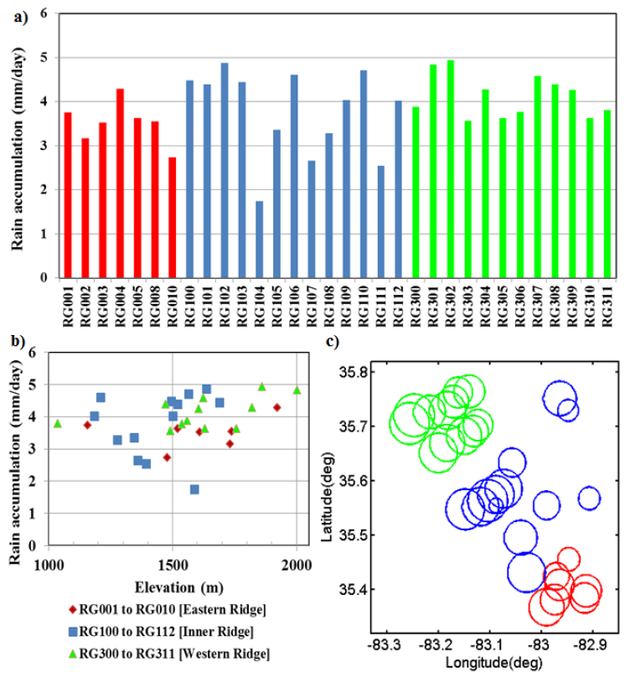
Outline
2008 - 2013
Duan, Wilson, and Barros (2015)

Slide 13
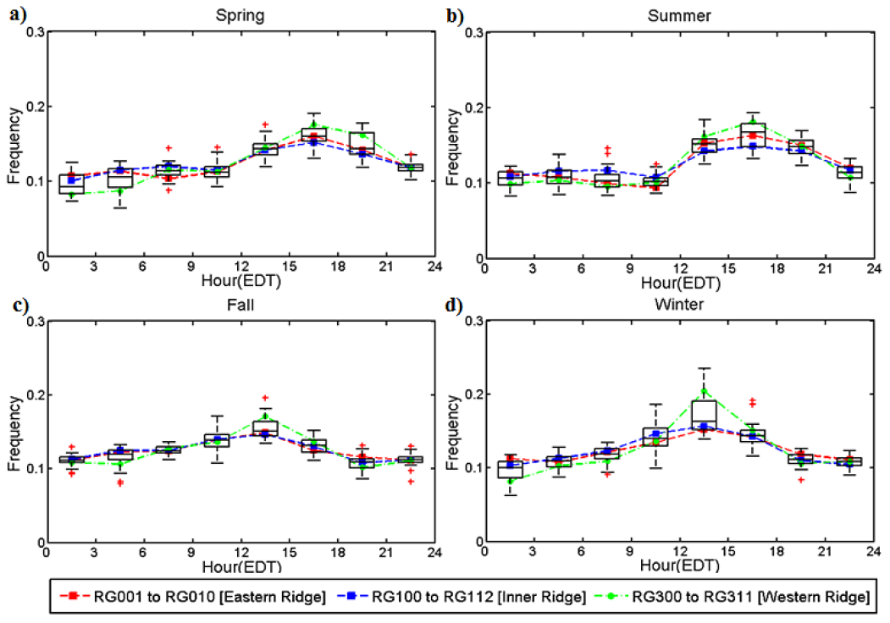
Outline
Duan, Wilson, and Barros (2015)

Slide 14
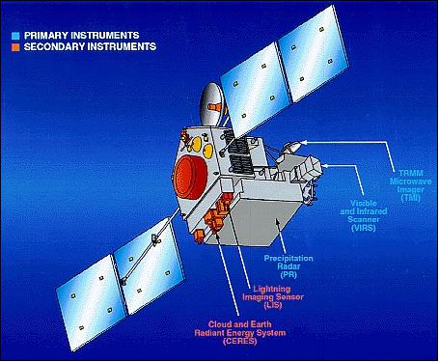
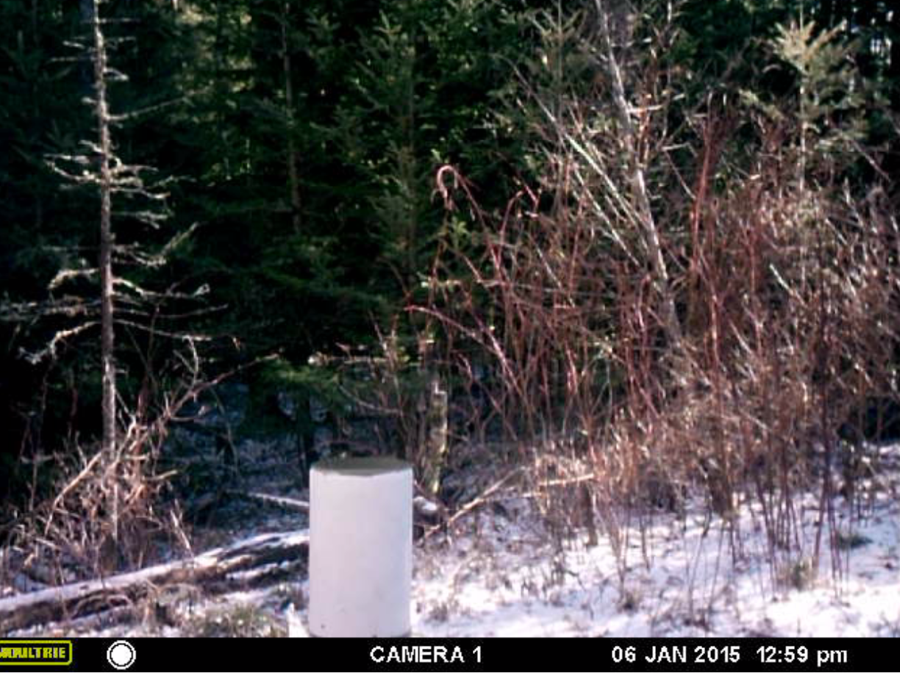
What have we learned?
https://directory.eoportal.org/web/eoportal/satellite-missions/t/trmm
TRMM

Slide 15

What have we learned?
Remote sensing of precipitation (active sensors)
  Send out microwave wavelength energy
  Returned energy (reflectivity) at multiple vertical levels is converted to rain rate using an assumed DSD
Returned energy is the integrated reflection from numerous targets → from a statistical perspective, there are an infinite variety of DSDs that could yield the same returned energy value
http://forecast.weather.gov/jetstream/doppler/how.htm

Slide 16
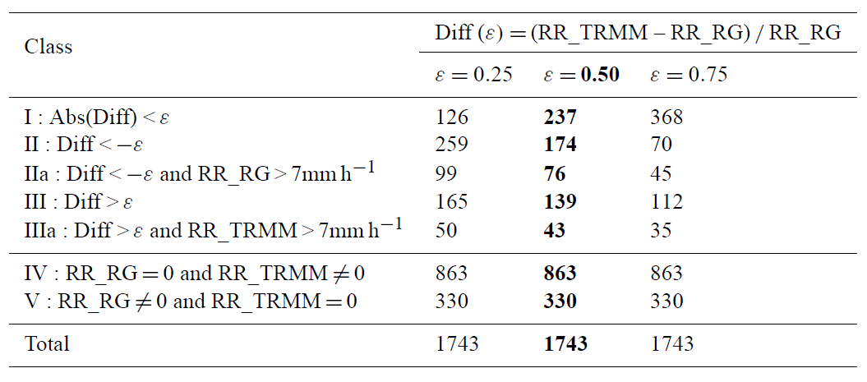
What have we learned?
100 – stratiform certain,
120 – probably stratiform,
130 – maybe stratiform,
140 – maybe stratiform or maybe transition or something else,
200 and 210 – convective certain,
237 – probably convective
Duan, Wilson, and Barros (2015)

Slide 17
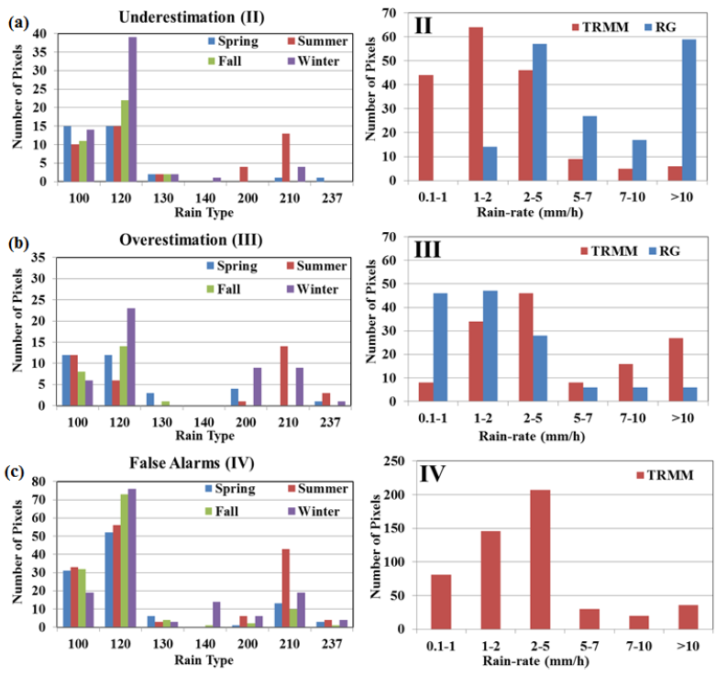
Outline
Prat and Barros (2010a)
Duan, Wilson, and Barros (2015)
Notes:
Little/no hope of bias correction in UND cases [Fig. 6(a), right panel] due to differences in skew (TRMM < 5 mm/h, RG > 10 mm/h).
Bias correction IS possible in OVR cases [Fig 6(b), right panel] due to good overall agreement between TRMM and RG rain rate histogram.
False alarms associated with 100 & 120 precip types throughout the year [Fig 6(c)] and light rainfall rates.

Slide 18
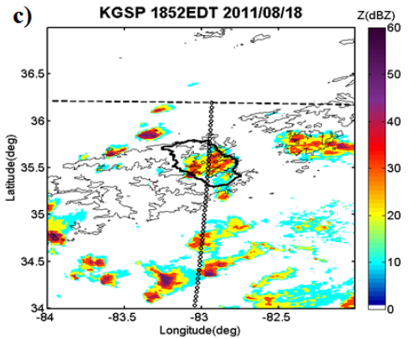
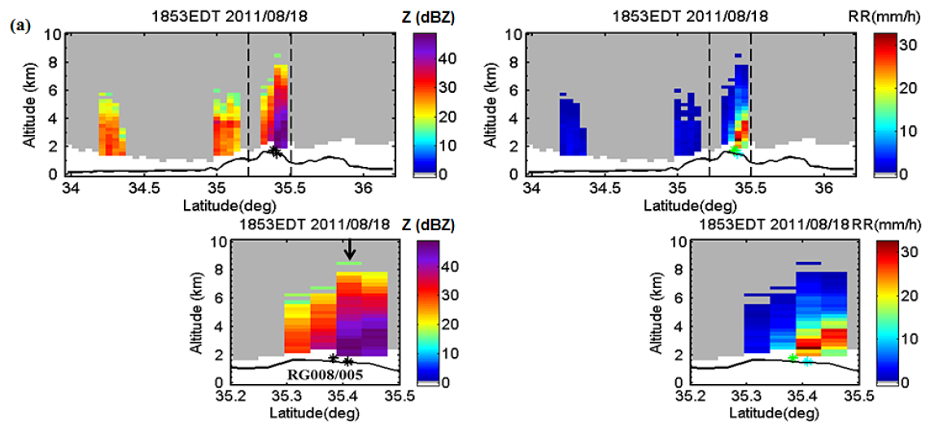
What have we learned?
Local overestimation (III) [TR flag = 200]
RG 005 = 12 mm h⁻¹ (~24 mm h⁻¹)
RG 008 = 18 mm h⁻¹ (~24 mm h⁻¹)
[alt.; RG 005 ~ 1.52 km, RG 008 ~ 1.74 km]
Gauges at edge of isolated convective cluster
At RG locations,
TRMM = 40-50 dBZ
KGSP = 20-30 dBZ
[between 2 and 4 km]
Duan, Wilson, and Barros (2015)

Slide 19
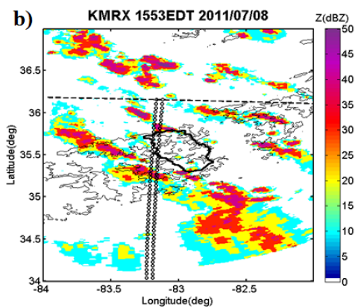
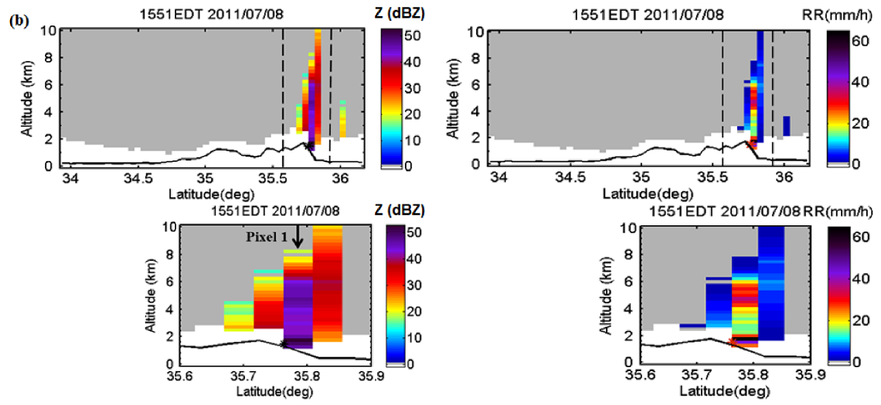
What have we learned?
Local underestimation (II) [TR flag = 200]
RG 303 = 40 mm h⁻¹ (22-25 mm h⁻¹)
RG 311 = 60 mm h⁻¹ (22-25 mm h⁻¹)
[alt.; RG 303 ~ 1.5 km, RG 311 ~ 1.25 km]
Ground clutter effects
Miss low-level processes
bright band
Duan, Wilson, and Barros (2015)

Slide 20
What have we learned?
(valley)
(ridge)
MRR observations
Prat and Barros (2010b)

Slide 21
What have we learned?
the right-hand side of observed valley DSDs is ‘‘heavier’’ than that of DSDs in adjacent ridges for the same event, suggesting enhanced drop coalescence between ridge and valley locations.
during such events, there are no significant differences among the reflectivity profiles obtained from paired Micro Rain Radars, suggesting that the rainfall enhancement is taking place primarily in the vertical direction and is not an artifact of lateral advection of heavier rainfall (Prat and Barros 2010b)

Slide 22
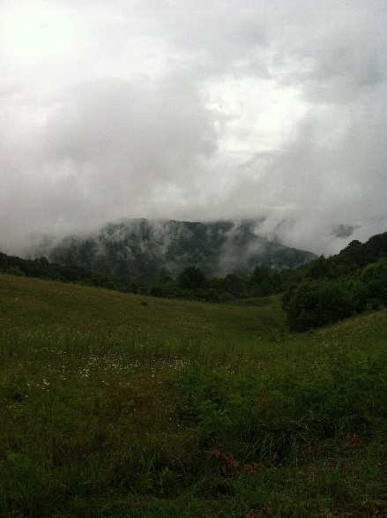
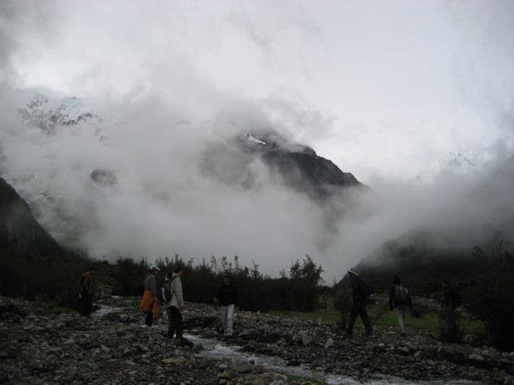
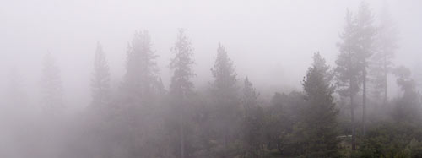
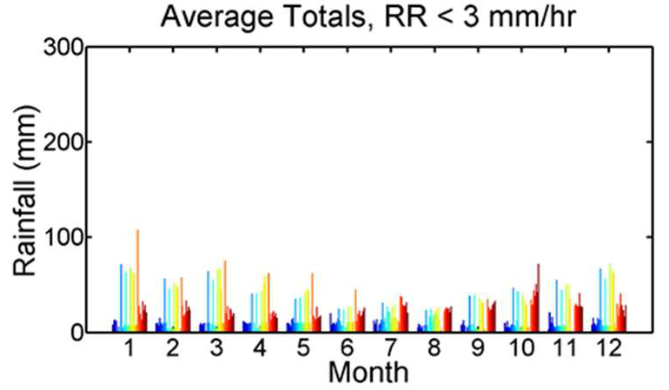
California
North Carolina
Peru
Seeder-Feeder Fog:
Light rainfall occurrence
Orographic enhancement
Wilson and Barros (2014)
Notes:
Occurs in other regions (use pictures)
R1 is PK and R2 is in an open region
PK is in inter-mountain region that has a higher potential for moisture than open area.
Graph on right: Gauges PRB, seasonal cycle. Blue to red equals southeast to northwest in PRG (through winter)
22

Slide 23
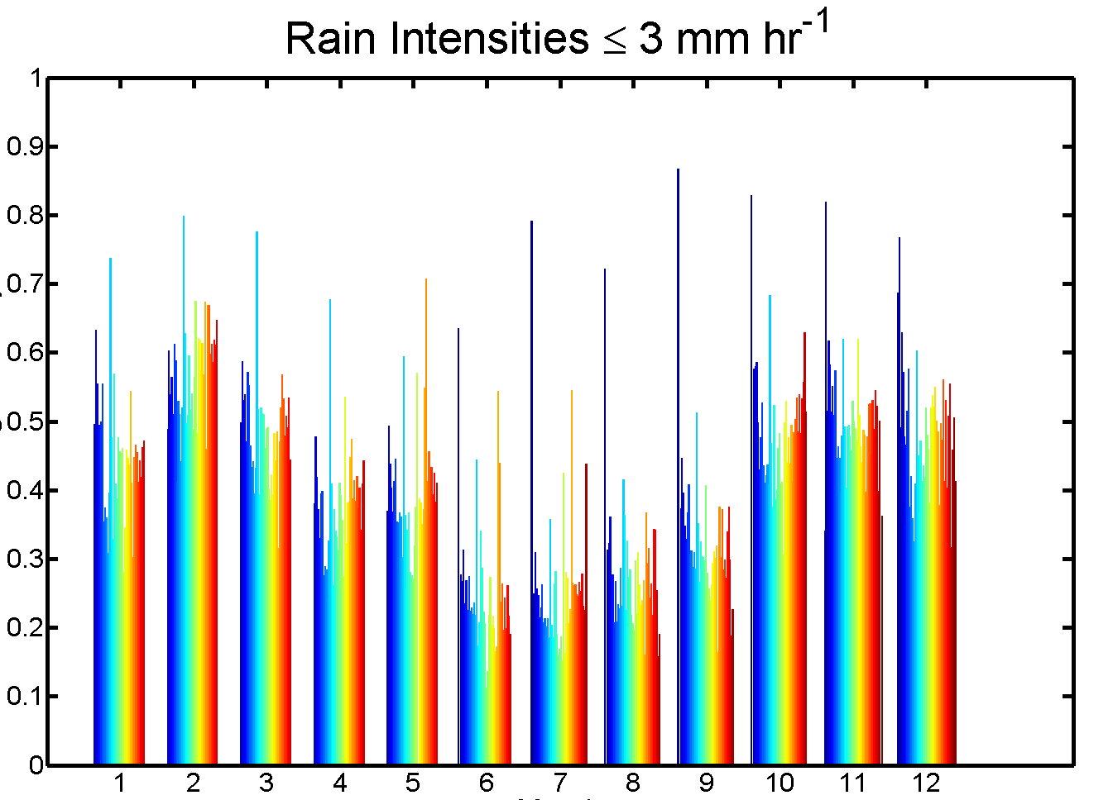
What have we learned?
light rainfall (rain rates less than 3 mm h⁻¹ at 5-min time scales) at ridgelines represents 30%–50% of total annual precipitation based on 2007–2013 records
Percent Average Total
50%
25%
Month
MRR observations
Wilson and Barros (2014)
Notes:
Occurs in other regions (use pictures)
R1 is PK and R2 is in an open region
PK is in inter-mountain region that has a higher potential for moisture than open area.
Graph on right: Gauges PRB, seasonal cycle. Blue to red equals southeast to northwest in PRG (through winter)

Slide 24
Case Studies: Detailed Analysis
Explicit Raindrop Population Dynamics Model
Boundary condition
Z values BC DSD
2. Model simulates DSD evolution
throughout the column – 10 m steps
Precipitating cloud
3. Seeder-Feeder Mechanism added
LWC Fog DSD
FINDINGS
Pre existing moisture source at low levels causes orographic enhancement up to one order of magnitude through increasing coalescence efficiency
Pre-existing Fog or Low Level Cloud
Upwind
Lee
Wilson and Barros, 2014
Wilson et al. (2014)
Notes:
Initial Boundary Condition is full column then after that they just use upper boundary. The accumulation/intensity is only see. when added low level moisture.
24

Slide 25
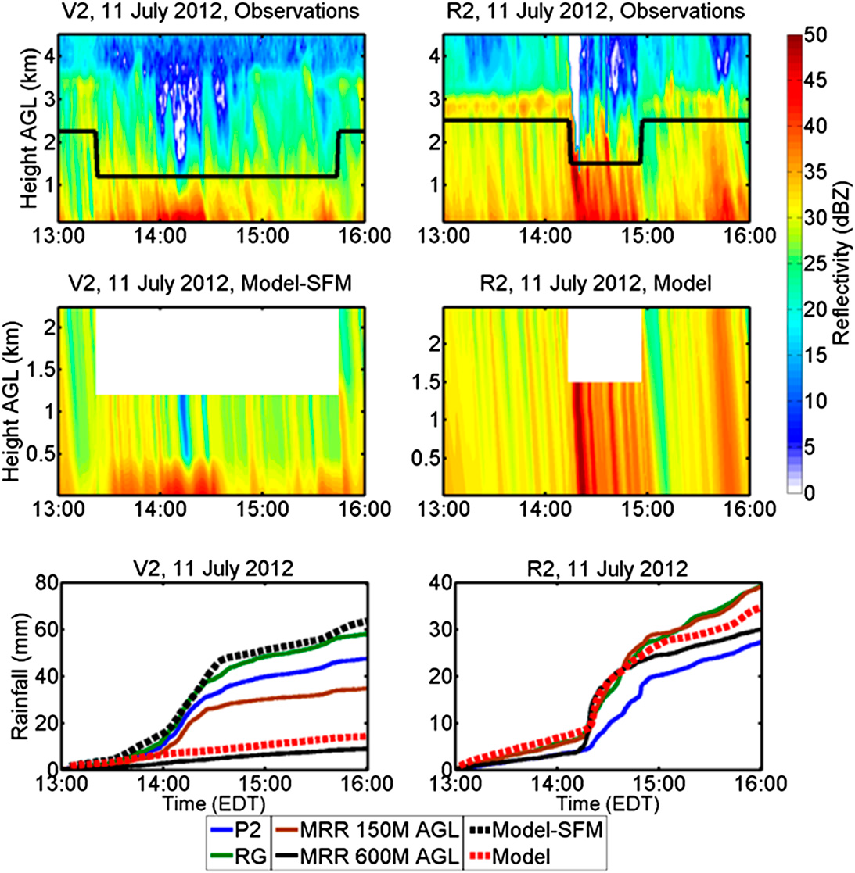
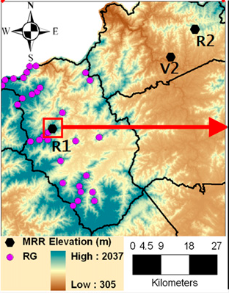
Case Studies: Detailed Analysis
Explicit Raindrop Population Dynamics Model
Wilson and Barros, 2014
Notes:
25

Slide 26
What have we learned?
examples of TRMM missed detection of precipitation events are linked to fog and multi-tiered low-level clouds, especially in the inner mtn region (Duan et al. 2015)
TRMM PR tends to underestimate small-scale winter storms and embedded convection in the summer; [a] coarse horizontal resolution {NUBF}, [b] misclassification of convective systems as stratiform (Duan et al. 2015)

Slide 27
What have we learned?
summer precipitation is characterized by large event-to-event variability including both stratiform and convective properties
during fall, stratiform precipitation dominates and rainfall is two times more frequent at the ridge than in the valley, corresponding to a 100% increase in cumulative rainfall at high elevation (Prat and Barros 2010b)

Slide 28
What have we learned?
for concurrent rain events
  orographic rainfall enhancement is very strong, on the order of 60% at ridge compared to valley locations (Prat and Barros 2010b)

Slide 29
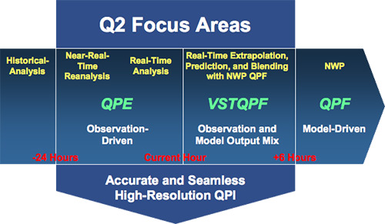
What have we learned?
https://www.nssl.noaa.gov/projects/q2/q2.php

Slide 30
What have we learned?
(Tao and Barros 2013)

Slide 31
What have we learned?
Rain gauge data has been used successfully to adaptively correct biases in the gridded Next Generation Multi-sensor QPE (Q2) data set used as input to a high-resolution physically-based hydrological model (3D-LSHM,Tao and Barros 2013) on successful quantitative flash-flood estimates for three case studies occurring in the Pigeon River Basin

Slide 32
What have we learned?
Rain gauge data has been used successfully to adaptively correct biases in the gridded Next Generation Multi-sensor QPE (Q2) data set used as input to a high-resolution physically-based hydrological model (3D-LSHM) used as input for a slope stability model to investigate the mechanisms triggering debris flows (Tao and Barros 2014)

Slide 33
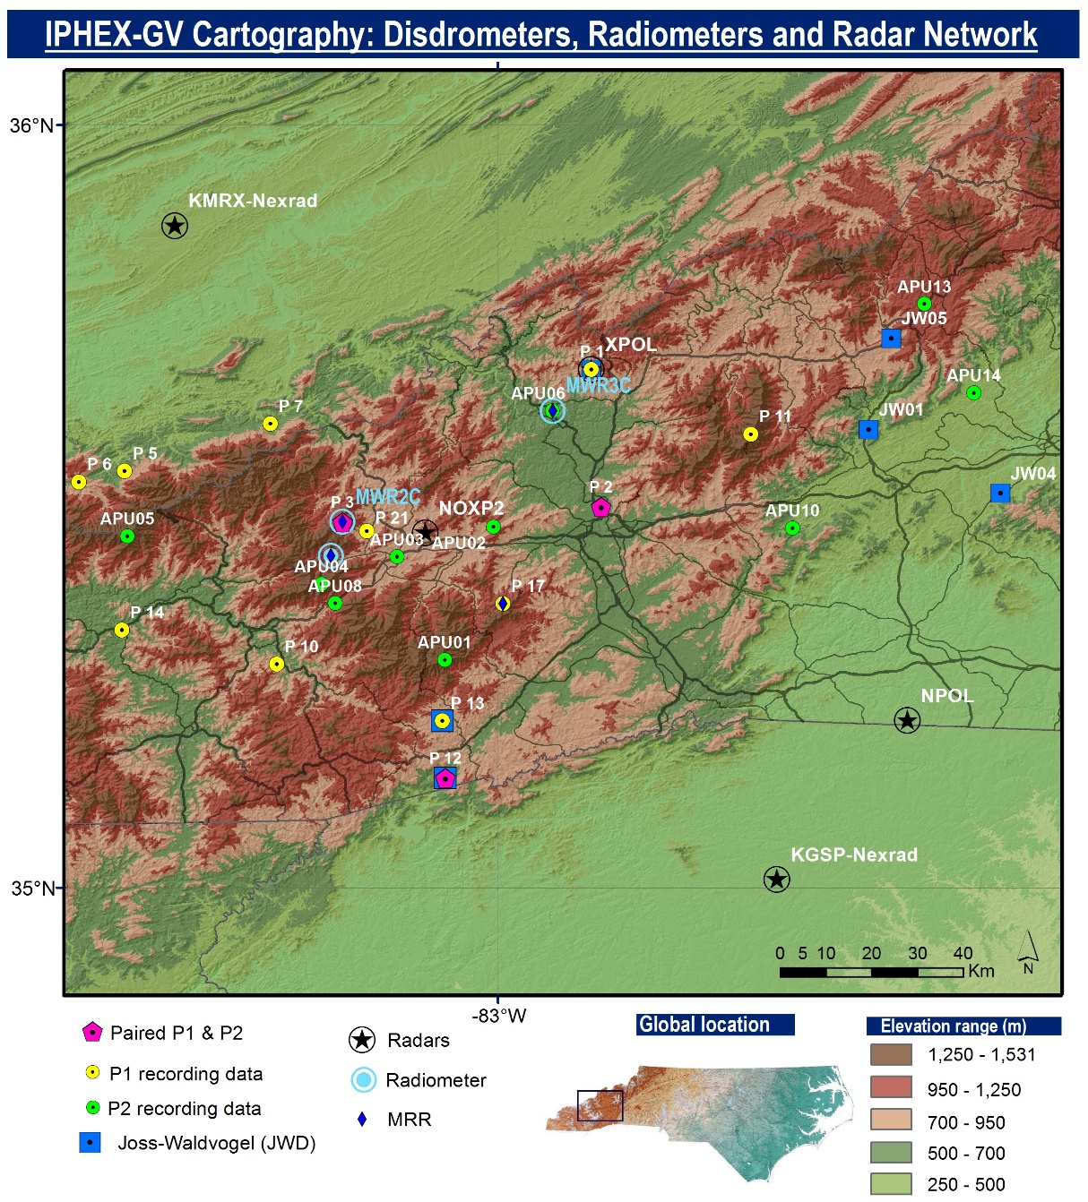

What have we learned?
IPHEx
1 May – 15 June 2014
Wilson et al. (2014)

Slide 34
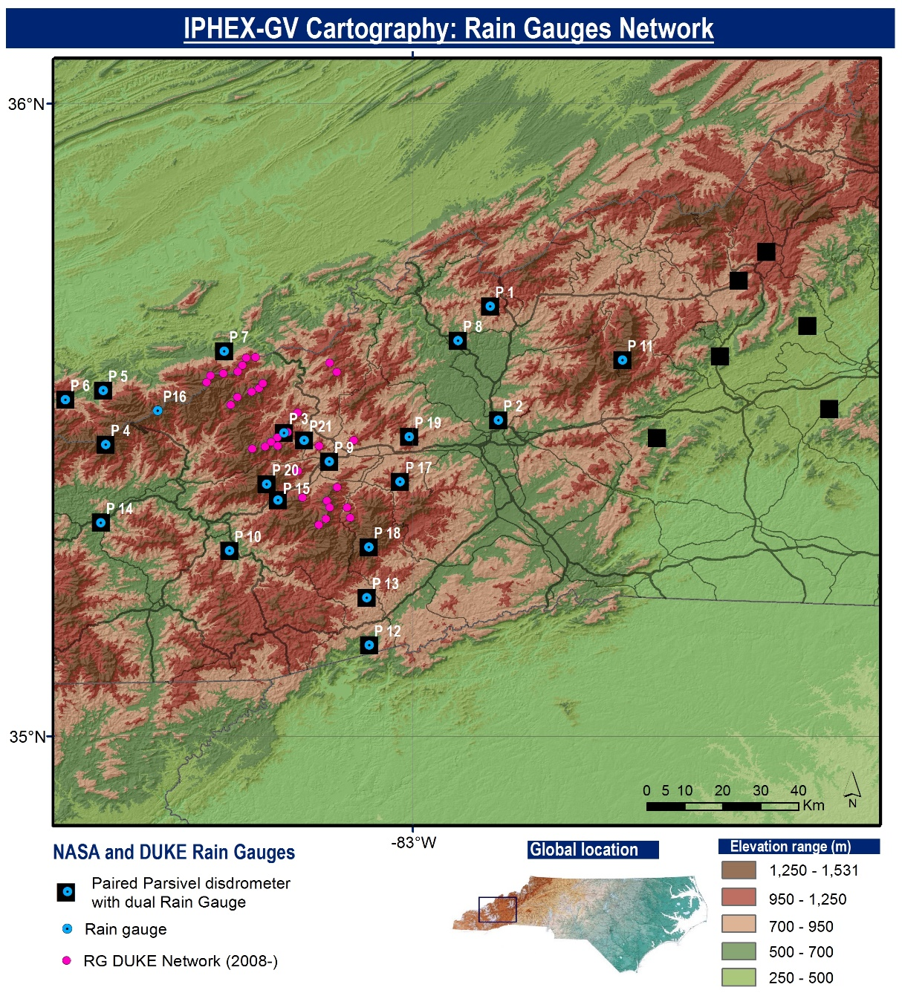
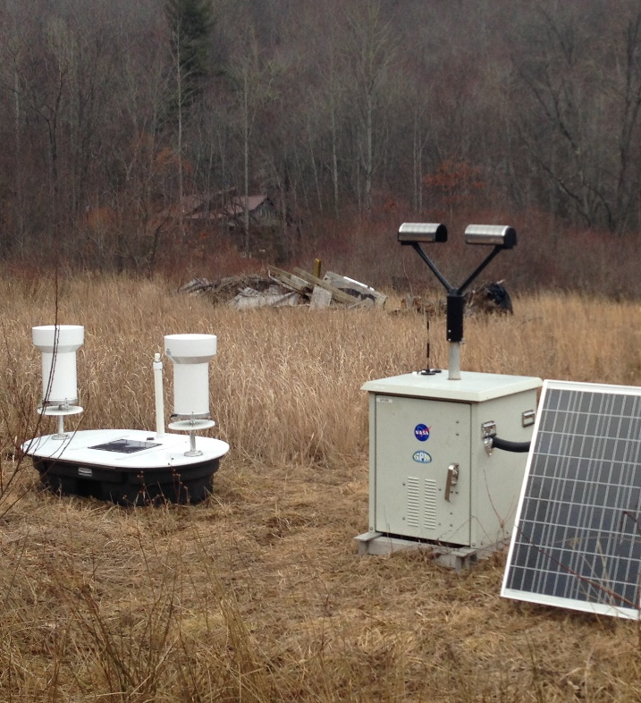
What have we learned?
IPHEx
1 May – 15 June 2014
Wilson et al. (2014)

Slide 35
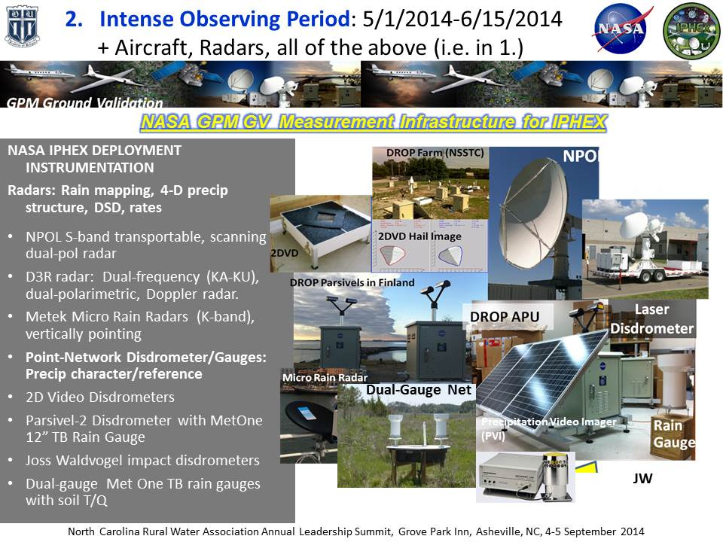

Notes:
Add two Pluvio’s?
35

Slide 36


High Altitude and in the Column: GPM Airborne Assets in IPHEX
GPM Core Satellite “Simulator”
In Situ Microphysics
NASA ER-2: Satellite simulator
80 flight hours
Base: Warner-Robbins AFB, Georgia
UND Citation
Microphysics
60 flight hours
Base: KAVL, Asheville, NC
Instrument | Measurement
AMPR H+V (Radiometer) | 10.7, 19.35, 37.1, 85.5 GHz
Footprint (@20 km) | 2.8 km (10.7-19.35 GHz) , 1.5 km (37.1 GHz), 0.6 km(85.5 GHz)
CoSMIR H+V (Radiometer) | 37, 89, 165.5, 183.3+/-1, 183.3+/-3, 183.3+/-8 GHz
Footprint (@20 km | 1.4 km
HIWRAP (Radar) | 13.91/13.35 GHz, 35.56/33.72 GHz
Footprint (@20 km) | 1 km Ku / 420 m Ka (2.9º Ku, 1.2º Ka)
EXRAD (Radar) | 9.4 GHz (nadir); 9.6 GHz (scanning)
Footprint (@20 km) | 1.2 km (3º beamwidth)
CRS (Radar) | 94.15 GHz (dual-polarized)
Footprint (@20 km) | ~0.24 km (0.6º x 0.8º beamwidth)
Instrument | Measurement
King | Cloud liquid water
2D-C / 2D-S | Cloud and precipitation particle spectra
HVPS | Precipitation spectra
CPI | Cloud particle images
CDP | Cloud particle spectra
Nevzorov | Total water content
Rosemount icing probe | Supercooled water
CN Counter | Aerosols (CN)
Flight altitude | 600-700 AGL up to 10km
Wilson et al. (2014)
Notes:
Any important information I should point out about both plans?
36

Slide 37

What have we learned?
IPHEx

Slide 38
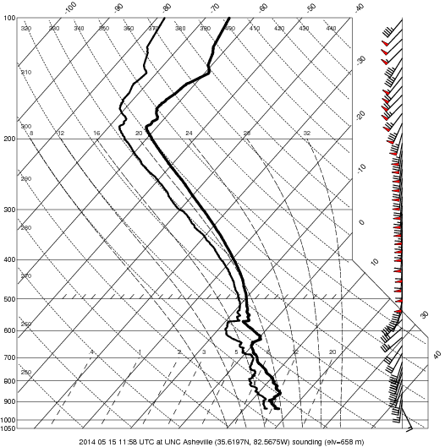
What have we learned?
IPHEx
8:00 am EDT
15 May 2014
http://www.atms.unca.edu/iphex/iphex2014_iop4/iphex2014_iop4.html

Slide 39
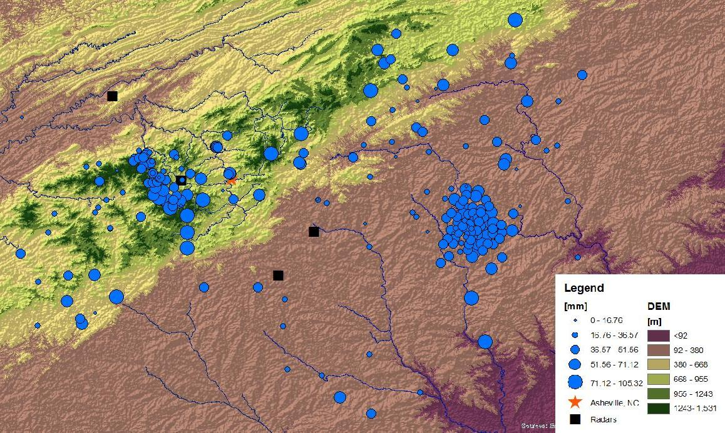
What have we learned?
IPHEx
NOXP
Barros et al. (2014)

Slide 40
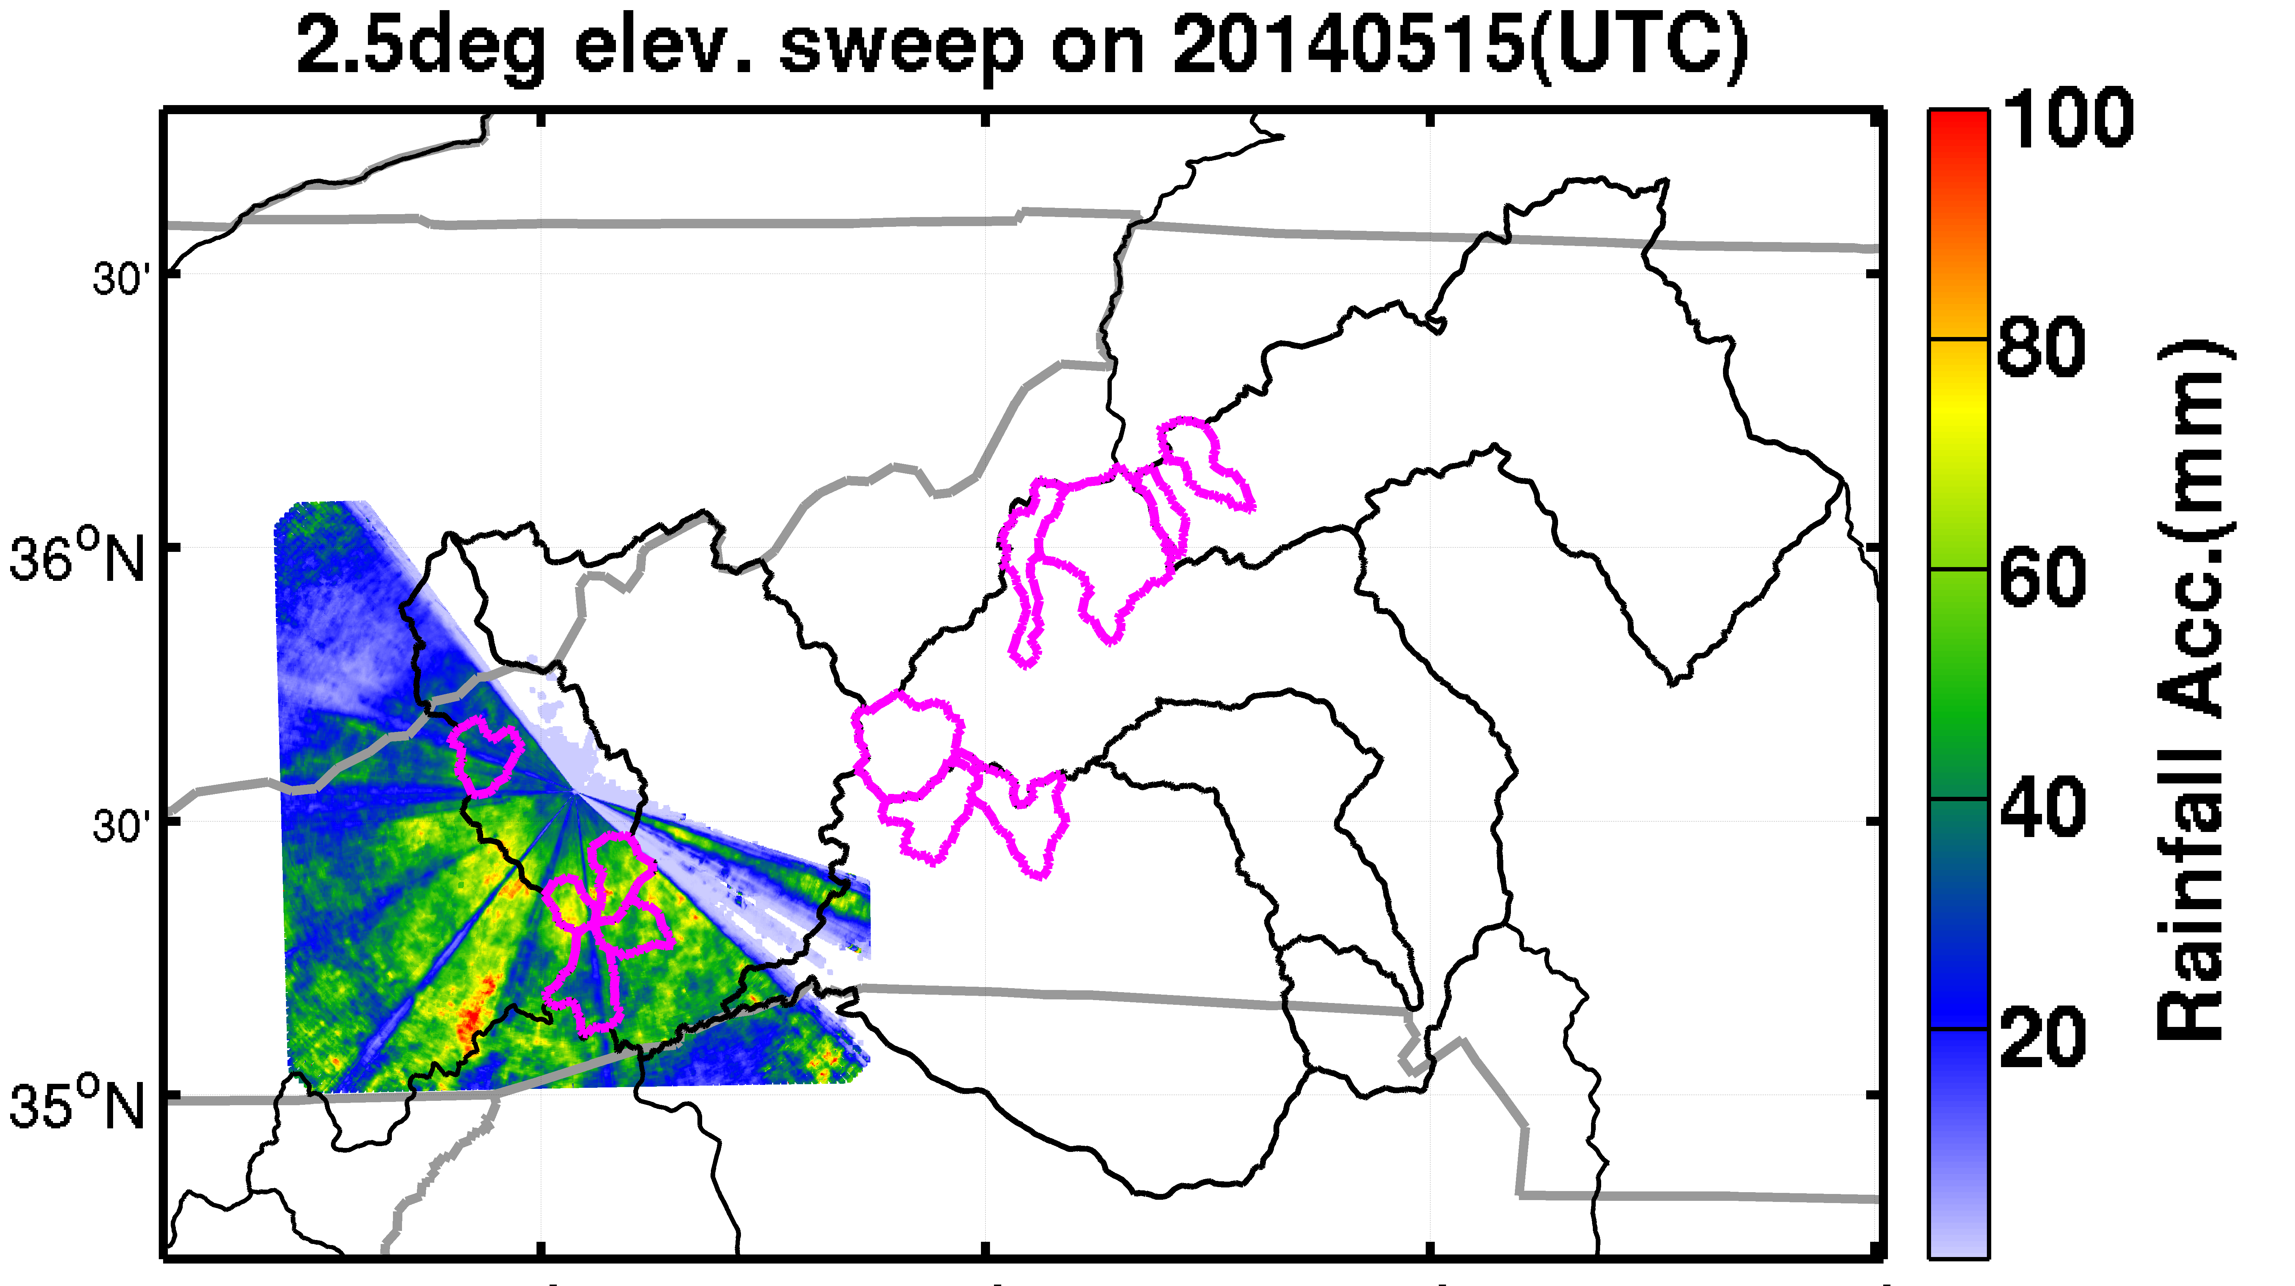
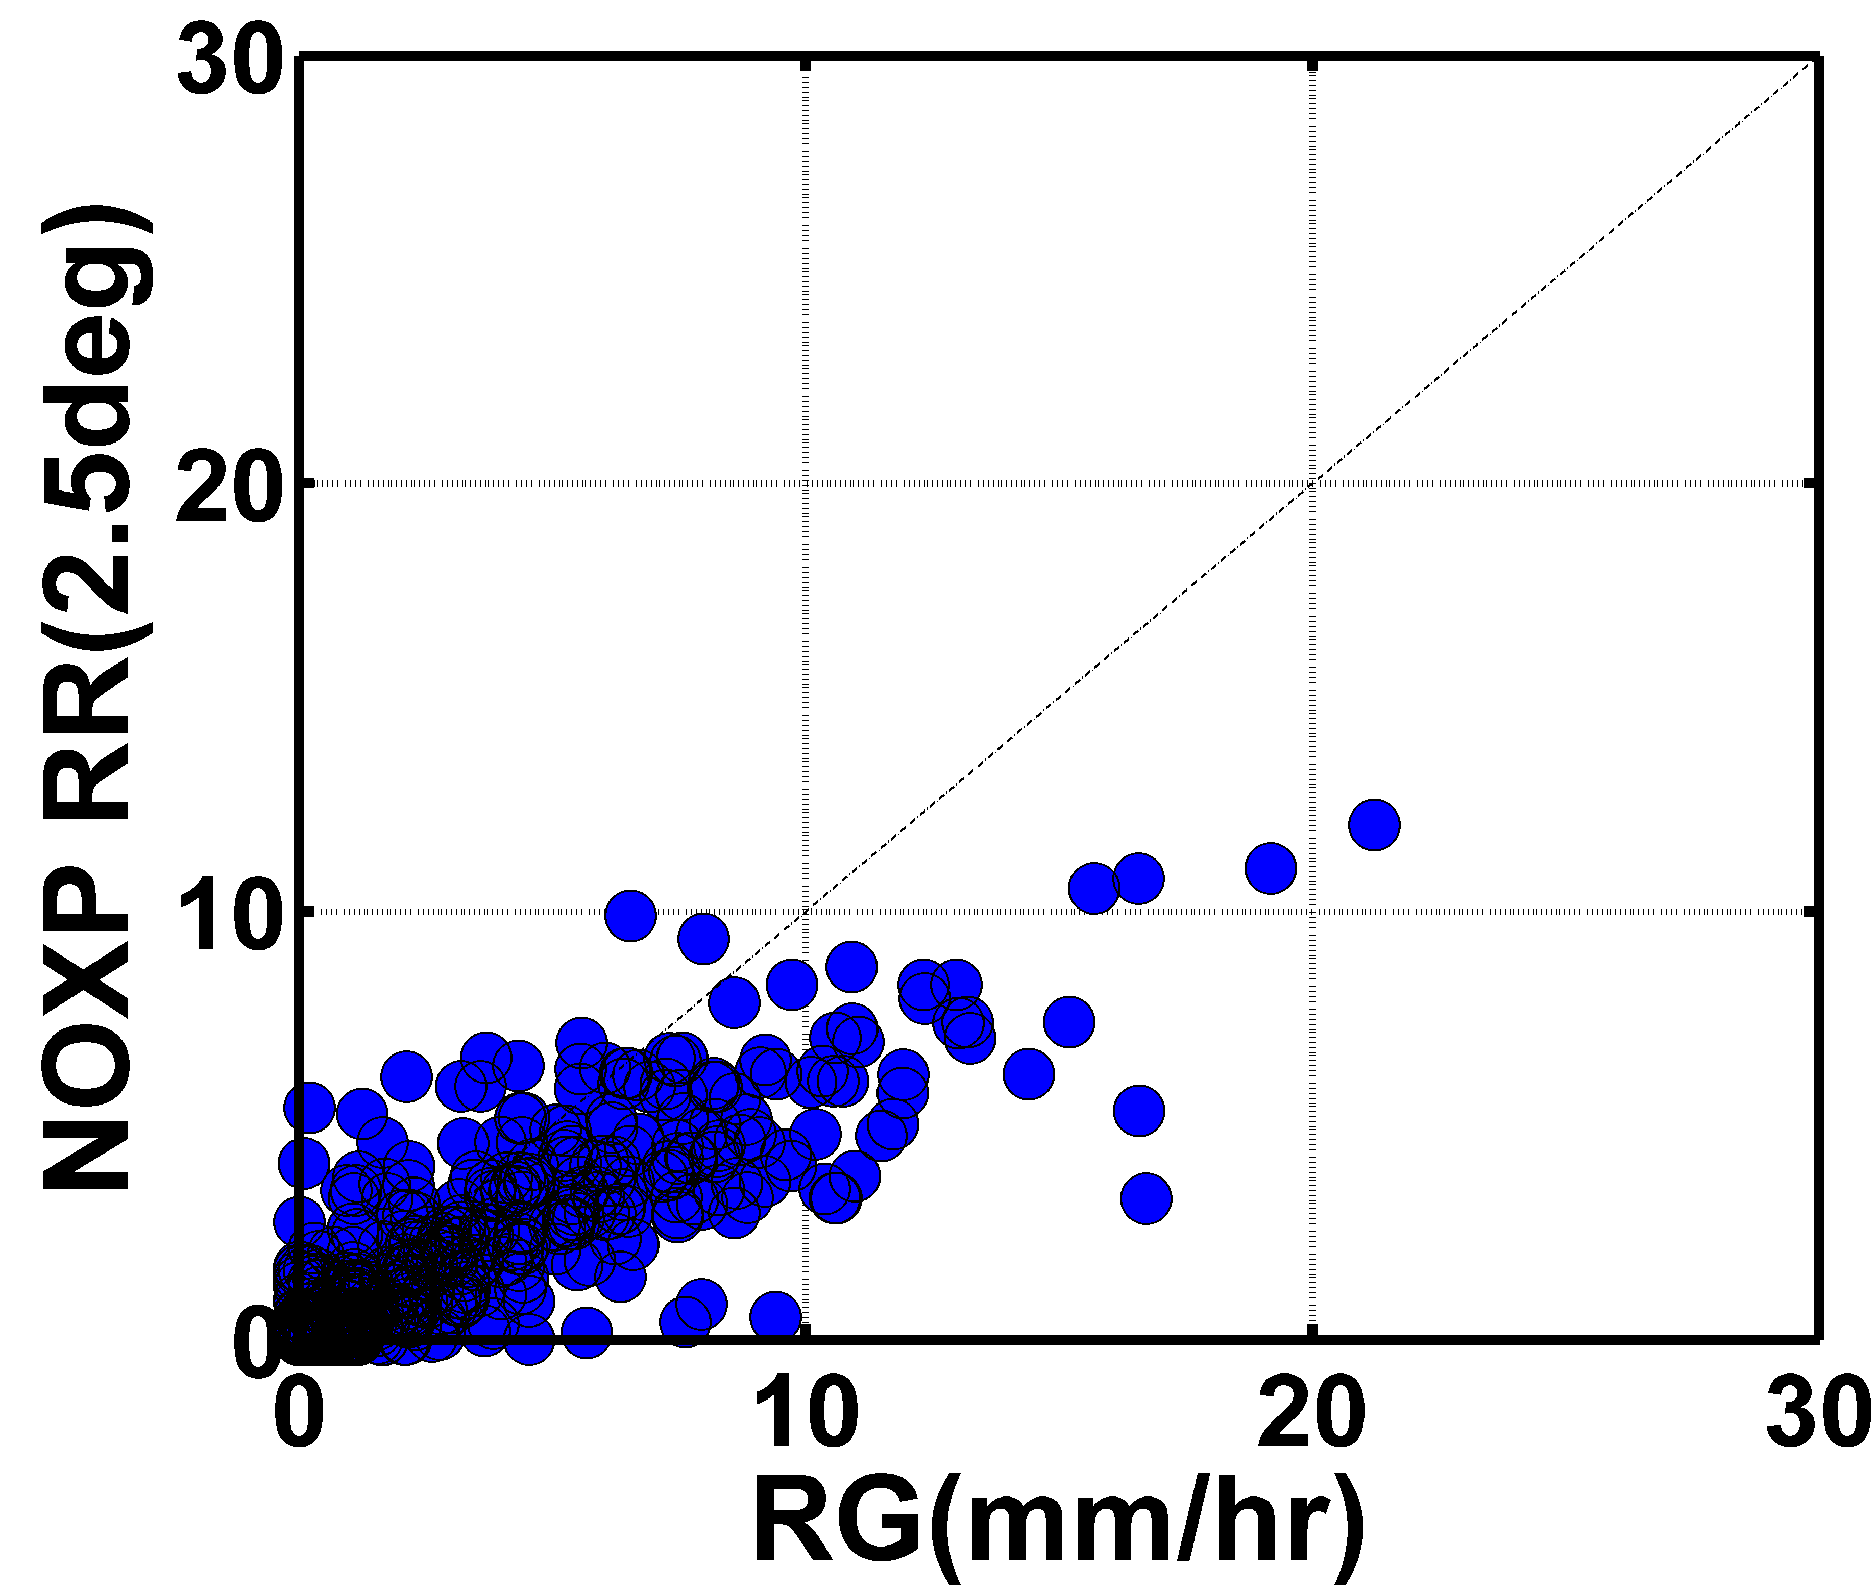
What have we learned?
IPHEx
Barros et al. (2014)

Slide 41
How do we continue the hydrological record?
For NSF Earth Sciences: Instrumentation and Facilities (EAR/IF) funding…
  Demonstration of uniqueness of data set
  How observations will answer “critical zone” science questions (e.g., hydrology)
  Host of people using data in a clever way (nothing new about rain gauge networks)
  Make data freely available (e.g., CUAHSI https://www.cuahsi.org/ )

Slide 42
References
Duan, Y, Wilson, AM, Barros, AP(2015). “Scoping a field experiment: error diagnostics of TRMM precipitation radar estimates in complex terrain as a basis for IPHEx2014” Hydrology and Earth System Sciences.19(1): 1501- 1520
Barros, AP; Tao, J; Wilson, A; Duan, Y; Noguiera, M; Lowman, L; Weston, L; and Cutrell, G (2014). “The Integrated Precipitation and Hydrology Experiment 2014, precipitation uncertainty and hydrologic predictability” CUAHSI Biennial Colloquium, Shepherdstown, WV
Tao, J; Barros, AP(2014)."Coupled prediction of flood response and debris flow initiation during warm- and cold-season events in the Southern Appalachians, USA" Hydrology and Earth System Sciences.18(1): 367- 388
Wilson, AM; Barros, AP(2014)."An Investigation of Warm Rainfall Microphysics in the Southern Appalachians: Orographic Enhancement via Low-Level Seeder–Feeder Interactions" Journal of the Atmospheric Sciences.71(5): 1783- 1805
Wilson, AM; Cutrell, G; Miller, DK; Barros, AP(2014).“Investigating Orographic
Precipitation Processes in the Southern Appalachians” Great Smoky Mountains National Park Science Colloquium, Gatlinburg, TN
Tao, J; Barros, AP(2013)."Prospects for flash flood forecasting in mountainous regions - An investigation of Tropical Storm Fay in the Southern Appalachians" Journal of Hydrology.506: 68- 89
Lee, LG; Tanner, PA; Horne, CS; and Greer, S(2011). “The Qualla Boundary flash flood of 14 and 15 July 2011.” available at: http://www.erh.noaa.gov/er/gsp/localdat/cases/2011/14JulyQuallaBoundaryFF (last access: 13 May 2015).
Prat, OP; Barros, AP(2010a)."Assessing satellite-based precipitation estimates in the Southern Appalachian mountains using rain gauges and TRMM PR" Advances in Geosciences.25: 143- 153
Prat, OP; Barros, AP(2010b)."Ground observations to characterize the spatial gradients and vertical structure of orographic precipitation - Experiments in the inner region of the Great Smoky Mountains" Journal of Hydrology.391(1-2): 141- 156

Slide 43
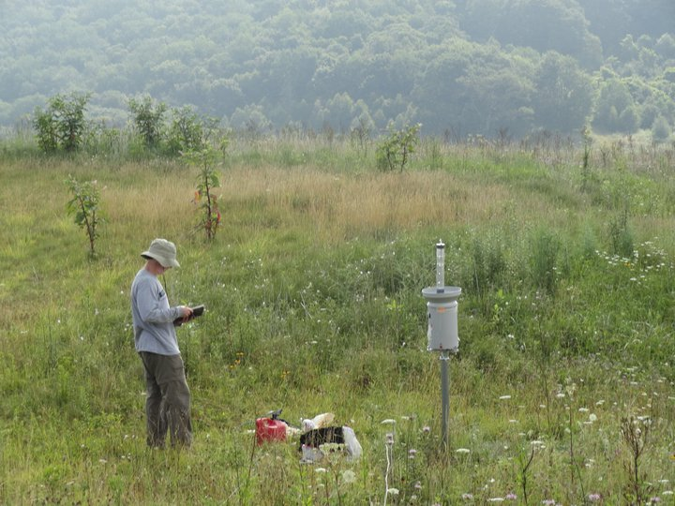
The End
Near Purchase Knob, credit: Michael Goldsbury

