Slide 1
The Influence of Atmospheric Rivers on Extreme Precipitation Events Observed in the Southern Appalachians.
Douglas Miller and Lukas Stewart
Atmospheric Sciences Department
UNC Asheville
David Hotz and Jessica Winton
National Weather Service
Morristown, TN

Slide 2
Outline
Atmospheric Rivers
Background
U.S. west coast
southeastern U.S.
Purpose of COMET GOES-R Partners Project
Methodology
Current results
Comparison and contrast
Continued analysis

Slide 3
Background
U.S. west coast

Slide 4
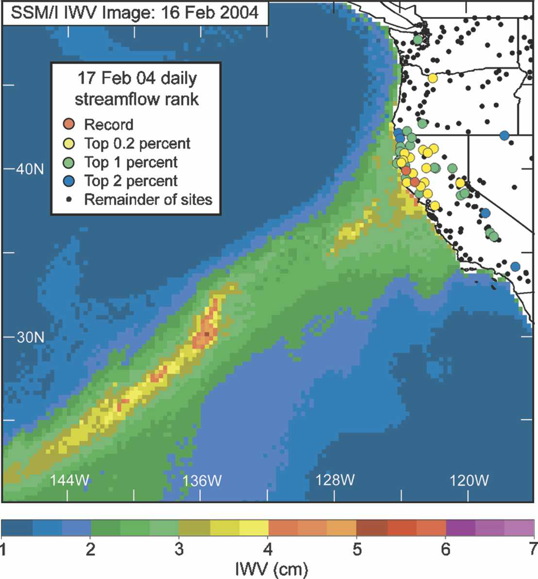
IWV = Integrated Water Vapor
“narrow plumes of SSM/I IWV with values > 2 cm that were > 2000 km long and < 1000 km wide were defined as atmospheric rivers”
Neiman et al. (2008)

Slide 5
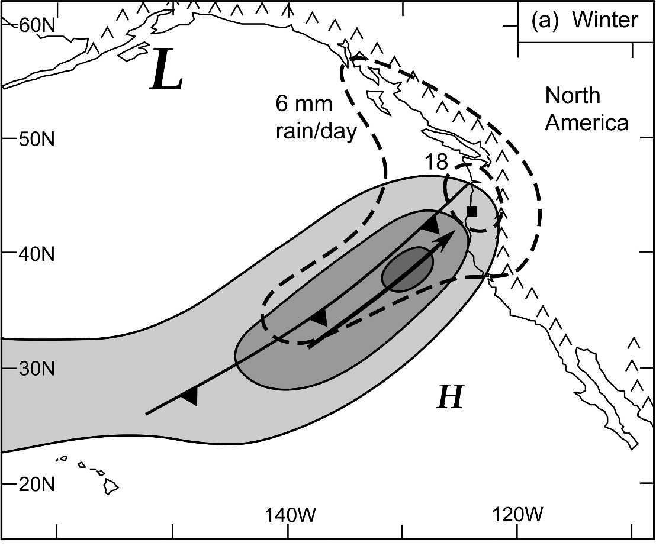
Wintertime mean plan view of IVT (solid contours; light shading: weak water vapor flux of 250–350 kg s-1 m-1, medium shading: moderate flux of 350–450 kg s-1 m-1, dark shading: strong flux 450 kg s-1 m-1), daily rainfall (dashed; mm day-1), 925-hPa cold front (standard notation) and pre-cold frontal flow direction (bold arrow), and the location of the primary cyclone and anticyclone (L and H, respectively; the size of the letters reflect their relative intensities). The black square marks the position of the composite sounding shown in (c). The primary near-coast mountains are also shown.
Neiman et al. (2008)

Slide 6
Background
southeastern U.S.

Slide 7
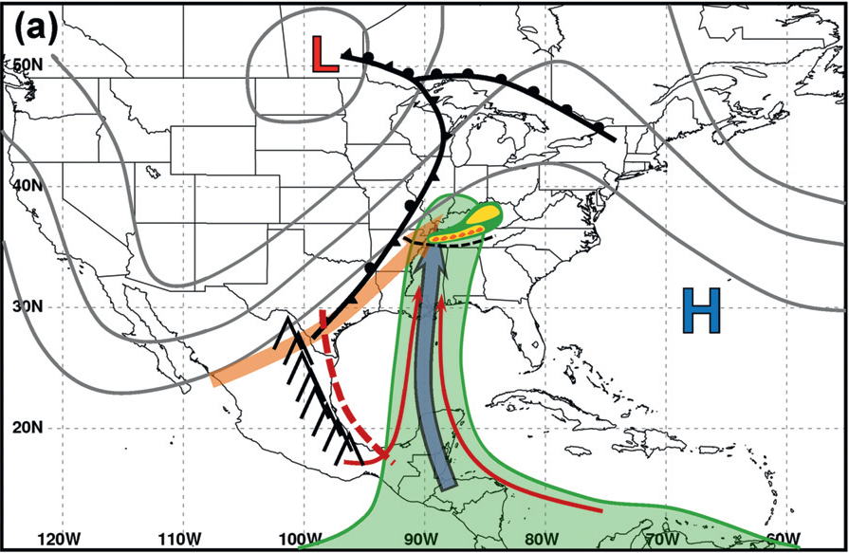
1 – 2 May 2010
Moore et al. (2012)

Slide 8
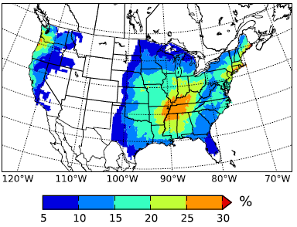
Climatology in SE U.S.
“The Appalachian Mountains are clearly visible as a low AR fraction region dividing relatively high percentages along the U.S. East Coast and the central United States.”
Lavers and Villarini (2015)

Slide 9
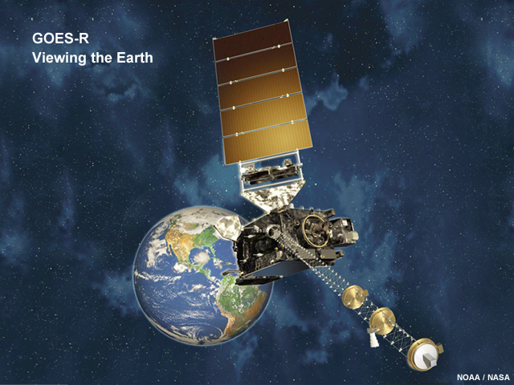
Purpose
Do Atmospheric Rivers impact the southern Appalachians?
Are they responsible for flooding events?
Are they detectable by today’s GOES sounder observations?
Will they be detectable by tomorrow’s GOES-R sounder observations?
http://www.goes-r.gov/users/comet/goes_r/abi/print.php.htm

Slide 10
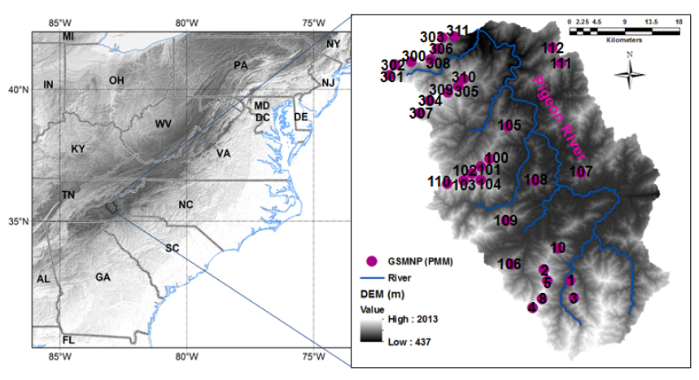
Duke University Great Smoky Mountain Rain Gauge Network
Duan et al. (2015)
Notes:
10

Slide 11
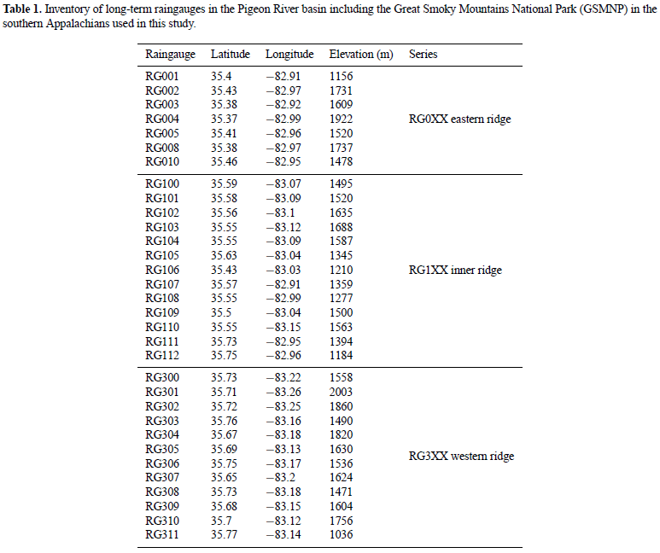
32 gauges
Duan et al. (2015)
Notes:
11

Slide 12
Methodology
Sustained rainfall events
rainfall parameter [RP]
RP = number of tips x dt [hours]
event start/finish
time between tips is greater than six hours
at each rain gauge location
rank RP values for every event
two sizes of tipping buckets (0.1 & 1.0 mm)
normalize [NRP] individually at each site
NRP = RP/RP_{max}

Slide 13
Methodology
Sustained rainfall events (continued)
combine results at ALL gauges
events between gauges are considered a single event if start/finish time at one gauge falls within ONE hour of the finish/start at a different gauge
at least 27 (of 32) rain gauges reporting in order to qualify as an event
rank upper-quartile (UQ) and above median (AM) events
top 15** of each category selected for in-depth analysis

Slide 14
Methodology
Integrated vapor transport…
Moore et al. (2012)

Slide 15
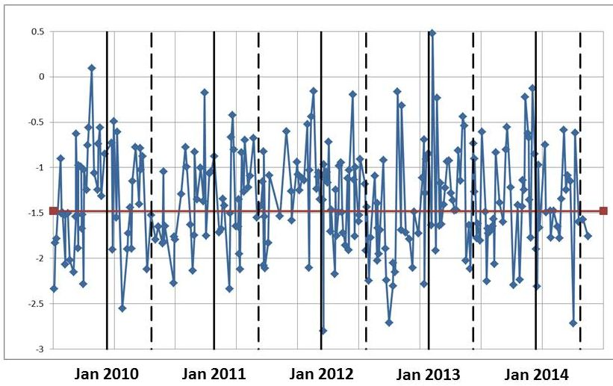
Current Results
UQ
AM

Slide 17
Current Results
No UQ sustained rainfall events in meteorological summer (June-August)
Newport, TN USGS Pigeon River gauge
15 AM events
No flooding (minor, moderate, or major)
Four ‘action stage’ events
15 UQ events
Two minor, four moderate, three major flooding events
Two ‘action stage’ events

Slide 18
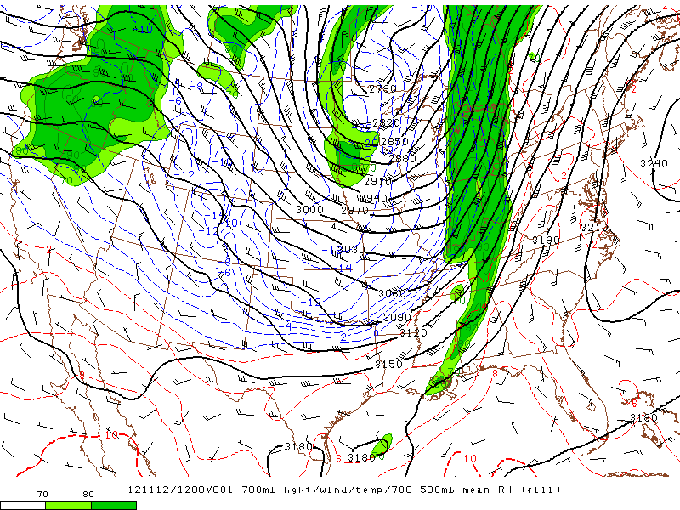
700 hPa level Geo Ht / RH / Temp
1200 UTC 12 November 2012 - AM
(no flooding)
NOAA - SPC

Slide 19
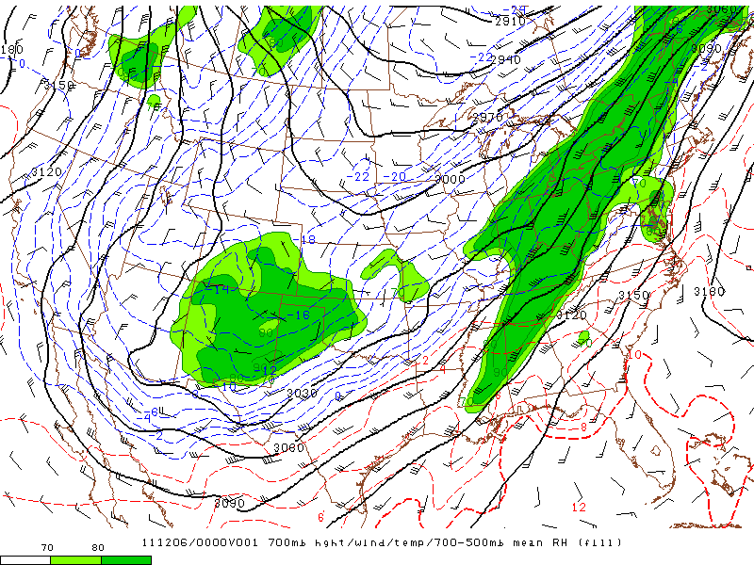
700 hPa level Geo Ht / RH / Temp
0000 UTC 6 December 2011 - UQ
(major flooding)
NOAA - SPC

Slide 20
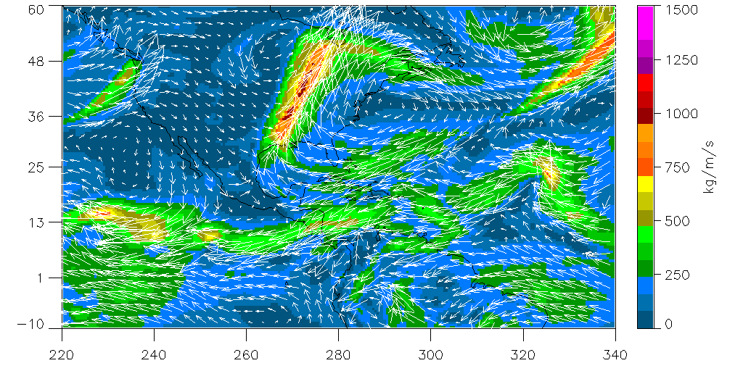
Integrated Vapor Transport
1200 UTC 12 November 2012 - AM
GFS gridded analyses
(no flooding)
NOAA - NOMADS

Slide 21
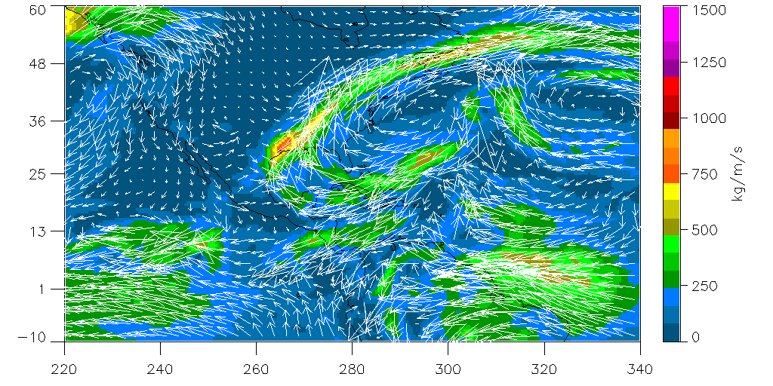
Integrated Vapor Transport
0000 UTC 6 December 2011 - UQ
GFS gridded analyses
(major flooding)
NOAA - NOMADS

Slide 22
Continued Analysis
Do Atmospheric Rivers impact the southern Appalachians?
Are they responsible for flooding events?
Are they detectable by today’s GOES sounder observations? Will they be detectable by tomorrow’s GOES-R sounder observations?

Slide 23
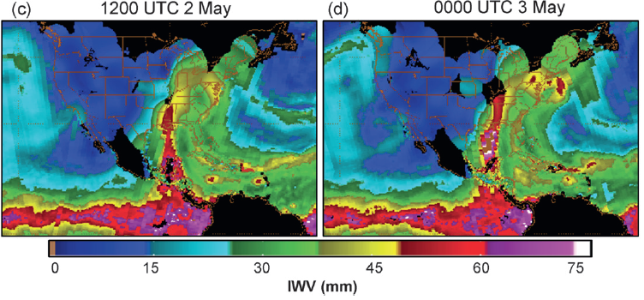
Continued Analysis
Do Atmospheric Rivers (ARs) impact the southern Appalachians?
Blended IWV archives (Colorado St. Univ.)
Moore et al. (2012)

Slide 24
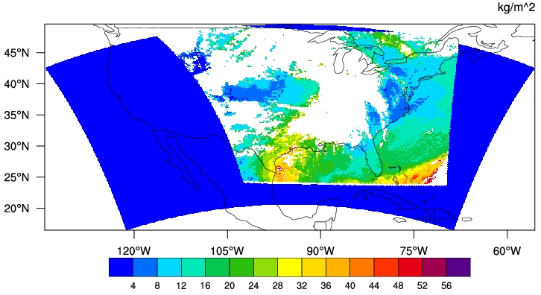
Continued Analysis
Are ARs detectable by today’s GOES sounder observations?
TPW
Univ. of Alabama
Huntsville archives
0000 UTC 13 November 2012 - AM

Slide 25
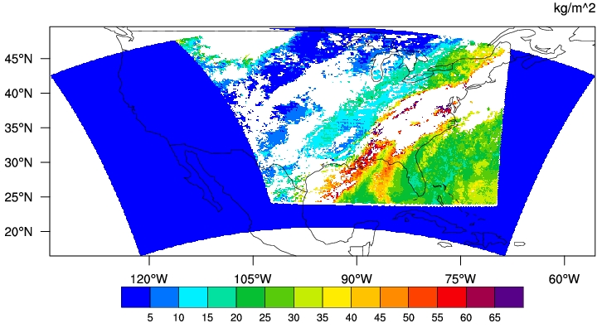
Continued Analysis
Are ARs detectable by today’s GOES sounder observations?
TPW
Univ. of Alabama
Huntsville archives
1200 UTC 6 December 2011 - UQ

Slide 26
Continued Analysis
Will ARs be detectable by tomorrow’s GOES-R sounder observations?
Current launch schedule; October 2016
http://www.goes-r.gov/users/comet/goes_r/abi/print.php.htm

Slide 27
Duke University Great Smoky Mountain Rain Gauge Network
Problem!! Unless funding can be found to support the Duke University Smoky Mountain
Rain Gauge Network, it will be removed in mid-Spring 2016 => lose a critical method for detecting high elevation sustained rainfall
Duan et al. (2015)
Notes:
27

Slide 28
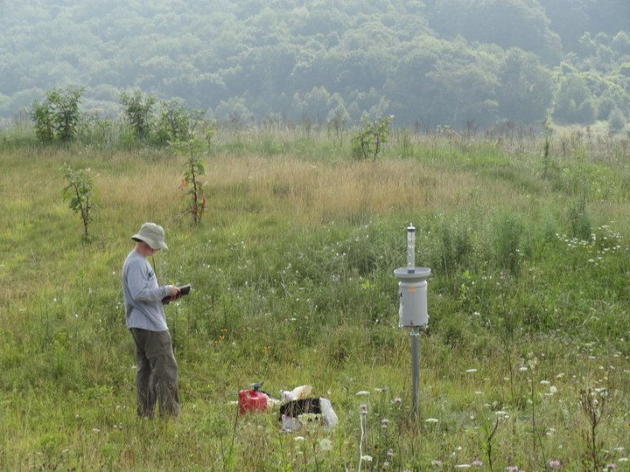
Acknowledgements
Special thanks to Paul Super, Jim Renfo, and everyone in the Great Smoky Mountains NP for your invaluable help and cooperation!
Near Purchase Knob, credit: Michael Goldsbury

Slide 29
References
Carbone, R. E., J. D. Tuttle, D. A. Ahijevych, and S. B. Trier, 2002: Inferences of predictability associated with warm season precipitation episodes. J. Atmos. Sci., 59, 2033–2056.
Duan, Y., A. M. Wilson, and A. P. Barros, 2015: Scoping a field experiment: error diagnostics of TRMM precipitation radar estimates in complex terrain as a basis for IPHEx2014. Hydrology and Earth System Sciences, 19(1), 1501- 1520.
Gaffin, D. M., and D. G. Hotz, 2000: A precipitation and flood climatology with synoptic features of heavy rainfall across the southern Appalachian Mountains. Posted online. Last accessed on 29 May 2015 at http://www.srh.noaa.gov/mrx/?n=heavyrainclimo .
Geerts, B., 1998: Mesoscale convective systems in the southeast United States during 1994–1995: A survey. Wea. Forecasting, 13, 860–869.
Hansen, J. W., A. W. Hodges, and J. W. Jones, 1998: ENSO influences on agriculture in the southeastern United States. J. Clim., 11, 404–411.
Kelly, G.M., L. B. Perry, B. F. Taubman, and P. T. Soulé, 2012: Synoptic classification of 2009–2010 precipitation events in the southern Appalachian Mountains, USA. Climate Research, 55, 1-15.
Konrad, C. E., 1997: Synoptic-scale features associated with warm season heavy rainfall over the interior southeastern United States. Wea. Forecasting, 12, 557-571.
Lavers, D. A., and G. Villarini, 2015: The contribution of atmospheric rivers to precipitation in Europe and the United States. J. Hydrology, 522, 382-390.
Moore, B. J., K. M. Mahoney, E. M. Sukovich, R. Cifelli, and T. M. Hamill, 2015: Climatology and environmental characteristics of extreme precipitation events in the southeastern United States. Mon. Wea. Rev., 143, 718-741.

Slide 30
References
Moore, B. J., P. J. Neiman, F. M. Ralph, and F. E. Barthold, 2012: Physical processes associated with heavy flooding rainfall in Nashville, Tennessee, and vicinity during 1–2 May 2010: The role of an atmospheric river and mesoscale convective systems. Mon. Wea. Rev., 140, 358-378.
Neiman, P. J., F. M. Ralph, G. A. Wick, J. D. Lundquist, and M. D. Dettinger, 2008: Meteorological characteristics and overland precipitation impacts of atmospheric rivers affecting the west coast of North America based on eight years of SSM/I satellite observations. J. of Hydrometeorology, 9, 22-47.
Parker, M. D., and D. A. Ahijevych, 2007: Convective episodes in the east-central United States. Mon. Weather Rev., 135, 3707–3727.
Ralph, F. M., P. J. Neiman, and G. A. Wick, 2004: Satellite and CALJET aircraft observations of atmospheric rivers over the eastern North Pacific Ocean during the winter of 1997/98. Mon. Wea. Rev., 132, 1721–1745.
Rickenbach, T. M., R. Nieto-Ferreira, C. Zarzar, and B. Nelson, 2015:A seasonal and diurnal climatology of precipitation organization in the southeastern United States. Q. J. R. Meteorol. Soc., DOI:10.1002/qj.2500.
Stevenson, S. N., and R. S. Schumacher, 2014: A 10-year survey of extreme rainfall events in the central and eastern United States using gridded multisensor precipitation analyses. Mon. Wea. Rev., 142, 3147-3162.
Tao, J., and A. P. Barros, 2013: Prospects for flash flood forecasting in mountainous regions - an investigation of Tropical Storm Fay in the southern Appalachians. J. Hydrology, 506, 69-89.
Zhu, Y., and R. E. Newell, 1998: A proposed algorithm for moisture fluxes from atmospheric rivers. Mon. Wea. Rev., 126, 725–735.

