Slide 1


BIG Climate and the Southern Appalachians
Our global (BIG) climate driver
The BIG climate picture
How stable is the BIG climate?
Impacts close to home
Douglas Miller
Professor, Atmospheric Sciences Dept.
UNC Asheville

Slide 2
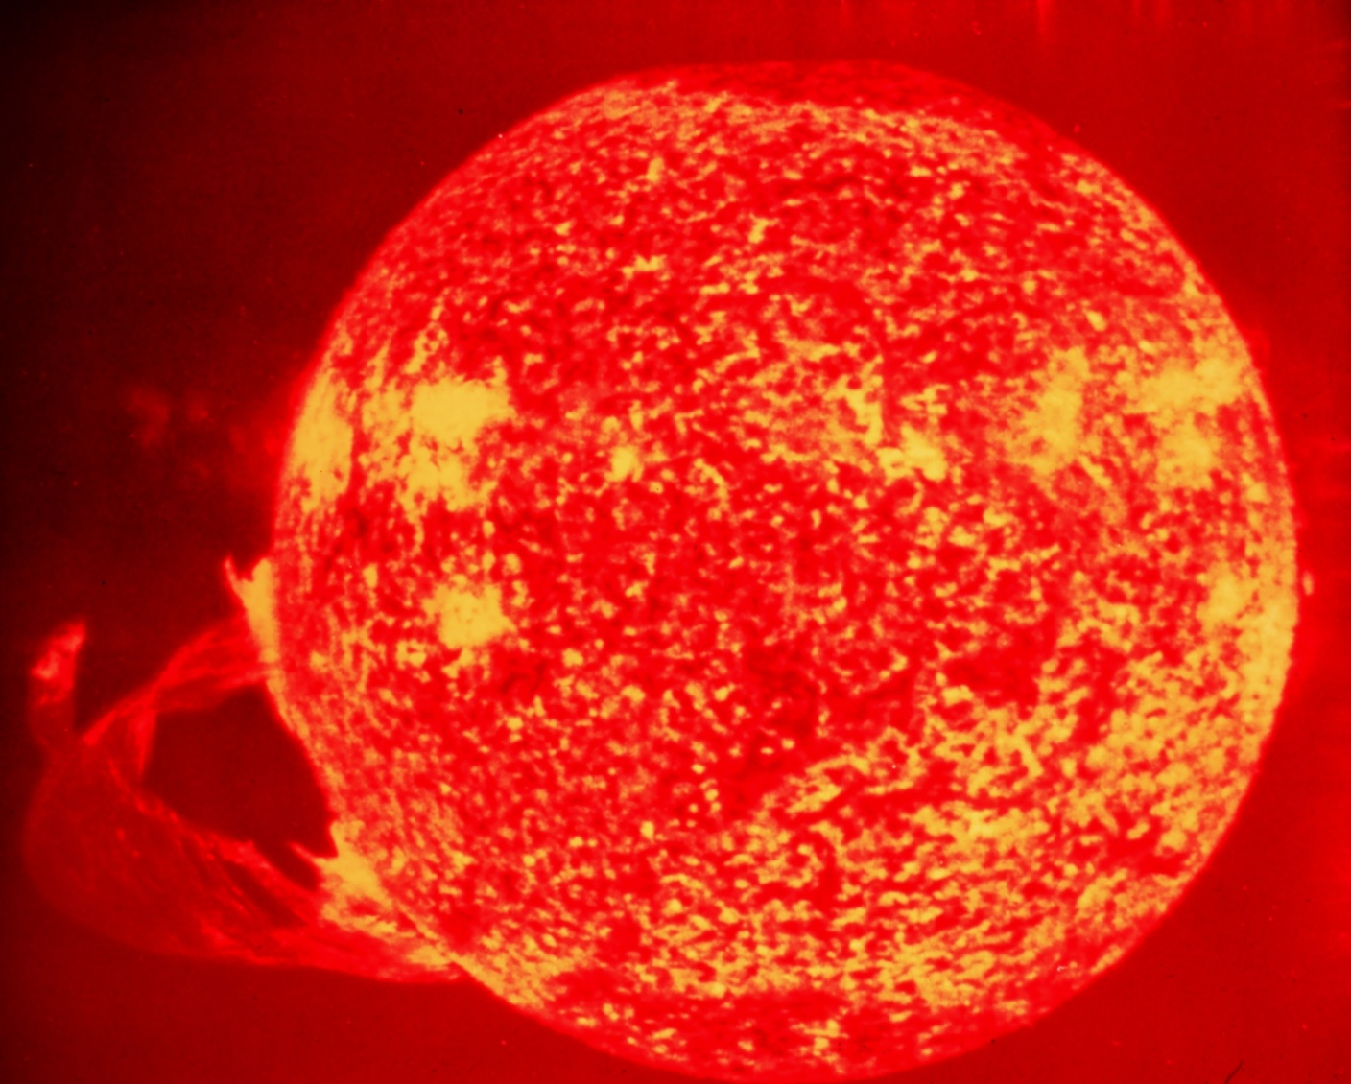
What drives our global climate?
http://www.noaanews.noaa.gov/stories2005/images/solar-flare.jpg

Slide 3
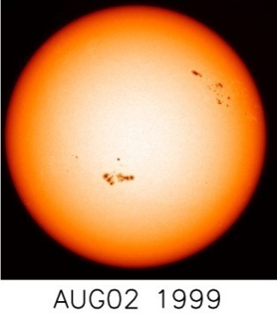
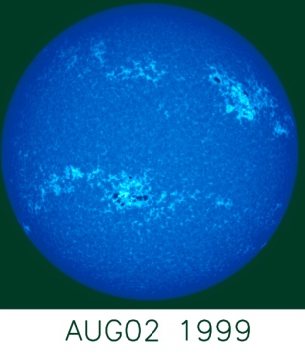
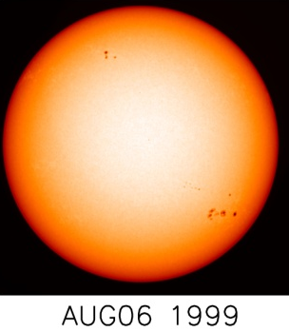
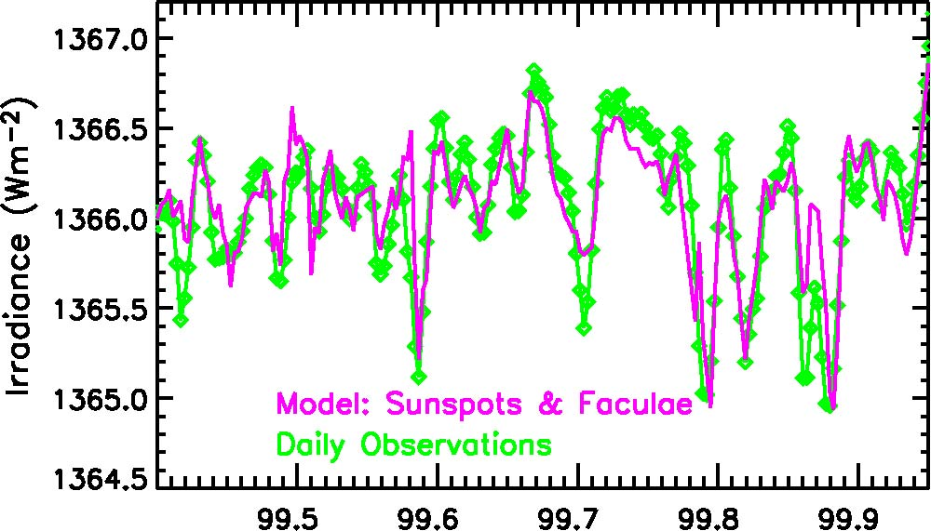
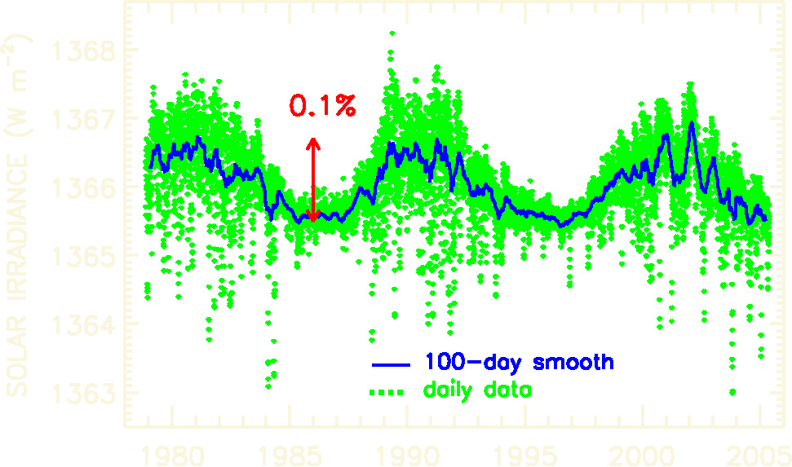
Total Solar Irradiance
5-min oscillation ~ 0.003%
27-day solar rotation ~ 0.2%
11-year solar cycle ~ 0.1%
longer-term variations not yet detectable
cycle 21
max
cycle 22
max
solar photosphere
near UV,VIS,IR
radiation
1366 Wm⁻²
climate
data: Fröhlich & Lean,GRL,1998
http://www.pmodwrc.ch

Slide 4
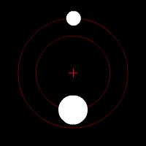
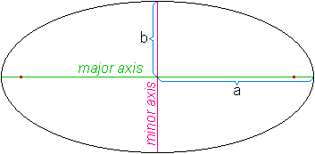
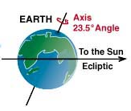
What drives our global climate?
Mean earth-sun distance is 92,955,807 miles
http://en.wikipedia.org/wiki/Orbit
http://en.wikipedia.org/wiki/Ellipse
http://www.windows.ucar.edu/tour/link=/the_universe/uts/log_jpg.html

Slide 5
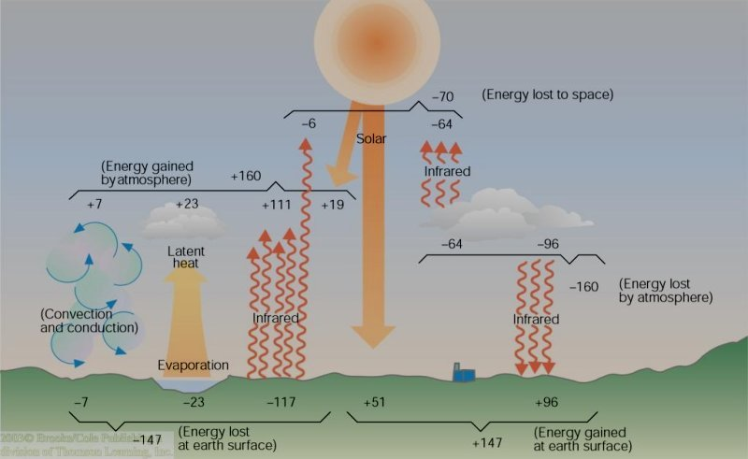
What drives our global climate?
Ahrens (2005)

Slide 6
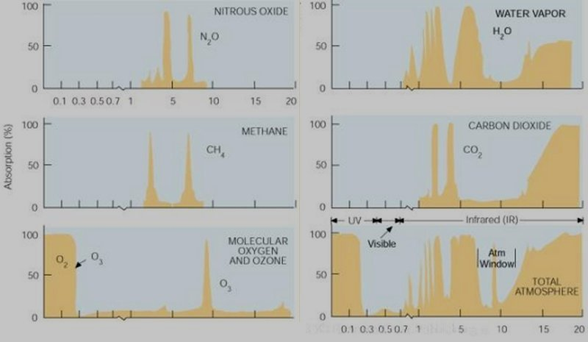
What drives our global climate?
Ahrens (2005)

Slide 7
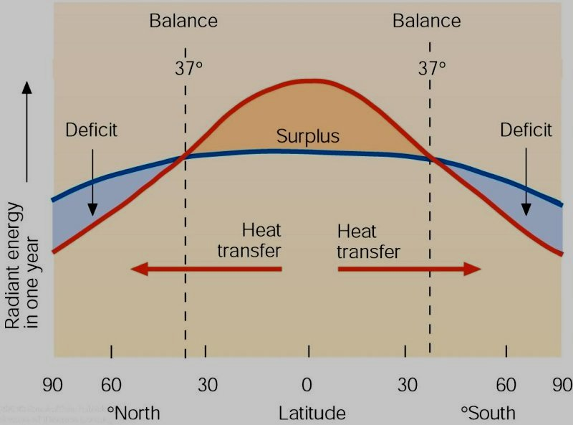
What drives our global climate?
Ahrens (2005)

Slide 8
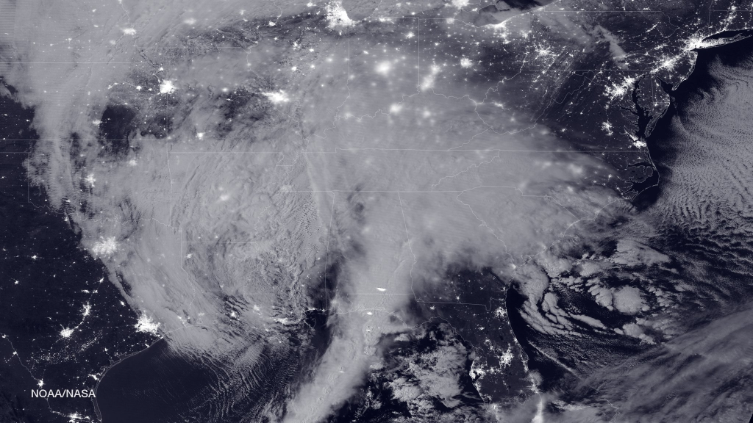
The BIG climate picture
https://www.nasa.gov/image-feature/2016-blizzard-by-moonlight

Slide 9
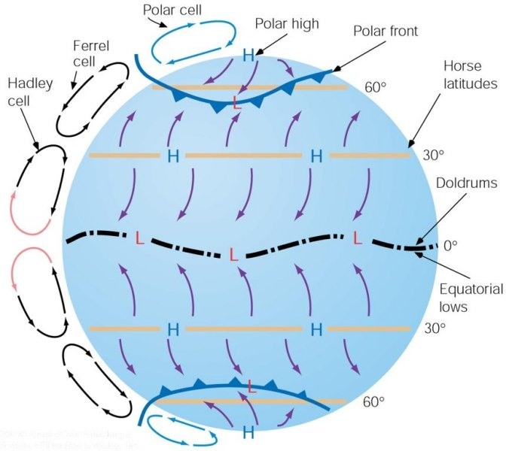
The BIG climate picture
Global circulation – the long-term atmospheric response to the uneven global energy distribution
Ahrens (2005)

Slide 10
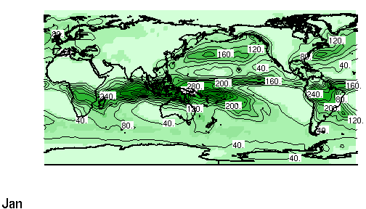

The BIG climate picture
Tropical low pressure (Intertropical convergence zone, ITCZ)
http://iri.ldeo.columbia.edu/~bgordon/ITCZ.html

Slide 11
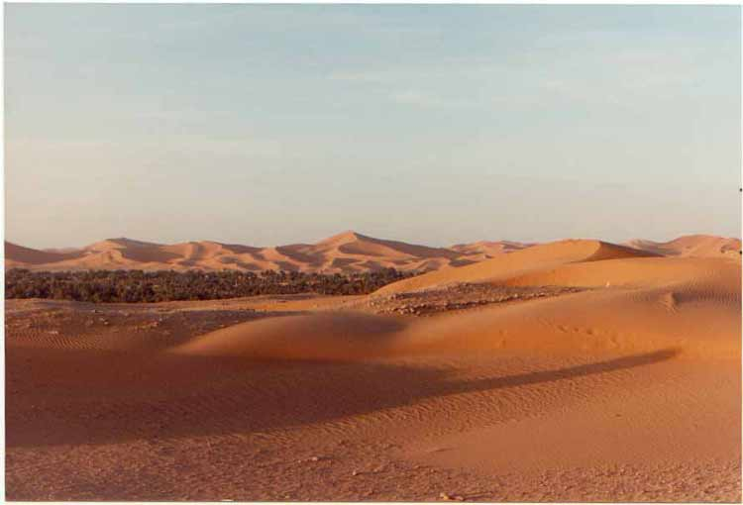
The BIG climate picture
Sub-tropical high pressure (Pacific High, Bermuda High)
http://www.martinreeds-page.co.uk/afrpics/pic10.jpg

Slide 12
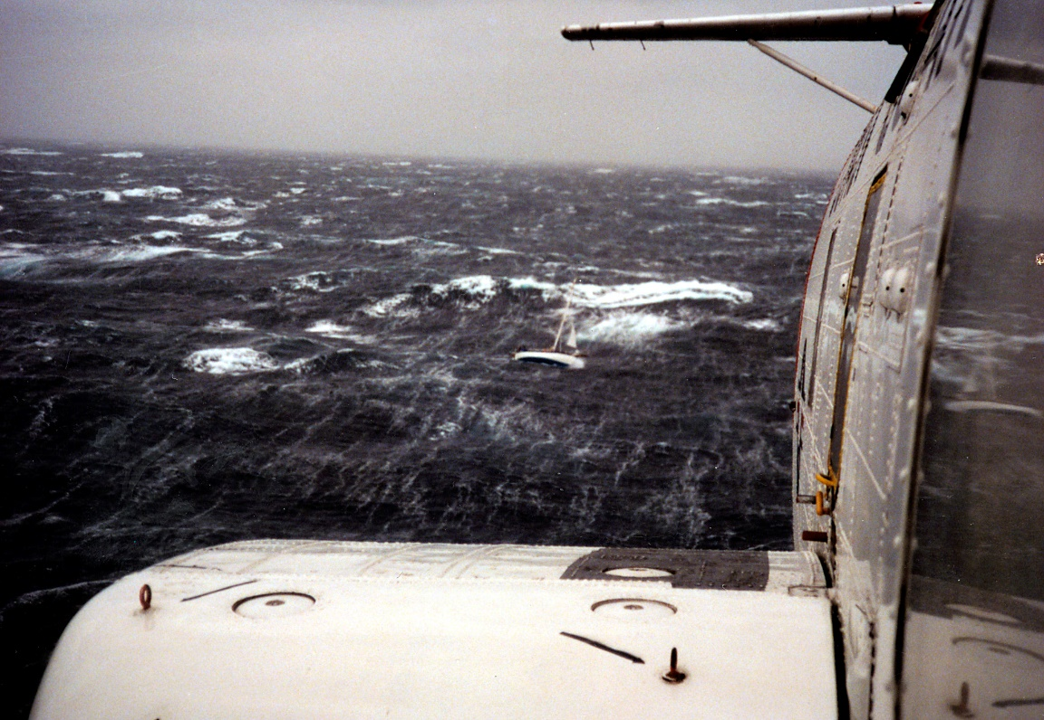
The BIG climate picture
Mid-latitude low pressure- our winter cyclones (Aleutian Low, Icelandic Low)
http://www.uscg.mil/news/PerfectStorm/Image14.jpg

Slide 13
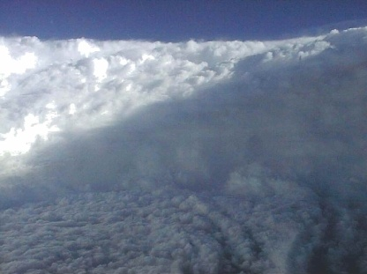
The BIG climate picture
Mid-latitude low pressure- our summer tropical cyclones
http://earthsci.org/processes/weather/cyclone/cyclone.html

Slide 14
The BIG climate picture
All global circulations are acting to move
  Warm, moist air poleward
  Cold, dry air equatorward
to even out the inequity of the global energy distribution
Ahrens (2005)

Slide 15
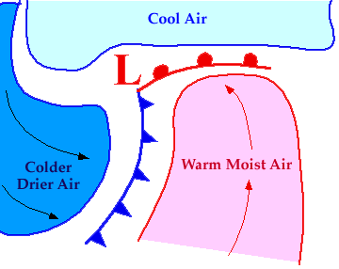
The BIG climate picture
But the global circulations are not the only atmospheric circulations acting to even out the inequity of the global energy distribution
http://ww2010.atmos.uiuc.edu/(Gh)/wwhlpr/cyclone.rxml?hret=/guides/rs/sat/home.rxml&prv=1

Slide 16
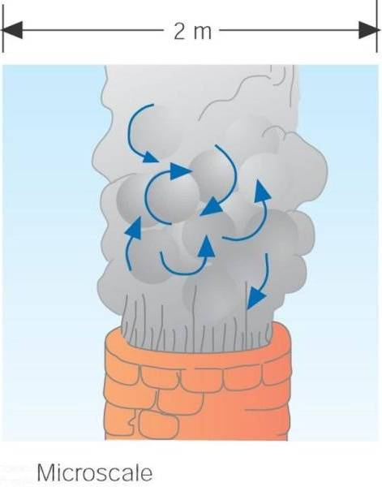
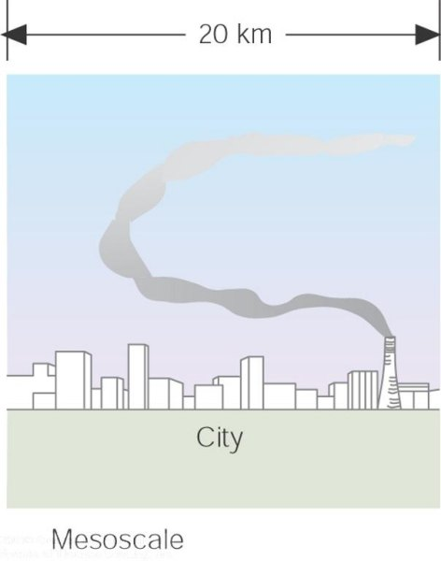
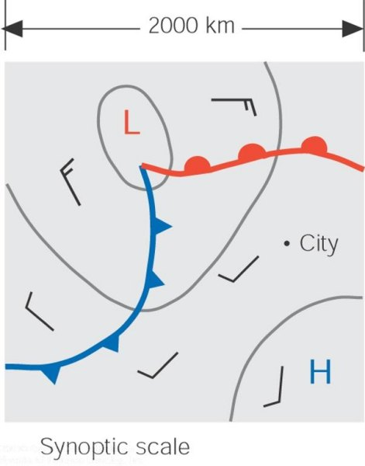
The BIG climate picture
Ahrens (2005)
Atmospheric Circulation Scales:
molecular→microscale→mesoscale→synoptic scale→planetary scale→intraseasonal→interseasonal→BIG (global) climate

Slide 17
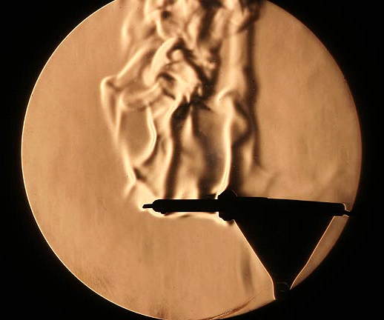
The BIG climate picture
Molecular circulations (turbulence)
http://www.rit.edu/~andpph/photofile-c/schlieren-3659.jpg

Slide 18
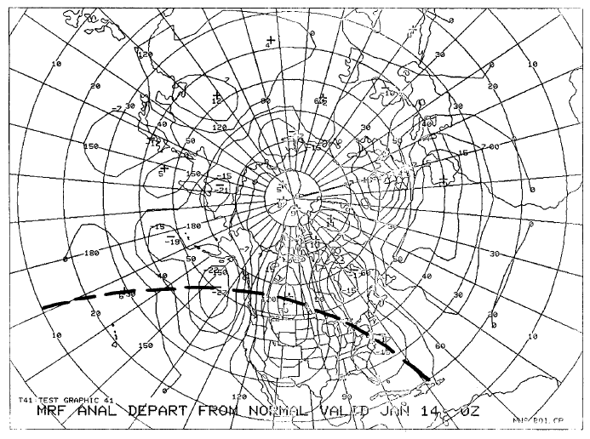
The BIG climate picture
Planetary-scale circulations (Rossby Waves)
http://www.nws.noaa.gov/im/pub/wrta8604.pdf

Slide 19
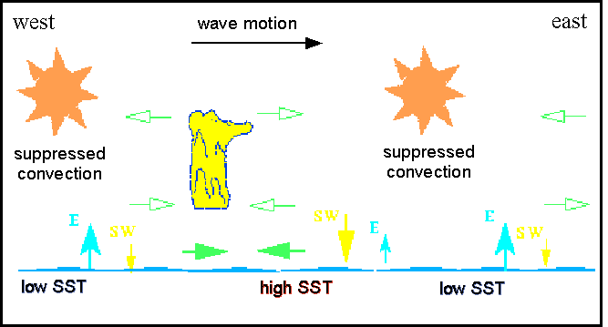
The BIG climate picture
Intraseasonal circulations (e.g. Madden-Julian Oscillation, MJO)
  40-50 day oscillation over the tropical Pacific Ocean
http://www-das.uwyo.edu/~geerts/cwx/notes/chap12/mjo1.gif

Slide 20
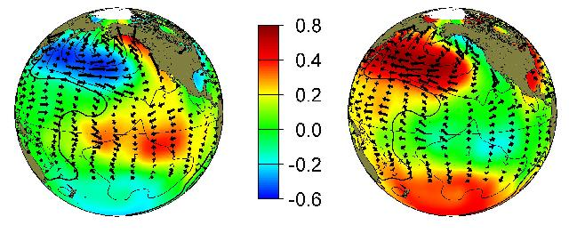
The BIG climate picture
Interseasonal circulations (e.g. El Niño, La Niña, Pacific Decadal Oscillation [PDO]…
warm
cool
http://tao.atmos.washington.edu/pdo/

Slide 21
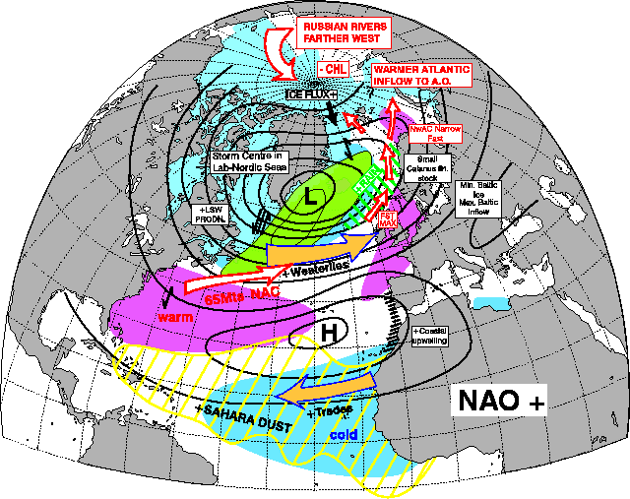
The BIG climate picture
Interseasonal circulations (e.g. El Niño, La Niña, PDO, North Atlantic Oscillation [NAO]…
http://www.met.rdg.ac.uk/cag/Images/naoplus.gif

Slide 22
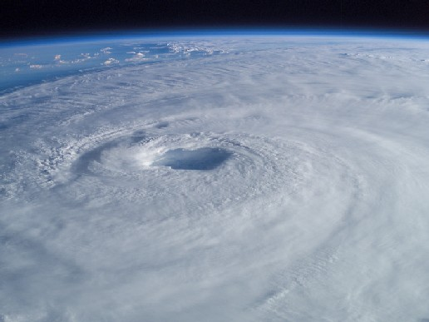
The BIG climate picture
The net effect of ALL atmospheric motions is to move
  Warm, moist air poleward
  Cold, dry air equatorward
to even out the inequity of the global energy distribution
http://www.nasa.gov/images/content/51677main_isabel_new_4.jpg

Slide 23
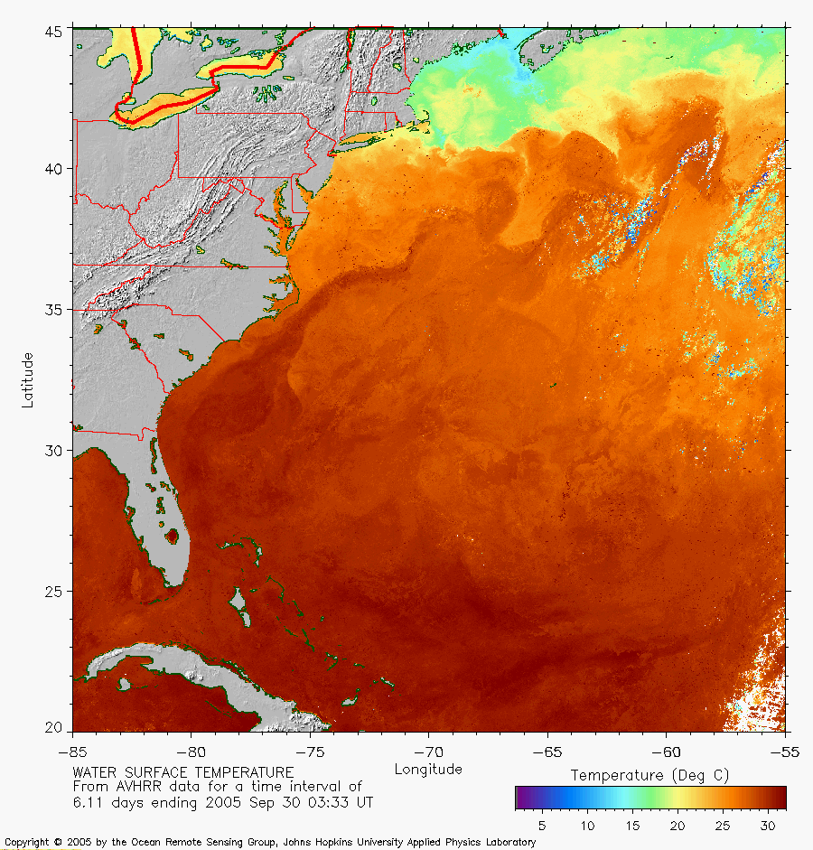
The BIG climate picture
And don’t forget about the ocean circulations!
http://fermi.jhuapl.edu/avhrr/gs/averages/05sep/gs_05sep30_0333_mult.png

Slide 24
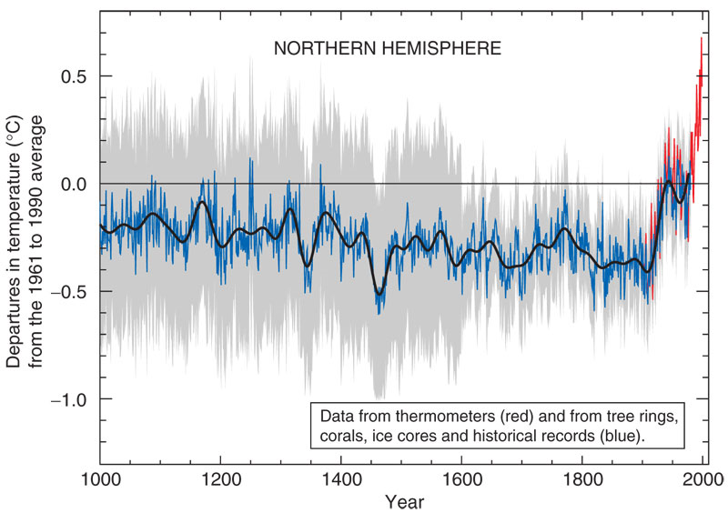
The BIG climate picture
Scientists are confident that
  Global surface temperatures are increasing
  Humans are a likely cause of the accelerated temperature increase
http://en.wikipedia.org/wiki/Hockey_stick_controversy#Mann.2C_Bradley_and_Hughes_1999

Slide 25
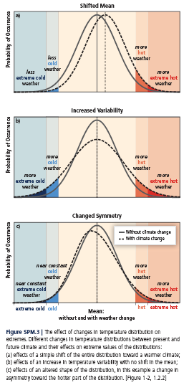
The BIG climate picture
Increase in global surface temperatures
  Shifted mean
  Increased variability
  Changed symmetry
  current research is trying to determine which is happening
http://www.ipcc-wg2.gov/SREX/images/uploads/SREX-All_FINAL.pdf

Slide 26
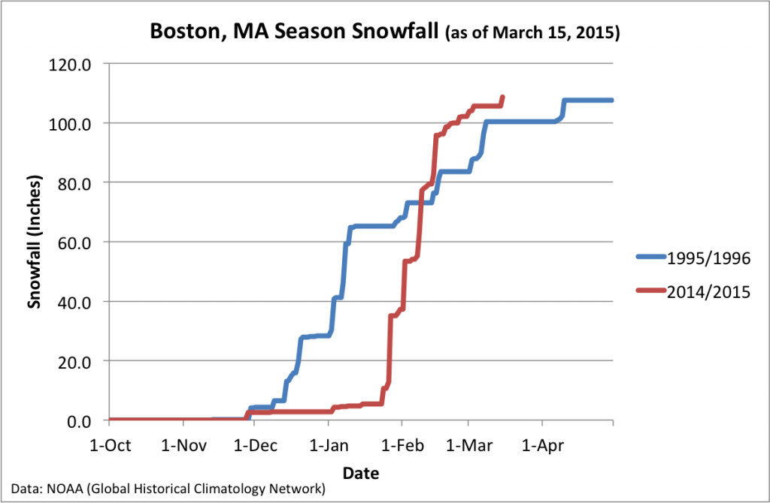
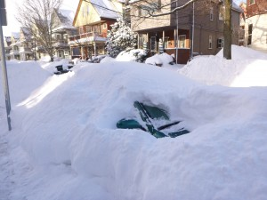
The BIG climate picture
Even with a global surface temperature increase, we can have
  cold outbreaks
  serious snowstorms
http://extremeweather.columbia.edu/2015/03/18/boston-breaks-seasonal-snowfall-record/

Slide 27
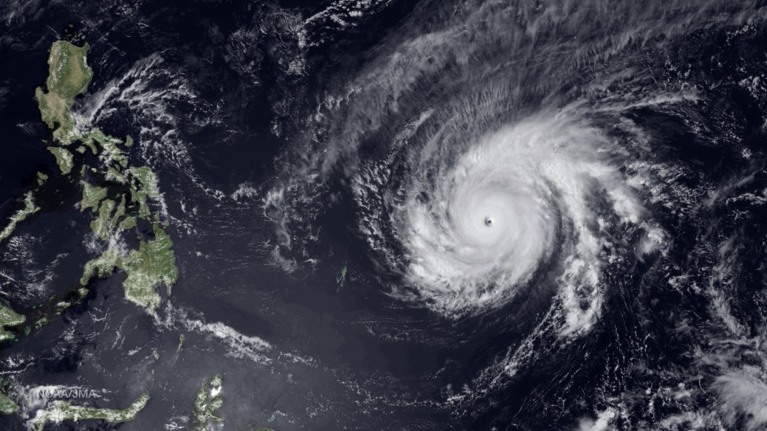
How stable is the BIG climate?
https://www.washingtonpost.com/news/capital-weather-gang/wp/2015/03/31/pacific-super-typhoon-maysak-among-strongest-on-record-so-early-in-the-season/

Slide 28
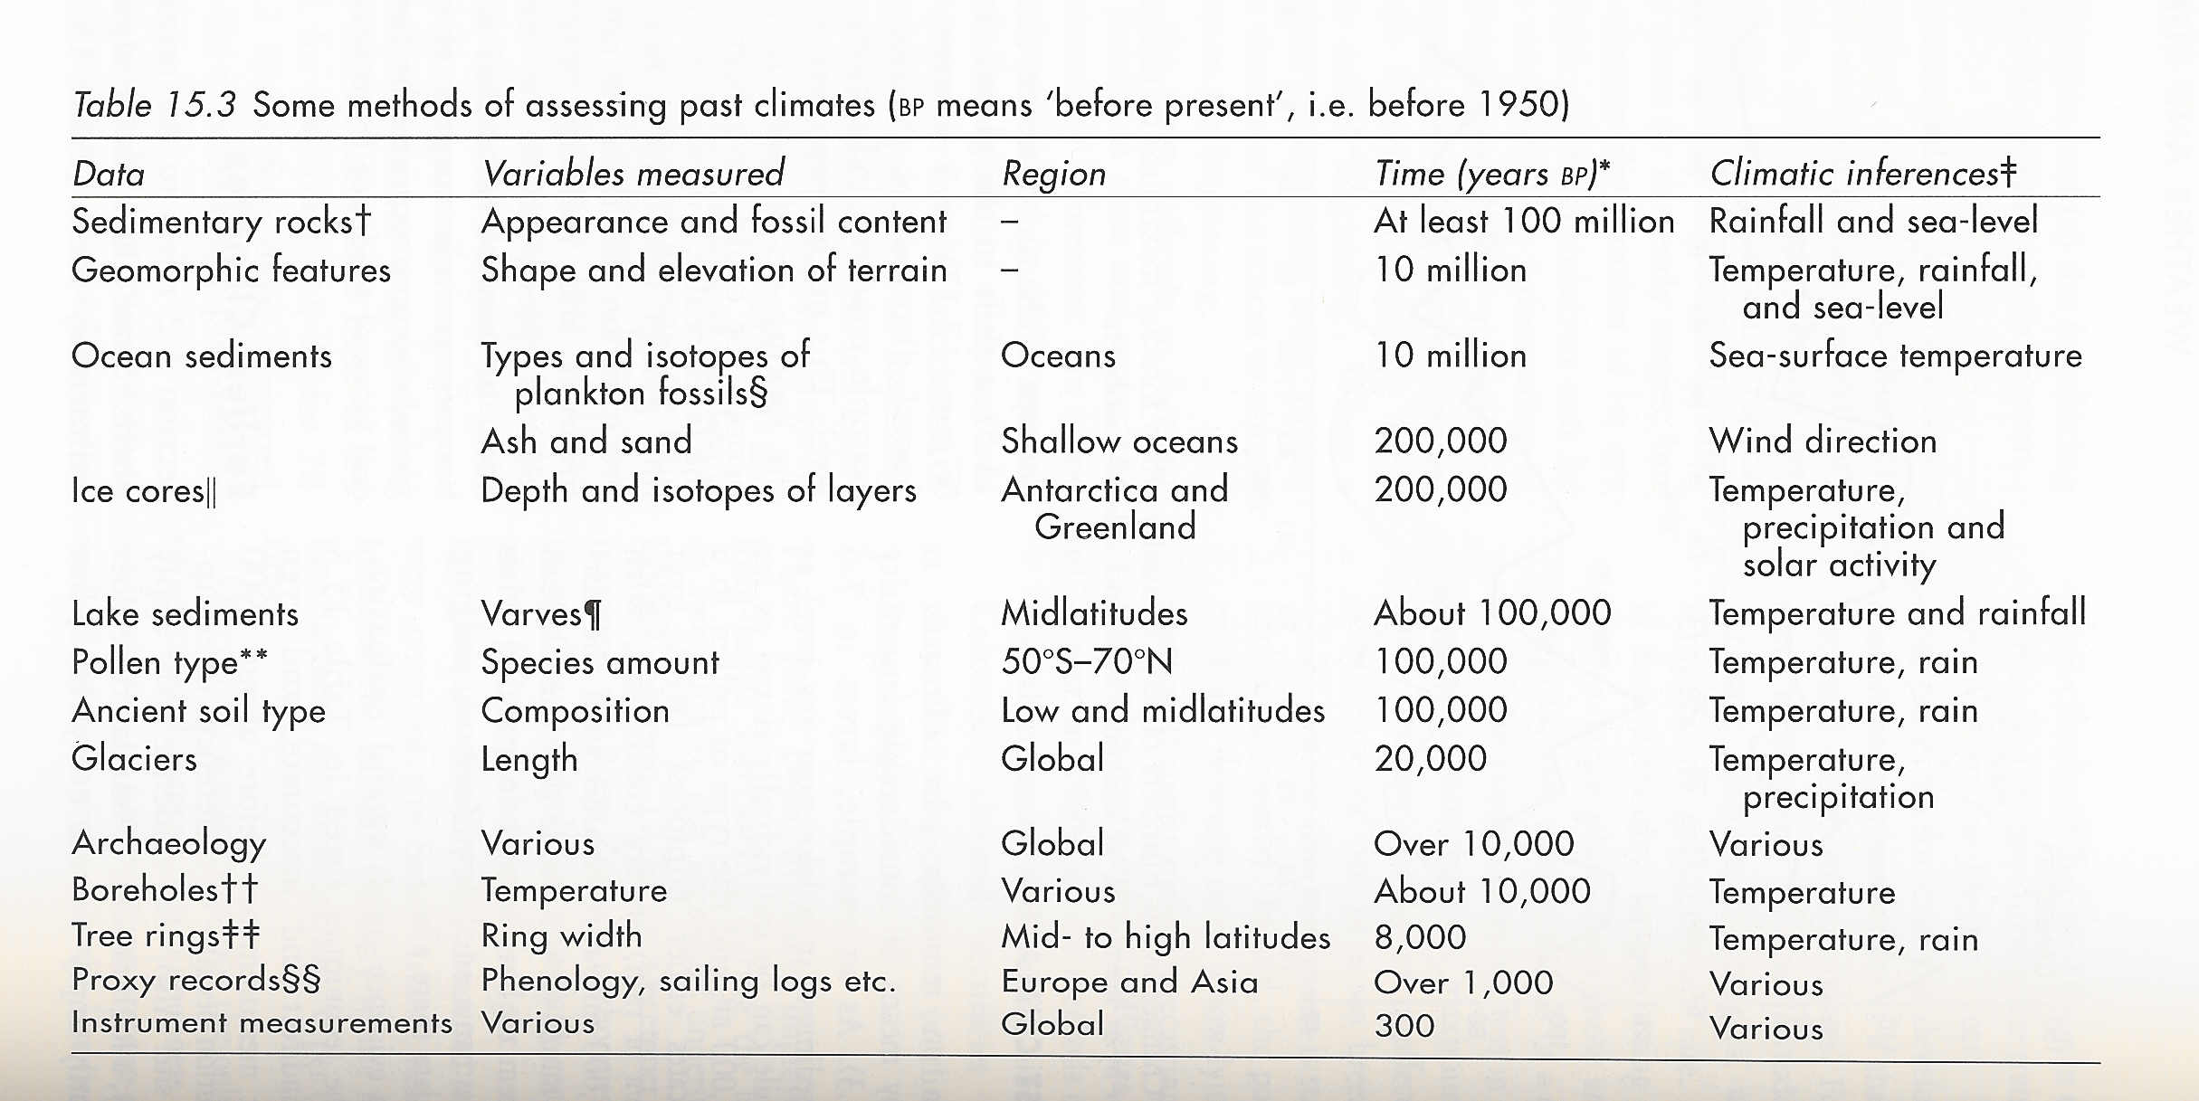
How stable is the BIG climate?
Does our BIG climate change?
  Looking to the past…
Linacre and Geerts (1997)

Slide 29
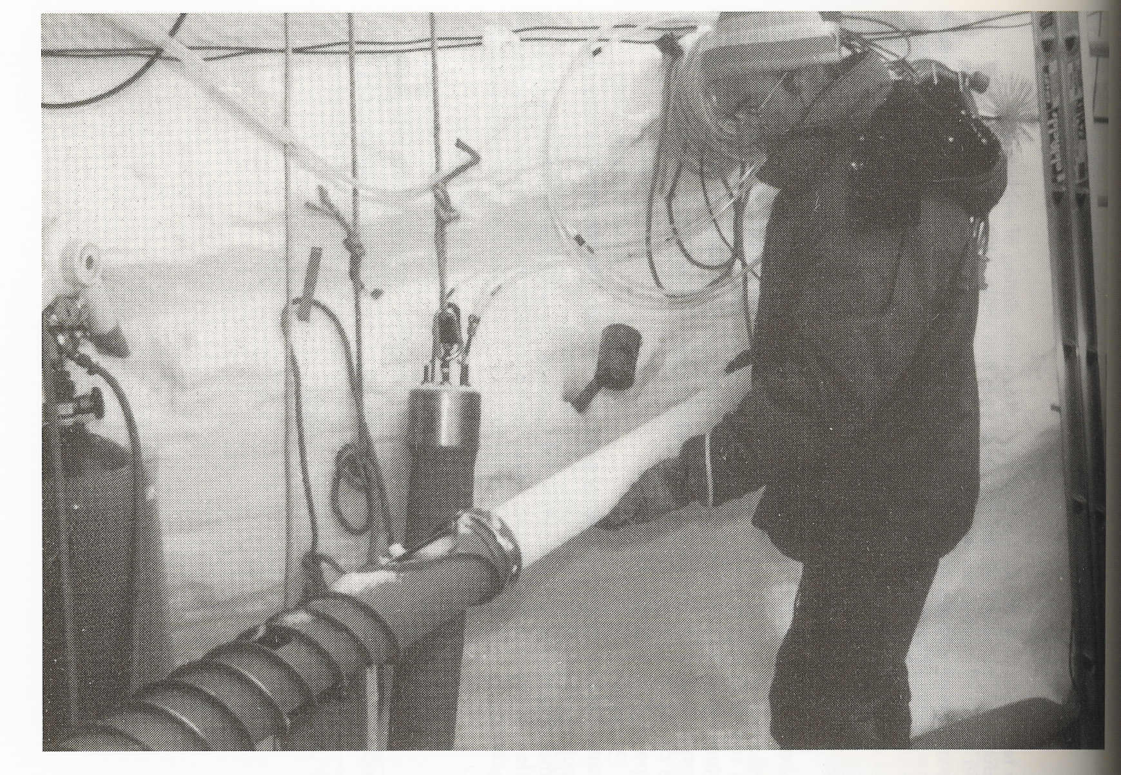
How stable is the BIG climate?
Linacre and Geerts (1997)

Slide 30
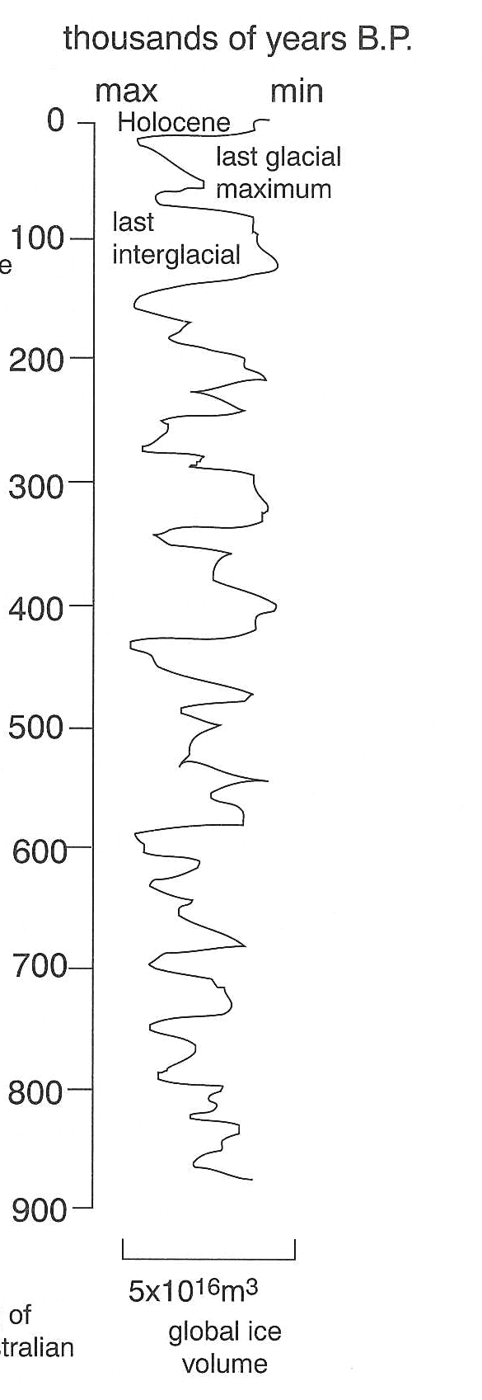
How stable is the BIG climate?
What do observations seem to indicate?
  Several major cold periods in the last 900 millenia (glaciations)
  Several warm periods (interglacial periods)
Linacre and Geerts (1997)

Slide 31
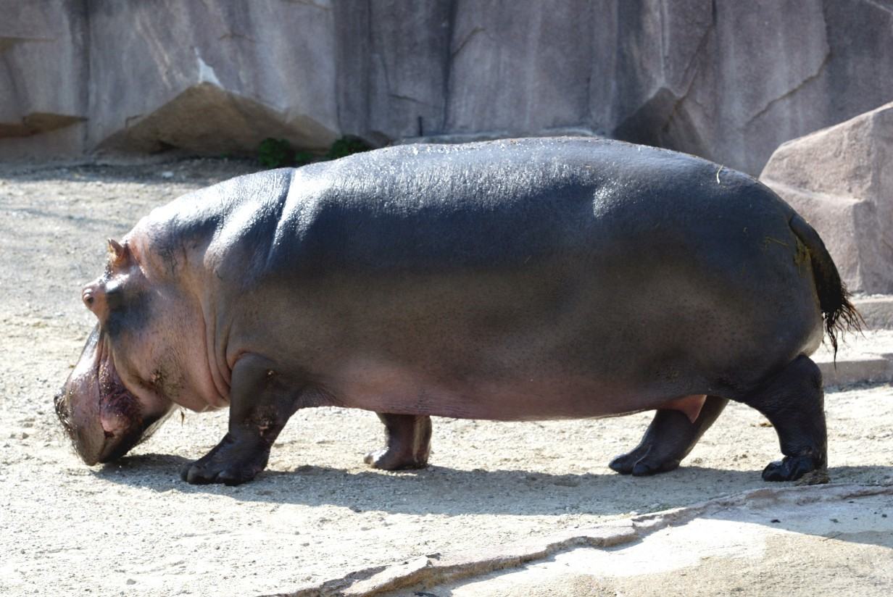
How stable is the BIG climate?
The intergalacial period previous to the current one (lasted until 120 millenia)
  Hippopotamus in the Thames River
  European temperatures were 2 K warmer than today
  Sea-levels were 6 m higher than today
http://www.pirateplanet.com/Milwaukee_Zoo.html

Slide 32
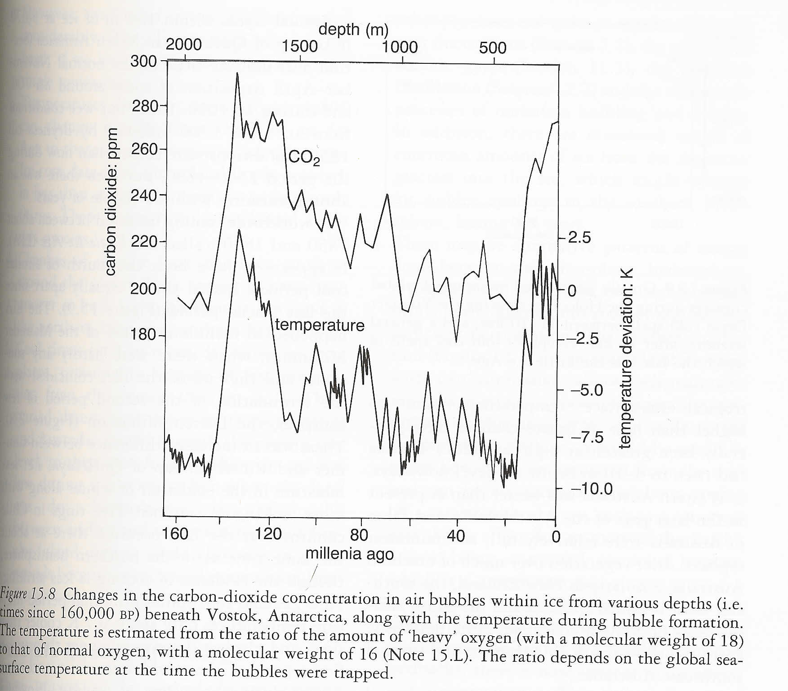
How stable is the BIG climate?
Linacre and Geerts (1997)

Slide 33
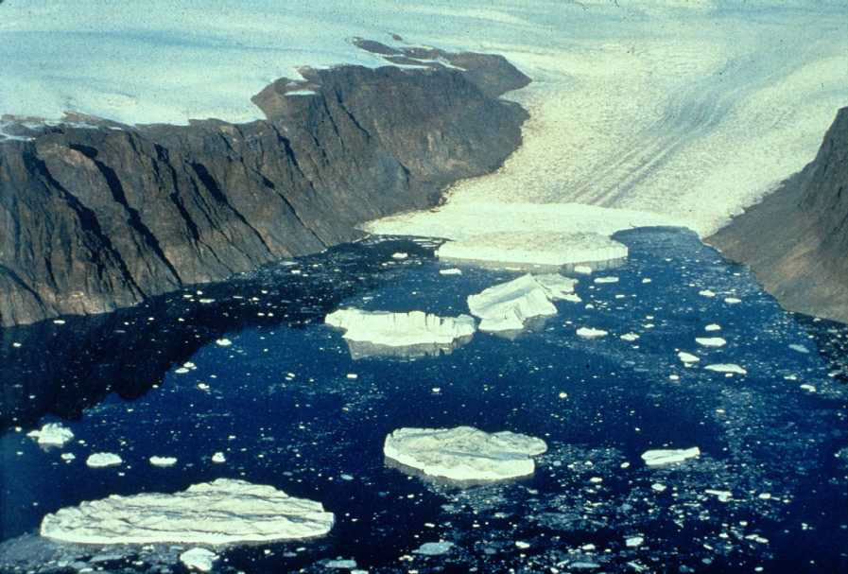
How stable is the BIG climate?
The last glaciation
  Sea-level 120 m below today’s level
  Extensive glacial coverage
  Extensive aridity
http://www.uscg.mil/lantarea/iip/pics/glacier.jpg

Slide 34
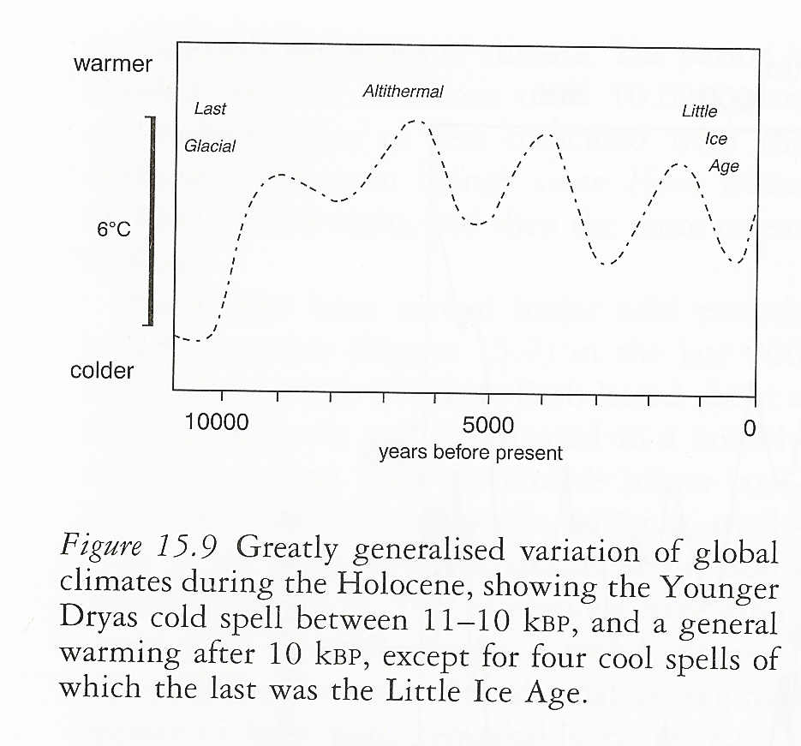
How stable is the BIG climate?
The here and now (Holocene)
Linacre and Geerts (1997)

Slide 35
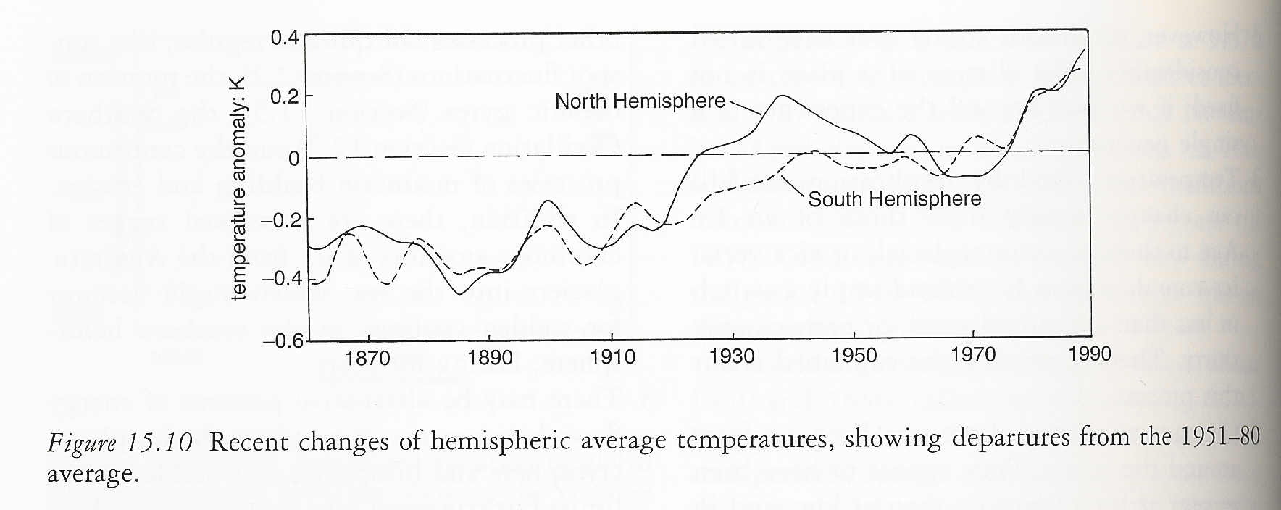
How stable is the BIG climate?
Linacre and Geerts (1997)

Slide 36
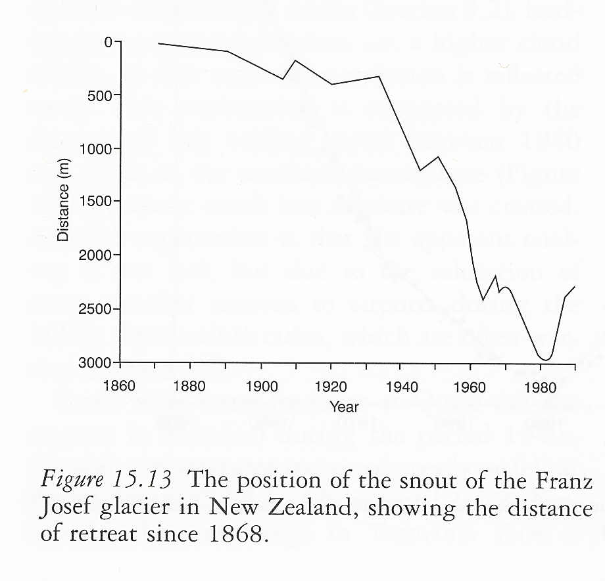
How stable is the BIG climate?
Linacre and Geerts (1997)

Slide 37
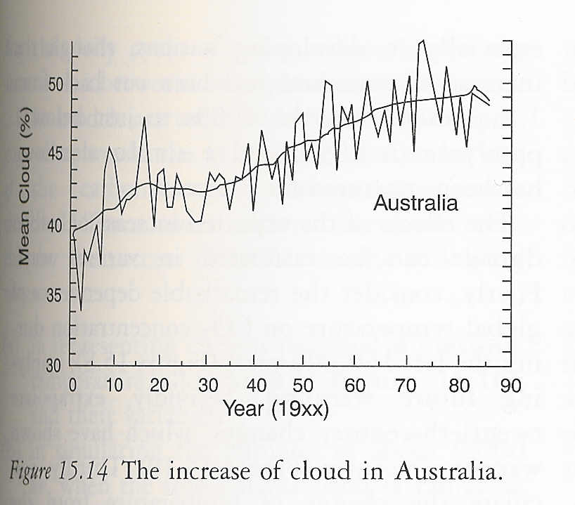
How stable is the BIG climate?
The issue of feedbacks; positive and negative…
Linacre and Geerts (1997)

Slide 38
How stable is the BIG climate?
The issue of feedbacks; positive and negative…
Positive feedback a response to a warming climate creating conditions increasing warming
Negative feedback a response to a warming climate creating conditions opposing warming

Slide 39
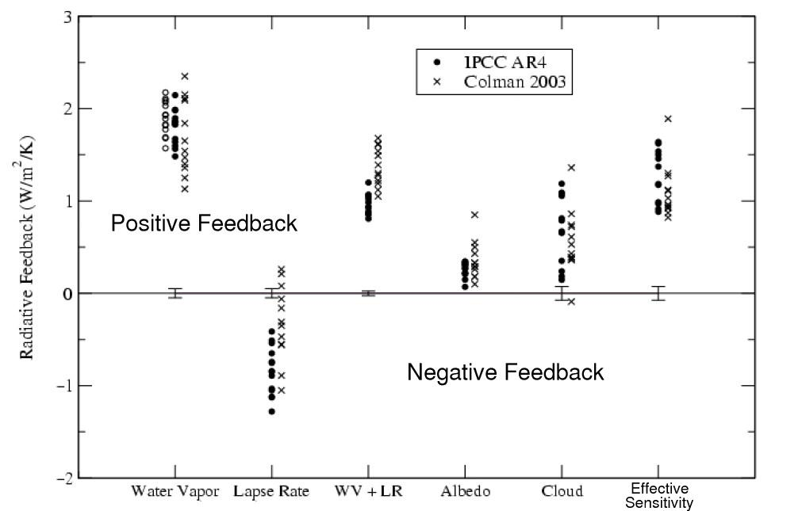
How stable is the BIG climate?
Negative (cool!)
  Warming + increased outgoing longwave radiation
Positive (hot!)
  Retreating ice + planetary albedo
  Warming + water vapor
http://www.realclimate.org/index.php/archives/2006/08/climate-feedbacks/
http://www.realclimate.org/index.php/archives/2006/07/runaway-tipping-points-of-no-return/

Slide 40
How stable is the BIG climate?
What have we learned from the past up to “the here and now”?
  Global mean temperature has varied over time within 10 K
Linacre and Geerts (1997)

Slide 41
How stable is the BIG climate?
What have we learned from the past up to “the here and now”?
  Global mean temperature has varied over time within 10 K
  Conditions at a given location can vary considerably
Linacre and Geerts (1997)

Slide 42
How stable is the BIG climate?
What have we learned from the past up to “the here and now”?
  Global mean temperature has varied over time within 10 K
  Conditions at a given location can vary considerably
  Temperatures can “switch” as quickly as 100-30 years
Linacre and Geerts (1997)

Slide 43
How stable is the BIG climate?
What have we learned from the past up to “the here and now”?
  Global mean temperature has varied over time within 10 K
  Conditions at a given location can vary considerably
  Temperatures can “switch” as quickly as 100-30 years
  Climate change is not uniform around the globe
    Appear to be greatest at the higher latitudes and in the Northern Hemisphere
Linacre and Geerts (1997)

Slide 44
How stable is the BIG climate?
What have we learned from the past up to “the here and now”?
  Global mean temperature has varied over time within 10 K
  Conditions at a given location can vary considerably
  Temperatures can “switch” as quickly as 100-30 years
  Climate change is not uniform around the globe
    Appear to be greatest at the higher latitudes and in the Northern Hemisphere
  Cool times tend to mean dry times in most places
Linacre and Geerts (1997)

Slide 45
How stable is the BIG climate?
What have we learned from the past up to “the here and now” – causes of BIG climate change…
  Random events; atmospheric, geological (e.g. volcanic erruptions)
Linacre and Geerts (1997)

Slide 46
How stable is the BIG climate?
What have we learned from the past up to “the here and now” – causes of BIG climate change…
  Random events; atmospheric, geological (e.g. volcanic erruptions)
  Irregular events; sun spots, mountain building & erosion, sudden surges of Antarctic ice into the sea
Linacre and Geerts (1997)

Slide 47
How stable is the BIG climate?
What have we learned from the past up to “the here and now” – causes of BIG climate change…
  Random events; atmospheric, geological (e.g. volcanic erruptions)
  Irregular events; sun spots, mountain building & erosion, sudden surges of Antarctic ice into the sea
  “Pushed” into another regime by interseasonal events
Linacre and Geerts (1997)

Slide 48
How stable is the BIG climate?
What have we learned from the past up to “the here and now” – causes of BIG climate change…
  Random events; atmospheric, geological (e.g. volcanic erruptions)
  Irregular events; sun spots, mountain building & erosion, sudden surges of Antarctic ice into the sea
  “Pushed” into another regime by interseasonal events
  Human activities; urban heating, alteration of surface reflectivity, modification of air’s chemical composition
Linacre and Geerts (1997)

Slide 49

How stable is the BIG climate?
So, where are we headed?
  A slow (stable) change?
  An abrupt (unstable) change?
http://falcon.tamucc.edu/~wiki/uploads/FRC/frc-compass.gif

Slide 50
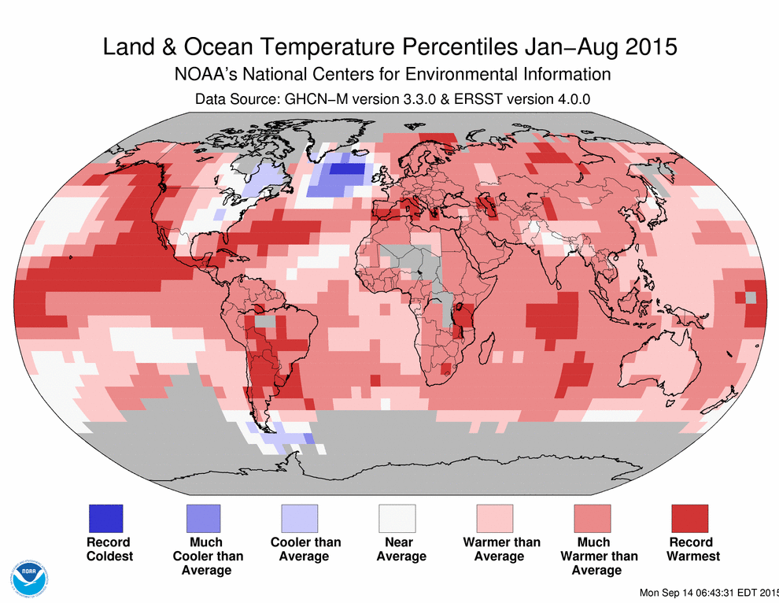
Feedback scenarios
Impacts elsewhere
  North Atlantic Ocean overturning circulation
  Arctic summer sea ice
    “Polar amplification”
  Ice sheets
    Greenland
    West Antarctic
  Rise in sea level
https://www.washingtonpost.com/news/energy-environment/wp/2015/09/24/why-some-scientists-are-worried-about-a-cold-blob-in-the-north-atlantic-ocean/

Slide 51
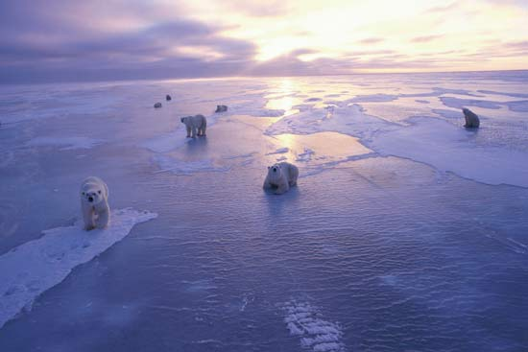
Feedback scenarios
Impacts elsewhere
  North Atlantic Ocean overturning circulation
  Arctic summer sea ice
    “Polar amplification”
  Ice sheets
    Greenland
    West Antarctic
  Rise in sea level
http://kids.britannica.com/comptons/art-90106/The-dramatic-decrease-in-the-area-and-thickness-of-Arctic

Slide 52
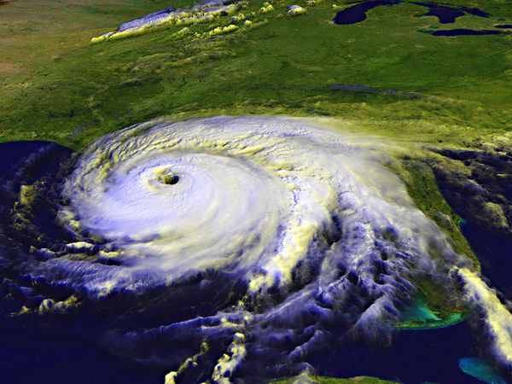
Feedback scenarios
Impacts elsewhere
  Tropical cyclones
    Decrease or little change in frequency
    Increase in mean intensity
    Increase in heavy rainfall
http://environment.nationalgeographic.com/environment/natural-disasters/hurricane-profile/

Slide 53
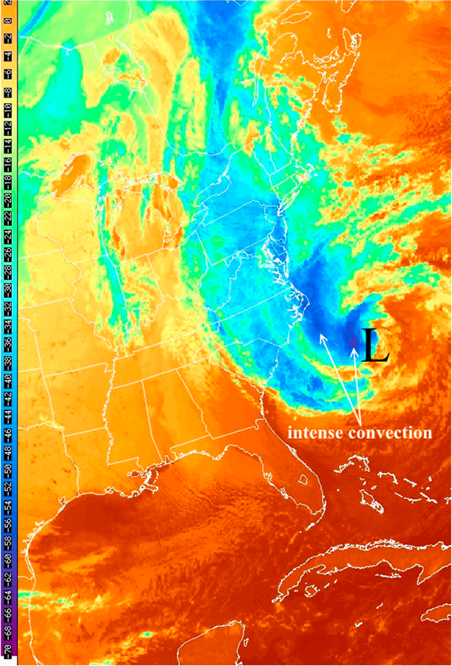
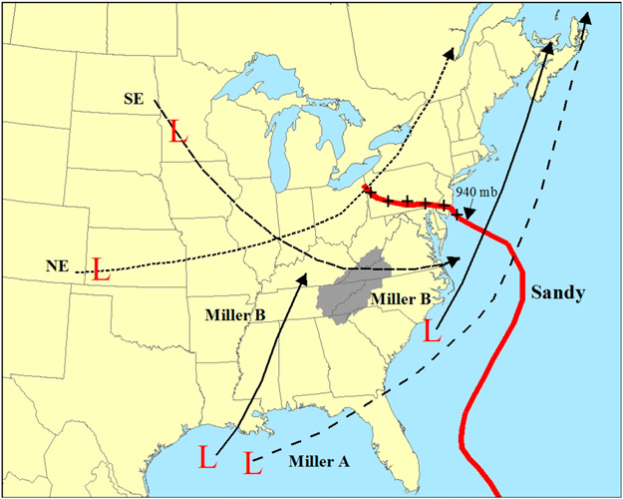
Impacts close to home
Hurricane Sandy - 29–31 October 2012
http://journals.ametsoc.org/doi/abs/10.1175/WAF-D-15-0069.1

Slide 54

Impacts close to home
Background
  Temperature generally decreases with altitude
    Cool near the top of mountains
    Warm near the base of mountains
T = 30ºF
T = 50ºF
http://hilljunkie.blogspot.com/2009/04/clingmans-dome.html

Slide 55

Impacts close to home
Background
  Several of the tallest peaks east of the Mississippi River are located in eastern Tennessee and western NC
    How would the winter and summer seasons be different at the tops and at the base of these peaks in a normal year?
http://hilljunkie.blogspot.com/2009/04/clingmans-dome.html

Slide 56


Impacts close to home
Background
  Some plants and animals found at the top of the mountains in TN/NC are also found thousands of miles away at low elevations
http://www.ncparks.gov/Visit/parks/momi/main.php
http://www.zonu.com

Slide 57


Impacts close to home
Background
  Some plants and animals found at the top of the mountains in TN/NC are found nowhere else
http://digitalheritage.org/2010/08/mount-mitchell/
http://www.nps.gov/grsm/naturescience/plants.htm

Slide 58

Impacts close to home
Plants and animals
  trout
  salamanders
  elk
  plants and soil
  all are sensitive to temperature and moisture conditions of their environment
http://reachhigherground.wordpress.com/category/great-smoky-mountains-national-park/

Slide 59


Impacts close to home
Trout
  Only as healthy as the water is clean
    Acid rain washes trace metals (Al.) into the streams at high elevations (> 3000 feet)
    Increases water acidity
    Negatively impacts gill plate development
    Reduces growth and survival
Michelle Connolly
otoliths
http://www.nps.gov/grsm/naturescience/trout-metal-deposits.htm

Slide 60

Impacts close to home
Salamanders (amphibians)
  Depend strongly on stable moisture conditions, some are
    Fully aquatic
    Semi-aquatic
  Different families reside at different elevations; depend strongly on stable temperature conditions
Brightly colored black-chinned red salamanders are fairly common throughout the park at elevations up to 3,000 feet.
http://www.nps.gov/grsm/naturescience/amphibians.htm

Slide 61


Impacts close to home
Elk
  Have preferred habitat locations in the Great Smoky Mtn. N.P.
  Trails (and fecal pellets) show preferences for particular forest and vegetation types
http://www.nps.gov/grsm/naturescience/elk.htm
Elizabeth Hillard
http://news-prod.wcu.edu/2013/01/students-elk-research-to-help-national-park-manage-its-resources/

Slide 62

Impacts close to home
Plants and soil
  Transitions between tree species and community types occur rapidly over steep environmental and topographic gradients
  Soil moisture and below-canopy temperature
  Soil types differ by elevation
  High elevation soil is typically “fast” drying
http://wnca.org/march-24-elk-knob-hike/
Research designed to better understand species distribution shifts of trees.
Mark Lesser
https://sites.google.com/site/mlesser22/research

Slide 63

Impacts close to home
Feedback from plants to the atmosphere…
  Shift in aerosol types from anthropogenic to biogenic sources, impact on
    Regional radiation budget
    Formation of clouds and precipitation
D. Martin

Slide 64
References
C. D. Ahrens, 2005: Essentials of Meteorology – An Invitation to the Atmosphere. Thomson Brooks/Cole Press. 473 pp.
E. Linacre and B. Geerts, 1997: Climates & Weather Explained. Routledge Press. 432 pp.
https://www.ipcc-wg2.gov/SREX/images/uploads/SREX-All_FINAL.pdf
https://www.washingtonpost.com/graphics/national/gauging-climate-change/?hpid=hp_no-name_graphic-story-a%3Ahomepage%2Fstory

Slide 66

Coming soon![?]

