Slide 1
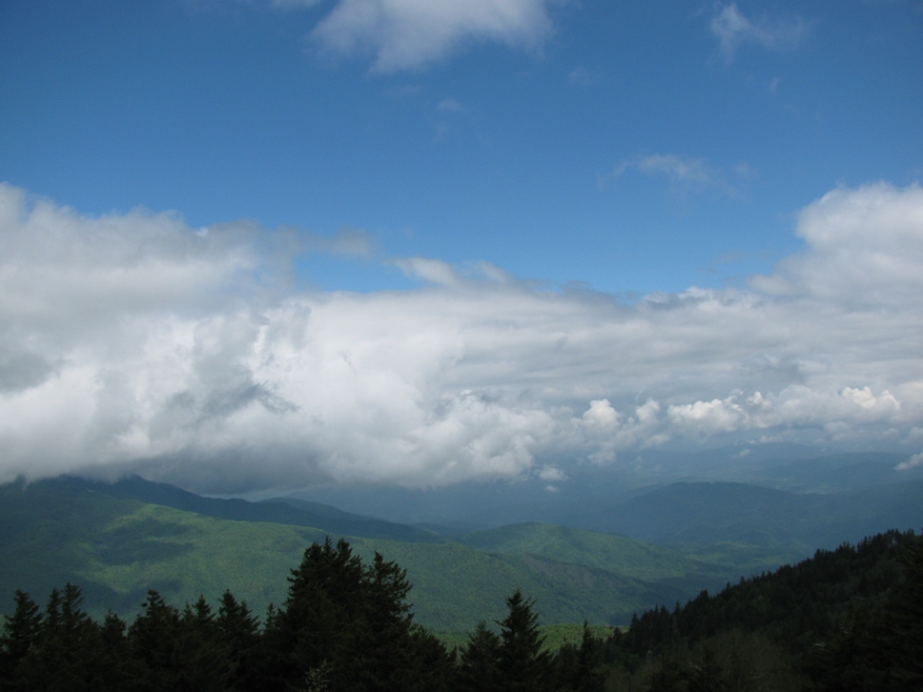
Question and Answer Session Related to the Weather
Douglas K. Miller
Professor and Chair
Atmospheric Sciences Department
UNC Asheville
photo: D. Martin

Slide 2
Outline
Background
  14 questions submitted
  Common themes
    Clarification of weather- and climate-related terms used in the mass media
    Unique regional weather & difficulties in forecasting them
Clouds
Global warming (climate change)
Weather extremes

Slide 3
Outline (cont.)
Discussion – warm season
  2014 hurricane season
  El Niño, La Niña
Discussion – cool season
  2014, 2015 seasonal outlook
  Polar vortex, Omega block
  Inversions
  8 weather sources, 8 different forecasts

Slide 4
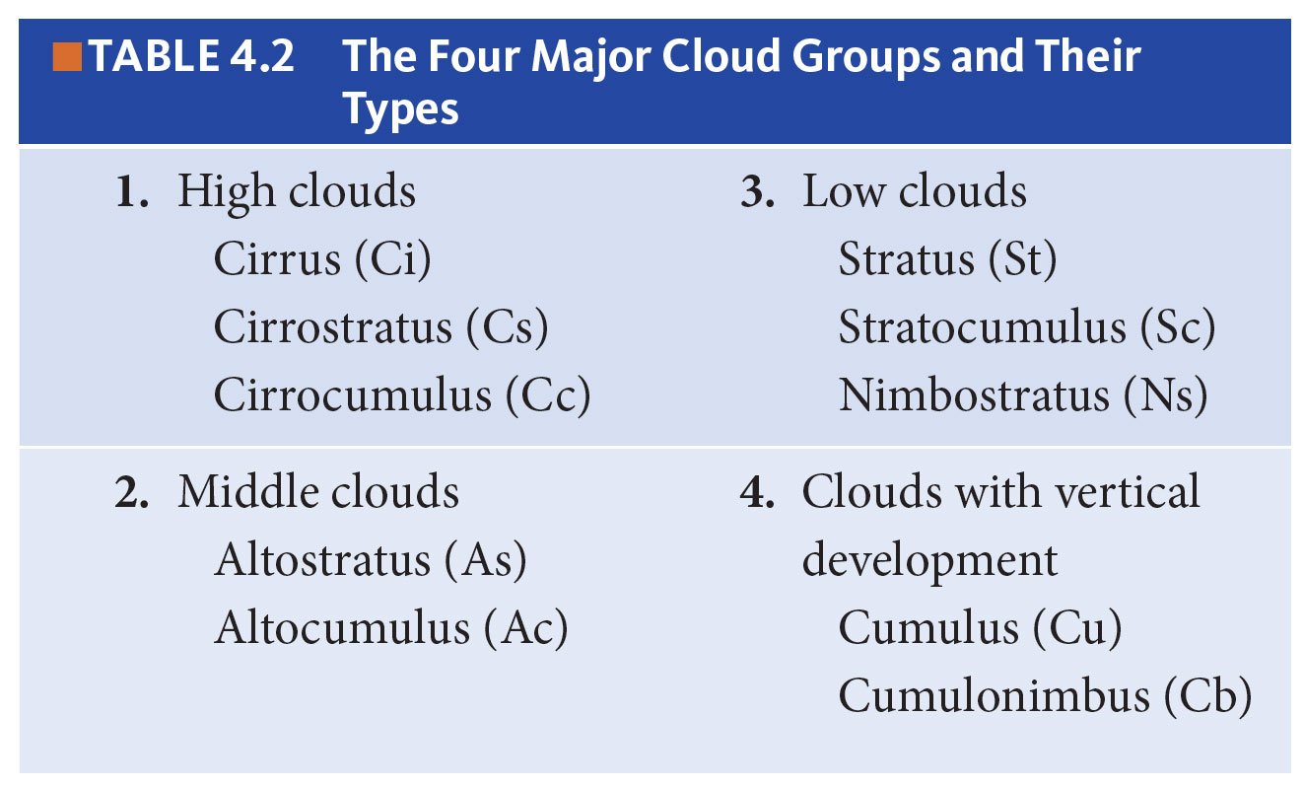
Clouds
Essentials of Meteorology, Ahrens, 6th Edition

Slide 5
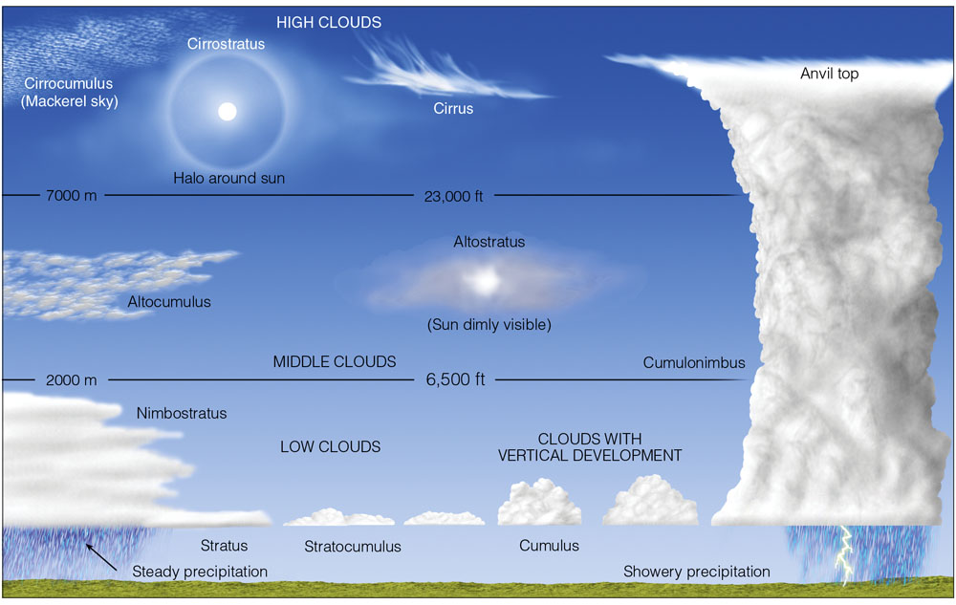
Clouds
Essentials of Meteorology, Ahrens, 6th Edition

Slide 6
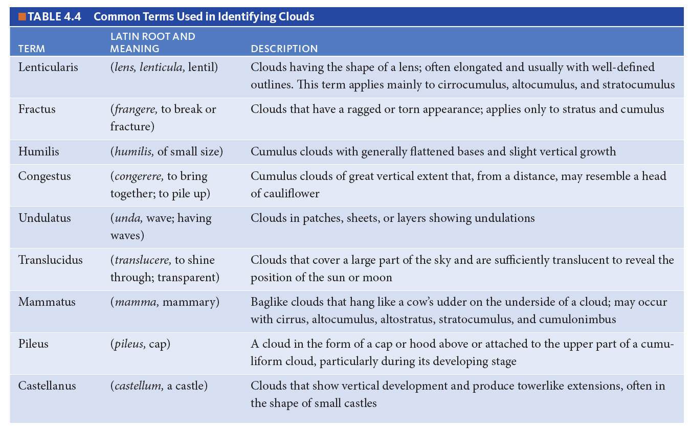
Clouds
Essentials of Meteorology, Ahrens, 6th Edition

Slide 7
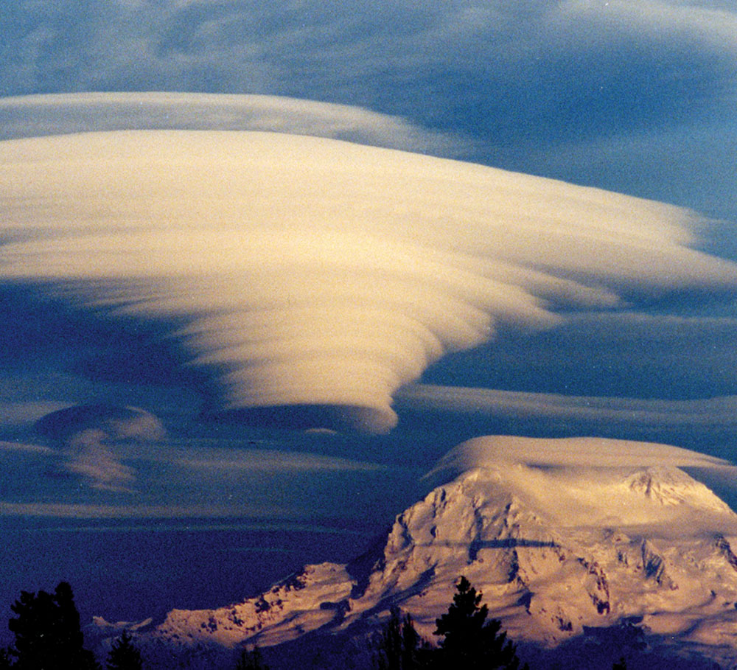
Clouds
Essentials of Meteorology, Ahrens, 6th Edition

Slide 8
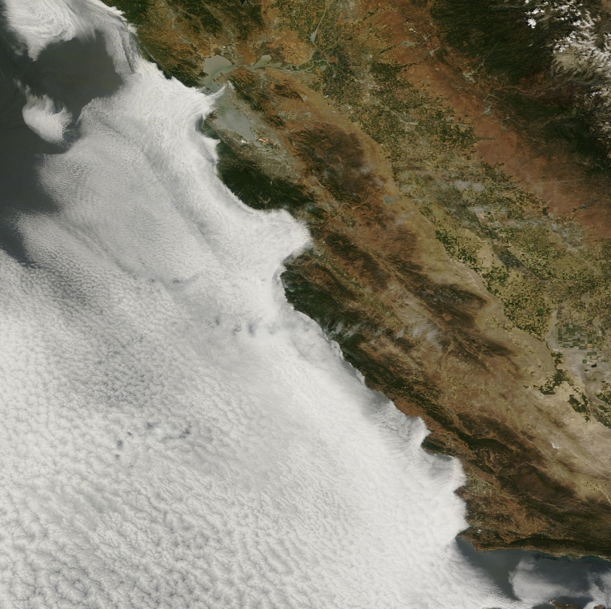
Climate change (a.k.a, global warming)
http://blogs.discovermagazine.com/imageo/files/2014/06/California-marine-stratus.jpeg

Slide 9
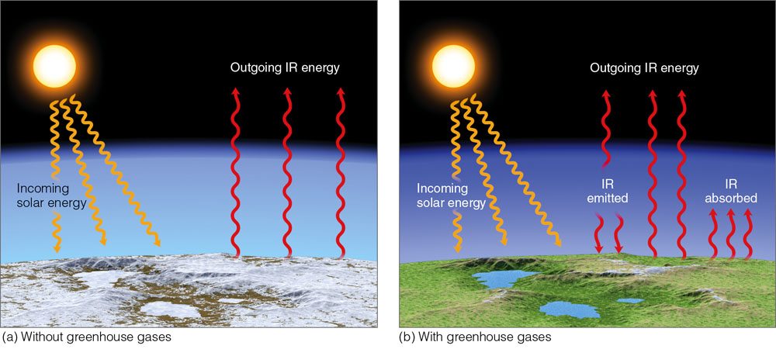
Climate change
Ave. surface air temp. = 0ºF
Ave. surface air temp. = 59ºF
Essentials of Meteorology, Ahrens, 6th Edition
Notes:
Figure 2.12: (a) Near the surface in an atmosphere with little or no greenhouse gases, the earth’s surface would constantly emit infrared (IR) radiation upward, both during the day and at night. Incoming energy from the sun would equal outgoing energy from the surface, but the surface would receive virtually no IR radiation from its lower atmosphere. (No atmospheric greenhouse effect.) The earth’s surface air temperature would be quite low, and small amounts of water found on the planet would be in the form of ice. (b) In an atmosphere with greenhouse gases, the earth’s surface not only receives energy from the sun but also infrared energy from the atmosphere. Incoming energy still equals outgoing energy, but the added IR energy from the greenhouse gases raises the earth’s average surface temperature to a more habitable level.

Slide 10
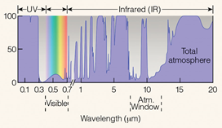
Climate change
Essentials of Meteorology, Ahrens, 6th Edition

Slide 11
Climate change
How do we know it’s real?
How do we know humans are likely accelerating the change?
What can the U.S. do to change it or slow it down?
Coming soon…relationship between climate change and the polar vortex

Slide 12
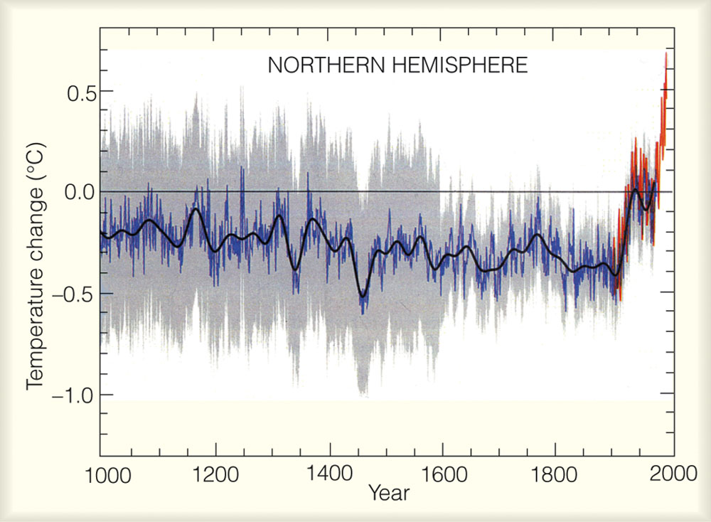
Essentials of Meteorology, Ahrens, 6th Edition
Notes:
Figure 13.5: The average temperature variations over the Northern Hemisphere for the last 1000 years relative to the 1961 to 1990 average (zero line). Yearly temperature data from tree rings, corals, ice cores, and historical records are shown in blue. Yearly temperature data from thermometers are in red. The black line represents a smoothing of the data. (The gray shading represents a statistical 95 percent confidence range in the annual temperature data, after Mann, et al., 1999.) (Source: From Climate Change 2001: The Scientific Basis, 2001, by J. T. Houghton, et al. Copyright c 2001 Cambridge University Press. Reprinted with permission of the Intergovernmental Panel on Climate Change.)

Slide 13
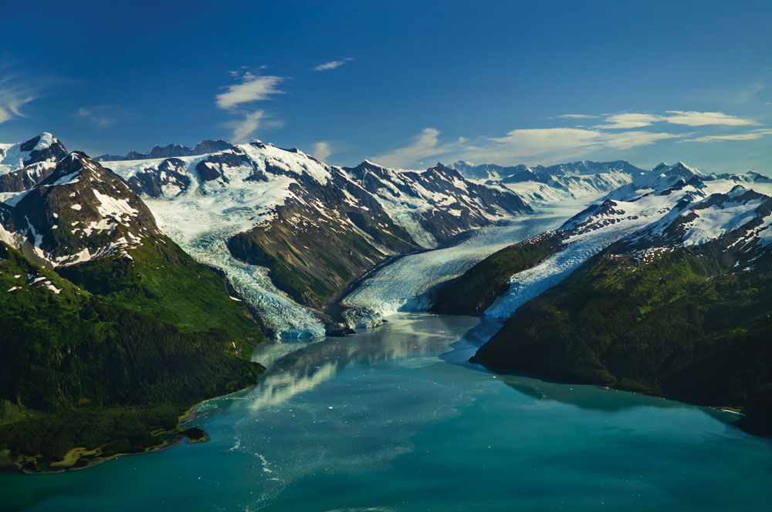
Climate change
Essentials of Meteorology, Ahrens, 6th Edition

Slide 14
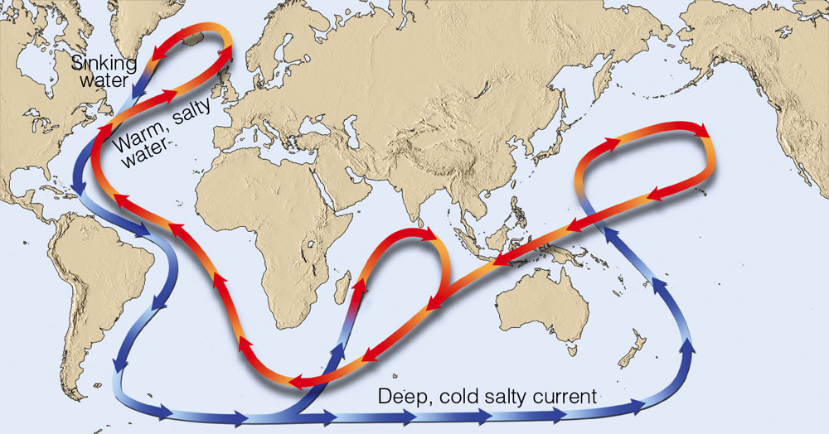
Climate change
Essentials of Meteorology, Ahrens, 6th Edition
Notes:
Figure 1: The ocean conveyor belt. In the North Atlantic, cold, salty water sinks, drawing warm water northward from lower latitudes. The warm water provides warmth and moisture for the air above, which is then swept into northern Europe by westerly winds that keep the climate of that region milder than one would normally expect. When the conveyor belt stops, winters apparently turn much colder over northern Europe.

Slide 15
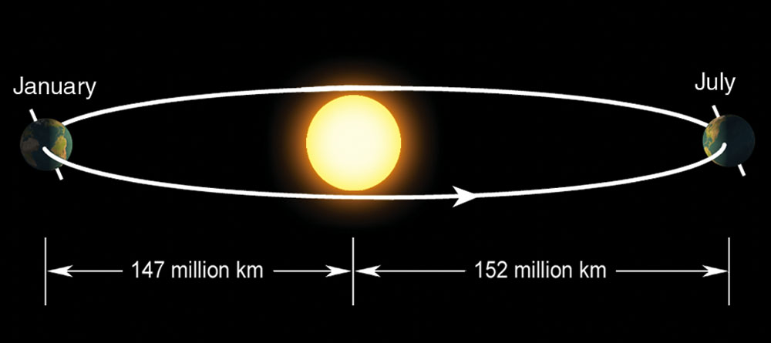
Climate change
Essentials of Meteorology, Ahrens, 6th Edition
Notes:
Figure 2.20: The elliptical path (highly exaggerated) of the earth about the sun brings the earth slightly closer to the sun in January than in July.

Slide 16
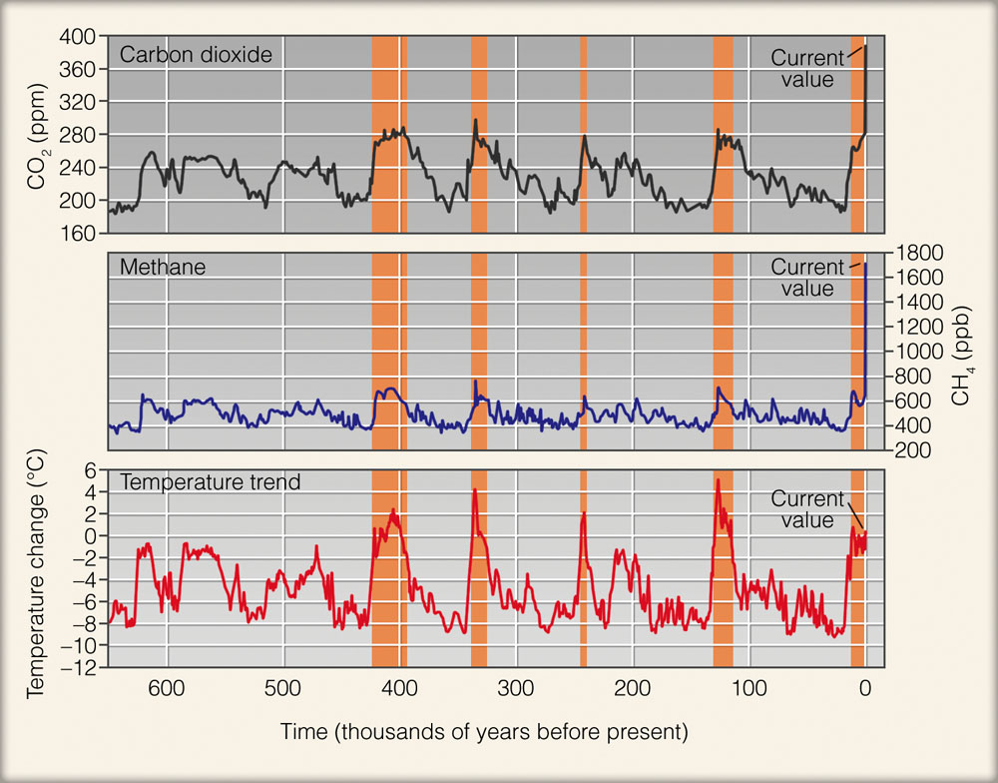
Essentials of Meteorology, Ahrens, 6th Edition
Notes:
Figure 13.12: Variations of carbon dioxide (top, ppm), methane (middle, ppb), and temperatures (bottom, °C). Concentrations of gases are derived from air bubbles trapped within the ice sheets of Antarctica and extracted from ice cores. Temperatures are derived from the analysis of oxygen isotopes. The shaded orange band indicates current and previous interglacial warm periods. (Note: ppm represents parts per million by volume, and ppb represents parts per billion by volume.) (Adopted from the Technical Summary by the Working Group 1 contribution to the Fourth Assessment Report to the IPCC, 2007.)

Slide 17
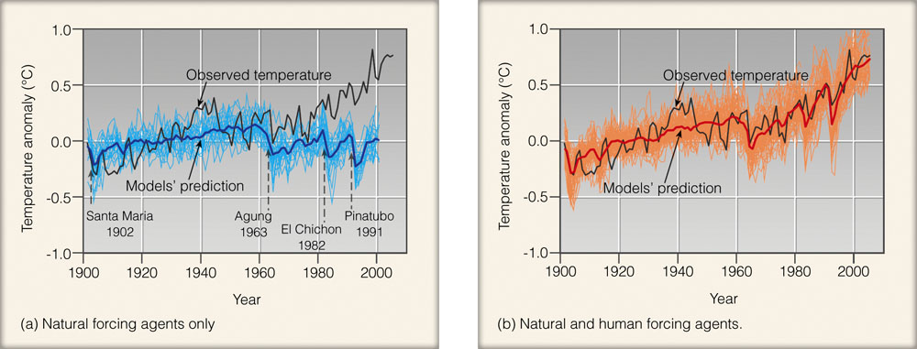
Climate change
Essentials of Meteorology, Ahrens, 6th Edition
Notes:
Figure 13.16: (a) Projected global surface air temperature changes using only natural forcing agents (dark blue line) compared to observed global surface air temperature changes (gray line). Light blue lines show range of model simulations. (Names and dates of major volcanic eruptions are given at the bottom of the graph.) (b) Projected global surface air temperature changes using both natural and human forcing agents (dark red line) compared to observed global surface air temperature changes (gray line). Orange lines show range of model simulations. (Temperature changes in both (a) and (b) are relative to the period 1901 to 1950.) (Adopted from the Technical Summary by the Working Group 1 contribution to the Fourth Assessment Report to the IPCC, 2007.)

Slide 18
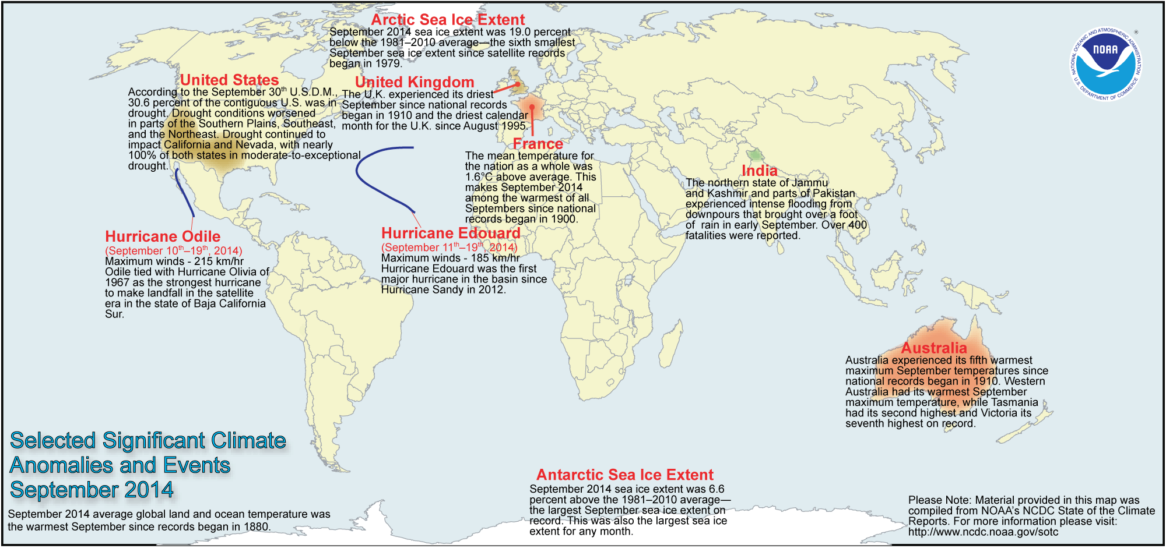
Weather extremes
NOAA’s “State of the Climate” publication – September 2014
http://www.ncdc.noaa.gov/sotc/global/2014/9

Slide 19
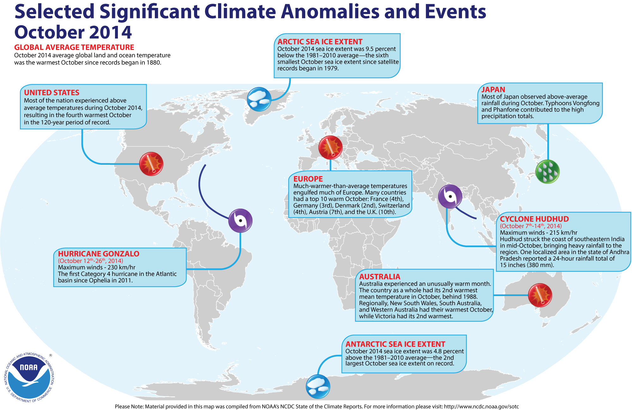
Weather extremes
NOAA’s “State of the Climate” publication
http://www.ncdc.noaa.gov/sotc/global/2014/9

Slide 20
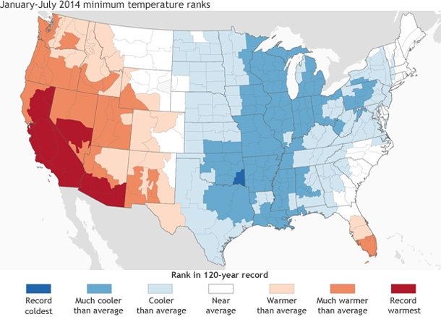
Weather extremes
http://www.climate.gov/news-features/event-tracker/2014-temperature-extremes-us-runs-hot-and-cold

Slide 21
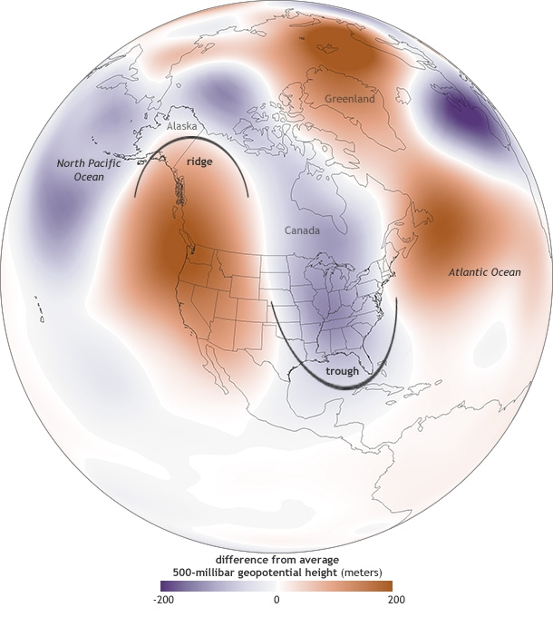
Weather extremes
Mid-Troposphere
Difference from average pressure at 500 millibar (mb) pressure level January 14-21, 2014
http://www.climate.gov/news-features/event-tracker/us-temperature-extremes-and-polar-jet-stream

Slide 22
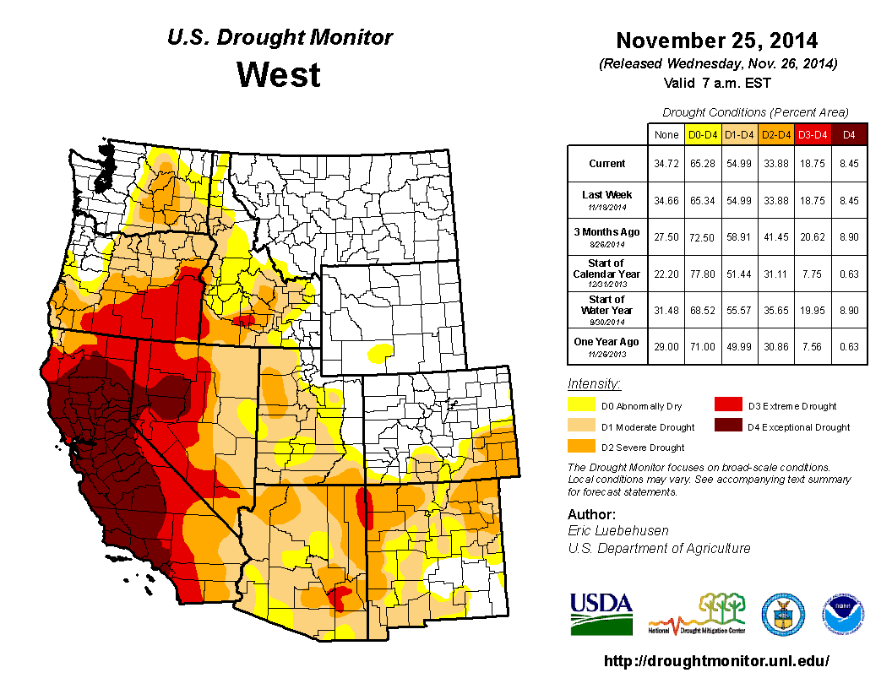
Weather extremes
http://droughtmonitor.unl.edu/

Slide 23
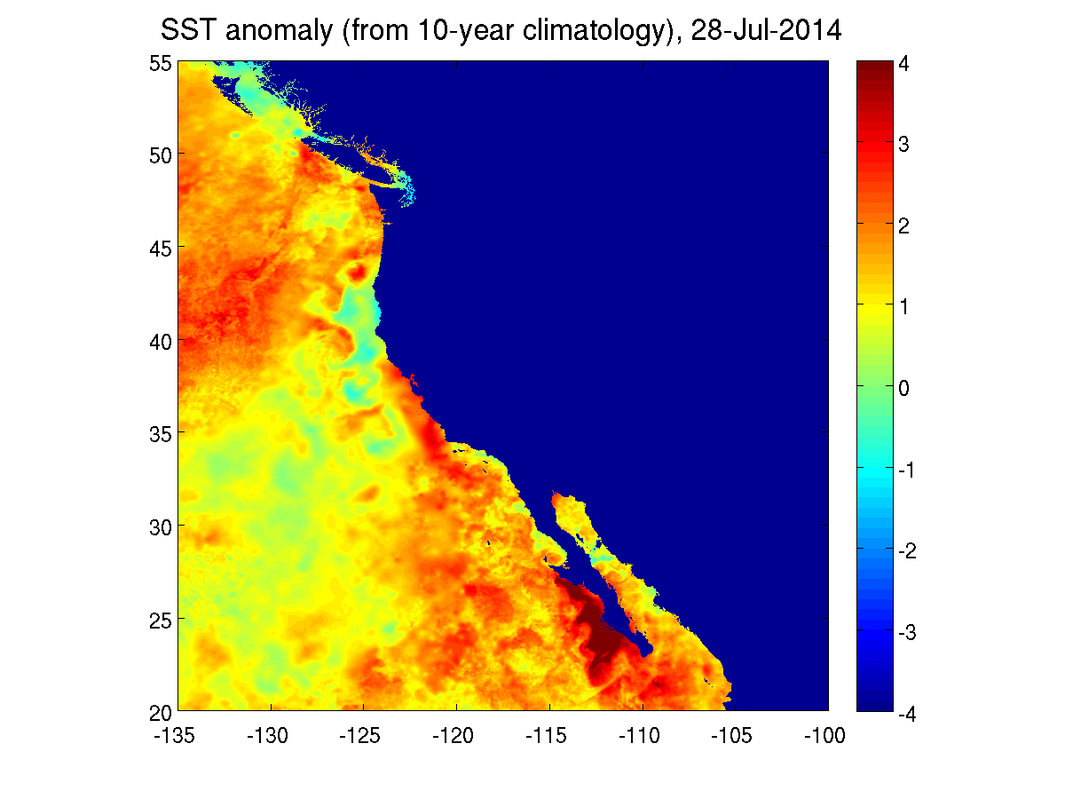
Weather extremes
http://podaac.jpl.nasa.gov/OceanEvents/2014_09_04_CaliforniaCoast_warming

Slide 24
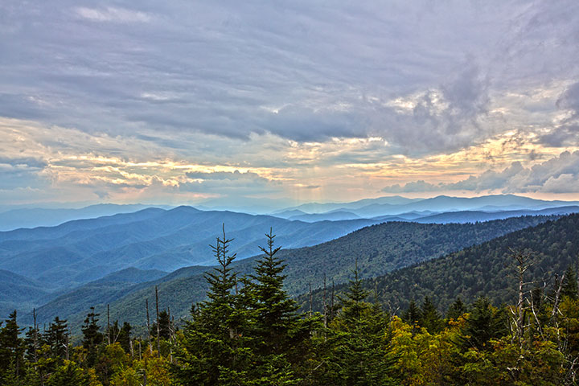
Warm season
http://www.city-data.com/forum/attachments/western-north-carolina/101706d1348832930-western-nc-official-photo-thread-s75a0327-edit.jpg

Slide 25
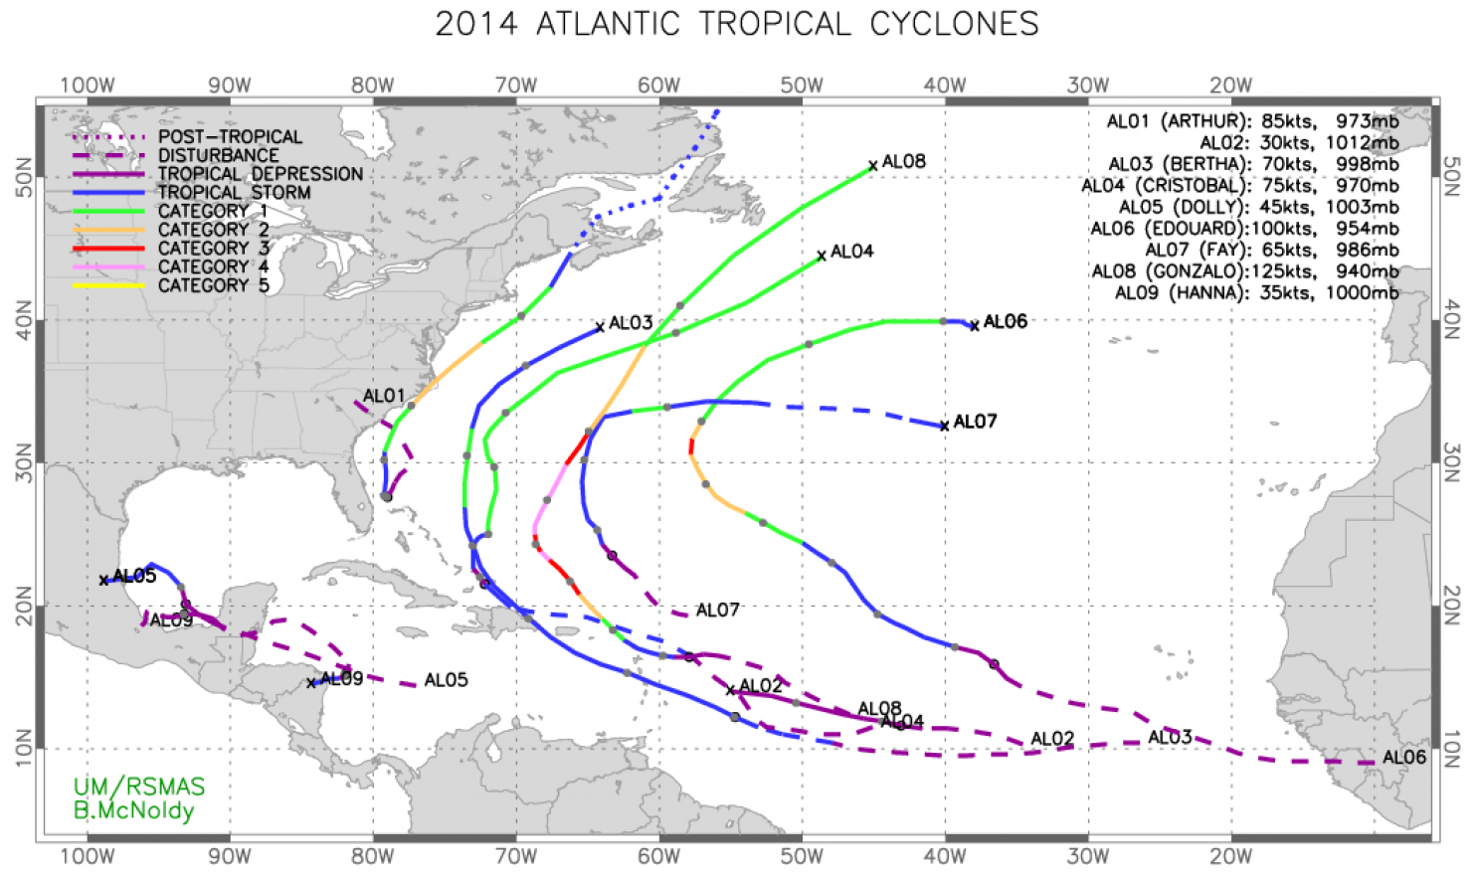
2014 hurricane season
Atlantic Ocean basin…
Year | Named | Hurricanes | Major
Average | 12.1 | 6.4 | 2.7
2014 | 8 | 6 | 2
http://www.washingtonpost.com/blogs/capital-weather-gang/wp/2014/12/01/unprecedented-lull-in-major-hurricane-landfalls-continues-as-atlantic-season-comes-to-a-close/
http://en.wikipedia.org/wiki/2014_Atlantic_hurricane_season

Slide 26
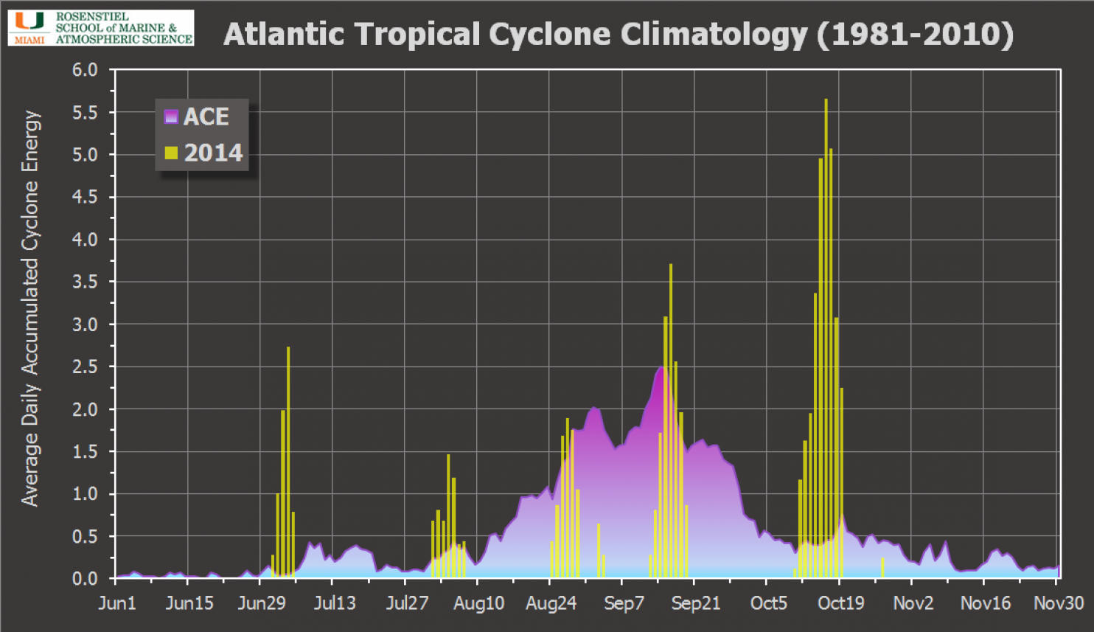
2014 hurricane season
Atlantic Ocean basin…
2014; Total ACE was 62 % of a normal season
http://www.washingtonpost.com/blogs/capital-weather-gang/wp/2014/12/01/unprecedented-lull-in-major-hurricane-landfalls-continues-as-atlantic-season-comes-to-a-close/
Notes:
The ACE index is a wind energy index, defined as the sum of the squares of the maximum sustained surface wind speed (knots) measured every six hours for all named storms while they are at least tropical storm strength.

Slide 27
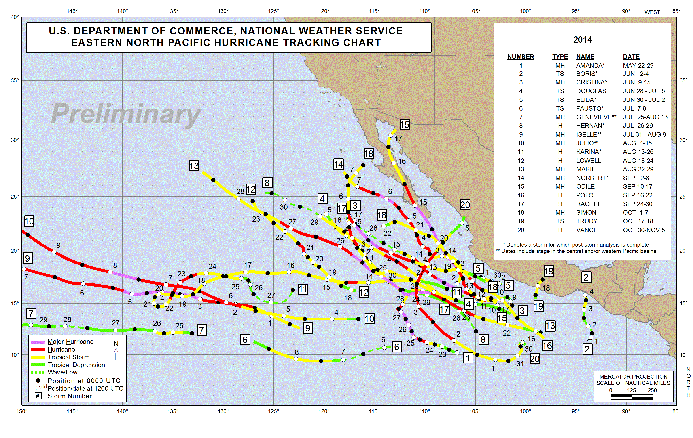
2014 hurricane season
E. Pacific Ocean basin…
Year | Named | Hurricanes | Major
Average | 15.4 | 7.6 | 3.2
2014 | 22 | 16 | 9
http://www.nhc.noaa.gov/data/tcr/index.php?season=2014&basin=epac
http://en.wikipedia.org/wiki/2014_Pacific_hurricane_season

Slide 28
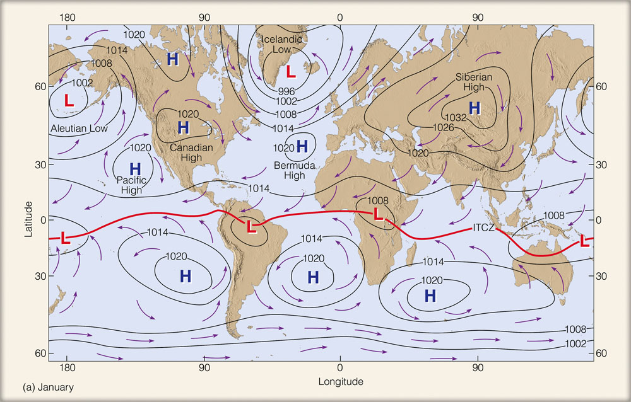
  El Niño, La Niña
Essentials of Meteorology, Ahrens, 6th Edition

Slide 29
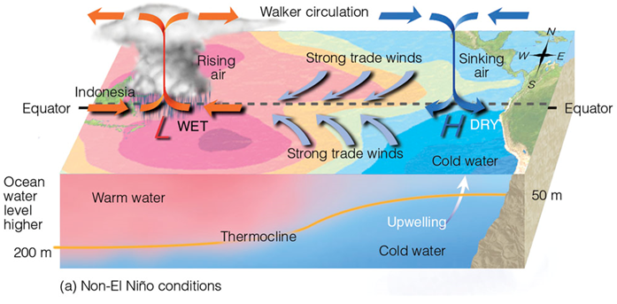
  El Niño, La Niña
Essentials of Meteorology, Ahrens, 6th Edition

Slide 30
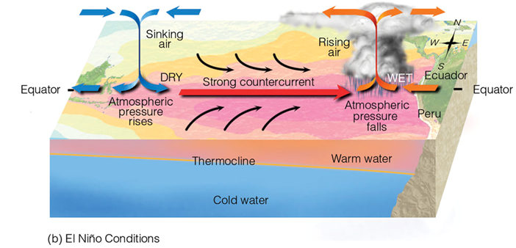
  El Niño, La Niña
Essentials of Meteorology, Ahrens, 6th Edition

Slide 31
  El Niño, La Niña
Essentials of Meteorology, Ahrens, 6th Edition

Slide 32
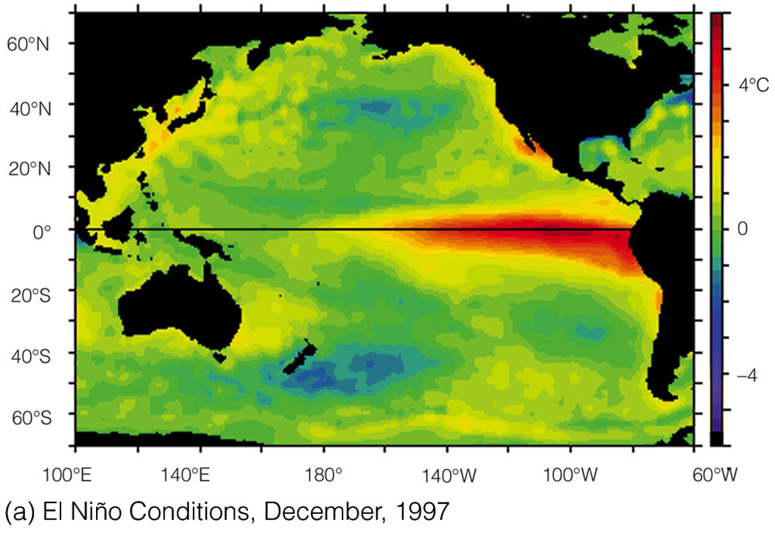
  El Niño, La Niña
Essentials of Meteorology, Ahrens, 6th Edition

Slide 33
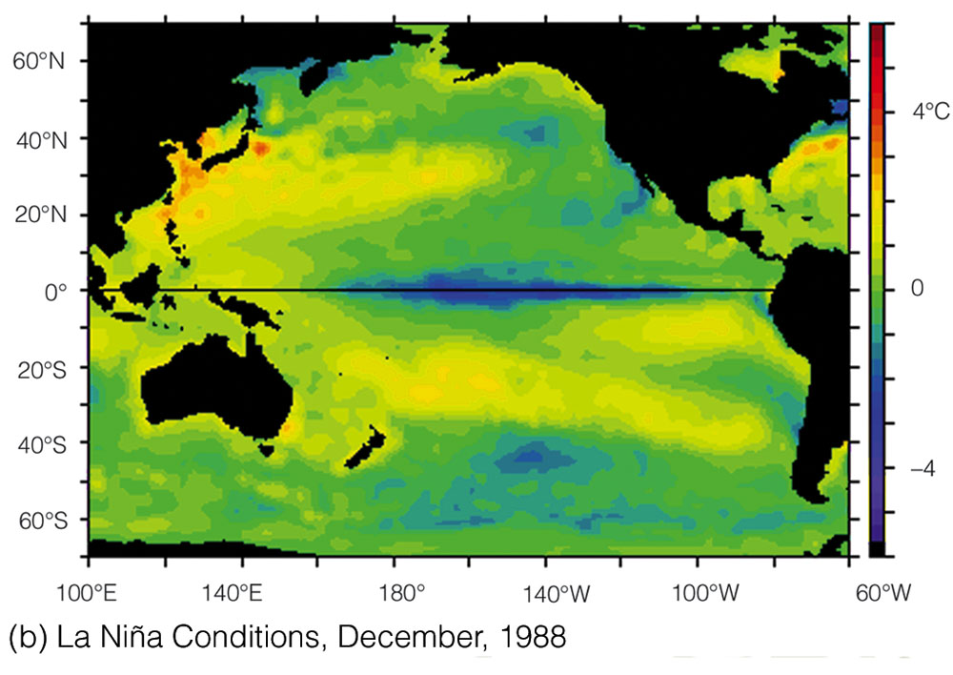
  El Niño, La Niña
Essentials of Meteorology, Ahrens, 6th Edition

Slide 34
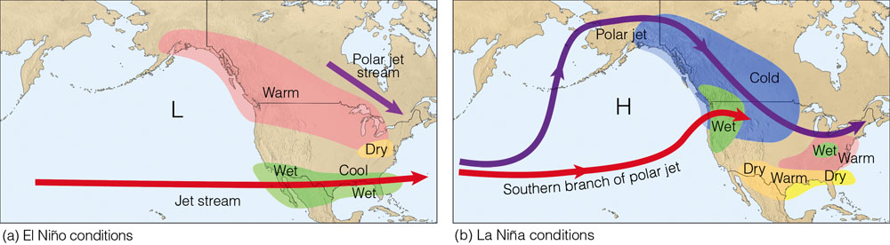
  El Niño, La Niña
Essentials of Meteorology, Ahrens, 6th Edition

Slide 35
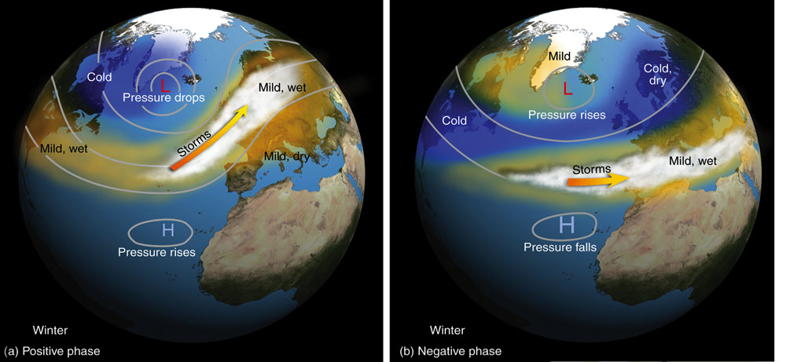
  El Niño, La Niña
Other oscillations have an impact on our winter…
North Atlantic Oscillation
Essentials of Meteorology, Ahrens, 6th Edition

Slide 36
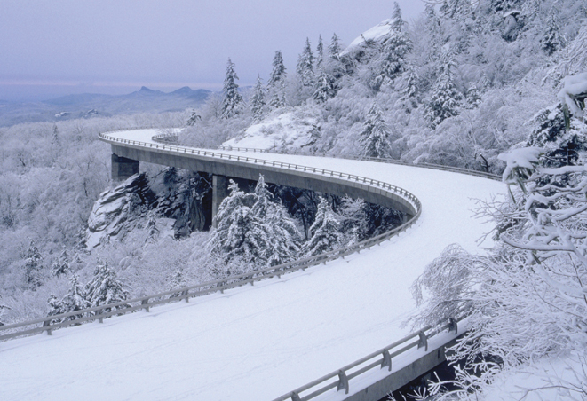
Cool season
http://www.hcpress.com/img/viaduct-8.jpg

Slide 37
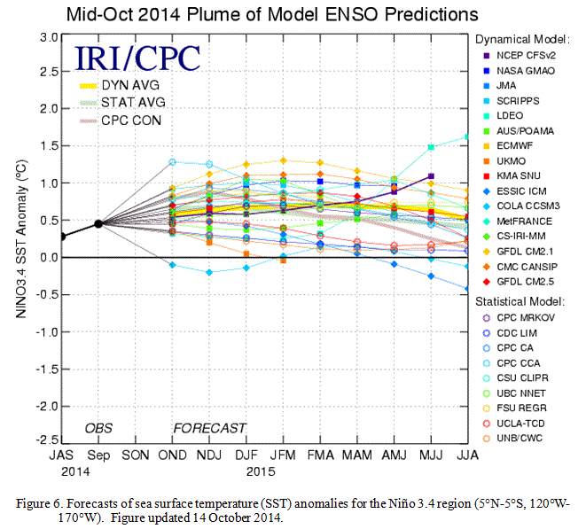
2014, 2015 seasonal outlook
El Niño predictions for this winter…
http://www.cpc.noaa.gov/products/analysis_monitoring/enso_advisory/ensodisc.html

Slide 38
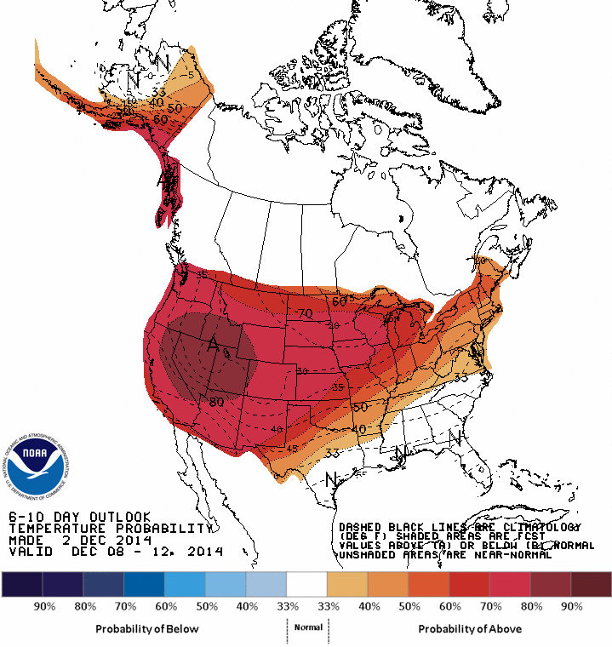
2014, 2015 seasonal outlook
Climate Prediction Center’s 6 – 10 day outlook…
Temperature
http://www.cpc.ncep.noaa.gov/products/predictions/610day/

Slide 39
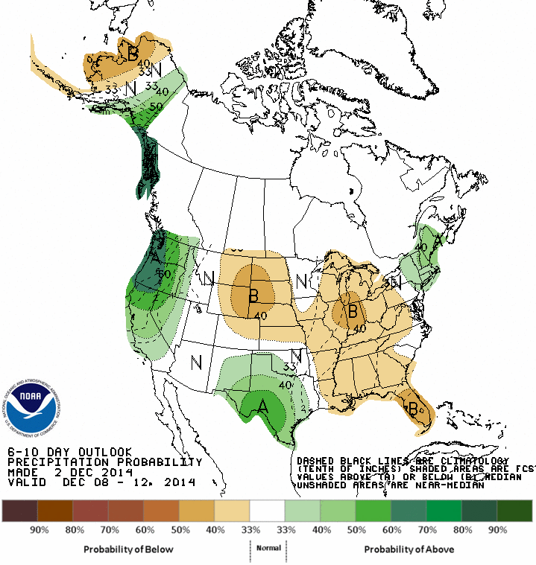
2014, 2015 seasonal outlook
Climate Prediction Center’s 6 – 10 day outlook…
Precipitation
http://www.cpc.ncep.noaa.gov/products/predictions/610day/

Slide 40
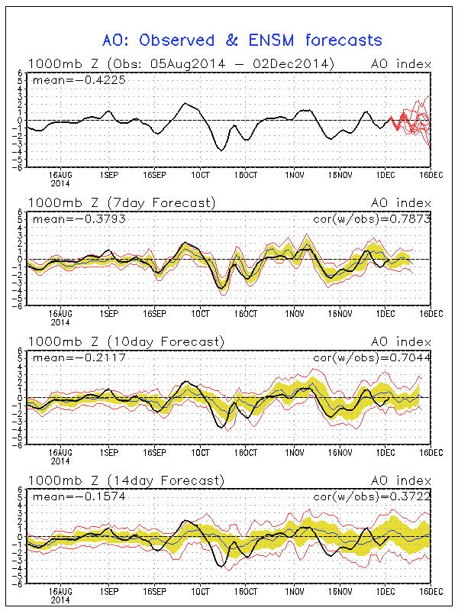
2014, 2015 seasonal outlook
NAO-related predictions for this month…
http://www.cpc.ncep.noaa.gov/products/precip/CWlink/daily_ao_index/ao_index_ensm.shtml

Slide 41
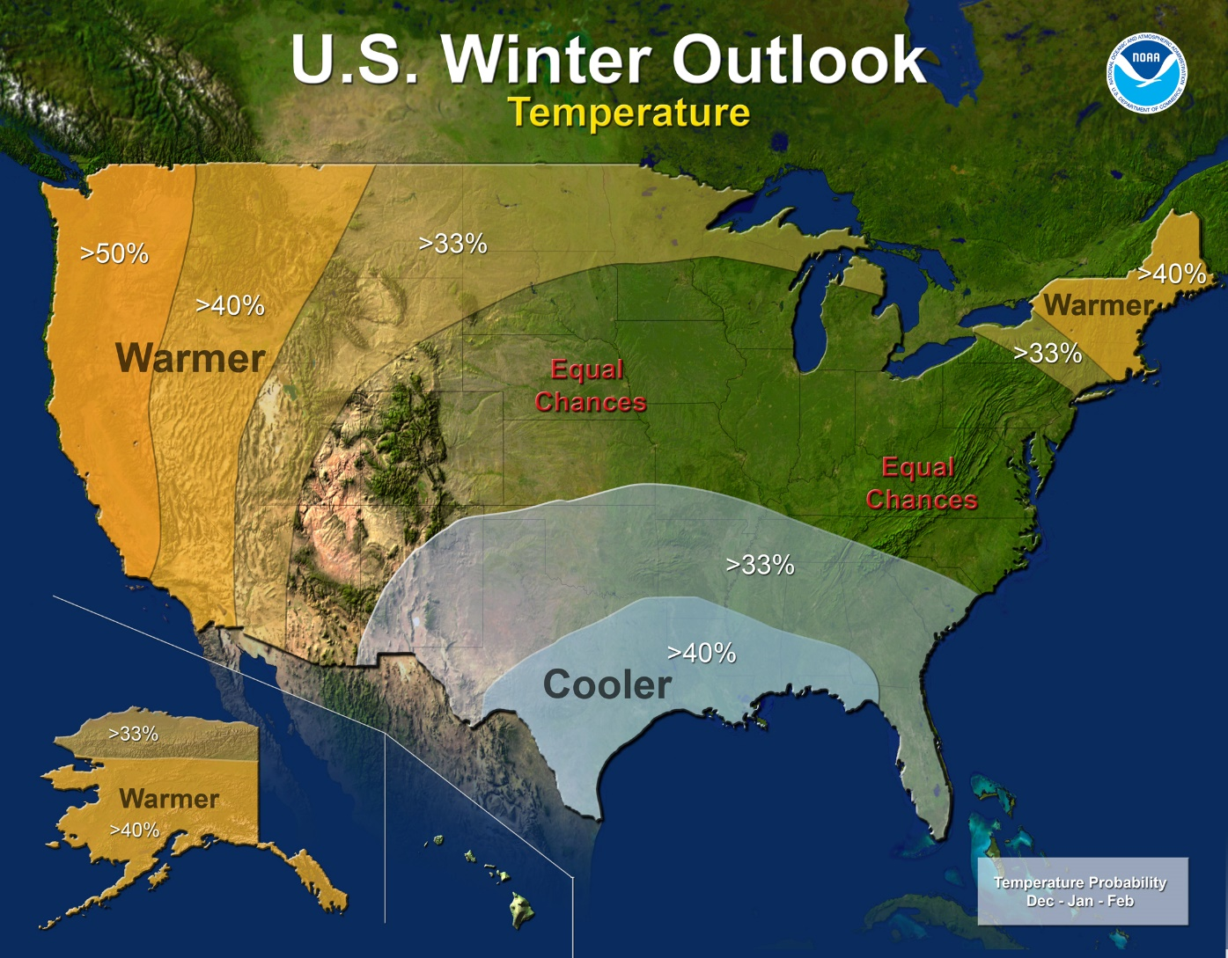
2014, 2015 seasonal outlook
NOAA…
http://www.noaanews.noaa.gov/stories2014/20141016_winteroutlook.html

Slide 42
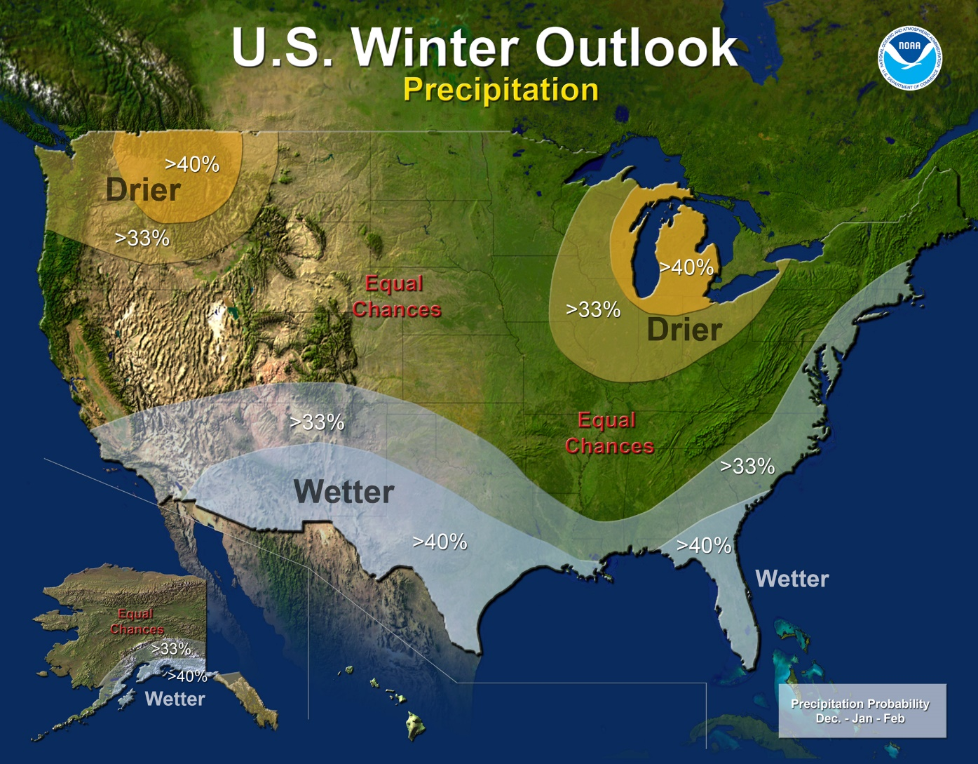
2014, 2015 seasonal outlook
NOAA…
http://www.noaanews.noaa.gov/stories2014/20141016_winteroutlook.html

Slide 43
Polar vortex, Omega block
A planetary-scale mid- to high-latitude circumpolar cyclonic circulation, extending from the middle troposphere to the stratosphere. The Northern Hemisphere vortex often features two centers—one near Baffin Island and the other over northeast Siberia—with analogous circumpolar asymmetry atypical in the Southern Hemisphere. The westerly airflow is largely a manifestation of the thermal wind above the polar frontal zone of middle and subpolar latitudes. The vortex is strongest during the winter in the upper troposphere and stratosphere when the pole-to-equator temperature gradient is strongest. The stratosphere component of the circulation may be referred to separately as the “polar stratospheric vortex.” In summer, the strongest westerly circulation is largely confined to the troposphere, and the polar stratospheric vortex reverses in the upper stratosphere because of solar heating during the polar day.
http://glossary.ametsoc.org/wiki/Main_Page

Slide 44
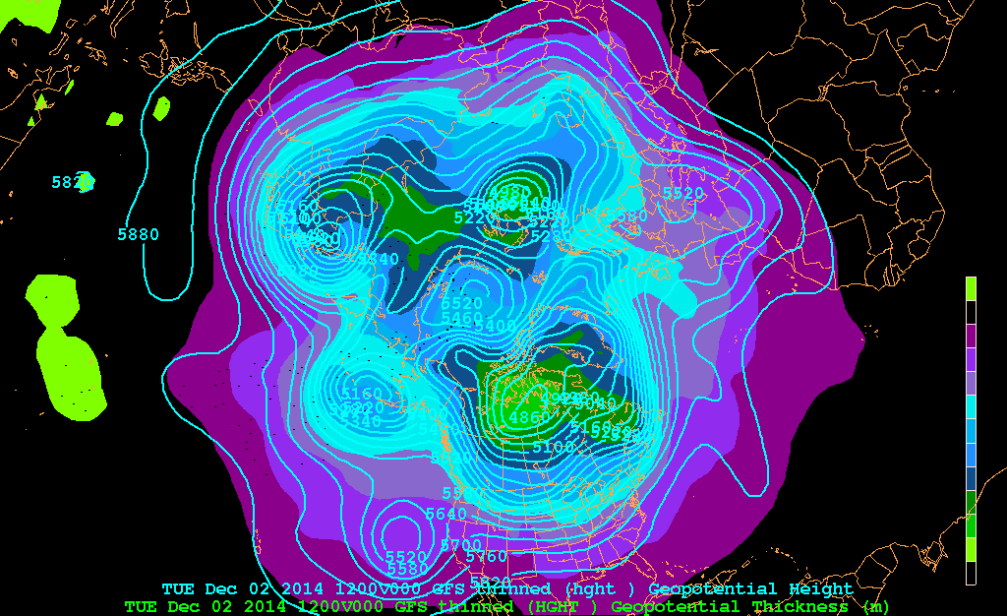
Polar vortex, Omega block
2 – 5 December 2014
Essentials of Meteorology, Ahrens, 6th Edition

Slide 45
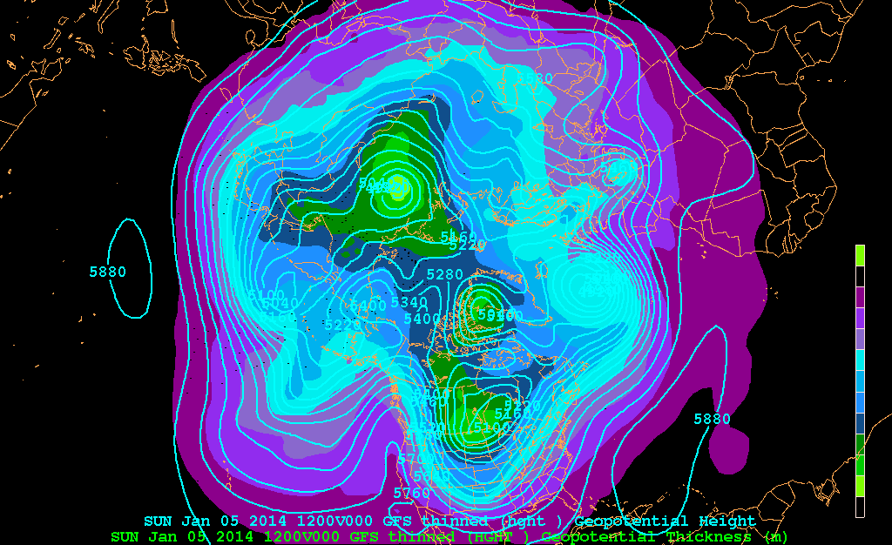
Polar vortex, Omega block
5 – 8 January 2014
Essentials of Meteorology, Ahrens, 6th Edition

Slide 46
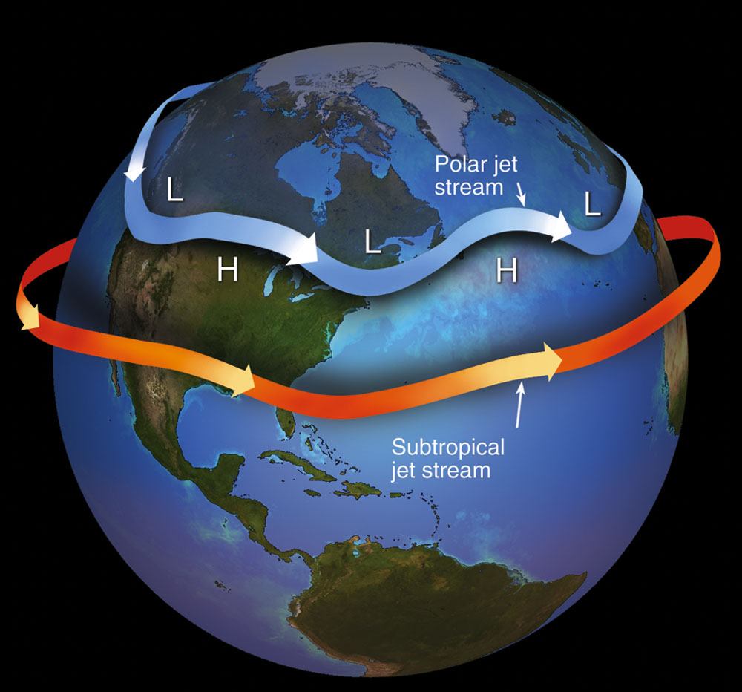
Polar vortex, Omega block
Polar vortex – climate change connection?
Essentials of Meteorology, Ahrens, 6th Edition
http://www.washingtonpost.com/blogs/wonkblog/wp/2014/11/20/theres-growing-evidence-that-global-warming-is-driving-crazy-winters/

Slide 47
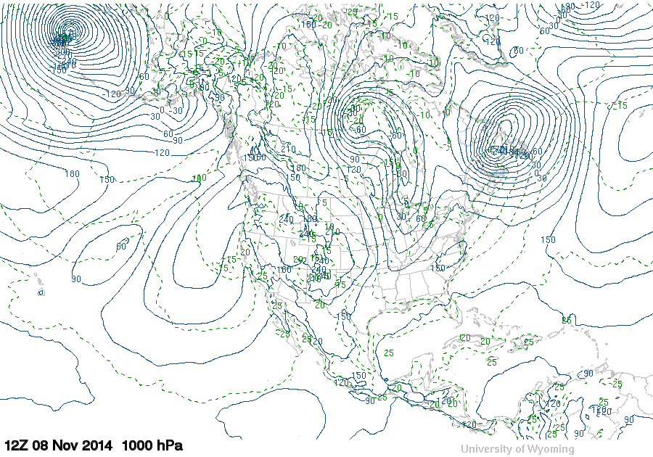
Polar vortex, Omega block
Remnants of Typhoon Nuri
http://weather.uwyo.edu/upperair/uamap.html

Slide 48
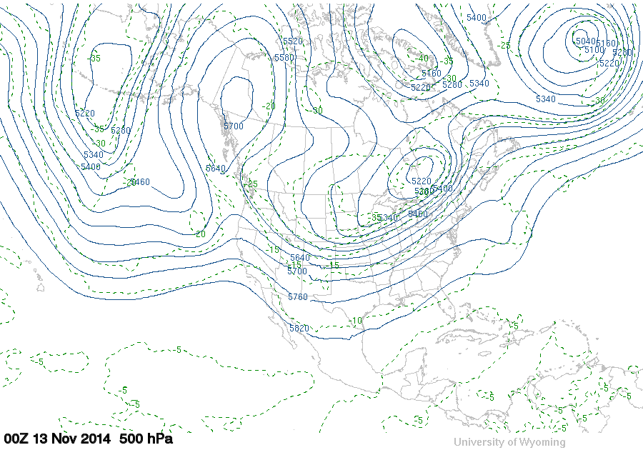
Polar vortex, Omega block
Mid-Troposphere
Ω
http://weather.uwyo.edu/upperair/uamap.html

Slide 49

Polar vortex, Omega block
Mid-Troposphere
http://weather.uwyo.edu/upperair/uamap.html

Slide 50
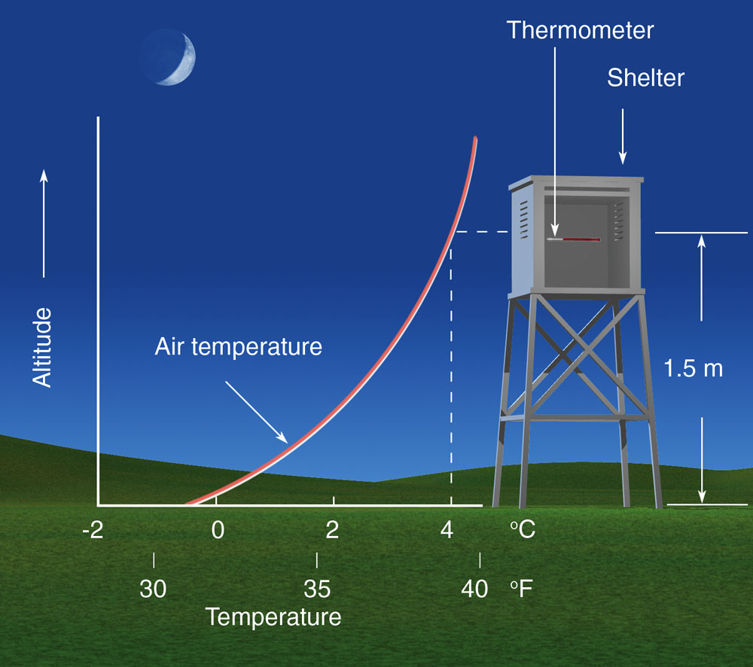
Inversions
surface (radiational)
Essentials of Meteorology, Ahrens, 6th Edition

Slide 51
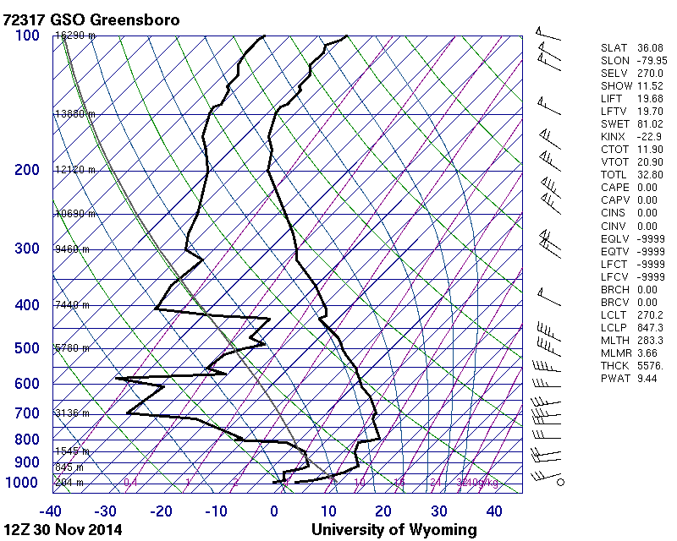
Inversions
surface (radiational)
http://weather.uwyo.edu/upperair/sounding.html

Slide 52
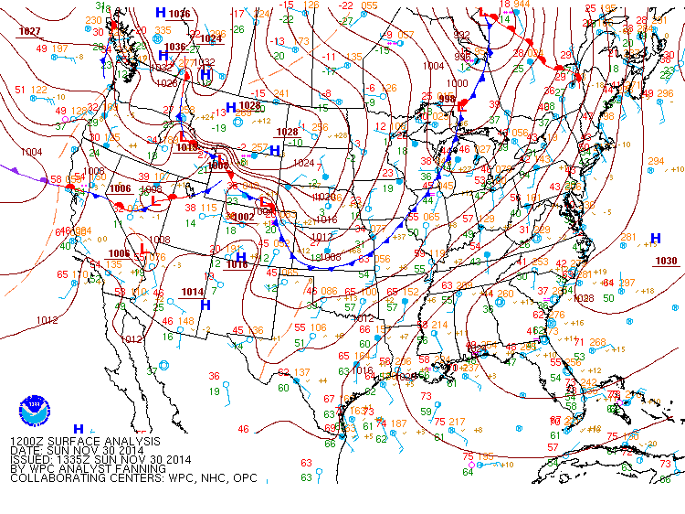
Inversions
http://www.hpc.ncep.noaa.gov/archives/web_pages/sfc/sfc_archive.php

Slide 53
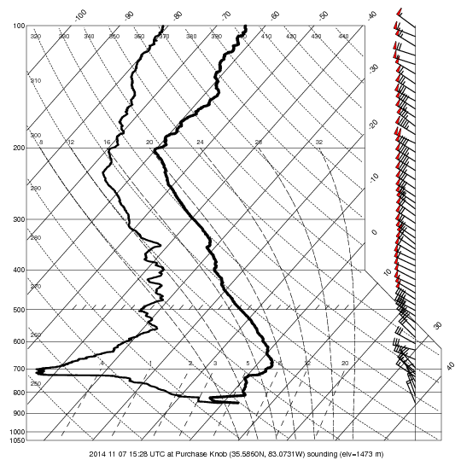
Inversions
subsidence
Purchase Knob, 7 November 2014, 11:30 am EST

Slide 54
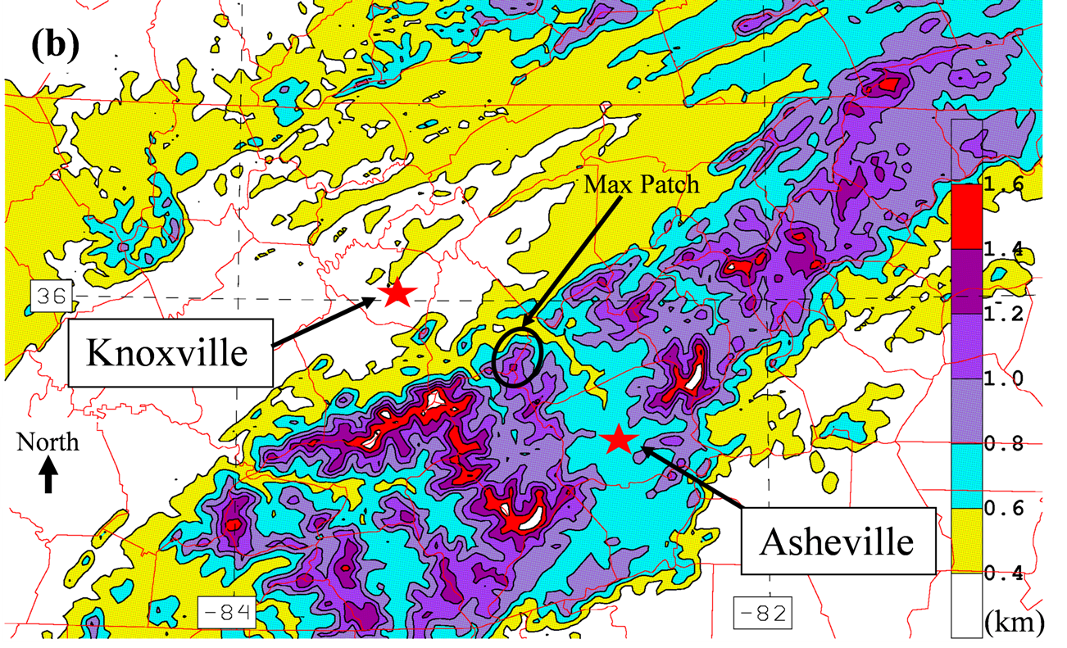
8 weather sources, 8 different weather forecasts
Miller, WaF, 2012

Slide 55
8 weather sources, 8 different weather forecasts
Why do we see so many different forecasts?
  Everyone has access to the same information, but it seems every forecast is different, especially during the winter months.
Answer
(1) does source have local weather expertise?
(2) which weather “animal” is driving the weather-of-the-day?

Slide 56
8 weather sources, 8 different weather forecasts
Answer
(1) does source have local weather expertise?
(2) which weather “animal” is driving the weather-of-the-day?
[i] planetary scale → forecast consistency
[ii] local scale → forecast inconsistency

Slide 57
8 weather sources, 8 different weather forecasts
Answer
(2) which weather “animal” is driving the weather-of-the-day?
[i] planetary scale → forecast consistency*
[ii] local scale → forecast inconsistency
*there are exceptions to [i] (last week)

Slide 58
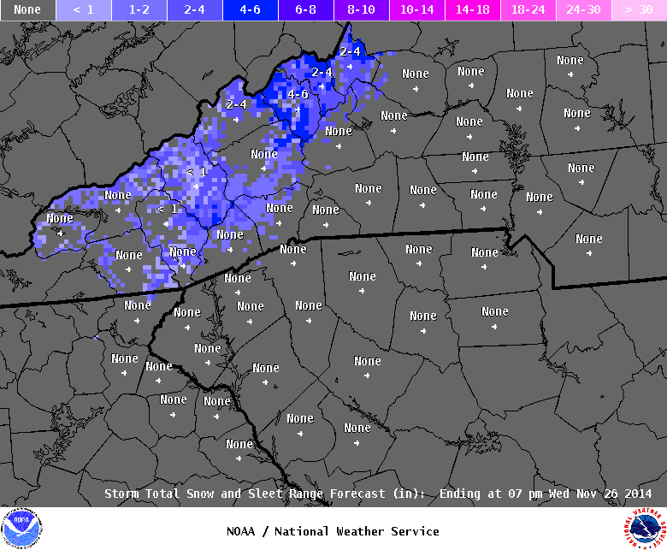
8 weather sources, 8 different weather forecasts
NWS snow forecast ending 7:00 pm EST 26 Nov 2014

Slide 59
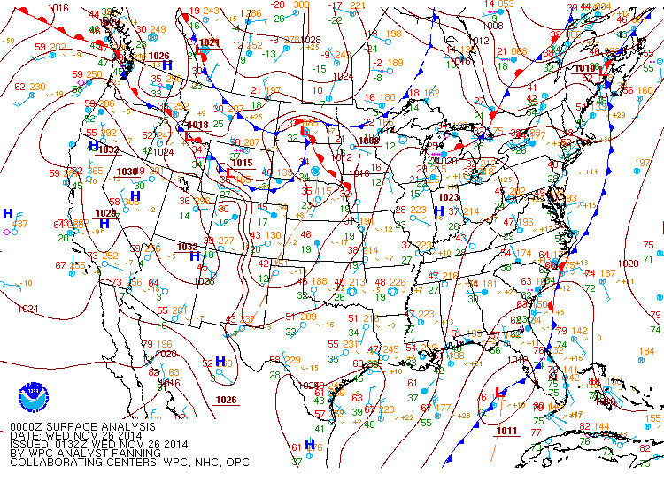
8 weather sources, 8 different weather forecasts
7:00 pm EST 25 Nov – 7:00 am EST 27 Nov 2014
http://www.hpc.ncep.noaa.gov/archives/web_pages/sfc/sfc_archive.php

Slide 60
8 weather sources, 8 different weather forecasts
7:00 pm EST 25 Nov – 7:00 am EST 27 Nov 2014
http://www.hpc.ncep.noaa.gov/archives/web_pages/sfc/sfc_archive.php

Slide 61

8 weather sources, 8 different weather forecasts
7:00 pm EST 25 Nov – 7:00 am EST 27 Nov 2014
http://www.hpc.ncep.noaa.gov/archives/web_pages/sfc/sfc_archive.php

Slide 62
8 weather sources, 8 different weather forecasts
Miller, WaF, 2012

Slide 63

8 weather sources, 8 different weather forecasts
7:00 pm EST 17 January 2013

Slide 64

8 weather sources, 8 different weather forecasts
1:00 pm EST 25 January 2013

Slide 65
The End
photo: D. Martin

Slide 66

Helpful weather resources
  Lead time from the event
    2 to 7 days
    0 to 2 days
    Now
Courtesy: D. Martin

Slide 67

Helpful weather resources
  2 to 7 day event lead time
  Climate Prediction Center 6-10 day outlook site
    http://www.cpc.ncep.noaa.gov/products/predictions/610day/
  NCEP computer weather model site
    http://mag.ncep.noaa.gov/
  Storm Prediction Center site
    http://www.spc.noaa.gov/
  National Hurricane Center site
    http://www.nhc.noaa.gov/
  Weather Prediction Center analysis site
    http://www.hpc.ncep.noaa.gov/
  National Weather Service forecast site
    http://www.weather.gov/

Slide 68
Helpful weather resources
  0 to 2 day event lead time
  NCEP computer weather model site
    http://mag.ncep.noaa.gov/
  Storm Prediction Center site
    http://www.spc.noaa.gov/
  National Hurricane Center site
    http://www.nhc.noaa.gov/

Slide 69
Helpful weather resources
  0 to 2 day event lead time
  Weather Prediction Center analysis site
    http://www.hpc.ncep.noaa.gov/
  National Weather Service forecast site
    http://www.weather.gov/
  Short Range Ensemble plume diagrams
    http://www.spc.noaa.gov/exper/sref/fplumes/index.php?YMD=20140127&RT=09&PRM=Total-SNO&SID=AVL&INC=ALL&NNC=&max=&min=&mZOOM=7&mLAT=35.58110839297158&mLON=-81.53716719970703&mTYP=roadmap

Slide 70
Helpful weather resources
  Now
  National Weather Service forecast site
    http://www.weather.gov/
  Regional WSR88D radar mosaic
    http://radar.weather.gov/Conus/full_loop.php
  Regional observations
    http://weather.rap.ucar.edu/
  Local mesonet observations
    http://preview.weather.gov/edd/

