Slide 1
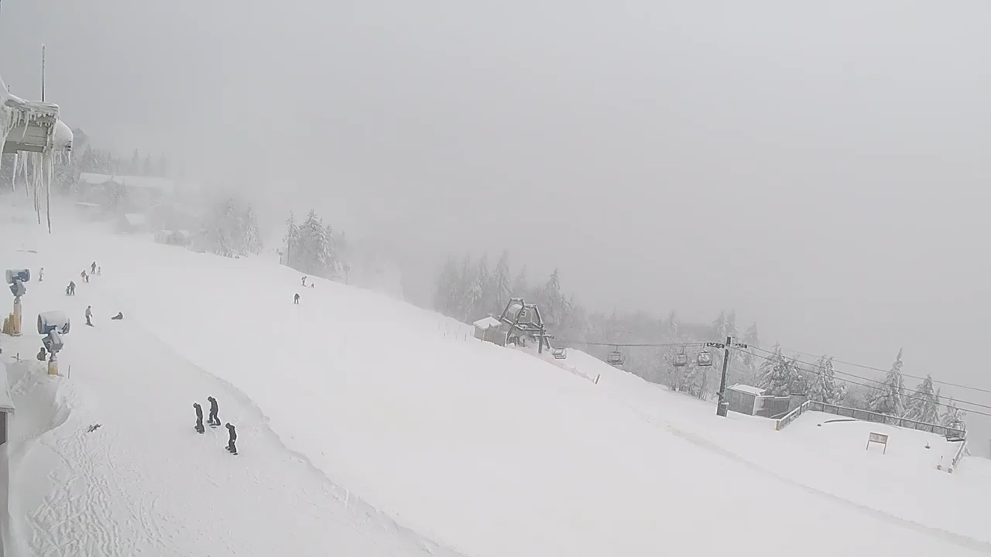
Mountain Weather – 8 January 2025;
Appalachian Mountains, WV and PA
Snowshoe, WV
https://www.snowshoemtn.com/media-room/skidder-slope-live-cam

Slide 2
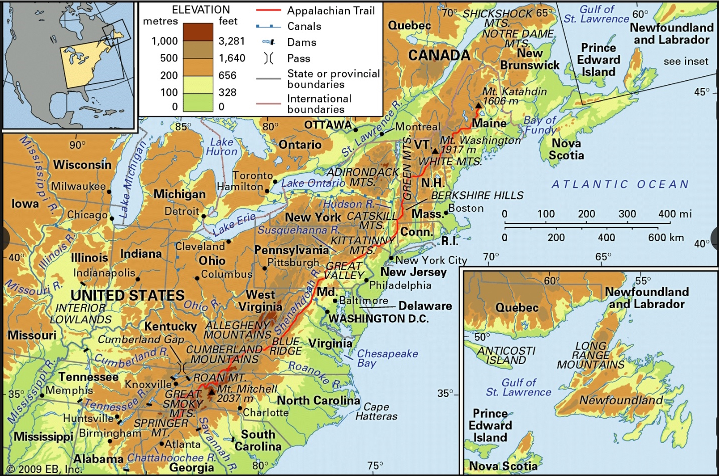
Appalachian Mountains
https://www.britannica.com/place/Appalachian-Mountains

Slide 3
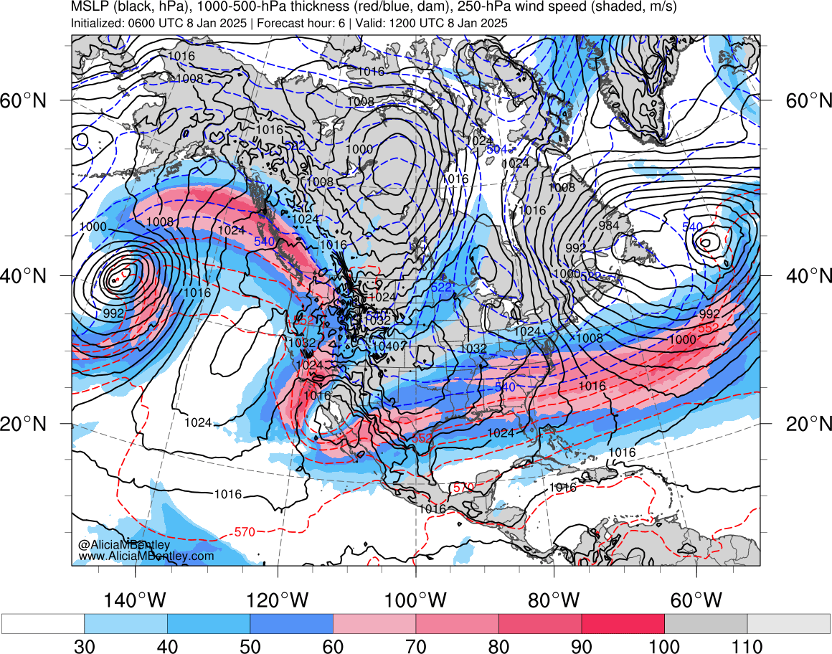
https://www.atmos.albany.edu/student/abentley/realtime/standard.php?domain=northamer&variable=mslp_jet

Slide 4
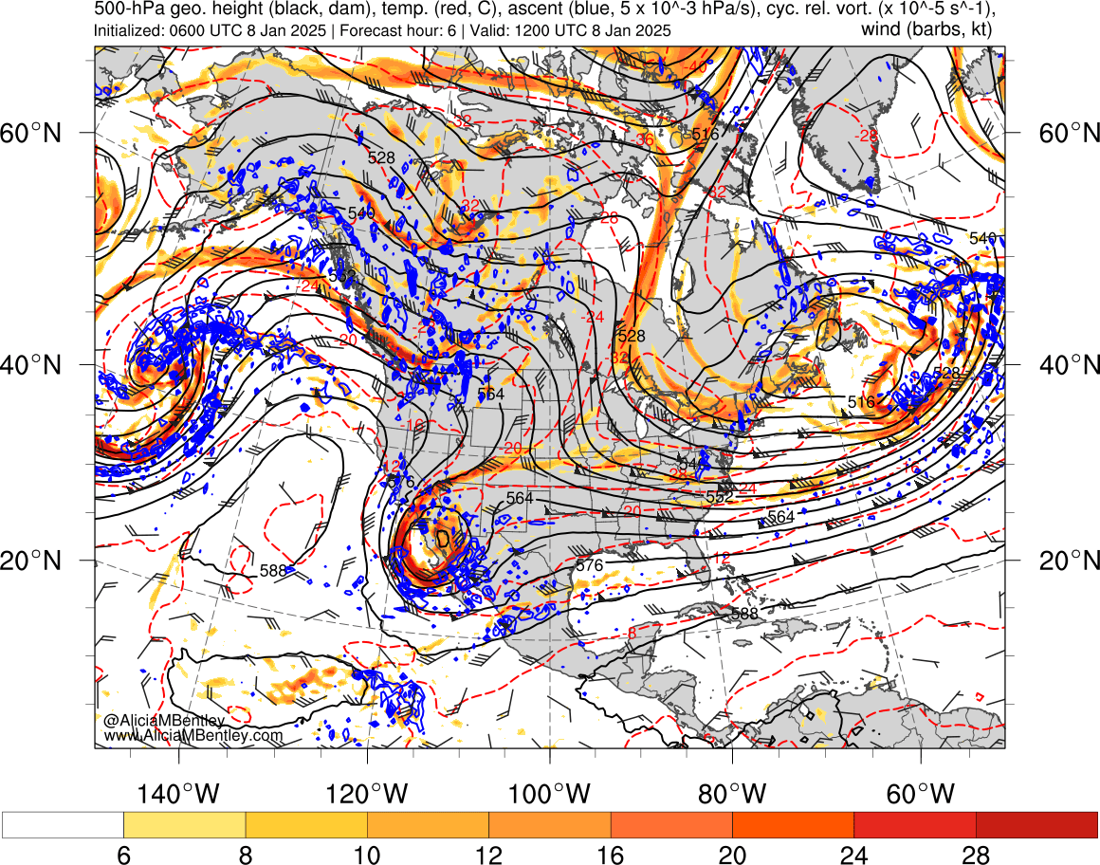
https://www.atmos.albany.edu/student/abentley/realtime/standard.php?domain=northamer&variable=mslp_jet

Slide 5
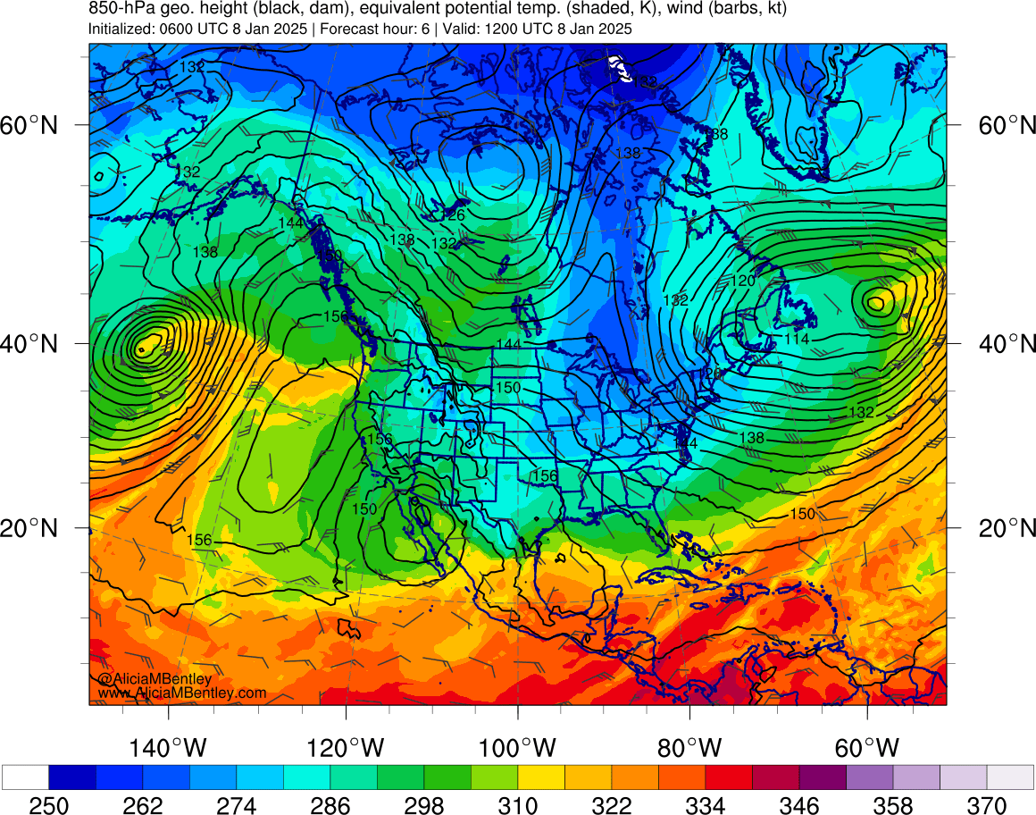
https://www.atmos.albany.edu/student/abentley/realtime/standard.php?domain=northamer&variable=mslp_jet

Slide 6
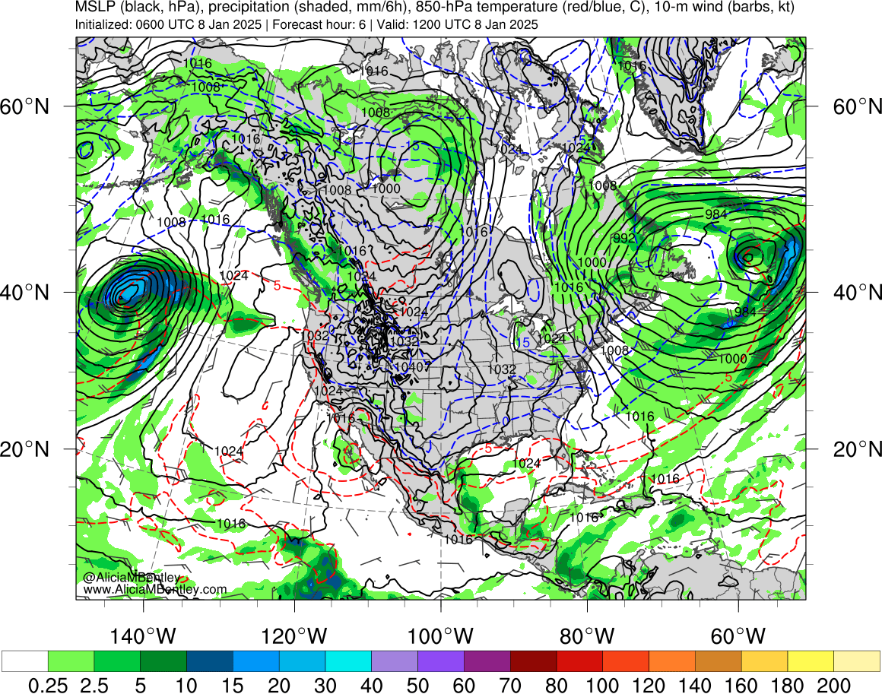
https://www.atmos.albany.edu/student/abentley/realtime/standard.php?domain=northamer&variable=mslp_jet

Slide 7
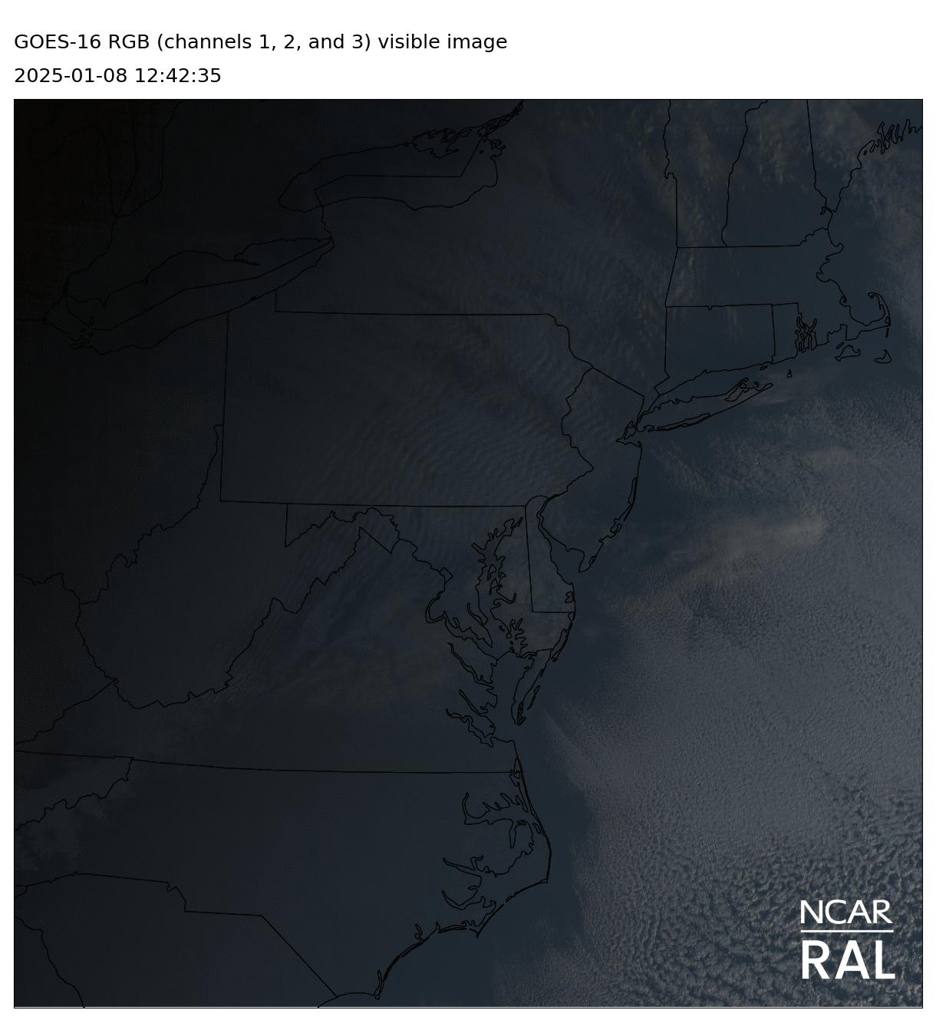
Visible satellite loop
https://weather.ral.ucar.edu/

Slide 8
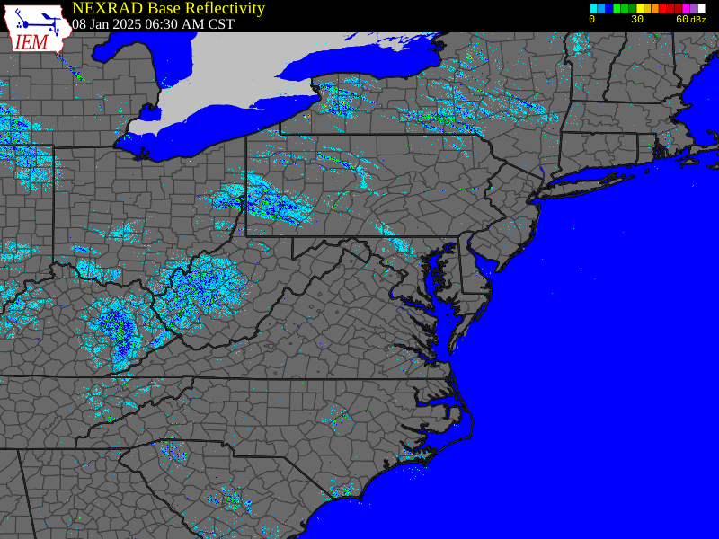
WSR-88D composite – east coast
http://www2.mmm.ucar.edu/imagearchive/

Slide 9
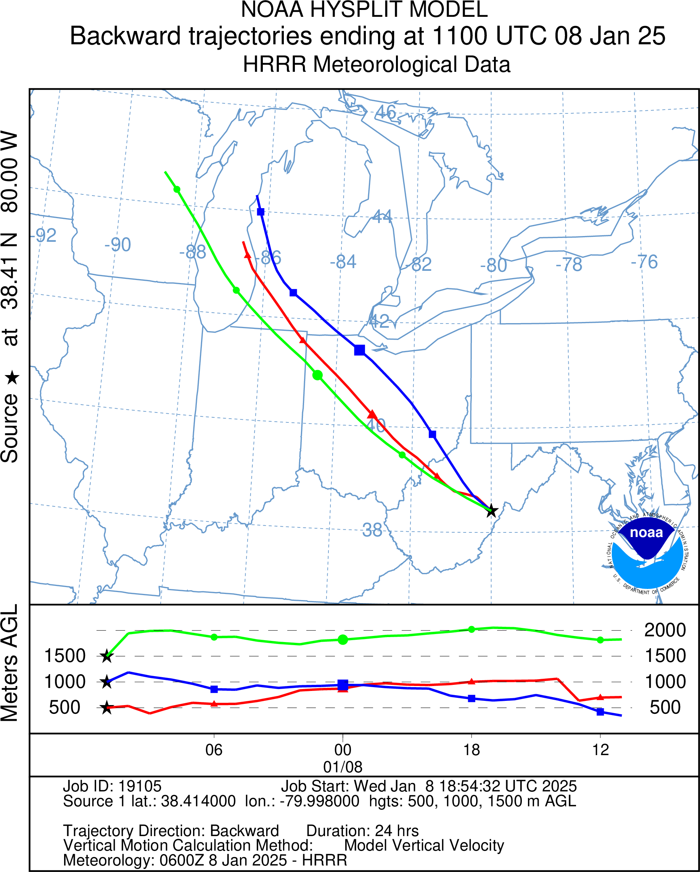
HYSPLIT Trajectory – Snowshoe, WV
https://www.ready.noaa.gov/hypub-bin/trajtype.pl?runtype=archive

Slide 10
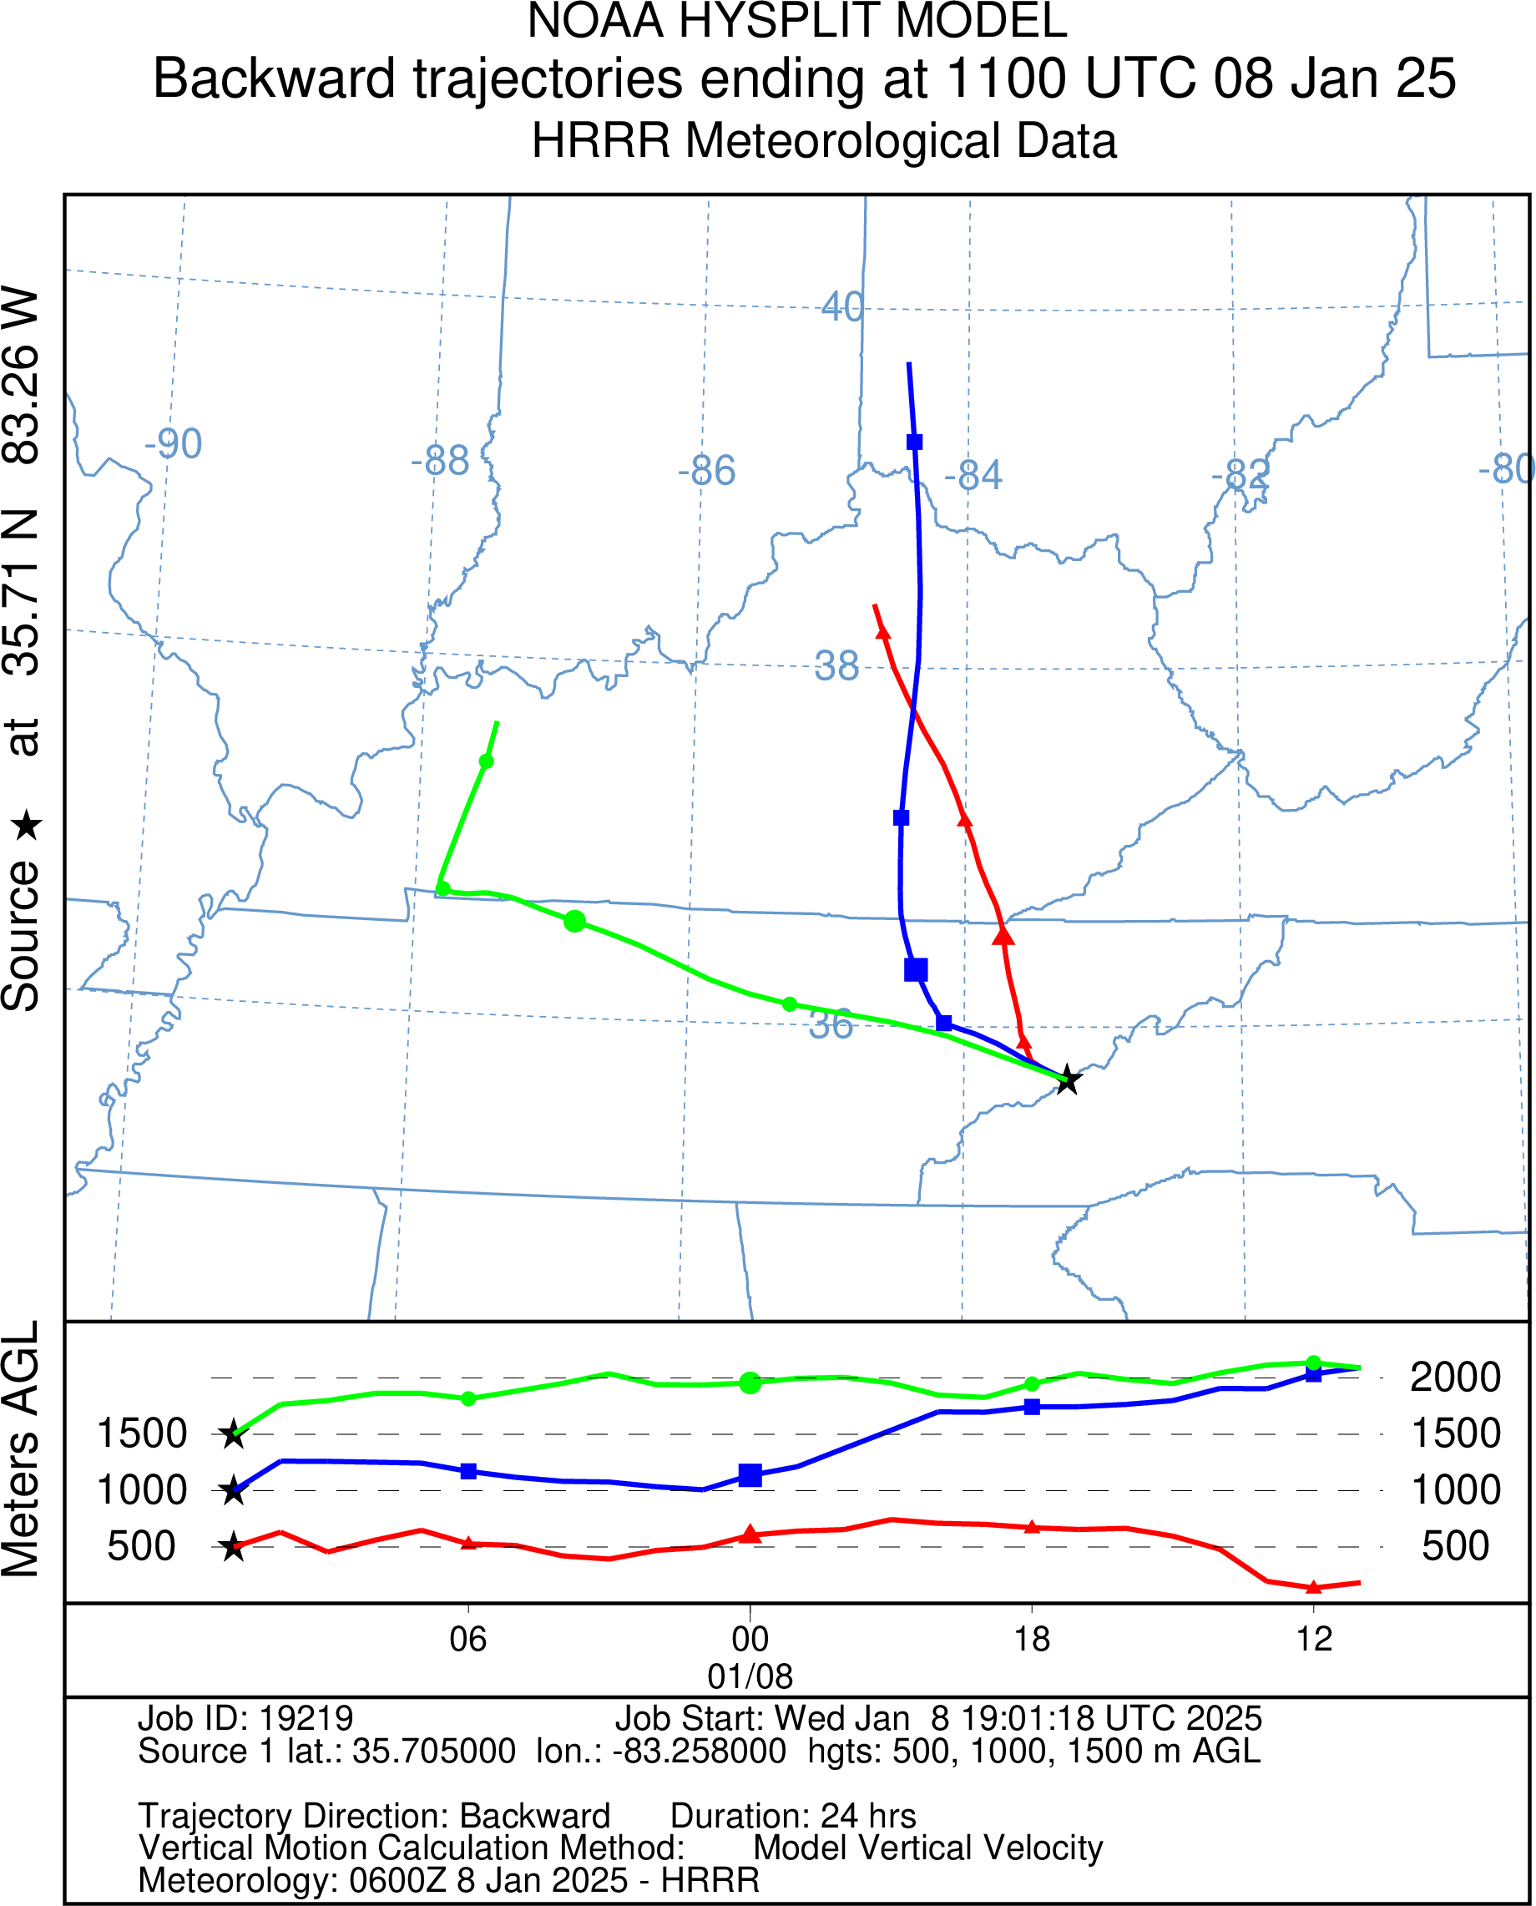
HYSPLIT Trajectory – Mt. Guyot, GSMNP
https://www.ready.noaa.gov/hypub-bin/trajtype.pl?runtype=archive

