Slide 1
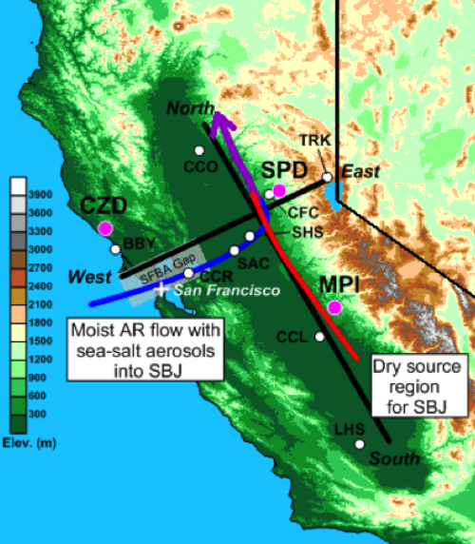
Mountain Weather – 22 January 2017;
Northern Sierra Nevada Mountains
https://www.esrl.noaa.gov/psd/news/2015/img/sierra-nevada-gap.png

Slide 2
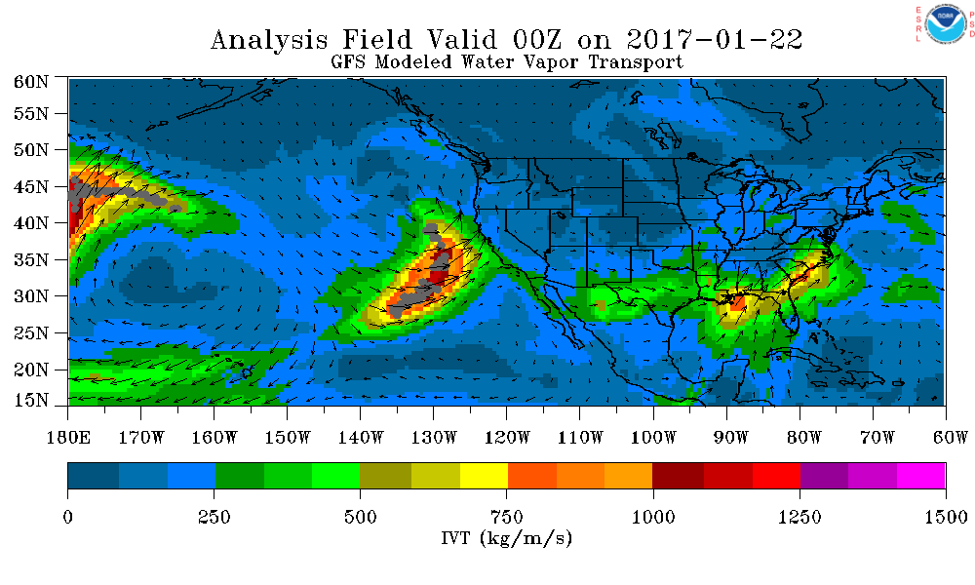
GFS Analysis – Atmospheric River ‘locator’
https://www.esrl.noaa.gov/psd/psd2/coastal/satres/data/html/ardt_gfs.php

Slide 3
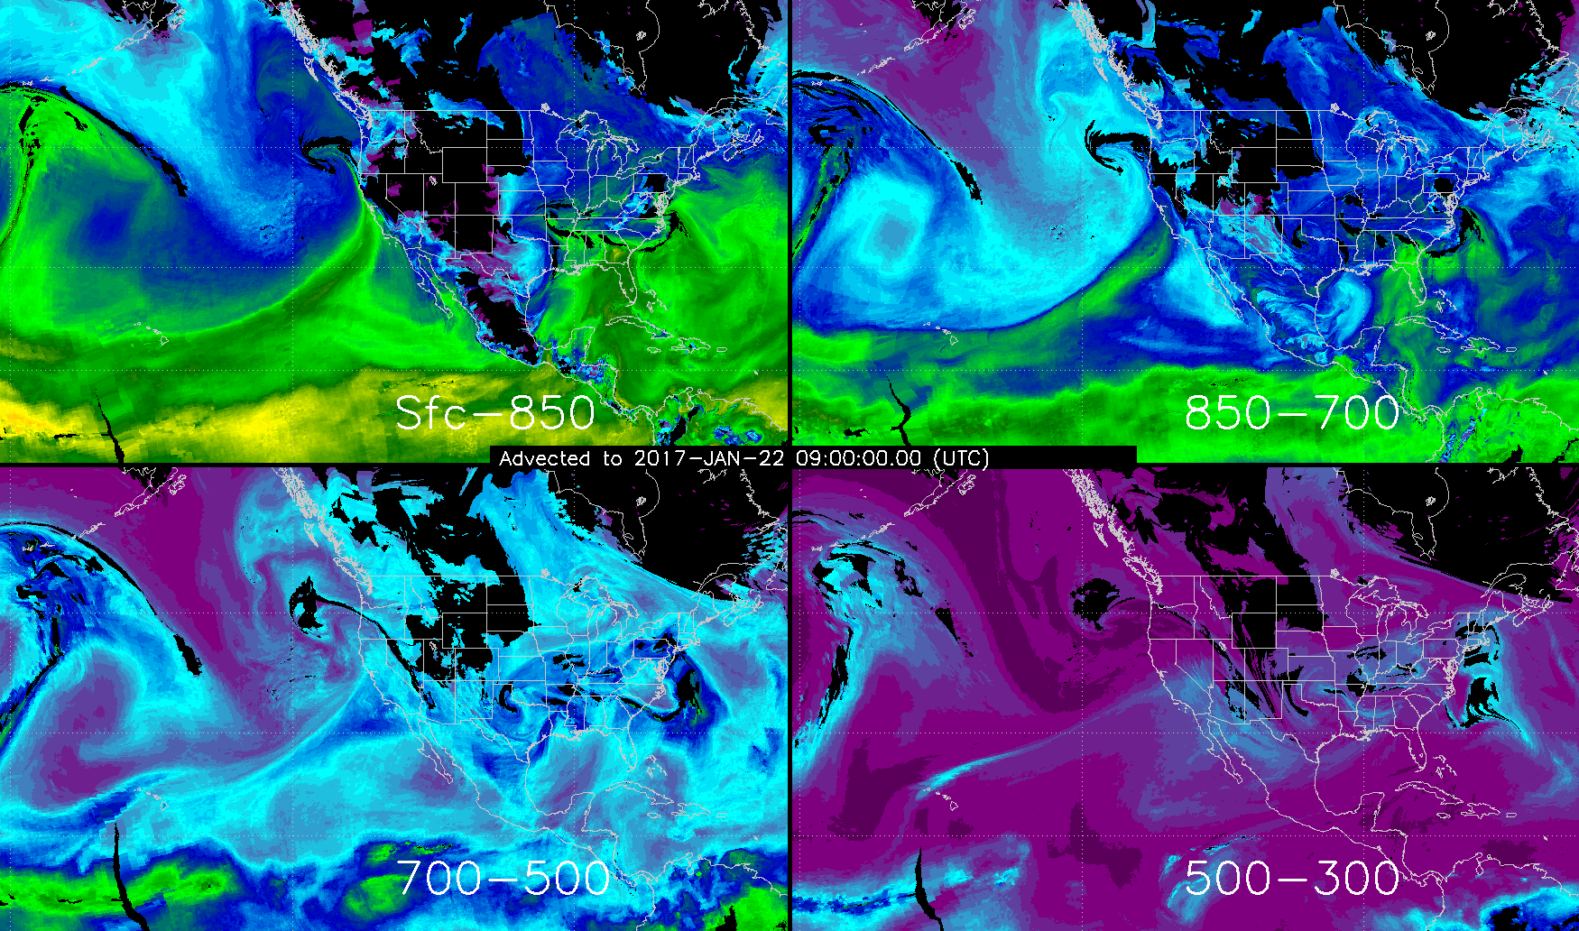
Layered PW (mm) – satellite observations
http://cat.cira.colostate.edu/sport/layered/advected/lpw.htm

Slide 4
Sacramento- NWS Prediction
FXUS66 KSTO 220630
AFDSTO
Area Forecast Discussion
National Weather Service Sacramento CA
1030 PM PST Sat Jan 21 2017
.Discussion (Today through Tuesday)...
Satellite imagery showing next Pacific frontal system and
associated atmospheric river approaching. Blended TPW indicating
1 to 1.4 inches along baroclinic zone. Models suggest widespread
precip spreading into the CWA after about 03z tonight. Strong
cyclogenesis progged off the southern Oregon coast tonight with
10-12 mb NW-SE surface pressure gradient between KMFR-KSAC over
Interior NorCal. Wind speeds increase this evening and become
windy after 06z tonight throughout most of the Sacramento/Northern
San Joaquin Valley. Southerly wind of 25 to 40 mph with gusts 50
to 60 mph. Some isolated spots my reach into lower end high wind
warning criteria. Wind will be strong enough in some areas to
possibly down trees and cause power outages. Moderate to heavy
rain forecast overnight with heavy snow in the mountains. Snow
levels 3000 to 4000 feet overnight.
http://www.wrh.noaa.gov/total_forecast/getprod.php?wfo=sto&pil=AFD&sid=STO&version=4

Slide 5
Sacramento- NWS Prediction
FXUS66 KSTO 220630
AFDSTO
Area Forecast Discussion
National Weather Service Sacramento CA
1030 PM PST Sat Jan 21 2017 [continued…]
Front pushes south of the forecast area Sunday morning, then
vertically stacked system off the Oregon coast drops southward
offshore and fills through Monday. This will continue valley
showers and mountain snow. Cold air aloft will steepen lapse rates
and increase potential for thunderstorms Sunday and Monday,
mainly in the afternoon. 500 mb temps of -28 to -32 deg C support
potential for small hail with thunderstorms. Shear profiles show
strong helicity and potential for rotating storms. Guidance
indicating wind speeds decrease Sunday morning with fropa, but
remain breezy through Sunday evening. Snow levels lower Monday
into the 2000 to 3000 ft elevation with some accumulations
possible into the foothills.
Storm total QPF looks to be about 1 to 2 inches in the Central
Valley, 2 to 5 inches in the foothills with 2 to 4 feet of snow
above 4000 feet, locally higher amounts. Decreasing showers
Monday night into Tuesday morning then drier northerly flow
develops as subsidence increase over NorCal.
PCH
http://www.wrh.noaa.gov/total_forecast/getprod.php?wfo=sto&pil=AFD&sid=STO&version=4

Slide 6
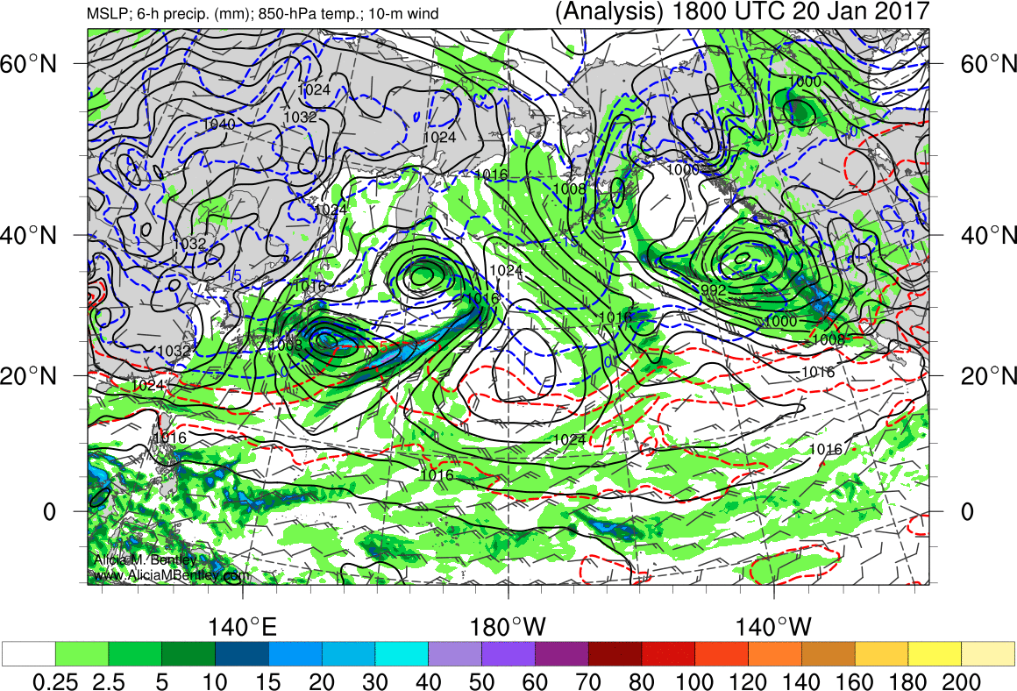
WRF – ARW computer model prediction
SLP (hPa), 3-hr Acc Precip, 1000-500 mb Thickness
27-hr forecast valid 0900 UTC 20 Jan 2011, (1:00 am PST)
http://www.atmos.albany.edu/student/abentley/realtime/pacific.php

Slide 7
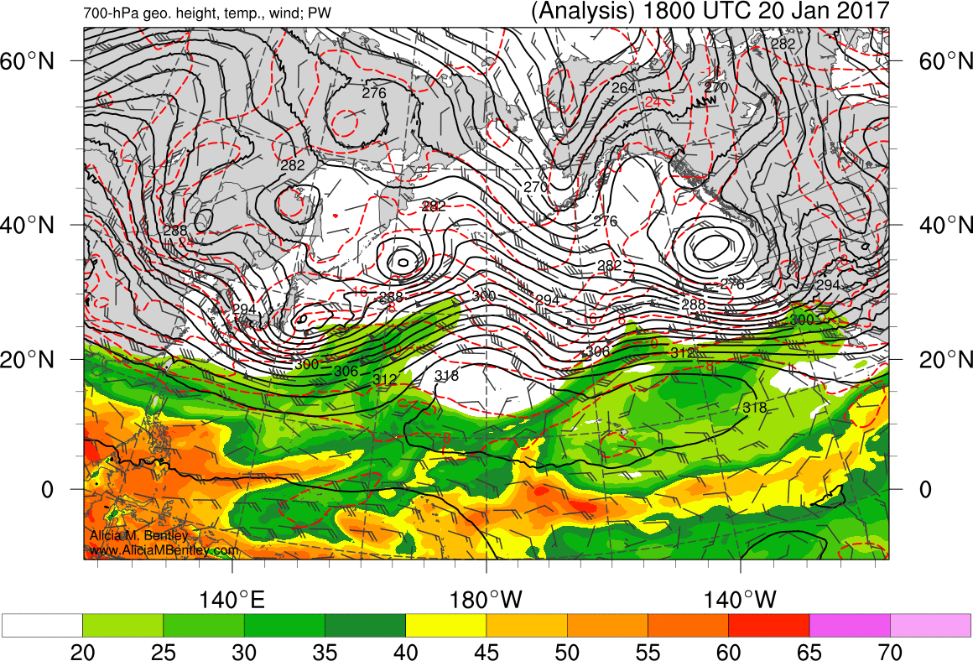
WRF – ARW computer model prediction
SLP (hPa), 3-hr Acc Precip, 1000-500 mb Thickness
27-hr forecast valid 0900 UTC 20 Jan 2011, (1:00 am PST)
http://www.atmos.albany.edu/student/abentley/realtime/pacific.php

Slide 8
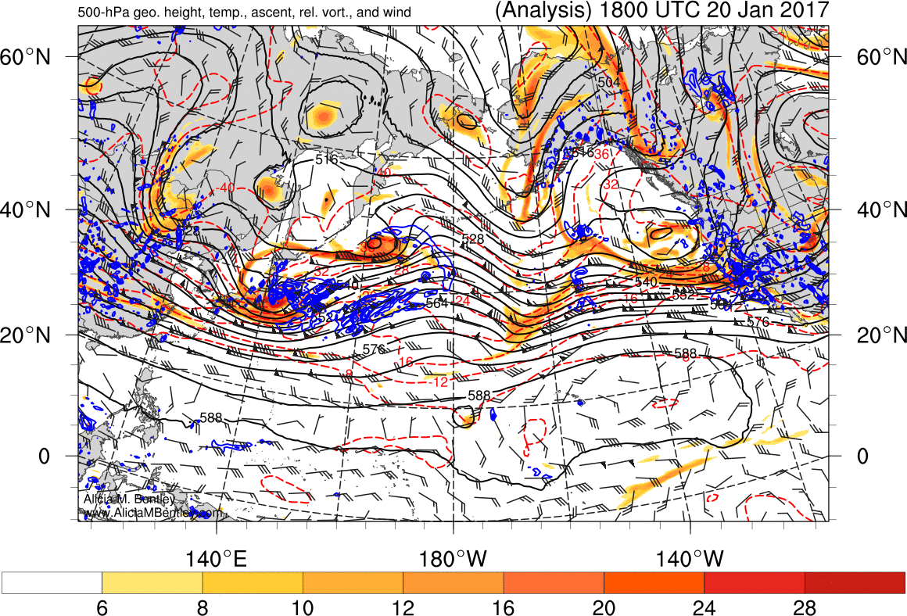
WRF – ARW computer model prediction
SLP (hPa), 3-hr Acc Precip, 1000-500 mb Thickness
27-hr forecast valid 0900 UTC 20 Jan 2011, (1:00 am PST)
http://www.atmos.albany.edu/student/abentley/realtime/pacific.php

Slide 9
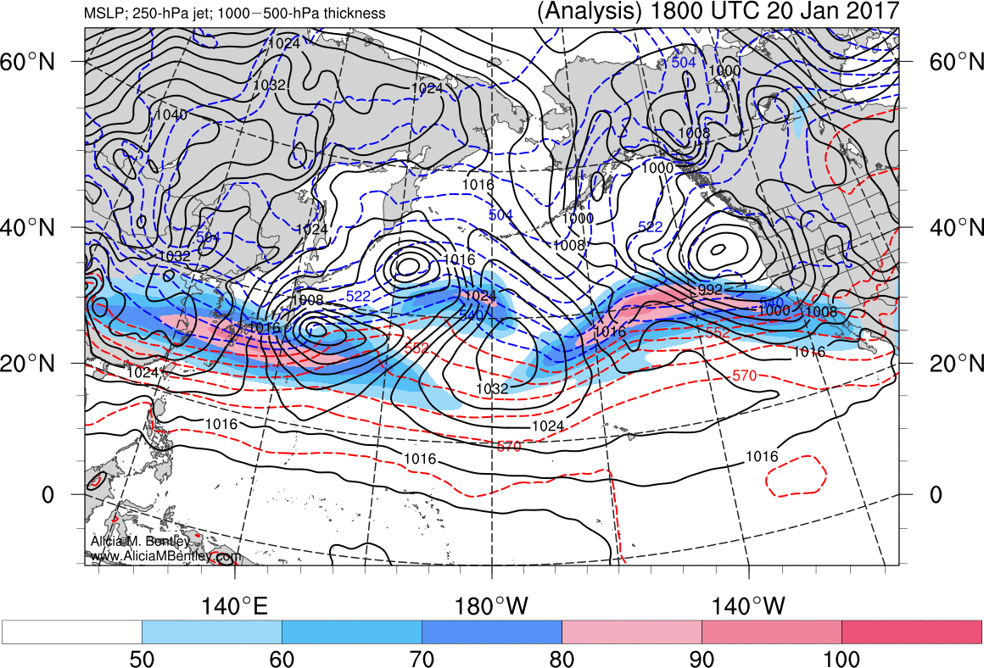
WRF – ARW computer model prediction
SLP (hPa), 3-hr Acc Precip, 1000-500 mb Thickness
27-hr forecast valid 0900 UTC 20 Jan 2011, (1:00 am PST)
http://www.atmos.albany.edu/student/abentley/realtime/pacific.php

Slide 10
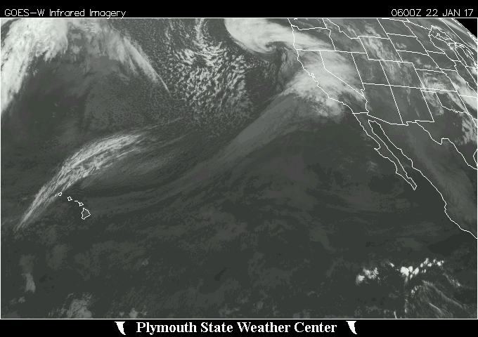
IR satellite loop
http://vortex.plymouth.edu/myo/sat/archive.html

Slide 11
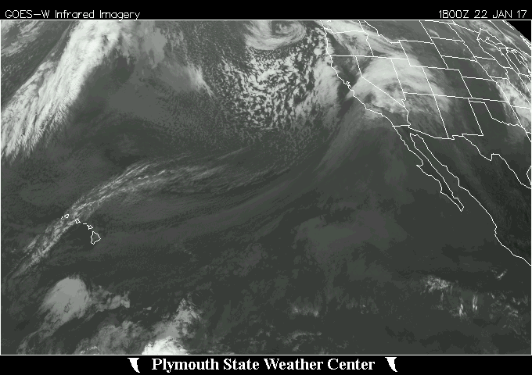
IR satellite loop
http://vortex.plymouth.edu/myo/sat/archive.html

Slide 12
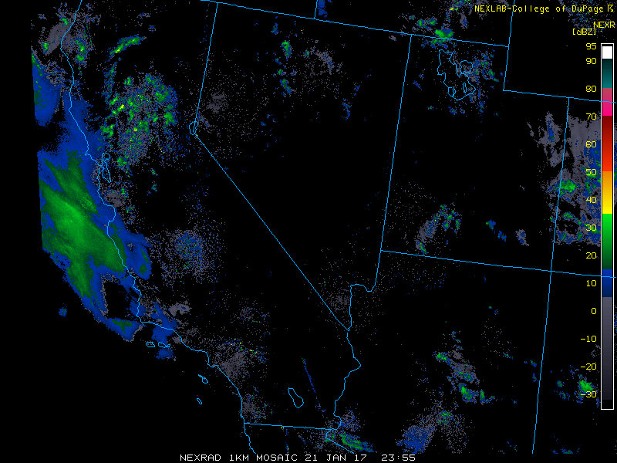
WSR88D composite - southwest
SLP (hPa), 3-hr Acc Precip, 1000-500 mb Thickness
http://www2.mmm.ucar.edu/imagearchive/

Slide 13
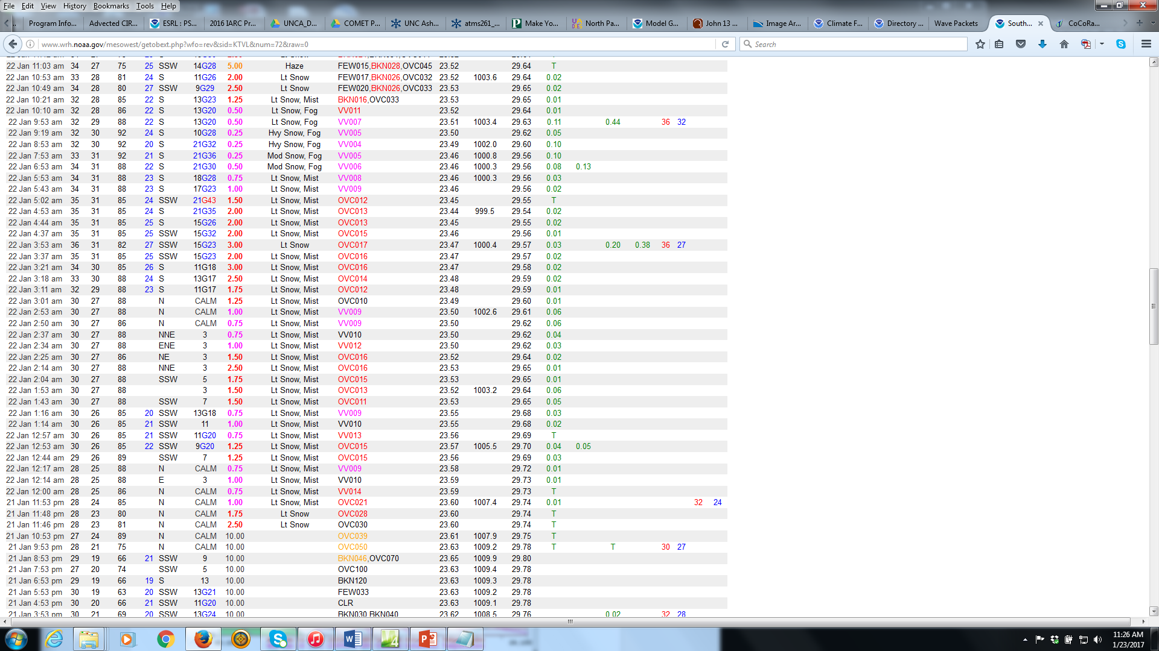
South Lake Tahoe ASOS
0746 UTC 22 Jan 2017
http://www.wrh.noaa.gov/mesowest/getobext.php?wfo=rev&sid=KTVL&num=72&raw=0

Slide 14
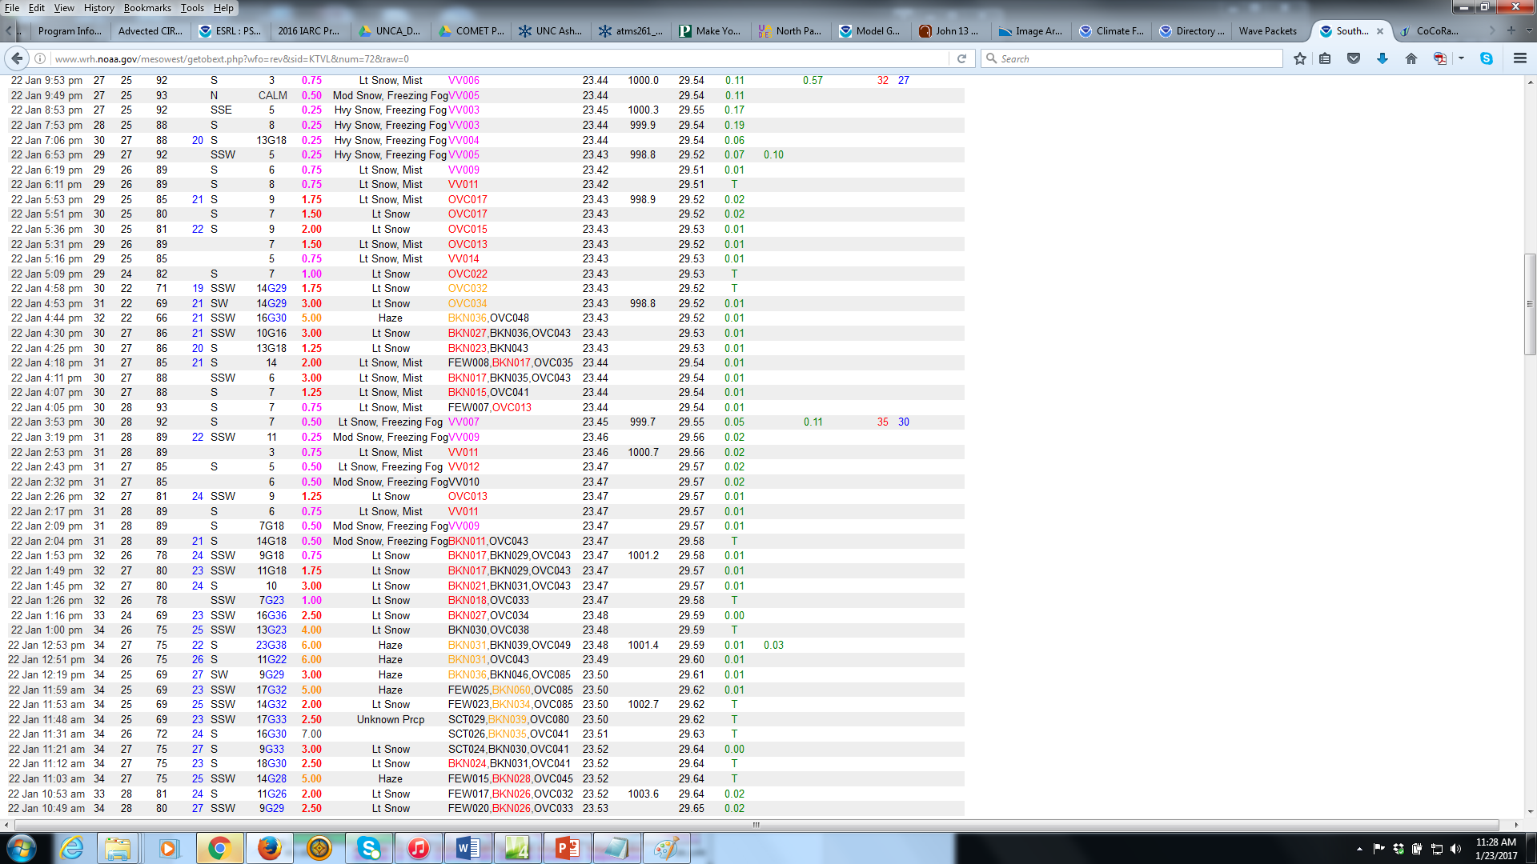
South Lake Tahoe ASOS
http://www.wrh.noaa.gov/mesowest/getobext.php?wfo=rev&sid=KTVL&num=72&raw=0

Slide 15
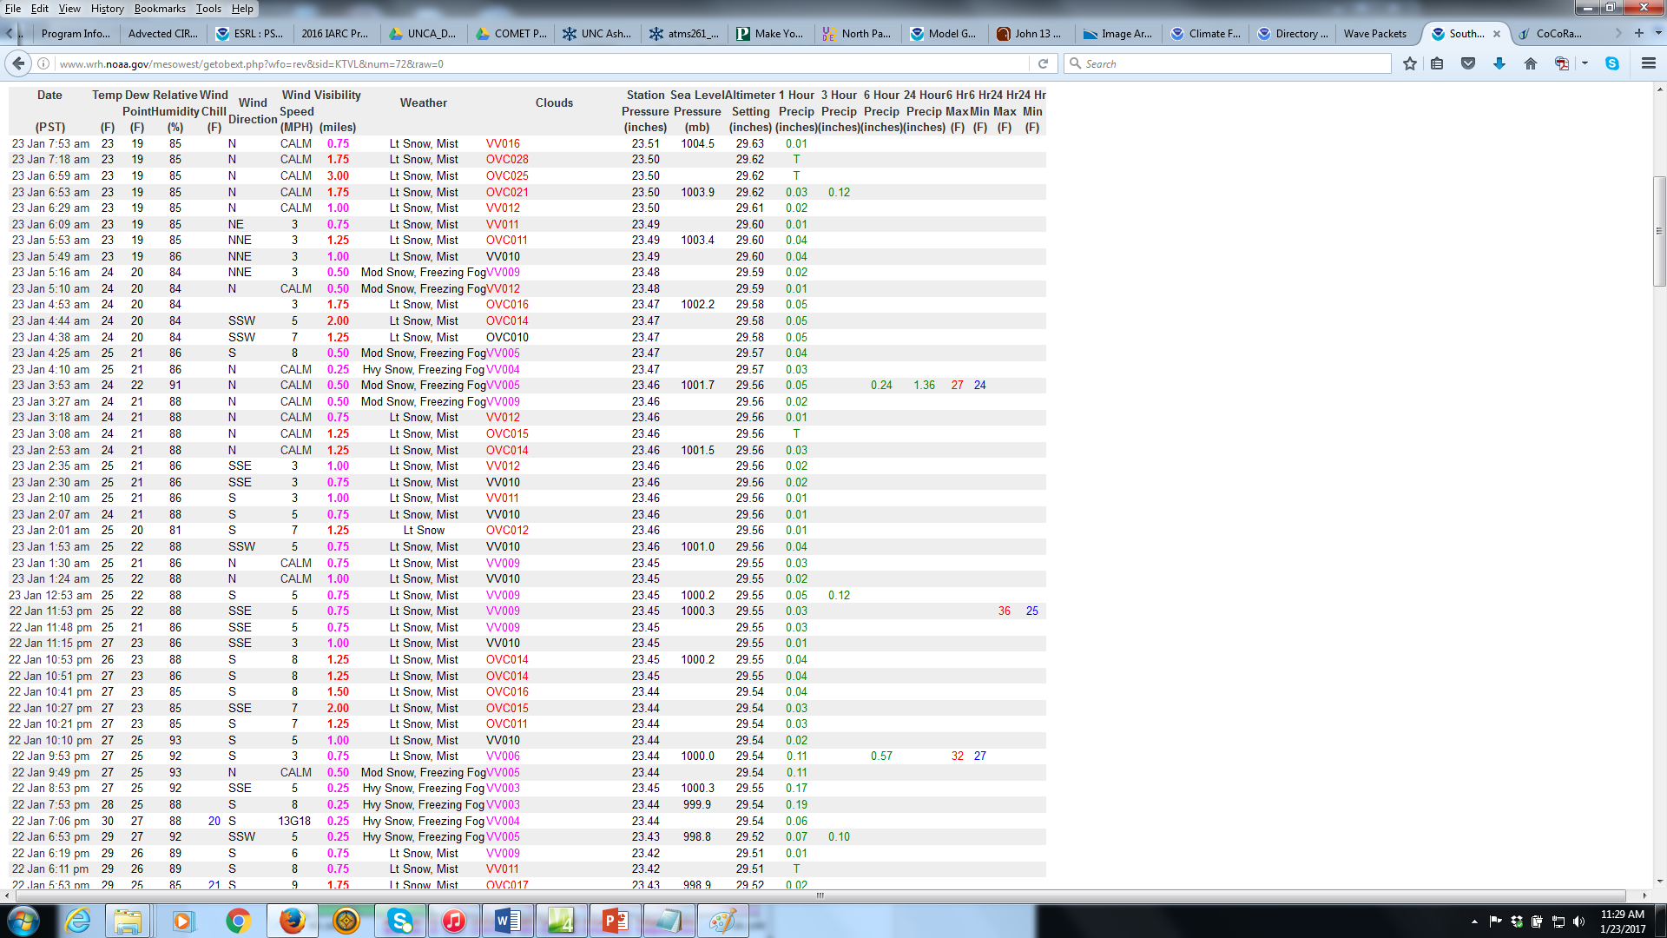
South Lake Tahoe ASOS
2.50“ liquid equivalent
7:00 am PST 22 Jan –
6:59 am PST 23 Jan 2017
http://www.wrh.noaa.gov/mesowest/getobext.php?wfo=rev&sid=KTVL&num=72&raw=0

Slide 16
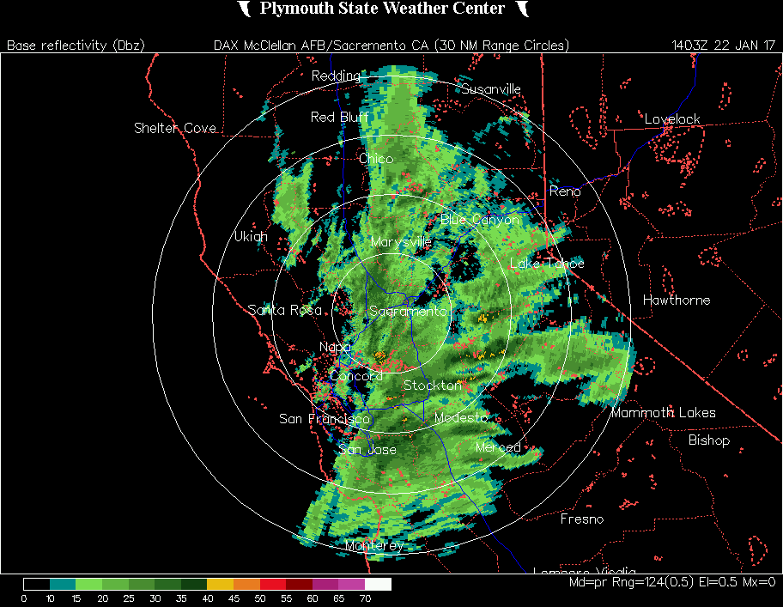
WSR88D – Sacramento (DAX)
front
6:03 – 8:00 am PST 22 Jan 2017
http://vortex.plymouth.edu/myo/rad/nids.html

Slide 17
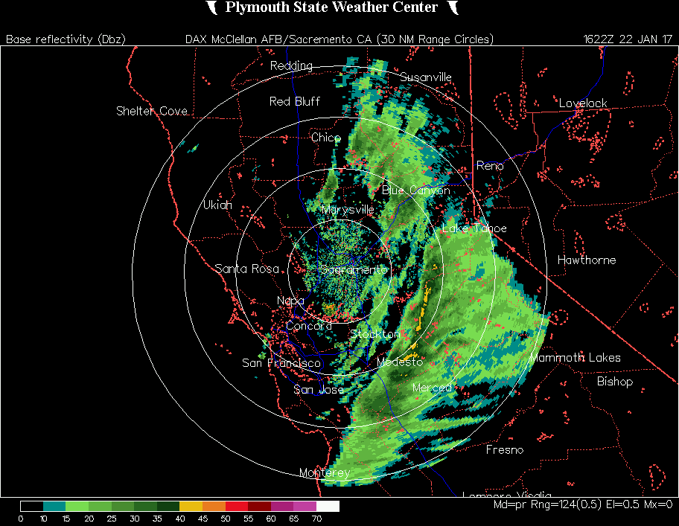
WSR88D – Sacramento (DAX)
front
8:22 – 10:00 am PST 22 Jan 2017
http://vortex.plymouth.edu/myo/rad/nids.html

Slide 18
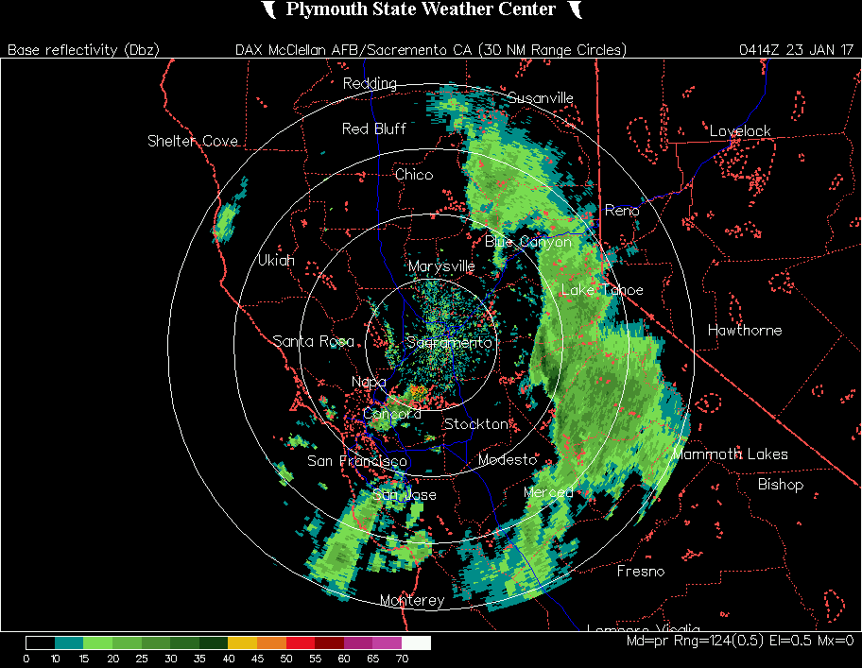
WSR88D – Sacramento (DAX)
shortwave
8:14 – 10:00 pm PST 22 Jan 2017
http://vortex.plymouth.edu/myo/rad/nids.html

Slide 19
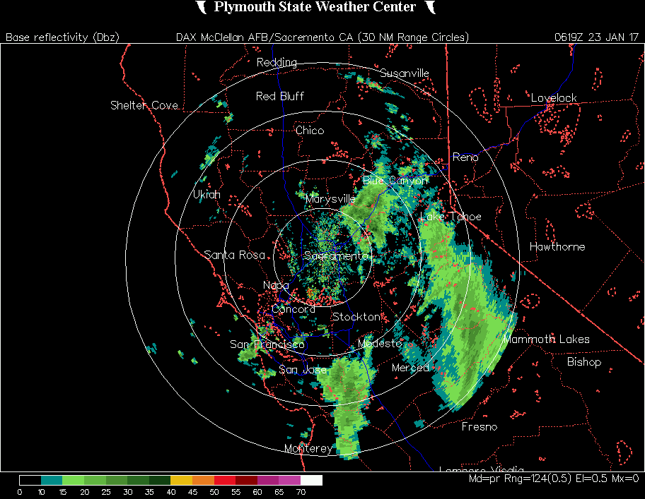
WSR88D – Sacramento (DAX)
shortwave
10:19 – 11:59 pm PST 22 Jan 2017
http://vortex.plymouth.edu/myo/rad/nids.html

Slide 20
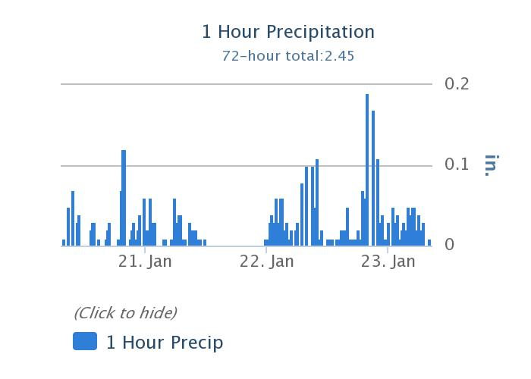
South Lake Tahoe ASOS
shortwave
front
http://www.wrh.noaa.gov/mesowest/getobext.php?wfo=rev&sid=KTVL&num=72&raw=0

Slide 21
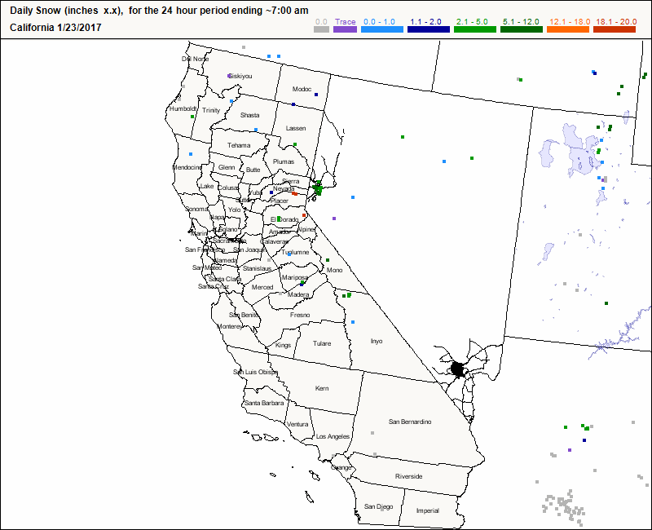
CoCoRaHS
http://www.cocorahs.org/

Slide 22
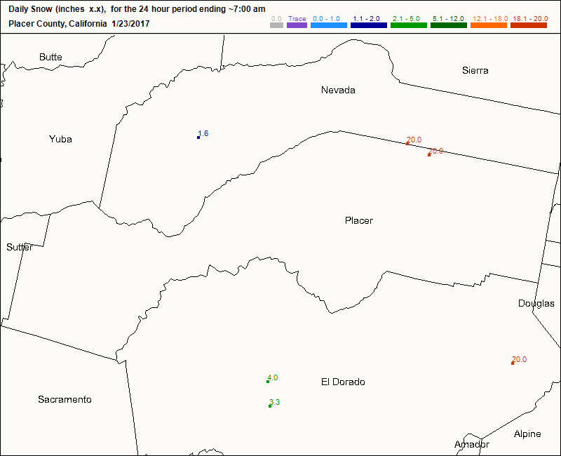
CoCoRaHS
20“ snow/ 2.5” LE = 8:1 SLR
http://www.cocorahs.org/

