Slide 1
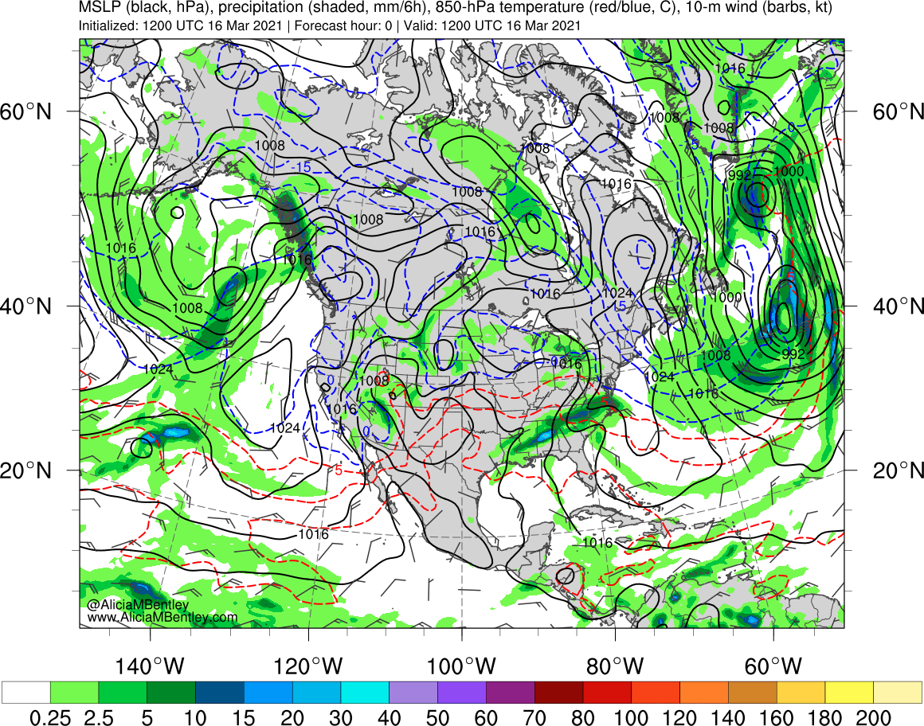
http://www.atmos.albany.edu/student/abentley/realtime.html

Slide 2
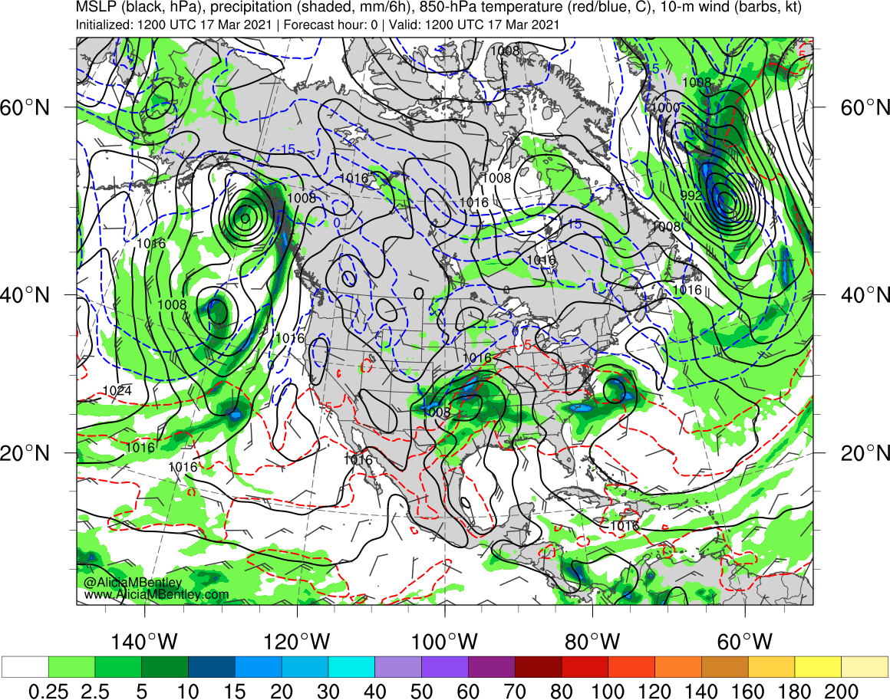
http://www.atmos.albany.edu/student/abentley/realtime.html

Slide 3
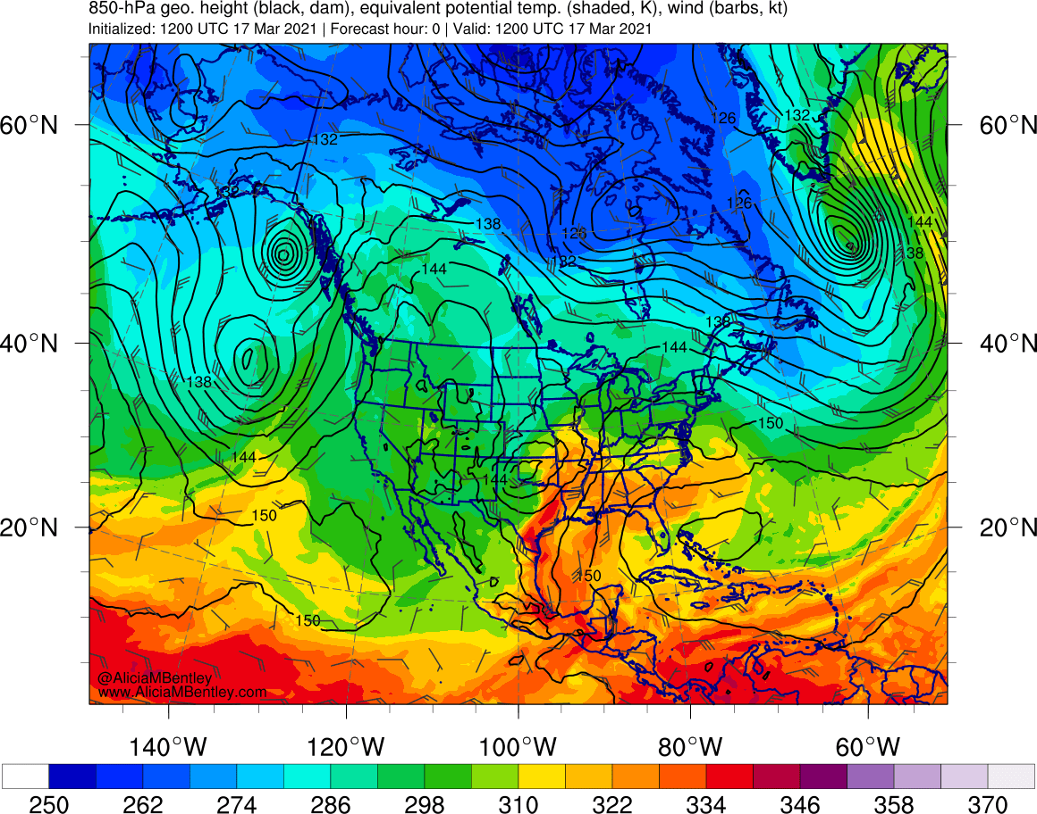
http://www.atmos.albany.edu/student/abentley/realtime.html

Slide 4
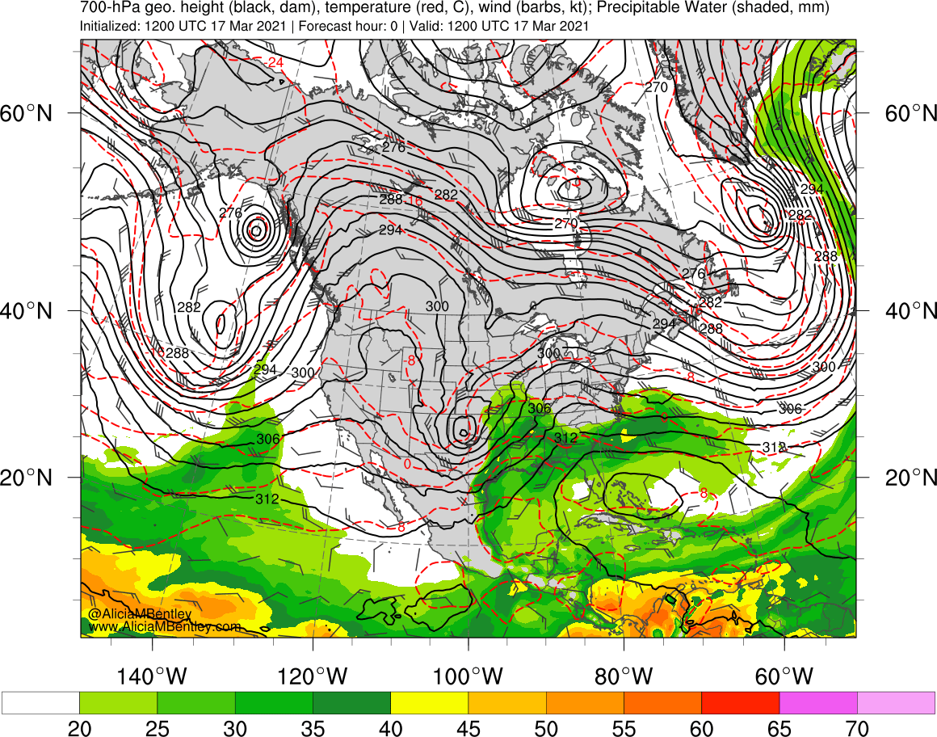
http://www.atmos.albany.edu/student/abentley/realtime.html

Slide 5
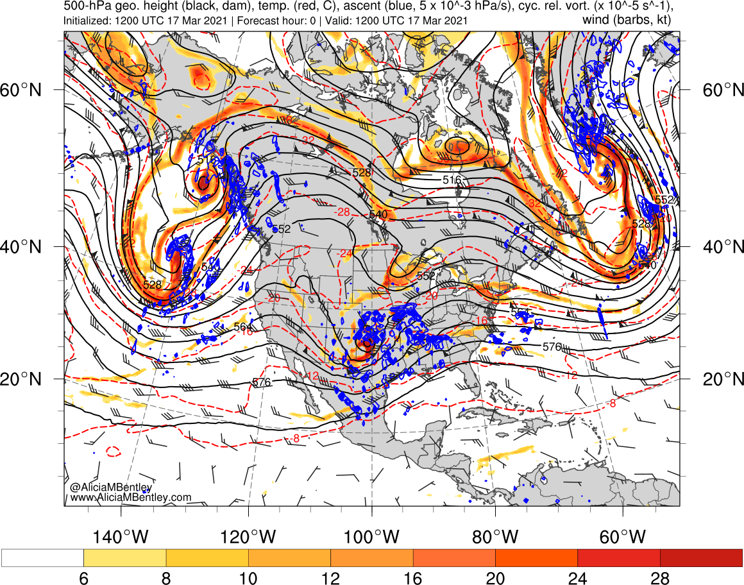
http://www.atmos.albany.edu/student/abentley/realtime.html

Slide 6
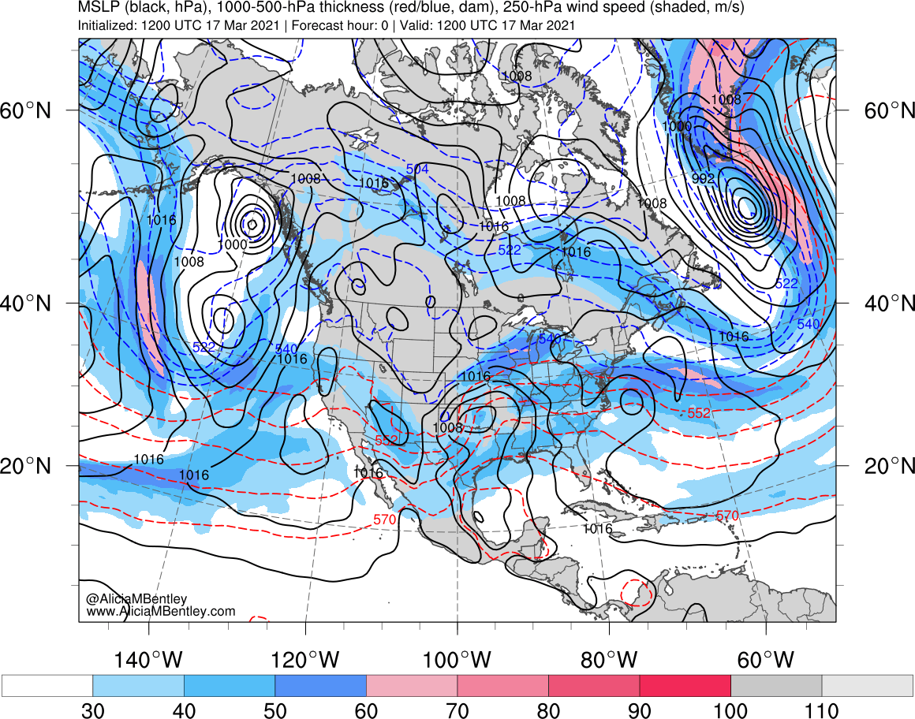
http://www.atmos.albany.edu/student/abentley/realtime.html

Slide 7
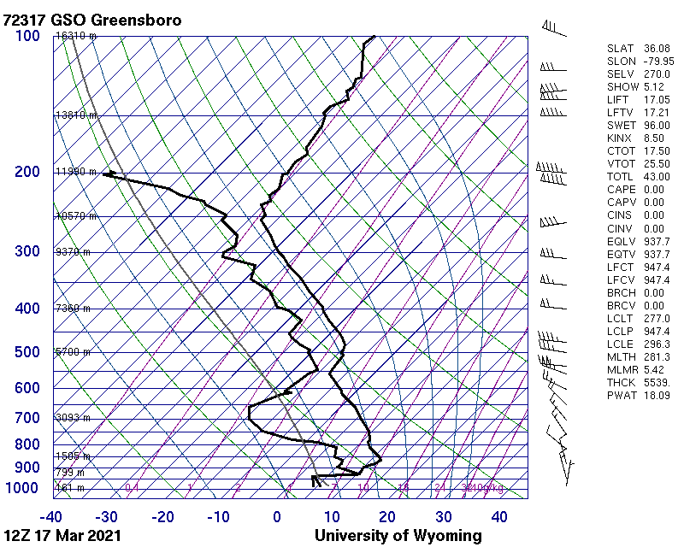
Greensboro, NC sounding
1200 UTC 17 Mar 2021
http://weather.uwyo.edu/upperair/sounding.html

Slide 8
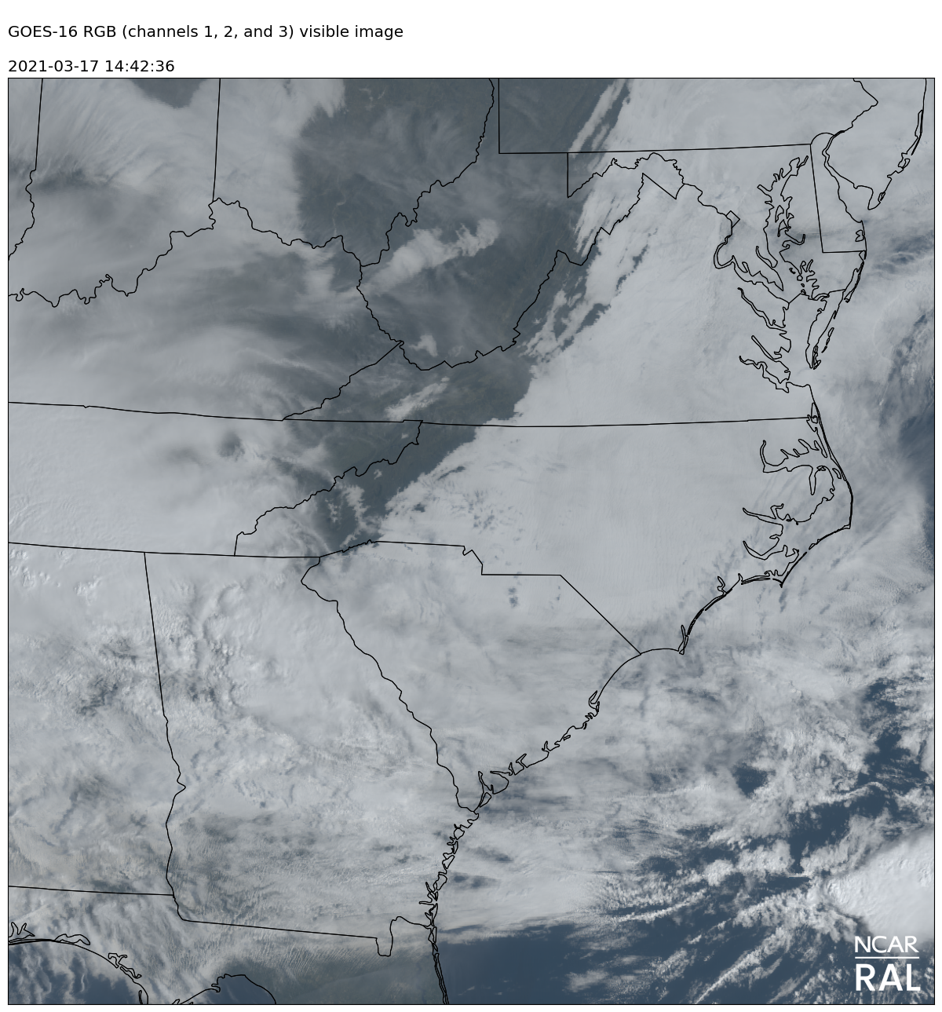
GOES-16 Vis; 1200 – 1500 UTC 17 Mar 2021

