Slide 1
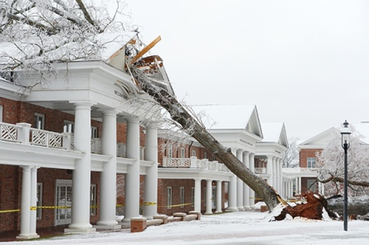
Mountain Weather – 7 March 2014;
Western NC
http://www.thetimesnews.com/news/top-news/ice-in-the-oaks-at-elon-1.288379

Slide 2
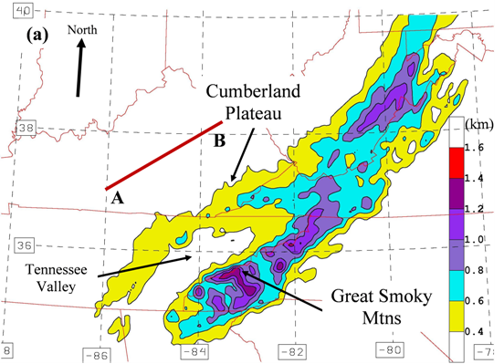
Topography, KY, TN, NC

Slide 3
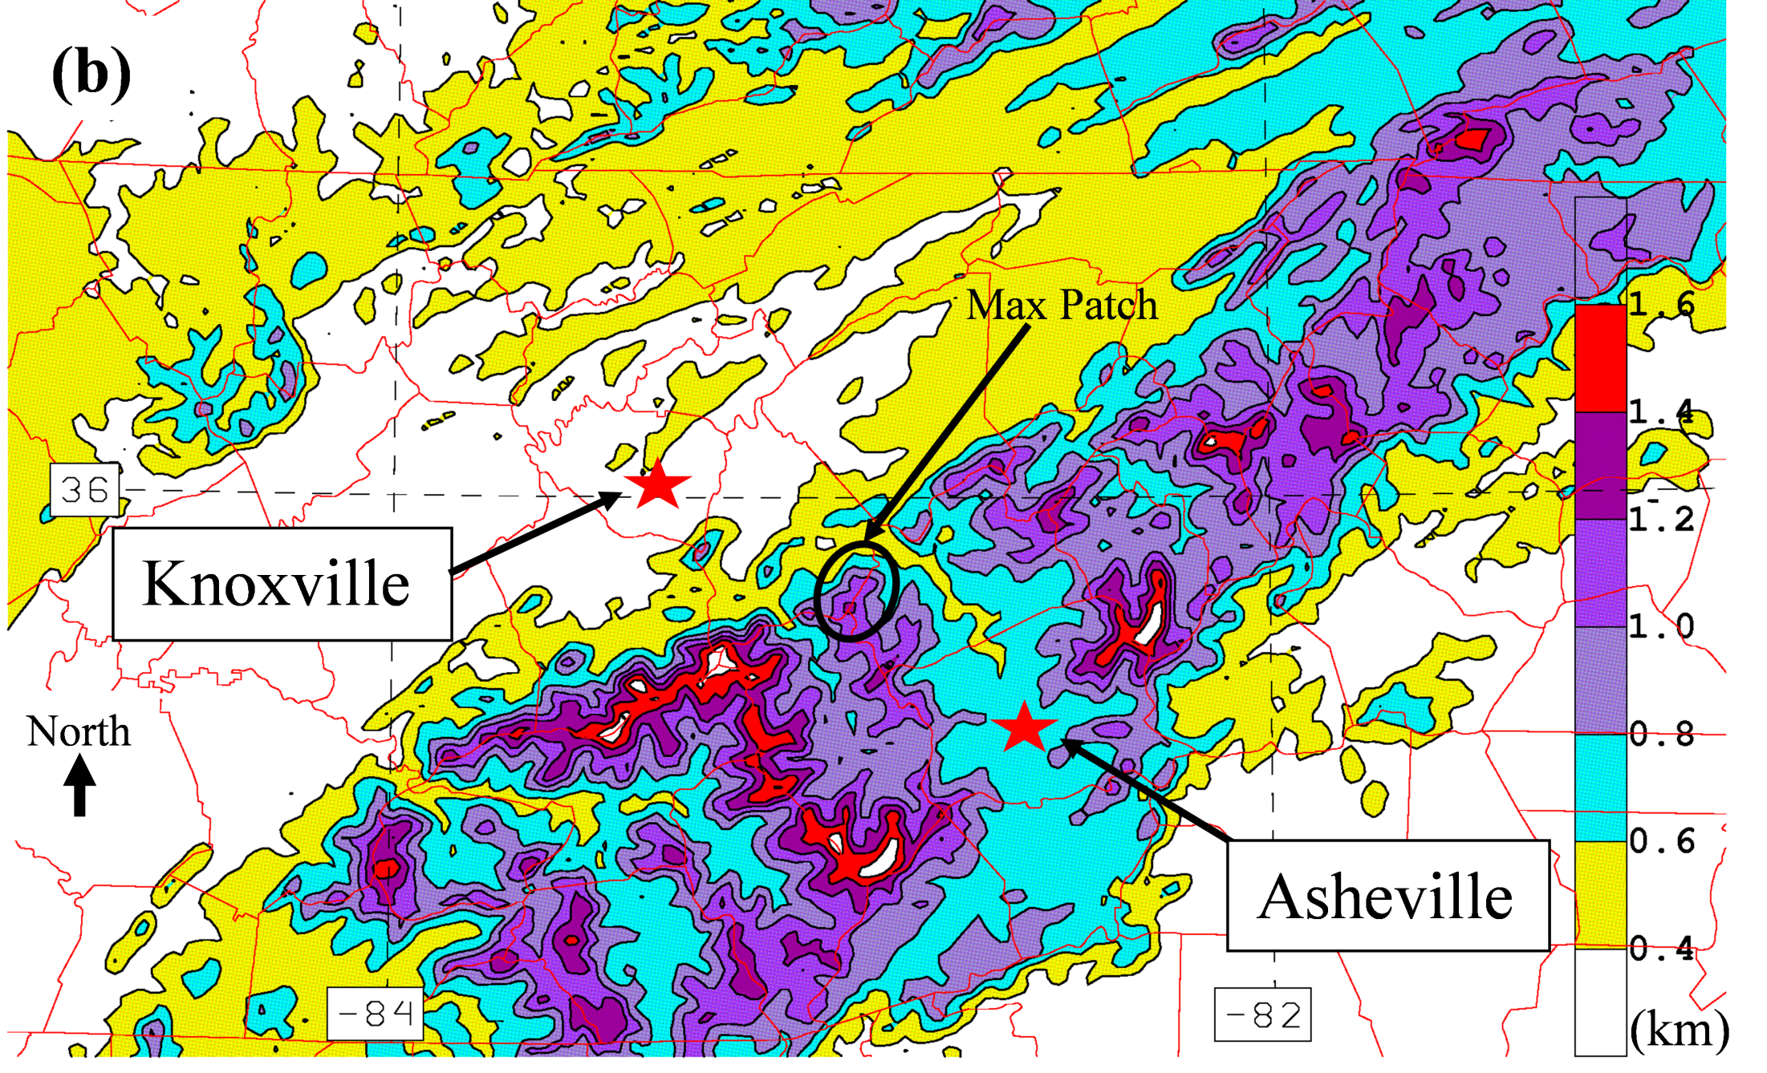
Topography, KY, TN, NC

Slide 4
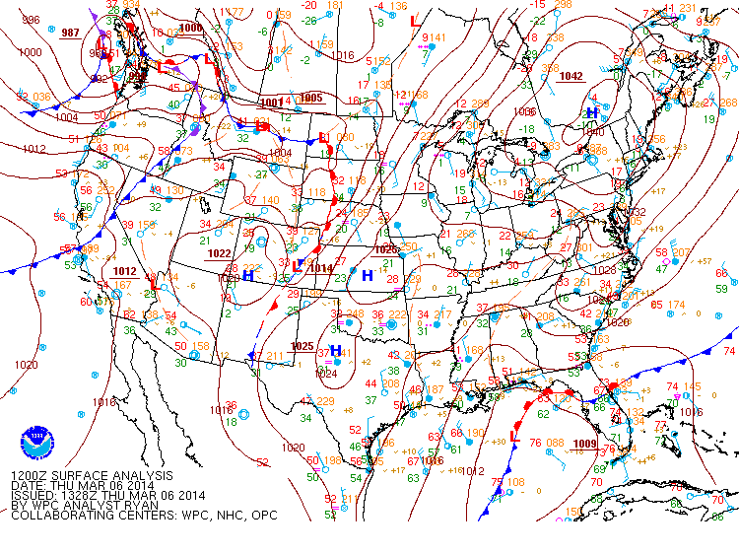
WPC analysis
SLP (hPa)
valid 0000 UTC 7 Mar 2014, (7:00 pm EST)
http://www.hpc.ncep.noaa.gov/html/sfc2.shtml

Slide 5
IR satellite loop
http://locust.mmm.ucar.edu/imagearchive/

Slide 6
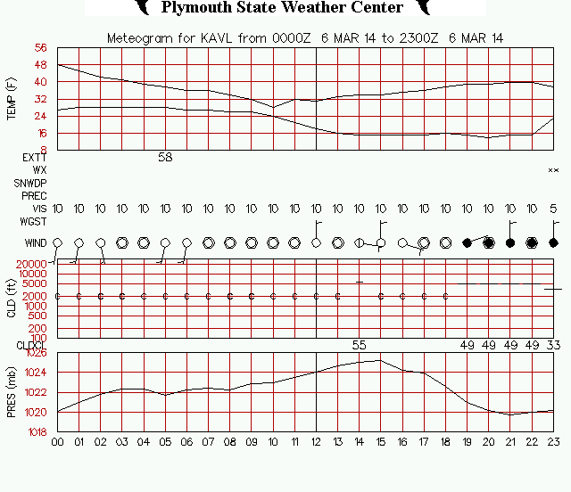
Asheville, NC - meteogram
http://vortex.plymouth.edu/statlog.html

Slide 7
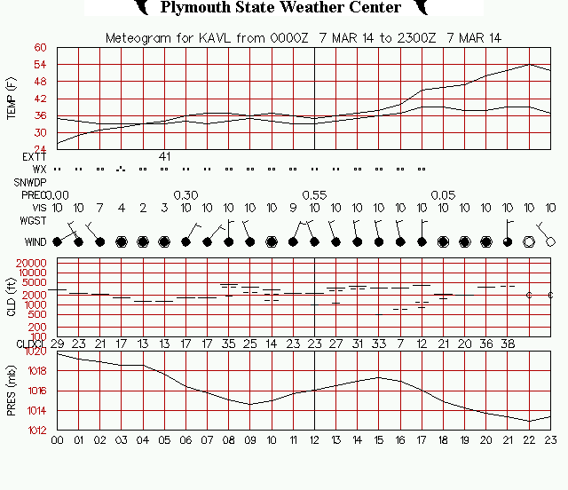
Asheville, NC - meteogram
http://vortex.plymouth.edu/statlog.html

Slide 8
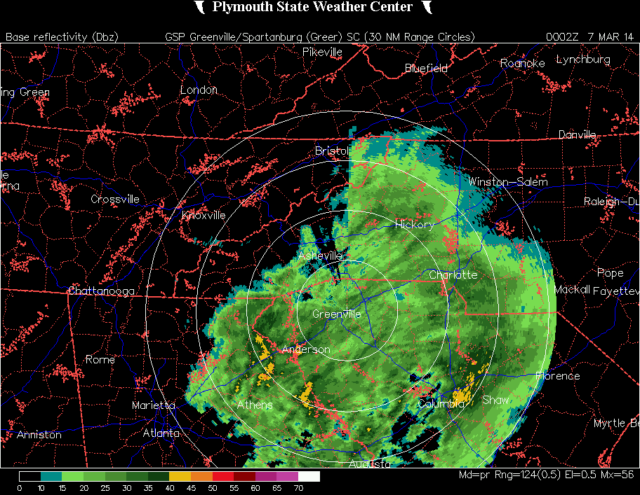
KGSP Radar loop
http://vortex.plymouth.edu/nids.html

Slide 9
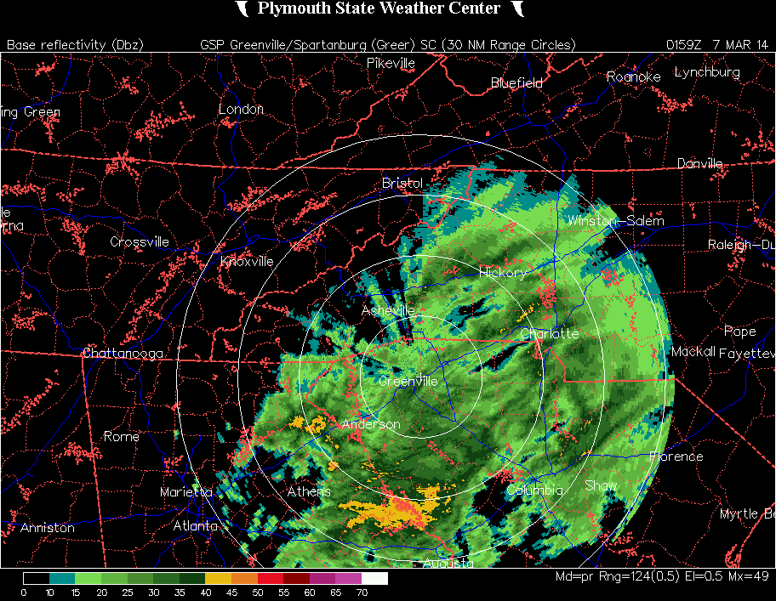
KMRX Radar loop
http://vortex.plymouth.edu/nids.html

Slide 10
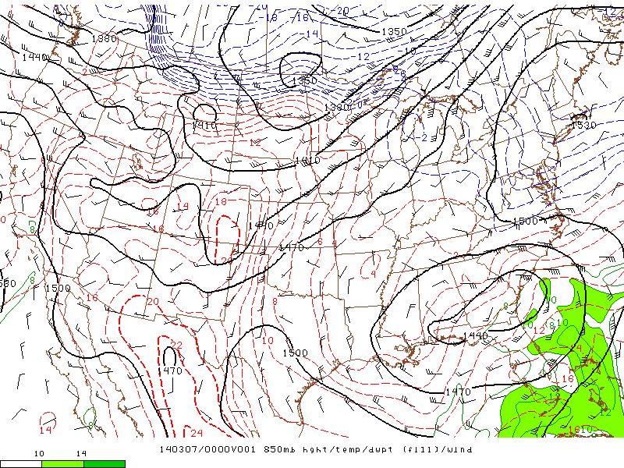
SPC analysis
850 hPa Geo Ht (dm), Temp (ºC), Wind (kt)
L
valid 0000 UTC 7 Mar 2014, (7:00 pm EST)
http://www.spc.noaa.gov/exper/ma_archive/images_s4/

Slide 11
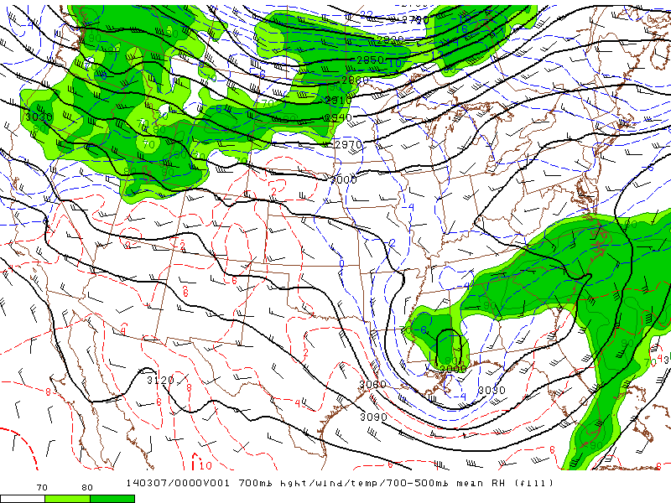
SPC analysis
700 hPa Geo Ht (dm), Rel Hum (%), Wind (kt)
valid 0000 UTC 7 Mar 2014, (7:00 pm EST)
http://www.spc.noaa.gov/exper/ma_archive/images_s4/

Slide 12
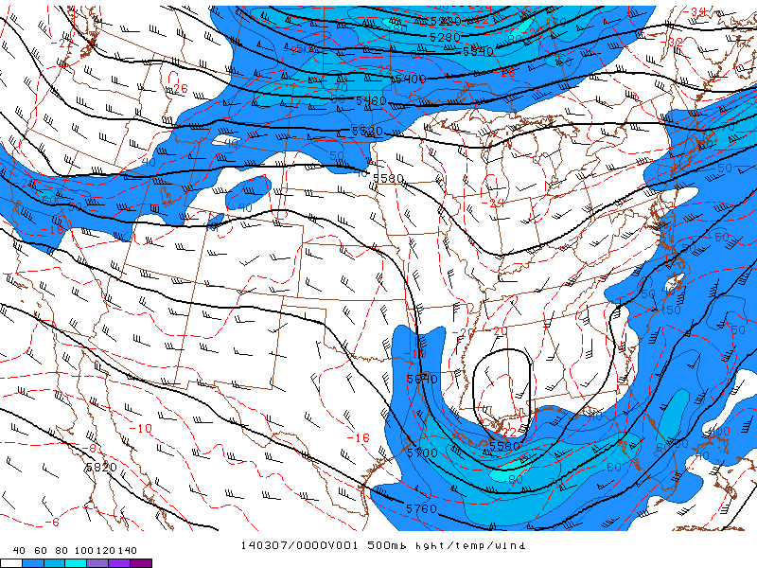
SPC analysis
500 hPa Geo Ht (dm), Geo Abs Vort, Wind (kt)
valid 0000 UTC 7 Mar 2014, (7:00 pm EST)
http://www.spc.noaa.gov/exper/ma_archive/images_s4/

Slide 13
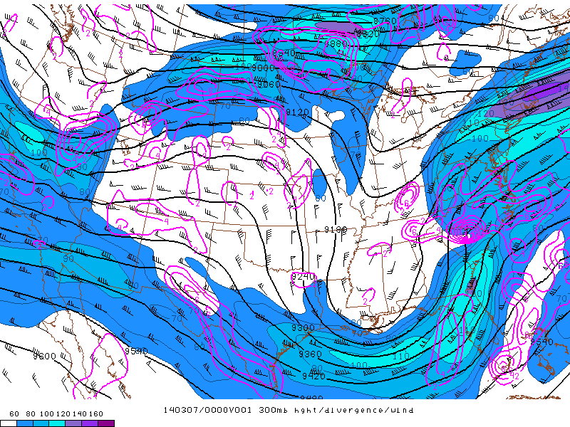
SPC analysis
300 hPa Geo Ht (dm), Isotachs and Wind (kt), Divergence
valid 0000 UTC 7 Mar 2014, (7:00 pm EST)
http://www.spc.noaa.gov/exper/ma_archive/images_s4/

Slide 14
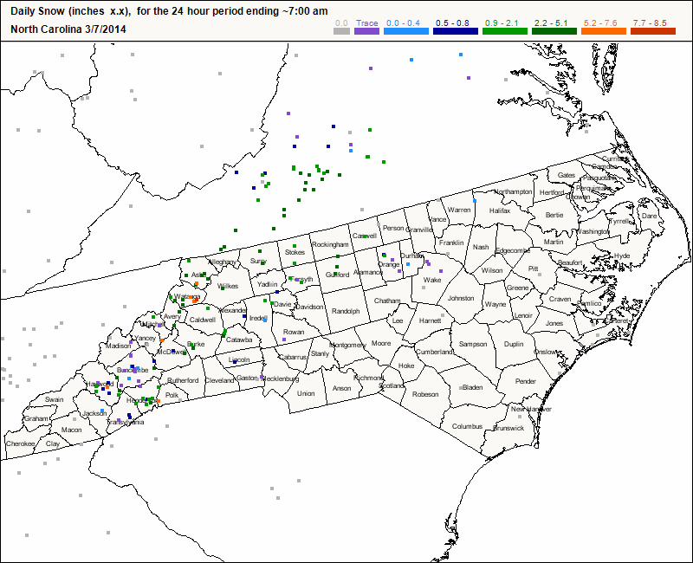
Mountain Weather – 7 March2014;
Western NC
http://www.cocorahs.org/

Slide 15
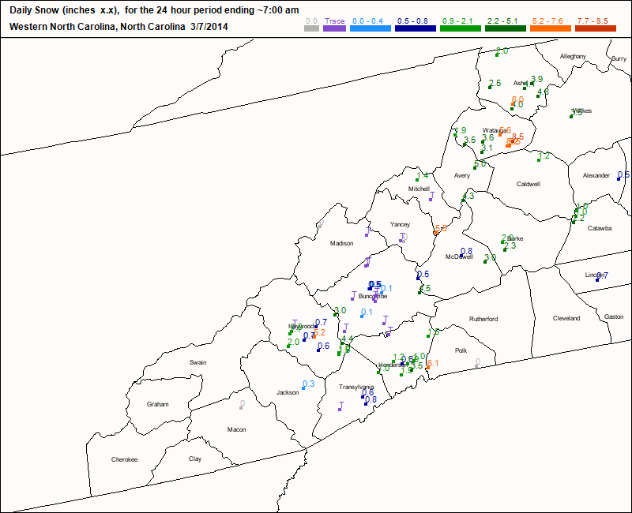
Mountain Weather – 7 March2014;
Western NC
http://www.cocorahs.org/

Slide 16
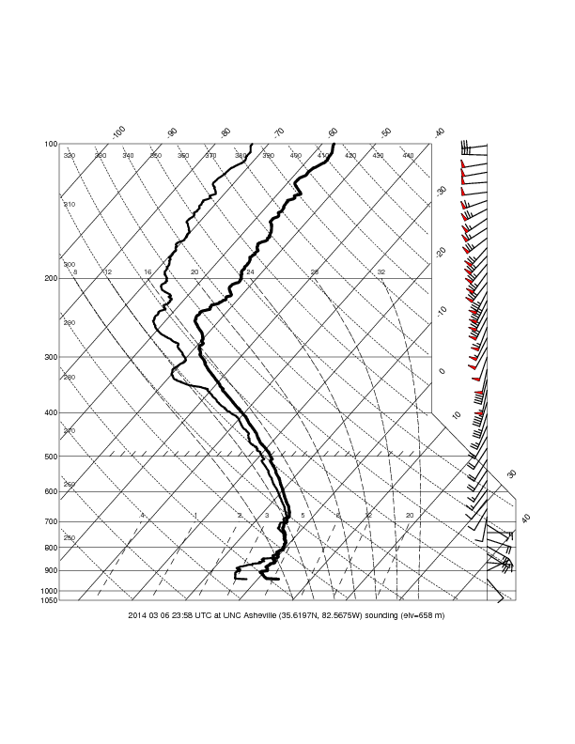
SEMPE1314 sounding; 0000 UTC 7 Mar 2014
http://www.atms.unca.edu/sempe/rt_sempe1314.html

Slide 17
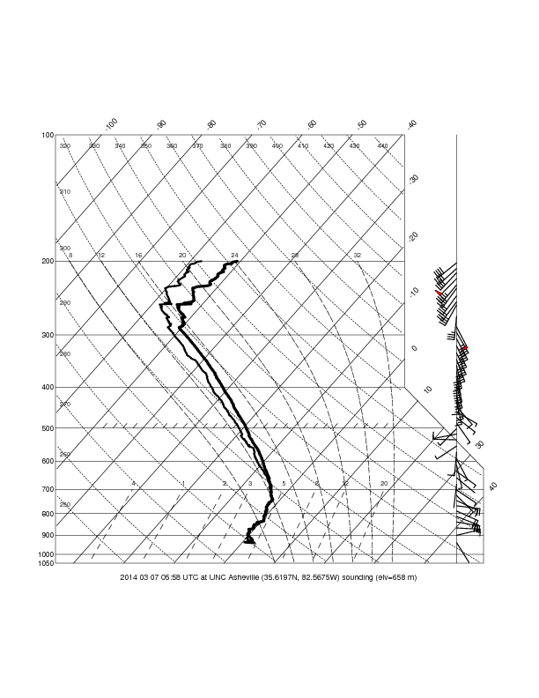
SEMPE1314 sounding; 0600 UTC 7 Mar 2014
http://www.atms.unca.edu/sempe/rt_sempe1314.html

Slide 18
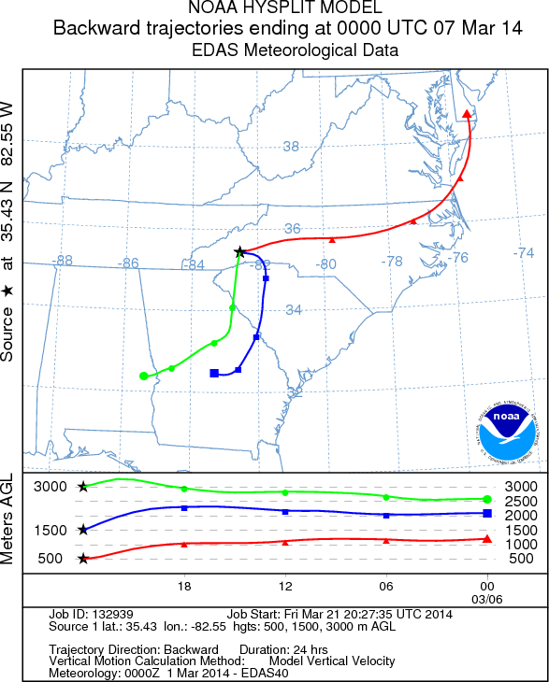
HYSPLIT trajectory – EDAS 40 km grids
24-hr forward air trajectory at 500, 1500, and 3000 m AGL; ending 0000 UTC 7 Mar 2014
NNNNNhttp://www.nco.ncep.noaa.gov/pmb/nwprod/analysis/namer/hiresw/06/model_m.shtml
http://ready.arl.noaa.gov/HYSPLIT_traj.php

Slide 19
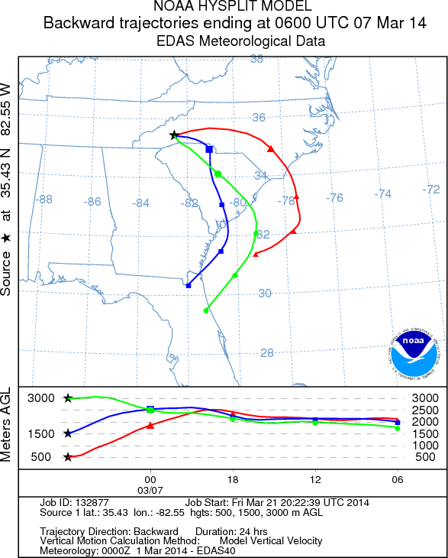
HYSPLIT trajectory – EDAS 40 km grids
24-hr forward air trajectory at 500, 1500, and 3000 m AGL; ending 0600 UTC 7 Mar 2014
NNNNNhttp://www.nco.ncep.noaa.gov/pmb/nwprod/analysis/namer/hiresw/06/model_m.shtml
http://ready.arl.noaa.gov/HYSPLIT_traj.php

