Slide 1
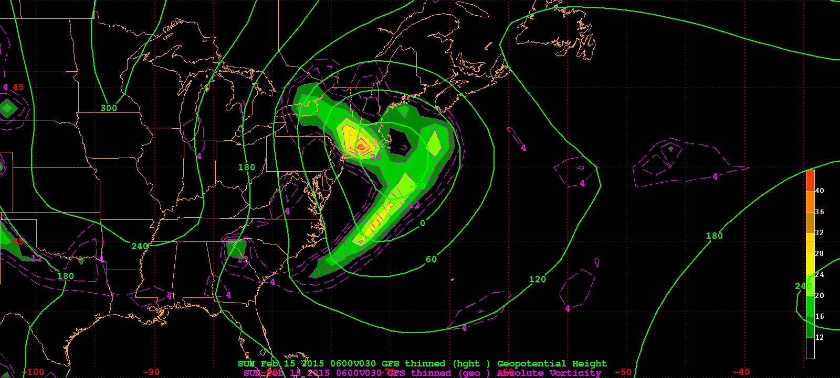
1000 hPa Z/Geo Rel Vort at t0
+
+

Slide 2
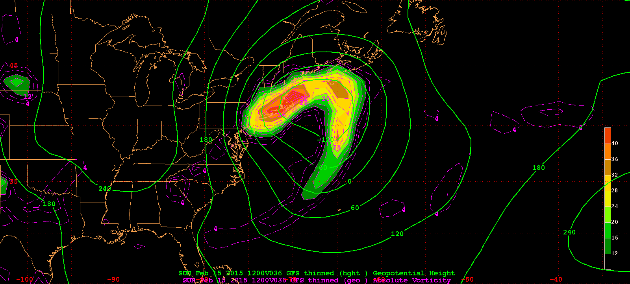
1000 hPa Z/Geo Rel Vort at t1
+

Slide 3
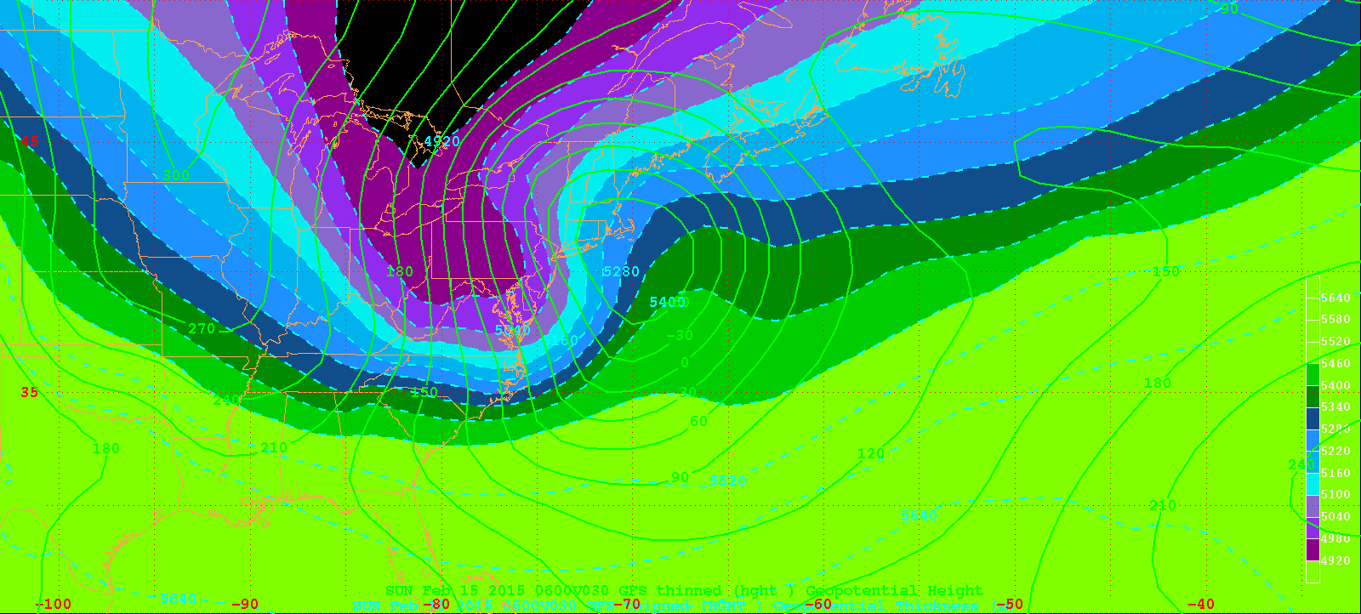
1000 hPa Z/10-5 thick (m) at t0
+

Slide 4
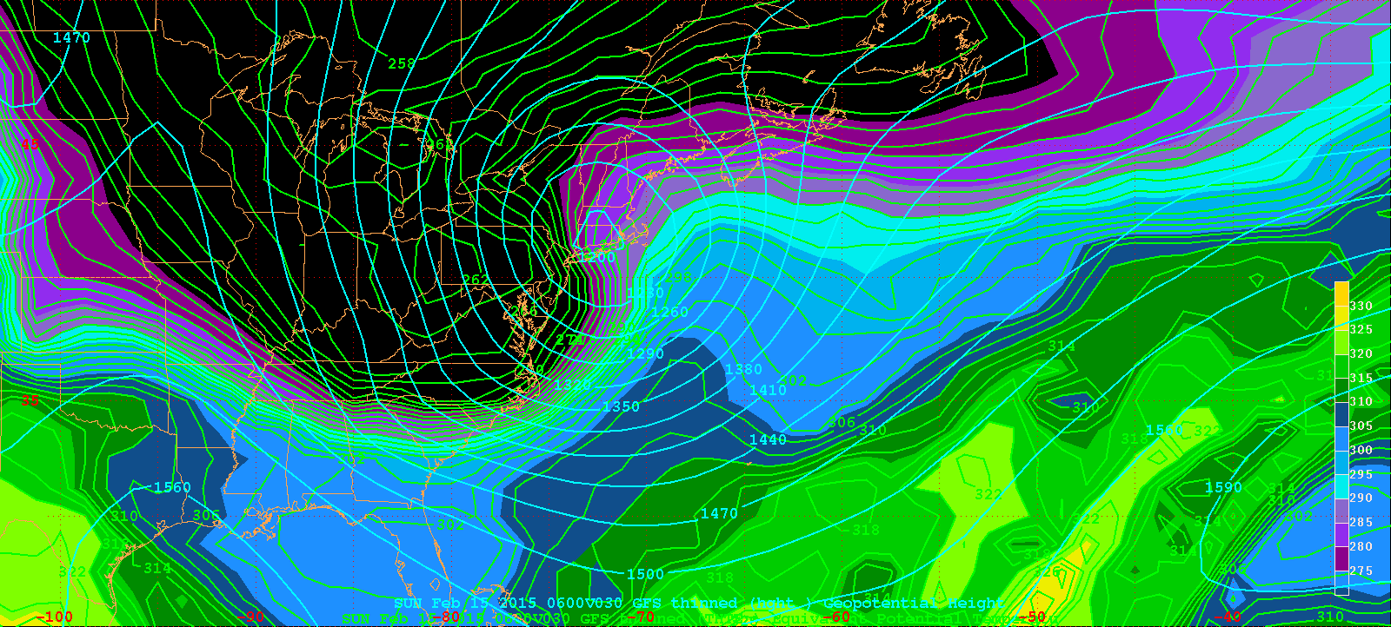
850 hPa Z, THTE at t0
+

Slide 5
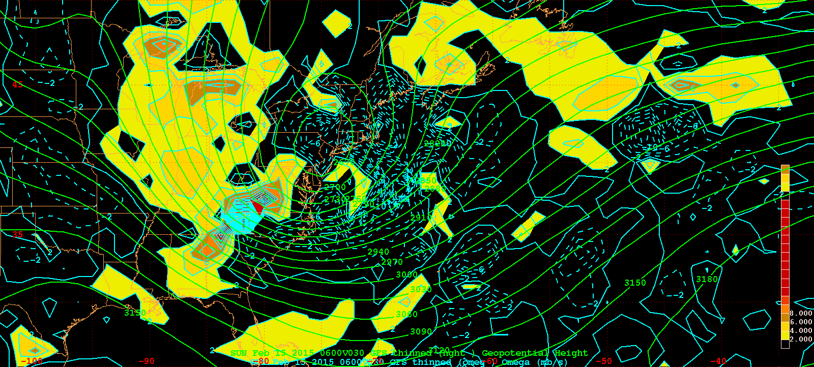
700 hPa Z & Omeg at t0
+

Slide 6
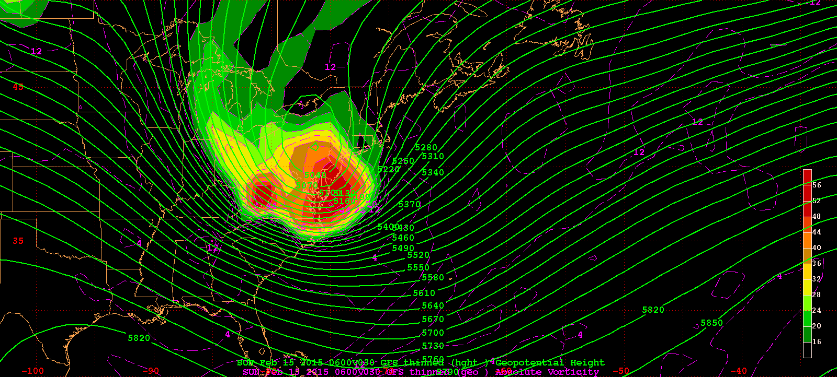
500 hPa Z, Geo Abs Vort at t0
+

Slide 7
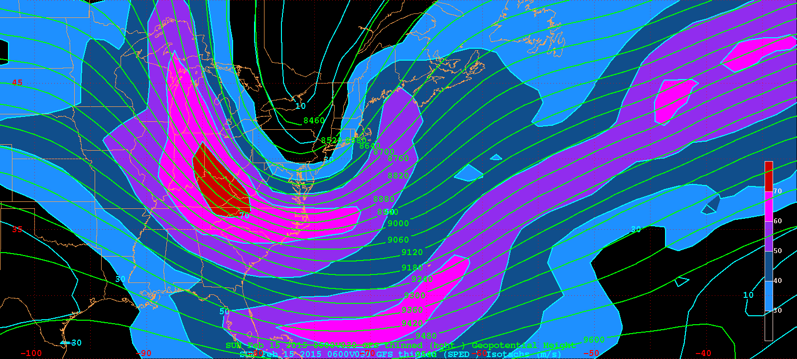
300 hPa Z, WS at t0
+

Slide 8
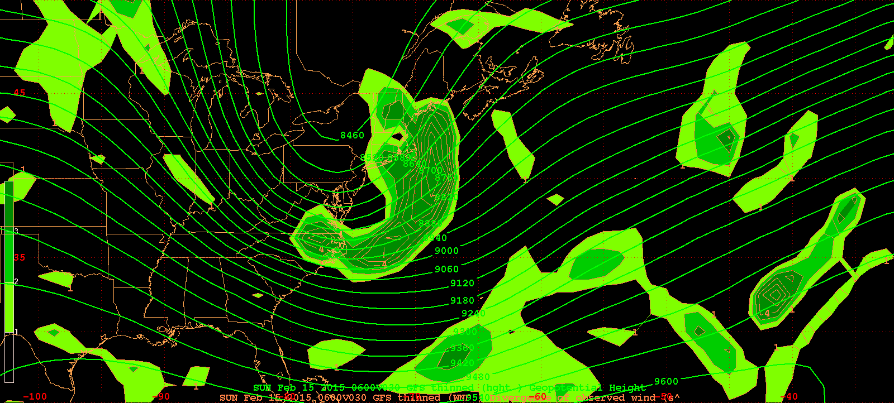
300 hPa Z, Div at t0
+

Slide 9
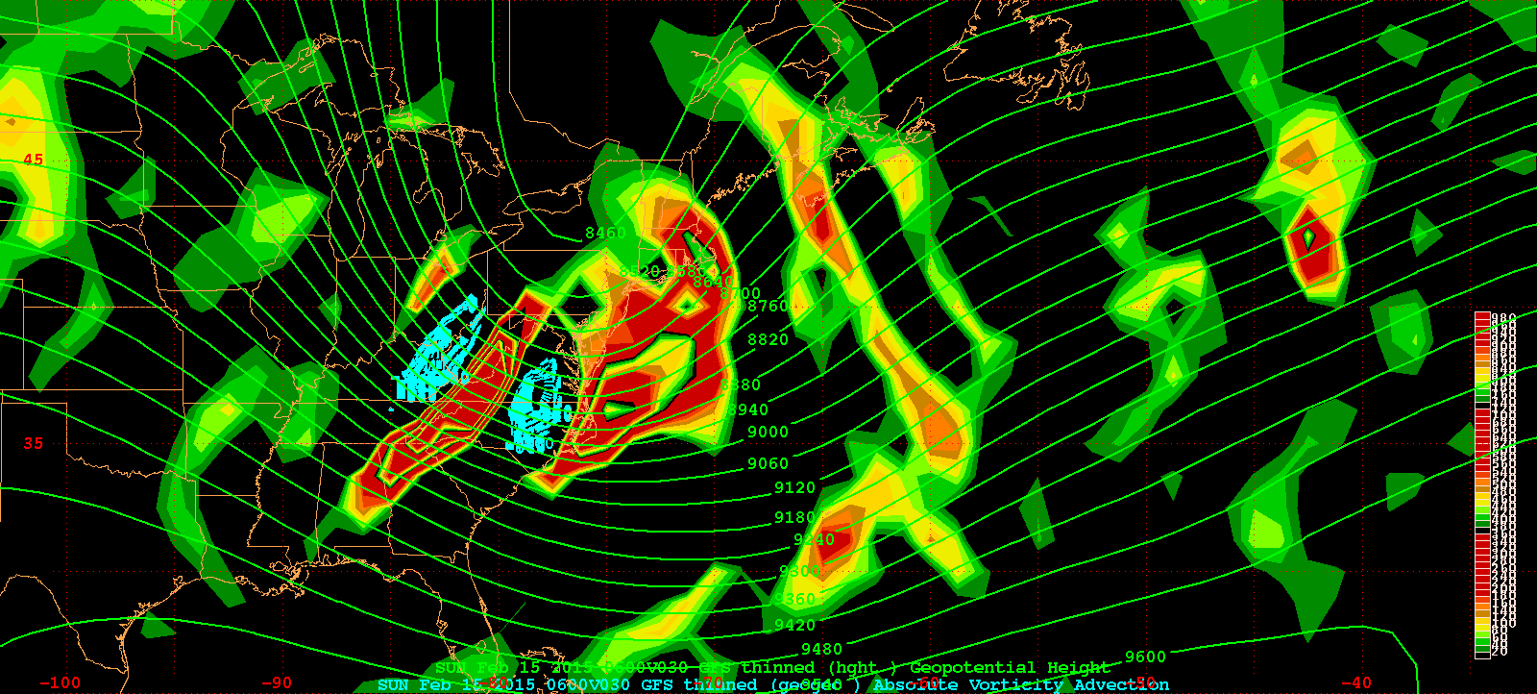
300 hPa Z, GAVA at t0
+

Slide 10
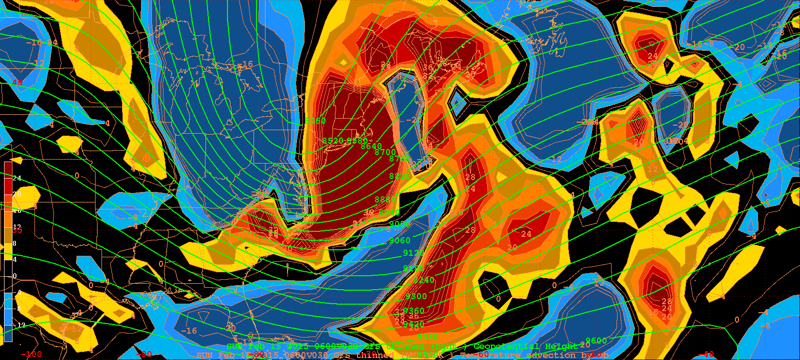
300 hPa Z, Temp Adv at t0
+

Slide 11
15 Feb 2015 case study facts:
1000 hPa cyclone center
  t0 = 0000 UTC 15 Feb 2015 (F030)
    Z₀ = -85 m at 40ºN, 70ºW
  t1 = 1200 UTC 15 Feb 2015 (F036)
    Z₀ = -163 m at 41.25ºN, 66.25ºW
Map projection
  25;-85;50;-50
  mer

