Slide 1
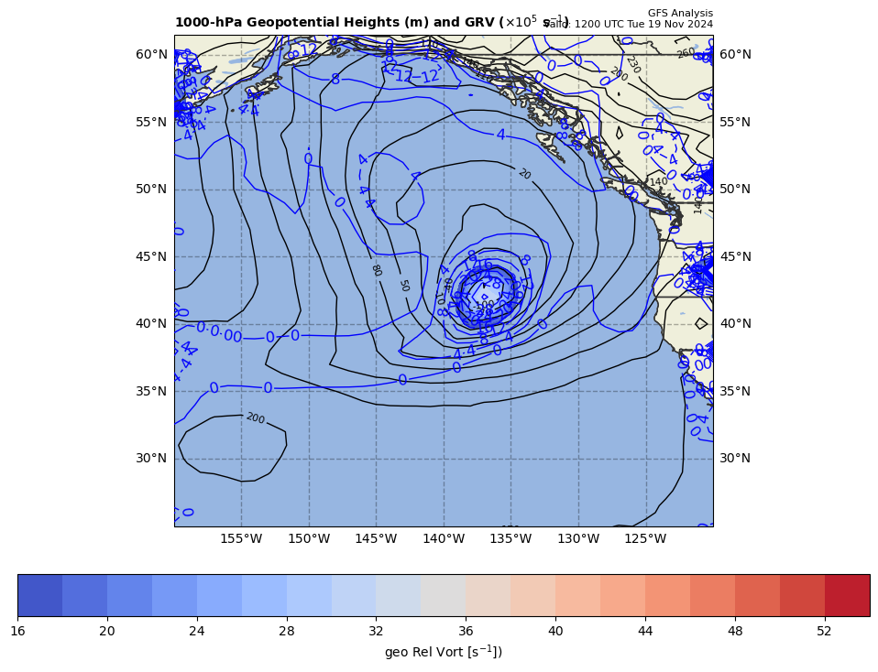
1000 hPa Z/Geo Rel Vort at t0
+

Slide 2
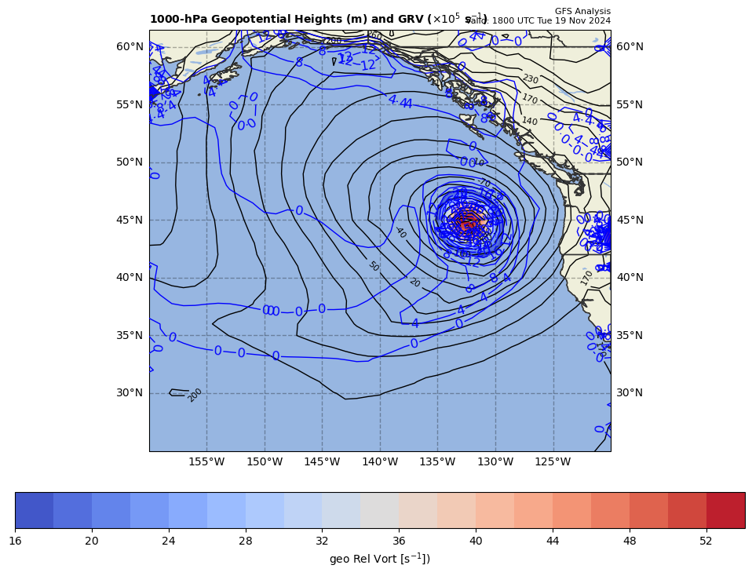
1000 hPa Z/Geo Rel Vort at t1
+
+

Slide 3
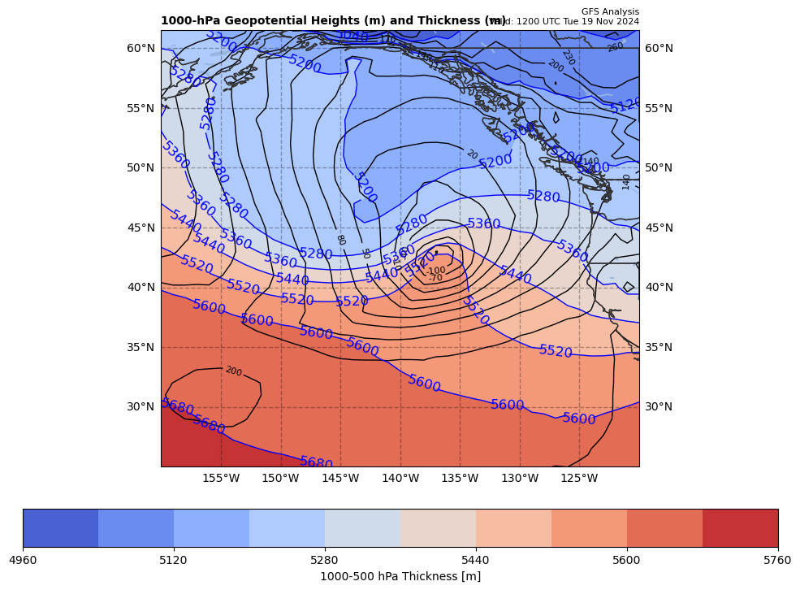
1000 hPa Z/10-5 thick (m) at t0
+

Slide 4
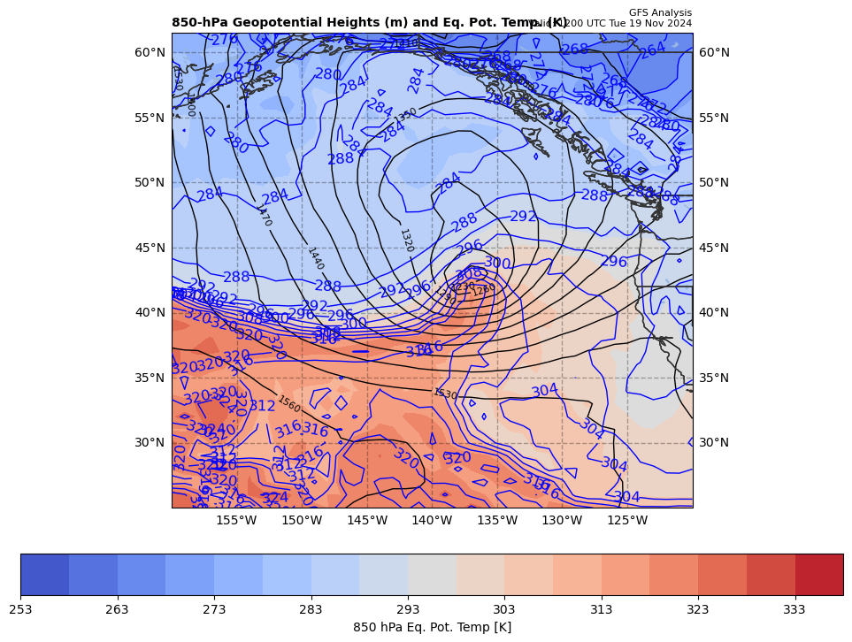
850 hPa Z, THTE at t0
+

Slide 5
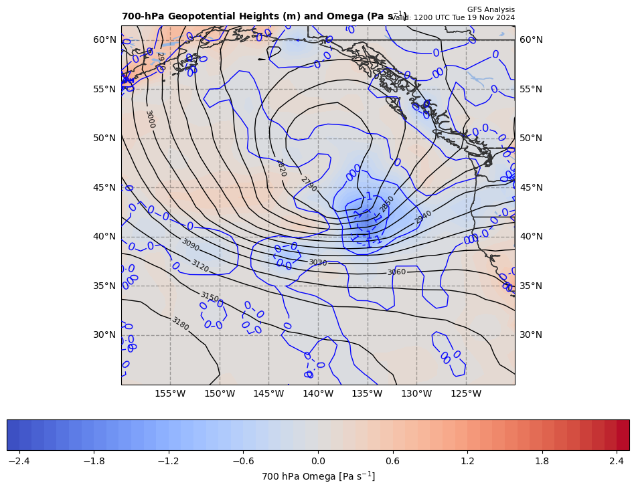
700 hPa Z & Omega at t0
+

Slide 6
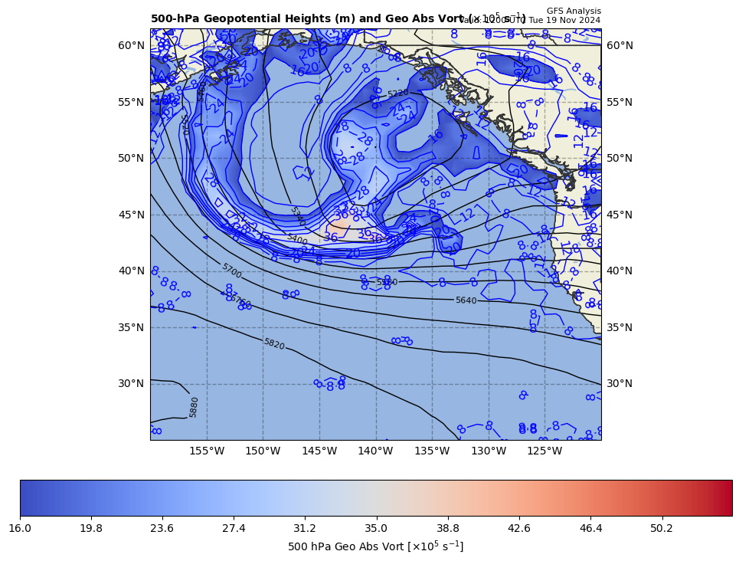
500 hPa Z, Geo Abs Vort at t0
+

Slide 7
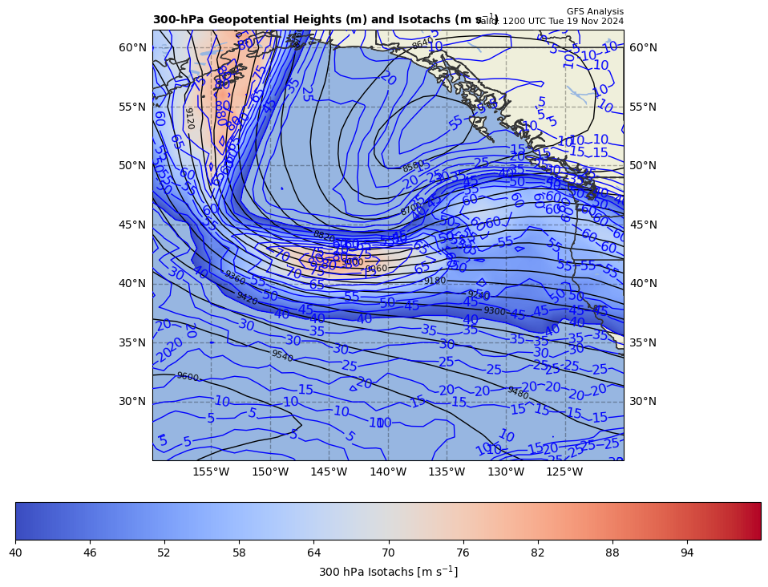
300 hPa Z, WS at t0
+

Slide 8
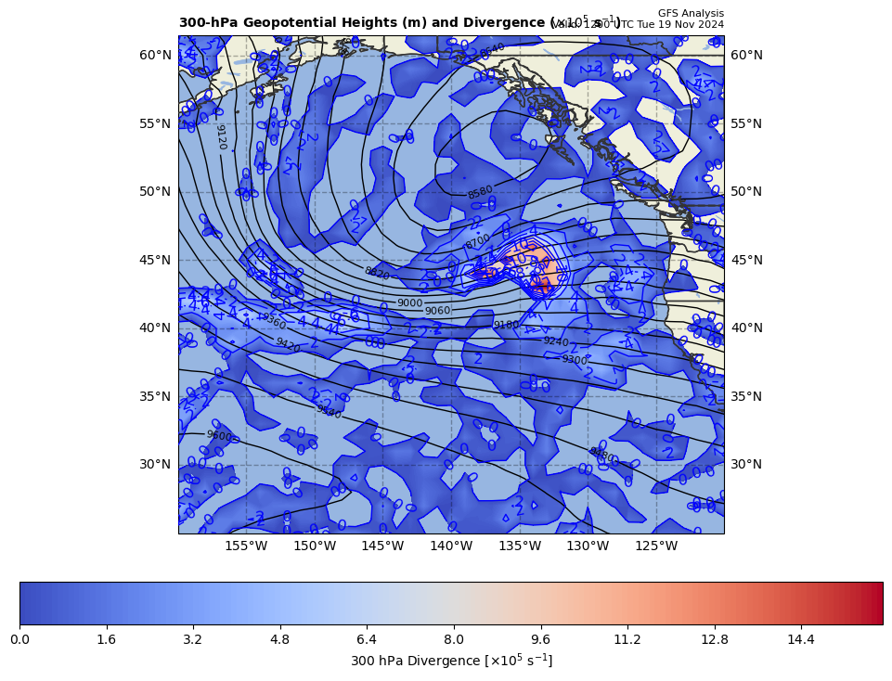
300 hPa Z, Div at t0
+

Slide 9
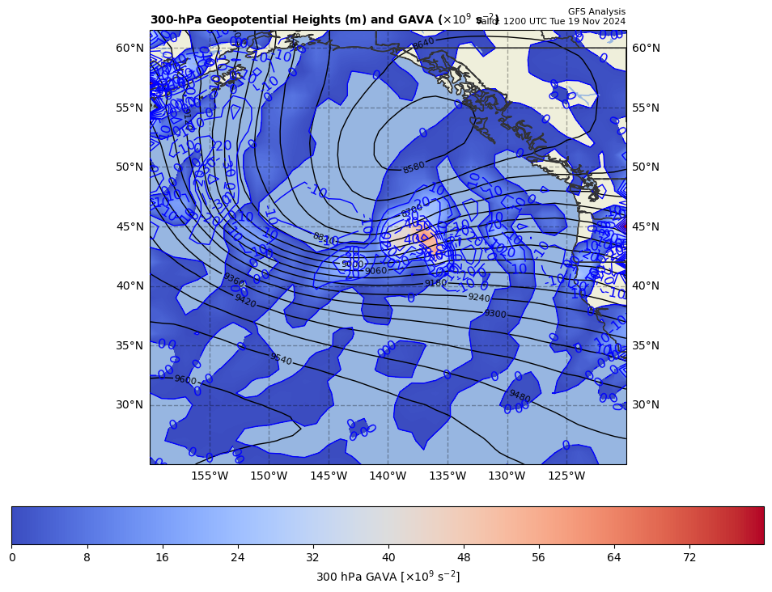
300 hPa Z, GAVA at t0
+

Slide 10
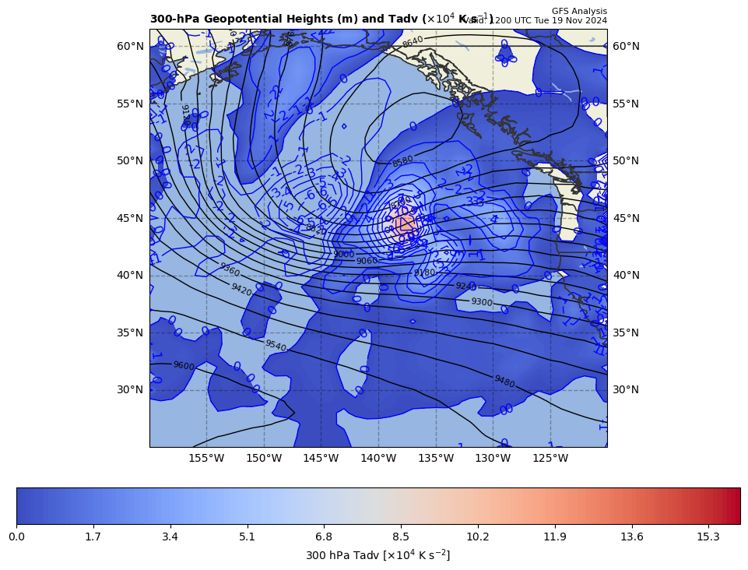
300 hPa Z, Temp Adv at t0
+

Slide 11
19 Nov 2024 case study facts:
1000 hPa cyclone center
t0 = 1200 UTC 19 Nov 2024
Z₀ = −131.4 m at 43.0ºN, 137.0ºW
t1 = 1800 UTC 19 Nov 2024
Z₀ = −360.0 m at 45.0ºN, 133.0ºW
Map projection
ax.set_extent([200, 240, 25, 60])
cart_proj=ccrs.PlateCarree(central_longitude= -140.0)

