Slide 1
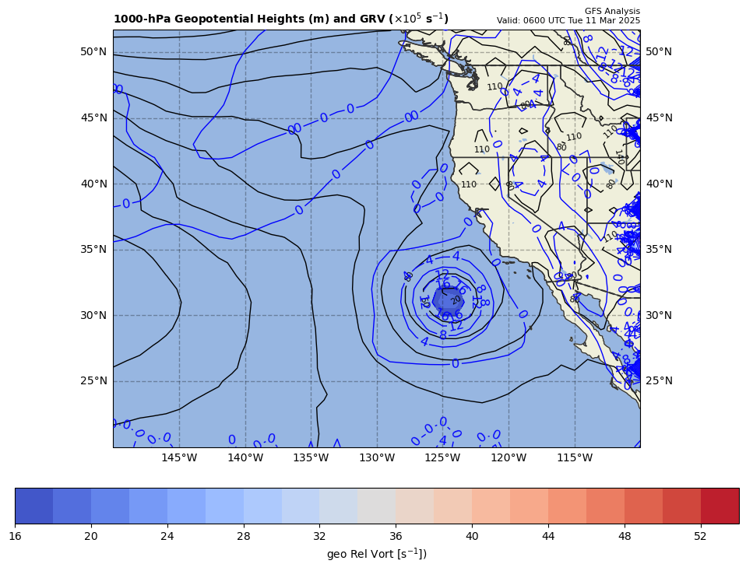
1000 hPa Z/Geo Rel Vort at t0
+

Slide 2
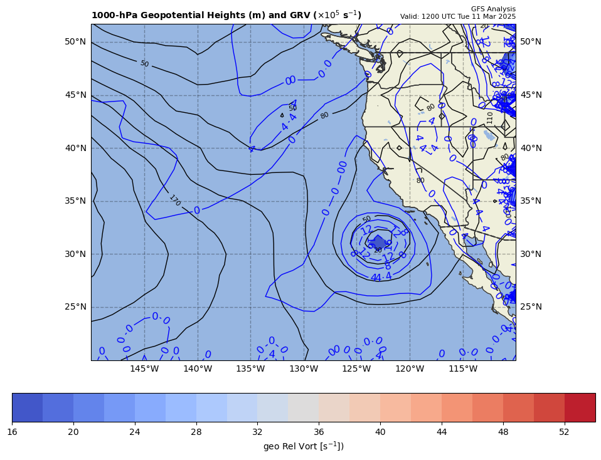
1000 hPa Z/Geo Rel Vort at t1
+
+

Slide 3
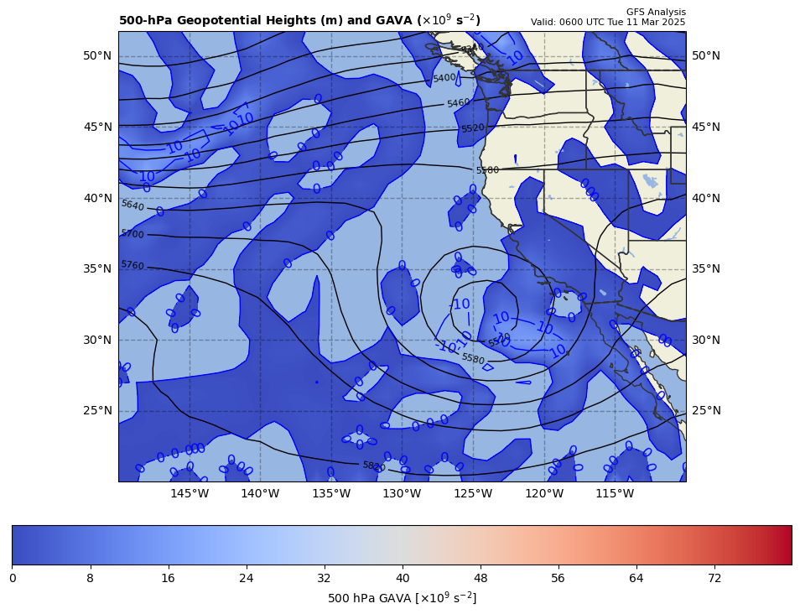
06Z GAVA (x 10⁻⁹ s⁻²); positive at 12Z position
+
+13.5 x 10⁻⁹ s⁻²
Giving a positive GAVA contribution to cyclogenesis

Slide 4
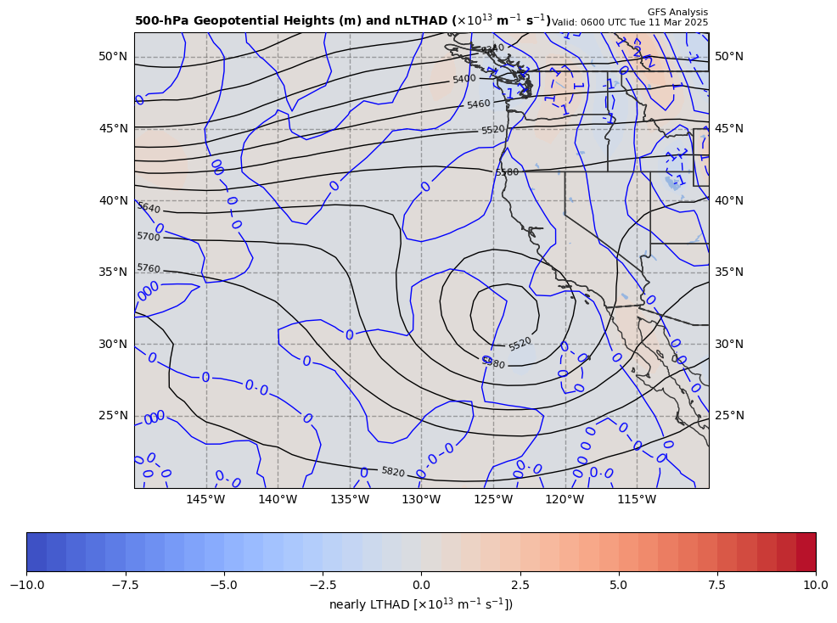
06Z nearly LTHAD (x 10⁻¹³ m⁻¹s⁻¹); negative at 12Z position
OLD WAY!!
+
-[9.81 m s⁻²/ (7.490925x10⁻⁵ s⁻¹)]*(-0.400879 x10⁻¹³ m⁻¹s⁻¹) = +5.24985 x 10⁻⁹ s⁻²
So, multiply by –g/f, giving a positive LTHAD contribution to cyclogenesis

Slide 5
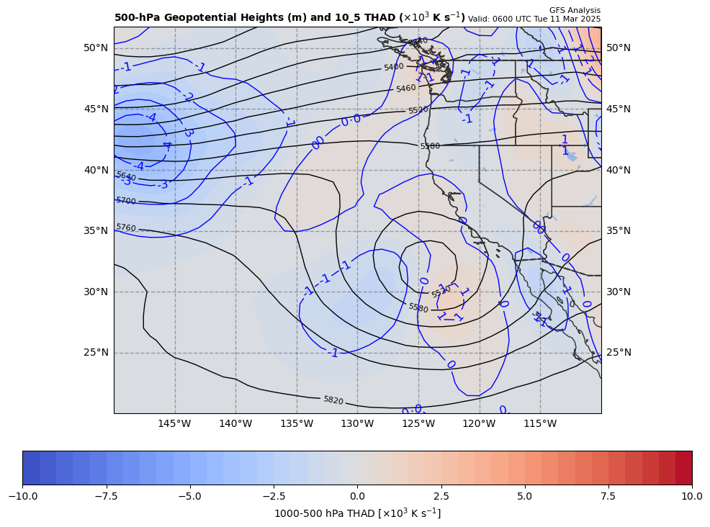
06Z nearly LTHAD (x 10⁻¹³ m⁻¹s⁻¹); negative at 12Z position
THAD field shown
NEW WAY!!
+
-[9.81 m s⁻²/ (7.490925x10⁻⁵ s⁻¹)]*(-0.400879 x10⁻¹³ m⁻¹s⁻¹) = +5.24985 x 10⁻⁹ s⁻²
So, multiply by –g/f, giving a positive LTHAD contribution to cyclogenesis

Slide 6
06Z nearly LTHAD (x 10⁻¹³ m⁻¹s⁻¹); negative at 12Z position
+0.233
+
THAD field shown
x 10⁻³ m s⁻¹
NEW WAY!!
1.0º long. = 95.15 km
+
-0.394
+0.793
+0.785
+
+
+
+
+
+
+
+1.223
-[9.81 m s⁻²/ (7.490925x10⁻⁵ s⁻¹)]*(-0.35591x10⁻¹³ m⁻¹s⁻¹) = +4.66096 x 10⁻⁹ s⁻²
So, multiply by –g/f, giving a positive LTHAD contribution to cyclogenesis

Slide 7
Coriolis parameter= 7.49093E-005 for Lat= 31.0
GARP-based LTHAD= 5.24985E-9
finite diff-based LTHAD= 4.66096E-9
d2tdx2, d2tdy2, xnnLTHAD= -3.2960E-14 -2.63112E-15 -3.55911E-14

Slide 8
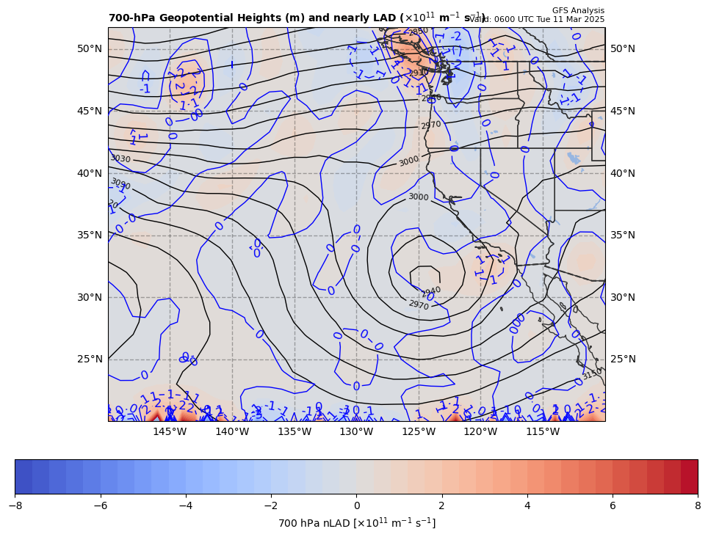
06Z nearly 700 hPa LAD (x 10⁻¹³ units); positive at 12Z position
+
+4.66096 x 10⁻⁹ s⁻² * 85% = −3.96181 x 10⁻⁹ s⁻²
So, multiply by –g/f, giving a negative LAD contribution to cyclogenesis

Slide 9
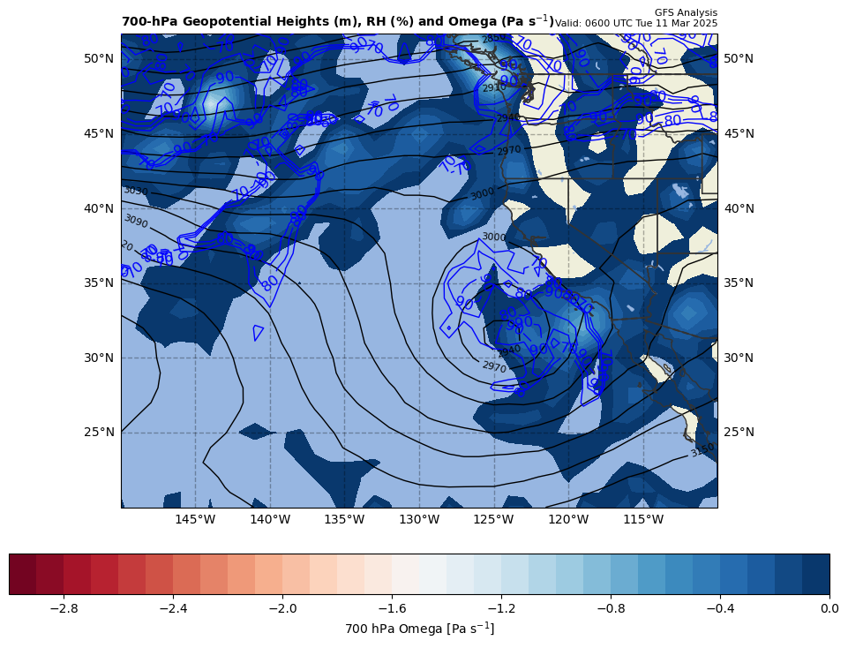
06Z nearly LDIA; latent heat release at 12Z position
+
3.96181 x 10⁻⁹ s⁻² * 70% = +2.77327 x 10⁻⁹ s⁻²
ω < 0 mb s⁻¹ & RH > 70%!!!

Slide 10
Calculations
Sum of terms on RHS = GAVA + LTHAD + LAD + LDIA
= +17.0724 x 10⁻⁹ s⁻²
Finite difference approximation of LHS = ∂GRV/∂t
= [(17.8 – {14.3}]) x 10⁻⁵ s⁻¹ ] / [6 h * 60 min/h * 60 s/min]
= +1.62037 x 10⁻⁹ s⁻²
RHS = +10.536 x LHS

Slide 11
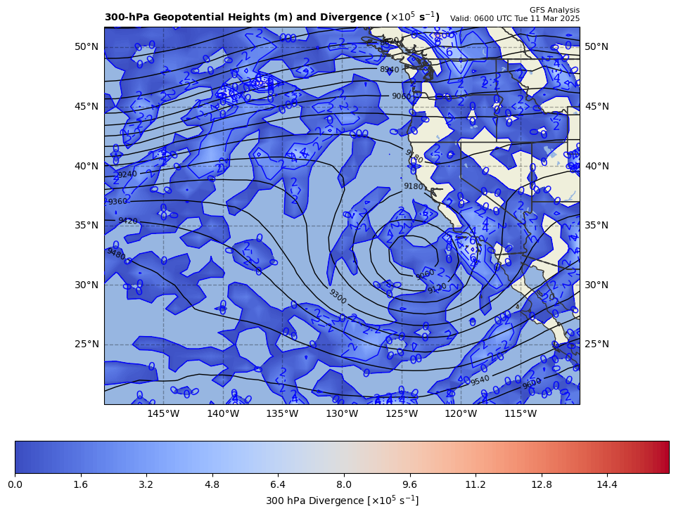
300 hPa Z, Div at t0
+
[+]

Slide 12
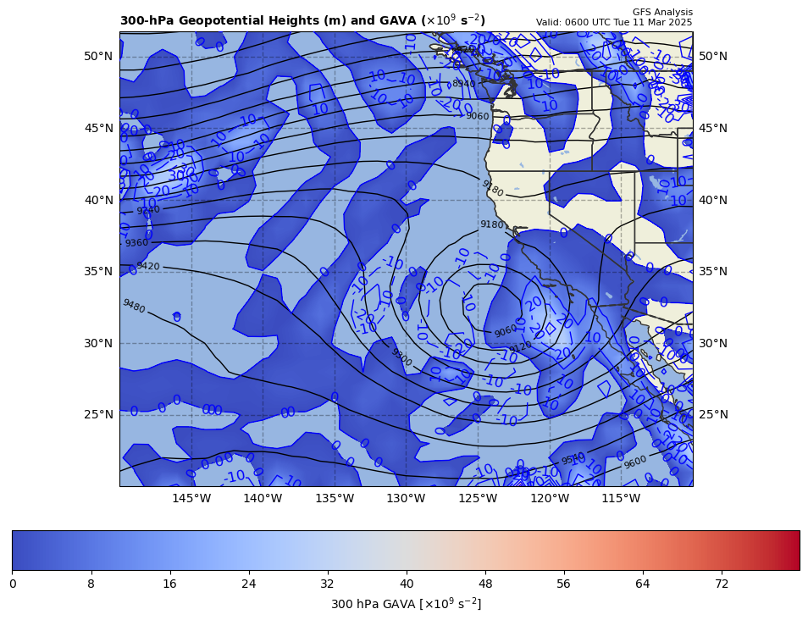
300 hPa Z, GAVA at t0
+
[+]

Slide 13
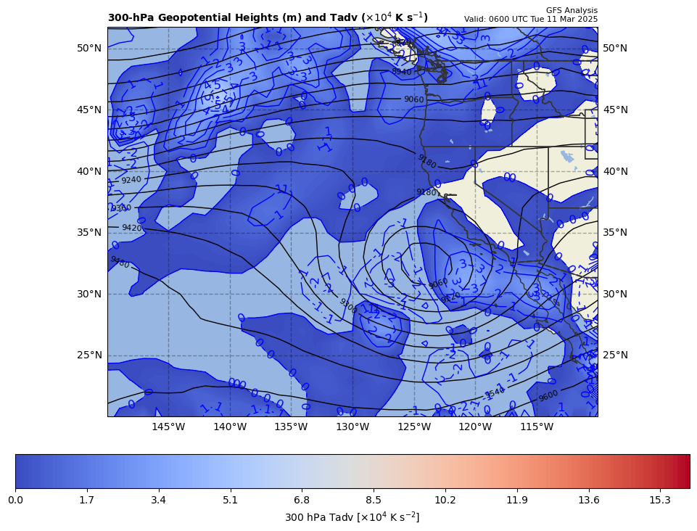
300 hPa Z, Temp Adv at t0
+
[+]

