Slide 1
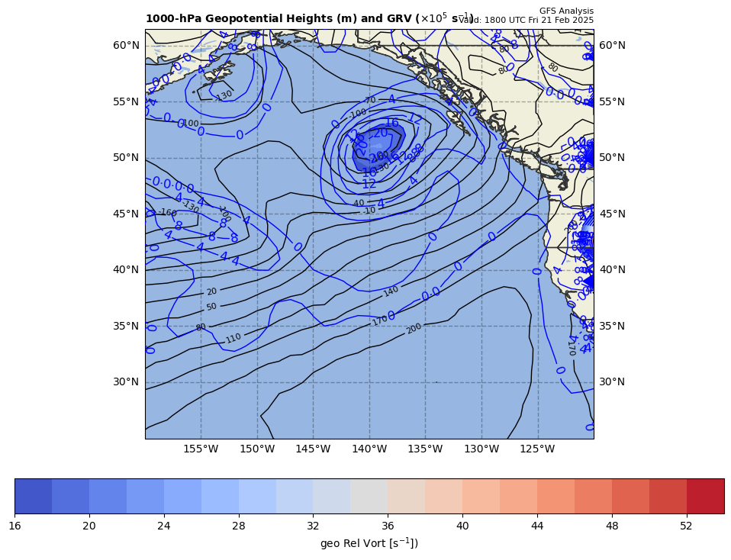
1000 hPa Z/Geo Rel Vort at t0
+

Slide 2
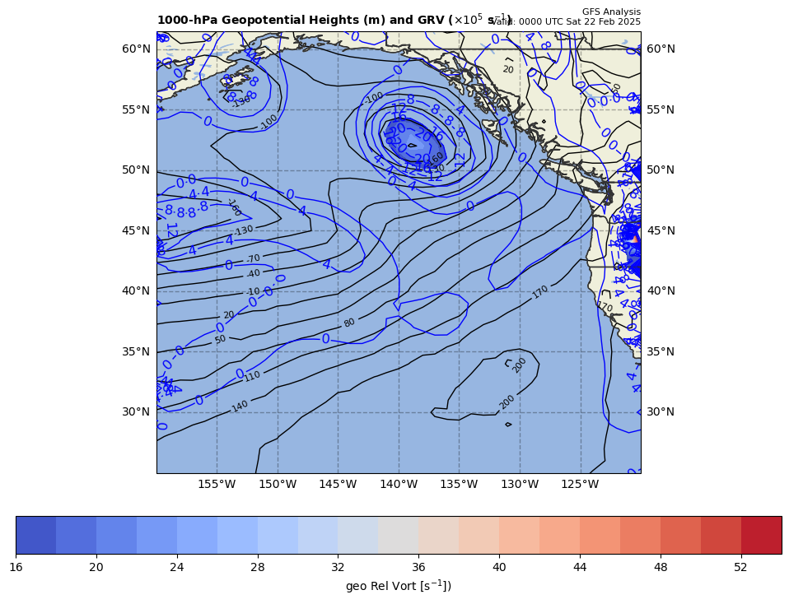
1000 hPa Z/Geo Rel Vort at t1
+
+

Slide 3
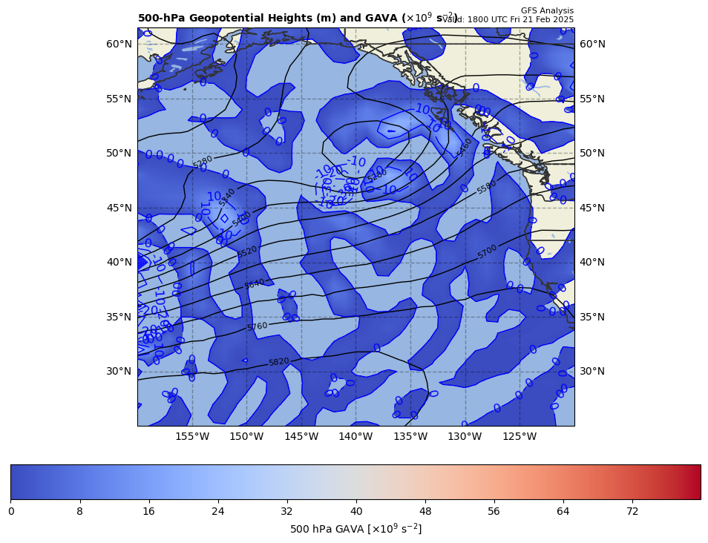
18Z GAVA (x 10⁻⁹ s⁻²); positive at 00Z position
+
+6.14 x 10⁻⁹ s⁻²
Giving a positive GAVA contribution to cyclogenesis

Slide 4
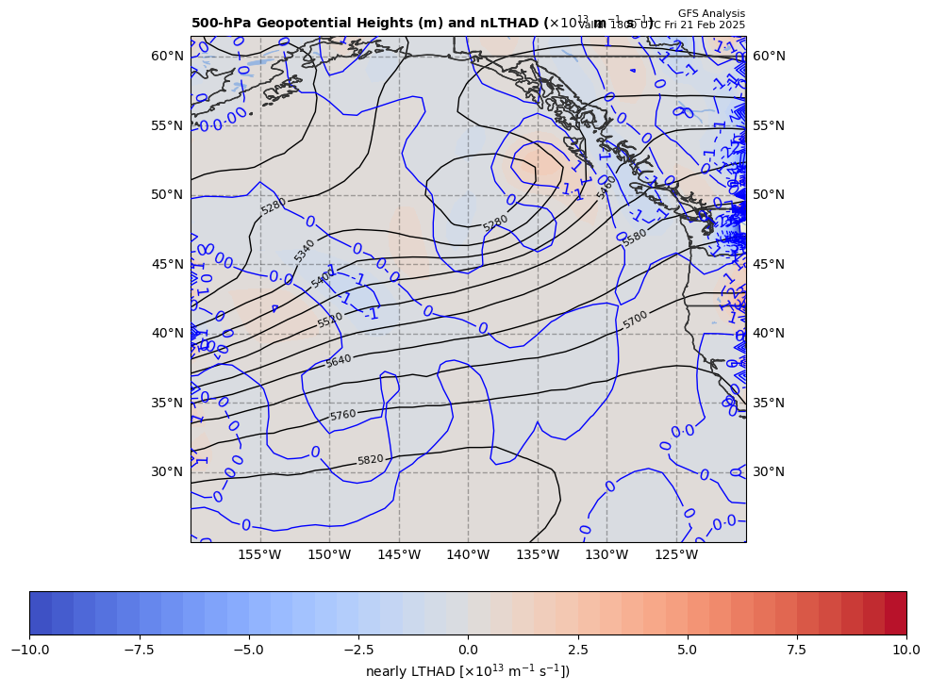
18Z nearly LTHAD (x 10⁻¹³ m⁻¹s⁻¹); negative at 00Z position
+
OLD WAY!!
-[9.81 m s⁻²/ (11.61568x10⁻⁵ s⁻¹)]*(-0.5306 x10⁻¹³ m⁻¹s⁻¹) = +4.2485 x 10⁻⁸ s⁻²
So, multiply by –g/f, giving a positive LTHAD contribution to cyclogenesis

Slide 5
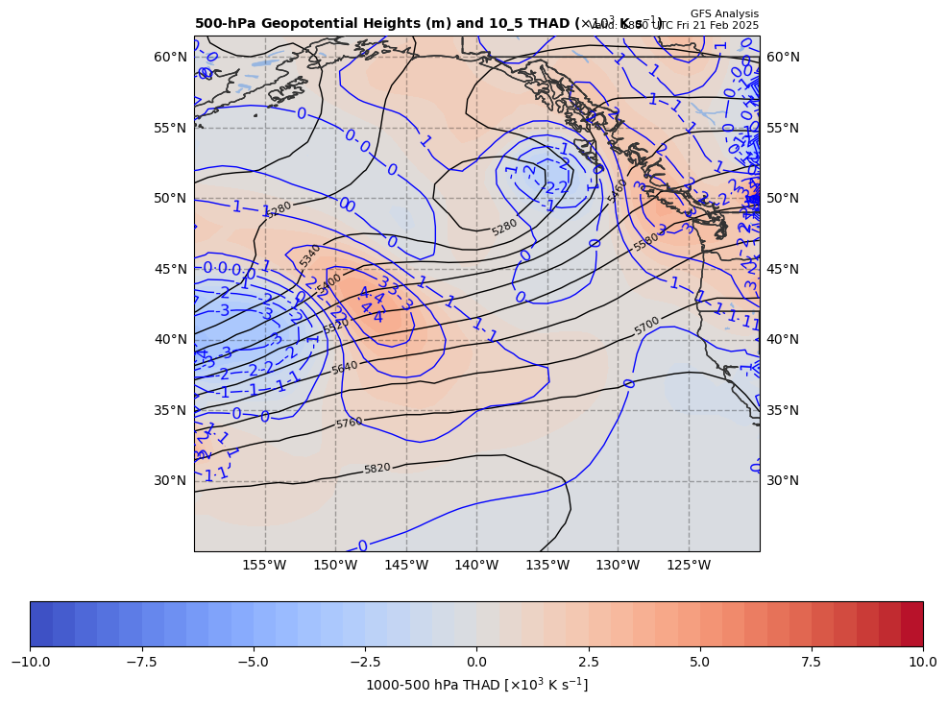
18Z nearly LTHAD (x 10⁻¹³ m⁻¹s⁻¹); negative at 00Z position
+
THAD field shown
NEW WAY!!
-[9.81 m s⁻²/ (11.61568x10⁻⁵ s⁻¹)]*(-0.5306 x10⁻¹³ m⁻¹s⁻¹) = +4.2485 x 10⁻⁸ s⁻²
So, multiply by –g/f, giving a positive LTHAD contribution to cyclogenesis

Slide 6
18Z nearly LTHAD (x 10⁻¹³ m⁻¹s⁻¹); negative at 00Z position
+1.63
+
THAD field shown
x 10⁻³ m s⁻¹
NEW WAY!!
1.0º long. = 66.80 km
+
+1.04
+
+
+
+1.28
+
+
+0.65
+
+
+0.84
-[9.81 m s⁻²/ (11.61568x10⁻⁵ s⁻¹)]*(-5.03055x10⁻¹⁴ m⁻¹s⁻¹) = +4.24854 x 10⁻⁹ s⁻²
So, multiply by –g/f, giving a positive LTHAD contribution to cyclogenesis

Slide 7
Coriolis parameter= 1.16157E-004 for Lat= 53.0
GARP-based LTHAD= 4.24055E-9
finite diff-based LTHAD= 4.24854E-9
d2tdx2, d2tdy2, xnnLTHAD= -4.86782E-14 -1.62726E-15 - 5.03055E-14

Slide 8
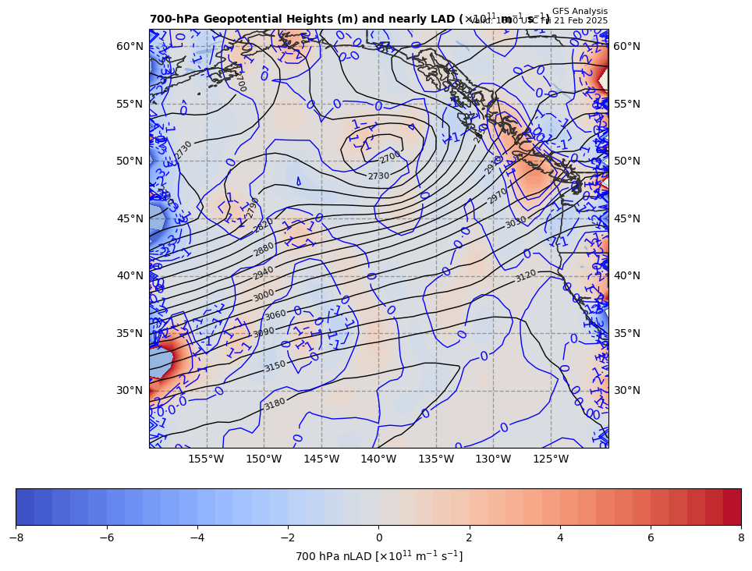
18Z nearly 700 hPa LAD (x 10⁻¹³ units); positive at 00Z position
+
+4.24854 x 10⁻⁹ s⁻² * 85% = −3.61126 x 10⁻⁹ s⁻²
So, multiply by –g/f, giving a negative LAD contribution to cyclogenesis

Slide 9
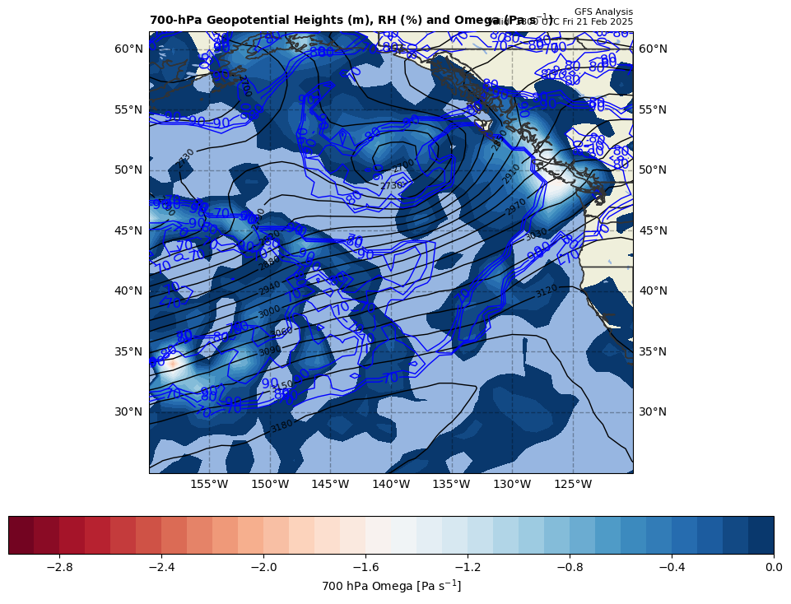
18Z nearly LDIA; latent heat release at 00Z position
+
3.61126 x 10⁻⁹ s⁻² * 70% = +2.52788 x 10⁻⁹ s⁻²
ω < 0 mb s⁻¹ & RH > 70%!!!

Slide 10
Calculations
Sum of terms on RHS = GAVA + LTHAD + LAD + LDIA
= +9.30516 x 10⁻⁹ s⁻²
Finite difference approximation of LHS = ∂GRV/∂t
= [(16.6 – {8.8}]) x 10⁻⁵ s⁻¹ ] / [6 h * 60 min/h * 60 s/min]
= +3.61111 x 10⁻⁹ s⁻²
RHS = +2.5768 x LHS

Slide 11
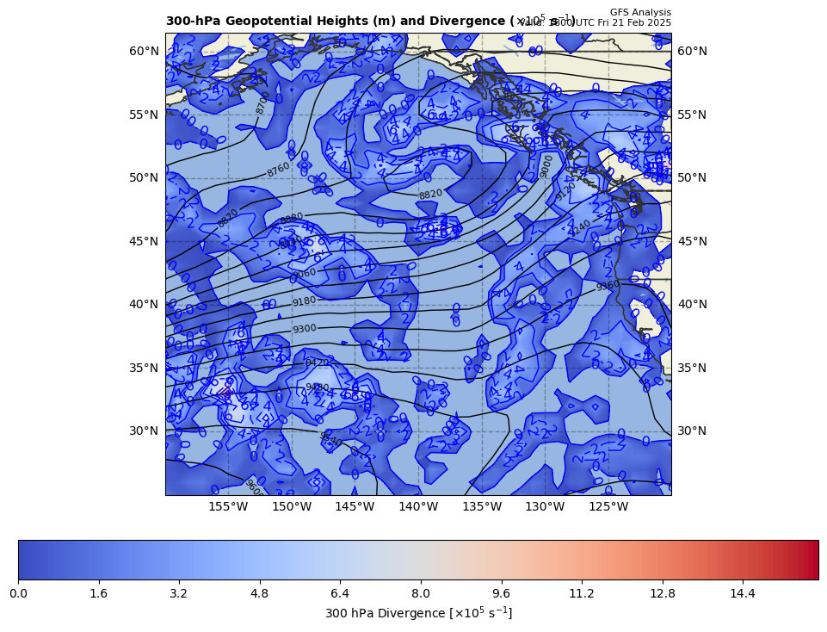
300 hPa Z, Div at t0
+
[+]

Slide 12
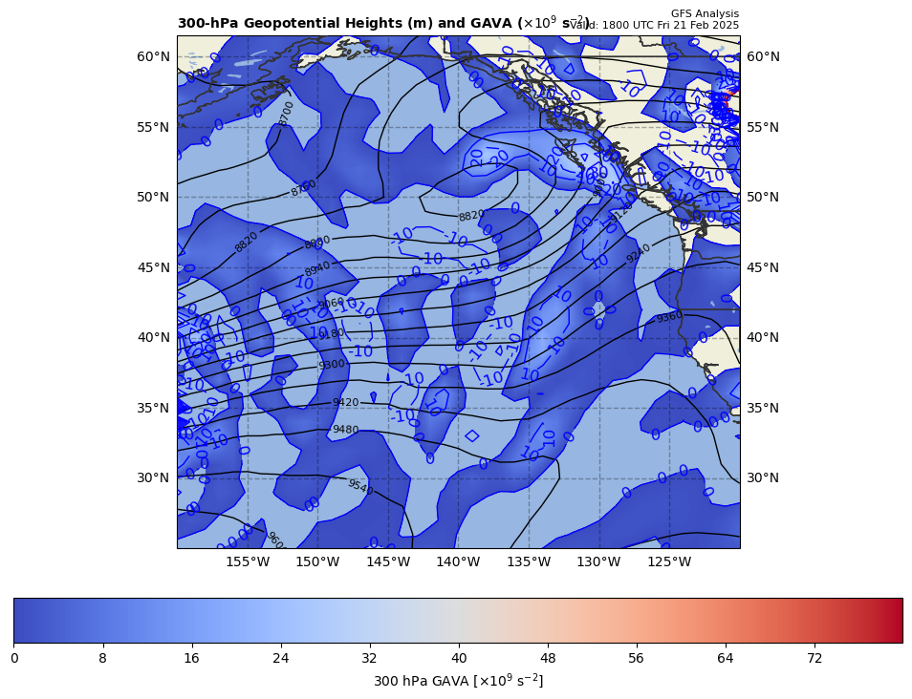
300 hPa Z, GAVA at t0
+
[+]

Slide 13
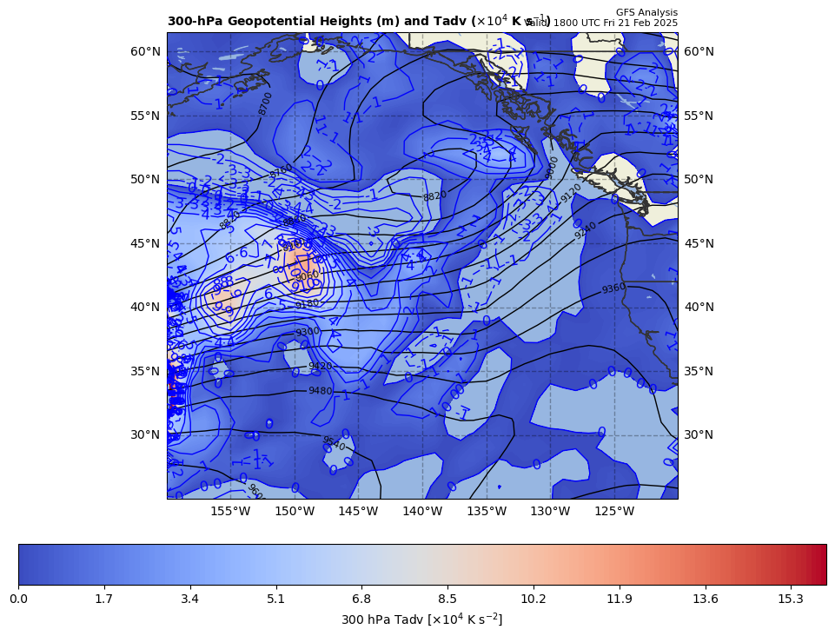
300 hPa Z, Temp Adv at t0
+
[+]

