Slide 1
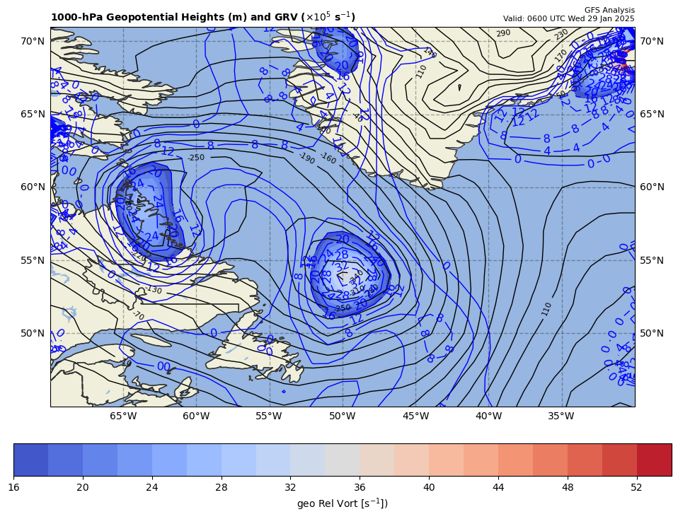
1000 hPa Z/Geo Rel Vort at t0
+
+

Slide 2
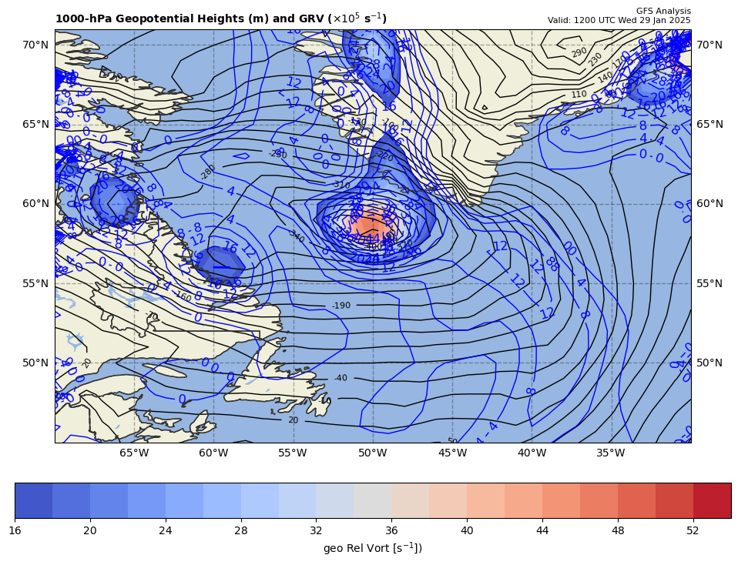
1000 hPa Z/Geo Rel Vort at t1
+

Slide 3
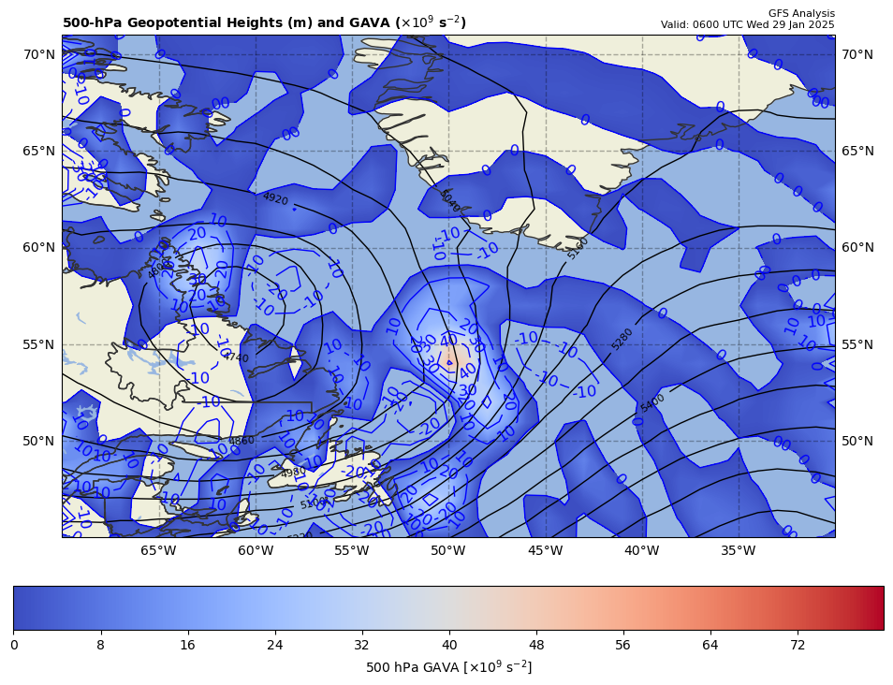
06Z GAVA (x 10⁻⁹ s⁻²); positive at 12Z position
+
+16.67 x 10⁻⁹ s⁻²
Giving a positive GAVA contribution to cyclogenesis

Slide 4
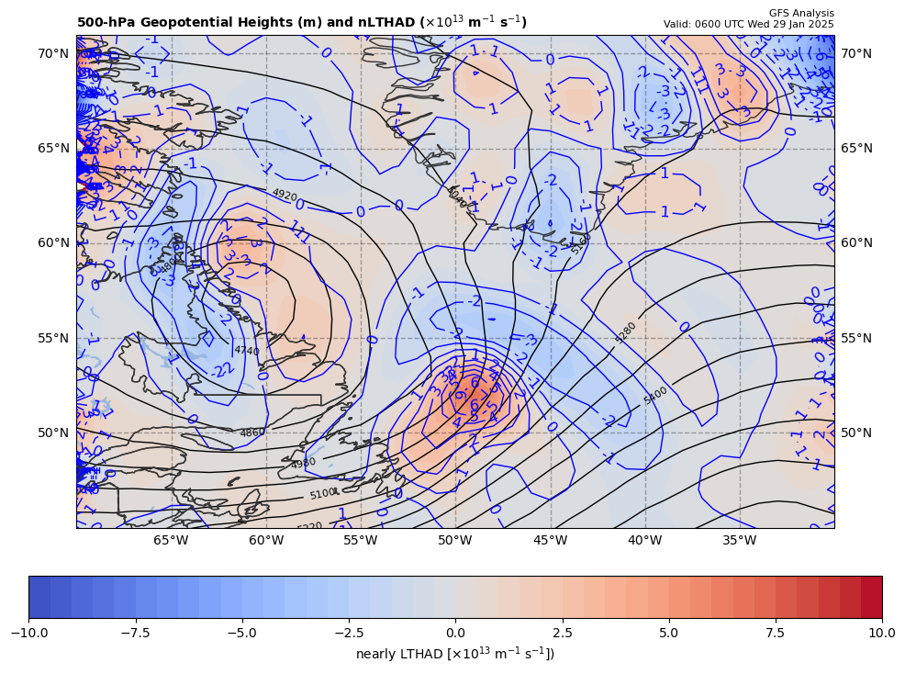
06Z nearly LTHAD (x 10⁻¹³ m⁻¹s⁻¹); negative at 12Z position
+
-[9.81 m s⁻²/ (10.10340x10⁻⁵ s⁻¹)]*(-0.9344295x10⁻¹³ m⁻¹s⁻¹) = +7.431884 x 10⁻⁹ s⁻²
So, multiply by –g/f, giving a positive LTHAD contribution to cyclogenesis

Slide 5
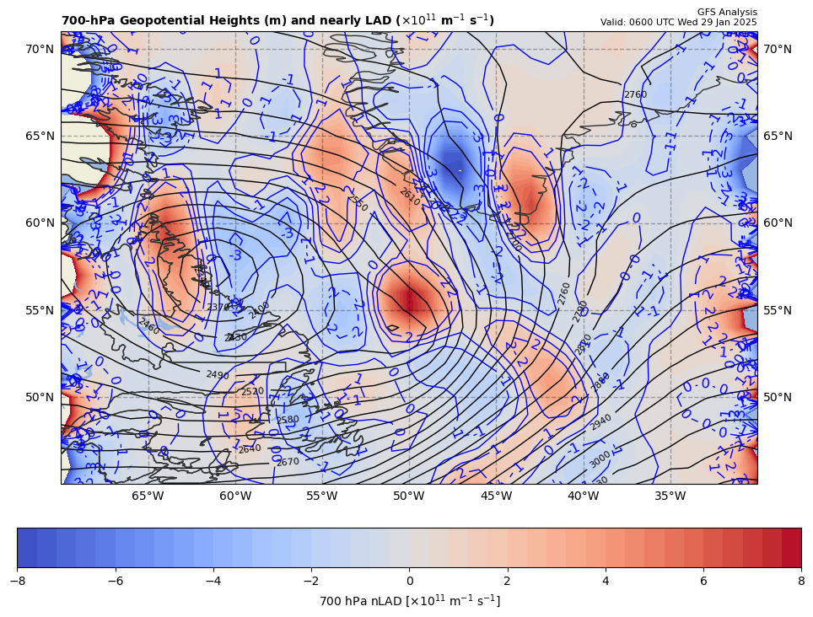
06Z nearly 700 hPa LAD (x 10⁻¹³ units); positive at 12Z position
+
7.431884 x 10⁻⁹ s⁻² * 85% = −6.317101 x 10⁻⁹ s⁻²
So, multiply by –g/f, giving a negative LAD contribution to cyclogenesis

Slide 6
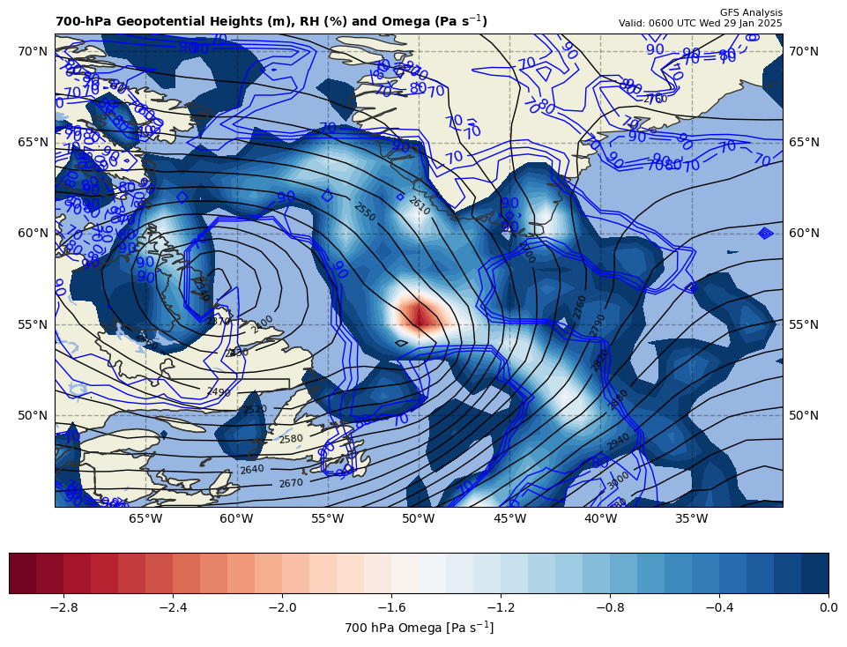
06Z nearly LDIA; latent heat release at 12Z position
+
6.317101 x 10⁻⁹ s⁻² * 70% = +4.421971 x 10⁻⁹ s⁻²
ω < 0 m s⁻¹ & RH ≥ 70%!!!

Slide 7
Calculations
Sum of terms on RHS = GAVA + LTHAD + LAD + LDIA
= +22.13675 x 10⁻⁹ s⁻²
Finite difference approximation of LHS = dGRV/dt
= [(47.5 – {11.0}]) x 10⁻⁵ s⁻¹ ] / [6 h * 60 min/h * 60 s/min]
= +16.89815 x 10⁻⁹ s⁻²
RHS = 1.31 x LHS

Slide 8
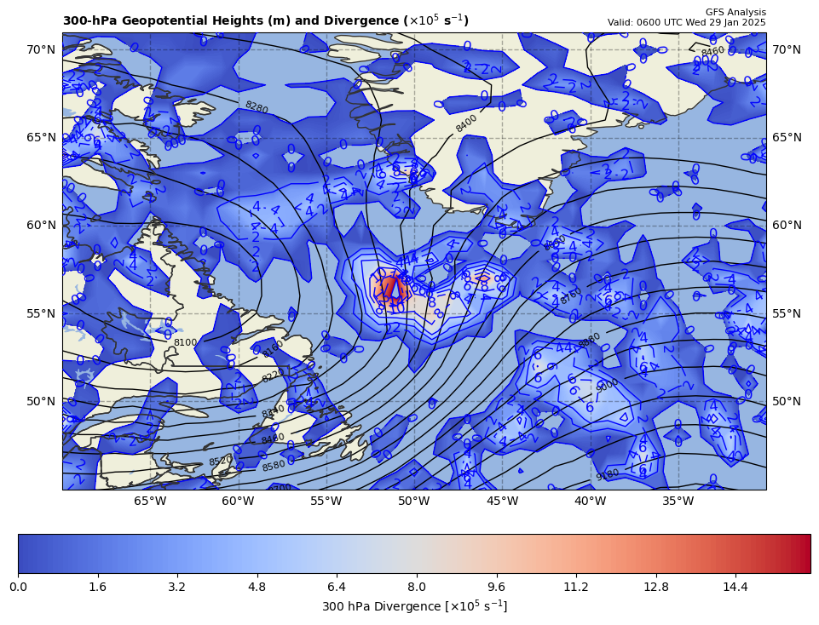
300 hPa Z, Div at t0
+
[+]

Slide 9
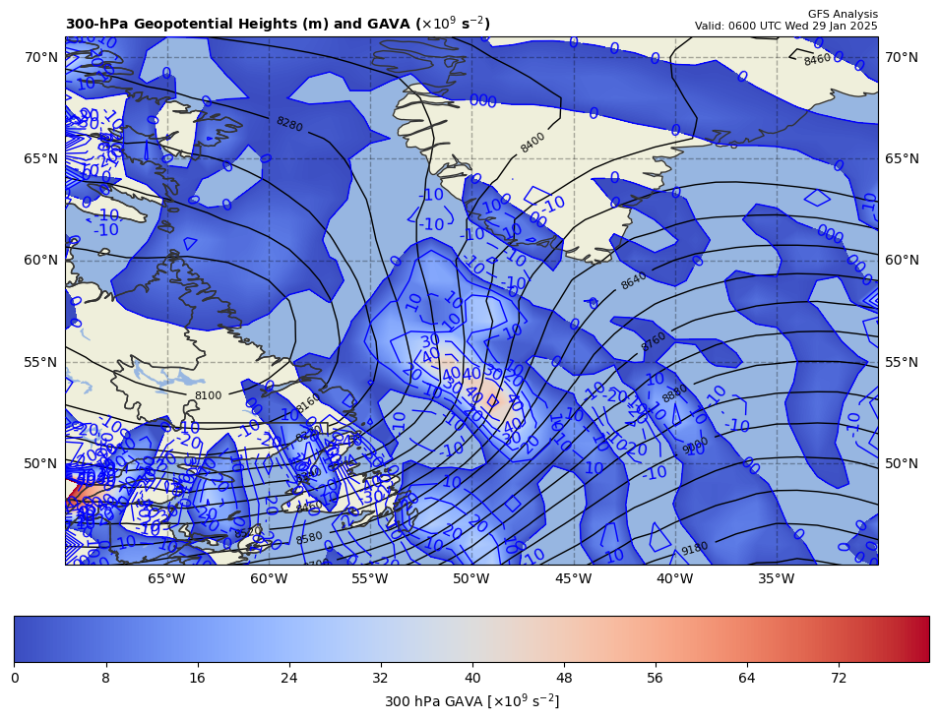
300 hPa Z, GAVA at t0
+
[+]

Slide 10
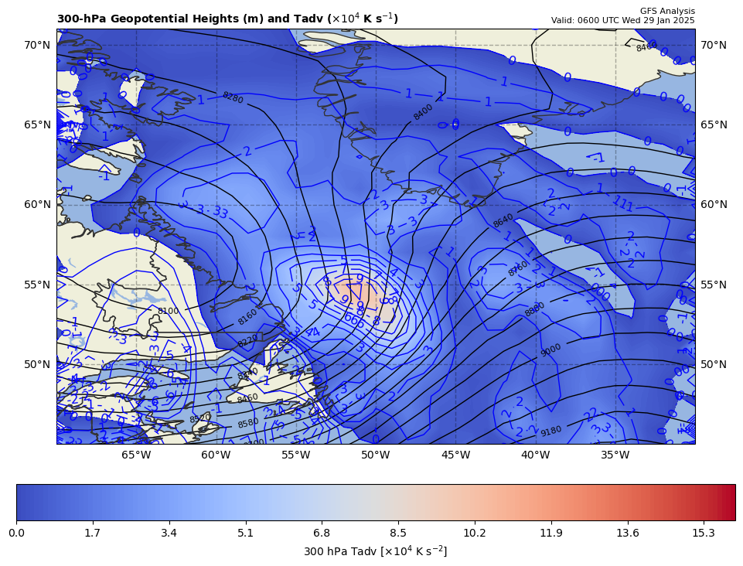
300 hPa Z, Temp Adv at t0
+
[+]

