Slide 1
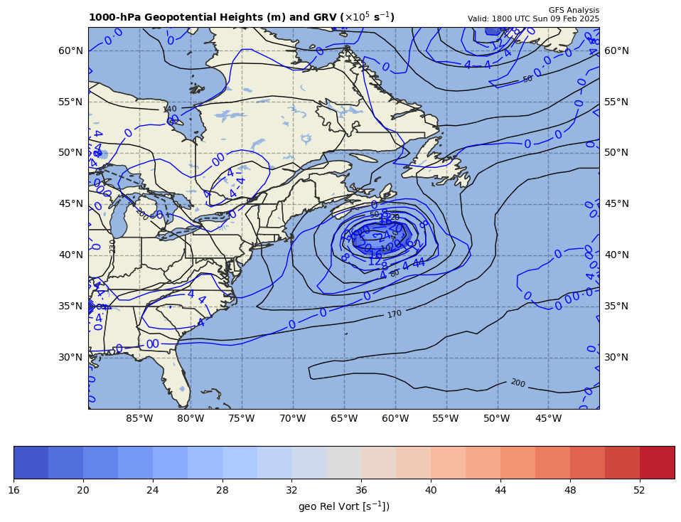
1000 hPa Z/Geo Rel Vort at t0
+

Slide 2
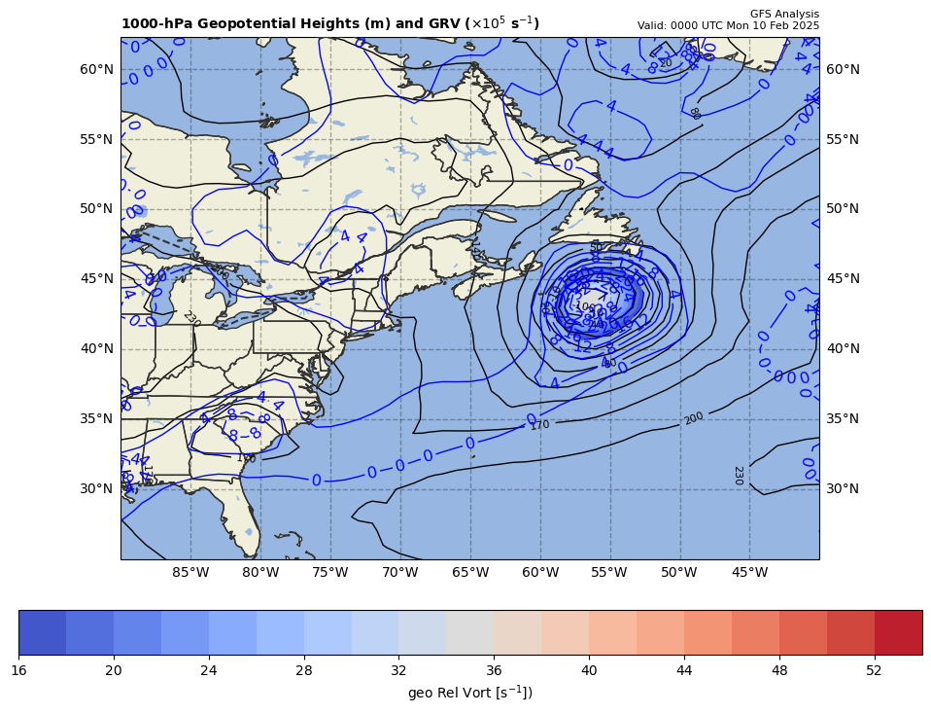
1000 hPa Z/Geo Rel Vort at t1
+

Slide 3
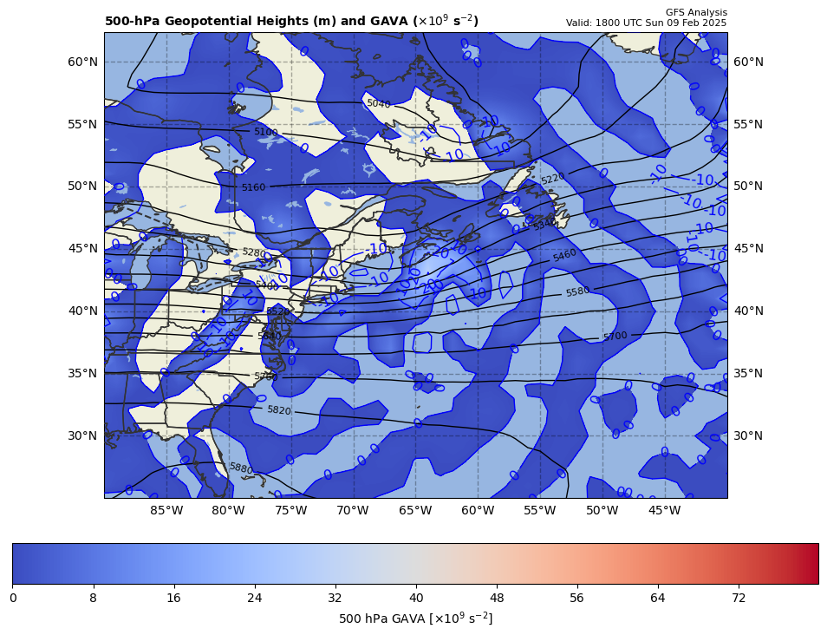
12Z GAVA (x 10⁻⁹ s⁻²); negative at 18Z position
+
−6.21 x 10⁻⁹ s⁻²
Giving a negative GAVA contribution to cyclogenesis

Slide 4
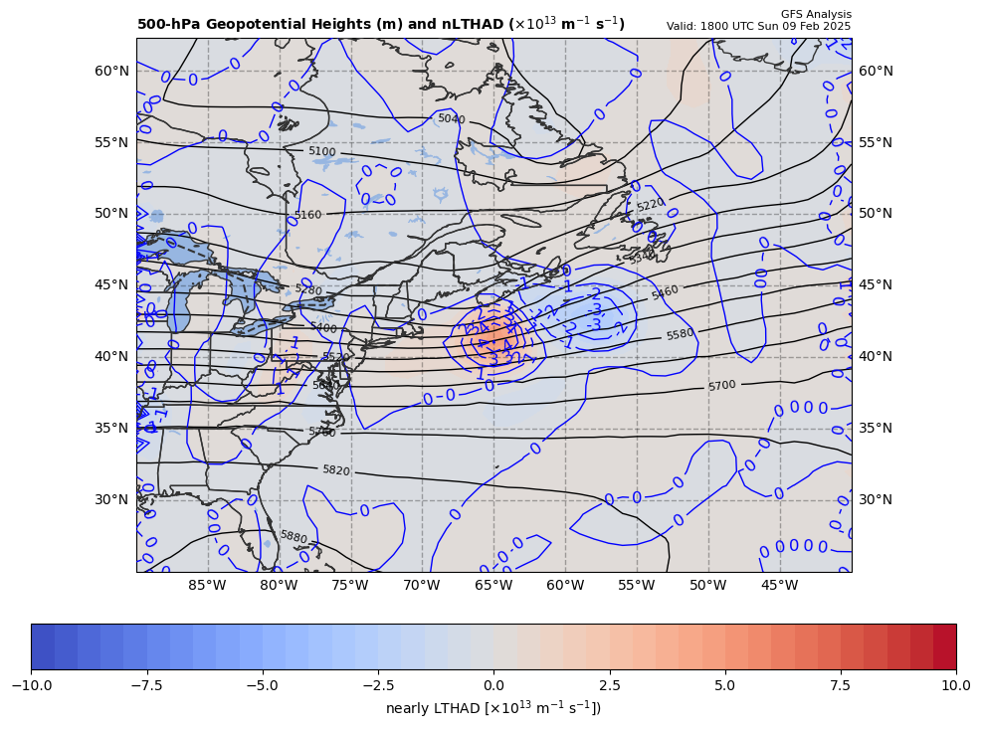
12Z nearly LTHAD (x 10⁻¹³ m⁻¹s⁻¹); negative at 18Z position
+
-[9.81 m s⁻²/ (10.10340x10⁻⁵ s⁻¹)]*(-2.136368x10⁻¹³ m⁻¹s⁻¹) = +20.74329 x 10⁻⁹ s⁻²
So, multiply by –g/f, giving a positive LTHAD contribution to cyclogenesis

Slide 5
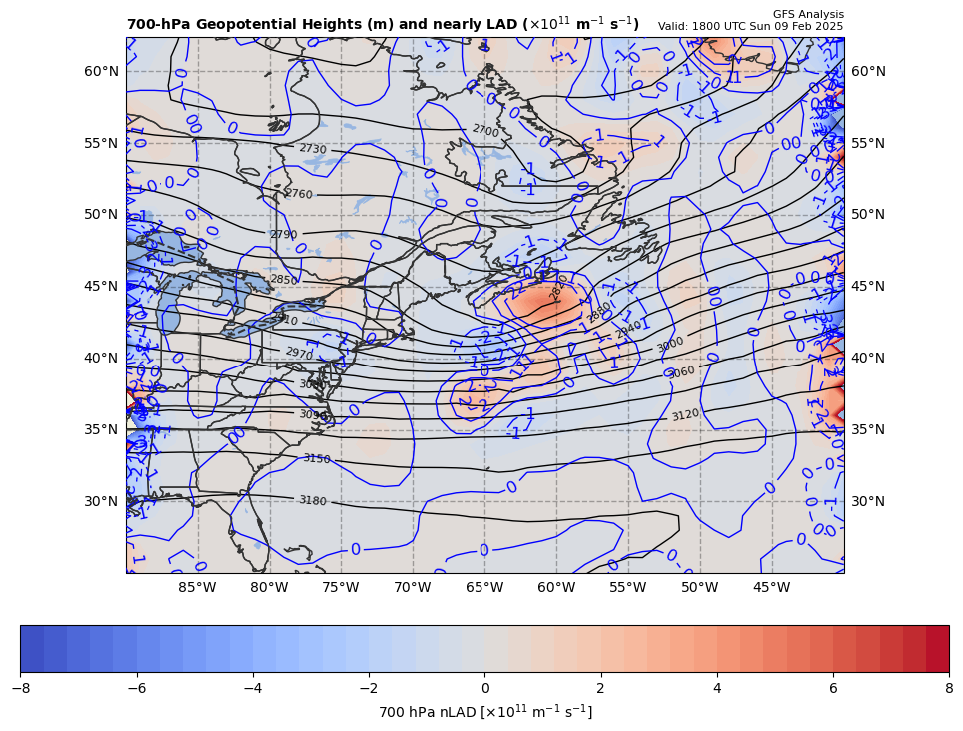
12Z nearly 700 hPa LAD (x 10⁻¹³ units); negative at 18Z position
+
+20.74329 x 10⁻⁹ s⁻² * 85% = +17.631796 x 10⁻⁹ s⁻²
So, multiply by –g/f, giving a positive LAD contribution to cyclogenesis

Slide 6
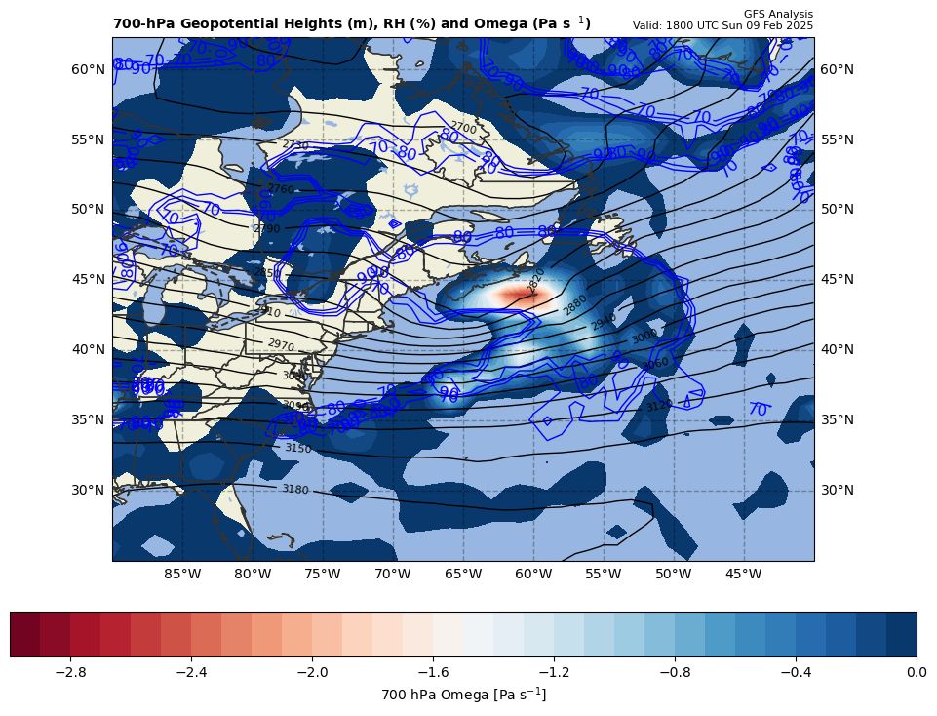
12Z nearly LDIA; latent heat release at 18Z position
+
17.631796 x 10⁻⁹ s⁻² * 70% = +12.34226 x 10⁻⁹ s⁻²
ω < 0 m s⁻¹ & RH ≥ 70%!!!

Slide 7
Calculations
Sum of terms on RHS = GAVA + LTHAD + LAD + LDIA
= +44.50734 x 10⁻⁹ s⁻²
Finite difference approximation of LHS = dGRV/dt
= [(33.6 – {2.6}]) x 10⁻⁵ s⁻¹ ] / [6 h * 60 min/h * 60 s/min]
= +14.35185 x 10⁻⁹ s⁻²
RHS = 3.10 x LHS

Slide 8
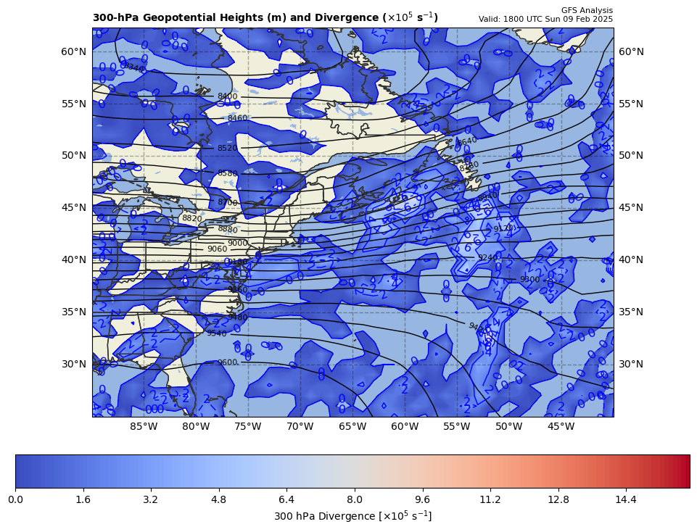
300 hPa Z, Div at t0
+
[+]

Slide 9
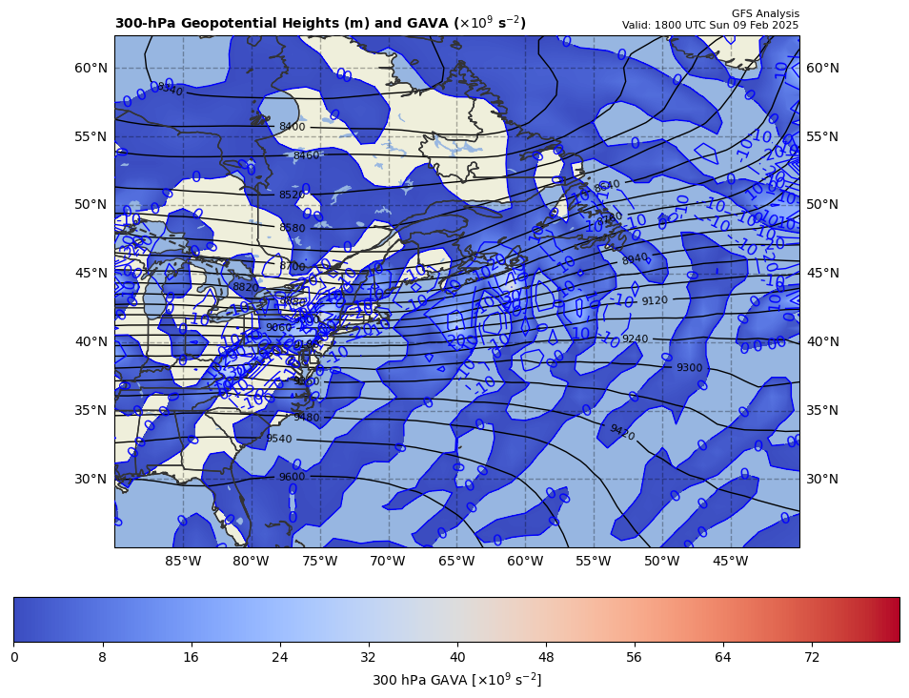
300 hPa Z, GAVA at t0
+
[+]

Slide 10
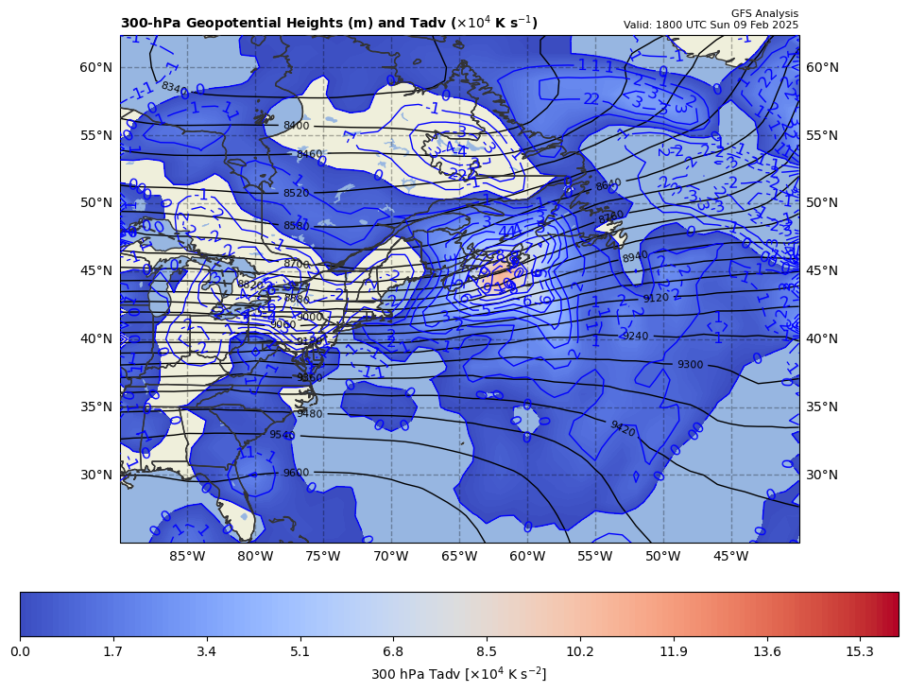
300 hPa Z, Temp Adv at t0
+
[+]

