Slide 1
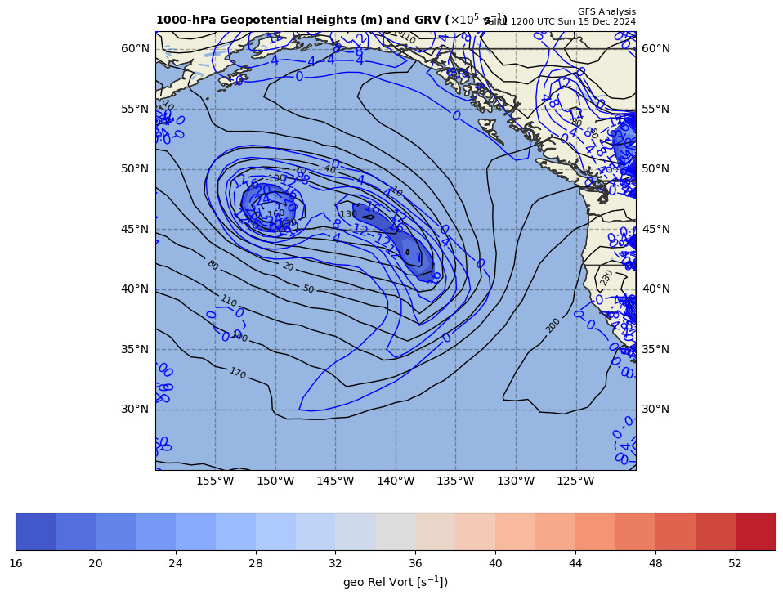
1000 hPa Z/Geo Rel Vort at t0
+
+

Slide 2
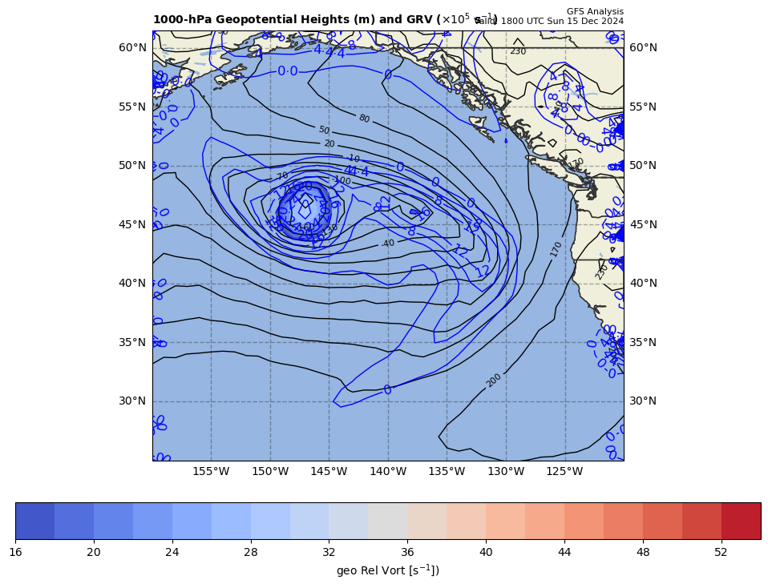
1000 hPa Z/Geo Rel Vort at t1
+

Slide 3
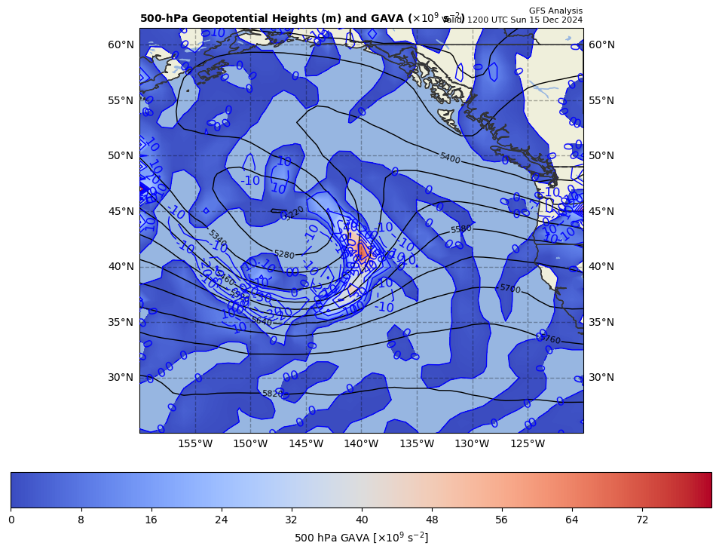
12Z GAVA (x 10⁻⁹ s⁻²); positive at 18Z position
+
+11.1 x 10⁻⁹ s⁻²
Giving a positive GAVA contribution to cyclogenesis

Slide 4
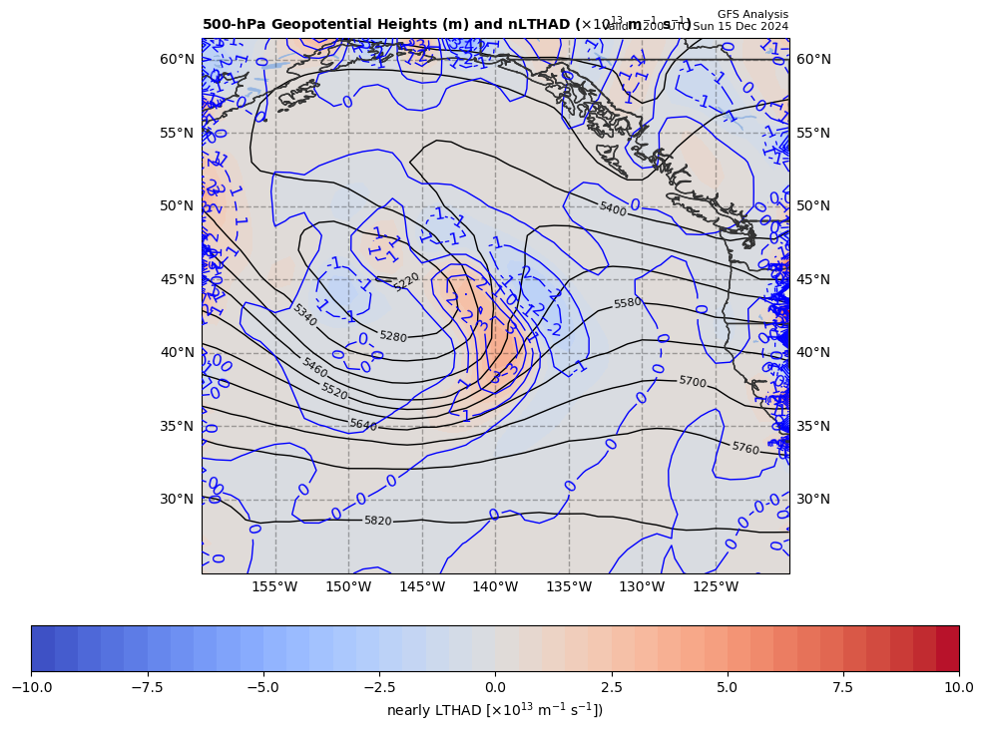
12Z nearly LTHAD (x 10⁻¹³ m⁻¹s⁻¹); positive at 18Z position
+
-[9.81 m s⁻²/ (10.637108x10⁻⁵ s⁻¹)]*(+1.10185x10⁻¹³ m⁻¹s⁻¹) = −10.16175 x 10⁻⁹ s⁻²
So, multiply by –g/f, giving a negative LTHAD contribution to cyclogenesis

Slide 5
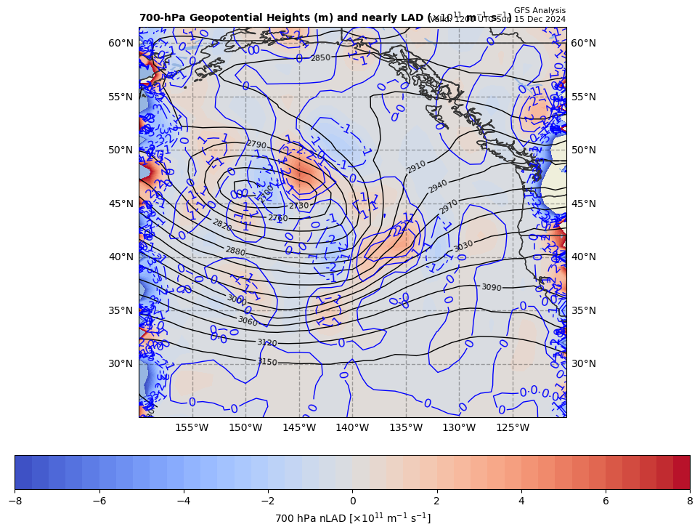
12Z nearly 700 hPa LAD (x 10⁻¹³ units); negative at 18Z position
+
+ 10.16175 x 10⁻⁹ s⁻² * 85% = +8.63748 x 10⁻⁹ s⁻²
So, multiply by –g/f, giving a positive LAD contribution to cyclogenesis

Slide 6
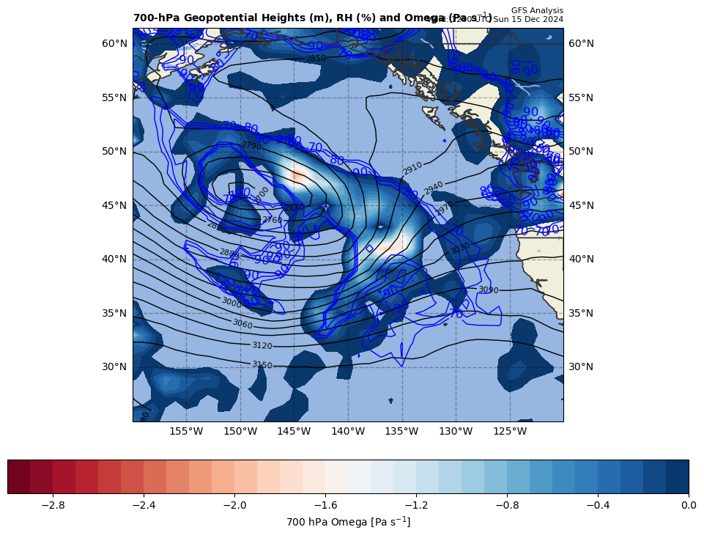
12Z nearly LDIA; latent heat release at 18Z position
+
8.11075 x 10⁻⁹ s⁻² * 70% = +0.00000 x 10⁻⁹ s⁻²
ω > 0 (0.081 Pa s⁻¹) & RH ≥ 70%!!!

Slide 7
Calculations
Sum of terms on RHS = GAVA + LTHAD + LAD + LDIA
= +9.575738 x 10⁻⁹ s⁻²
Finite difference approximation of LHS = dGRV/dt
= [(23.9 – {9.5}]) x 10⁻⁵ s⁻¹ ] / [6 h * 60 min/h * 60 s/min]
= +8.842593 x 10⁻⁹ s⁻²
RHS = 1.083 x LHS

Slide 8
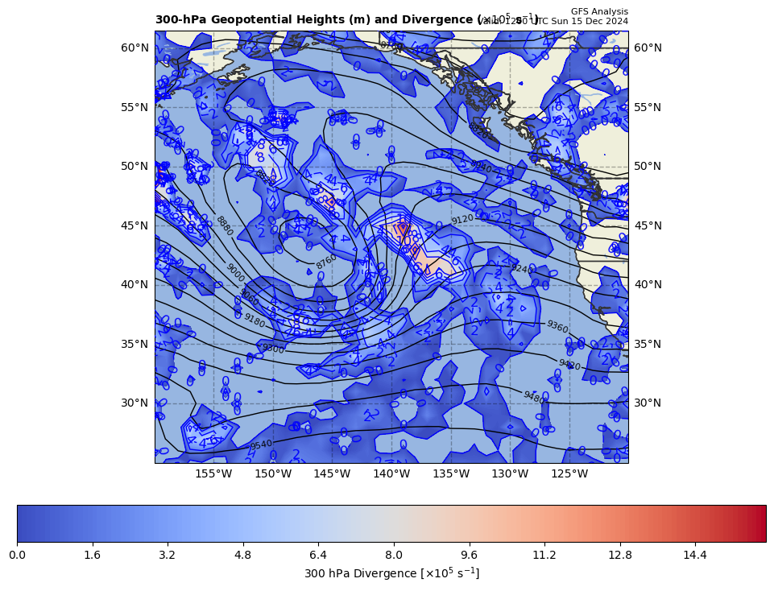
300 hPa Z, Div at t0
+
[−]

Slide 9
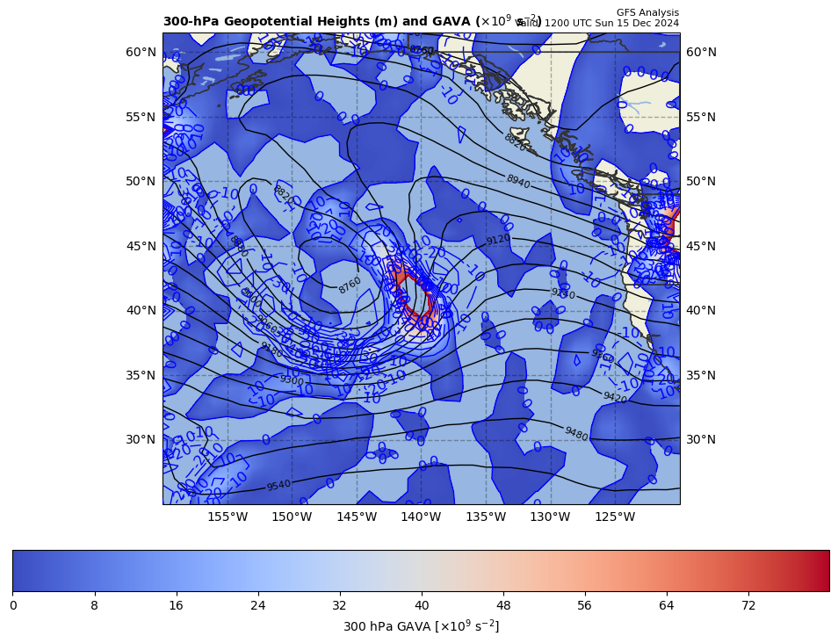
300 hPa Z, GAVA at t0
+
[+]

Slide 10
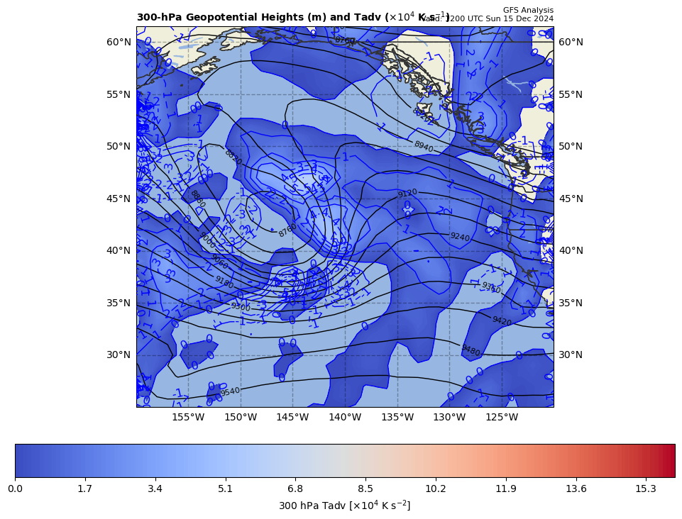
300 hPa Z, Temp Adv at t0
+
[+]

