Slide 1
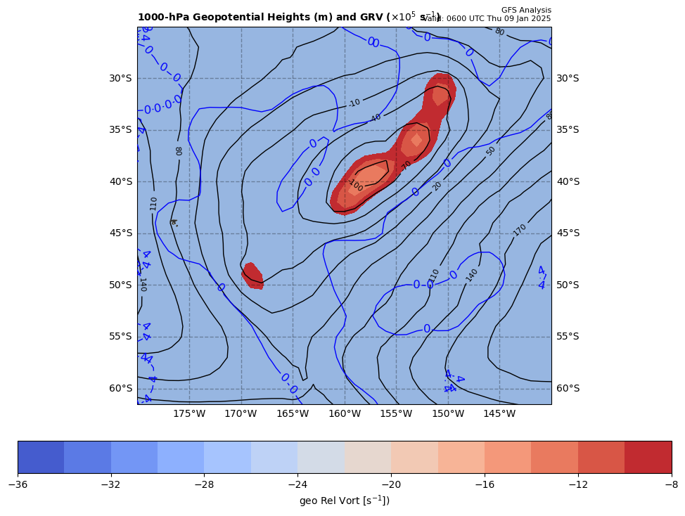
1000 hPa Z/Geo Rel Vort at t0
+

Slide 2
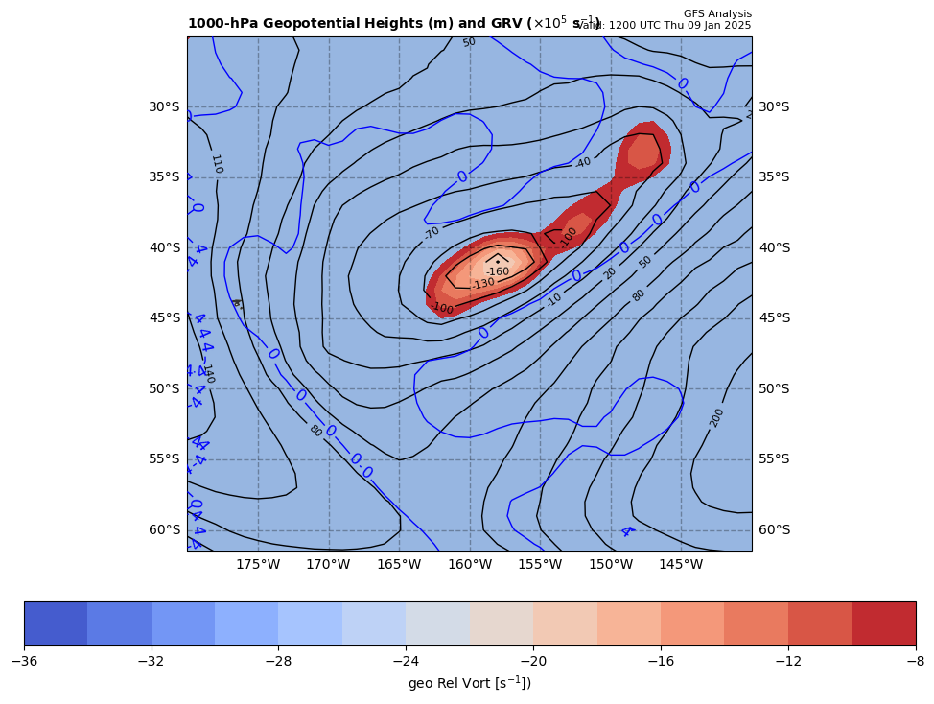
1000 hPa Z/Geo Rel Vort at t1
+
+

Slide 3
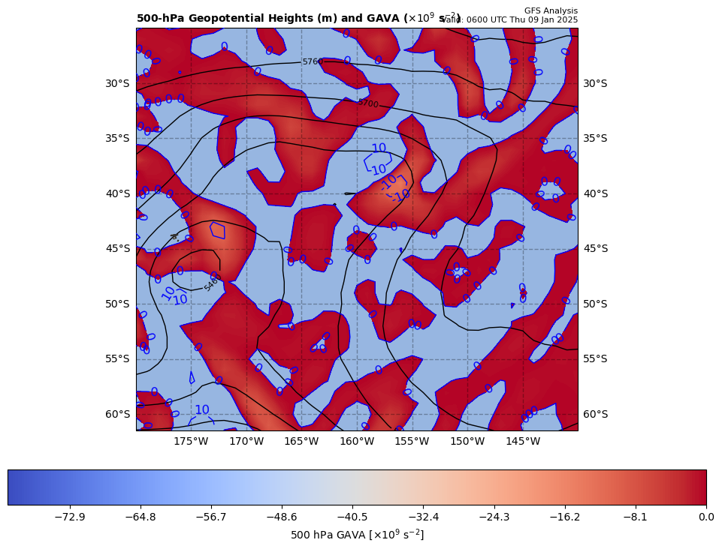
06Z GAVA (x 10⁻⁹ s⁻²); negative at 12Z position
+
−4.9467 x 10⁻⁹ s⁻²
Giving a GAVA contribution to cyclogenesis

Slide 4
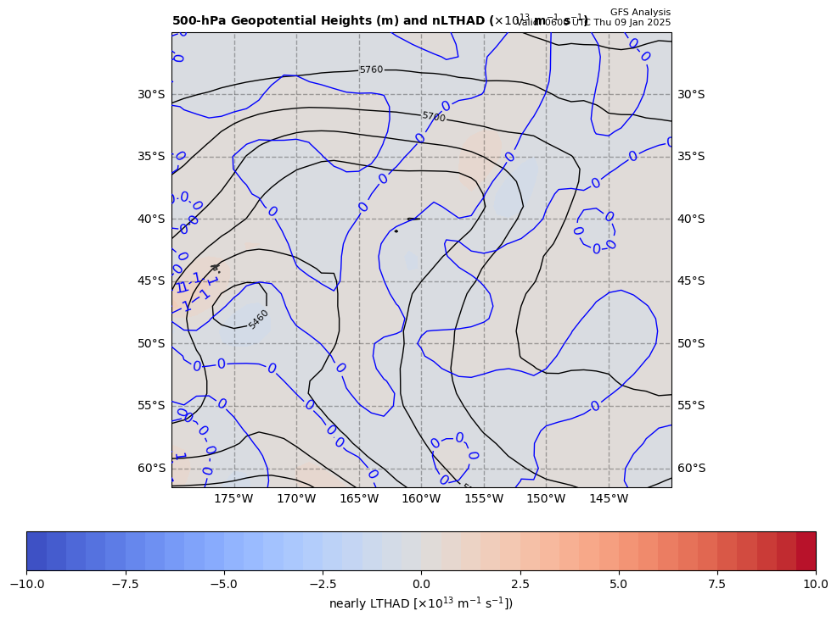
06Z nearly LTHAD (x 10⁻¹³ m⁻¹s⁻¹); negative at 12Z position
OLD WAY!!
+
-[9.81 m s⁻²/ (-9.541992x10⁻⁵ s⁻¹)]*(-0.041318x10⁻¹³ m⁻¹s⁻¹) = −0.42479 x 10⁻⁹ s⁻²
So, multiply by –g/f, giving a LTHAD contribution to cyclogenesis

Slide 5
06Z nearly LTHAD (x 10⁻¹³ m⁻¹s⁻¹); negative at 12Z position
-0.315
+
THAD field shown
x 10⁻³ m s⁻¹
NEW WAY!!
1.0º long. = 83.77 km
+
+0.747
+0.858
+1.153
+
+
+
+
+
+
+
+1.469
-[9.81 m s⁻²/ (-9.541992x10-5 s⁻¹)]*(-0.48352x10⁻¹³ m⁻¹s⁻¹) = −0.49710 x 10⁻⁹ s⁻²
So, multiply by –g/f, giving a positive LTHAD contribution to cyclogenesis

Slide 6
Coriolis parameter= -9.541992E-5 for Lat= -41.0
GARP-based LTHAD= -4.247885E-10
finite diff-based LTHAD= -4.9709861E-10
d2tdx2, d2tdy2, xnnLTHAD= 6.570439E-15 -1.140562E-14 -4.8351792E-15

Slide 7
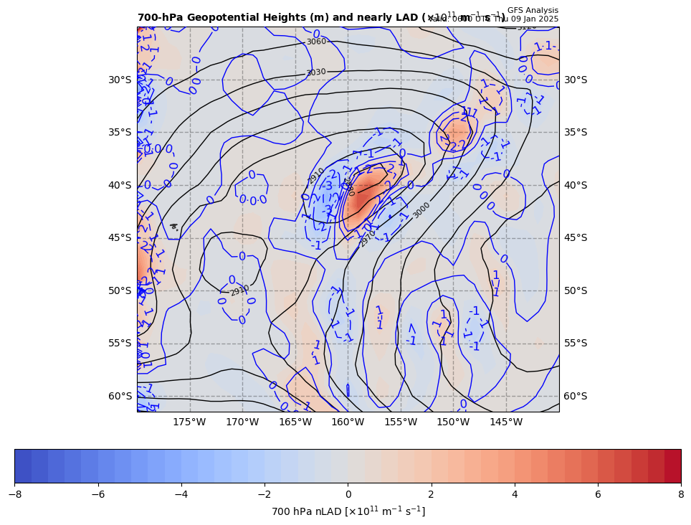
06Z nearly 700 hPa LAD (x 10⁻¹³ units); positive at 12Z position
+
0.49710 x 10⁻⁹ s⁻² * 85% = +0.42253 x 10⁻⁹ s⁻²
So, multiply by –g/f, giving a LAD contribution to cyclolysis

Slide 8
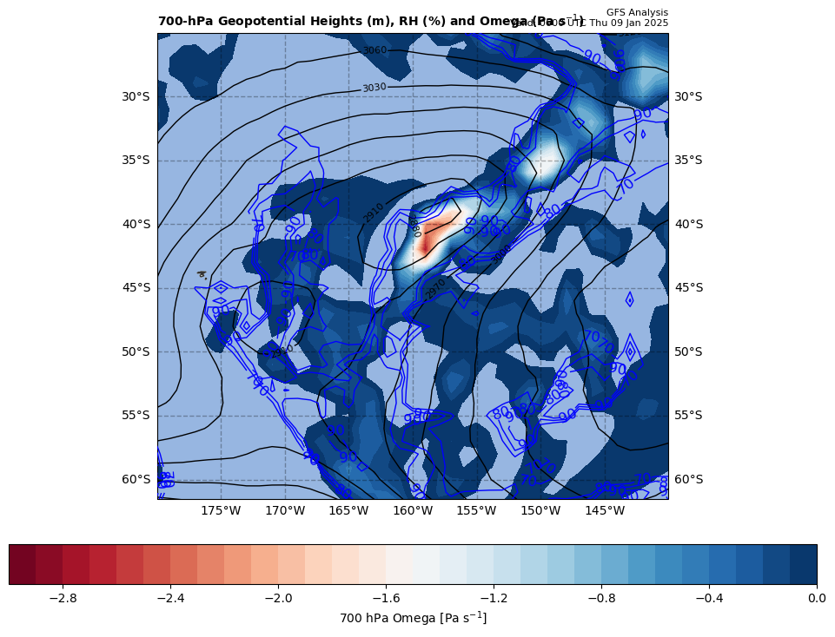
06Z nearly LDIA; latent heat release at 12Z position
+
0.42253 x 10⁻⁹ s⁻² * 70% = −0.29577 x 10⁻⁹ s⁻²
ω < 0 m s⁻¹ & RH ≥ 70%!!!

Slide 9
Calculations
Sum of terms on RHS = GAVA + LTHAD + LAD + LDIA
= -5.31704 x 10⁻⁹ s⁻²
Finite difference approximation of LHS = dGRV/dt
= [(-20.4 – {-11.6}]) x 10⁻⁵ s⁻¹ ] / [6 h * 60 min/h * 60 s/min]
= -4.07407 x 10⁻⁹ s⁻²
RHS = 1.3051 x LHS

Slide 10
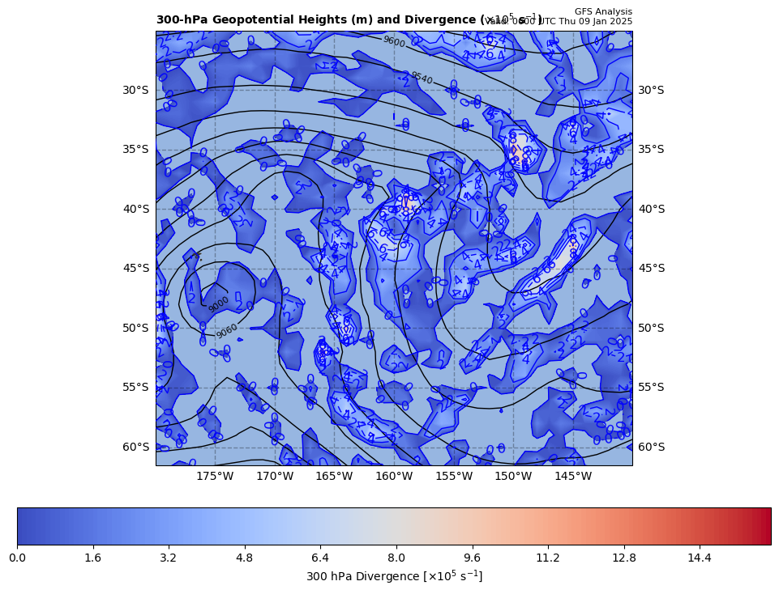
300 hPa Z, Div at t0
+
[+]

Slide 11
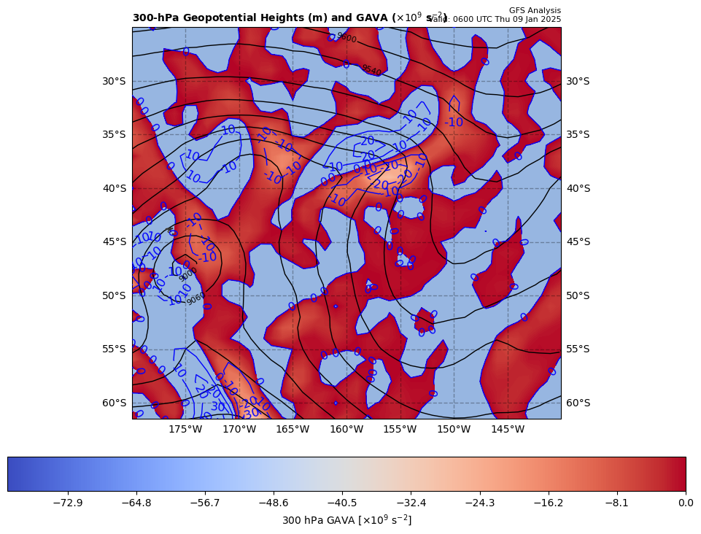
300 hPa Z, GAVA at t0
+
[−]

Slide 12
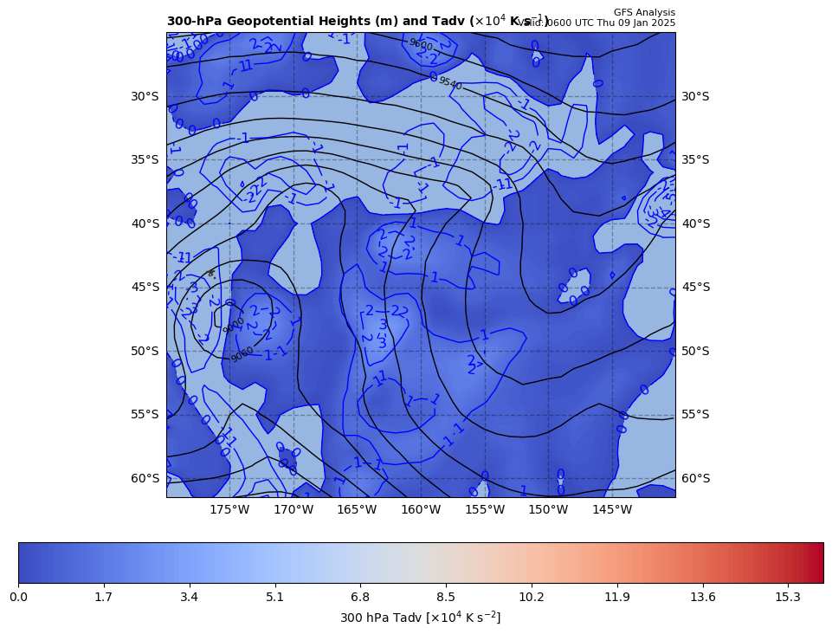
300 hPa Z, Temp Adv at t0
+
[+]

