Slide 1
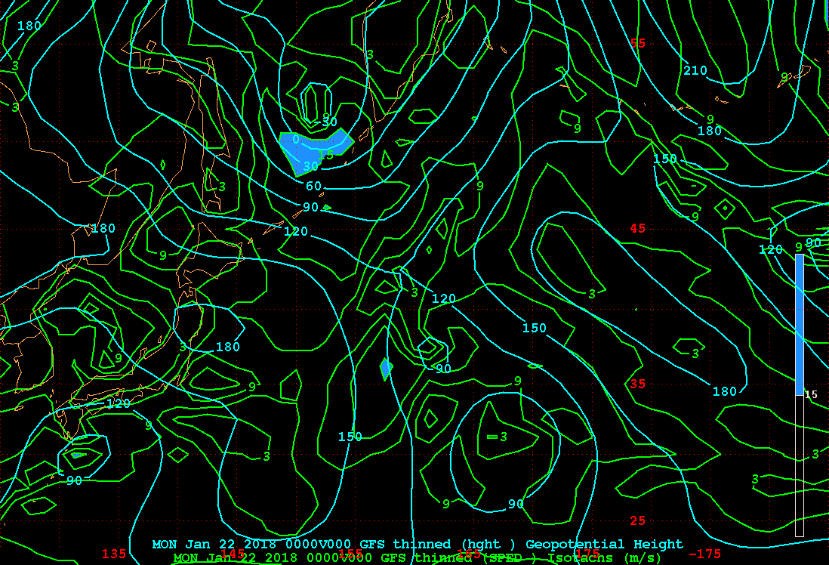
P1
0000 UTC 22 Jan 2018

Slide 2
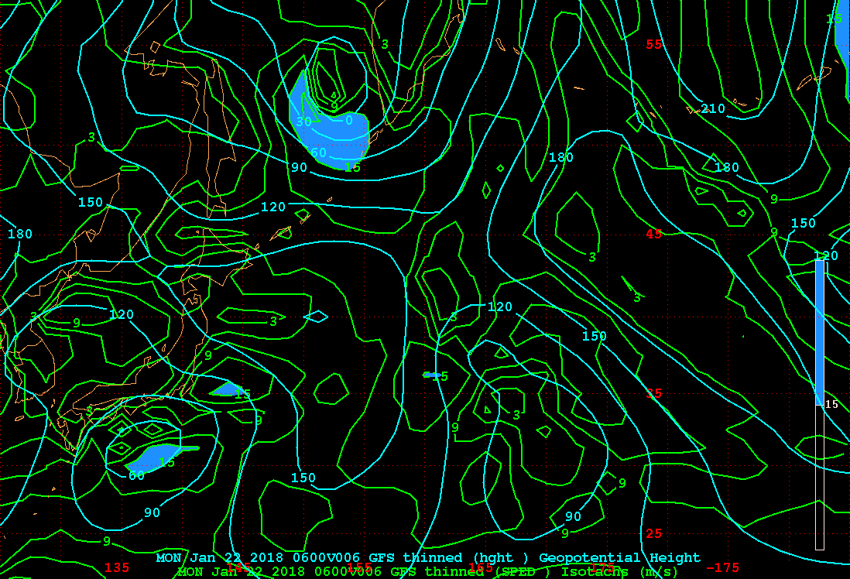
P2
0600 UTC 22 Jan 2018

Slide 3
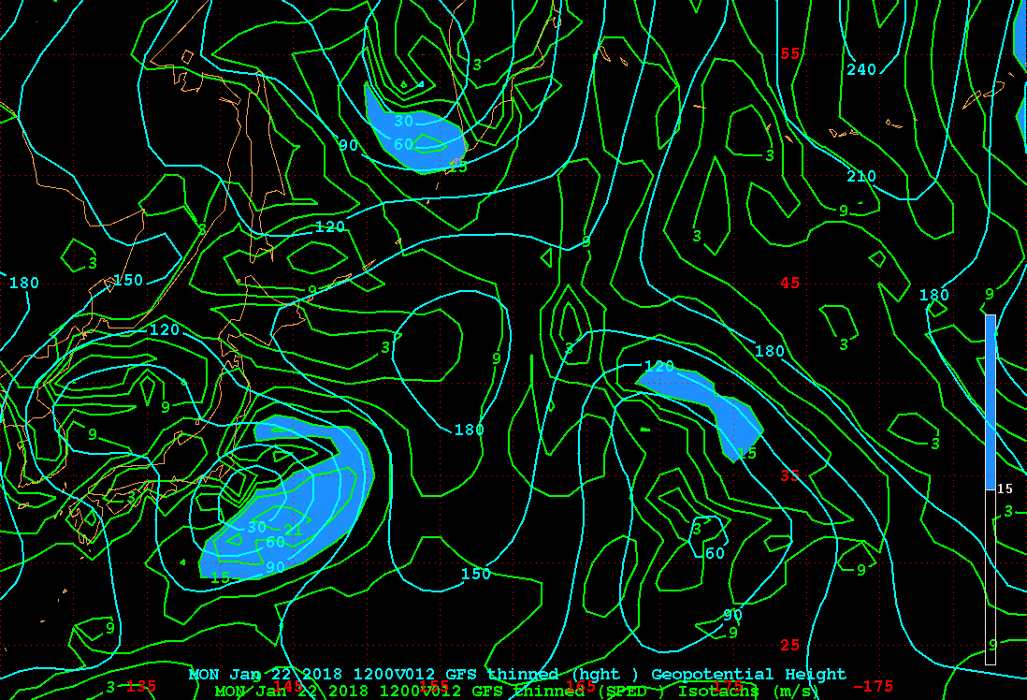
P3
1200 UTC 22 Jan 2018

Slide 4
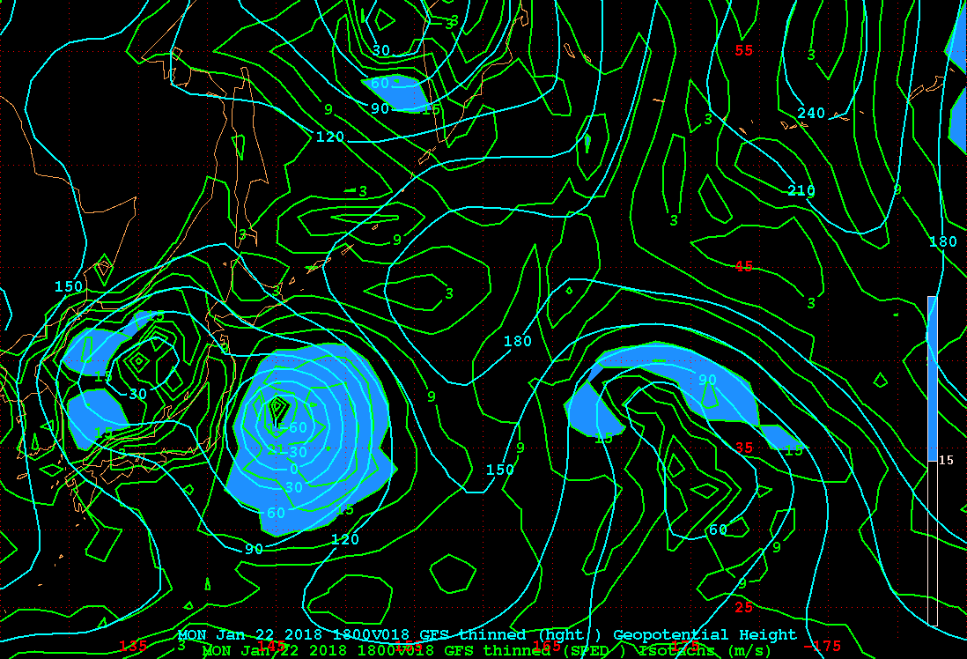
P4
1800 UTC 22 Jan 2018

Slide 5
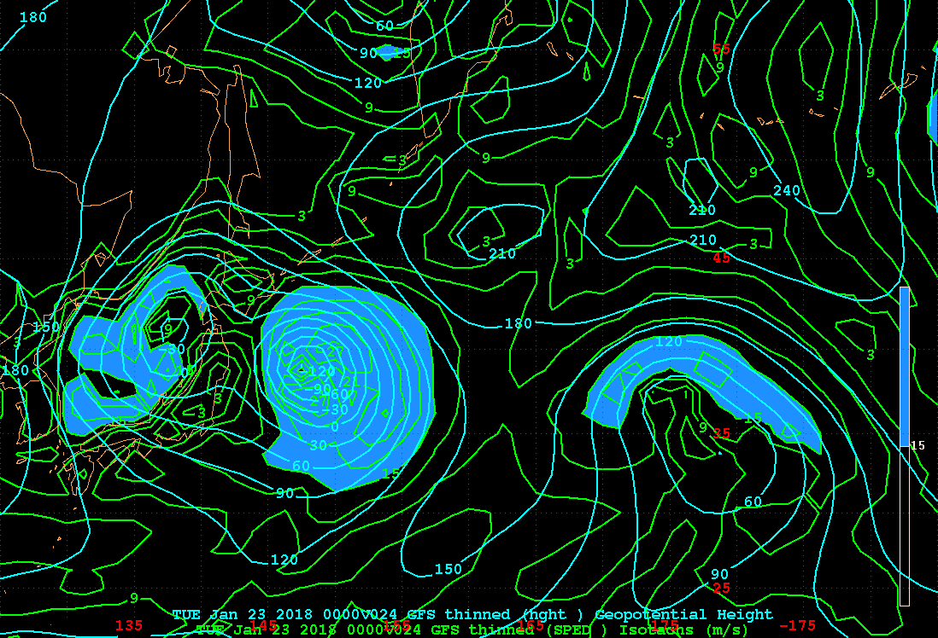
P5
0000 UTC 23 Jan 2018

Slide 6
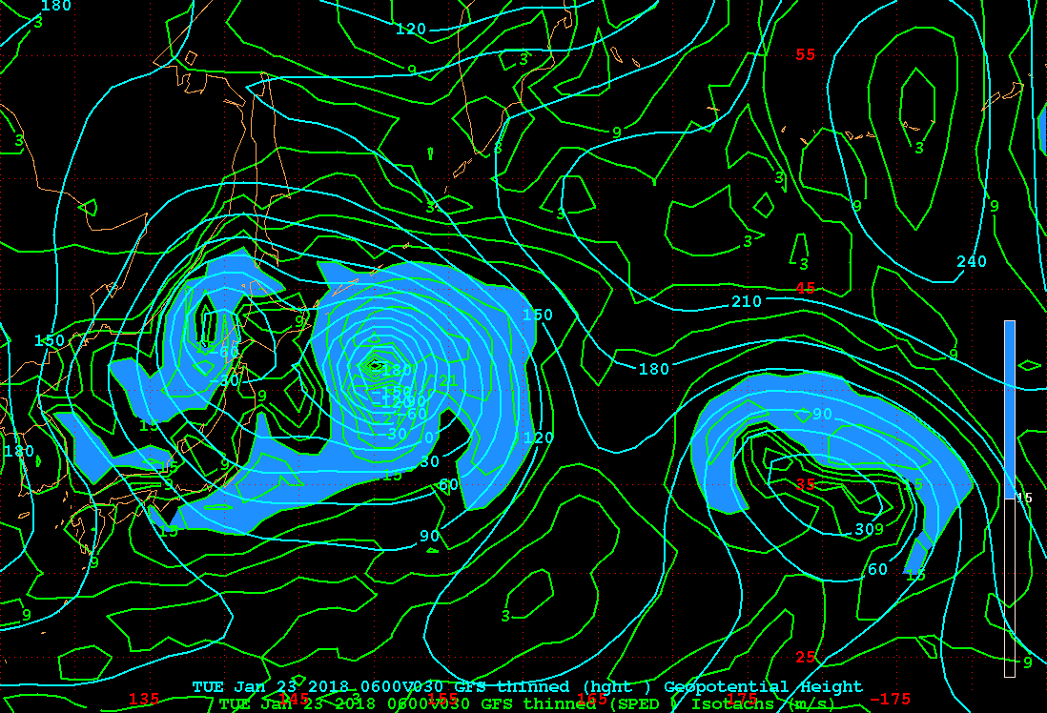
P6
0600 UTC 23 Jan 2018

Slide 7
Date | Lat/Lon | Z₁₀₀₀ (m)
00 Z 22 Jan | 30.00/132.50 36.50/131.25 | +82 +136
06 Z 22 Jan | 31.25/136.25 38.00/132.50 | +43 +103
12 Z 22 Jan | 33.75/142.50 38.75/133.00 | +7 +72
18 Z 22 Jan | 36.25/145.00 40.00/135.00 | -61 +18
00 Z 23 Jan | 38.75/147.50 41.25/137.50 | -122 -37
06 Z 23 Jan | 41.25/150.00 42.50/140.00 | -188 -71
12 Z 23 Jan | 43.75/152.50 43.75/140.00 | -195 -68
18 Z 23 Jan | 46.25/153.75 45.00/138.75 | -220 -57
39
36
68
61
66
7
25

Slide 8
Group | Group 1 | Group 2
Final Project | Abby, Kaitlyn, Sara | Marcus, Zachary
88%
100%
Boat sank by 1800 UTC 23 Jan

