Slide 1
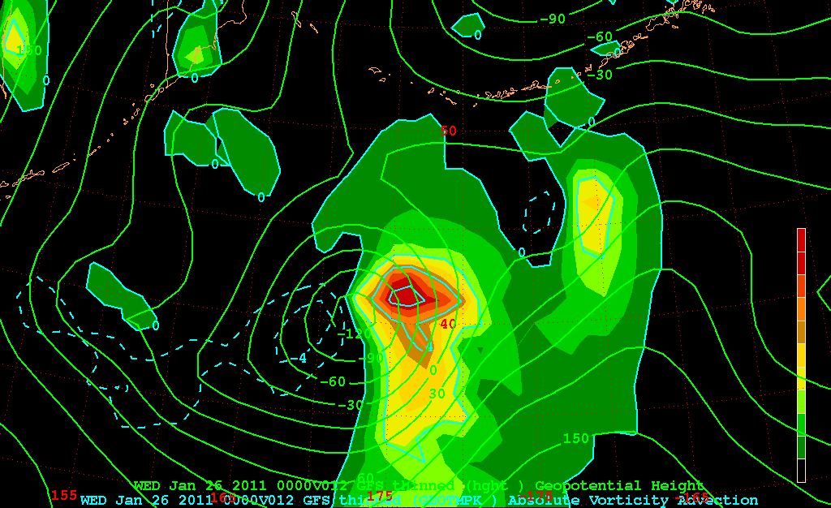
Temperature advection (by GEO) at the 1000 hPa level
+

Slide 2
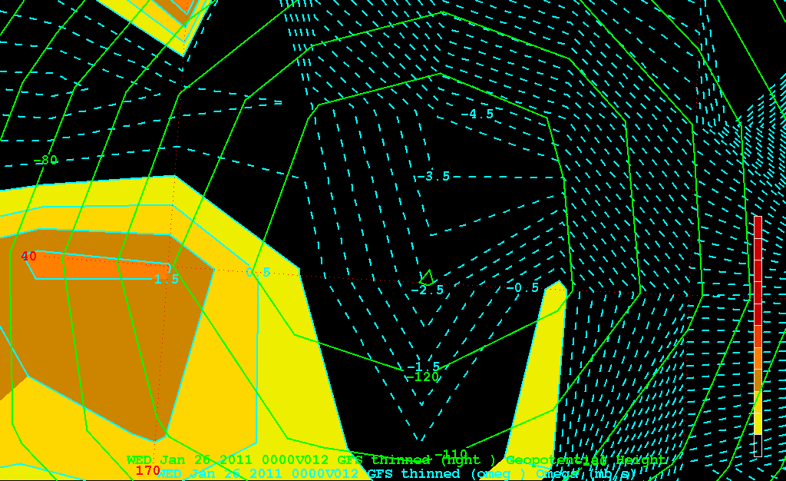
Omega (mb/s) – 850 hPa level
+
−0.0026 mb/s

Slide 3
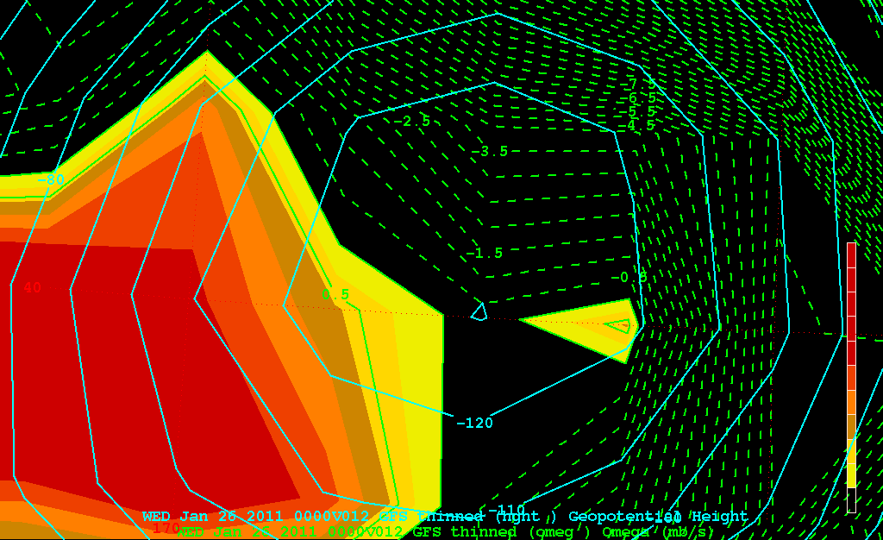
Omega (mb/s) – 700 hPa level
+
−0.0003 mb/s

Slide 4
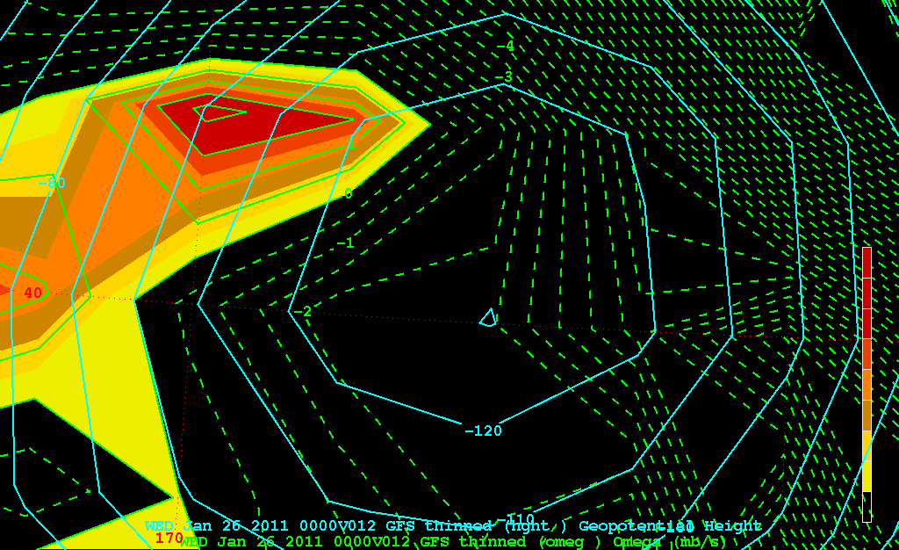
Omega (mb/s) – 500 hPa level
+
−0.0024 mb/s

Slide 5
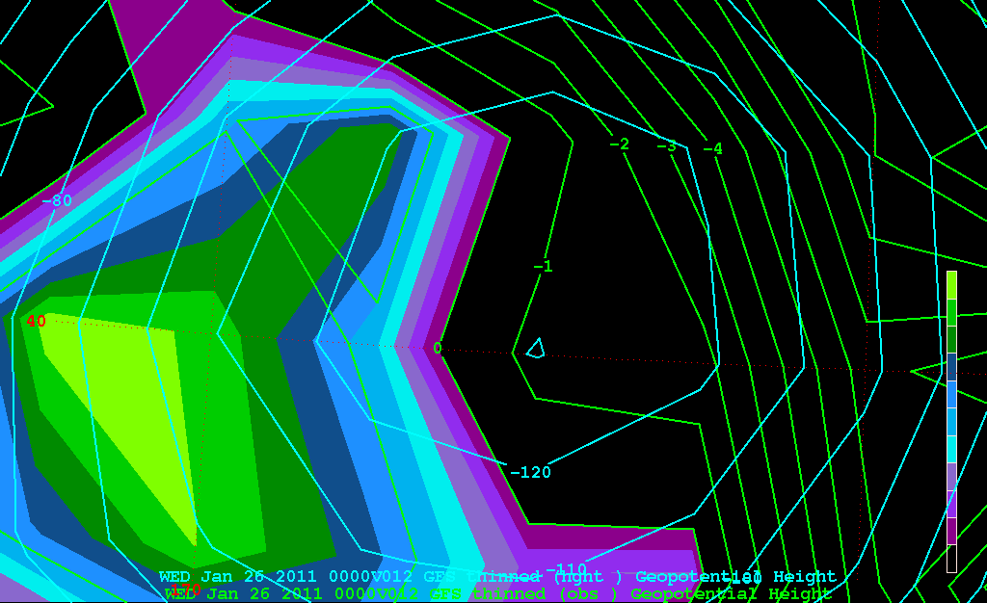
DIV(OBS) – 850 hPa level
+
−1.2x10⁻⁵ s⁻¹

Slide 6
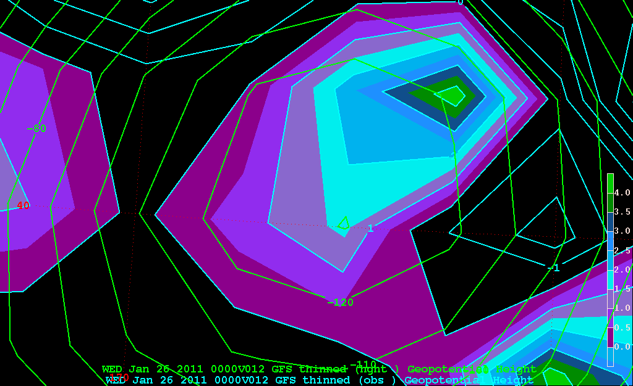
DIV(OBS) – 700 hPa level
+
+1.6x10⁻⁵ s⁻¹

Slide 7
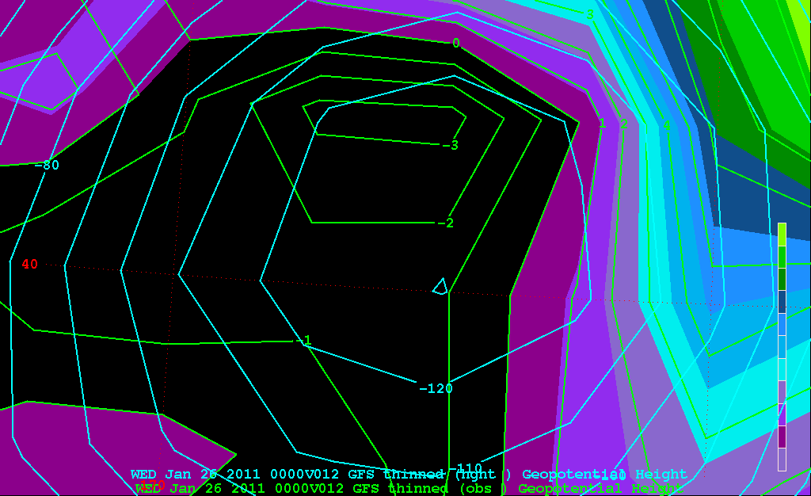
DIV(OBS) – 500 hPa level
+
−1.2x10⁻⁵ s⁻¹

Slide 8
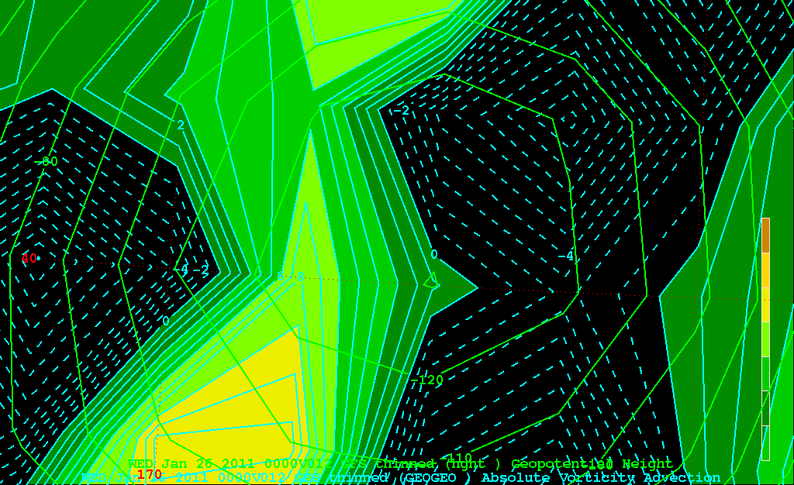
Geostrophic Absolute Vorticity Advection – 850 hPa level
+
+1.2x10⁻⁹ s⁻²

Slide 9
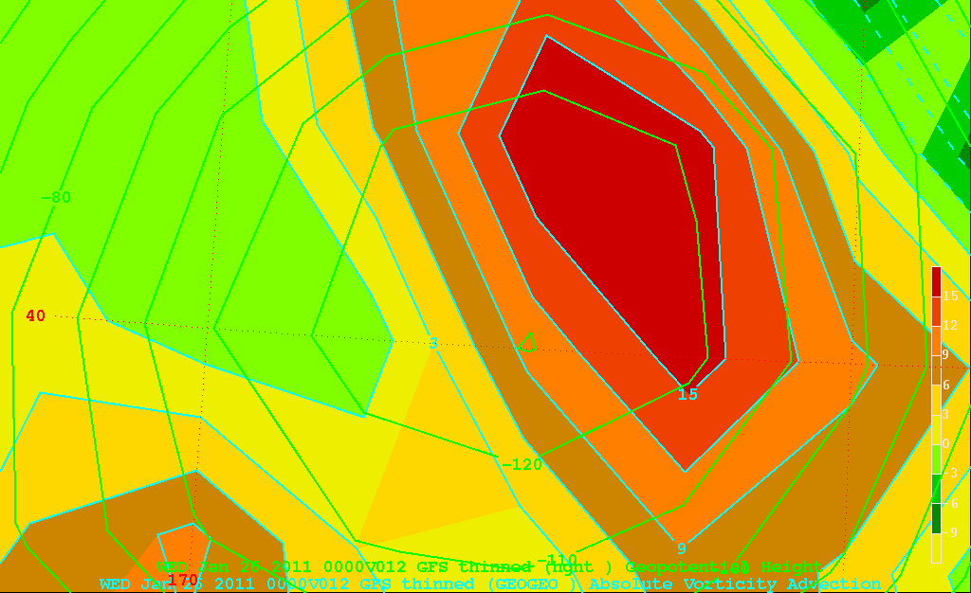
Geostrophic Absolute Vorticity Advection – 500 hPa level
+
+10.0x10⁻⁹ s⁻²

Slide 10
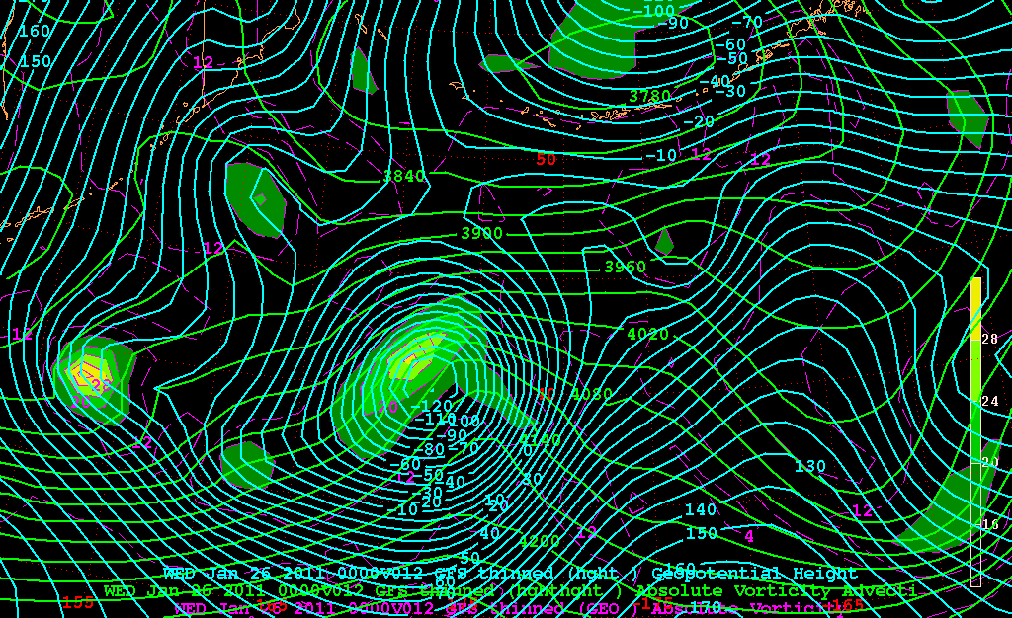
700 hPa level GAV (dashed), 850-500 hPa thickness (green)
+

Slide 11
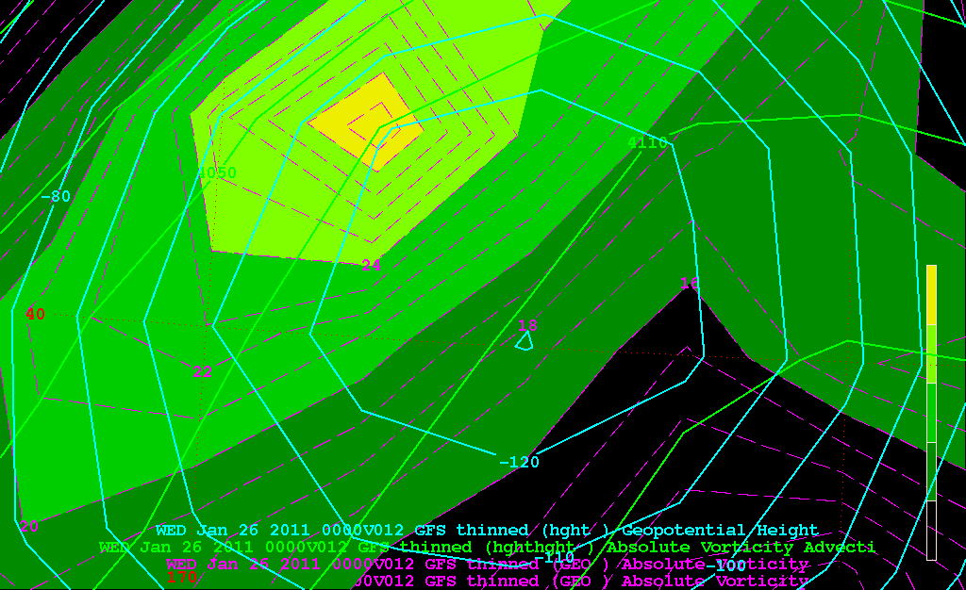
700 hPa level GAV (dashed), 850-500 hPa thickness (green)
+

