Slide 1
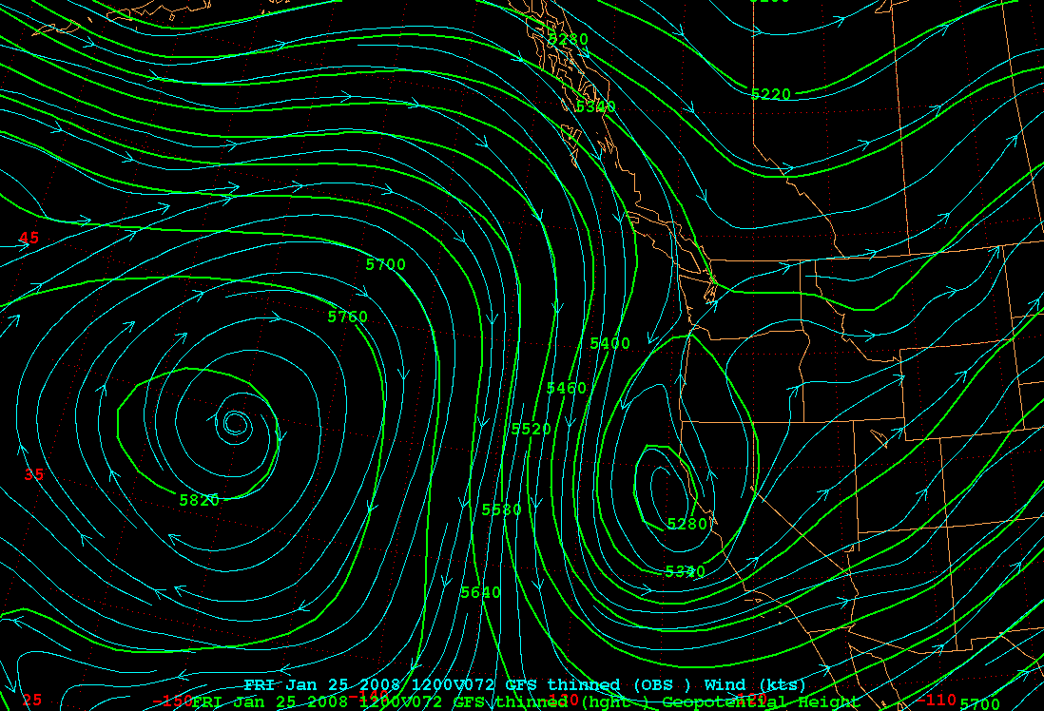

Slide 2
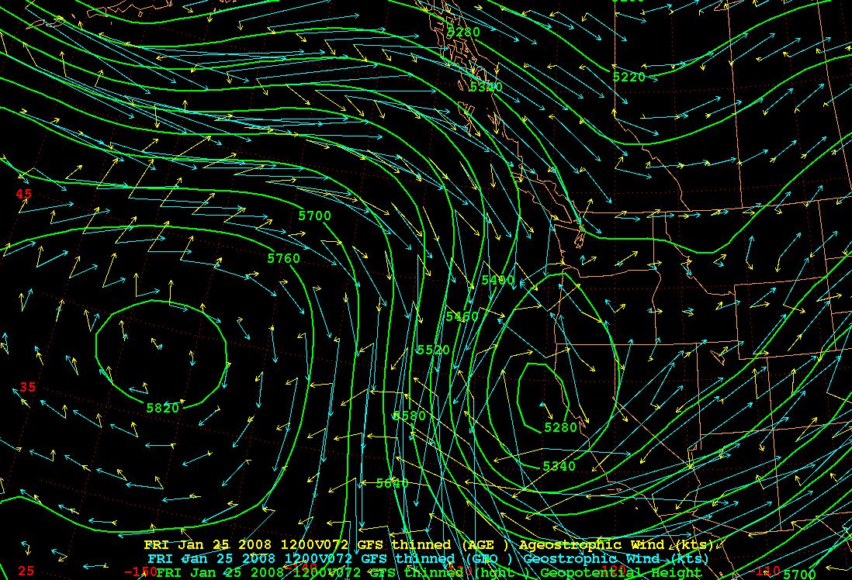

Slide 3
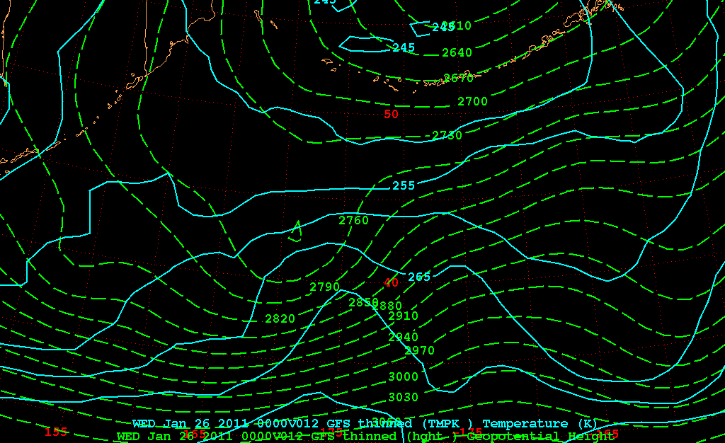
700 hPa Geo Ht (m), Temp (K)

Slide 4
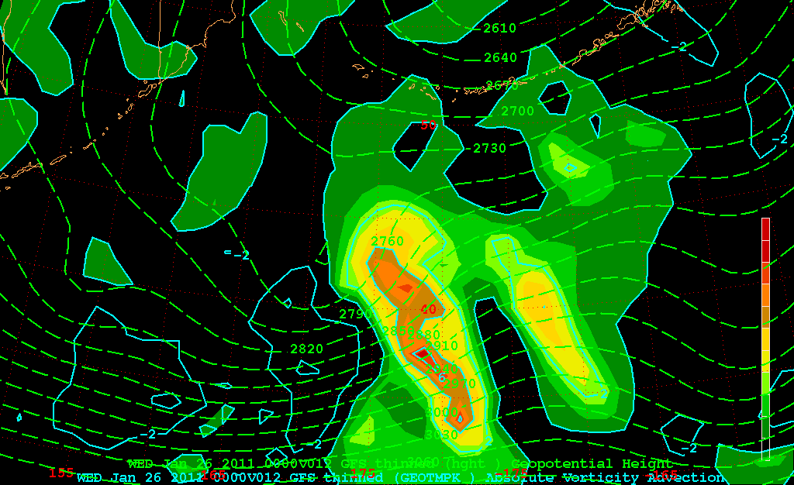
700 hPa Geo Ht (m), Geo Temp Adv (K s⁻¹)

Slide 5
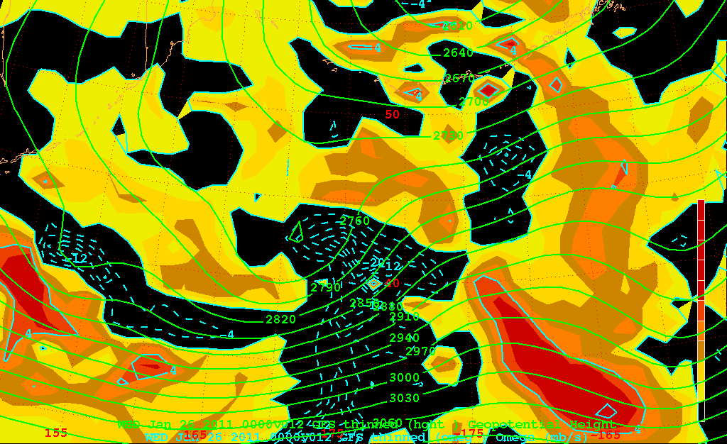
700 hPa Omega (mb s⁻¹)

Slide 6
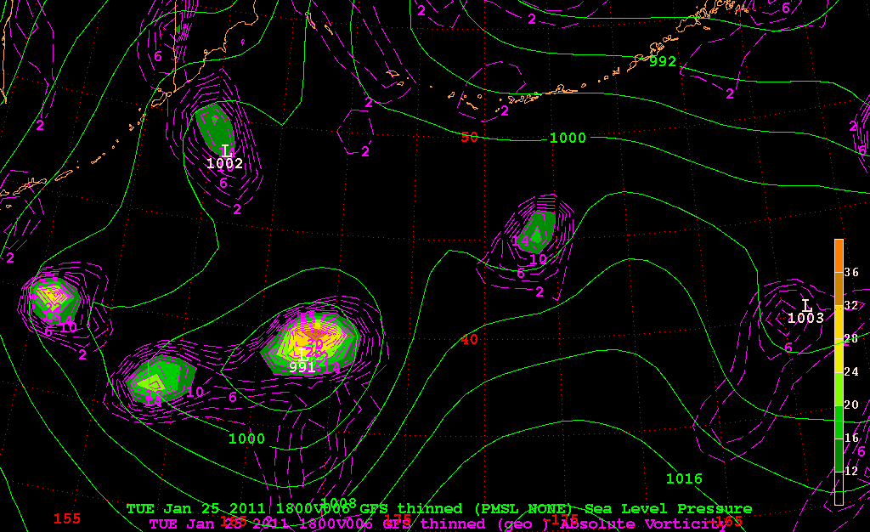
MSLP (green), 1000 hPa Vorticity Advection (x10⁻⁵)
F006

Slide 7
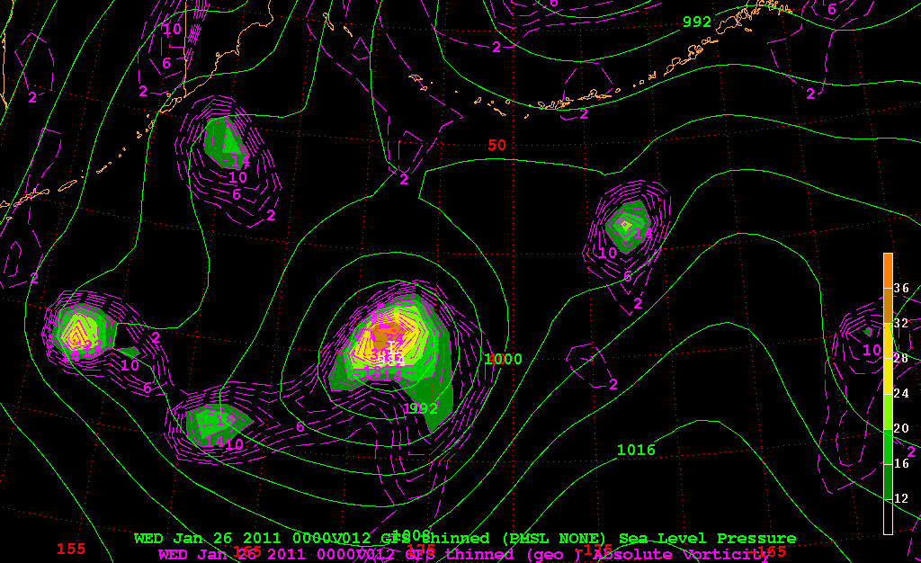
MSLP (green), 1000 hPa Vorticity Advection (x10⁻⁵)
F012

Slide 8
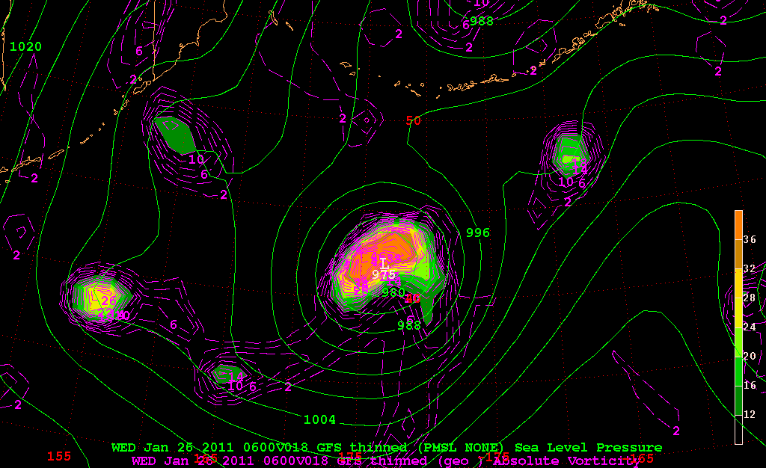
MSLP (green), 1000 hPa Vorticity Advection (x10⁻⁵)
F018

Slide 9
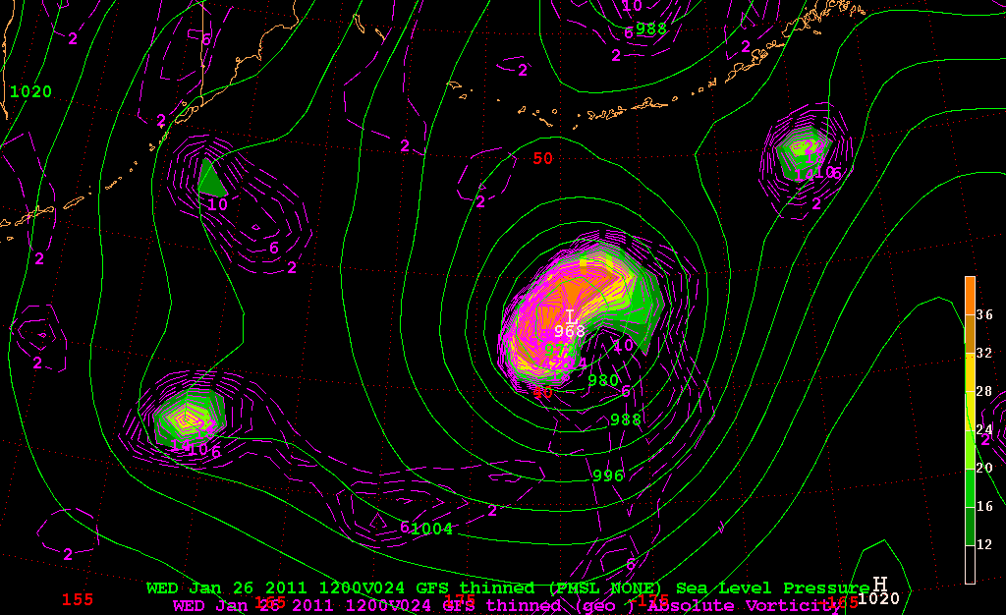
MSLP (green), 1000 hPa Vorticity Advection (x10⁻⁵)
F024

Slide 10
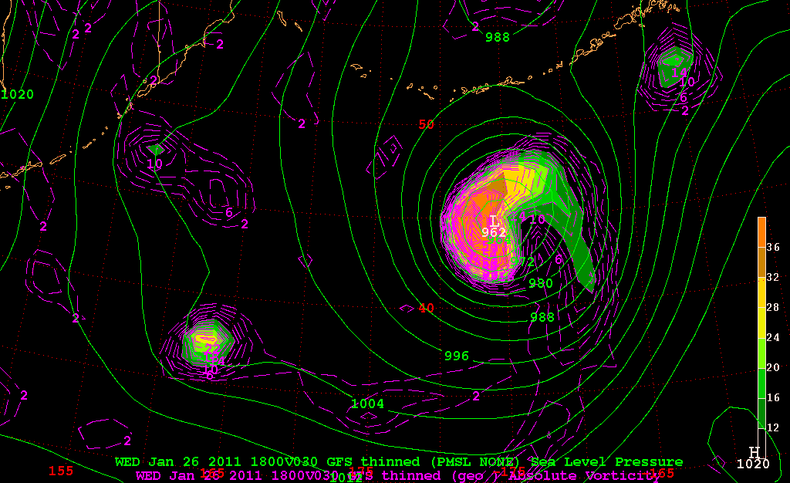
MSLP (green), 1000 hPa Vorticity Advection (x10⁻⁵)
F030

