Slide 1
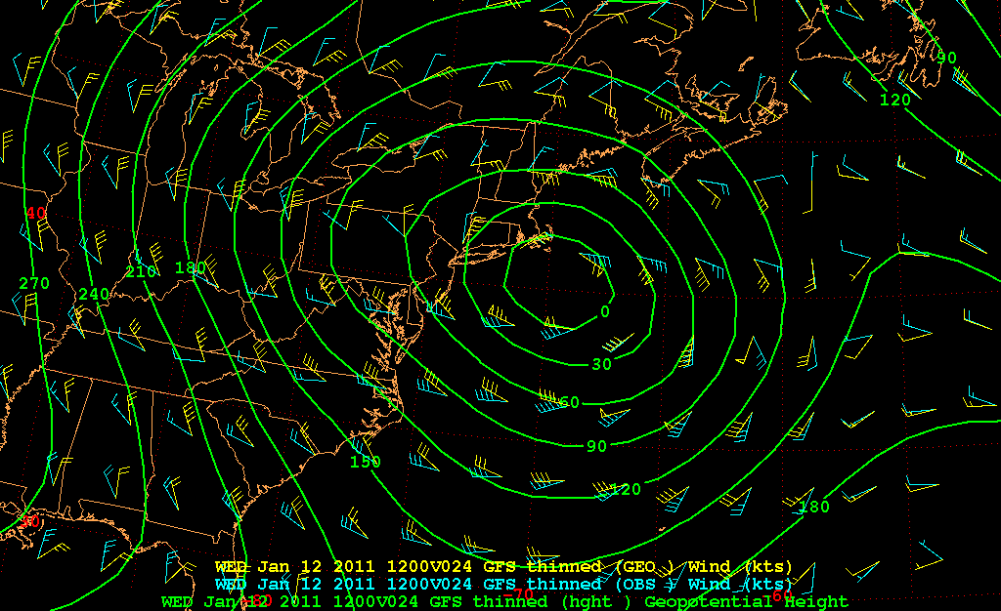
1000 hPa heights, geostrophic winds, actual winds

Slide 2
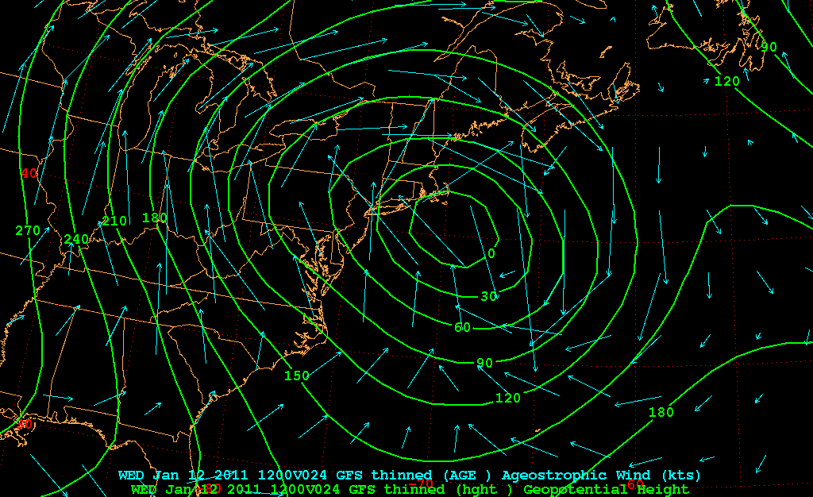
1000 hPa ageostrophic winds

Slide 3
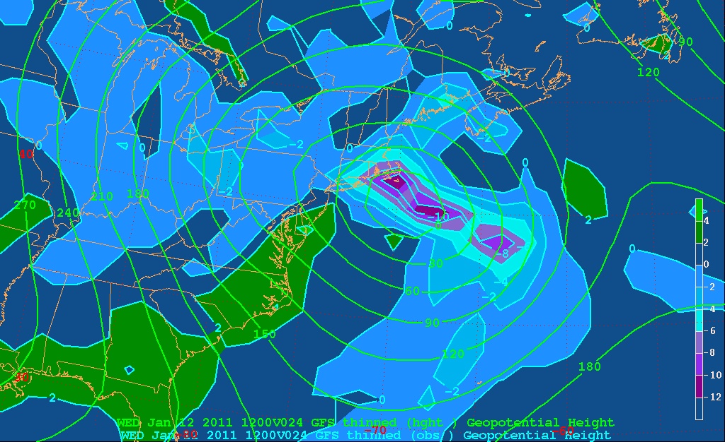
1000 hPa divergence (actual winds)

Slide 4
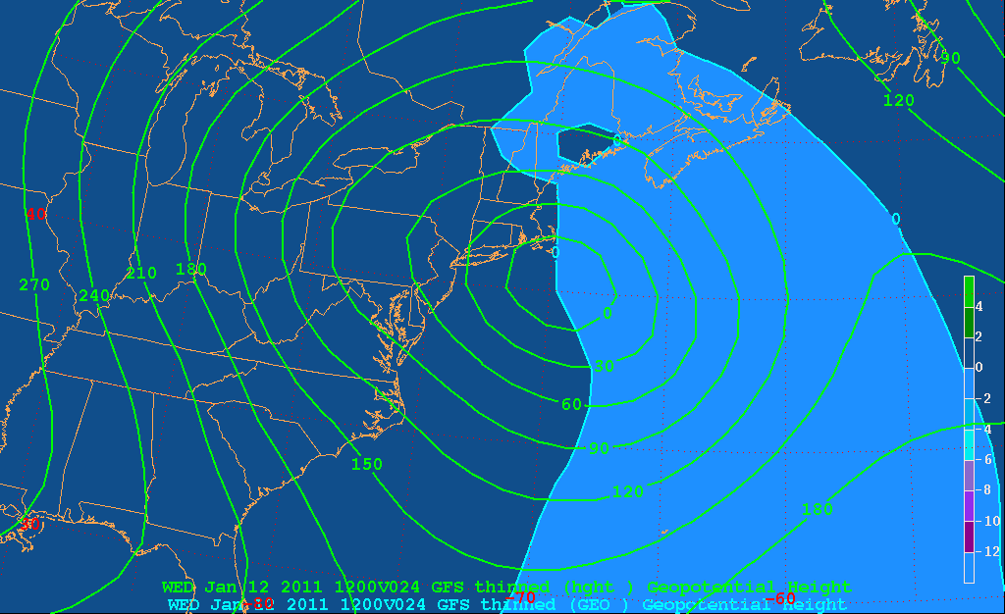
1000 hPa geostrophic divergence

Slide 5
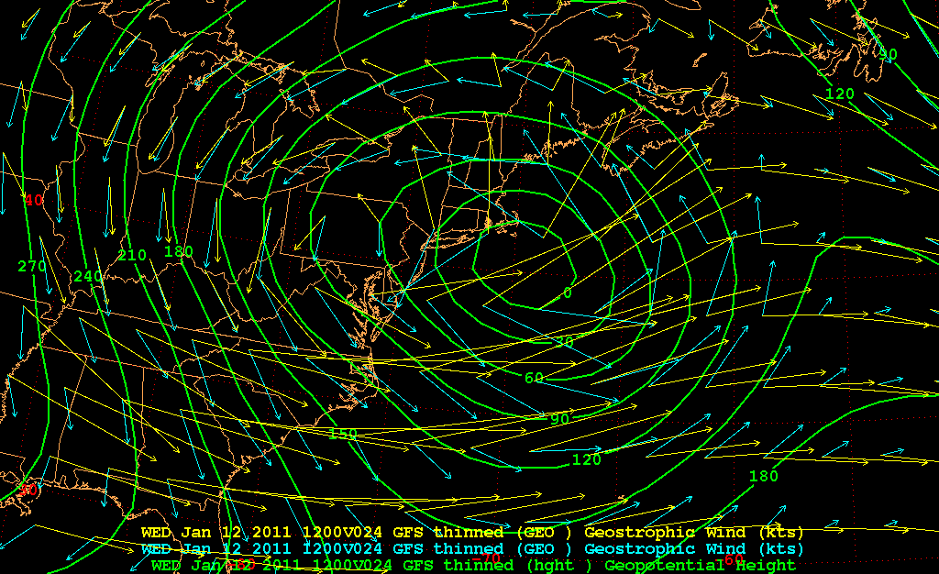
Geostrophic winds
1000 hPa winds (blue)
500 hPa winds (yellow)

Slide 6
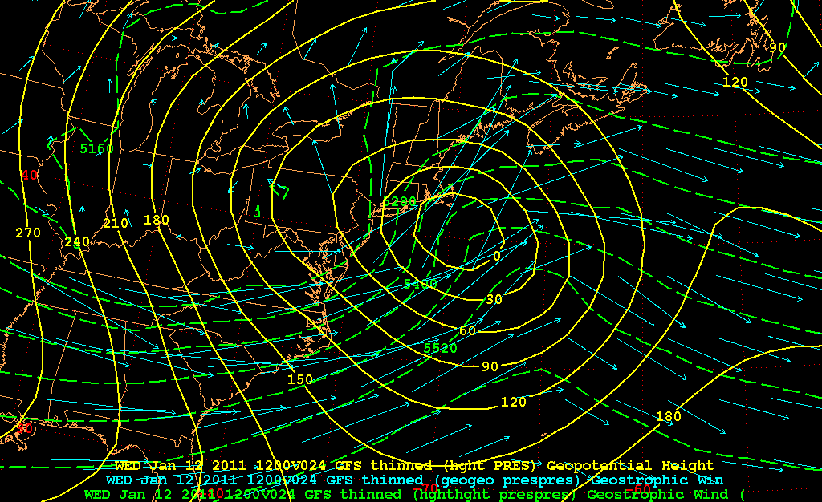
Thermal wind (1000-500 hPa layer)
1000-500 hPa Thicknesses (dashed)

Slide 7
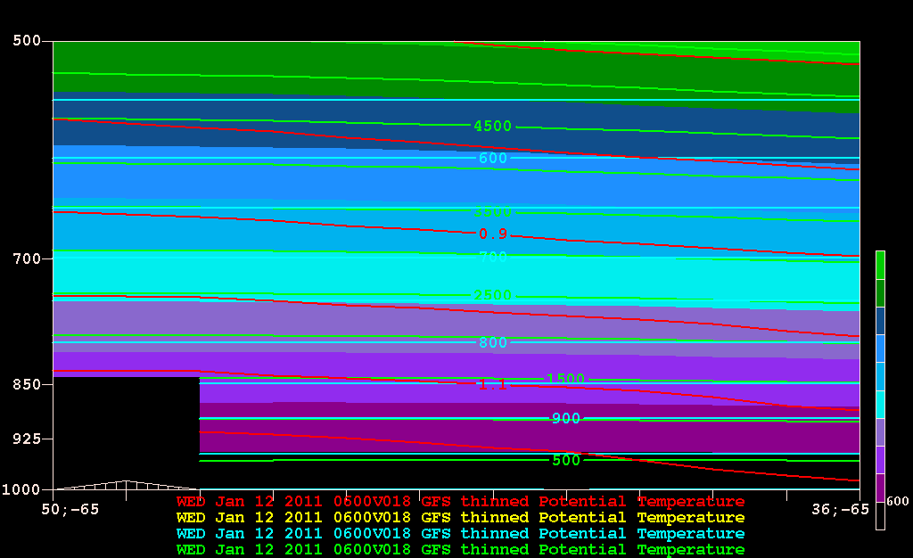
0600 UTC 12 Jan 2011
density (red), geopotential height (green), pressure (blue)

Slide 8
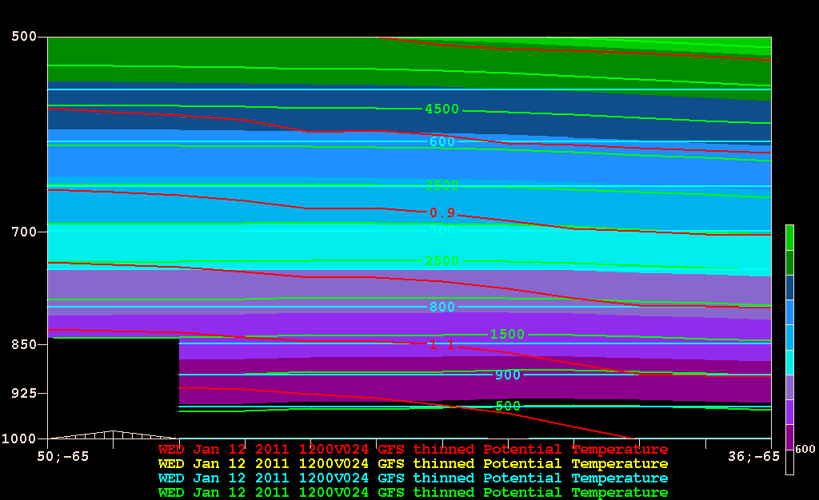
1200 UTC 12 Jan 2011
density (red), geopotential height (green), pressure (blue)

Slide 9
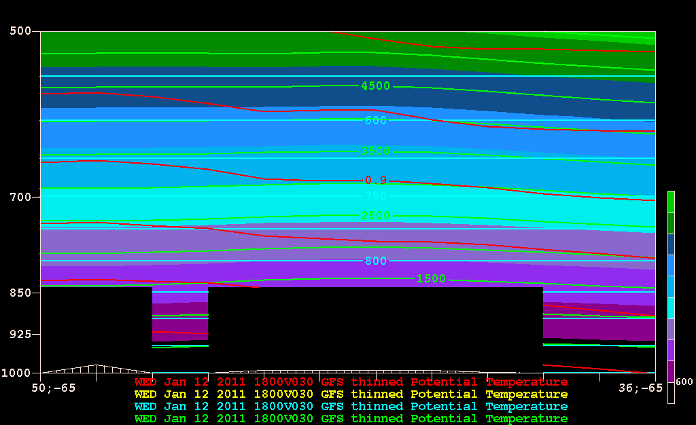
1800 UTC 12 Jan 2011
density (red), geopotential height (green), pressure (blue)

Slide 10
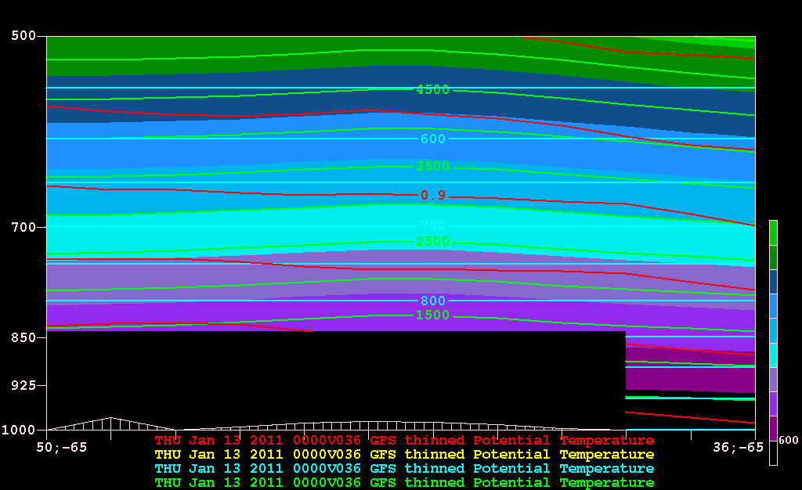
0000 UTC 13 Jan 2011
density (red), geopotential height (green), pressure (blue)

Slide 11
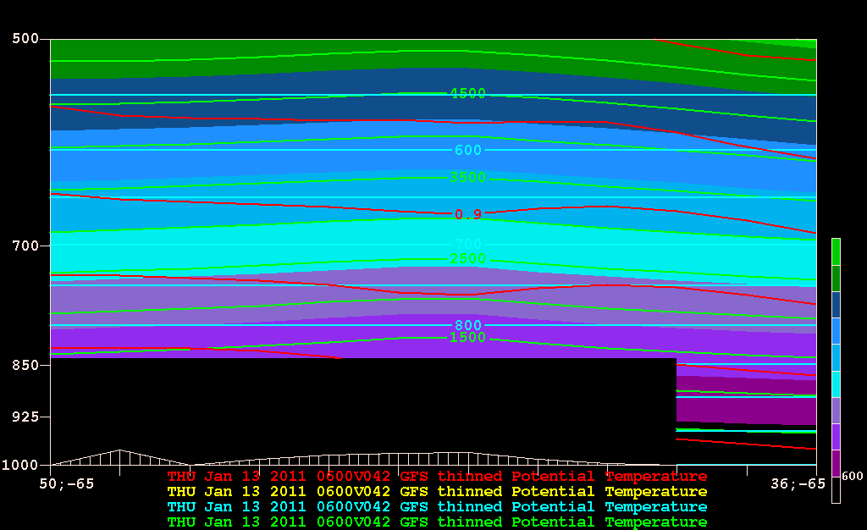
0600 UTC 13 Jan 2011
density (red), geopotential height (green), pressure (blue)

Slide 12
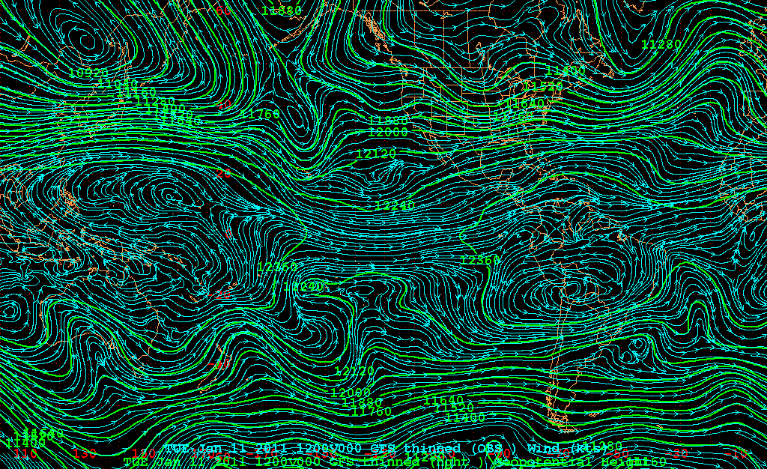
200 hPa geopotential height/ streamlines

