Slide 1
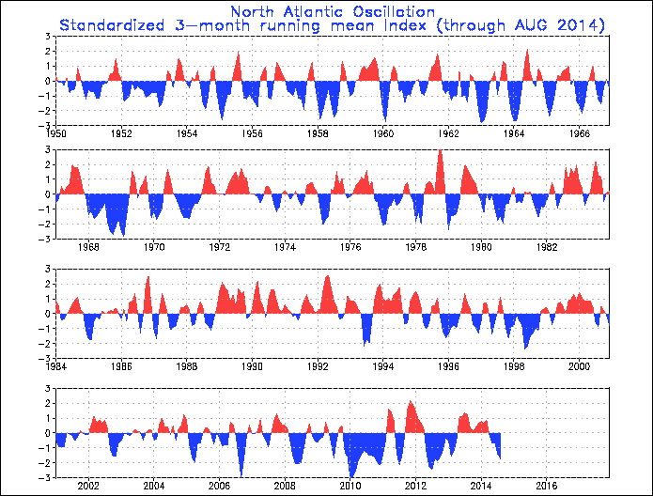
2014 1 9 +0.186

Slide 2
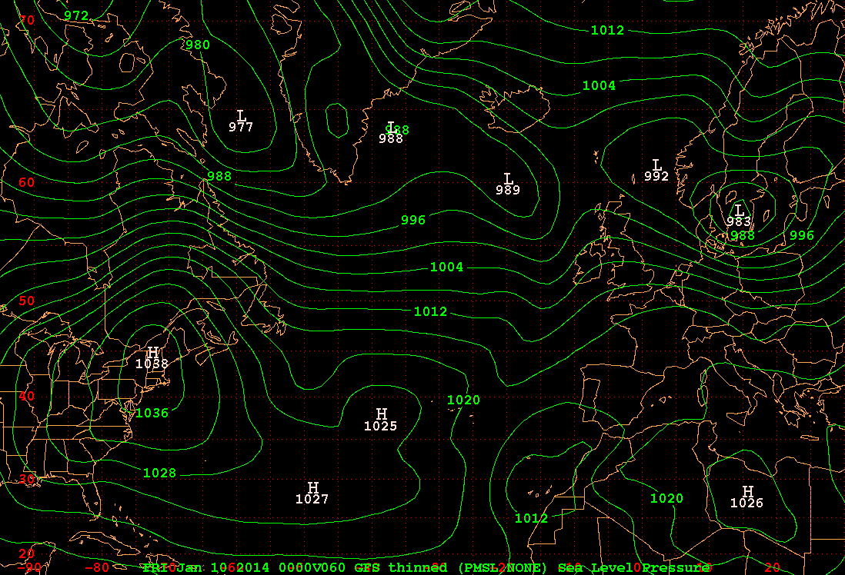
SLP (hPa)

Slide 3
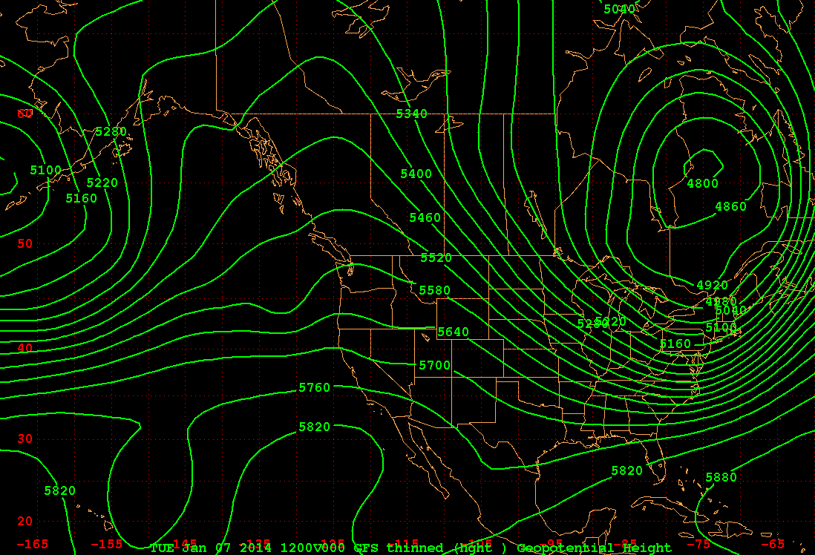
500 hPa at F00 [1200 UTC 7 Jan 2014]

Slide 4
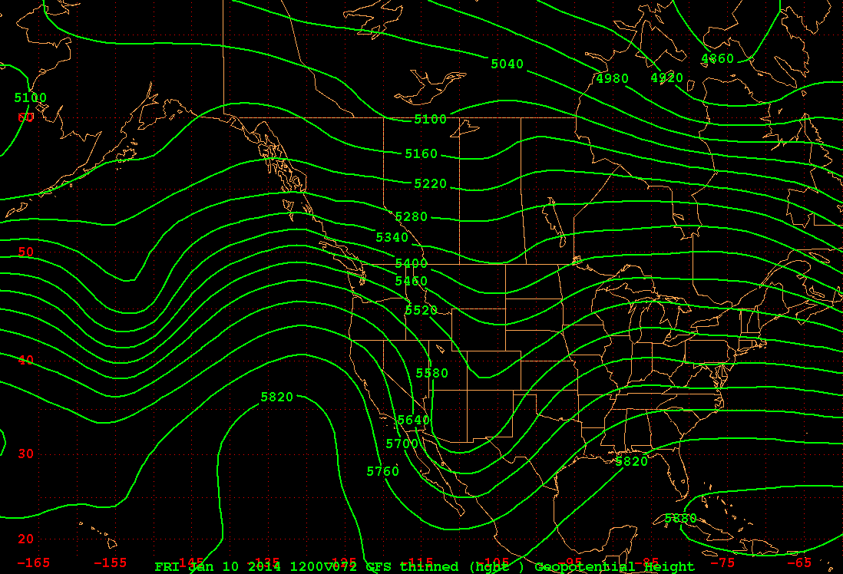
500 hPa at F72 [1200 UTC 10 Jan 2014]

Slide 5
here are the PNA numbers;
20N, 160W 45N, 165W 55N, 115W 30N, 85W
F00 5814 m 5248 m 5435 m 5749 m
F72 5786 m 5492 m 5232 m 5824 m
F00 = ({5814-5820} - {5248-5380} + {5435-5320} - {5749-5760}) * 0.25 = +63
F72 = ({5786-5820} - {5492-5380} + {5232-5320} - {5824-5760}) * 0.25 = -74.5

Slide 6
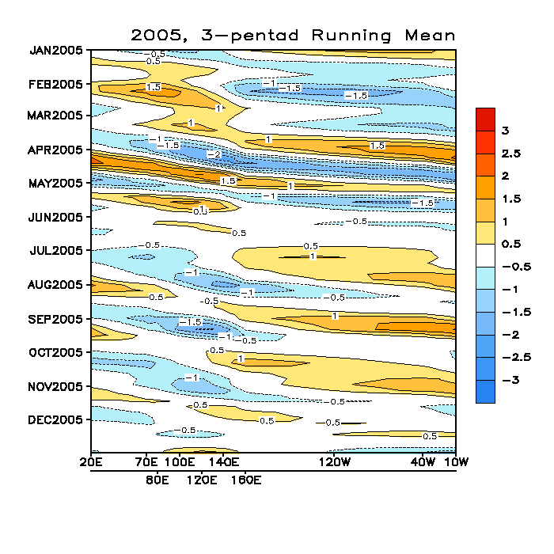
MJO - 2005

Slide 7
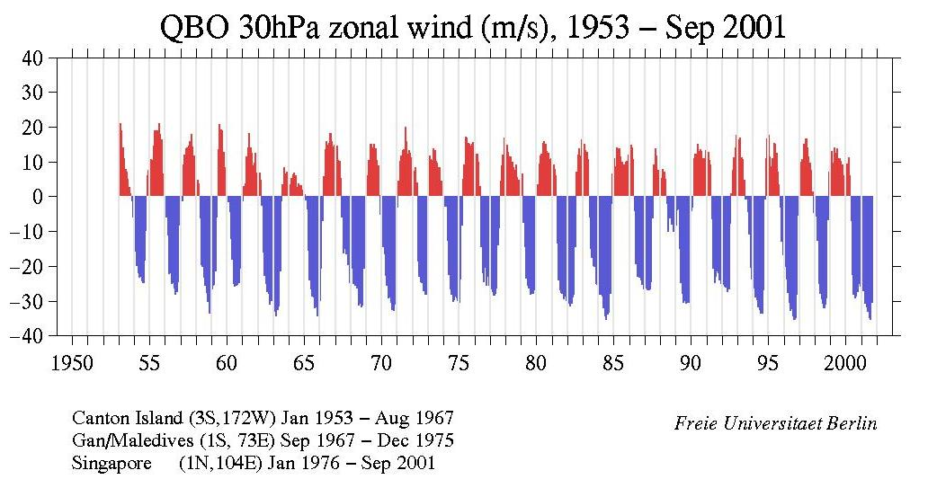

Slide 8
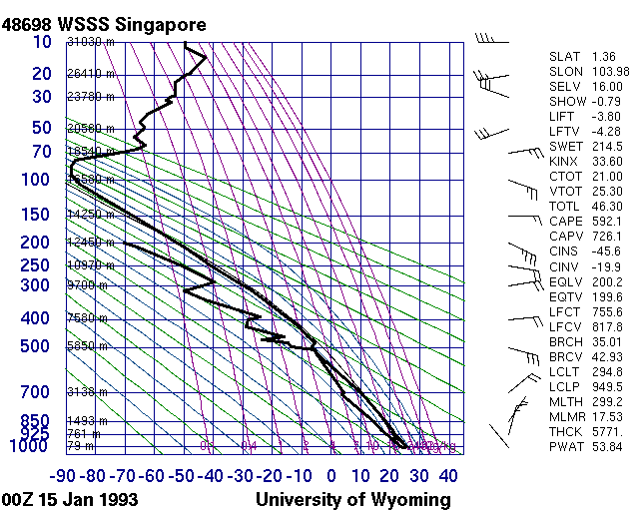

Slide 9
