Slide 1
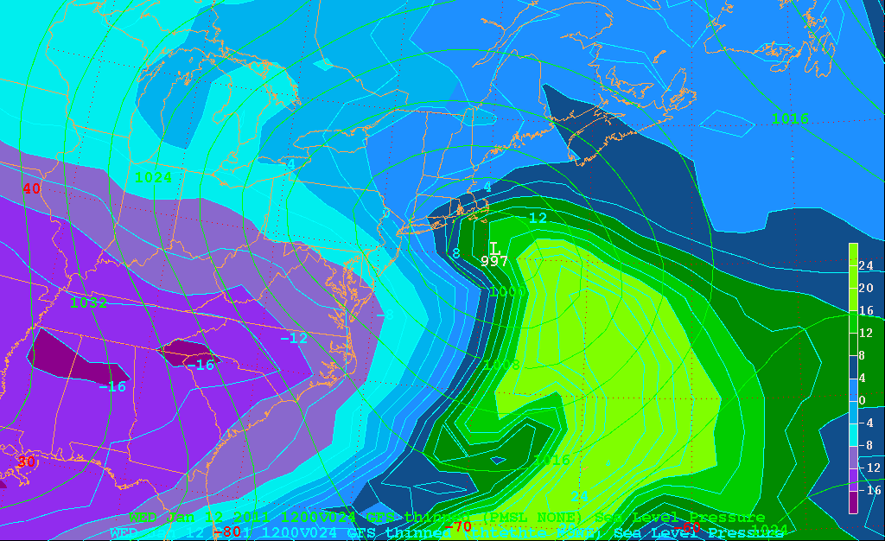
APE approximation (THTE anomaly)
850 hPa lvl

Slide 2
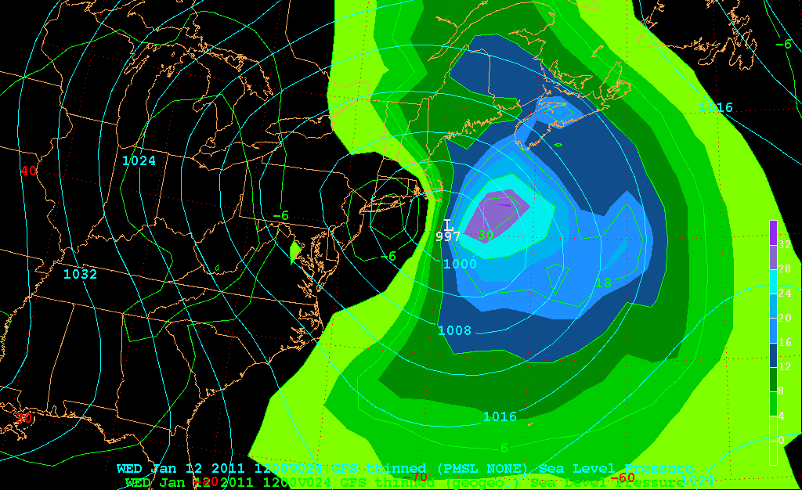
v_{g}*
850 hPa lvl

Slide 3
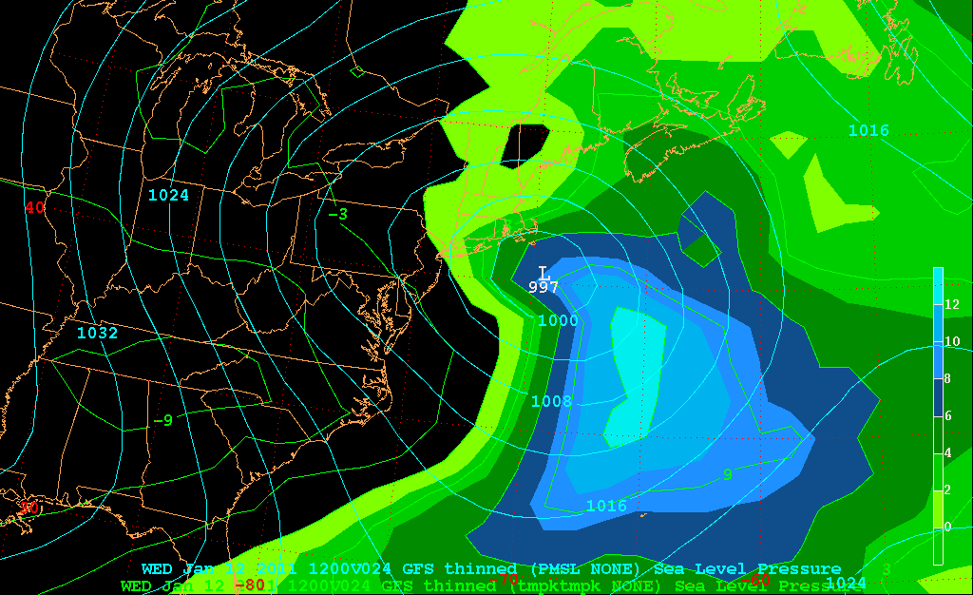
T*
850 hPa lvl

Slide 4
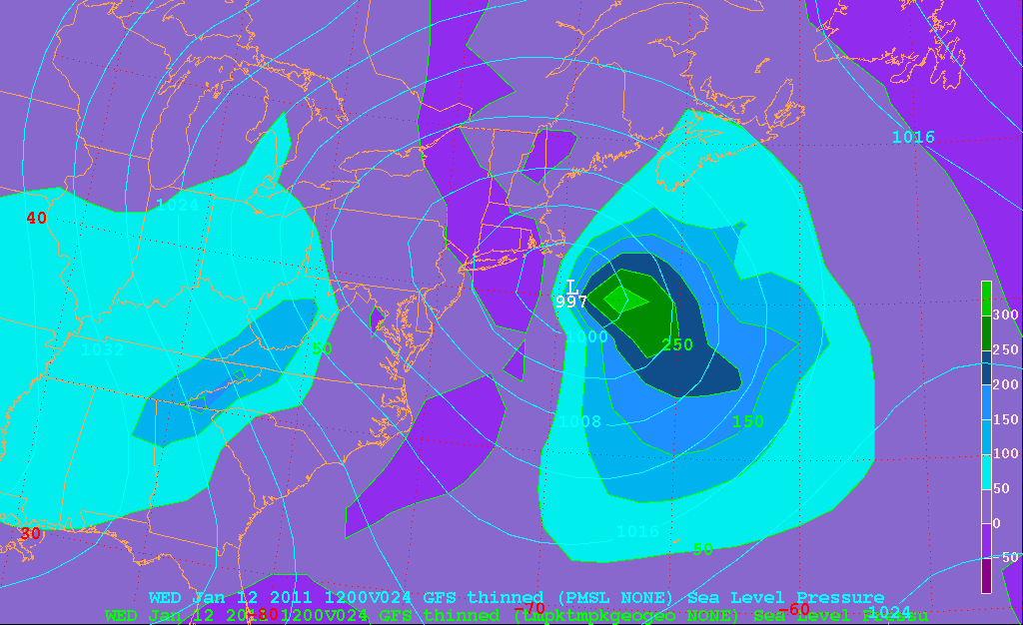
v_{g}* T*
850 hPa lvl

Slide 5
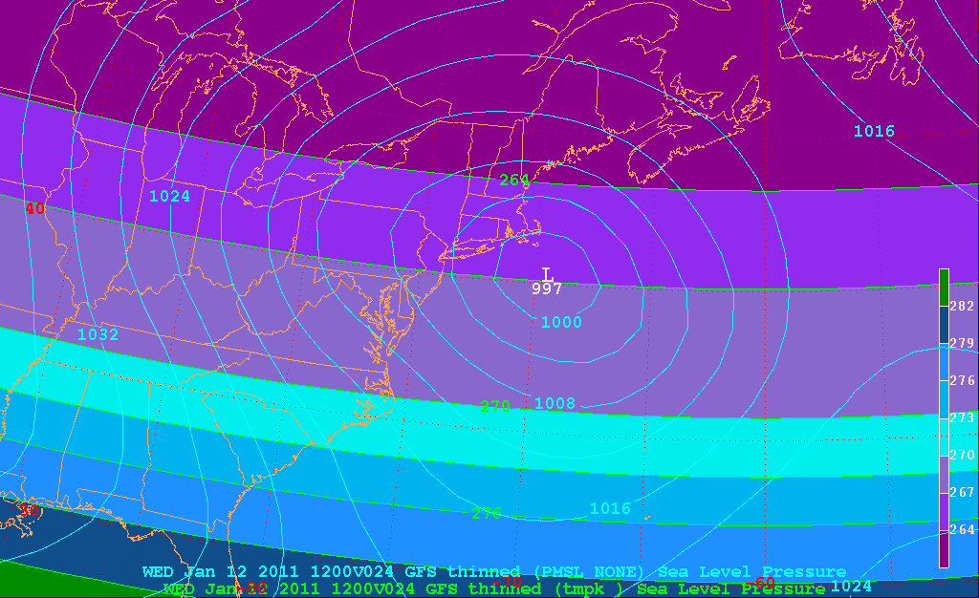
[T]
850 hPa lvl

Slide 6
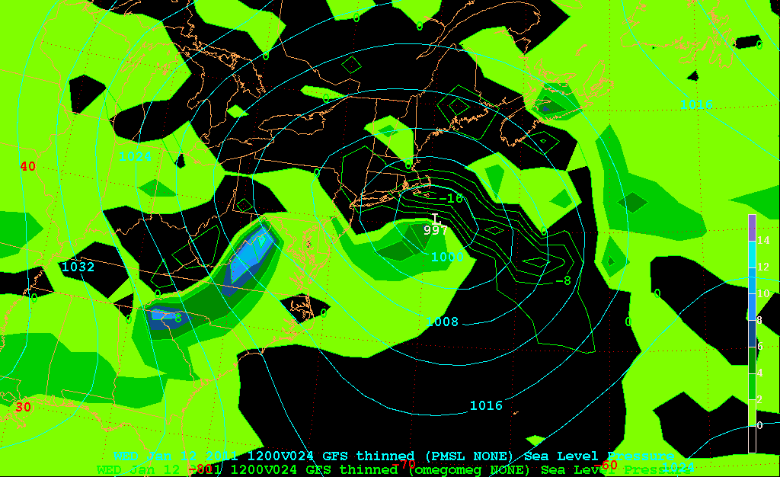
ω*
850 hPa lvl

Slide 7
T*
850 hPa lvl

Slide 8
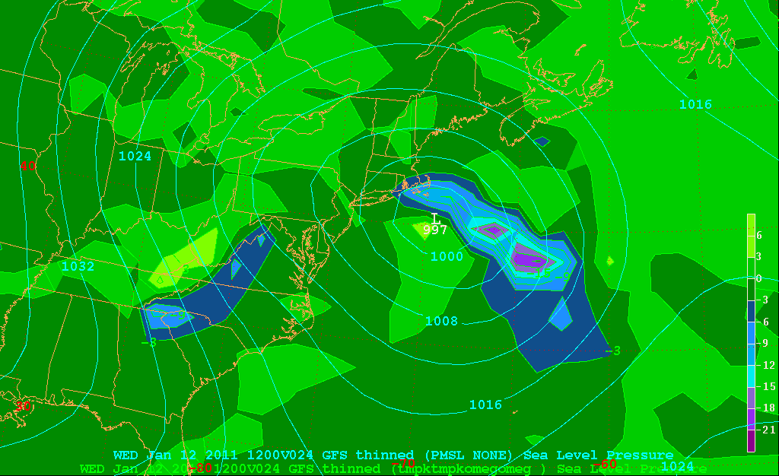
ω*T*
850 hPa lvl

Slide 9
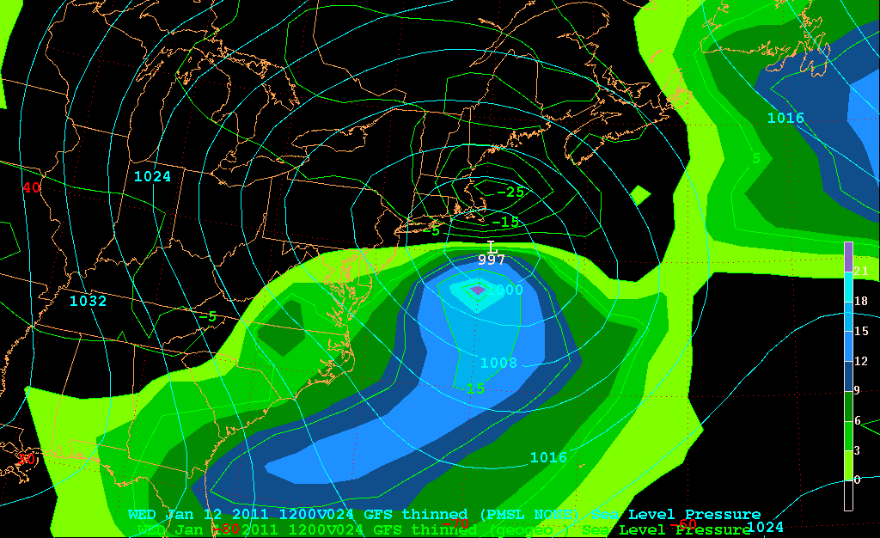
u_{g}*
850 hPa lvl

Slide 10
v_{g}*
850 hPa lvl

Slide 11
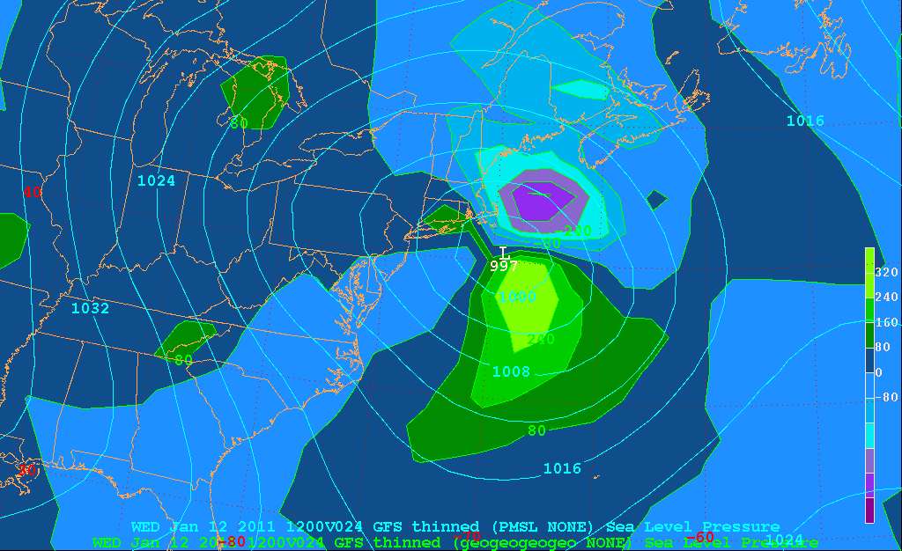
u_{g}* v_{g}*
850 hPa lvl

Slide 12
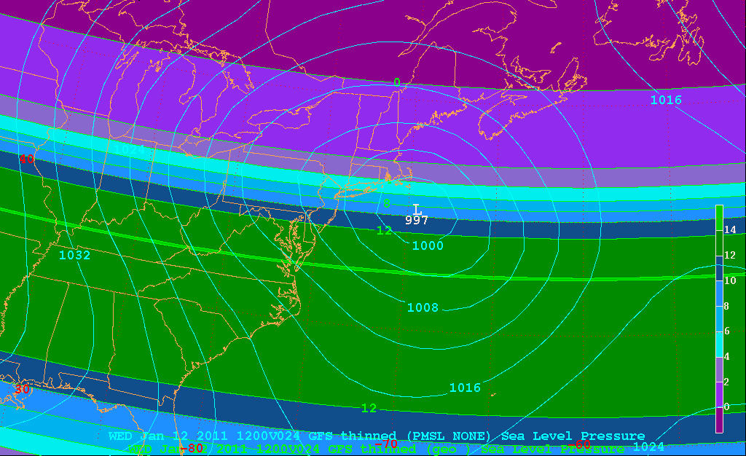
[u_{g}]
[−]
[+]
850 hPa lvl

Slide 13
u_{g}* v_{g}*
850 hPa lvl

