Slide 1
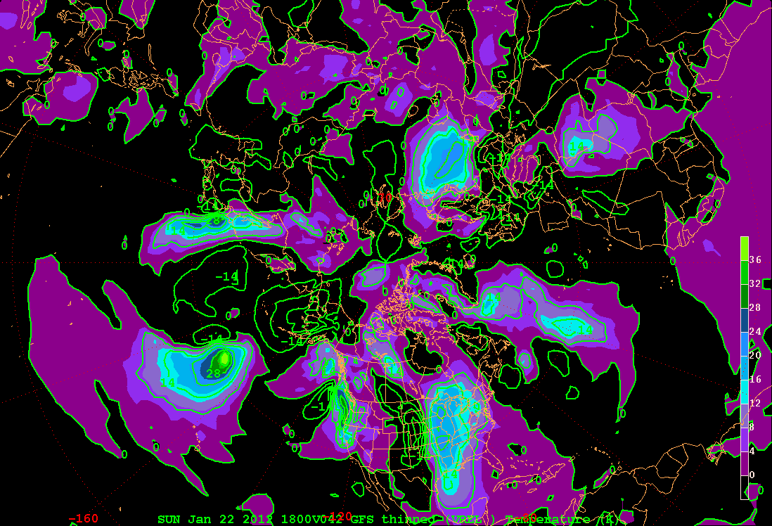
850 hPa level v (m s⁻¹)

Slide 2
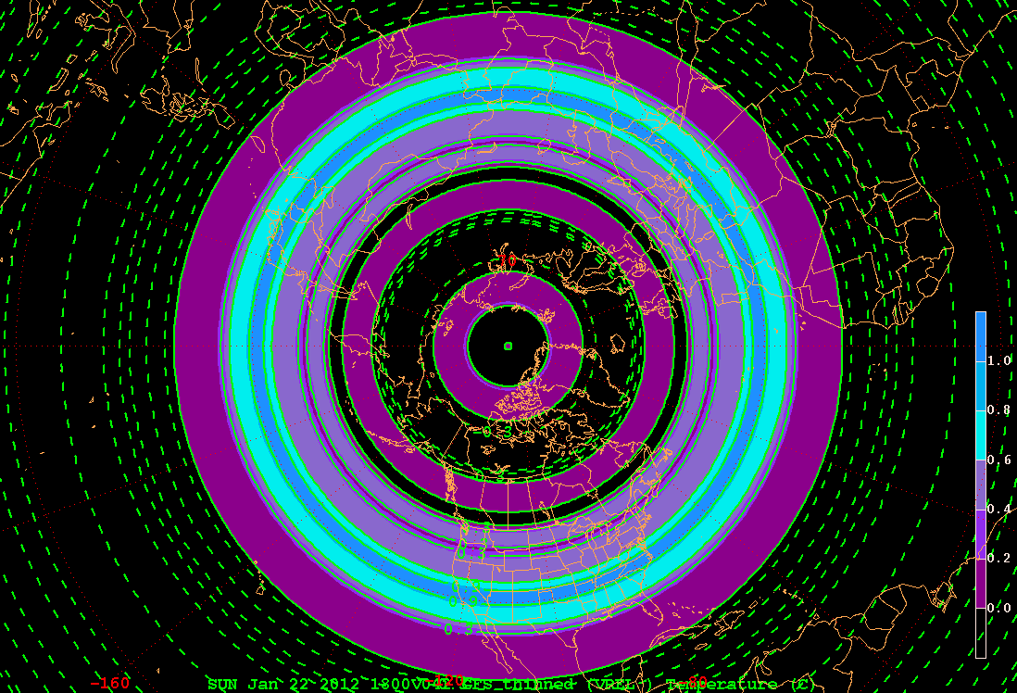
850 hPa level [v] (m s⁻¹)

Slide 3
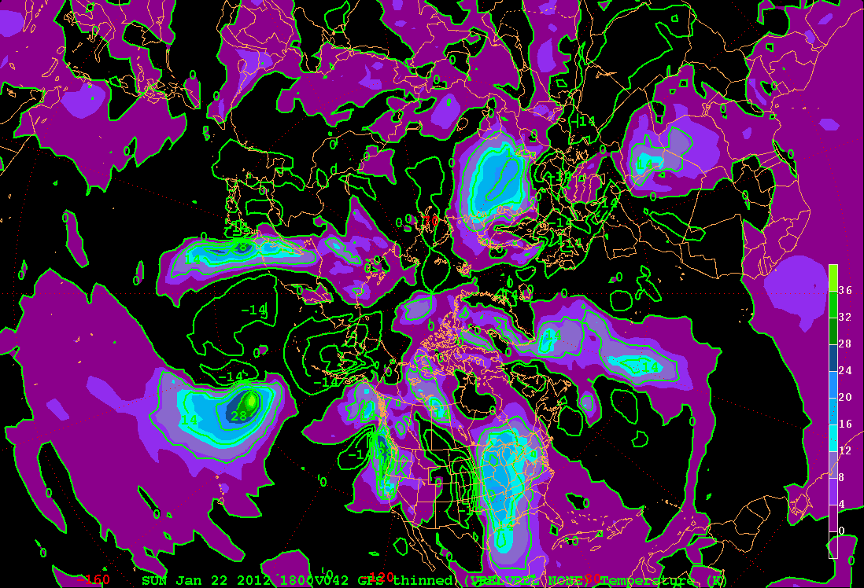
850 hPa level v* (m s⁻¹)

Slide 4
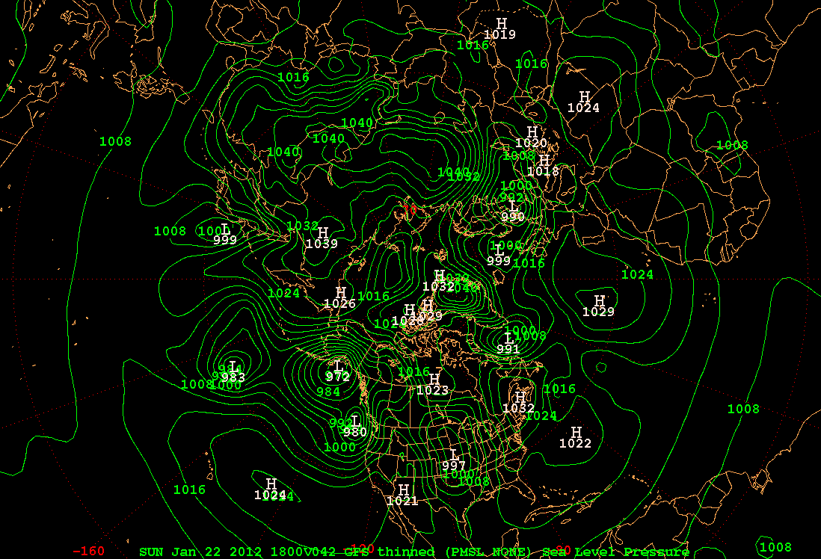

Slide 5
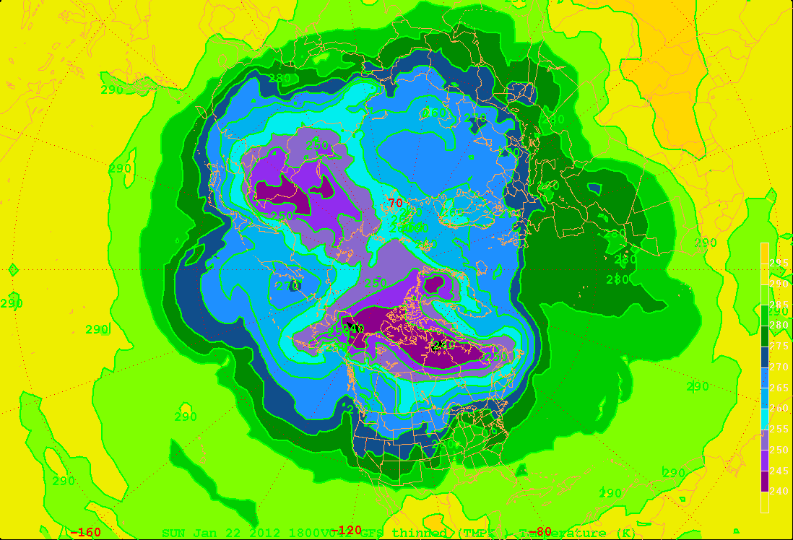
850 hPa level T (K)

Slide 6
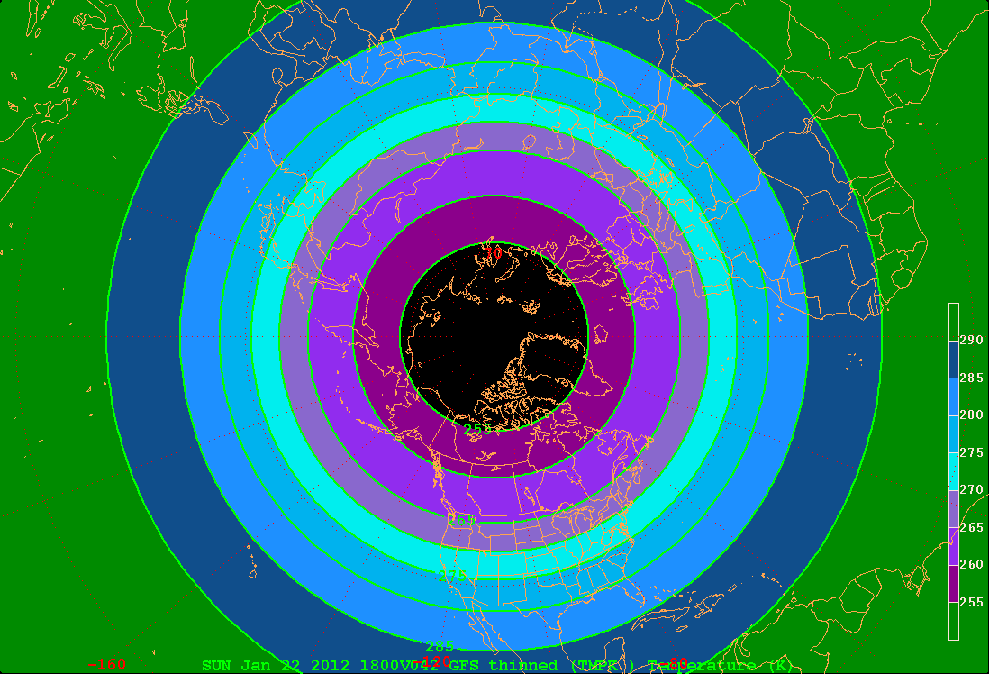
850 hPa level [T] (K)

Slide 7
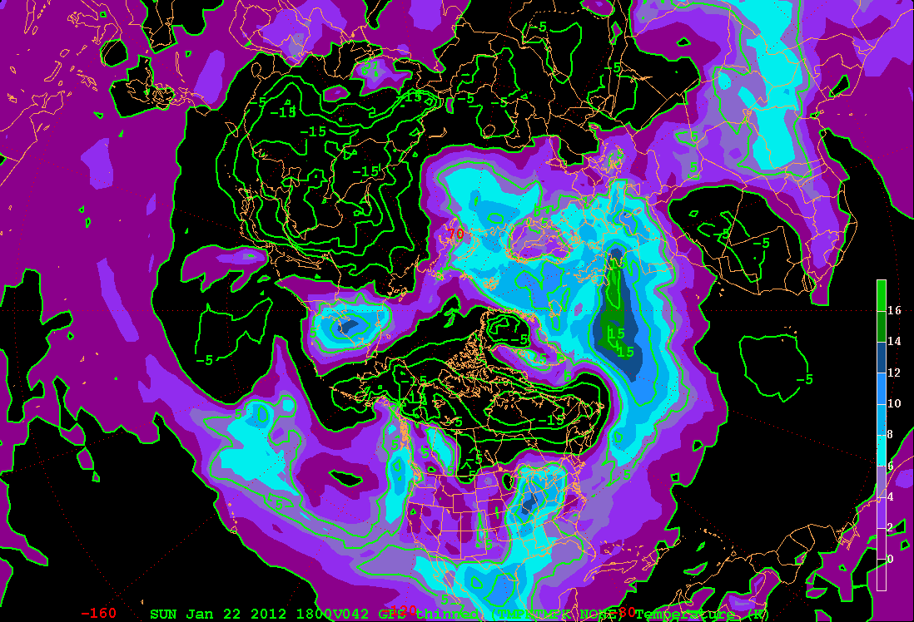
850 hPa level T* (K)

Slide 9
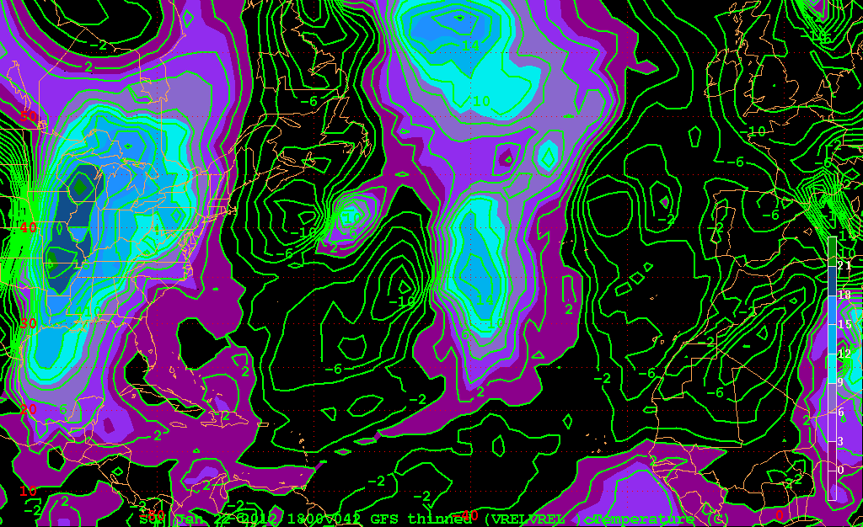
850 hPa level v* (m s⁻¹)

Slide 10
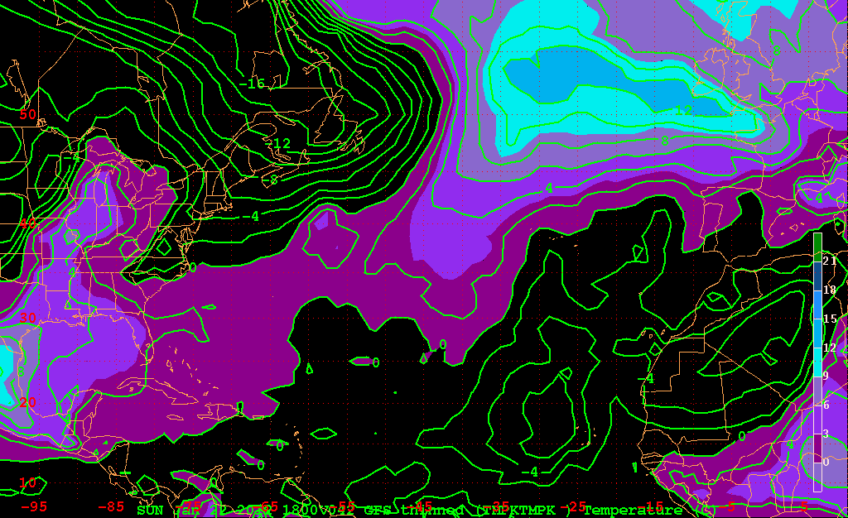
850 hPa level T* (K)

Slide 11
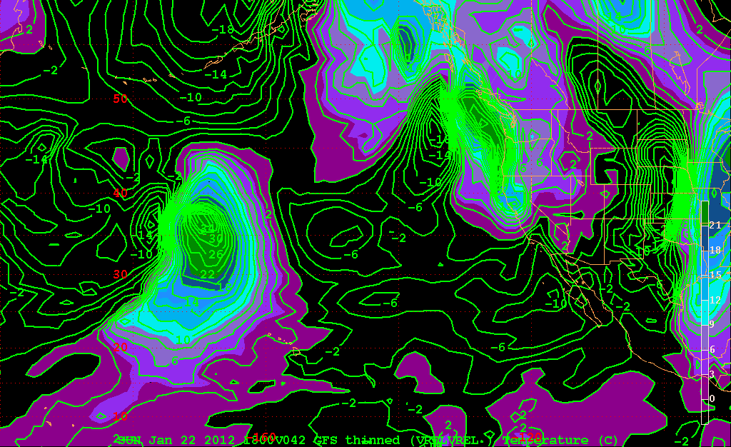
850 hPa level v* (m s⁻¹)

Slide 12
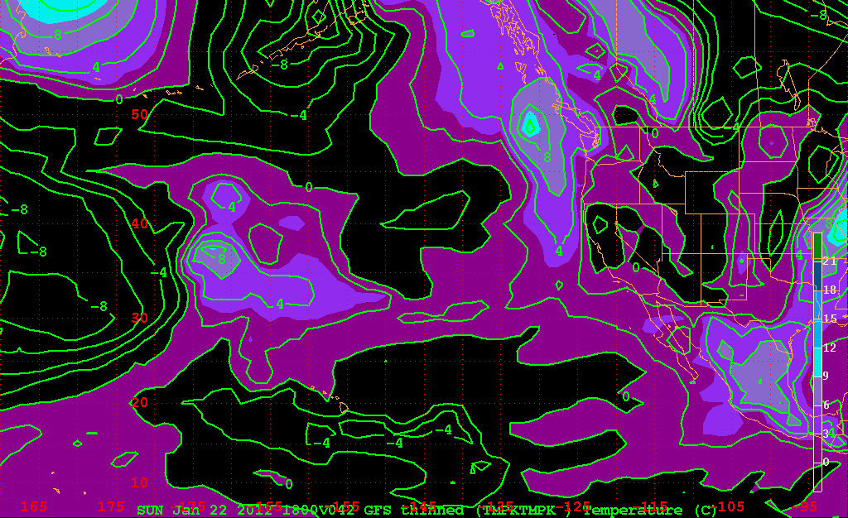
850 hPa level T* (K)

Slide 13
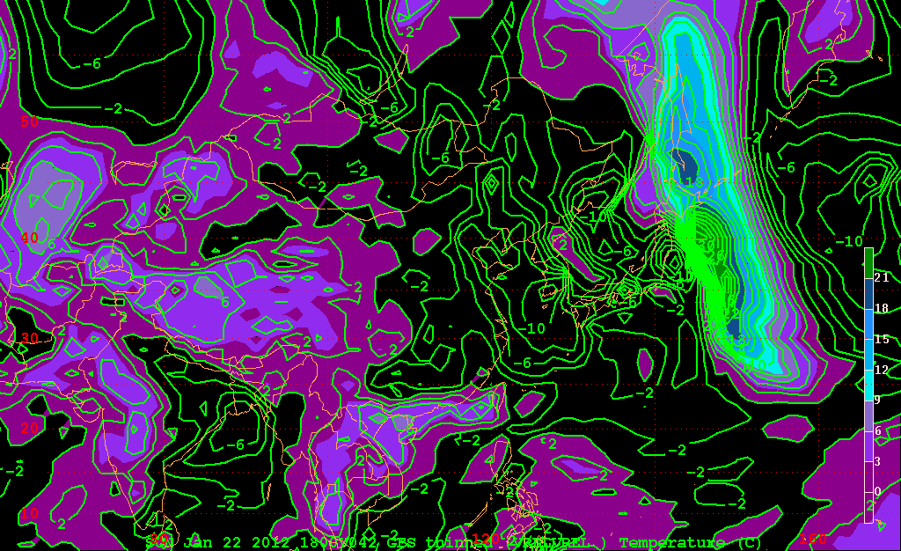
850 hPa level v* (m s⁻¹)

Slide 14
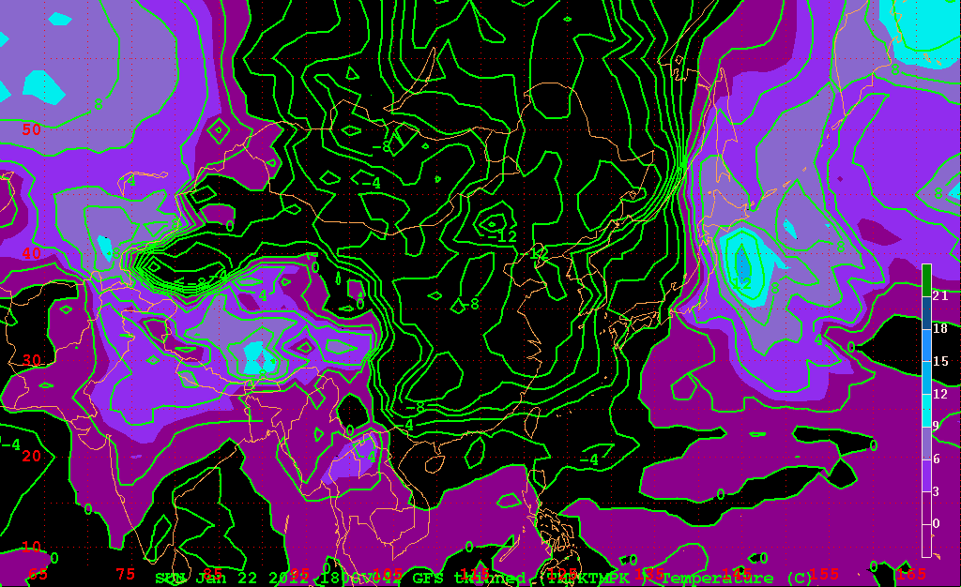
850 hPa level T* (K)

Slide 15
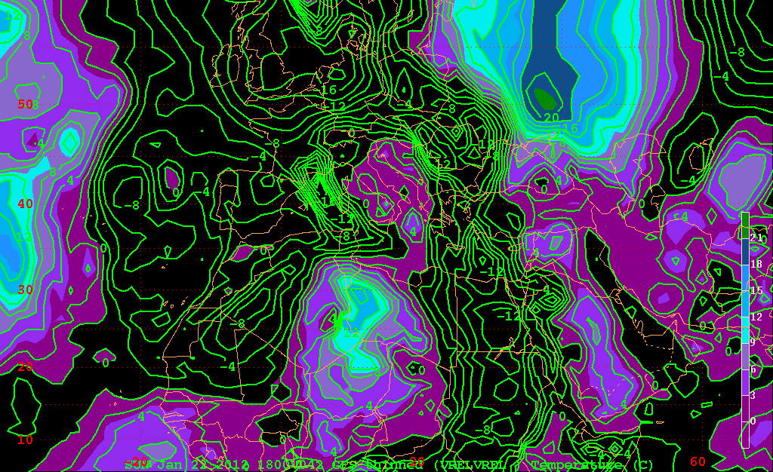
850 hPa level v* (m s⁻¹)

Slide 16
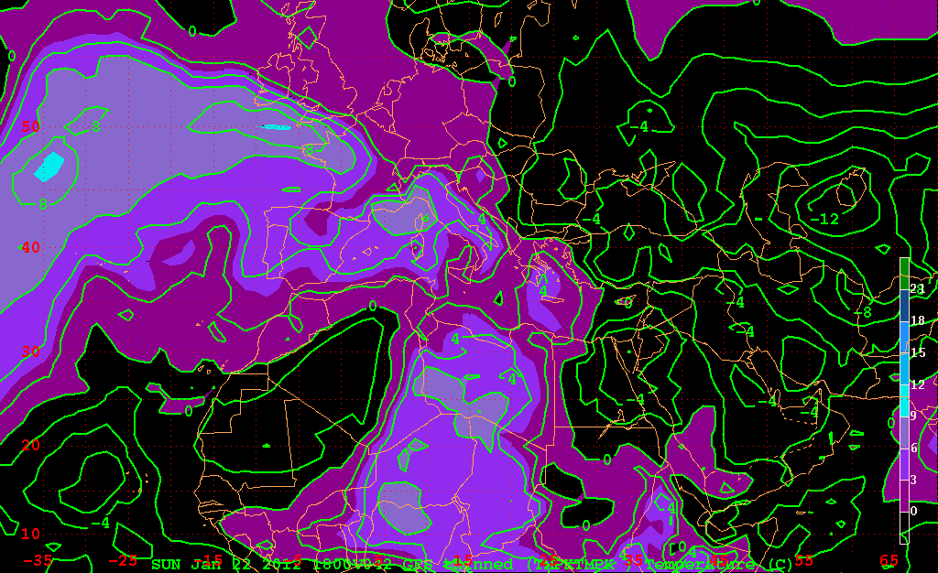
850 hPa level T* (K)

Slide 18
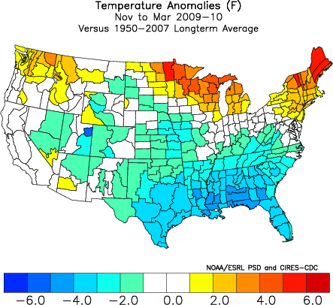

Slide 19
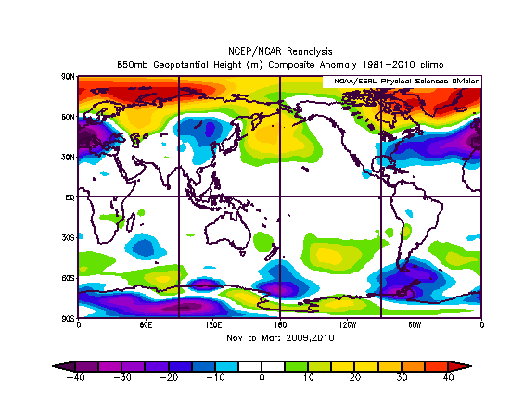

Slide 20
Individual part (v*T*)
Examples of ZERO meridional heat transport

Slide 21
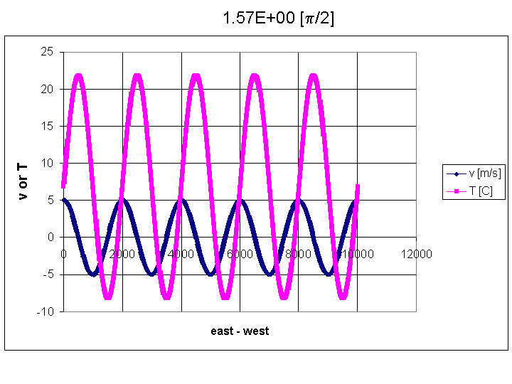
v-comp waves are NOT geopotential waves

Slide 22

v-comp waves are NOT geopotential waves

