Slide 1
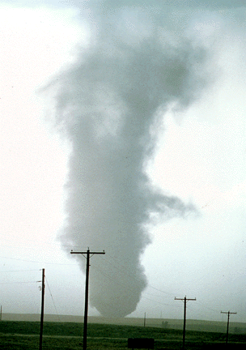
ATMS 316- Mesoscale Meteorology
Packet#6
Interesting things happen at the boundaries, or at the interface…
  Cold air, warm air
http://www.ucar.edu/communications/factsheets/Tornadoes.html

Slide 2
ATMS 316- Mesoscale Meteorology
Outline
  Background
  Synoptic Fronts

Slide 3
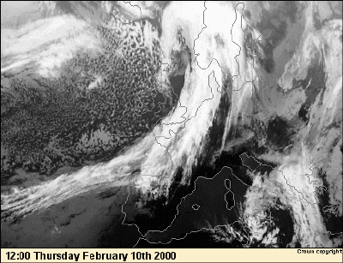
ATMS 316- Background
Air masses and fronts, a review
  Main features of the Norwegian cyclone model (early 1900s)
  Fronts are transition zones separating air masses having different origins
  Cross-front scale is mesoscale, along-front scale can be synoptic scale
  Form as a result of large-scale geostrophic deformation (a.k.a. confluence)
http://www.bsmo.co.uk/newsfeatures/beginnersguides/guides/coldfrontsimulation/1.htm

Slide 4
Baroclinic zone
A region of strong thermal contrast
  Significant horizontal temperature gradient
N
E
T₁
Baroclinic zone
T₂
T₃
T₄
T₅
Notes:
Fronts are commonly thought of as relatively narrow zones of rapid transition in temperature. This definition of a front is not always apparent from an examination of the isotherms. There is much mesoscale structure along a front such that the kinematic front is not always aligned with the thermodynamic front.
In a horizontal plane, fronts appear as long narrow features with cross-front gradients that are typically several orders of magnitude larger than along-front gradients. This observed difference in scale allows us to often consider fronts in two-dimensional plane perpendicular to the front and extending through the depth of the troposphere. [MR3234].

Slide 5
Observed Structure
[Carlson 1991]
A zone of stronger
  Temperature, moisture, and vertical motion gradients normal to the frontal boundary on the cold side of the front
Frontal gradients that appear discontinuous from those of the synoptic-scale background
Relative minimum in pressure
Relative maximum of vorticity along the front
Zone of confluence along the front
Strong vertical and lateral (cyclonic) wind shear
Rapid changes in cloud cover and precipitation
Notes:
Fronts are commonly thought of as relatively narrow zones of rapid transition in temperature. This definition of a front is not always apparent from an examination of the isotherms. There is much mesoscale structure along a front such that the kinematic front is not always aligned with the thermodynamic front.
In a horizontal plane, fronts appear as long narrow features with cross-front gradients that are typically several orders of magnitude larger than along-front gradients. This observed difference in scale allows us to often consider fronts in two-dimensional plane perpendicular to the front and extending through the depth of the troposphere. [MR3234].

Slide 6
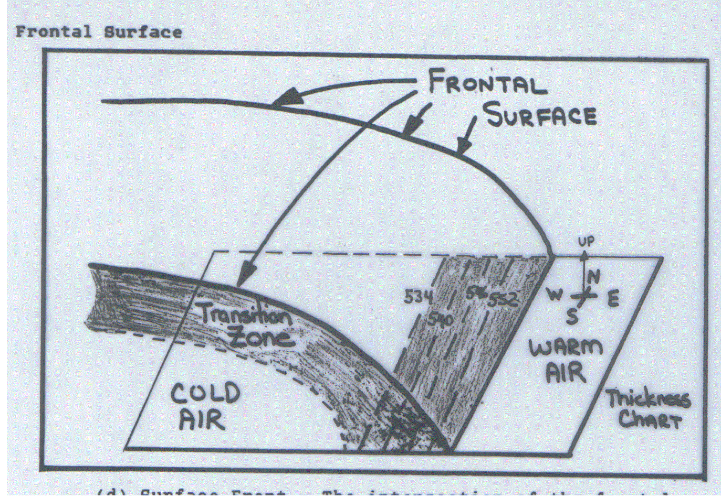
Frontal Surface
Notes:
Since a front is a zone of transition between two air masses of different densities, there must be some sort of boundary between these air masses. One of these boundaries is the FRONTAL SURFACE. The frontal surface is the surface that separates the two air masses. It is the surface next to the warmer air (less dense air). In reality, however, the point at which two air masses touch is not a nice, abrupt separation. This area is a zone of a large density gradient. This zone is called the FRONTAL ZONE. A frontal zone is the transition zone between two adjacent air masses of different densities, bounded by a frontal surface. Since the temperature distribution is the most important regulator of atmospheric density, a front almost invariably separates air masses of different temperatures. At this point you should be aware of the various types of fronts. The question in your mind should be how a front is classified as either cold, warm, stationary, and so on. A front is classified by determining the instantaneous movement. The direction of movement of the front for the past 3 to 6 hours is often used. Classification is based on movement relative to the warm and cold air masses involved.

Slide 7
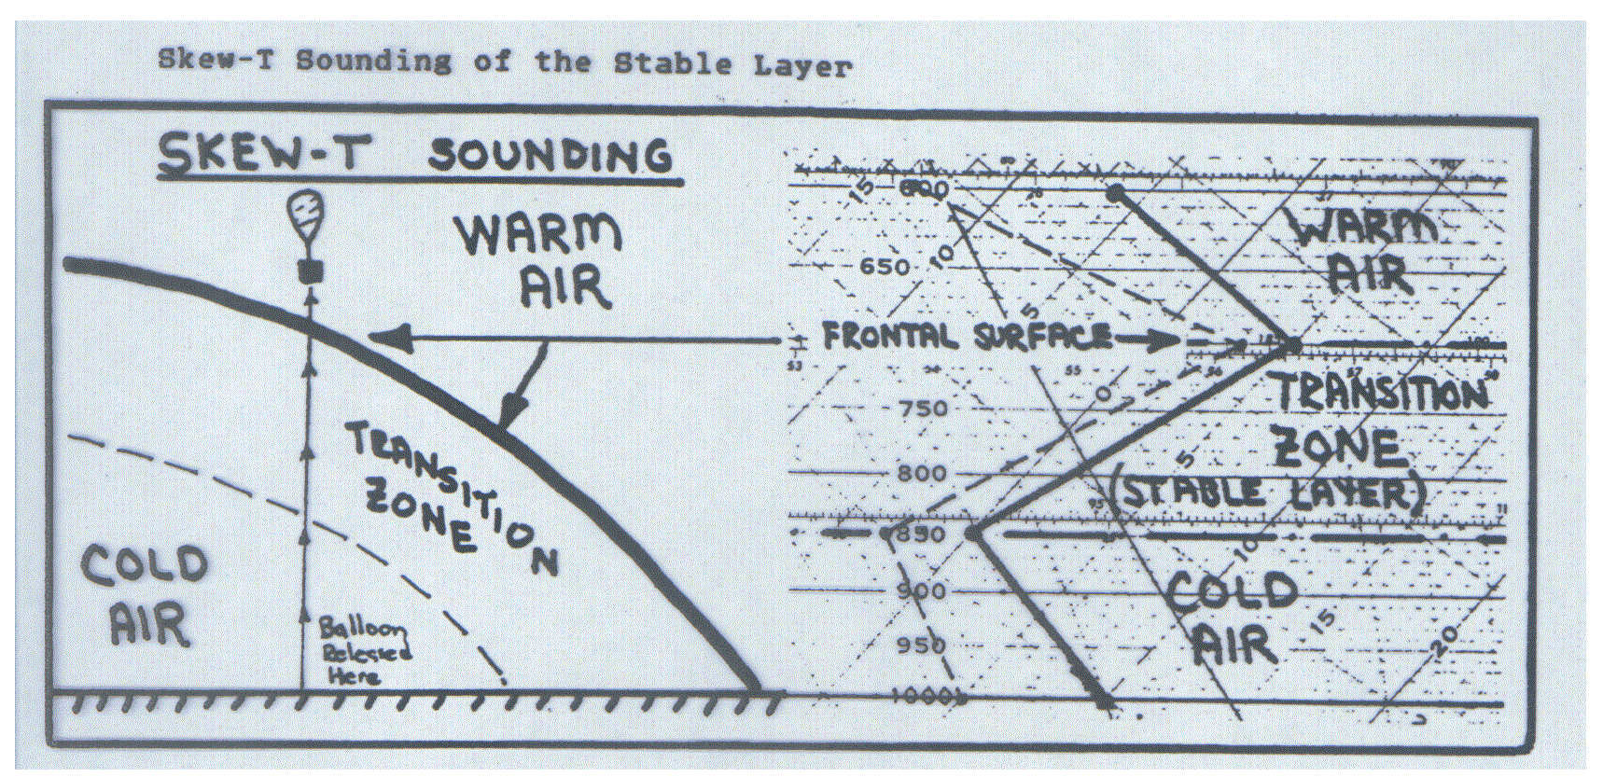
Transition (Frontal) Zone

Slide 8
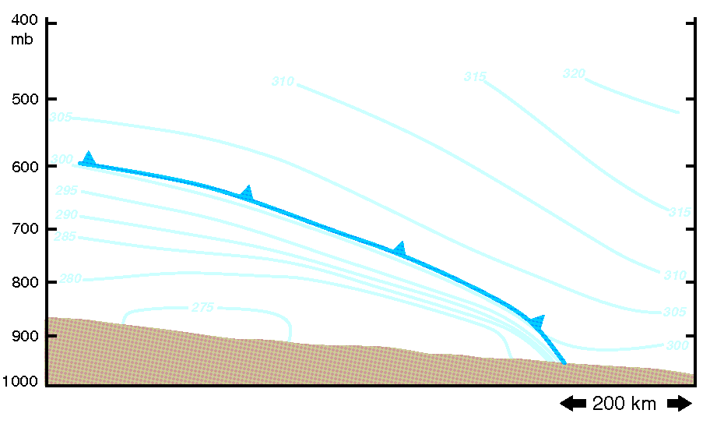
ATMS 316- Synoptic Fronts
Chapter 5, p. 115 – 133
  General characteristics
  Types of fronts
  Motion of fronts
  Slope of fronts
  Kinematics of frontogenesis
  Dynamics of frontogenesis and the vertical circulation at fronts
  Frontal rainbands
Focus is on air mass boundaries observed at the surface.

Slide 9
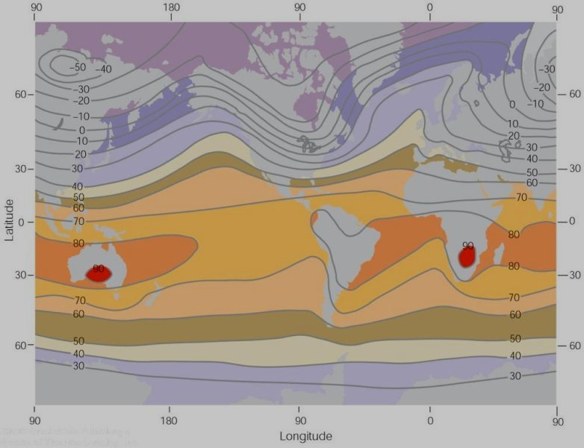
ATMS 316- Synoptic Fronts
General characteristics
  Fronts
    elongated zones of strong horizontal temperature gradient, where the gradient magnitude is at least an order of magnitude larger than the mean meridional temperature gradient
Average air temperature near sea level in January (°F).

Slide 10
ATMS 316- Synoptic Fronts
General characteristics
  Fronts, also corridors of enhanced
    cyclonic vorticity
    vertical wind shear
    static stability (if the frontal zone is tilted over the cold air mass)

Slide 11
ATMS 316- Synoptic Fronts
General characteristics
  Fronts, Rossby number (Ro)
    relatively small (Ro << 1) in the along-front direction
    relatively large (Ro ≥ 1) in the cross-front direction
      quasi-geostrophic theory is inadequate

Slide 12
ATMS 316- Synoptic Fronts
General characteristics
  Fronts; inadequacy of quasi-geostrophic theory → semigeostrophic theory
    Advection of momentum and temperature by the ageostrophic wind is allowed, in addition to the advections accomplished by the geostrophic wind

Slide 13
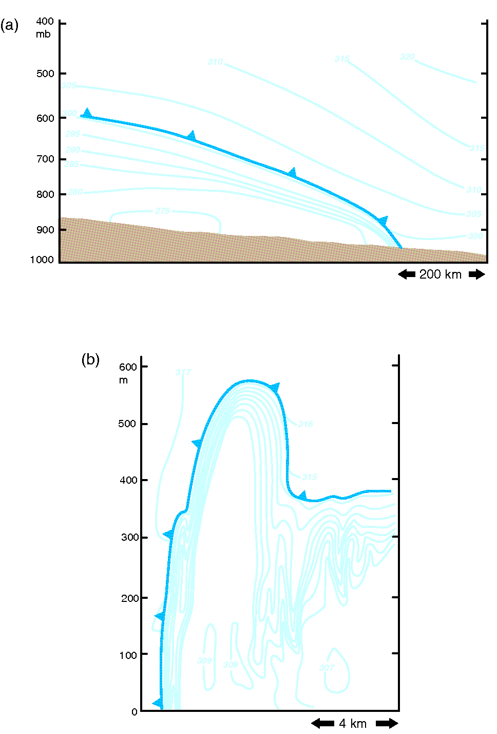
ATMS 316- Synoptic Fronts
Types of fronts
  cold front (a, b)
    cold air mass advances relative to the warm air mass
  intense cold front (b)
    Near-discontinuity in potential temperature → similar characteristics to density currents
contours = potential temperature

Slide 14
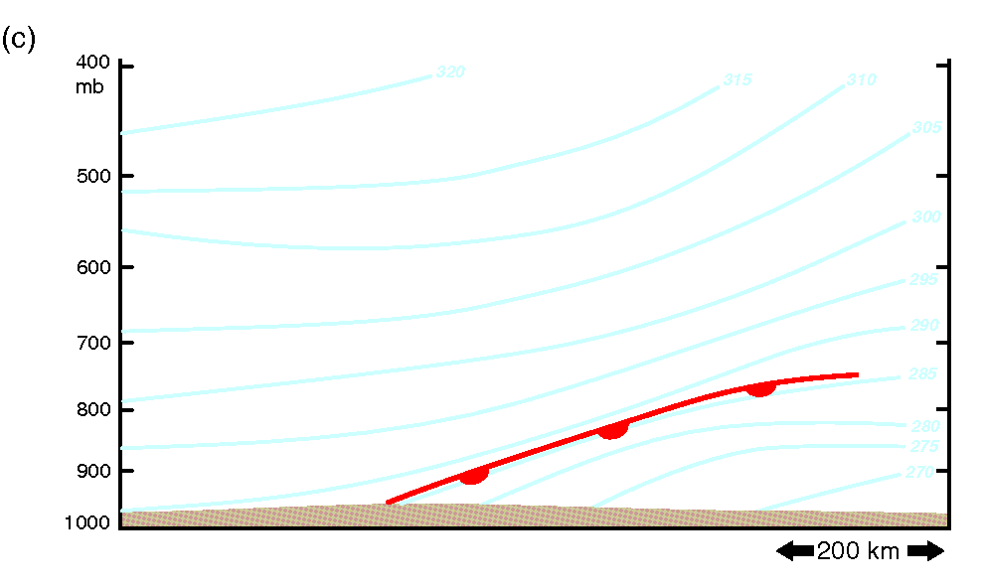
ATMS 316- Synoptic Fronts
Types of fronts
  warm front (c)
    warm air advances relative to the cold air mass
  stationary front
    little or no motion of air masses
contours = potential temperature

Slide 15
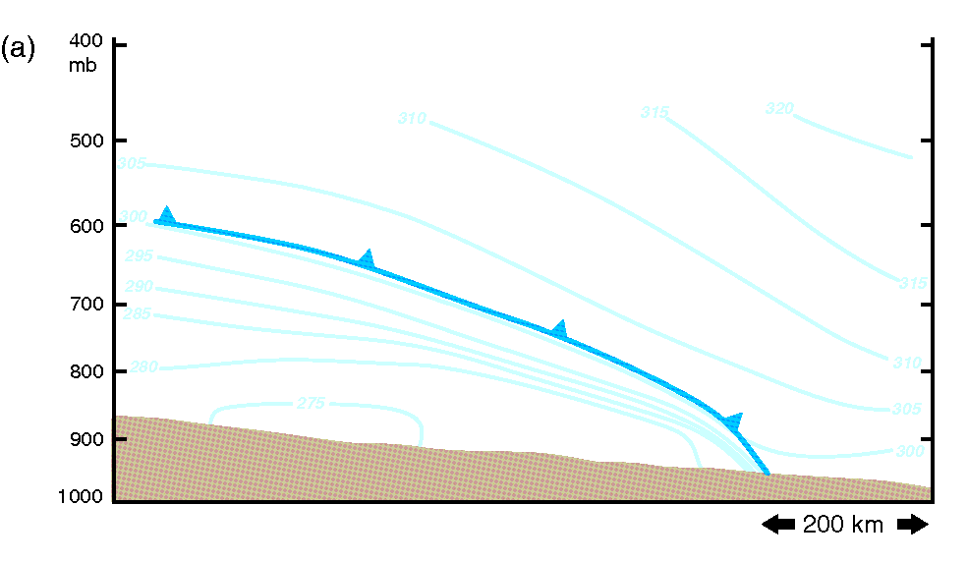
ATMS 316- Synoptic Fronts
Types of fronts
  slopes of fronts are impacted by
    surface drag
      steepens cold fronts
      shallows out warm fronts
    surface fluxes on the cold side of the front
      Stronger positive surface heat flux in the cold frontal zone → stronger deeper vertical mixing → isentropes more vertical → increasing cold frontal slope

Slide 16
ATMS 316- Synoptic Fronts
Types of fronts
  slopes of fronts are impacted by
    cloud cover and precipitation
      greater insolation and associated low-level destabilization generally might be favored behind cold fronts

Slide 17
ATMS 316- Synoptic Fronts
Types of fronts
  chinook fronts
    warm fronts that form when air crosses a mtn range, and the downsloping adiabatically warming air advances in the lee of the mtn range (common east of Rocky Mountains)

Slide 18
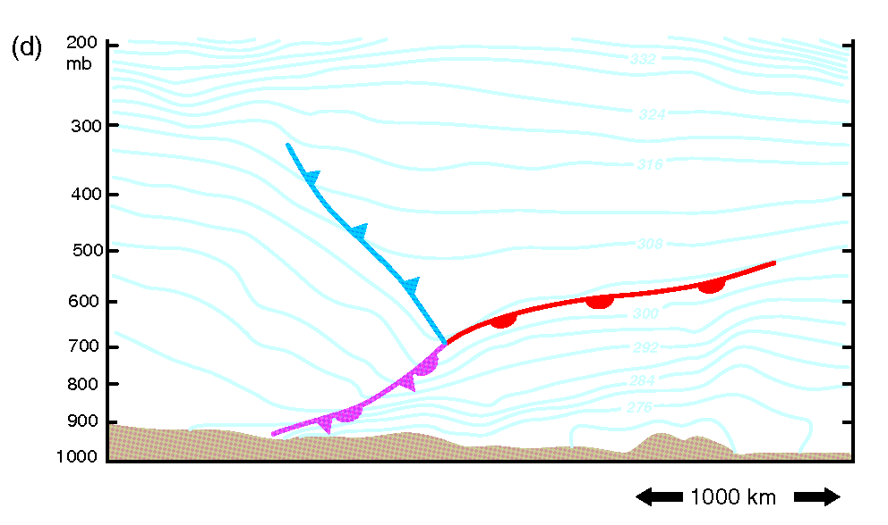
ATMS 316- Synoptic Fronts
Types of fronts
  occluded fronts
    formation first postulated as part of the Norwegian cyclone model
    their formation mechanisms have been controversial and remains a topic of ongoing research

Slide 19
ATMS 316- Synoptic Fronts
Types of fronts
  occluded fronts
    cold occlusion
      Schultz and Mass (1993) were unable to find a single case of a cold occlusion documented in the literature in their review of occluded fronts
    warm occlusion
      [shown in Panel (d) to the right]

Slide 20
ATMS 316- Synoptic Fronts
Types of fronts
  occluded fronts
    formation examples
      a low deepens on the cold side of a front, independent of a narrowing of the warm sector by a cold front outrunning a warm front
      a low initially located at the warm & cold front junction often propagates into the cold air as it deepens, thereby separating itself from the junction- occluded front joins low center with warm & cold front junction

Slide 21
ATMS 316- Synoptic Fronts
Types of fronts
  occluded fronts, formation
    recent research; type of occlusion is diagnosed by the difference in static stability within the cold air masses straddling the narrowing warm sector (Stoelinga et al. 2002)
warm occlusion; statically more stable air lies ahead of the warm front (example above)*
*static stability differences do not cause occlusions to form

Slide 22
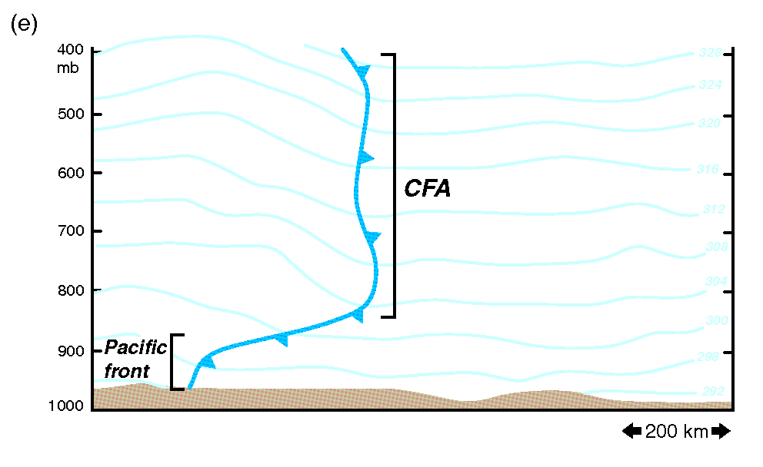
ATMS 316- Synoptic Fronts
Types of fronts
  occluded fronts, examples whose static stability structures resemble a warm occlusion
    Pacific cold front overtakes a dryline (Great Plains)
      modified maritime polar air mass overtakes a moist air mass
      results in a cold front aloft (CFA)

Slide 23
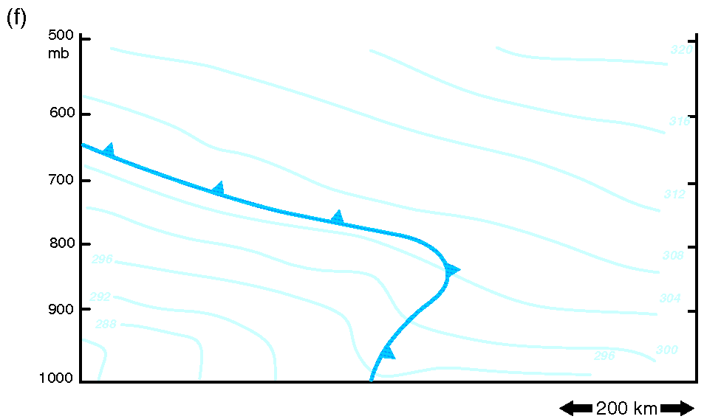
ATMS 316- Synoptic Fronts
Types of fronts
  occluded fronts, examples whose static stability structures resemble a warm occlusion*
    forward-tilting cold fronts
      cold fronts that encounter a stable prefrontal layer not associated with a warm front or dryline (Schultz and Steenburgh 1999)
*forward-tilting frontal boundaries involve processes more complicated than simply the result of interactions between surface fronts separating air masses with different stratifications

Slide 24
ATMS 316- Synoptic Fronts
Motion of fronts
  surface front propagation is strongly dependent on
    changing pressure on either side the front (front-normal isallobaric gradient)
    movement highly correlated with temperature advection (and wind direction) on cold side of the front
      temperature gradient is usually largest on the cool side of a front

Slide 25
ATMS 316- Synoptic Fronts
Motion of fronts
  a comparison
    cold fronts tend to move faster than warm fronts
      ageostrophic cold air advection* works
        with the forward speed contributed by geostrophic temperature advection for a cold front (acceleration)
        against the forward speed contributed by geostrophic temperature advection for a warm front (deceleration)
*to be examined in greater detail in “Dynamics of …” section

Slide 26
ATMS 316- Synoptic Fronts
Motion of fronts
  fronts having a relatively small along-front length scale (Ro ~ 1)
    motion is a function of the temperature differential across the front
      horizontal pressure gradient drives the motion
    motion can also be a function of
      latent cooling
      surface fluxes
      which can promote frontal “jumps”

Slide 27
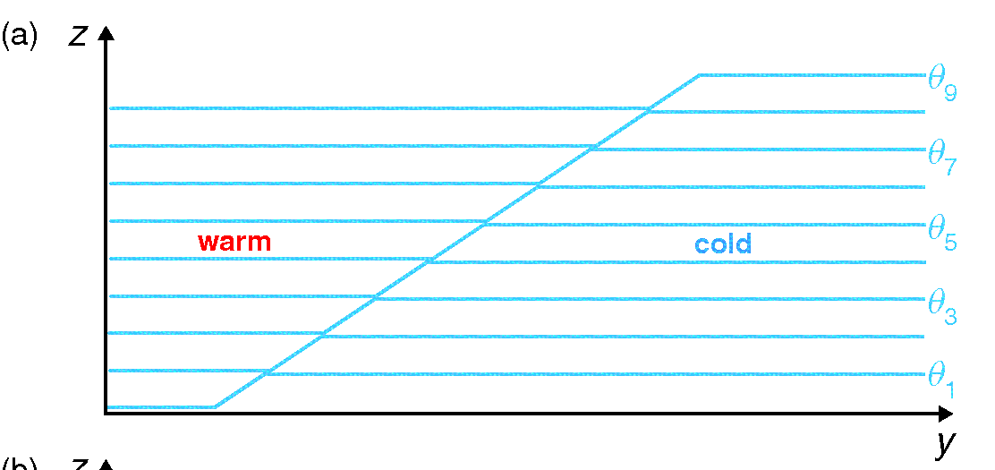
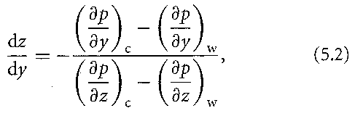
ATMS 316- Synoptic Fronts
Slope of fronts
  simplest model
    zero-order temperature (density) discontinuity [a]
    Eq (5.2) here
where dz/dy is the slope of the front. The slope must be “+” in order for the density distribution to be statically stable (less dense air overlies relatively dense air)

Slide 28

ATMS 316- Synoptic Fronts
Slope of fronts
  simplest model
    To have a positive slope, Eq. (5.2) requires that the front lies within a pressure trough
    Eq (5.3) here

Slide 29

ATMS 316- Synoptic Fronts
Slope of fronts
  simplest model, after applying hydrostatic and geostrophic balance assumptions
    Eq (5.4) here
where T_{w} – T_{c} is the temperature difference across the front, u_{gw} = u_{gc} is a measure of the cyclonic wind shear across a front, and is some representative temperature [Margules’ formula]

Slide 30
ATMS 316- Synoptic Fronts
Slope of fronts
  Margules’ formula
    provides estimates that are the right order of magnitude for the slope of warm fronts
    underestimates the slope of cold fronts
      surface drag, surface heat fluxes, nonhydrostatic effects
    cannot assume that strong fronts are more gently sloped than weak fronts (T_{w} – T_{c})

Slide 31
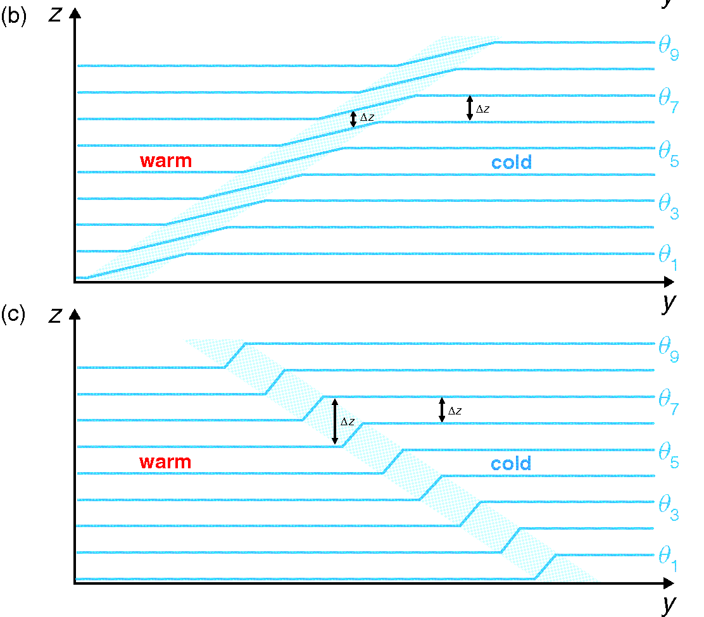
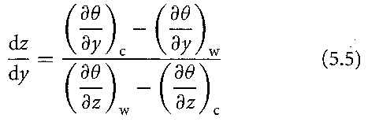
ATMS 316- Synoptic Fronts
Slope of fronts
  more realistic model
    first-order temperature (density) discontinuity [b, c]
    Eq (5.5) here
where the subscripts c and w indicate that the derivatives are to be taken on the immediate cold and warm sides of the front, respectively (front is on the warm side of the frontal zone)

Slide 32
ATMS 316- Synoptic Fronts
Slope of fronts
  more realistic model
    Eq (5.5) here
    numerator on the RHS is always negative
      slope of front is determined by the static stability change across the front

Slide 33
ATMS 316- Synoptic Fronts
Slope of fronts
  more realistic model
    Eq. (5.5) implies that a frontal zone can tilt over the warm air while remaining statically stable [Panel (c)]
      forward-tilting frontal zones are characterized by a relative minimum in static stability
      Margules’ formula cannot predict warm occlusions nor forward-tilting cold fronts

Slide 34
ATMS 316- Synoptic Fronts
Kinematics of frontogenesis
  frontogenesis
    an increase in the magnitude of the horizontal density (temperature) gradient
  frontolysis
    a decrease in the magnitude of the horizontal density (temperature) gradient

Slide 35
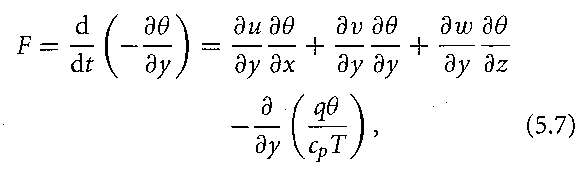
ATMS 316- Synoptic Fronts
Kinematics of frontogenesis
  expression for the time rate of change of the strength of the baroclinity along a front
    Eq. (5.7) here
where F is the scalar frontogenetical function or accumulation of the potential temperature gradient. Note that the “+y” direction must be pointing normal to the front, toward the cold air.

Slide 36
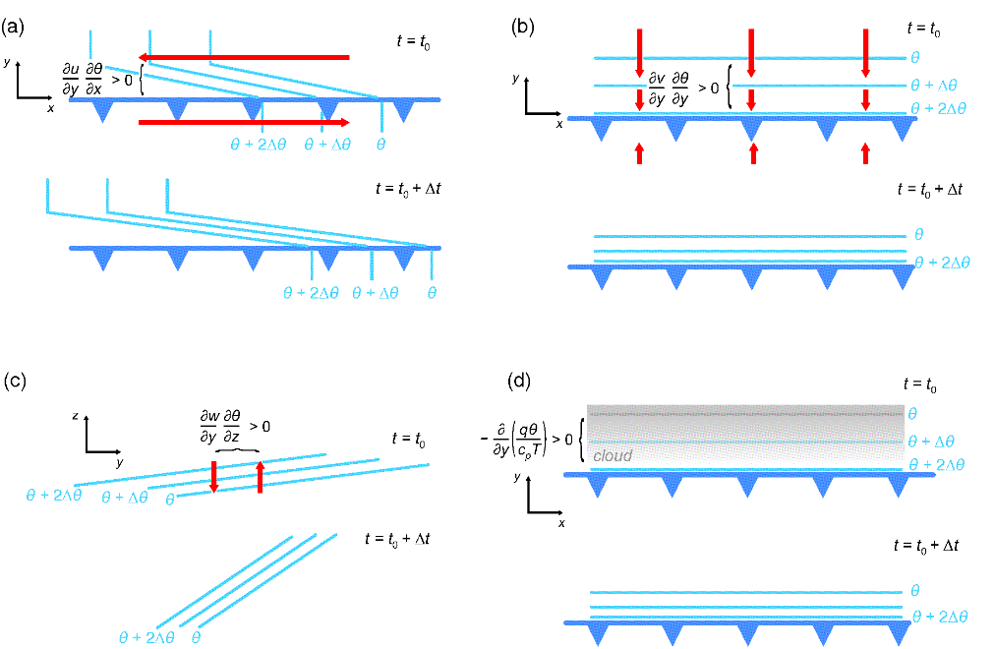
ATMS 316- Synoptic Fronts
Kinematics of frontogenesis
  scalar frontogenetical function (5.7) terms on RHS
    horizontal shear (a)
    confluence (b)
    tilting (c)
    diabatic heating (d)

Slide 37
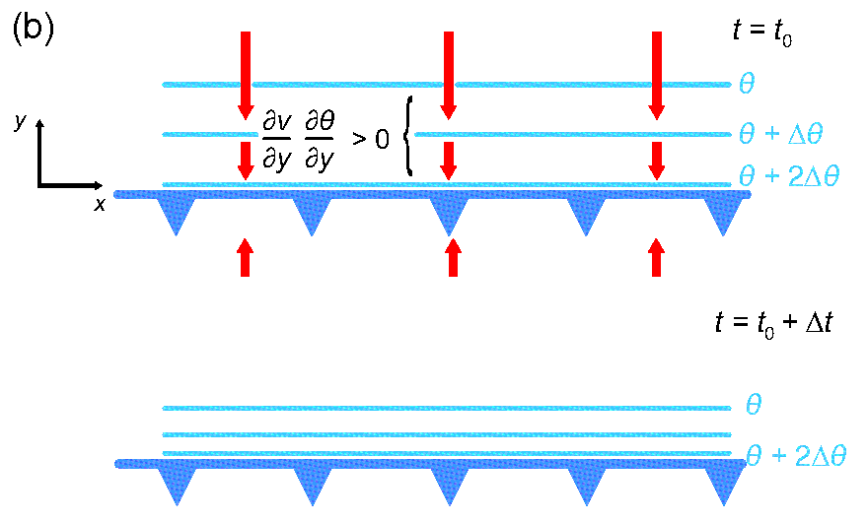
ATMS 316- Synoptic Fronts
Kinematics of frontogenesis
  the form of Eq. (5.7) implies that F is the change of the horizontal potential temperature gradient following a parcel’s motion
    it is shown [see Eqs. (5.8) and (5.9)] that changes in frontal strength can be evaluated accurately using the terms on the RHS of Eq. (5.7) by following the frontal zone

Slide 38

ATMS 316- Synoptic Fronts
Kinematics of frontogenesis
  For adiabatic, horizontal motion, Eq. (5.7) simplifies to
    Eq. (5.10) here
Note, Eq. (5.10) is evaluated using x and y axes that are unrotated
where β is the angle between the isentropes and the axis of dilatation, δ is the horizontal divergence, and D is the resultant or total (stretching + shearing) deformation [see Eq. (5.11)]

Slide 39
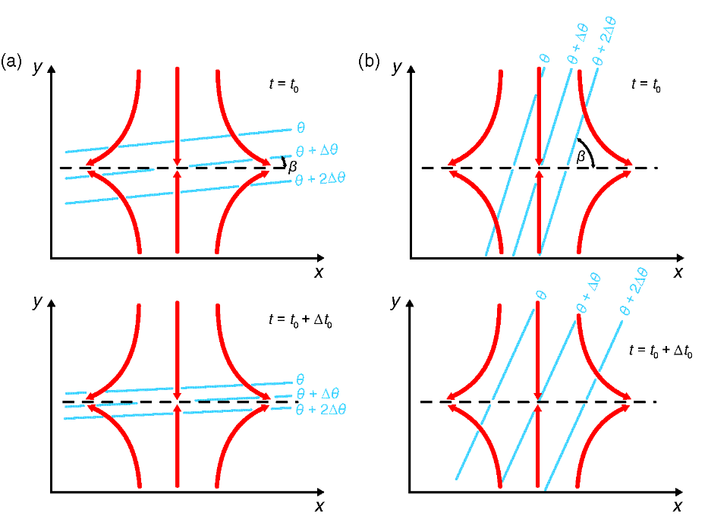
ATMS 316- Synoptic Fronts
Kinematics of frontogenesis
  Simplified frontogenetical function [ Eq. (5.10) ]
    axis of dilatation is indicated by the dashed lines in the figure
      axis along which a fluid element is stretched in a flow containing deformation

Slide 40
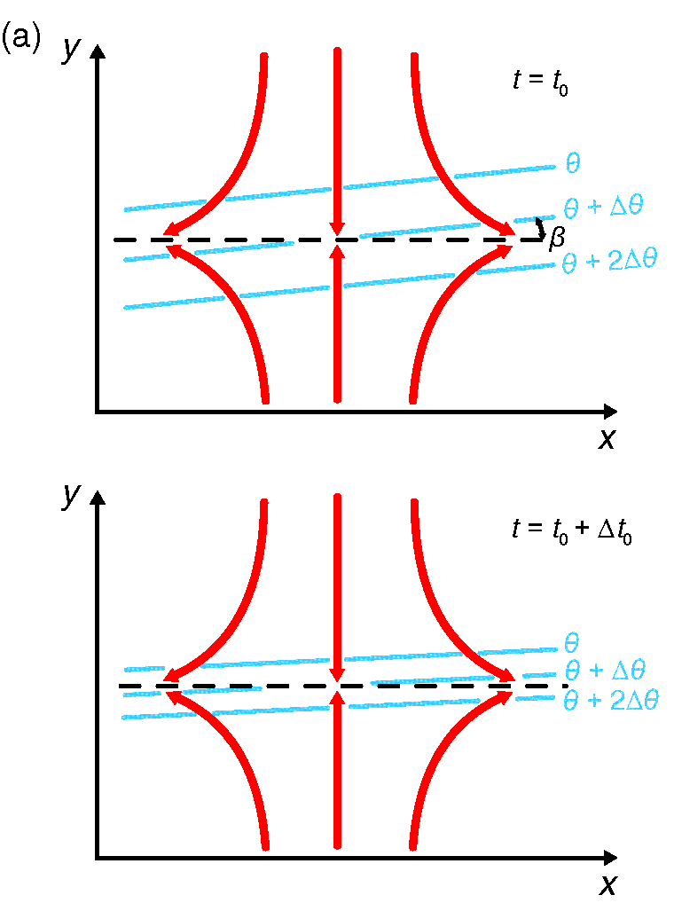
ATMS 316- Synoptic Fronts
Kinematics of frontogenesis
  Simplified frontogenetical function [ Eq. (5.10) ]
    frontogenesis
      whenever the total deformation field acts upon isentropes that are oriented within 45º of the axis of dilatation
      convergence (δ < 0)

Slide 41
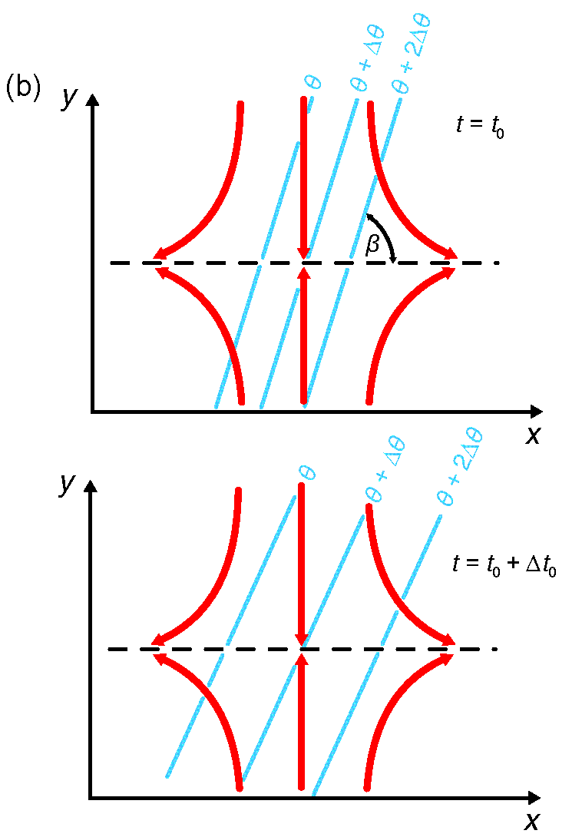
ATMS 316- Synoptic Fronts
Kinematics of frontogenesis
  Simplified frontogenetical function [ Eq. (5.10) ]
    frontolysis
      whenever the total deformation field acts upon isentropes that are oriented between 45º and 90º of the axis of dilatation
      divergence (δ > 0)
vorticity does not contribute directly but can affect frontogenesis or frontolysis by rotating the isentropes

Slide 42
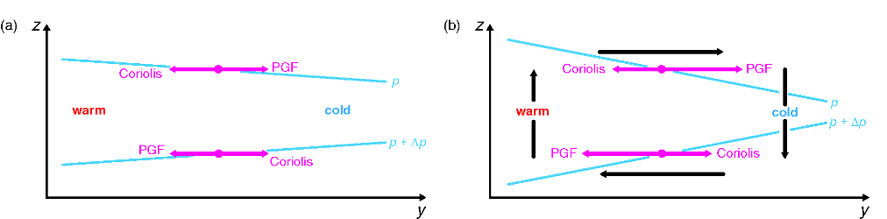
ATMS 316- Synoptic Fronts
Dynamics of frontogenesis and the vertical circulation at fronts
  positive feedback
    ageostrophic wind accelerates frontogenesis once the process has started through geostrophic deformation
← KEY POINT!!
← also applies to frontolysis

Slide 43


ATMS 316- Synoptic Fronts
Dynamics of frontogenesis and the vertical circulation at fronts
  positive feedback
    ageostrophic flow contributes through increasing confluence (∂v/∂y) defined in Eq. (5.7) as the horizontal temperature gradient increases, contributing to additional frontogenesis

Slide 44
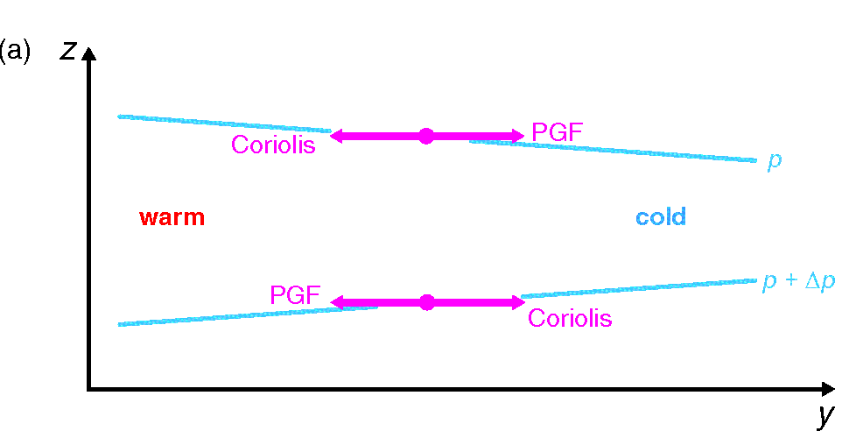
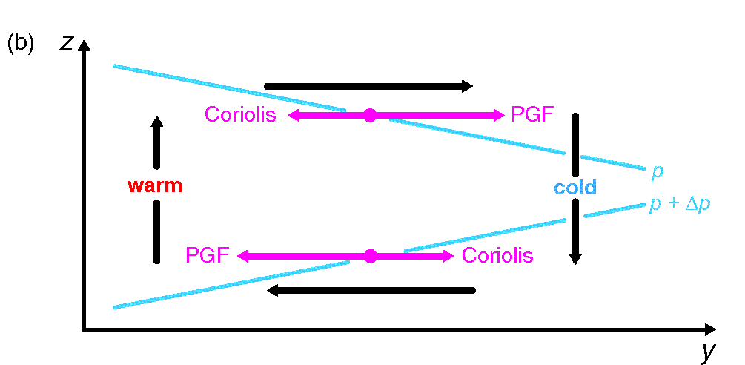
ATMS 316- Synoptic Fronts
Dynamics of frontogenesis and the vertical circulation at fronts
  feedback loop → thermal wind balance
    hydrostatic and geostrophic balance
    ageostrophic winds are a response that maintain thermal wind balance

Slide 45
ATMS 316- Synoptic Fronts
Dynamics of frontogenesis and the vertical circulation at fronts
  initial time [Panel (a)]
    winds are in geostrophic balance
    frontogenetical geostrophic deformation is advecting warmer air into the warm air and colder air into the cold air

Slide 46
ATMS 316- Synoptic Fronts
Dynamics of frontogenesis and the vertical circulation at fronts
  later time [Panel (b)]
    winds are out of geostrophic balance
    force imbalances yield ageostrophic winds that
      accelerate the horizontal winds back into geostrophic balance*
      force vertical motion (Continuity Equation)
*see Eqs. (4.77) and (4.78)

Slide 47
ATMS 316- Synoptic Fronts
Dynamics of frontogenesis and the vertical circulation at fronts
  later time [Panel (b)]
    Coriolis force acts on the ageostrophic winds, increasing the vertical shear
      necessary to maintain thermal wind balance in the presence of an increasing temperature gradient

Slide 48
ATMS 316- Synoptic Fronts
Dynamics of frontogenesis and the vertical circulation at fronts
  later time [Panel (b)]
    vertical motion and attendant adiabatic cooling (rising) and warming (sinking) oppose the effects of the horizontal temperature advection by the geostrophic wind

Slide 49
ATMS 316- Synoptic Fronts
Dynamics of frontogenesis and the vertical circulation at fronts
  later, later time
    ageostrophic horizontal winds further enhance (∂θ/∂y), which then requires even stronger vertical motions and ageostrophic winds, leading to a continued enhancement of (∂v/∂y) and (∂θ/∂y)

Slide 50
ATMS 316- Synoptic Fronts
Dynamics of frontogenesis and the vertical circulation at fronts
  effects of ageostrophic wind
    cannot be represented using the quasigeostrophic (QG) approximation
      advections are only considered by the geostrophic wind
    semigeostrophic momentum equations

Slide 51
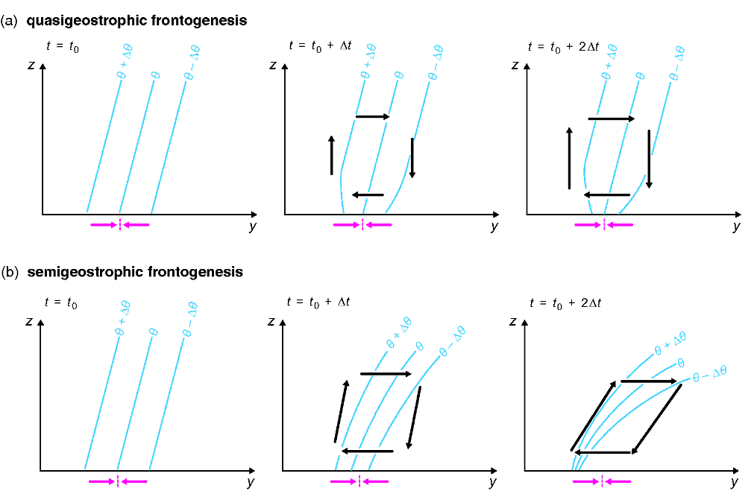
ATMS 316- Synoptic Fronts
Dynamics of frontogenesis and the vertical circulation at fronts
  semigeostrophic equations [Eqs. (5.12) and (5.13), rotated such that the +y axis points toward the cold air]

Slide 52
ATMS 316- Synoptic Fronts
Dynamics of frontogenesis and the vertical circulation at fronts
  Fig (5.7) - large

Slide 53
ATMS 316- Synoptic Fronts
Dynamics of frontogenesis and the vertical circulation at fronts
  without the deformation, divergence, and advections by the ageostrophic winds (QG), frontogenesis
    proceeds too slowly
    frontal zone tilt is unrealistic
    air on warm side of front is unrealistically statically unstable

Slide 54
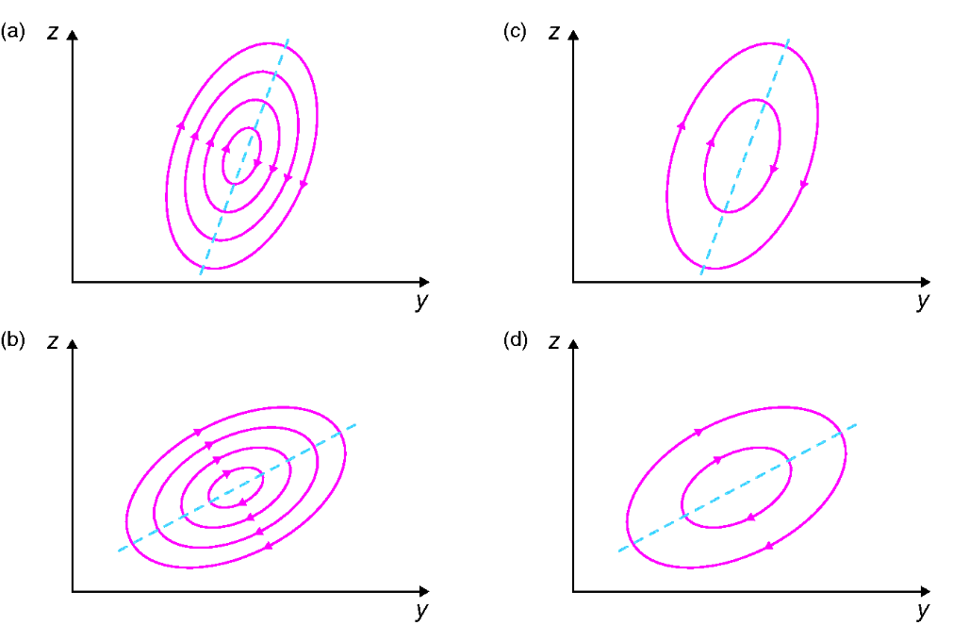
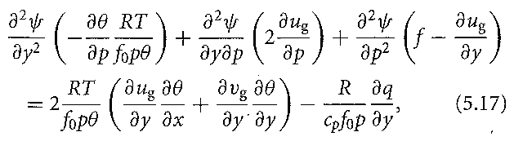
ATMS 316- Synoptic Fronts
Dynamics of frontogenesis and the vertical circulation at fronts
  Sawyer-Eliassen equation
The Sawyer-Eliassen equation gives the structure of the vertical circulation associated with frontogenesis or frontolysis under given atmospheric conditions

Slide 55
ATMS 316- Synoptic Fronts
Dynamics of frontogenesis and the vertical circulation at fronts
  Sawyer-Eliassen equation
    LHS
      static stability
      inertial stability
      horizontal temperature gradient
    RHS
      frontogenetical forcing by the geostrophic wind
      differential diabatic heating

Slide 56
ATMS 316- Synoptic Fronts
Dynamics of frontogenesis and the vertical circulation at fronts
  Sawyer-Eliassen equation
    linear, second-order partial differential equation
    if elliptical, frontal circulation is entirely determined by the RHS terms [see Eq. (5.19) for ellipticity condition]
    if hyperbolic, non-unique solutions arise
equation is hyperbolic if the atmosphere is statically, inertially, or symmetrically unstable

Slide 57
ATMS 316- Synoptic Fronts
Dynamics of frontogenesis and the vertical circulation at fronts
  Sawyer-Eliassen equation
    RHS [Eq. (5.17)] (forcing)
      thermally direct circulation
        (RHS +)
      thermally indirect circulation
        (RHS −)
      intensity of the circulation is proportional to the magnitude of the RHS forcing

Slide 58
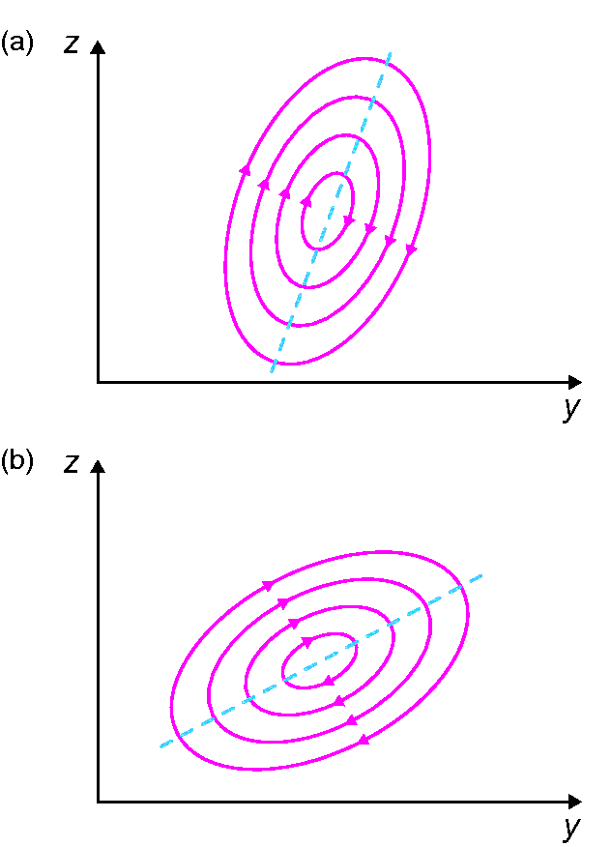
ATMS 316- Synoptic Fronts
Dynamics of frontogenesis and the vertical circulation at fronts
  Sawyer-Eliassen equation
    cold fronts (a, b)
      stronger vertical circulations
      sharper temperature gradients
      both deformation terms in the “frontogenetical forcing by the geostrophic wind” term on the RHS of Eq. (5.17) are usually frontogenetic

Slide 59
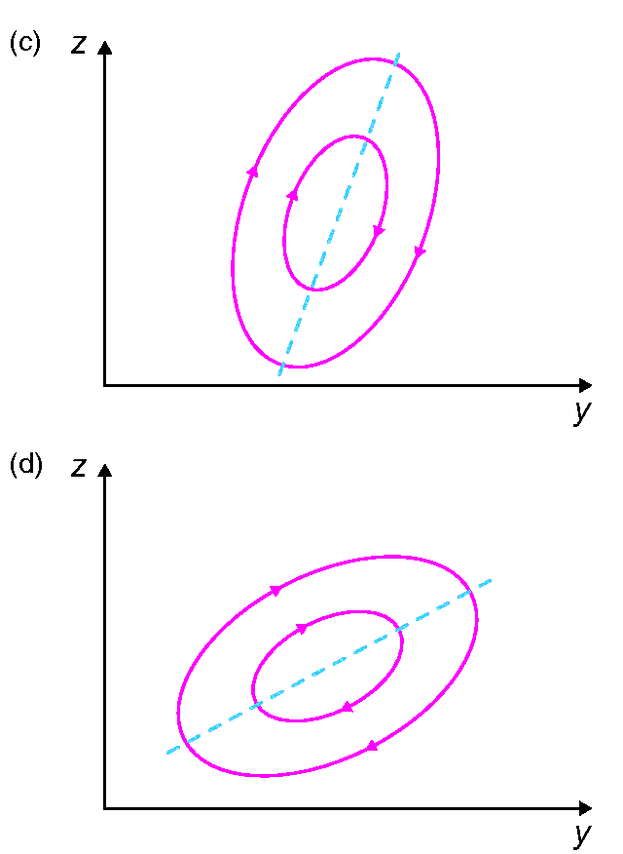
ATMS 316- Synoptic Fronts
Dynamics of frontogenesis and the vertical circulation at fronts
  Sawyer-Eliassen equation
    warm fronts (c, d)
      weaker vertical circulations
      weaker temperature gradients
      first term of the “frontogenetical forcing by the geostrophic wind” sum on the RHS of Eq. (5.17) often opposes frontogenesis (is negative)

Slide 60
ATMS 316- Synoptic Fronts
Dynamics of frontogenesis and the vertical circulation at fronts
  eccentricity of the ageostrophic circulation, controlled by the relative strengths of
    static stability
    inertial stability

Slide 61
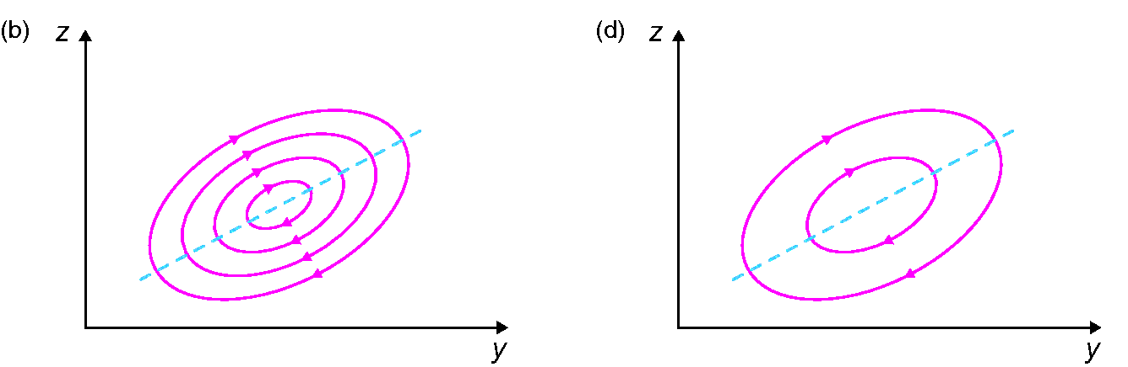
ATMS 316- Synoptic Fronts
Dynamics of frontogenesis and the vertical circulation at fronts
  eccentricity of the ageostrophic circulation
    static stability >> inertial stability → ‘squashed’ in the vertical ( b & d )

Slide 62
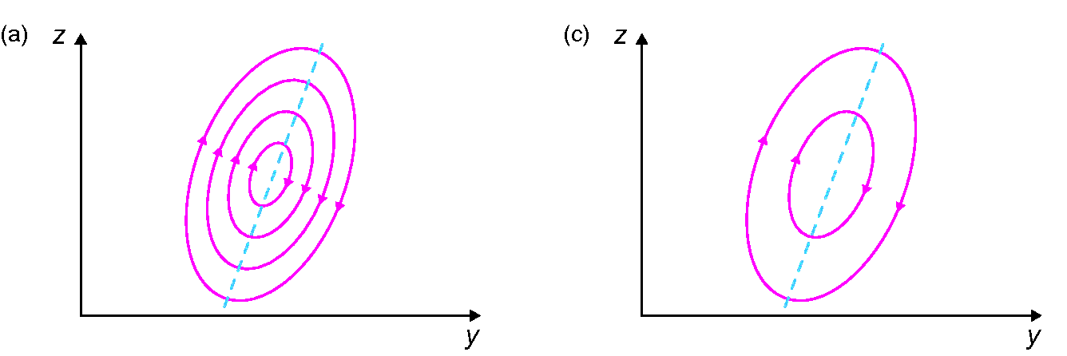
ATMS 316- Synoptic Fronts
Dynamics of frontogenesis and the vertical circulation at fronts
  eccentricity of the ageostrophic circulation
    static stability << inertial stability → ‘squashed’ in the horizontal ( a & c )

Slide 63
ATMS 316- Synoptic Fronts
Dynamics of frontogenesis and the vertical circulation at fronts
  eccentricity of the ageostrophic circulation
    tilt of the major axis of the ageostrophic circulation is equal to the slope of local geostrophic absolute momentum (M_{g}) surfaces
M_{g} = u_{g} – f y [see Section 3.3]

Slide 64
ATMS 316- Synoptic Fronts
Dynamics of frontogenesis and the vertical circulation at fronts
  slope of local geostrophic absolute momentum (M_{g}) surface
    For a given horizontal shear of the geostrophic wind, the slope of an M_{g} surface [front*] decreases as the horizontal temperature gradient increases
*similar conclusion reached using Margules’ formula (5.2)

Slide 65
ATMS 316- Synoptic Fronts
Dynamics of frontogenesis and the vertical circulation at fronts
  frontogenetical geostrophic deformation acting on a preexisting temperature gradient “jump starts” frontogenesis
  intensity of a front is limited by vertical and horizontal mixing
    prevents the magnitude of the horizontal temperature gradient from becoming infinitely large

Slide 66
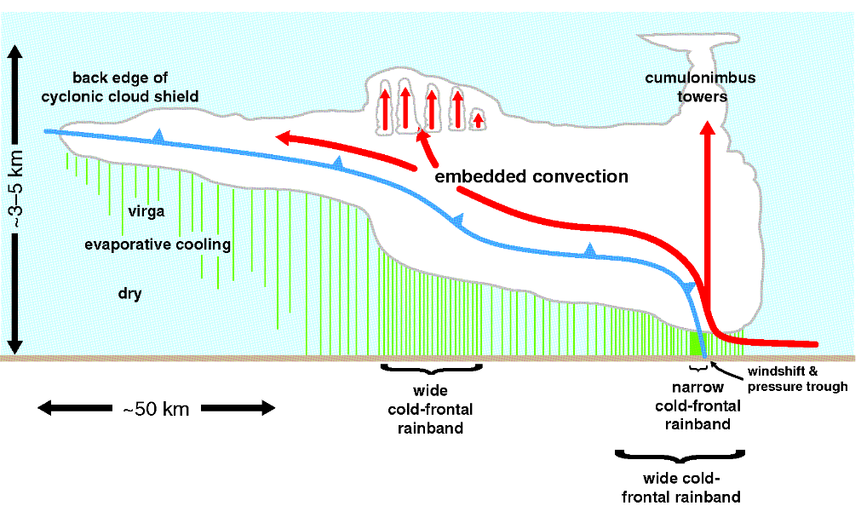
ATMS 316- Synoptic Fronts
Frontal rainbands
  mesoscale
    narrow cold-frontal rainbands; convective
    wide cold-frontal rainbands; enhanced stratiform precipitation
    warm-frontal rainbands; enhanced stratiform precipitation
    warm-sector rainbands; convective or stratiform

Slide 67
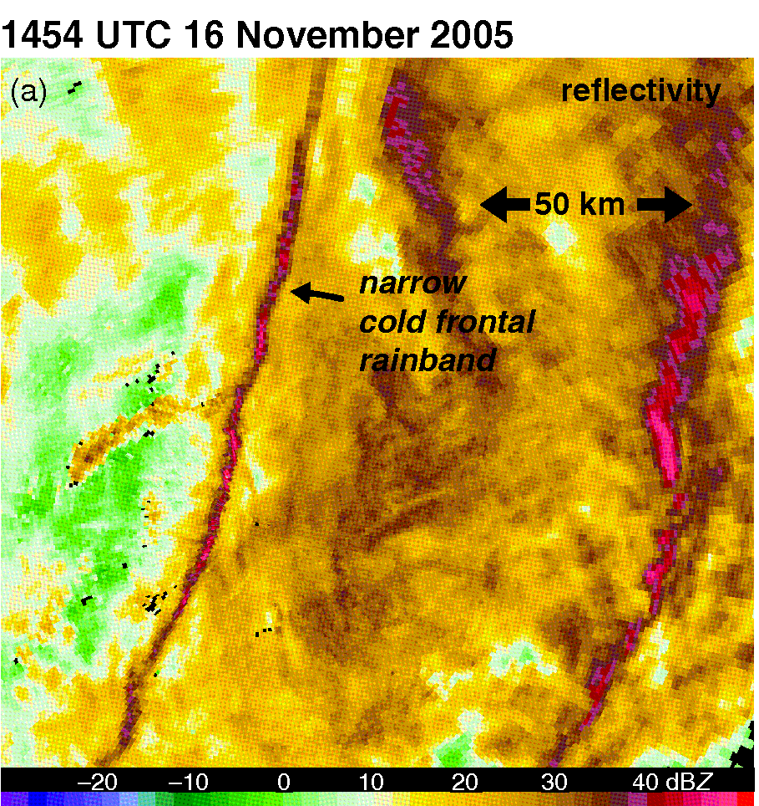
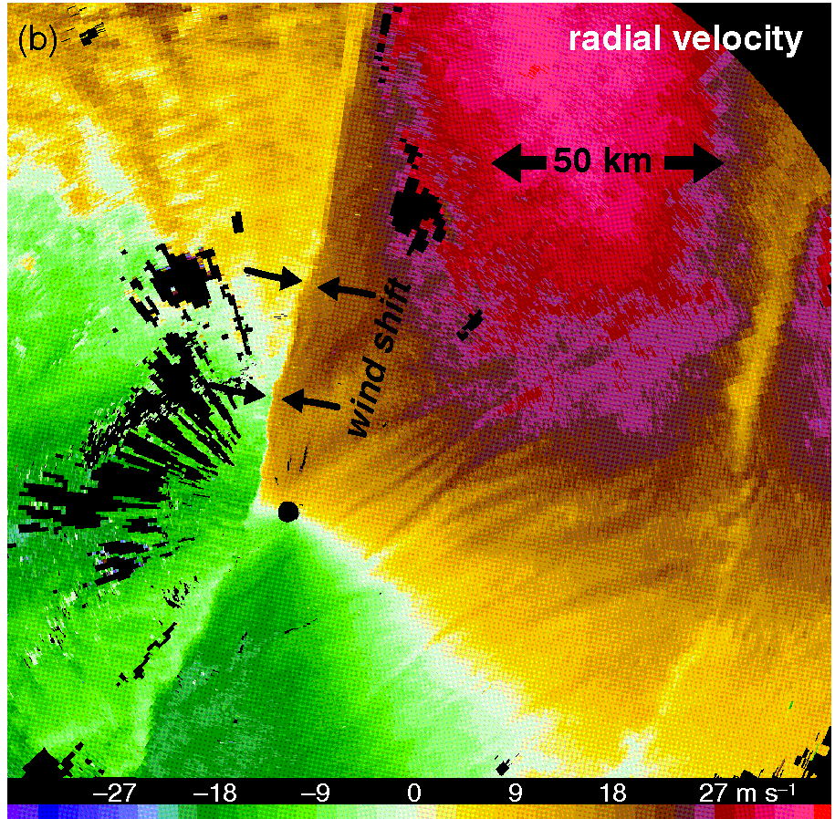
ATMS 316- Synoptic Fronts
Frontal rainbands
  mesoscale
    narrow cold-frontal rainbands
      cross-band dimension as small as 1-2 km [Panel (a)]
      along surface front, at the location of the wind shift [Panel (b)]
      intense updrafts (10 m s⁻¹) at altitudes as low as 1 km
      can spawn tornadoes

Slide 68
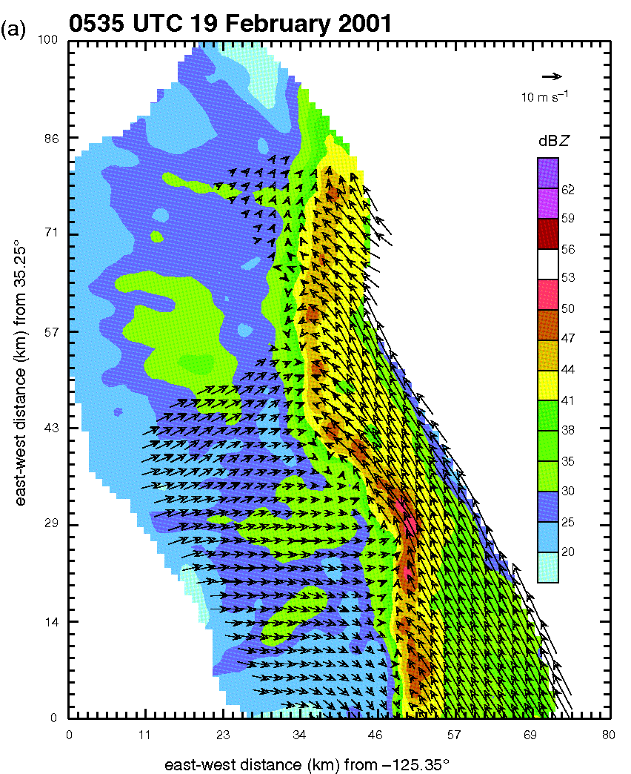
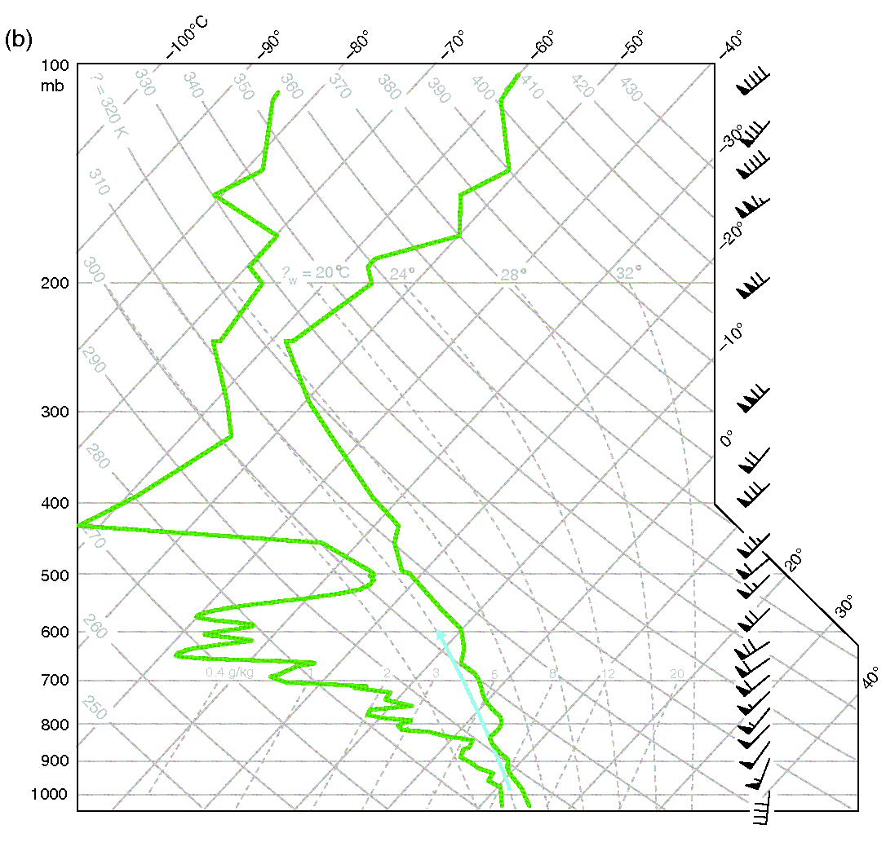
ATMS 316- Synoptic Fronts
Frontal rainbands
  mesoscale
    narrow cold-frontal rainbands
      form of forced convection
      driven principally by vertical perturbation pressure gradients associated with the vertical circulation along the front
      neutrally stratified [Panel (b)]
        little work needed to sustain updrafts
      laminar rope cloud in strongly stratified environments

Slide 69
ATMS 316- Synoptic Fronts
Frontal rainbands
  mesoscale
    narrow cold-frontal rainbands
      maintenance depends on a balance between
        horizontal vorticity in prefrontal air mass
        vertical circulation along the leading portion of the cold air mass
      kinks and breaks in the rainband [Panel (a)], core-and-gap structure

Slide 70
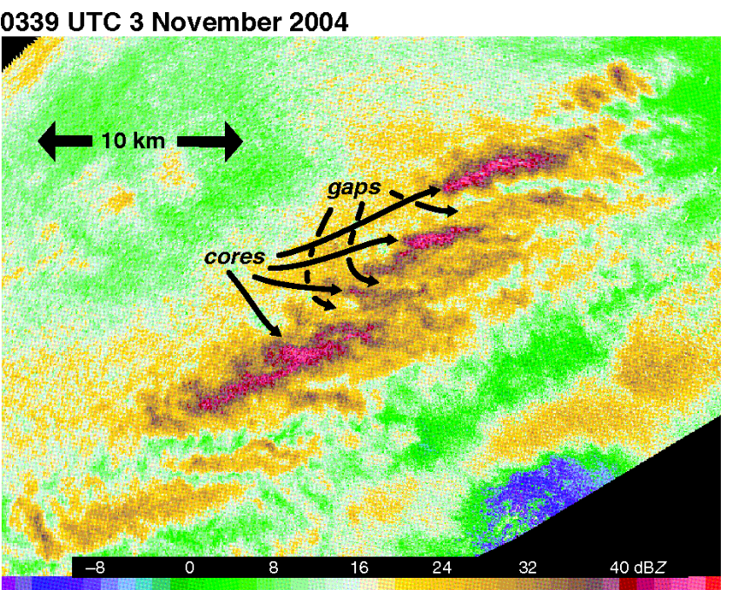
ATMS 316- Synoptic Fronts
Frontal rainbands
  mesoscale
    narrow cold-frontal rainbands
      core-and-gap structure
        meso-γ-scale vortices
        occasionally amplify to tornado strength
        likely arise from the instability of horizontal wind shear (Section 3.5)
        fracture frontal updraft
can also be the result of a front interacting with prefrontal boundary layer convective structures

Slide 71
ATMS 316- Synoptic Fronts
Frontal rainbands
  mesoscale
    wide cold-frontal rainbands
      only indirectly tied to processes near the surface
      motion independent of the motion of the front
      move with the winds in the cloud layer
        move ahead of cold front
        may overtake and move ahead of narrow cold-frontal rainband

Slide 72
ATMS 316- Synoptic Fronts
Frontal rainbands
  mesoscale
    wide cold-frontal rainbands
      multiple wide cold-frontal rainbands can be associated with a single cold front
      associated with a local steepening of the frontal surface
      May be attributable to the release of conditional symmetric instability (CSI)

Slide 73
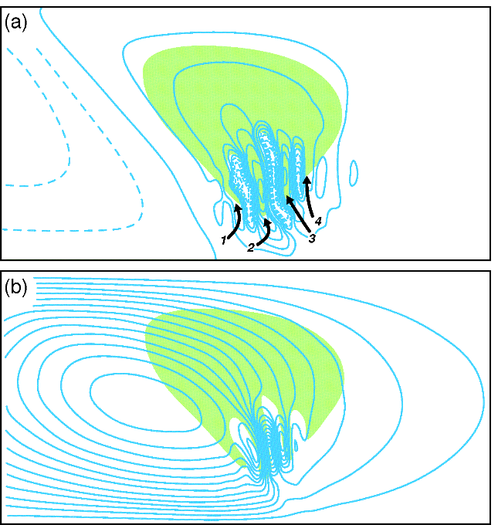
ATMS 316- Synoptic Fronts
Frontal rainbands
  mesoscale
    warm-frontal rainbands
      occur within and above the warm-frontal zone, on the poleward side of the surface warm front
      can be attributed to
        the release of CSI
        lifting of a potentially unstable layer over the warm-frontal surface
        ducted gravity waves
Regions of CSI are also often regions of frontogenesis, and the ageostrophic vertical circulation that accompanies frontogenesis is believed to be a mechanism that can release CSI.

Slide 74
ATMS 316- Synoptic Fronts
Frontal rainbands
  mesoscale
    warm-sector rainbands
      likely associated with a CFA or a split front
        upward velocity near a CFA is likely the result of frontal vertical circulations associated with the CFA
        midtropospheric potential instability associated with the relatively dry air behind the split front

Slide 75
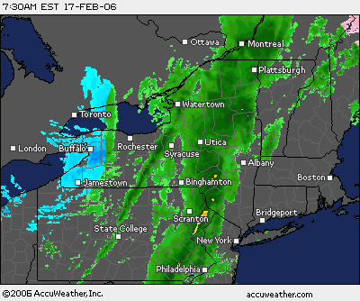
ATMS 316- Synoptic Fronts
Which scenario?
  Scenario#1; synoptic scale forcing alone
  Scenario#2; synoptic scale dominates mesoscale forcing
  Scenario#3; weak synoptic scale forcing
http://www.jeffsweather.com/archives/2006/02/
17 February 2006
Cold front passage

