Slide 1
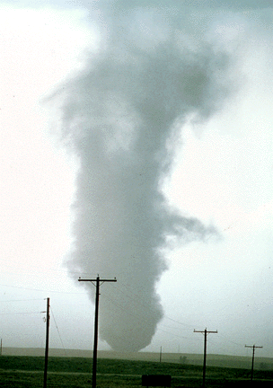
ATMS 316- Mesoscale Meteorology
Packet#5
Interesting things happen at the boundaries, or at the interface…
  Land, water (coastline)
http://www.ucar.edu/communications/factsheets/Tornadoes.html

Slide 2
ATMS 316- Mesoscale Meteorology
http://meted.ucar.edu/norlat/snow/polarlows/index.htm
http://meted.ucar.edu/norlat/snow/polarlow_case/index.htm
Outline
  Background
  Polar Low
    Introduction
    A synoptic/satellite image-based study of the development
    The landfall
    Numerical diagnostics
    Discussion and summary

Slide 3
ATMS 316- Background
Isentropic potential vorticity
  Potential vorticity in isentropic (rather than height or pressure) coordinates
  Why isentropic coordinates?
    θ (and P) is conserved for adiabatic frictionless motions which is a reasonable approximation for synoptic-scale motions
    Hence, an air parcel in synoptic-scale circulations will move along an isentropic surface
Holton (2004), p. 96
[see also p. 110]

Slide 4
ATMS 316- Polar Low
A Most Beautiful Polar Low. A Case Study of a Polar Low Development in the Bear Island Region
  Thor E. Nordeng and Erik A. Rasmussen
  Tellus, 44A, 1992
  p. 81-99

Slide 5
ATMS 316- Polar Low
Introduction
  Purpose: investigate whether a particular polar low should be considered equivalent to a tropical storm (“arctic hurricane”)

Slide 6
ATMS 316- Polar Low
Introduction
  Polar lows are similar in their structure and dynamics to tropical cyclones
    Deep convection
    “warm cores”
    Well defined “eyes”
    See Emanuel and Rotunno (1989) and Rasmussen (1989) for a more detailed discussion

Slide 7
ATMS 316- Polar Low
Introduction
  Montgomery and Farrel (1991); some polar low development consists of
    Initial baroclinic growth phase
    Prolonged slow intensification due to diabatic effects

Slide 8
ATMS 316- Polar Low
Introduction
  Fact…most polar lows when viewed from a satellite do not resemble small hurricanes in any striking way

Slide 9
ATMS 316- Polar Low
A synoptic/satellite image-based study of the development
  Small-scale cyclone situated over Norwegian Sea on 25 Feb 1987 is polar low precursor
  Incipient stage of polar low which forms around the central dark eye (arrow)
1244 UTC 26 Feb 1987

Slide 10
ATMS 316- Polar Low
A synoptic/satellite image-based study of the development
  Low level vortex apparent in low “warm” clouds
  Ship 200 km west of low centre (74ºN, 28ºE) observed a northerly wind of ~ 30 m s⁻¹
1702 UTC 26 Feb 1987
SV = Svalbard
FR = Fruholmen
lighthouse

Slide 11
ATMS 316- Polar Low
A synoptic/satellite image-based study of the development
  Radiosonde ascents from Bear Island (nearby) show the vortex formed in a region in which the surface layer was capped by a pronounced inversion
    Inhibited deep convection
1702 UTC 26 Feb 1987
SV = Svalbard
FR = Fruholmen
lighthouse

Slide 12
ATMS 316- Polar Low
A synoptic/satellite image-based study of the development
  capped surface layer, different from most other incipient polar lows
    Bands or clusters of deep convection were not present at this early stage of development
1702 UTC 26 Feb 1987
SV = Svalbard
FR = Fruholmen
lighthouse

Slide 13
ATMS 316- Polar Low
A synoptic/satellite image-based study of the development
  Strong cold air advection was occurring over the sea west and southwest of the low centre
  Baroclinic zone between cold air and “warm” modified air help trigger development of polar low?
1702 UTC 26 Feb 1987
SV = Svalbard
FR = Fruholmen
lighthouse

Slide 14
ATMS 316- Polar Low
A synoptic/satellite image-based study of the development
  Environment of polar lows normally is stable to small amplitude perturbations
    Disturbances of substantial amplitude appear to be necessary to initiate growth
      CISK
      Air-sea interaction
1702 UTC 26 Feb 1987
SV = Svalbard
FR = Fruholmen
lighthouse

Slide 15
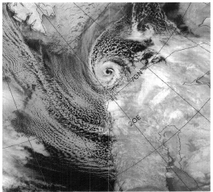
ATMS 316- Polar Low
A synoptic/satellite image-based study of the development
  Satellite imagery unavailable from 1702 26 Feb until 0244 UTC 27 Feb (not shown)
    Polar low moved 300 km
    Low evolved into an intense small scale cyclone
    Deep convection and well developed spiral arms had formed
0418 UTC 27 Feb 1987

Slide 16
ATMS 316- Polar Low
A synoptic/satellite image-based study of the development
  Satellite image features of note
    Similarity to tropical cyclones
    Deep convection in spiral arms
    Large diameter well-defined eye
    Air mass contrasts across spiral arms
0418 UTC 27 Feb 1987

Slide 17
ATMS 316- Polar Low
A synoptic/satellite image-based study of the development
  Important difference between this polar low and its tropical counterparts
    Contrasting air masses in the boundary layer; northern spiral arm
      Shallow very cold air mass to west
      “warm” air marked by cellular convection
0418 UTC 27 Feb 1987

Slide 18
ATMS 316- Polar Low
A synoptic/satellite image-based study of the development
  Arctic fronts
    Form due to confluence in low-level baroclinic zone
    Develop when shallow arctic air masses are advected from source regions over snow/ice out over the relatively warm sea surface
0418 UTC 27 Feb 1987

Slide 19
ATMS 316- Polar Low
The landfall
  Crosses coast at 0600 UTC 27 Feb 1987
  Low decays rapidly after landfall
  Polar low loses…
    Its hurricane-like structure
    Its well-defined eye
0831 UTC 27 Feb 1987

Slide 20
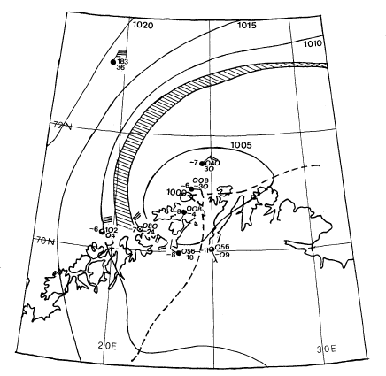
ATMS 316- Polar Low
The landfall
  Minimum pressure just under 1000 hPa
  No strong surface pressure gradient close to the center
  Strongest surface winds 200 km west of center 20 m s⁻¹
0600 UTC 27 Feb 1987
SLP/ spiral band map

Slide 21
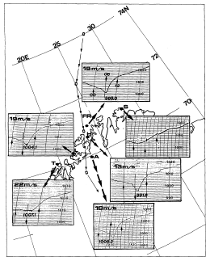
ATMS 316- Polar Low
track
The landfall
  Polar low pressure disturbance ~ 5 hPa
  Horizontal scale of a few hundred kilometers
  Highest wind speed measured at Fruholmen lighthouse = 19 m s⁻¹
Barograms and max mean
winds for coastal stations

Slide 22
ATMS 316- Polar Low
The landfall
  Maintains cyclonic circulation as it crosses Norway and Sweden
  Center fills ~ 5 hPa
  Marked pressure rise behind polar low
    Causes local wind increase to around 20 m s⁻¹
Barograms and max mean
winds for coastal stations

Slide 23
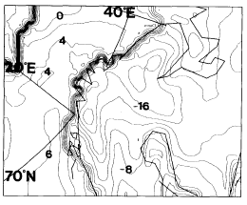
ATMS 316- Polar Low
Numerical diagnostics
  mesoscale numerical model of the Norwegian Meteorological Institute
  Δx = 25 km, 18 vertical levels
Model domain and SST/ice analysis

Slide 24
ATMS 316- Polar Low
Numerical diagnostics
Initial conditions at 1200 UTC 26 Feb 87

Slide 25
ATMS 316- Polar Low
parent low
Numerical diagnostics
  Develops in NW part of parent low
  Moves CCW while it deepens
+
6-h fcst valid 18 UTC 26 Feb 87
SLP Δp = 2 hPa

Slide 26
ATMS 316- Polar Low
Numerical diagnostics
  Some “noise” in the simulation
    Predicts development of three polar lows
12-h fcst valid 00 UTC 27 Feb 87

Slide 27
ATMS 316- Polar Low
Numerical diagnostics
  Central pressure is 997 hPa (observed of 994 hPa)
  Northernmost polar low is artificial
    Presence due to interaction between convection and surface moisture flux at a scale not properly resolved by model
15-h fcst valid 03 UTC 27 Feb 87

Slide 28
ATMS 316- Polar Low
Numerical diagnostics
  Northernmost polar low is artificial
    Quickly diffused by the implicit horizontal diffusion of the time integration scheme
    Authors confident that the evolution of the main low is not affected in any serious way
15-h fcst valid 03 UTC 27 Feb 87

Slide 29
ATMS 316- Polar Low
Numerical diagnostics
  Low quickly disappears in model simulation after it makes landfall
  Asymmetry of the “parent” low may be important for the development of the mesoscale (polar) low
18-h fcst valid 06 UTC 27 Feb 87

Slide 30
ATMS 316- Polar Low
Numerical diagnostics
  Do we believe the model?
    Model description of the low as compared to the Fruholmen observation is good
    Model precipitation compared to satellite pictures is good
    Model winds compare favorably with observed winds
    Authors claim “Yes.”
18-h fcst valid 06 UTC 27 Feb 87

Slide 31
ATMS 316- Polar Low
Numerical diagnostics; the role of potential vorticity anomalies (4.1)
  Cold air advection in strong flow at NW flank of parent low
  Weak winds at centre of parent low
    frontogenesis
6-h fcst valid 18 UTC 26 Feb 87
SLP Δp = 2 hPa

Slide 32
ATMS 316- Polar Low
Numerical diagnostics
  Fluxes of heat and moisture strong
    Flow is strong NW of parent low
    Large temperature difference between the warm ocean and cold air
Solid lines; surface fluxes of sensible and latent heat at contour intervals of 250 W m⁻². Fluxes exceeding 750 W m⁻² shaded.

Slide 33
ATMS 316- Polar Low
Numerical diagnostics
  Direct secondary flow (warm air rising, cold air sinking) forms as a result of
    Distribution of surface fluxes
    Cold air advection
    and must be set up to retain thermal wind balance to counteract frontogenesis
6-h fcst valid 18 UTC 26 Feb 87
SLP Δp = 2 hPa

Slide 34
ATMS 316- Polar Low
Numerical diagnostics
  Strong direct secondary flow in vicinity of newly formed polar low
    Deep circulation
    (moist) potential vorticity is small in region of strongest vertical velocities
    Latent heat release (LHR) is a sink of potential vorticity above the diabatic heating max
      Contributes to low stability, strong circulation above heating
W
C
θe (solid) and M along section A-a
valid at 1800 UTC 26 Feb 1987

Slide 35
ATMS 316- Polar Low
Numerical diagnostics
  Weaker direct secondary flow along the southern cross-section
  Is frontal circulation internal or external?
    Internal; caused by deepening polar low
    External; causing low to deepen
θe (solid) and M along section B-b
valid at 1800 UTC 26 Feb 1987

Slide 36
ATMS 316- Polar Low
Numerical diagnostics
  Is frontal circulation internal or external?
    Isentropic potential vorticity (IPV)
    278 K surface within 500 and 550 hPa layer
    Small scale IPV anomaly where polar low starts to develop
Potential vorticity contours (solid) on the 278 K isentropic surface and 6-h SLP forecast (dashed)

Slide 37
ATMS 316- Polar Low
Numerical diagnostics
  IPV anomaly; sets up a horizontal as well as a vertical circulation
    Ascending vertical motion where positive IPV anomaly advection
    Descending vertical motion where negative IPV anomaly advection
Potential vorticity contours (solid) on the 278 K isentropic surface and 6-h SLP forecast (dashed)

Slide 38
ATMS 316- Polar Low
Numerical diagnostics
  Complicated interactions
    Upper-level IPV anomaly
    Low-level IPV anomaly (not shown)
      Low-level circulation
      Low-level warm anomaly
      interaction of two anomalies could be source of deep circulation seen in section A-a
Potential vorticity contours (solid) on the 278 K isentropic surface and 6-h SLP forecast (dashed)

Slide 39
ATMS 316- Polar Low
Numerical diagnostics
  interaction of two anomalies
    More likely if stability of lower troposphere is small
    An IPV anomaly is required to generate a vertical circulation
    Vertical circulation becomes strong only if the induced vertical ascent is established in a region of low potential vorticity
Potential vorticity contours (solid) on the 278 K isentropic surface and 6-h SLP forecast (dashed)

Slide 40
ATMS 316- Polar Low
Numerical diagnostics
  Strong vertical circulation in a region of small potential vorticity*
    Vertical circulation tends to be aligned along absolute momentum (M) surfaces
      M is conserved for two-dimensional nonviscous flow
θe (solid) and M along section B-b
valid at 1800 UTC 26 Feb 1987
*small potential vorticity exists where the number of intersection points
between contours of θe and M within a unit area in the cross-section is small

Slide 41
ATMS 316- Polar Low
Numerical diagnostics
  Shut off LHR (no figures shown)
    Vertical circulation not as deep
    Potential vorticity in outflow region is not as small
θe (solid) and M along section B-b
valid at 1800 UTC 26 Feb 1987. Figure with LHR ON (Fig. 11a)

Slide 42
ATMS 316- Polar Low
Numerical diagnostics
  LHR “on”
    Weakened IPV aloft
    Stronger outflow aloft
    Stronger surface pressure falls (intensification)
θe (solid) and M along section B-b
valid at 1800 UTC 26 Feb 1987.

Slide 43
ATMS 316- Polar Low
Numerical diagnostics; Montgomery and Farrel (1991)
  2nd class of disturbances
    Grows from PV generation at low levels
      Due to LHR in ascent regions
    Slow development
    Not dependent on the presence of large amplitude perturbations aloft

Slide 44
ATMS 316- Polar Low
Numerical diagnostics; Montgomery and Farrel (1991)
  Suggest polar low development consists of
    Initial baroclinic growth phase
    Prolonged slow intensification due to diabatic effects

Slide 45
ATMS 316- Polar Low
Numerical diagnostics; Van Delden (1989a)
  Axisymmetric cyclone in an Arctic environment may grow from…
    Diabatic processes
      Sensible heating at surface
      LHR
    Gradient wind adjustment
    →slow deepening rate

Slide 46
ATMS 316- Polar Low
Numerical diagnostics; this case
  Deepening rate comparable to those of Van Delden
  Lack of upper level forcing after the initial stage (similar to Montgomery and Farrel)
  Theories of Montgomery and Farrel and Van Delden may apply to this polar low

Slide 47
ATMS 316- Polar Low
Numerical diagnostics; release of latent heat (4.2)
  LHR clearly important, but
  if LHR was to take place over a broad region, it would be out of phase with the growing polar low
    inhibit polar low development
    →need to explore the horizontal organization of precip and LHR

Slide 48
ATMS 316- Polar Low
Numerical diagnostics
  Spatial distribution of LHR must be explained
    Air parcels following these trajectories experience considerable heating rates from surface fluxes of latent and sensible heat
    Air parcels associated with cold air advection west of low center
Surface air trajectories ending at low valid 0300 UTC 27 Feb 1987

Slide 49
ATMS 316- Polar Low
Numerical diagnostics
  Sounding for air just leaving ice surface in cold air advection flow
    Air is extremely stable aloft
    Destabilizes near surface due to sensible heat fluxes from the “warm” ocean
    Note capping stable layer
Sounding from 6-h forecast
valid at 1800 UTC 26 Feb 1987

Slide 50
ATMS 316- Polar Low
Numerical diagnostics
  Sounding for cold air advection parcels entering updraft region near center of polar low
    Air is marginally stable
    Favors strong vertical motion
Sounding from 15-h forecast
valid at 0300 UTC 27 Feb 1987

Slide 51
ATMS 316- Polar Low
Numerical diagnostics
  Capping stable layer
    Limits the amount of air to be heated
      Considerable increase in air parcel temperatures
    Convection is localized in the vicinity of the polar low
      In phase- LHR contributes to development
    Økland (1989)
      Main factor in determining the scale and location of polar low development
Sounding from 6-h forecast
valid at 1800 UTC 26 Feb 1987

Slide 52
ATMS 316- Polar Low
Numerical diagnostics;
  Low-level air near center of polar low (small advection) increases its θe with time so that air is gradually destabilized without transport of moistened and heated air from the surroundings

Slide 53
ATMS 316- Polar Low
Numerical diagnostics;
  Increased θe with time at cyclone center
    A result of surface fluxes
      Van Delden; sensible heat flux is important because it affects the hydrostatic pressure distribution (decreases surface pressure)
    From adiabatic warming due to subsidence

Slide 54
ATMS 316- Polar Low
Numerical diagnostics
  Location of vertical cross sections in Figure 15…
15-h fcst valid 03 UTC 27 Feb 87

Slide 55
ATMS 316- Polar Low
Numerical diagnostics
  Air at low-levels is neutrally stable to slantwise convection in region of strong vertical velocity
    M surfaces parallel to θe surfaces
  Air parcels closely follow the M surfaces
θe (solid) and M along section D-d
valid at 0300 UTC 27 Feb 1987

Slide 56
ATMS 316- Polar Low
Numerical diagnostics
  Air is convectively unstable (dθe/dZ<0) near low center where simulated vertical velocity is weak
  Ring of LHR around the whole cyclone center
θe (solid) and M along section E-e
valid at 0300 UTC 27 Feb 1987

Slide 57
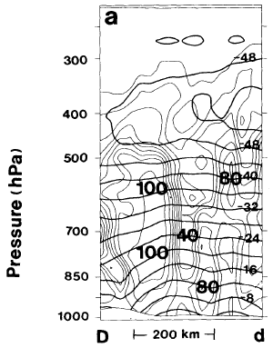
ATMS 316- Polar Low
Numerical diagnostics
  Clear “eye” in center of cyclone
Τ (thick) and RH along section D-d
valid at 0300 UTC 27 Feb 1987

Slide 58
ATMS 316- Polar Low
Numerical diagnostics
  Heavy “cloud-band” around center of polar low
  Model-simulated cloud top temperatures agree well with observed satellite (NOAA-9) temperature retrievals
Τ (thick) and RH along section E-e
valid at 0300 UTC 27 Feb 1987

Slide 59
ATMS 316- Polar Low
Discussion and summary
  Polar low of 27 Feb 1987 shared several similarities with tropical cyclones
    Low intensifies over the sea and rapidly decays after landfall
    Strong cyclonic inflow at low levels
    Ascending motion in a band around a central part with subsidence (the eye)
Winds at 925 hPa, 700 hPa vertical velocity (solid), contours of SLP

Slide 60
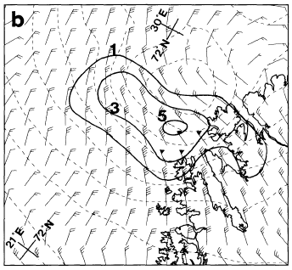
ATMS 316- Polar Low
Discussion and summary
  Polar low of 27 Feb 1987 shared several similarities with tropical cyclones
    Anticyclonic outflow close to the tropopause
    Warm core disturbance
    Vertical θe distribution within the core is similar to TCs (Rotunno and Emmanuel 1987)
Winds at 500 hPa, 700 hPa vertical velocity (solid), contours of SLP

Slide 61
ATMS 316- Polar Low
Discussion and summary
  Polar low of 27 Feb 1987 shared several similarities with tropical cyclones
    Interaction with extratropical upper level cold trough
      Camille (Simpson and Riehl 1981)
Winds at 500 hPa, 700 hPa vertical velocity (solid), contours of SLP

Slide 62
ATMS 316- Polar Low
Discussion and summary
  Role of eye size for intensification of cyclones driven by diabatic processes (Van Delden 1989b)
    Deepening of a cyclone is strongly inhibited if the heating is located dynamically too far away from cyclone center
      Rossby radius of deformation gives eye radius of optimal contribution to development by LHR

Slide 63
ATMS 316- Polar Low
Discussion and summary
  For present cyclone…
    Ro based on 15-h forecast ~ 75 km
    Eye radius ~ 75 km
    Optimal configuration for intensification

Slide 64
ATMS 316- Polar Low
Discussion and summary
  For present cyclone…
    Ro based on 15-h forecast ~ 75 km
    Eye radius ~ 75 km
    Optimal configuration for intensification

Slide 65
ATMS 316- Polar Low
Discussion and summary
  Summary of development mechanisms; 27 Feb 87 polar low
    Precursor- synoptic scale cyclone
      Re-intensified in its flank due to an approaching upper level IPV anomaly
    Upper level IPV anomaly induces upper level circulation
    Low level IPV anomaly induced by low level cyclonic circulation and temperature anomaly created by the parent low

Slide 66
ATMS 316- Polar Low
Discussion and summary
  Summary of development mechanisms; 27 Feb 87 polar low
    Upper and low level IPV anomalies “link” (frontogenetical circulation?) and a deep circulation develops
      LHR in ascending regions
    PV is destroyed aloft by LHR at mid-levels
      Increased upper level outflow
      Surface pressure fall

Slide 67
ATMS 316- Polar Low
Discussion and summary
  Similarity of 27 Feb 87 polar low to other strong cyclones
    Warm core cyclone in Mediterranean Sea (Rasmussen and Zick 1987)
    Secondary development along a bent-back warm front (Shapiro et al. 1990)
      Frontogenesis from cold air advection west of the large scale occluded low and an intensification along this newly formed front

Slide 68
ATMS 316- Polar Low
Discussion and summary
  27 Feb 87 polar low
    Trigger – upper level PV anomaly (release of baroclinic energy)*
    Driving mechanism - LHR
*“To our knowledge, a polar low development without an initial upper level forcing has not been documented in the literature”

Slide 69
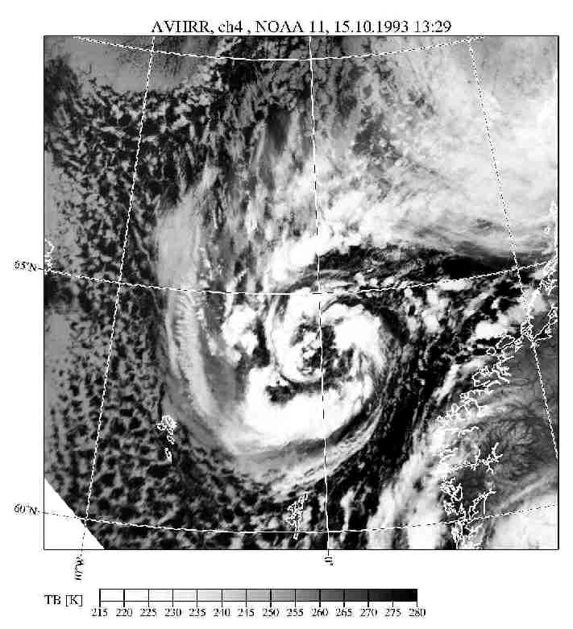
ATMS 316- Polar Low
Which scenario?
  Scenario#1; synoptic scale forcing alone
  Scenario#2; synoptic scale dominates mesoscale forcing
  Scenario#3; weak synoptic scale forcing
15 October 1993
Polar low
http://www.meteo.uni-bonn.de/mitarbeiter/GHeinemann/eplwg/gallery/arctic/151093_13h.jpg

