Slide 1
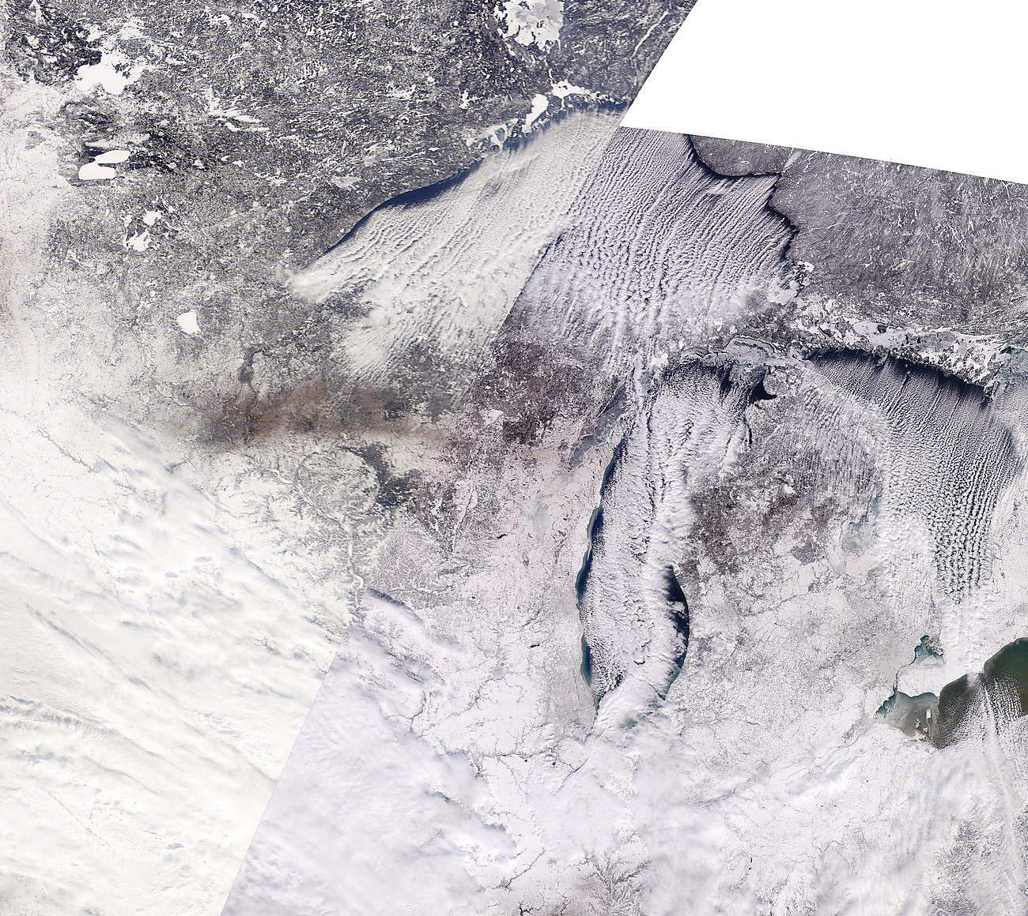
Lake-effect snowfall –
20 Jan 2019

Slide 2
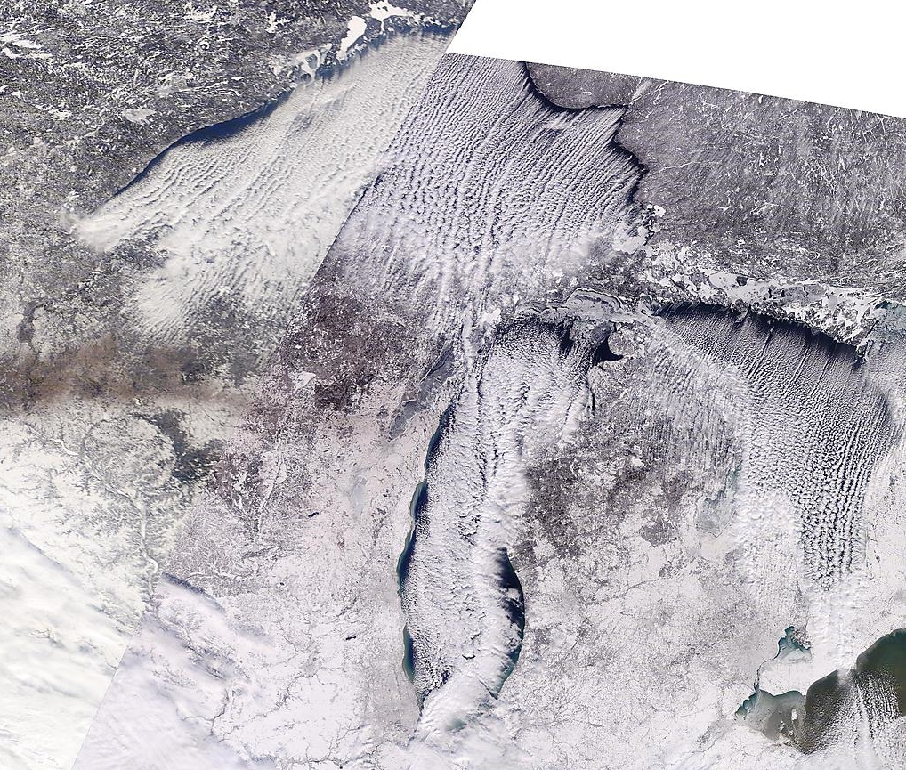
WPC summary – 20 Jan 2019
http://ge.ssec.wisc.edu/modis-today/

Slide 3
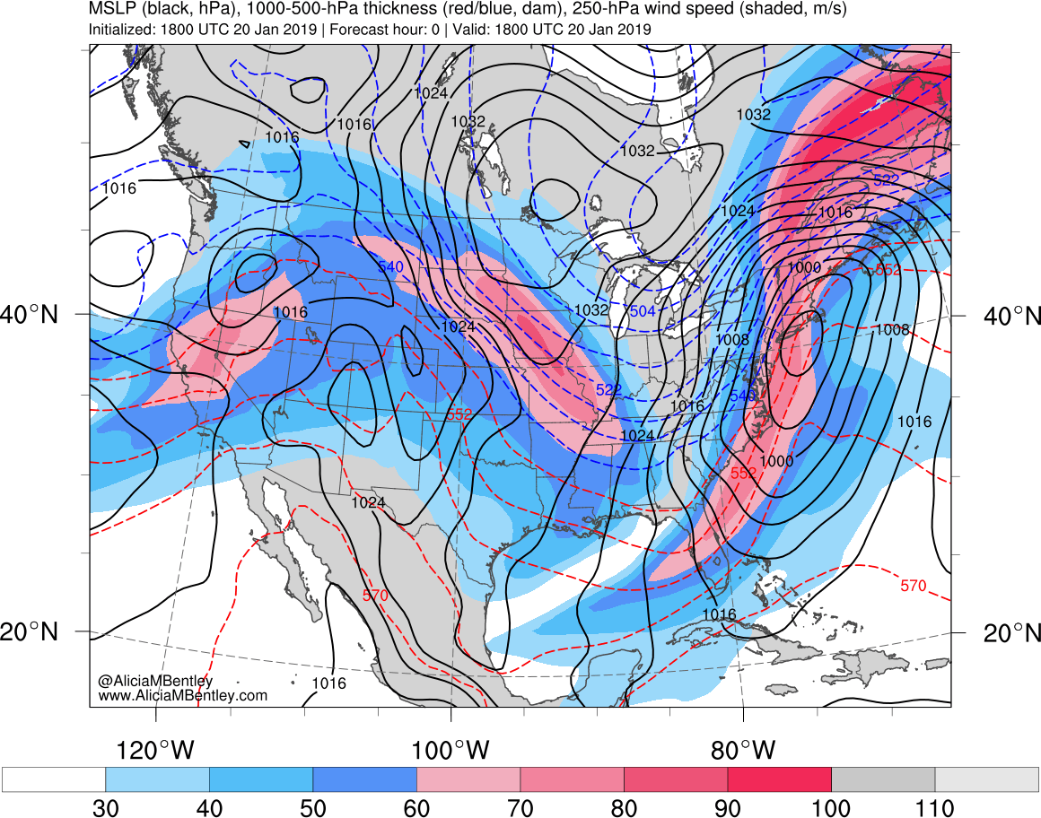
http://www.atmos.albany.edu/student/abentley/realtime.html

Slide 4
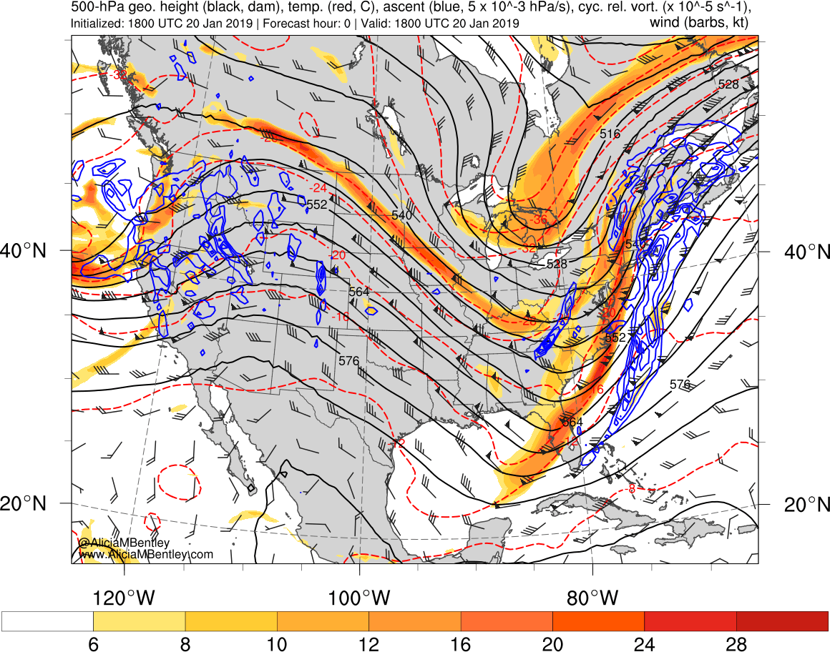
http://www.atmos.albany.edu/student/abentley/realtime.html

Slide 5
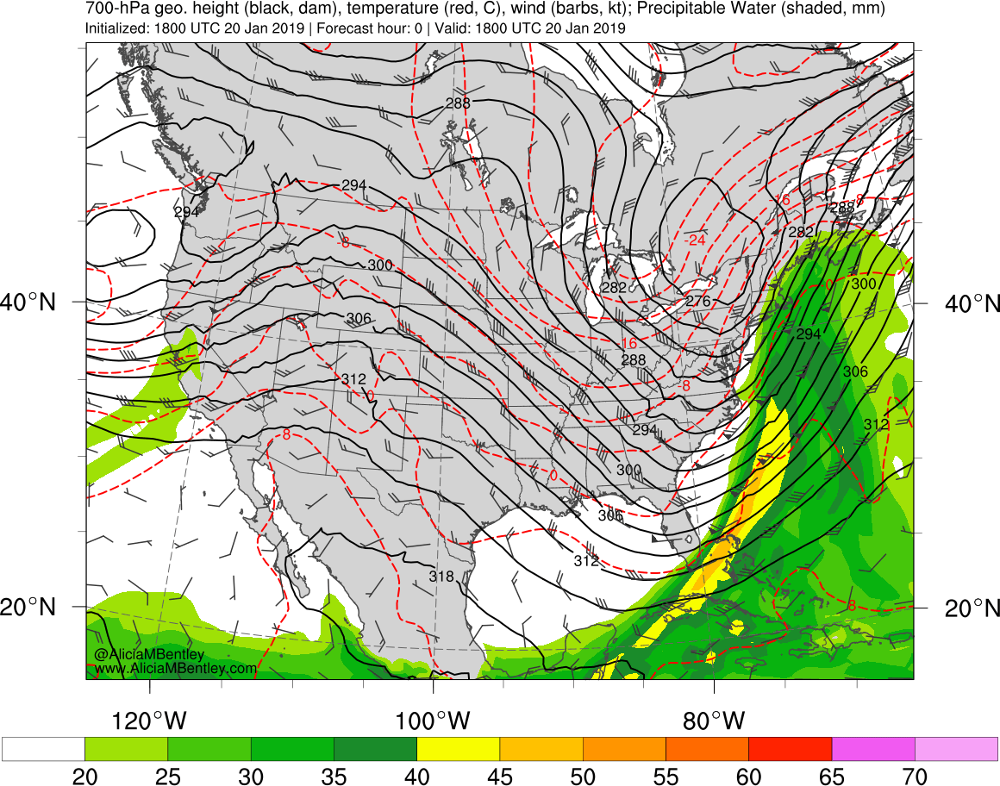
http://www.atmos.albany.edu/student/abentley/realtime.html

Slide 6
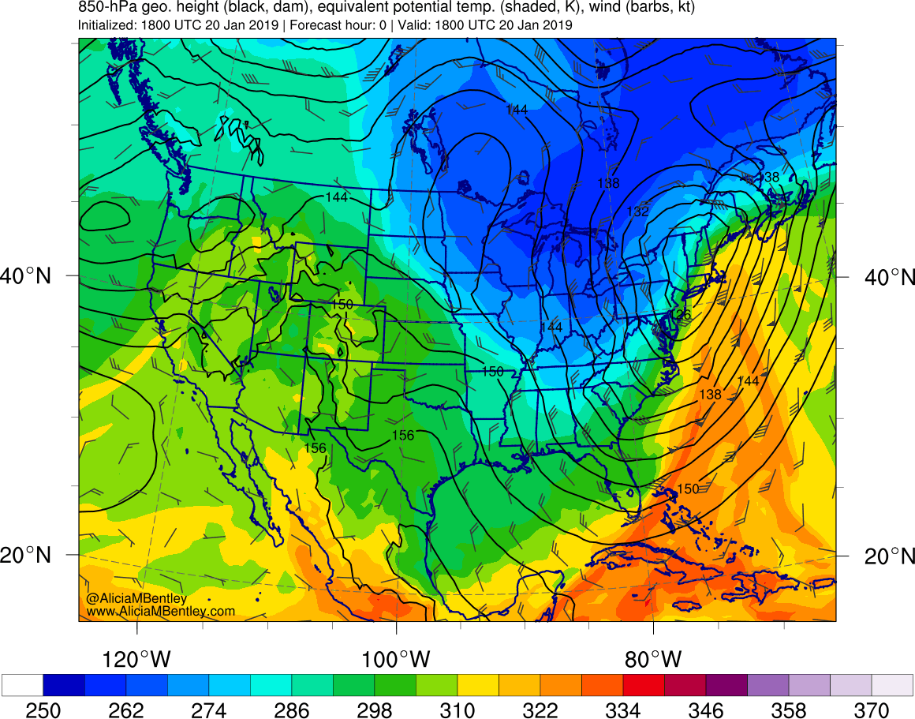
http://www.atmos.albany.edu/student/abentley/realtime.html

Slide 7
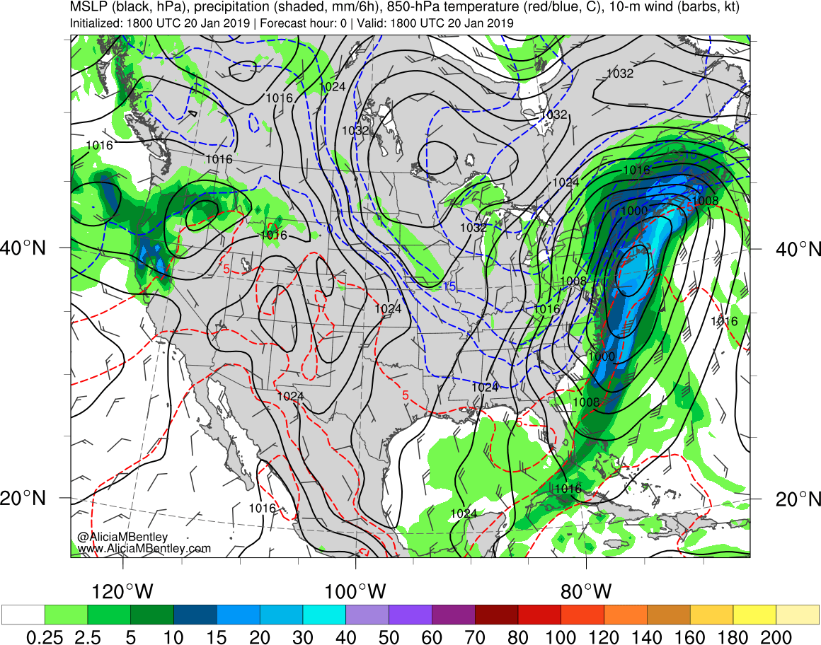
http://www.atmos.albany.edu/student/abentley/realtime.html

Slide 8
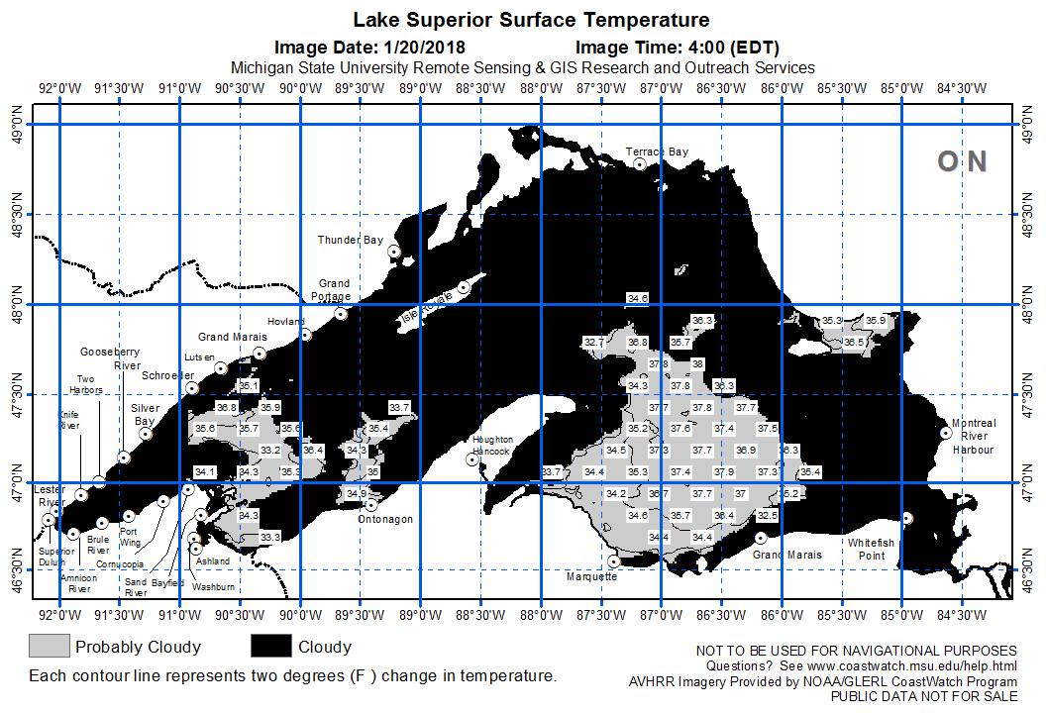
SSTs – 2000 UTC 20 Jan 2019
http://www.coastwatch.msu.edu/

Slide 9
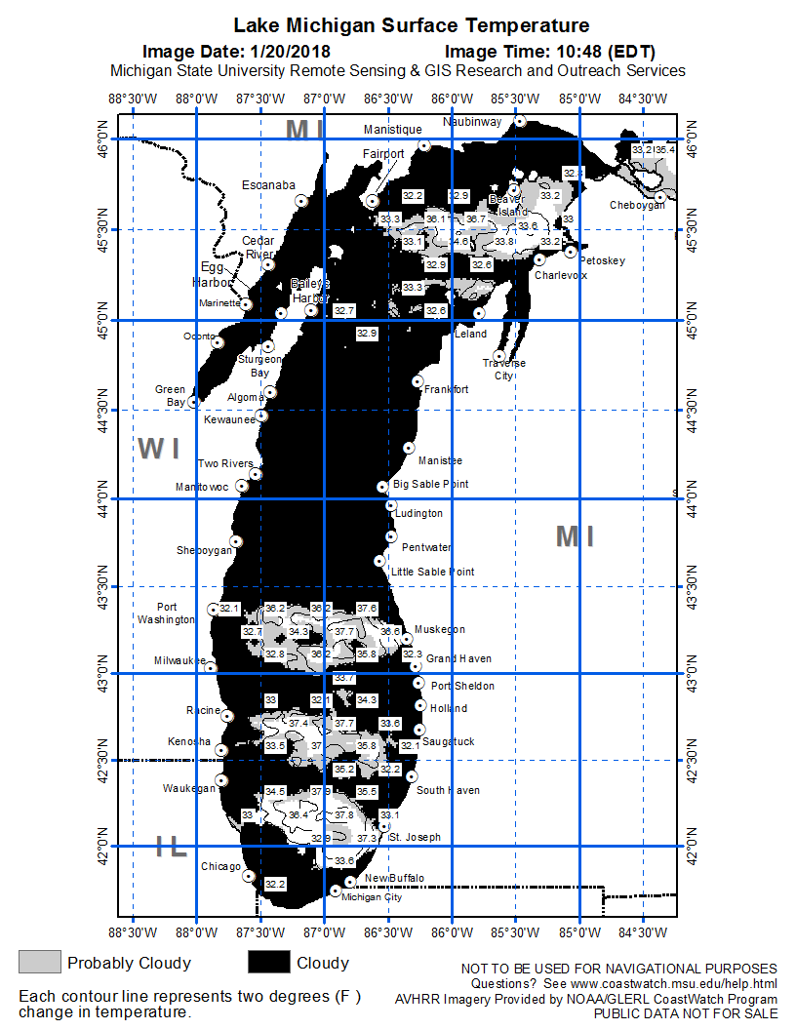
SSTs – 1500 UTC 20 Jan 2019
http://www.coastwatch.msu.edu/

Slide 10
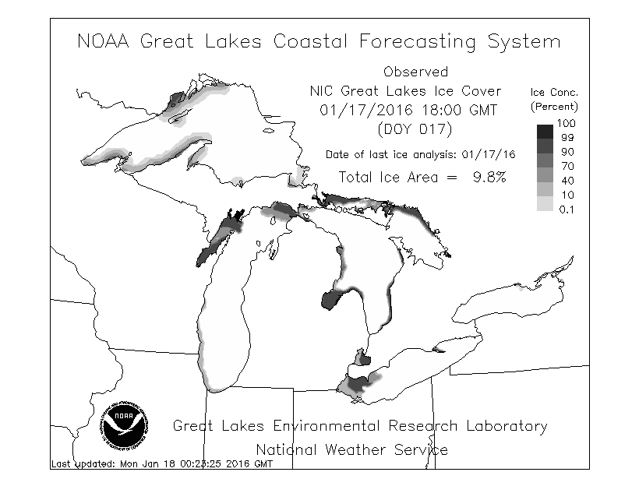
Ice coverage –20 Jan 2019
Web page closed
http://www.glerl.noaa.gov/res/glcfs/glcfs.php?hr=00&ext=ice&type=N&lake=l

Slide 11
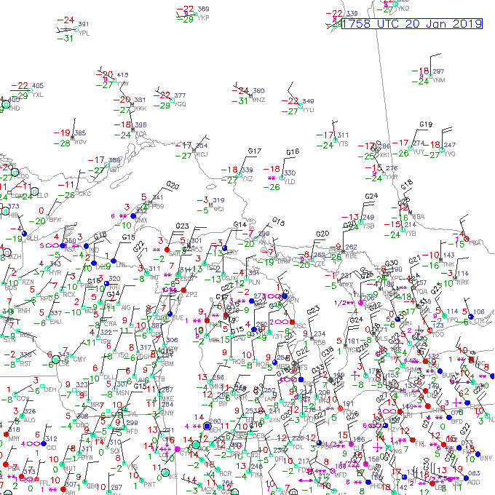
Obs – 1800 UTC 20 Jan 2019
http://weather.rap.ucar.edu/surface/

Slide 12
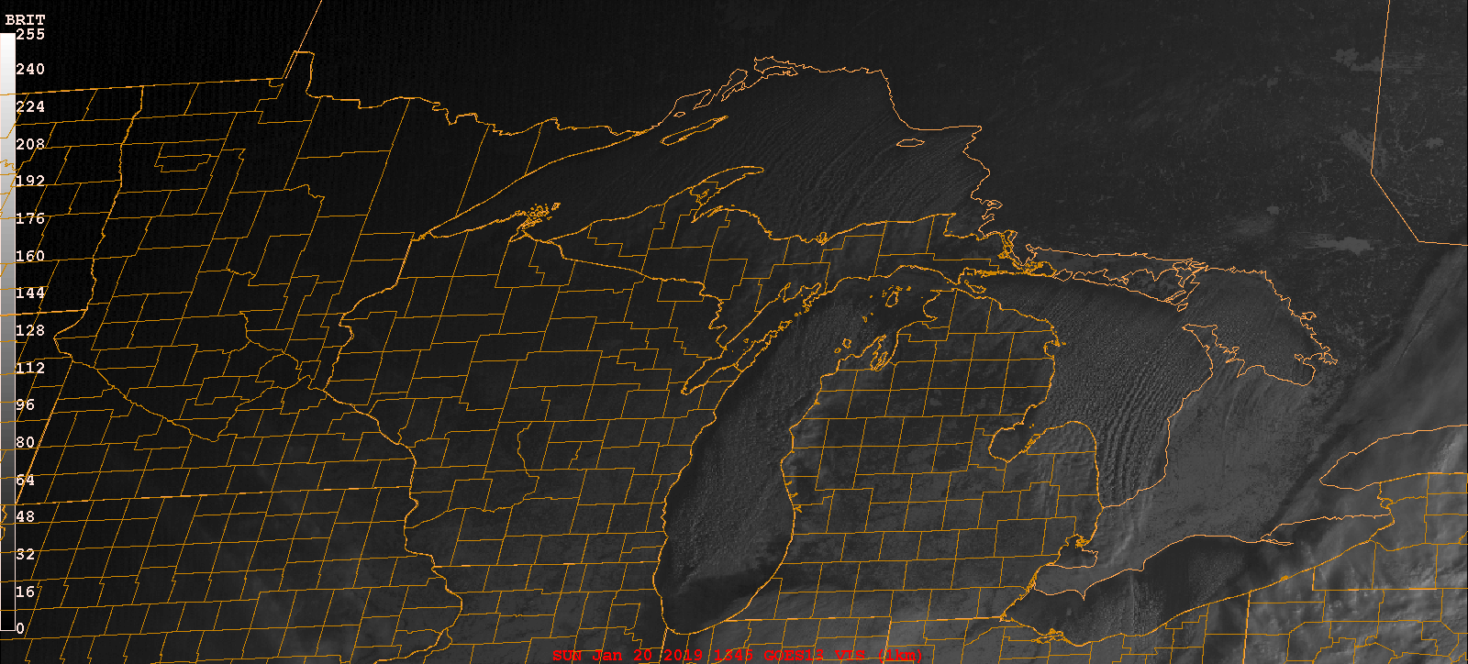
GOES-16 visible
GARP

Slide 13
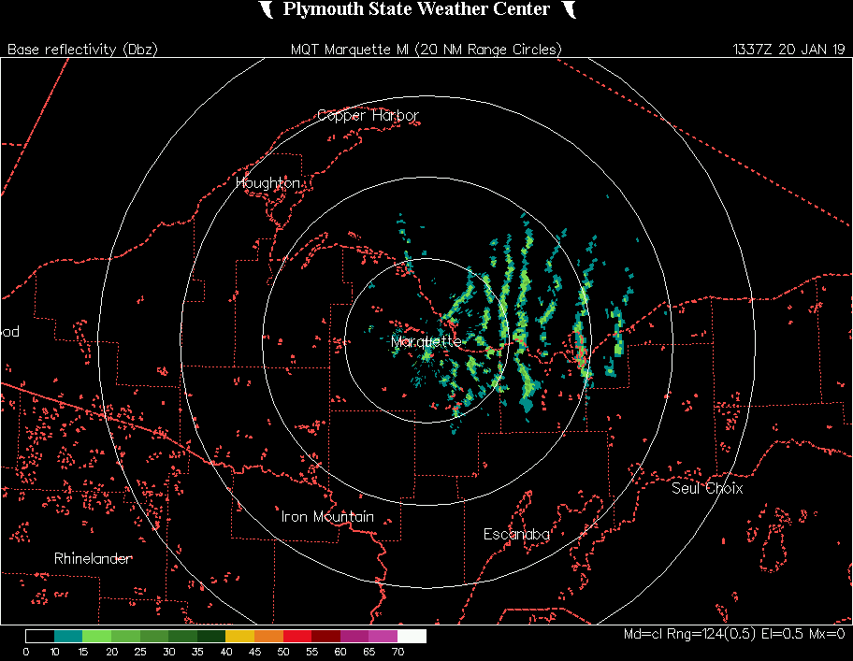
Marquette, MI
http://vortex.plymouth.edu/nids.html

Slide 14
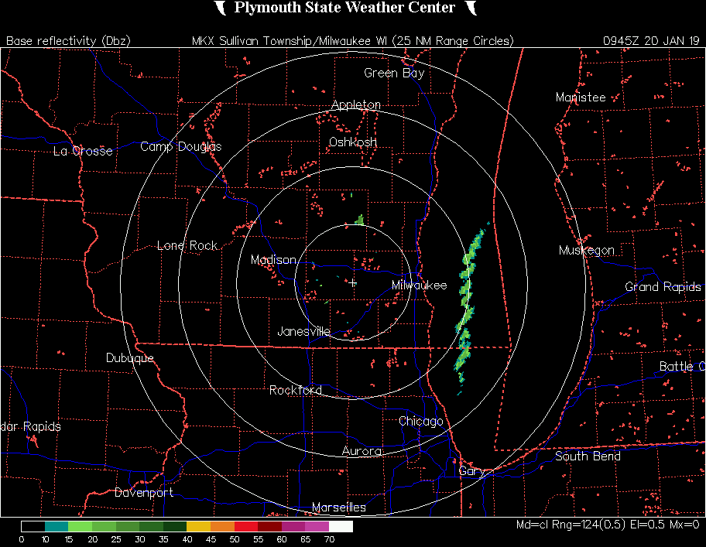
Milwaukee, WI
http://vortex.plymouth.edu/nids.html

Slide 15
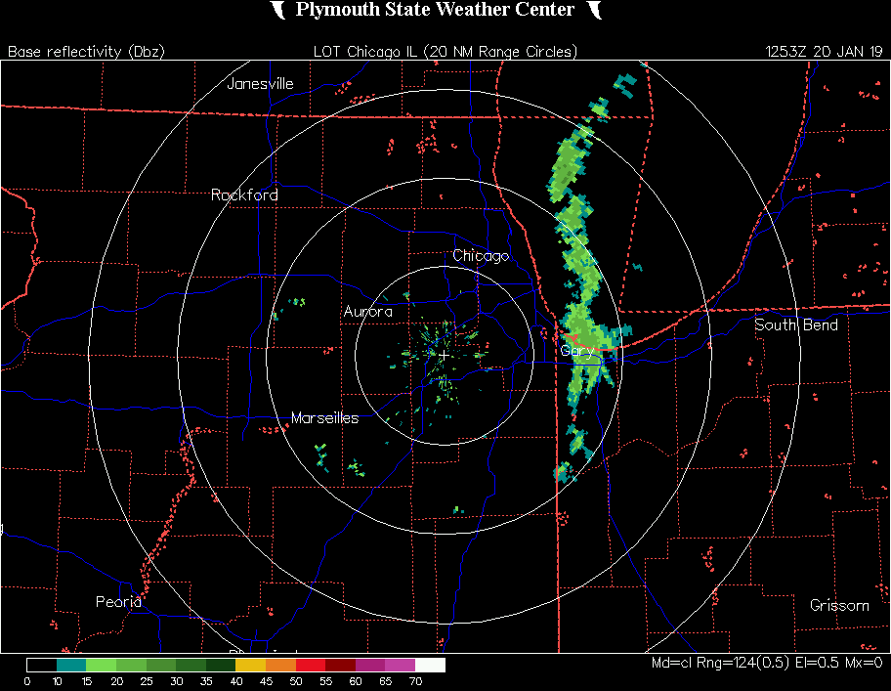
Chicago, IL
http://vortex.plymouth.edu/nids.html

Slide 16
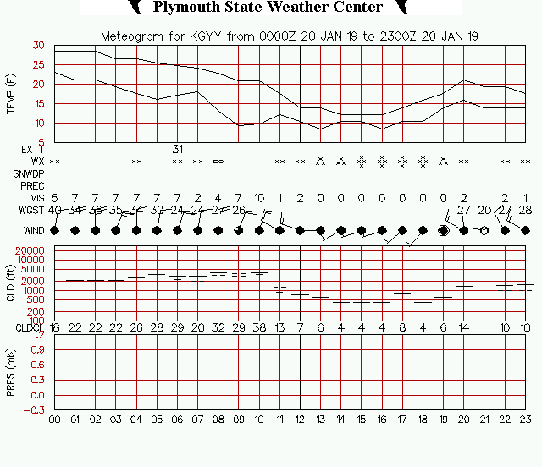
Gary, IN
https://vortex.plymouth.edu/myo/sfc/statlog-a.html

Slide 17
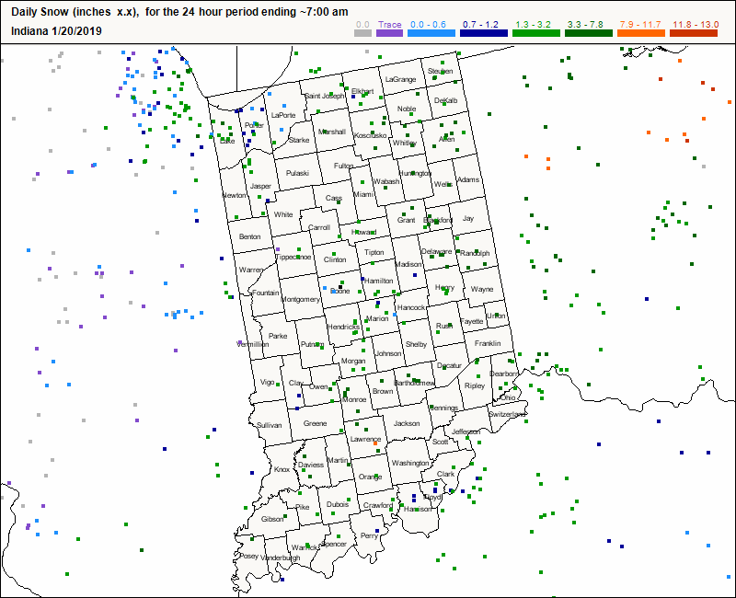
https://www.cocorahs.org/

Slide 18
