Slide 1
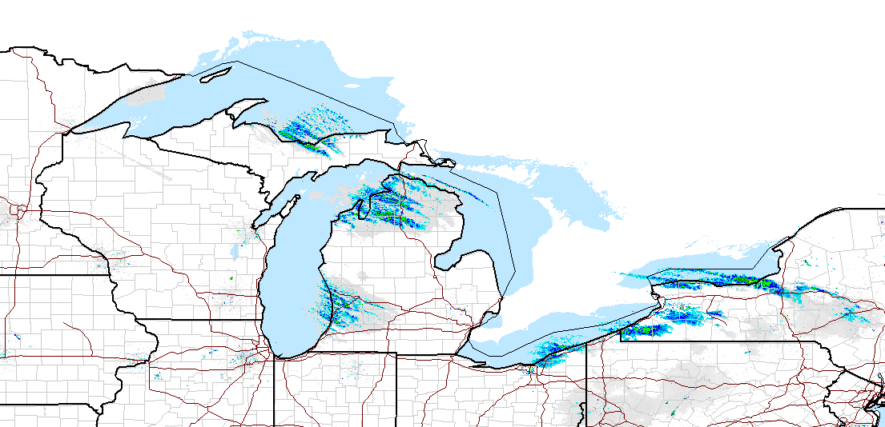
Lake-effect snowfall – 18 Jan 2016

Slide 2
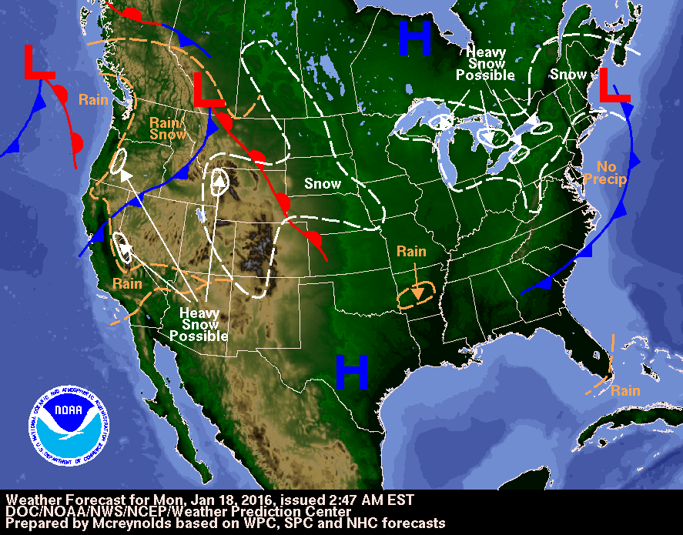
WPC summary – 18 Jan 2016

Slide 3
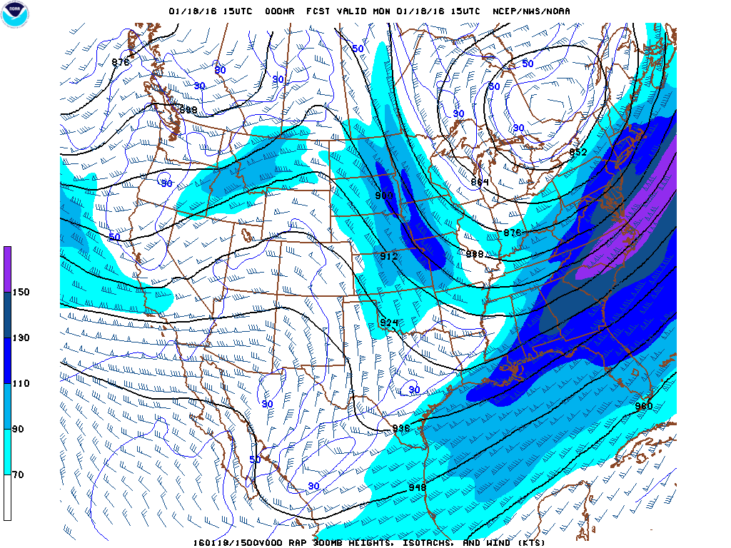
300 mb – 1500 UTC 18 Jan 2016

Slide 4
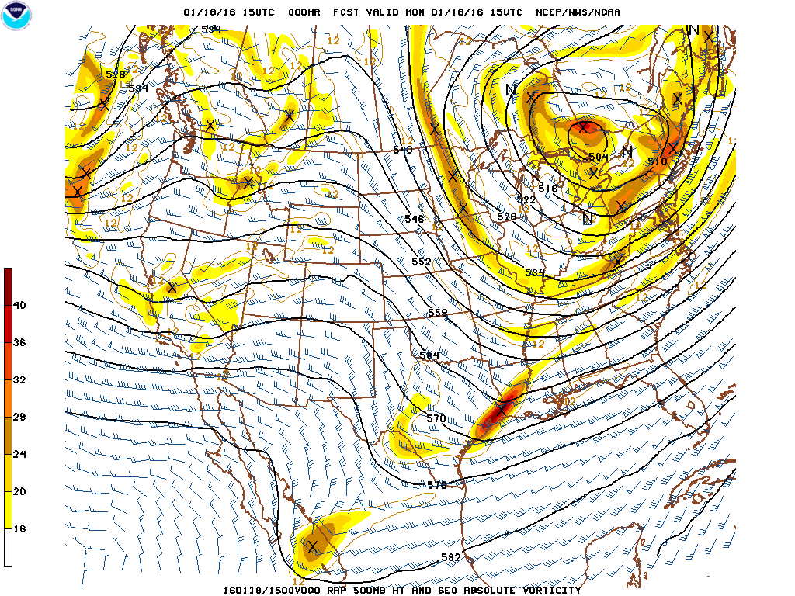
500 mb – 1500 UTC 18 Jan 2016

Slide 5
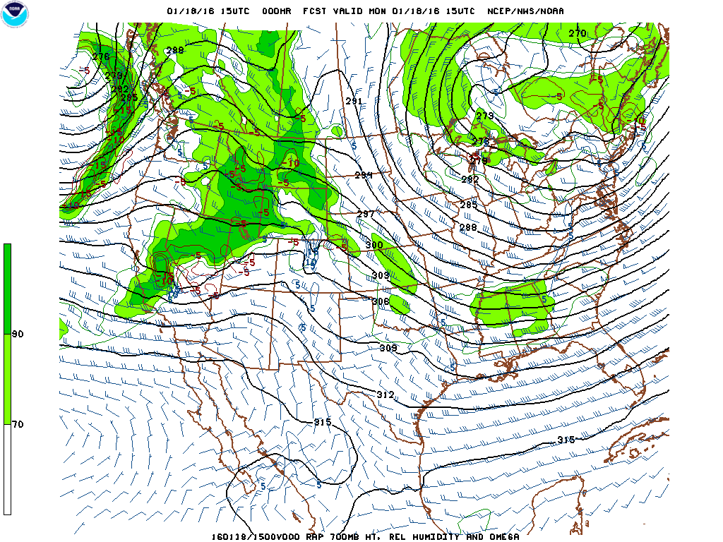
700 mb – 1500 UTC 18 Jan 2016

Slide 6
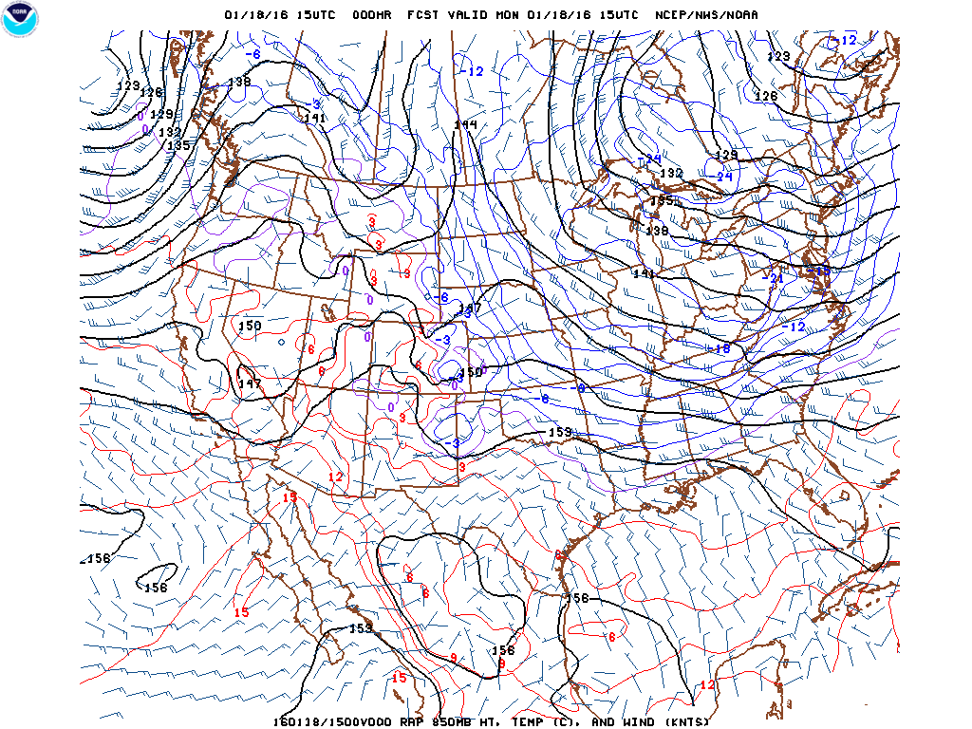
850 mb – 1500 UTC 18 Jan 2016

Slide 7
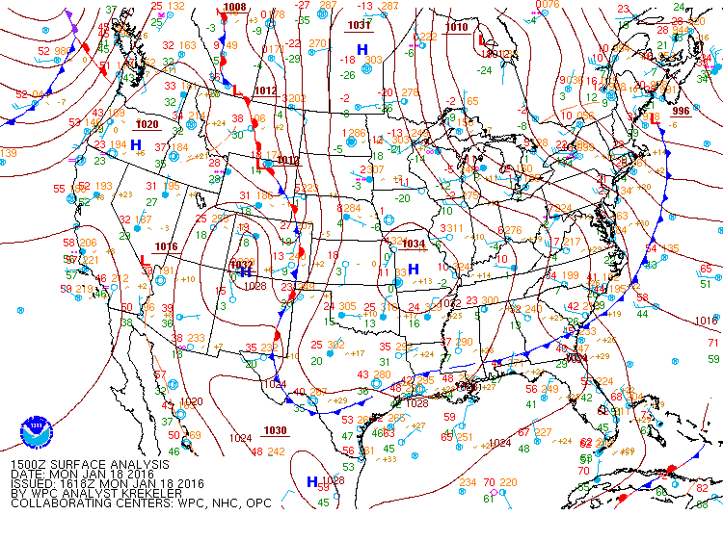
MSLP – 1500 UTC 18 Jan 2016

Slide 8
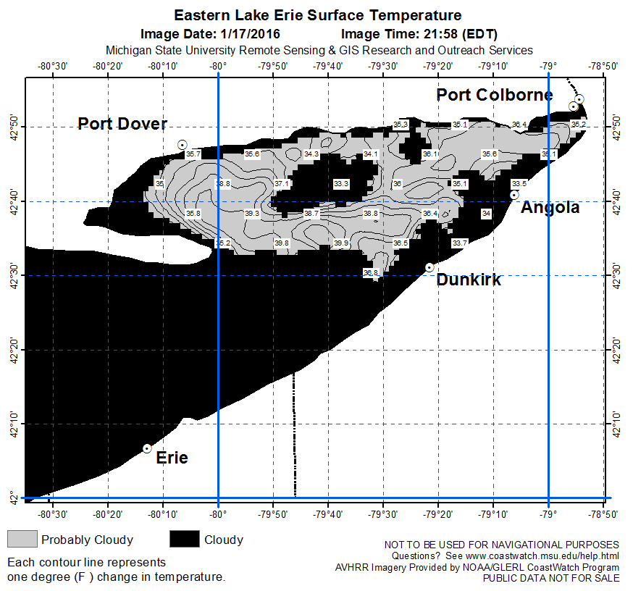
SSTs – 1500 UTC 17 Jan 2016
http://www.coastwatch.msu.edu/

Slide 9
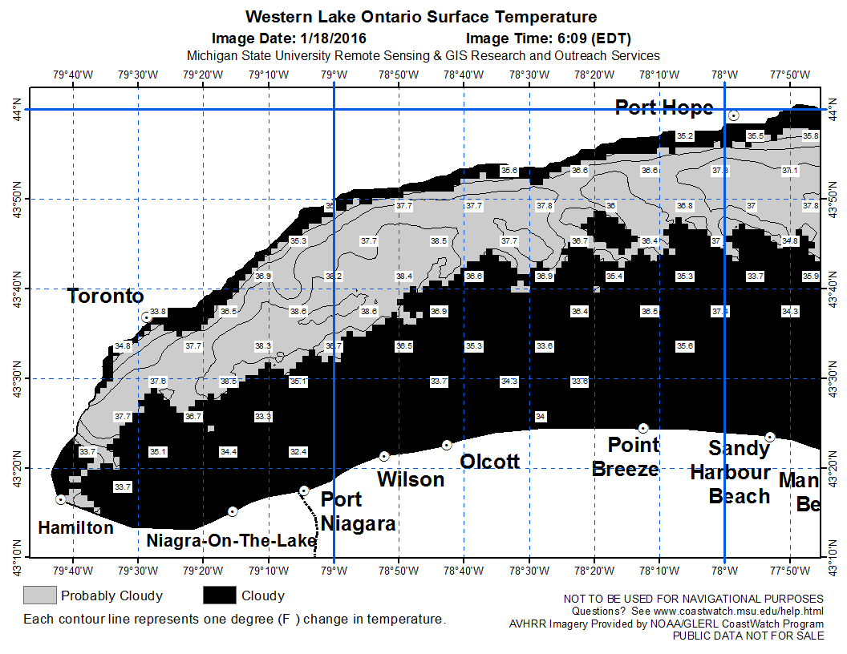
SSTs – 1500 UTC 18 Jan 2016
http://www.coastwatch.msu.edu/

Slide 10
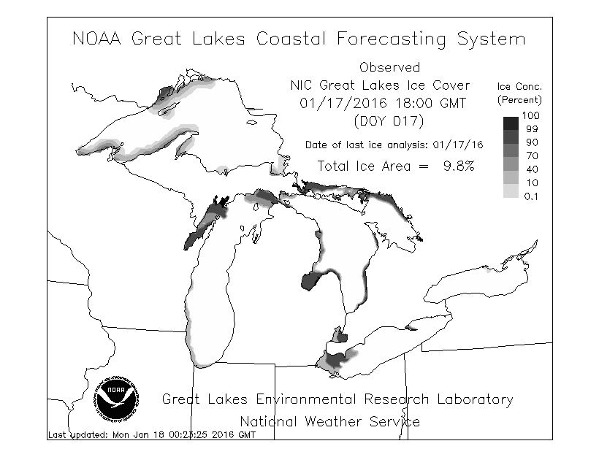
Ice coverage –17 Jan 2016
http://www.glerl.noaa.gov/res/glcfs/glcfs.php?hr=00&ext=ice&type=N&lake=l

Slide 11
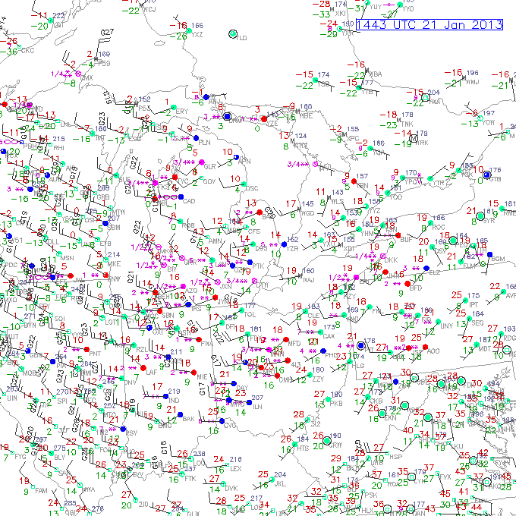
Obs – 1500 UTC 18 Jan 2016
http://weather.rap.ucar.edu/surface/displaySfc.php?region=dtw&endDate=20160118&endTime=15&duration=0

Slide 12
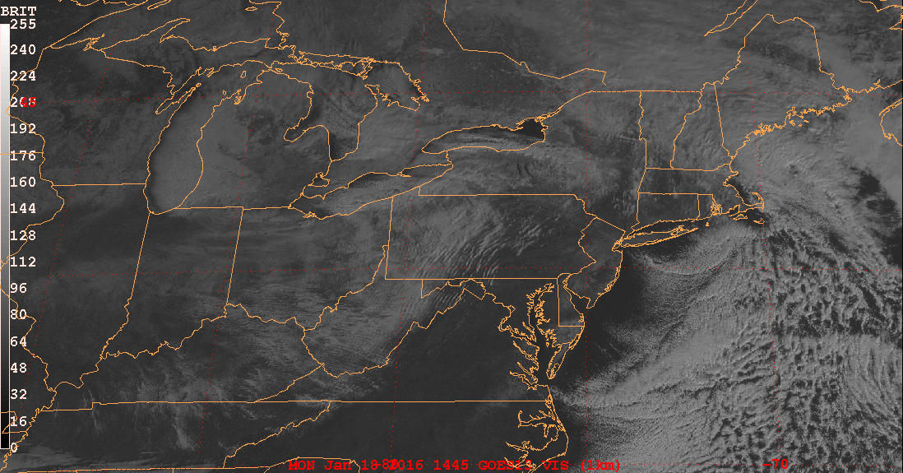
GOES visible
GARP

Slide 13
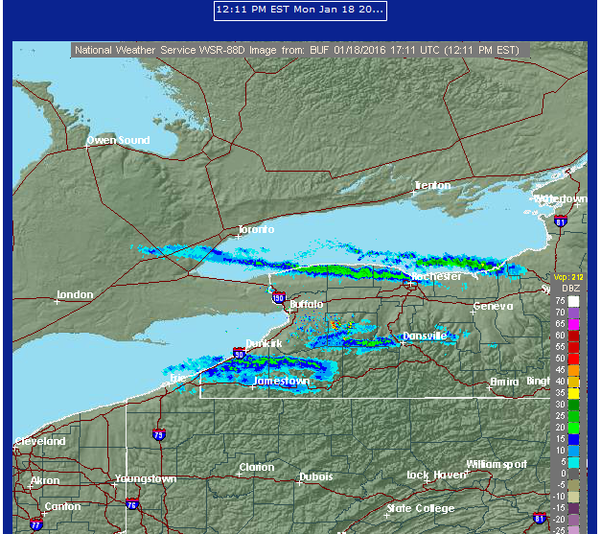
Buffalo NEXRAD
http://vortex.plymouth.edu/nids.html

Slide 14
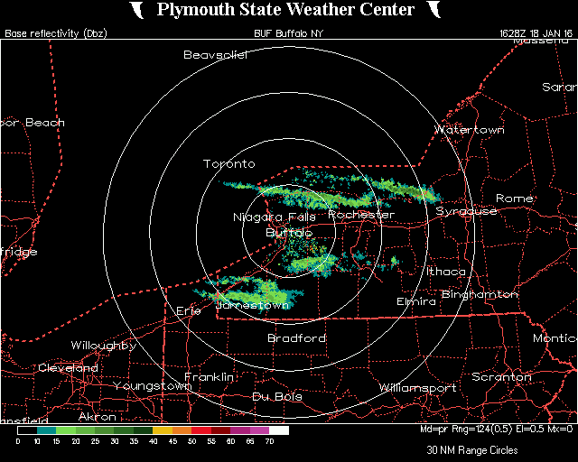
Buffalo NEXRAD
http://vortex.plymouth.edu/nids.html

Slide 15
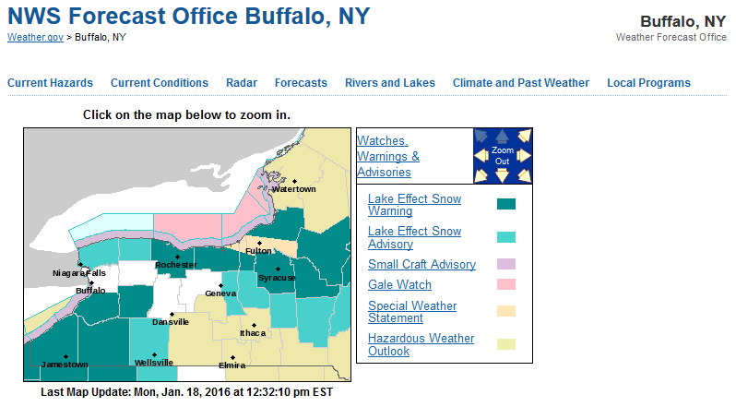
Buffalo NWSFO
http://www.crh.noaa.gov/grr/
http://www.weather.gov/buf/

Slide 16
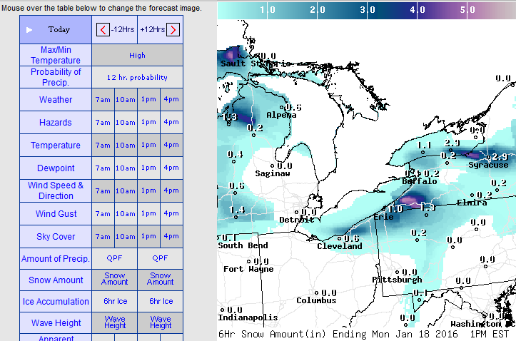
Buffalo NWSFO
http://www.crh.noaa.gov/grr/
http://graphical.weather.gov/sectors/eastgrtlakes.php?element=MaxT

Slide 17
Buffalo NWSFO
http://www.crh.noaa.gov/grr/
Snow Reports LOCATION OBSERVED
http://forecast.weather.gov/product.php?site=GRR&issuedby=GRR&product=LSR&format=CI&version=5&glossary=0

