Slide 1
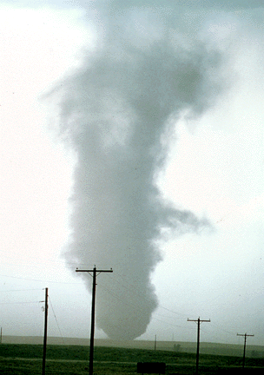
ATMS 316- Mesoscale Meteorology
Packet#8
Interesting things happen at the boundaries, or at the interface…
  Flat, mountainous
http://www.ucar.edu/communications/factsheets/Tornadoes.html

Slide 2
ATMS 316- Mesoscale Meteorology
http://meted.ucar.edu/mesoprim/mtnwave/print.htm
http://meted.ucar.edu/mesoprim/mtnwave/
Outline
  Mountain Waves and Downslope Windstorms
    Introduction
    Internal gravity waves forced by 2D terrain
      Series of ridges with constant zonal wind and static stability
      Isolated ridge with constant zonal wind and static stability
      Variations in zonal wind and stability with height: trapped waves
    Gravity waves forced by isolated peaks
    Downslope windstorms
      Amplified leeside winds in shallow-water theory
      More realistic treatment of DWs
    Rotors

Slide 3
ATMS 316- Mountain Waves
Introduction
  orographically induced wave propagation upward and downstream depend on environmental vertical profiles of
    wind
    temperature
    when sufficient moisture is present, clouds can allow us to “see” a portion of the mountain waves

Slide 4
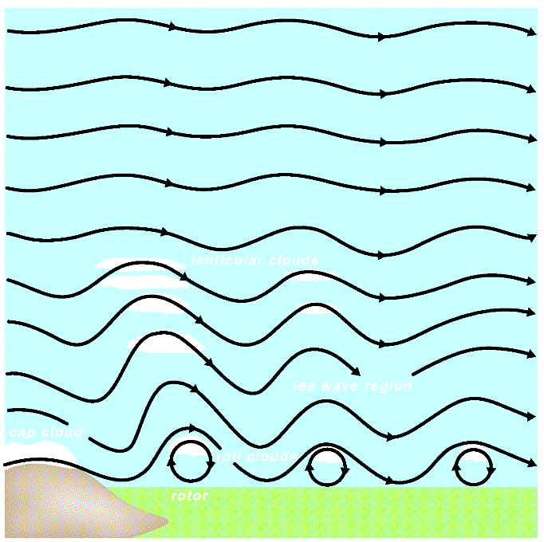
ATMS 316- Mountain Waves
Trapped waves and associated clouds in the lee of a mountain ridge (Fig 12.1)

Slide 5
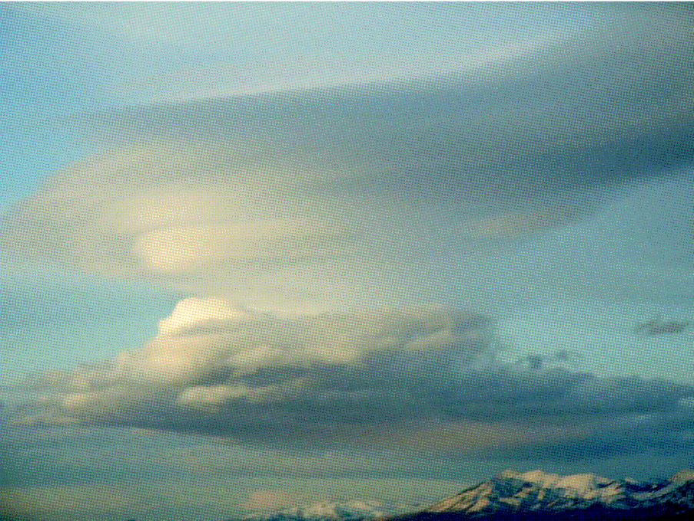
ATMS 316- Mountain Waves
Photograph of a lenticular cloud associated with a vertically propagating gravity wave forced by topography (Fig 12.2)

Slide 6
ATMS 316- Mountain Waves
Introduction
  linear theory is often used to aid in the understanding the internal gravity wave response of an environment with a particular profile of wind and temperature encountering mountains
    2D terrain
    isolated 3D mountains

Slide 7
ATMS 316- Mountain Waves
Internal gravity waves forced by 2D terrain
  assume steady state
  apply appropriate boundary conditions
    lower BC; free-slip
      flow is tangential to the terrain
    upper BC; flux of energy due to perturbed flow
      goes to zero as z → ∞
      is directed upward from the surface

Slide 8
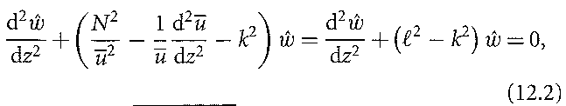

ATMS 316- Mountain Waves
Internal gravity waves forced by 2D terrain
  steady state solution, Taylor-Goldstein equation
  Eq. (12.2) here

Slide 9

ATMS 316- Mountain Waves
Series of ridges with constant zonal wind and static stability
  series of infinite ridges separated by a distance L_{x}
    defines k = 2π / L_{x} (horizontal wavenumber)
    l² – k² reduces to N²/u₀² – k²
    general solution using (12.2)
    Eq. (12.3) here
    A = ?, B = ?, use boundary conditions

Slide 10
ATMS 316- Mountain Waves
Series of ridges with constant zonal wind and static stability
  series of infinite ridges separated by a distance L_{x}
    if m {= sqrt[N²/u₀² – k²], vertical wavenumber} is real ( N² > u₀²k² ) {see p. 167, 168}
      solution is a plane wave in the x-z plane

Slide 11
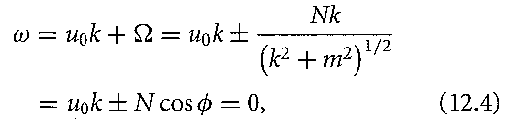
ATMS 316- Mountain Waves
Series of ridges with constant zonal wind and static stability
  series of infinite ridges separated by a distance L_{x}
    if m {vertical wavenumber} is real ( N² > u₀²k² )
      dispersion relation
Eq. (12.4) here
where ω is the ground-relative oscillation frequency, Ω is the intrinsic oscillation frequency, and φ is the angle of oscillation with respect to the vertical

Slide 12
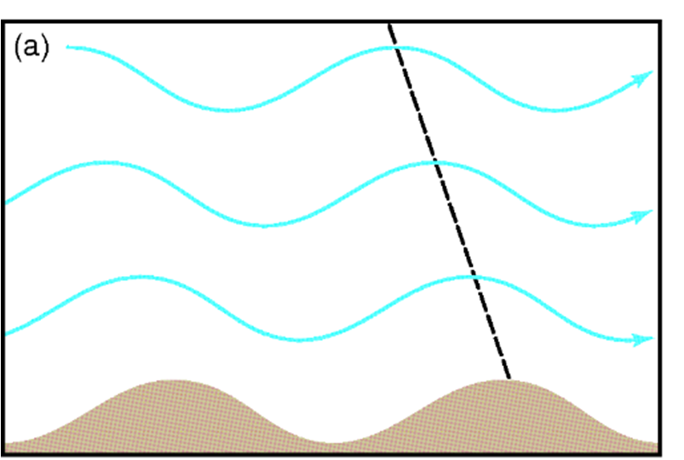
ATMS 316- Mountain Waves
Series of ridges with constant zonal wind and static stability
  series of infinite ridges separated by a distance L_{x}
    intrinsic frequency less than N (B-V frequency)
      wavefronts tilt upstream w/ ht for the A solution in (12.3)
      wavefronts tilt downstream w/ ht for the B solution in (12.3)
    Do both solutions give realistic results? Are they consistent with the upper and lower BCs?
example of wavefronts tilting upstream with height

Slide 13
ATMS 316- Mountain Waves
Series of ridges with constant zonal wind and static stability
  series of infinite ridges separated by a distance L_{x}
    solution of (12.3), A or B?
      energy propagates upward in the A solution
      energy propagates downward in the B solution
    B solution violates our upper boundary condition [see slide#7 above and Eq. (12.5)]

Slide 14

ATMS 316- Mountain Waves
Series of ridges with constant zonal wind and static stability
  series of infinite ridges separated by a distance L_{x}
    A solution of (12.3) is determined using the lower boundary condition (free slip), final solution…
(Fig 12.3)
where h_{m} is the amplitude of the terrain profile

Slide 15
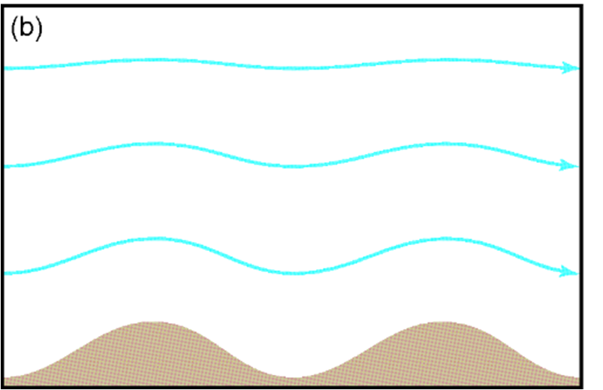

ATMS 316- Mountain Waves
Series of ridges with constant zonal wind and static stability
  series of infinite ridges separated by a distance L_{x}
    if m {vertical wavenumber} is imaginary ( N² < u₀²k² )
      lower boundary condition leads (12.3) to the form
    evanescent waves (Fig. 12.3b)
(Fig 12.3)

Slide 16

ATMS 316- Mountain Waves
Isolated ridge with constant zonal wind and static stability
  endless series of ridges is not a common form of topography
    topography no longer represented by a single wave mode (multiple modes)
      Fourier transform reveals the relevant wavenumbers
      ‘Witch of Agnesi’ terrain profile…
      ‘a’ tunes the mtn width→

Slide 17
ATMS 316- Mountain Waves
Isolated ridge with constant zonal wind and static stability
  ‘Witch of Agnesi’ terrain profile…
    The larger (smaller) we make ‘a’, the more (less) likely the solution will contain wavenumbers giving vertically propagating waves
      m {vertical wavenumber} must be real ( N² > u₀²k² )

Slide 18

ATMS 316- Mountain Waves
Isolated ridge with constant zonal wind and static stability
  ‘Witch of Agnesi’ terrain profile…
    The larger we make ‘a’, the the solution will contain smaller horizontal wavenumbers
      horizontal group velocity
in the hydrostatic limit (k² << m²), u₀ → N/m, hence, c_{gx} → 0

Slide 19
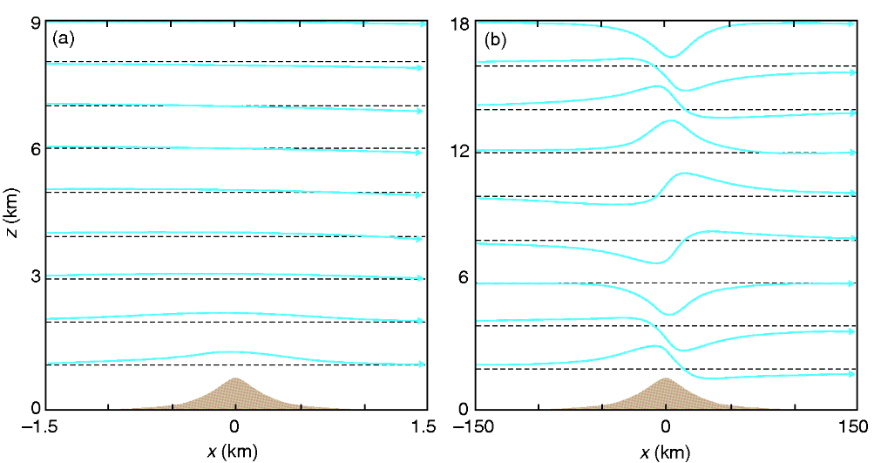
ATMS 316- Mountain Waves
in the hydrostatic limit (k² << m²), u₀ → N/m, hence, c_{gx} → 0, so most
energy does not propagate upstream or downstream from the mtn peak
Streamlines in steady air flow over an isolated ridge when (a) u₀a⁻¹ >> N {narrow mtn}and (b) u₀a⁻¹ << N {wide mtn, ~hydrostatic}(Fig 12.4)

Slide 20
ATMS 316- Mountain Waves
Note: spacing between streamlines is related inversely to the wind speed of the airflow (e.g., streamlines close together → fast winds)
Streamlines in steady air flow over an isolated ridge when (a) u₀a⁻¹ >> N {narrow mtn}and (b) u₀a⁻¹ << N {wide mtn, ~hydrostatic}(Fig 12.4)

Slide 21
ATMS 316- Mountain Waves
Variations in zonal wind and stability with height: trapped waves
  two layers of fluid in which
    zonal wind
    stability
    varies with height; two different Scorer parameters
      l_{U}
      l_{L}
      assume (l_{U} < l_{L})
Variation in l could be due to
variable vertical profile of N
curvature in vertical wind profile
both

Slide 22
ATMS 316- Mountain Waves
Variations in zonal wind and stability with height: trapped waves
  two layers of fluid
    assume (l_{U} < l_{L}), creates a situation in which waves
      propagate vertically in the lower layer
      decay with height in the upper layer
      for wavenumbers falling between the two Scorer parameter values
Notes:
22

Slide 23
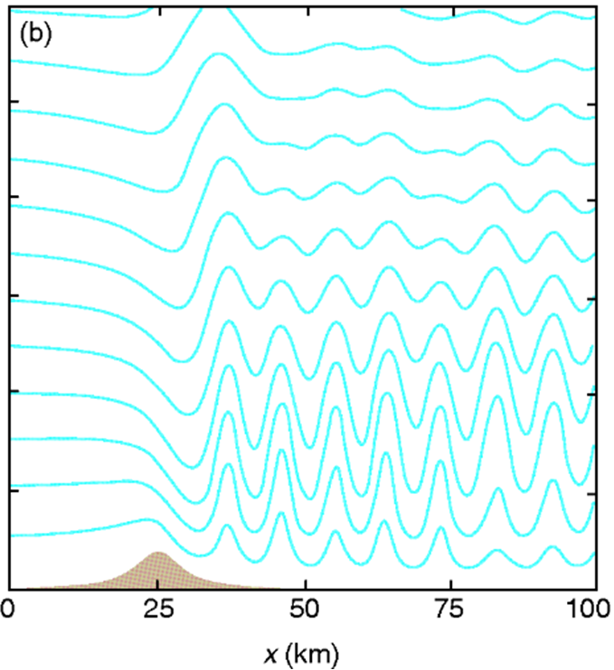
ATMS 316- Mountain Waves
Variations in zonal wind and stability with height: trapped waves
  two layers of fluid
    assume (l_{U} < l_{L}), for wavenumbers falling between the two Scorer parameter values
      constructive interference between upward- and downward-moving waves
        causes the waves to exhibit no tilt in the vertical
Notes:
23

Slide 24
ATMS 316- Mountain Waves
Variations in zonal wind and stability with height: trapped waves
  two layers of fluid
    assume (l_{U} < l_{L}), for wavenumbers falling between the two Scorer parameter values
      a solution exists if l_{L}² − l_{U}² > π²/4z_{r}² { z_{r} = height of interface}
        resonant wavelength depends on atmospheric properties downstream of the mountain rather than on the width of the mountain
Notes:
24

Slide 25
ATMS 316- Mountain Waves
Variations in zonal wind and stability with height: trapped waves
  two layers of fluid
    linear theory gives reasonably accurate results compared with fully nonlinear solutions when
      nondimensional mtn height << 1
      ū and N are constant (unless waves break)
      difference is large when ū and N are variable
Notes:
25

Slide 26
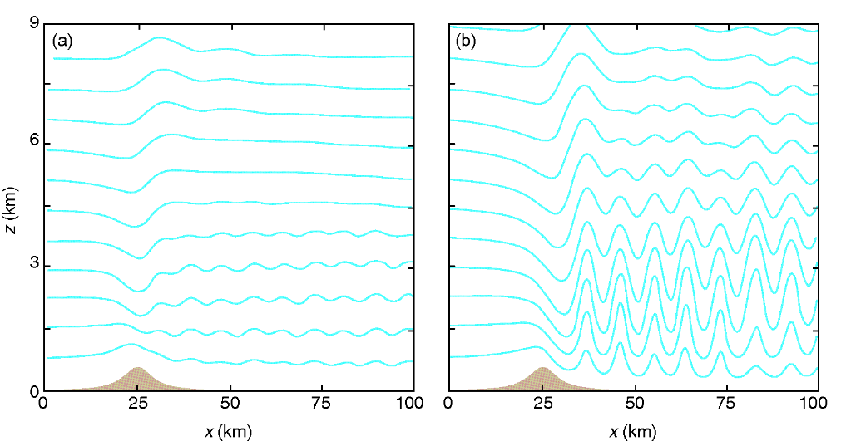
ATMS 316- Mountain Waves
Streamlines in steady air flow over a mountain for (a) steady flow subject to the linear approximation and (b) the fully nonlinear and unsteady solution (Fig 12.5)

Slide 27
ATMS 316- Mountain Waves
Variations in zonal wind and stability with height: trapped waves
  two layers of fluid
    Why the large difference?
      shorter wavelengths are enhanced through nonlinear wave interactions, a process excluded from linear theory
trapped or resonant lee waves
→Look familiar? Review the Northwest flow snowfall paper.
Notes:
27

Slide 28
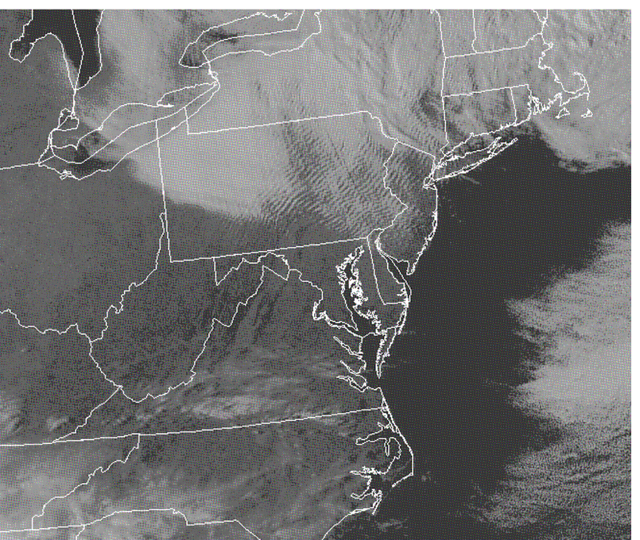
ATMS 316- Mountain Waves
Trapped lee waves triggered by the series of mountain ridges in Pennsylvania observed in visible satellite imagery at 2045 UTC 30 March 2009 (Fig 12.6)

Slide 29

ATMS 316- Mountain Waves
Gravity waves forced by isolated peaks
  Parcel and wave motions exist in 3D and the wavenumber relationship {analogous to (6.41)}

Slide 30
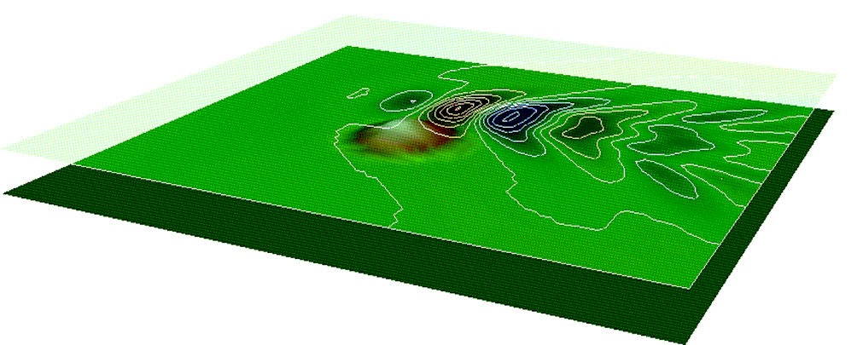
ATMS 316- Mountain Waves
Simulation of gravity waves triggered by westerly flow over an isolated peak, as viewed from the southeast. Contours of vertical velocity are shown at an altitude of 6 km at 1 m s⁻¹ intervals. Blue (red) shading indicates negative (positive) vertical velocities (Fig 12.7)
Gravity waves forced by isolated peaks
  wavenumber relationship
    waves can propagate vertically if N² > ū²k²
    the k²/(k² + l²) factor gives the waves a herringbone structure
Notes:
30

Slide 31
ATMS 316- Mountain Waves
Downslope windstorms
  at times flow accelerates as it passes over a barrier, societal impacts…
    downslope windstorms
    rotors
    other forms of clear-air turbulence
    particularly for mountains having a steep lee slope (Rocky Mtns)

Slide 32
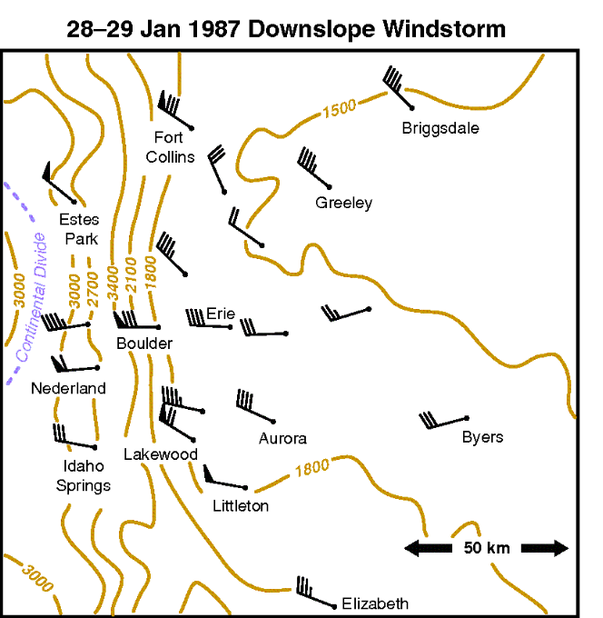
ATMS 316- Mountain Waves
Maximum wind gusts observed during a downslope windstorm in the lee of the Colorado Rockies on the night of 28-29 January 1987. Smoothed elevation contours (m) also are shown (Fig 12.8)

Slide 33
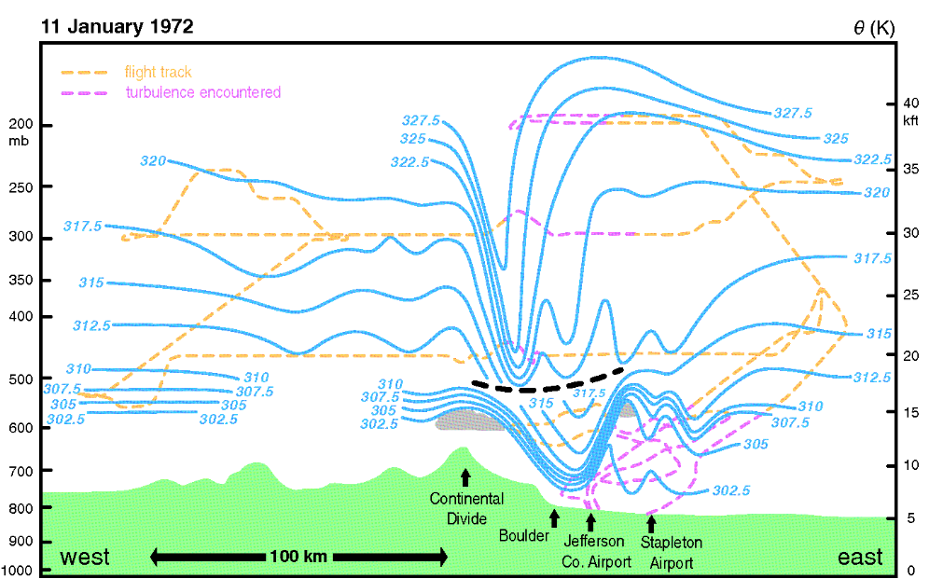
ATMS 316- Mountain Waves
Potential temperature (blue contours; K) from aircraft flight data and rawinsondes on 11 January 1972 during a downslope windstorm near Boulder, CO. Thick dashed line separates aircraft domains (Fig 12.9)

Slide 34
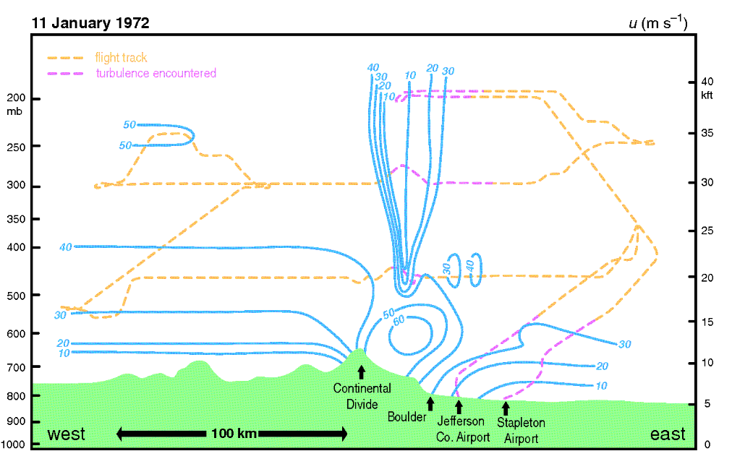
ATMS 316- Mountain Waves
Westerly wind component (blue contours; m s⁻¹) from aircraft flight data and rawinsondes on 11 January 1972 during a downslope windstorm near Boulder, CO (Fig 12.10)

Slide 35
ATMS 316- Mountain Waves
Downslope windstorms
  form when a deep layer of air is forced over a terrain barrier, usually with a strong stable layer present near the crest of the barrier and/or a critical level aloft
  most severe events may have winds exceeding hurricane strength (32 m s⁻¹)
Notes:
35

Slide 36
ATMS 316- Mountain Waves
Downslope windstorms
  At times flow accelerates as it passes over a barrier, societal impacts…
    downslope windstorms
    rotors
    other forms of clear-air turbulence
Notes:
36

Slide 37
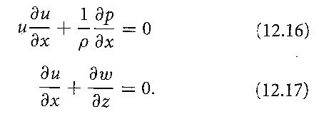
ATMS 316- Mountain Waves
Amplified leeside winds in shallow-water theory
  allows intuition into possible flow regimes
  nonlinear, steady-state equations applicable to an inviscid, hydrostatic fluid in a nonrotating reference frame
Notes:
37

Slide 38
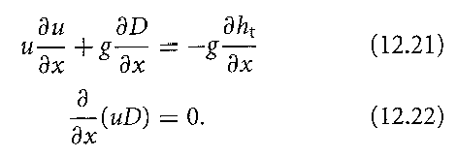
ATMS 316- Mountain Waves
Amplified leeside winds in shallow-water theory
  allows intuition into possible flow regimes
  balance between horizontal advection and horizontal PG force (12.21)
  thickening (thinning) of the fluid associated with deceleration (acceleration) following a parcel (12.22)
Notes:
38

Slide 39

ATMS 316- Mountain Waves
Amplified leeside winds in shallow-water theory
  allows intuition into possible flow regimes
  where Fr² = u²/c², c²=gD, and Fr is the Froude number for shallow water theory.
  Fr → ratio of the mean flow to the gravity wave phase speed
Notes:
39

Slide 40
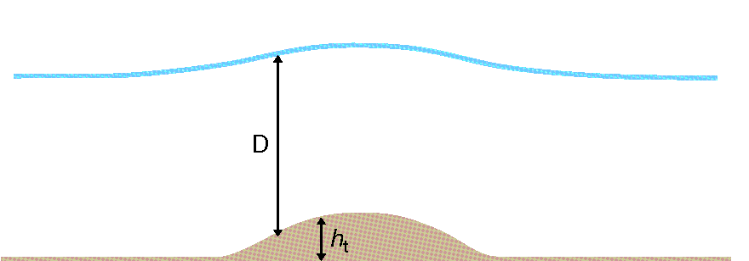
ATMS 316- Mountain Waves
Relationship between free surface height, depth (D), and terrain height ( h_{t} ) (Fig 12.11)

Slide 41
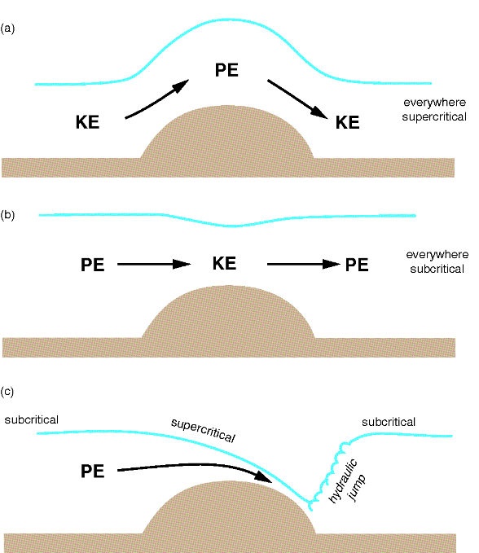
ATMS 316- Mountain Waves
Flow over an obstacle for the simple case of a single layer of fluid having a free surface for (a) supercritical flow everywhere, (b) subcritical flow everywhere, and (c) variable in the vicinity of a hydraulic jump (Fig 12.12)

Slide 42
ATMS 316- Mountain Waves
Amplified leeside winds in shallow-water theory
  Froude number (Fr)
    supercritical flow (Fr > 1, a)
      minimum wind speed at the top of the mountain (rolling ball analogy applies)
    subcritical flow (Fr < 1, b)
      maximum wind speed at the top of the mountain
      individual air parcel “feels” presence of other air parcels through the influence of the PG force
net result of both regimes; a return to the original zonal wind speeds when the parcel reaches the lee side

Slide 43
ATMS 316- Mountain Waves
Amplified leeside winds in shallow-water theory
  how to get winds on the lee side that greatly exceed their original value…
    acceleration on windward side
      subcritical flow
    acceleration on leeward side
      supercritical flow
    acceleration on windward side must cause u to cross the threshold from sub- to supercritical flow (Fr ~ 1)
Notes:
43

Slide 44
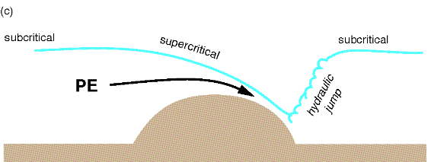
ATMS 316- Mountain Waves
Amplified leeside winds in shallow-water theory
  how to get winds on the lee side that greatly exceed their original value…
    fluid thickness will decrease over the entire path, causing the free surface to drop sharply on the leeward side (isentropes analog in downslope events), resulting in a hydraulic jump (c)
hydraulic jumps are very turbulent; large amounts of energy are dissipated within them
Notes:
44

Slide 45
ATMS 316- Mountain Waves
More realistic treatment of DWs
  real atmosphere
    extension of shallow water theory to the atmosphere is not straightforward, calculating a value for Fr appropriate to the atmosphere is especially challenging

Slide 46
ATMS 316- Mountain Waves
More realistic treatment of DWs
  other challenges in the real atmosphere
    no free surface; low-level pressure is not determined by the depth of the lowest layer
    internal gravity waves play an important role in energy transfer
Notes:
46

Slide 47
ATMS 316- Mountain Waves
More realistic treatment of DWs
  lines of thought regarding downslope windstorms (DWs)
    an atmospheric form of a hydraulic jump
    optimal conditions for wave reflection and amplification
Notes:
47

Slide 48
ATMS 316- Mountain Waves
More realistic treatment of DWs
  predominant situations in which DWs are observed
    standing waves in a deep cross-mtn flow overturn and break
    standing waves break and dissipate at a critical level in shallow cross-mtn flow
    a layer having strong static stability exists near the mtn-top with a layer of lesser stability above
Notes:
48

Slide 49
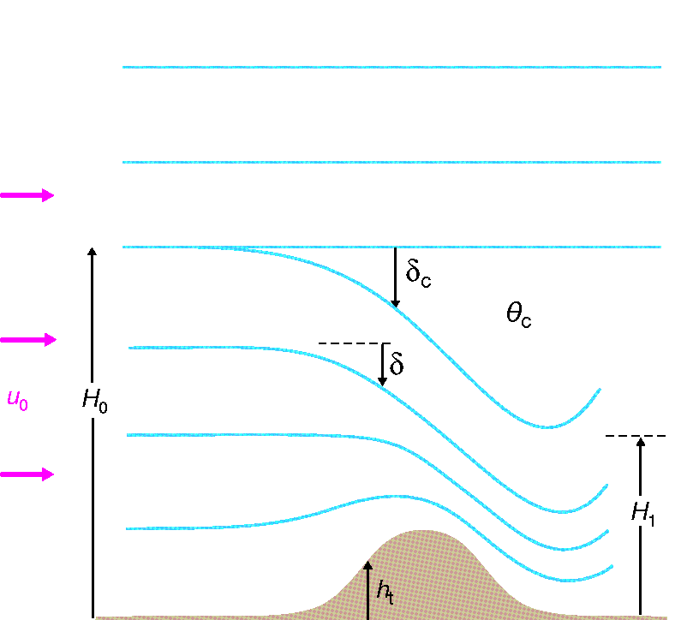
ATMS 316- Mountain Waves
Schematic of the idealized high-wind speed flow configuration, derived from aircraft observations and numerical simulations (Fig 12.13)

Slide 50
ATMS 316- Mountain Waves
More realistic treatment of DWs
  (1) standing waves in a deep cross-mtn flow overturn and break
    a region of low static stability and reversed flow with a critical level can develop
    dividing streamline (DS) is the lower boundary of the well-mixed region
    streamlines below the dividing streamlines are governed by an equation developed by Long (12.27)
DS
← this hydraulic analogy is possible when the undisturbed height of the DS falls within a prescribed range
Notes:
50

Slide 51
ATMS 316- Mountain Waves
More realistic treatment of DWs
  (2) standing waves break and dissipate at a critical level in shallow cross-mtn flow
    linear waves encountering a critical level can experience over-reflection when Ri is less than 1/4
    resonance only possible only for critical level heights of ¼, ¾, 5/4, …vertical wavelengths above the ground
model simulations suggest critical level heights that match better the hydraulic jump analog, rather than the heights suggested by wave-resonance theory
Notes:
51

Slide 52
ATMS 316- Mountain Waves
More realistic treatment of DWs
  (3) a layer having strong static stability exists near the mtn-top with a layer of lesser stability above
    displacement of the interface influences the pressure gradient (PG)
    as flow becomes more non-linear, the PG on the lee side is dominated by the contribution due to the displacement of the interface
      flow is then governed by the hydraulic analog
Notes:
52

Slide 53
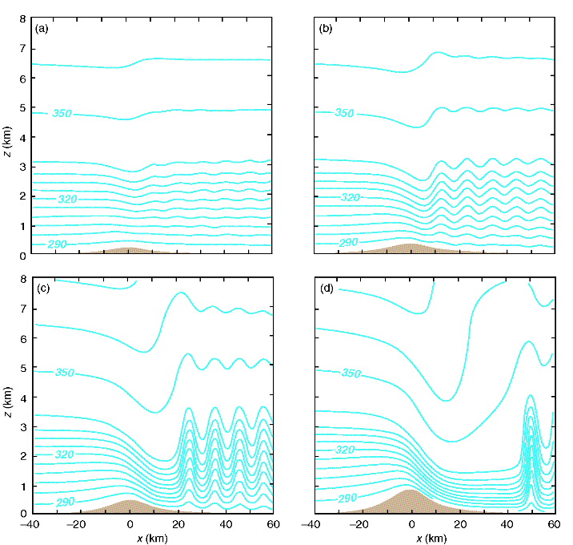
ATMS 316- Mountain Waves
Isentropes for the airflow in a two-layer atmosphere when the interface is fixed at 3 km, and the mtn height is (a) 200, (b) 300, (c) 500, and (d) 800 m (Fig 12.14)

Slide 54
ATMS 316- Mountain Waves
More realistic treatment of DWs
  (3) a layer having strong static stability exists near the mtn-top with a layer of lesser stability above
    PG on the lee side is dominated by the contribution due to the displacement of the interface
      simulations suggest that varying the depth of the stable layer has an influence similar to two-layer shallow water theory (Fig. 12.15)
Notes:
54

Slide 55
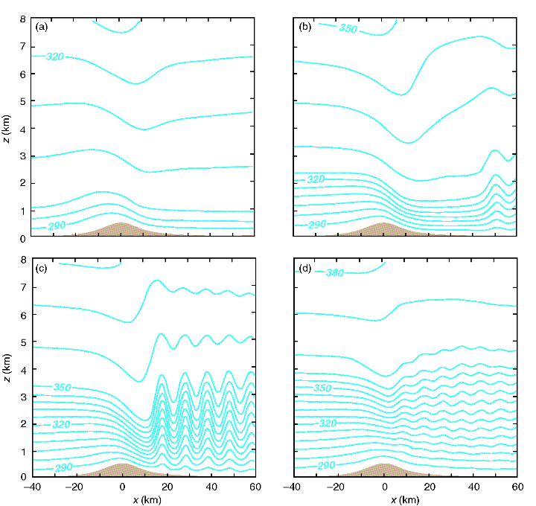
ATMS 316- Mountain Waves
Isentropes for the airflow in a two-layer atmosphere when the mtn height is fixed at 500 m, and the interface is (a) 1000, (b) 2500, (c) 3500, and (d) 4000 m (Fig 12.15)

Slide 56
ATMS 316- Mountain Waves
More realistic treatment of DWs
  (3) a layer having strong static stability exists near the mtn-top with a layer of lesser stability above
    PG on the lee side is dominated by the contribution due to the displacement of the interface
      when the low-level stable layer was removed in the simulation of an observed DW case, strong winds did not develop on the lee side
Notes:
56

Slide 57
ATMS 316- Mountain Waves
More realistic treatment of DWs
  three-layer model (strong, weak, strong stability) {recall LT76, p. 173 – 175}
    maximum amplification of the surface velocity
      occurs when the lower two layers each have a thickness equal to one-fourth of the vertical wavelength valid for that layer
      implies a relatively thin, low-level inversion with a thicker, less stable troposphere aloft
Notes:
57

Slide 58
ATMS 316- Mountain Waves
More realistic treatment of DWs
  conditions used by forecasters to predict DWs
    asymmetric mtn, gentle windward slope, steep lee slope
    strong cross-mtn geostrophic winds (> 15 m s⁻¹) at and just above mtn-top level
    angle between cross-mtn flow and ridgeline > 60º
    stable layer near or just above the mtn top, layer of lesser stability above
Notes:
58

Slide 59
ATMS 316- Mountain Waves
More realistic treatment of DWs
  conditions used by forecasters to predict DWs (continued)
    level of wind direction reversal or where cross-barrier flow goes to zero
    situations of cold advection and anticyclonic vorticity advection → generate and reinforce vertical stability structure
    absence of a deep, cold, stable layer in the lee of mtns→ keeps downslope flow from reaching the sfc
Notes:
59

Slide 60
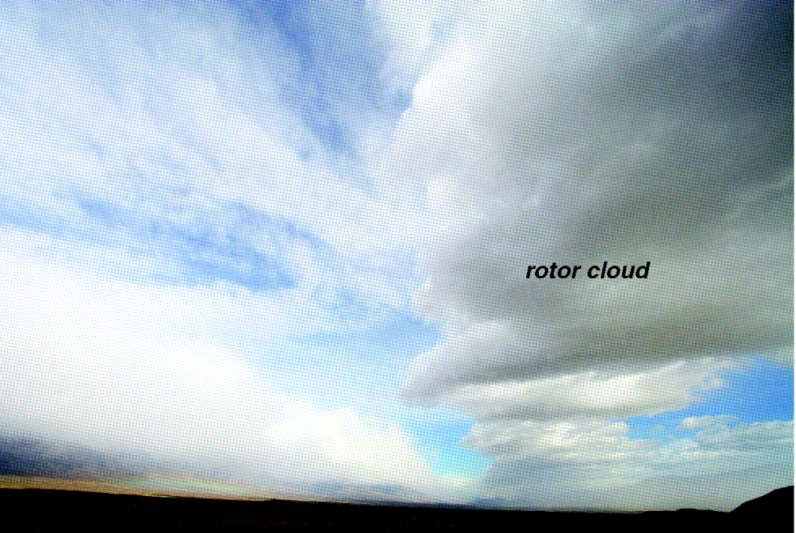
ATMS 316- Mountain Waves
Rotors
  intense horizontal vortices
    form near hydraulic jumps
      in conditions similar to those that favor DWs (supercritical flow on the lee side)
    large wind shear and turbulence
      hazardous to aircraft
Photograph of a rotor cloud taken during T-REX (Fig 12.16)

Slide 61
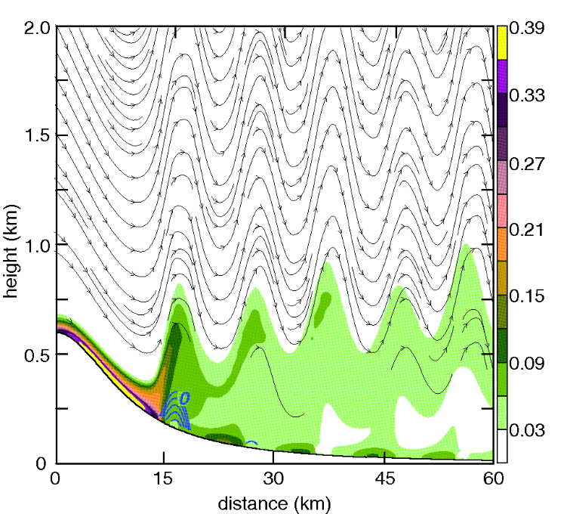
ATMS 316- Mountain Waves
Rotors
  form owing to flow separation in the wake of ridge tops (Fig. 12.17)
    strong horizontal vorticity
      created by surface friction
    a portion of the vortex sheet is captured below the wave crest of the lee wave train
      lee waves and surface friction both play an integral part in the formation of rotors
Streamlines and horizontal vorticity (shaded) in a numerical simulation. Horizontal wind speeds ≤ zero are shown in blue isotachs (Fig 12.17)
Notes:
61

Slide 62
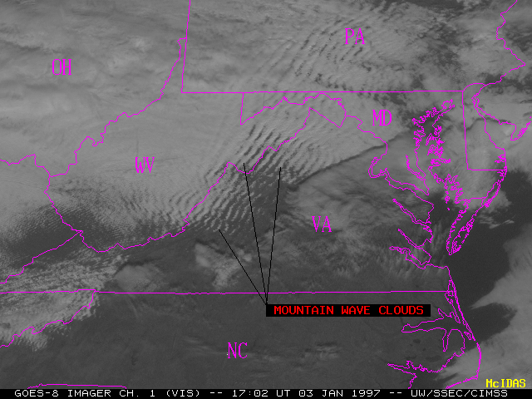
ATMS 316- Mountain Waves
Which scenario?
  Scenario#1; synoptic scale forcing alone
  Scenario#2; synoptic scale dominates mesoscale forcing
  Scenario#3; weak synoptic scale forcing
http://cimss.ssec.wisc.edu/goes/misc/mountain_waves_vis.gif
3 January 1997
Mountain waves

