Slide 1
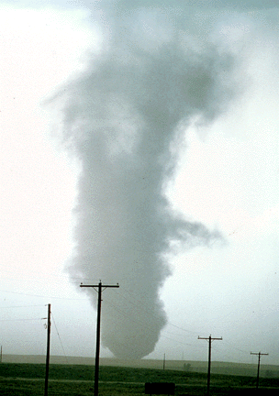
ATMS 316- Mesoscale Meteorology
Packet#7
Interesting things happen at the boundaries, or at the interface…
  Stable, unstable layers
http://www.ucar.edu/communications/factsheets/Tornadoes.html

Slide 2
ATMS 316- Mesoscale Meteorology
http://www.erh.noaa.gov/er/akq/GWave.htm
http://rams.atmos.colostate.edu/smsaleeb/gwaves/Tutorial/tutorial.html
Outline
  Background
  Mesoscale Gravity Waves

Slide 3
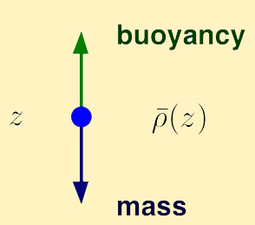
ATMS 316- Background
Mesoscale gravity waves
  contribute to mountain waves and downslope windstorms
  can help initiate convection
  cause much confusion for operational forecasters when trying to interpret pressure tendency plots based on observations or model simulations
  are often blamed for banded structures seen in imagery

Slide 4
ATMS 316- Background
Brunt-Väisälä frequency (N)
B-V frequency is a measure of the static stability: the higher the frequency, the greater the ambient stability.

Slide 5

ATMS 316- Background
Z
Brunt-Väisälä frequency (N)
  The highest frequency at which buoyancy forces can support periodic motion in a stably stratified fluid
  Parcels operating at the Brunt-Väisälä frequency move vertically, straight up and down
  Lower frequency oscillations are obtained when the parcel paths are tilted at some angle off the vertical
  Frequency of oscillation
    N cos φ, where φ is the angle between the slanted parcel trajectories and the vertical
P.P.
φ

Slide 6
ATMS 316- Background
Inviscid Boussinesq fluid
  Inviscid; no viscosity → frictionless flow
  Boussinesq fluid; density is treated as a constant in the governing equations except where it is coupled to gravity in the buoyancy term of the vertical momentum equation
linearized w-momentum equation

Slide 7
ATMS 316- Mesoscale Gravity Waves
Chapter 6, p. 161 - 175
  Basic wave conventions
  Internal gravity wave dynamics
  Environments with constant wind and static stability
  Wave reflection
  Critical levels
  Structure and environments of ducted mesoscale gravity waves
https://math.uwaterloo.ca/applied-mathematics/current-undergraduates/continuum-and-fluid-mechanics-students/am-463-students/internal-gravity-waves

Slide 8
ATMS 316- Mesoscale Gravity Waves
Gravity wave generation
  possible under statically stable conditions, generated by
    airflow over mountains
    penetration of stable layers by convection
    density impulses
    vertical shear instabilities
    disruption of balanced flow

Slide 9
ATMS 316- Mesoscale Gravity Waves
Gravity wave generation
  possible under statically stable conditions, generated by
    airflow over mountains
    penetration of stable layers by convection
    density impulses
    vertical shear instabilities
    disruption of balanced flow
      geostrophic adjustment
      jet streaks

Slide 10
ATMS 316- Mesoscale Gravity Waves
Gravity wave evolution
  generally transfer energy upward and die out after traveling a short distance horizontally from their source,
  UNLESS!!

Slide 11
ATMS 316- Mesoscale Gravity Waves
Gravity wave evolution
  when static stability or wind shear change with height, upward propagating wave energy can be reflected
    allows gravity waves to travel large distances horizontally from their source before losing most of their energy
Large-amplitude, ‘ducted’ gravity waves (a.k.a. mesoscale gravity waves) can have significant impact on weather by …

Slide 12
ATMS 316- Mesoscale Gravity Waves
Impact on weather…
  producing bands of enhanced precipitation within larger-scale regions of precipitation
  lifting air parcels to their LCL
  lifting air parcels to their LFC (if it exists) to ‘trigger’ convection

Slide 13
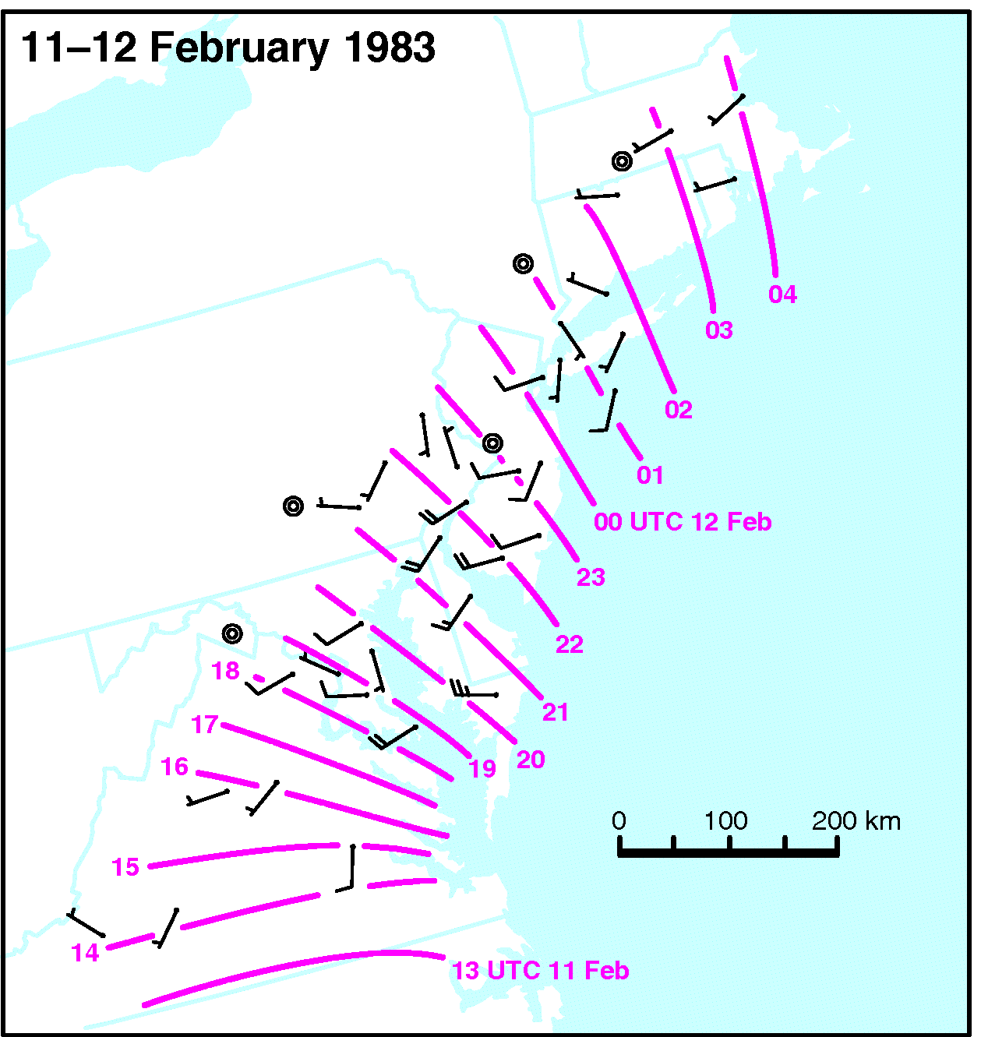
ATMS 316- Mesoscale Gravity Waves
Isochrones (UTC) of a large-amplitude gravity wave crest, during one of the heaviest snowstorms ever to strike the Northeast US major cities. Wind barbs indicate the vector wind shift associated with the wave passage (Fig 6.1)

Slide 14
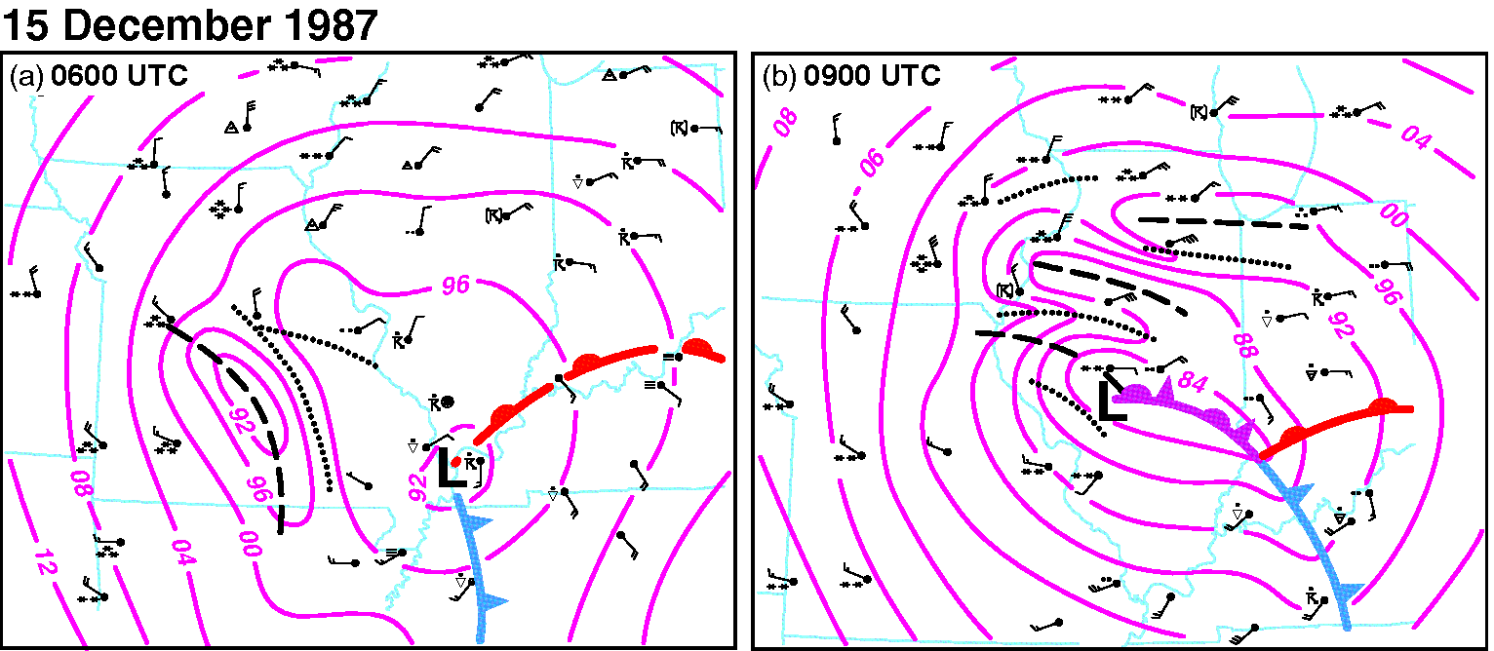
ATMS 316- Mesoscale Gravity Waves
Surface pressure analysis (mb) for (a) 0600 UTC and (b) 0900 UTC on 15 December 1987. Pressure troughs (ridges) associated with mesoscale gravity waves are indicated with dashed (dotted) lines. Forecasters mistakenly tried to correct model forecasts of the storm track (see discussion p. 175 of text). (Fig 6.2)

Slide 15
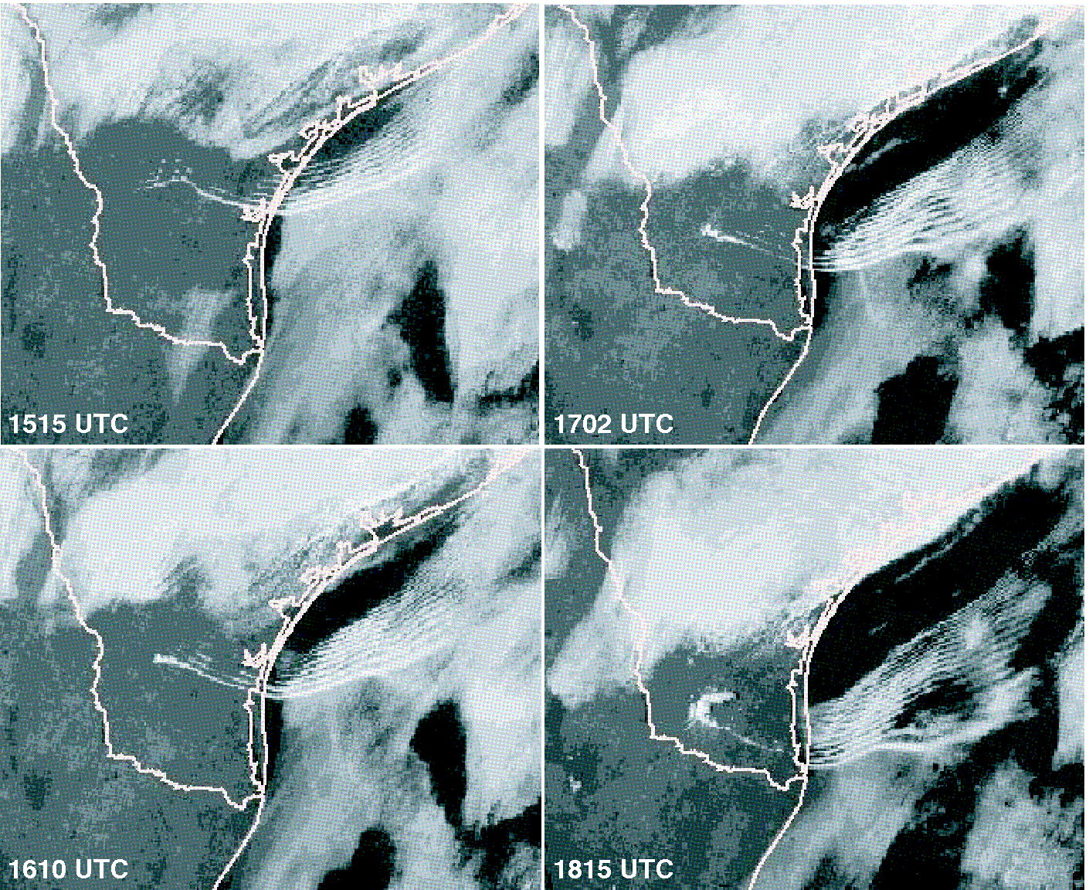
ATMS 316- Mesoscale Gravity Waves
Soliton (train of amplitude-ordered solitary waves ) Fig 6.3

Slide 16
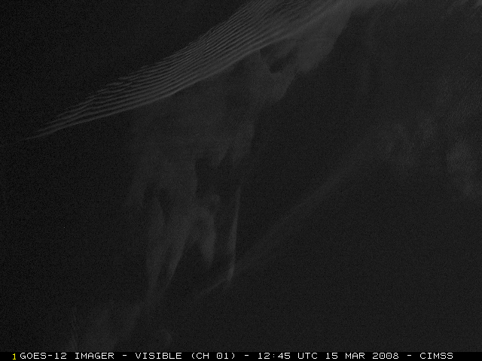
ATMS 316- Mesoscale Gravity Waves
Soliton (train of amplitude-ordered solitary waves)
www-das.uwyo.edu/~geerts/atsc5008/chap6.pptx

Slide 17
ATMS 316- Mesoscale Gravity Waves
Ducted gravity waves
  generally occur in the lower atmosphere in a deep stable layer
    a lower-tropospheric phenomena (unless they’re generated by jet streaks)

Slide 18

ATMS 316- Mesoscale Gravity Waves
Basic wave conventions
  it is common in meteorology to assume a wave solution for atmospheric variables and then use these solutions to assess properties of the flow
  Eq. (6.1) here
where λ_{x} is the wavelength in the x direction, c is the phase speed, and A is the amplitude.

Slide 19

ATMS 316- Mesoscale Gravity Waves
Basic wave conventions
  two-dimensional wave
  Eq. (6.3) here
where k = 2π/λ_{x} is the wavenumber in the x direction, m = 2π/λ_{z} is the wavenumber in the z direction, ω is the frequency of the wave, and
kx + mz – ω t is the phase of the wave. Lines of constant phase are called wavefronts, which are perpendicular to the wave vector (or wavenumber vector); κ = ki + mk {other info to be given on the board}

Slide 20
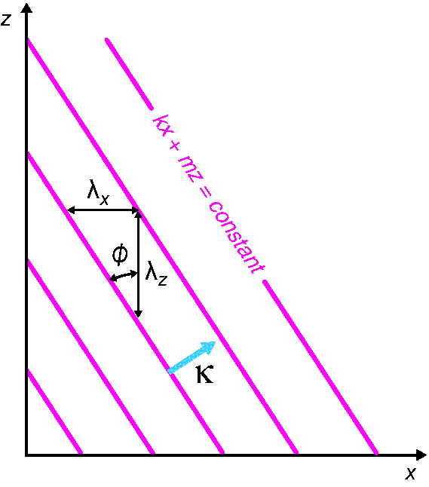
ATMS 316- Mesoscale Gravity Waves
Basic wave properties. Lines indicate constant phase for a plane wave; λ_{x} and λ_{z} are the wavelengths in the x and z directions, respectively, φ is the angle between the phase lines and the vertical, and κ is the wave vector. (Fig 6.4)

Slide 21
ATMS 316- Mesoscale Gravity Waves
Basic wave conventions
  on the board…
    phase speed
    effects of an ambient wind
      Doppler shift
      phase speed
    group velocity [see Fig. 6.5]

Slide 22
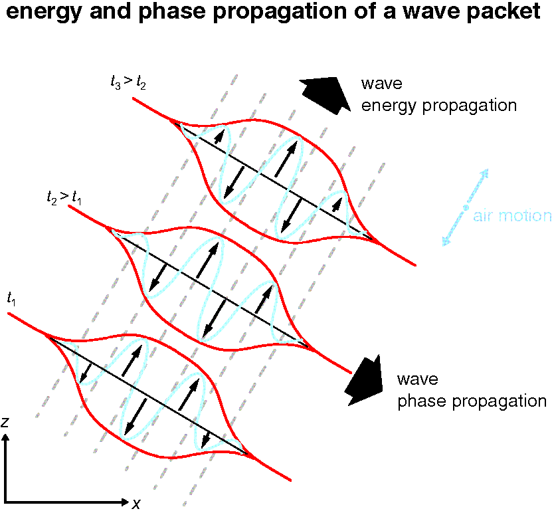
ATMS 316- Mesoscale Gravity Waves
Relationship between wavefronts, phase velocity, and group velocity for an internal gravity wave (Fig 6.5)

Slide 23
ATMS 316- Mesoscale Gravity Waves
Basic wave conventions
  waves occur in the form of wave packets (Fig. 6.5), limited regions within which waves have appreciable amplitude
    the result of superpositioning multiple waves having slightly different frequencies and wavenumbers
      amplitude envelope
group velocity is the speed of the amplitude envelope

Slide 24
ATMS 316- Mesoscale Gravity Waves
Basic wave conventions
  group velocity often provides a critical boundary condition on the wave solution
    energy is always required to travel away from the source of wave activity
Notes:
24

Slide 25
ATMS 316- Mesoscale Gravity Waves
Basic wave conventions
  external waves (surface waves)
    group and phase velocity are in the same direction
    waveform does not change shape as it moves
  internal waves
    group and phase velocity are not in the same direction
    different phase speeds for different wavelengths
Notes:
25

Slide 26
ATMS 316- Mesoscale Gravity Waves
Internal gravity wave dynamics
  external waves (surface waves)
    form along the interface between two fluids of very different densities (e.g. surface waves on lakes, oceans)
  internal waves
    found in a fluid with continually varying density and have their maximum amplitude within the fluid

Slide 27
ATMS 316- Mesoscale Gravity Waves
Internal gravity wave dynamics
  internal waves
    linearize the equations of motion
      flow consists of a mean part and a small-amplitude fluctuating part (perturbation)
      assume 2D waves (vary in x and z directions)
      neglect Coriolis and viscous forces
      adiabatic flow
      obtain Eqs. (6.22) – (6.25) and solve for w’…
Notes:
27

Slide 28
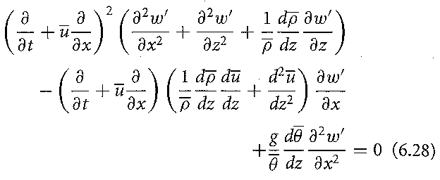
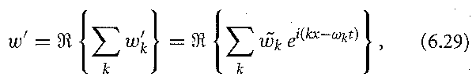
ATMS 316- Mesoscale Gravity Waves
Internal gravity wave dynamics
  linearize the equations of motion
    obtain Eqs. (6.22) – (6.25) and solve for w’…Eq. (6.28) here
    assume solutions for w’of the form
    Eq. (6.29) here
Notes:
28

Slide 29
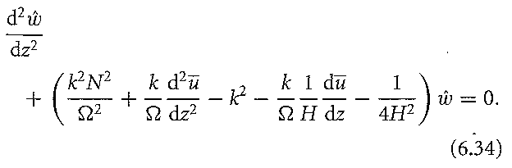
ATMS 316- Mesoscale Gravity Waves
Internal gravity wave dynamics
  linearize the equations of motion
    Plug Eq. (6.29) into Eq. (6.28) and, with some simple assumptions, derive the Taylor-Goldstein equation
    Eq. (6.34) here
gravity wave structure with height depends on (1) environmental static stability, (2) vertical wind profile, and (3) variation of density with height
Notes:
29

Slide 30

ATMS 316- Mesoscale Gravity Waves
Internal gravity wave dynamics
  linearize the equations of motion
    simplified Taylor-Goldstein equation [if density is constant with height]
    Eq. (6.36) here
Notes:
30

Slide 31
ATMS 316- Mesoscale Gravity Waves
Internal gravity wave dynamics
  linearize the equations of motion
    simplified Taylor-Goldstein equation [if density is constant with height]
      has the solutions given in Eqs. (6.37) – (6.39)
      z dependence of w is determined by whether the bracketed term in Eq. (6.36) {equivalent to ‘m’} is real or imaginary
        real; 2D wave with propagation in vertical & horizontal directions
        imaginary; evanescent solution, waves are unable to propagate vertically
Notes:
31

Slide 32
ATMS 316- Mesoscale Gravity Waves
  Environments with constant wind and static stability
    Eq. (6.39) reduces to Eq. (6.41)
      wave solutions possible only when
        Ω² < N²
      evanescent solutions when
        Ω² > N²
  recall that
  Ω is the frequency a wave would experience in the absence of an ambient wind (intrinsic frequency), N is the B-V (static stability) of the environment

Slide 33
ATMS 316- Mesoscale Gravity Waves
Z
  Environments with constant wind and static stability
  m is real (wave solutions possible)
    with buoyancy as the restoring force, the atmosphere can support oscillations with frequencies less than or equal to N for angles w.r.t. the vertical varying between
      90º (purely horizontal)
      0º (purely vertical)
      [child’s paddle toy analogy]
P.P.
φ

Slide 34
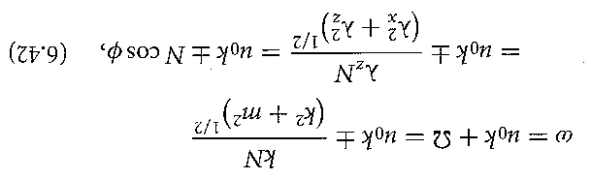
ATMS 316- Mesoscale Gravity Waves
  Environments with constant wind and static stability
  Dispersion relation
    Eq. (6.42) here
intrinsic oscillation frequency of the internal gravity wave depends only on (a) static stability and (b) angle at which the oscillation occurs w.r.t. the vertical
Notes:
34

Slide 35
ATMS 316- Mesoscale Gravity Waves
  Environments with constant wind and static stability
  dispersion relation [Eq. (6.42)]
    internal gravity waves are dispersive
      each wavelength has a different phase speed
Notes:
35

Slide 36
ATMS 316- Mesoscale Gravity Waves
  Environments with constant wind and static stability
  dispersion relation [Eq. (6.42)]
    c_{z} and c_{gz} have opposite signs
      upward (downward) transport of energy for downward (upward) phase propagation
Notes:
36

Slide 37
ATMS 316- Mesoscale Gravity Waves
Relationship between wavefronts, phase velocity, and group velocity for an internal gravity wave (Fig 6.5)
upward (downward) transport of energy for downward (upward) phase propagation
Notes:
37

Slide 38
ATMS 316- Mesoscale Gravity Waves
  Environments with constant wind and static stability
  multiple wave modes
    amplitude is tied to the sum of the values of all of the waves
      breaks the link between the magnitude of the packet and the phase of any single mode
      individual crests and troughs move through the amplitude envelope with their amplitudes changing according to their location within the packet
upward (downward) transport of energy for downward (upward) phase propagation
Notes:
38

Slide 39
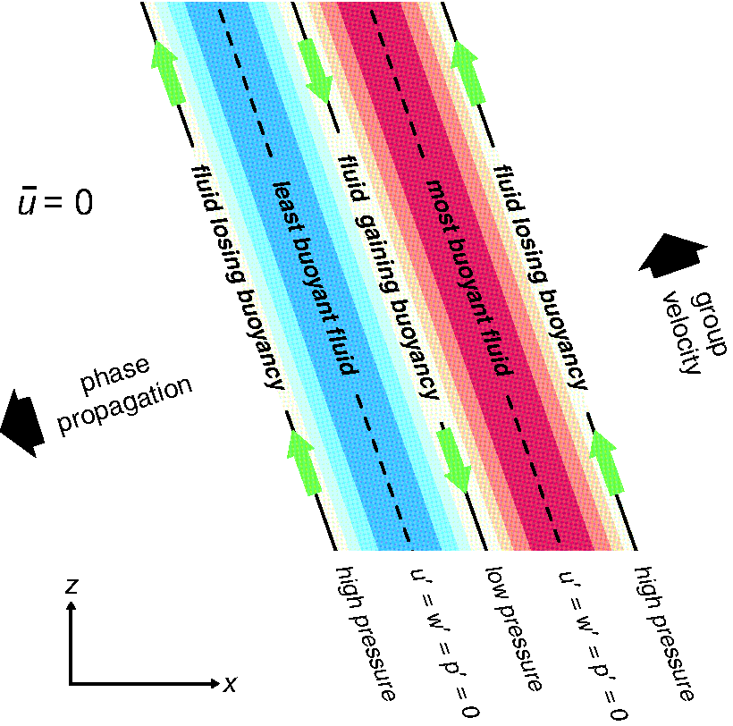

ATMS 316- Mesoscale Gravity Waves
Relationship between potential temperature, velocity, and pressure perturbations for an internal gravity wave with fffff (Fig 6.6)
both k and m are negative
←in Fig. 6.6

Slide 40
ATMS 316- Mesoscale Gravity Waves
  Environments with constant wind and static stability
  calm ambient wind (u₀ = 0)
    group velocity is perpendicular to phase velocity [(6.43)-(6.47)]
    amplitude envelope remains stationary along c [=(c_{x}, c_{y})] as the individual waves move through it
Notes:
40

Slide 41
ATMS 316- Mesoscale Gravity Waves
  Environments with constant wind and static stability
  calm ambient wind (u₀ = 0), Eqs. (6.52) – (6.54) reveal
    parcel motions are in the same direction as the group velocity, along the phase lines and perpendicular to the phase velocity (6.52)
Notes:
41

Slide 42
ATMS 316- Mesoscale Gravity Waves
  Environments with constant wind and static stability
  calm ambient wind (u₀ = 0), Eqs. (6.52) – (6.54) reveal
    pressure is in phase with w’ when m is negative {as it is in Fig (6.6)} and 180º out of phase with w’ when m is positive (6.53)
Notes:
42

Slide 43
ATMS 316- Mesoscale Gravity Waves
  Environments with constant wind and static stability
  calm ambient wind (u₀ = 0), Eqs. (6.52) – (6.54) reveal
    − θ’ is 90º out of phase with w’ (6.54)
    In contrast, θ’ and w’ are in phase for weather features due to buoyant convection.
Can you argue the phase propagation direction if it were not given in Fig 6.6? (see p. 170)
θ’ < 0,
cold
θ’ > 0,
warm
Notes:
43

Slide 44
ATMS 316- Mesoscale Gravity Waves
  Wave reflection
  multiple vertical layers, each having ~ constant static stability and winds
    wave reflection and/or refraction at the interface between layers
      If reflection → upward- and downward-propagating waves interact; constructive or destructive interference

Slide 45
ATMS 316- Mesoscale Gravity Waves
  Wave reflection
  wave reflection and/or refraction at the interface between layers
    reflection → constructive interference, leading to an increase in wave amplitude, leads to the trapping of wave energy within the lower layer (wave duct)
Notes:
45

Slide 46
ATMS 316- Mesoscale Gravity Waves
  Wave reflection
  Simple case, reflection between two layers* in the absence of any ambient wind (u₀ = 0)
    boundary conditions
      dynamic; pressure must be continuous across the interface
      kinematic; if density is continuous at the interface, the vertical velocities on either side must match
both are met simultaneously by requiring that the impedance (6.55) match at the height of the interface
*of infinite thickness
Notes:
46

Slide 47
ATMS 316- Mesoscale Gravity Waves
  Wave reflection
  Simple case, reflection between two layers in the absence of any ambient wind (u₀ = 0)
    intrinsic frequency is greater than N in the upper layer, smaller than N in the lower layer
      wave would be transmitted in the lower layer, evanescent in the upper layer
Notes:
47

Slide 48
ATMS 316- Mesoscale Gravity Waves
*of infinite thickness
  Wave reflection
  Simple case, reflection between two layers* in the absence of any ambient wind (u₀ = 0)
    intrinsic frequency is greater than N in the upper layer, smaller than N in the lower layer, result…
Realistic?
Reflection coefficient (R=energy reflected downward/energy originally reaching layer interface) equals one → perfect reflection of the wave, causing its energy to be trapped in the lower layer.
Notes:
48

Slide 49
ATMS 316- Mesoscale Gravity Waves
*of infinite thickness
  Wave reflection
  Simple case, reflection between two layers* in the absence of any ambient wind (u₀ = 0)
    Real atmosphere
      multiple layers of finite thickness
      reflection of downward propagating waves off of the ground must be considered
When the distance between the reflecting layer and the ground is such that all of the resultant waves are in phase, resonance occurs and the amplitude can grow in time when there is a continuous source of wave energy, such as in flow over a mountain.
Notes:
49

Slide 50
ATMS 316- Mesoscale Gravity Waves
*of infinite thickness
  Wave reflection
  Simple case, reflection between two layers* in the absence of any ambient wind (u₀ = 0)
    stable lower layer (constant static stability), less stable upper layer
      waves are trapped in the lower layer, known as a temperature duct
Notes:
50

Slide 51
ATMS 316- Mesoscale Gravity Waves
  Wave reflection
  Simple case, reflection between two layers* in the absence of any ambient wind (u₀ = 0)
    Layer exhibiting significant curvature of the wind speed profile with height*, surrounded by layers of ~ constant wind speed
      waves are trapped in the middle layer, known as a wind duct
*often associated with a jet, see ‘Morning Glory’
Notes:
51

Slide 52
ATMS 316- Mesoscale Gravity Waves
  Wave reflection
  Simple case, reflection between two layers in the absence of any ambient wind (u₀ = 0)
    analysis performed using a single mode
    concerned with propagation of wave packets and their reflected energy
      qualitative conclusions are unchanged from our simple analysis
Notes:
52

Slide 53

ATMS 316- Mesoscale Gravity Waves
  Wave reflection
  Simple case, reflection between two layers
    over-simplified as upper evanescent layer does not extend to infinity
    presence of a critical level (wind speed = phase speed) becomes important for wave reflection and trapping
      Richardson number (Ri) must be less than 0.25 [ see p. 66 of the textbook ]
Notes:
53

Slide 54
ATMS 316- Mesoscale Gravity Waves
  Critical levels (CLs)
  level at which wind speed = phase speed represents a singularity in the simplified Taylor-Goldstein equation (6.36)
    for Ri_{CL} > 2.0, waves are nearly completely absorbed (zero reflection at the critical level)
    0.25 < Ri_{CL} ≤ 2.0, increasing reflection at CL as Ri_{CL} → 0.25

Slide 55
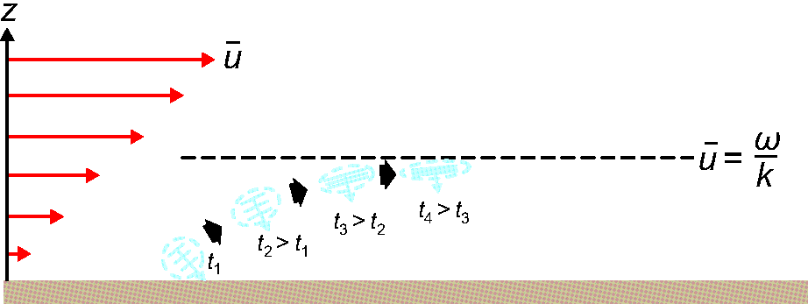
ATMS 316- Mesoscale Gravity Waves
An internal gravity wave approaching a critical level with Ri_{CL} > 0.25
(Fig 6.7)

Slide 56
ATMS 316- Mesoscale Gravity Waves
  Critical levels
  As gravity wave approaches critical level (Ri_{CL} > 0.25)
    phase lines become horizontal
    vertical group velocity goes to zero
    u → ∞ (wave breaks well before this condition, involving the overturning of isentropes and development of static instability, leading to momentum deposition)
Notes:
56

Slide 57
ATMS 316- Mesoscale Gravity Waves
  Critical levels
  As the wave packet approaches the critical layer, the restoring force (Bcosφ) becomes increasingly small as parcel oscillations become increasingly horizontal…wave simply becomes part of the mean wind
Notes:
57

Slide 58
ATMS 316- Mesoscale Gravity Waves
  Critical levels
  What about for Ri_{CL} < 0.25?
    layer is unstable to perturbations
    wave encountering this level extracts energy from mean flow
    R > 1 (overreflection), necessary condition for the ducting of internal gravity waves {subject of Section 6.5}
Notes:
58

Slide 59
ATMS 316- Mesoscale Gravity Waves
  Structure and environments of ducted mesoscale gravity waves
  Lindzen and Tung (1976, LT76) three layer model
    bottom two layers
      lowest; stable (the duct)
      upper; less stable (Ri < 0.25)
    top layer –additional stable layer
      provides a mechanism for energy loss to the system (R < 1 for bottom two layers)

Slide 60
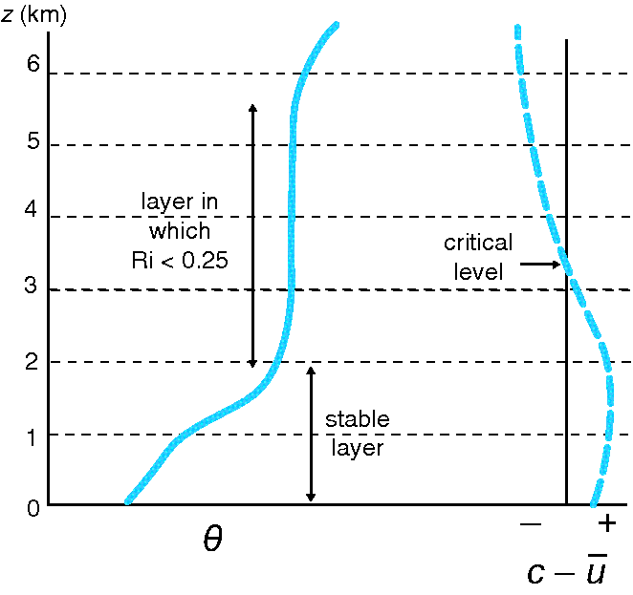
ATMS 316- Mesoscale Gravity Waves
Schematic representation of the typical environmental conditions for ducted gravity waves (Fig 6.8)

Slide 61
ATMS 316- Mesoscale Gravity Waves
  Structure and environments of ducted mesoscale gravity waves
  Lindzen and Tung (1976, LT76) three layer model
    free waves, waves experiencing no continued forcing would persist as they travel horizontally, cannot be supported
    almost free waves, waves showing a large response to a small forcing, are possible if the duct is ¼ the vertical wavelength (λ_{z} )
Notes:
61

Slide 62
ATMS 316- Mesoscale Gravity Waves
  Structure and environments of ducted mesoscale gravity waves
  LT76 three layer model
    vertical wavelength (λ_{z} ) not easily revealed in standard observations
      By tracking readily observed pressure anomalies, λ_{z} can be inferred using Eq. (6.81) and a useful test can be constructed in assessing the likelihood that an observed pressure pattern is due to a ducted wave
Notes:
62

Slide 63
ATMS 316- Mesoscale Gravity Waves
  Structure and environments of ducted mesoscale gravity waves
  LT76 conditions for a duct
    must be statically stable
    must be sufficiently thick to accommodate ¼ λ_{z} of the wave
    must be below a layer with significant reflection such that a wave can be sustained for at least two cycles
    cannot contain a critical level
Notes:
63

Slide 64
ATMS 316- Mesoscale Gravity Waves
  Structure and environments of ducted mesoscale gravity waves
  reflecting (evanescent) layer
    perfect reflection if the layer extends to infinity (previous section)
    for a finite depth, reflection is enhanced if the layer contains a critical level with Ri_{CL} < ¼
      if Ri < ¼ at a level that is almost critical (phase speed ~ ambient flow), reflectivity is enhanced
Notes:
64

Slide 65
ATMS 316- Mesoscale Gravity Waves
  Structure and environments of ducted mesoscale gravity waves
  reflecting (evanescent) layer
    How to get small Ri
      layer with large vertical wind shear and/or small static stability (N is small in an unsaturated environment, N_{m} is small in a saturated environment)
Notes:
65

Slide 66
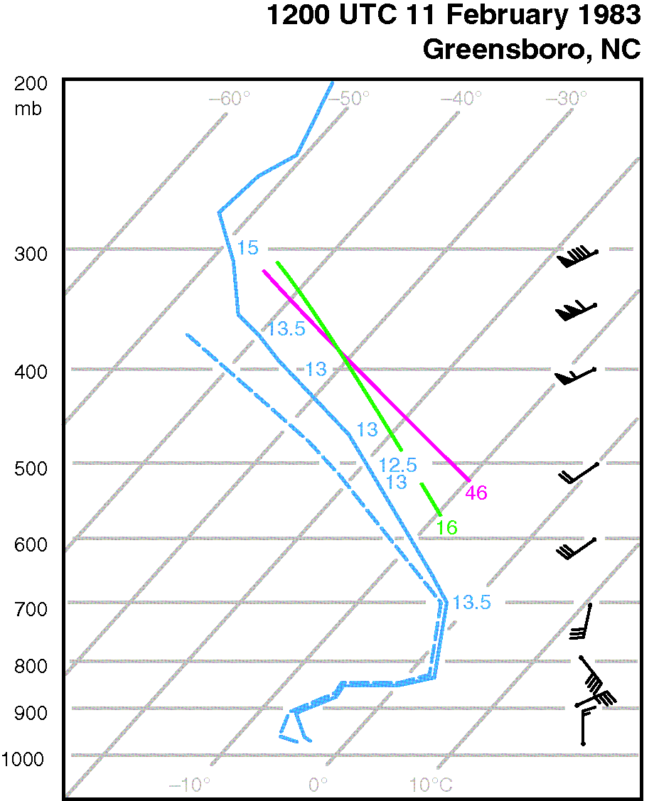
ATMS 316- Mesoscale Gravity Waves
Sounding from Greensboro, NC, during the event shown in Figure 6.1. Numbers plotted along the sounding are the θ_{w} values in ºC, and the two curves labeled ‘16’ and ‘46’ are the moist adiabat for θ_{w} = 16ºC and the 46ºC dry adiabat, respectively (Fig 6.9)

Slide 67
ATMS 316- Mesoscale Gravity Waves
  Structure and environments of ducted mesoscale gravity waves
  sounding meets conditions for a duct
    must be statically stable
    must be sufficiently thick to accommodate ¼ λ_{z} of the wave
    must be below a layer with significant reflection such that a wave can be sustained for at least two cycles
    cannot contain a critical level
Notes:
67

Slide 68
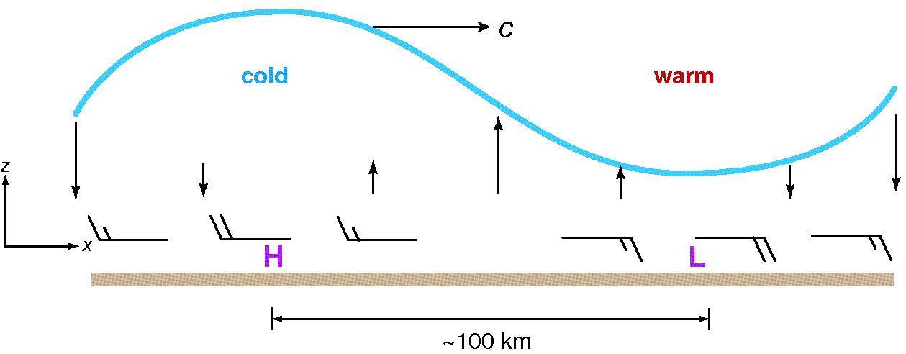
ATMS 316- Mesoscale Gravity Waves
Idealized vertical cross-section of a linear plane gravity wave, with no basic current, propagating toward the right at speed ‘c’. The heavy sinusoidal line is a representative isentropic surface or a temperature inversion. Cold and warm anomalies are indicated, as are a surface pressure maximum (‘H’) and minimum (‘L’) (Fig 6.10)

Slide 69
ATMS 316- Mesoscale Gravity Waves
  Structure and environments of ducted mesoscale gravity waves
  hydrostatic ducted mesoscale gravity wave
    large amplitude; pressure perturbations of several millibars
    extreme; pressure fluctuations of 10 millibars (tendencies as large as 10 mb h⁻¹)
often can be tracked for several hours, as in Fig 6.1
Notes:
69

Slide 70
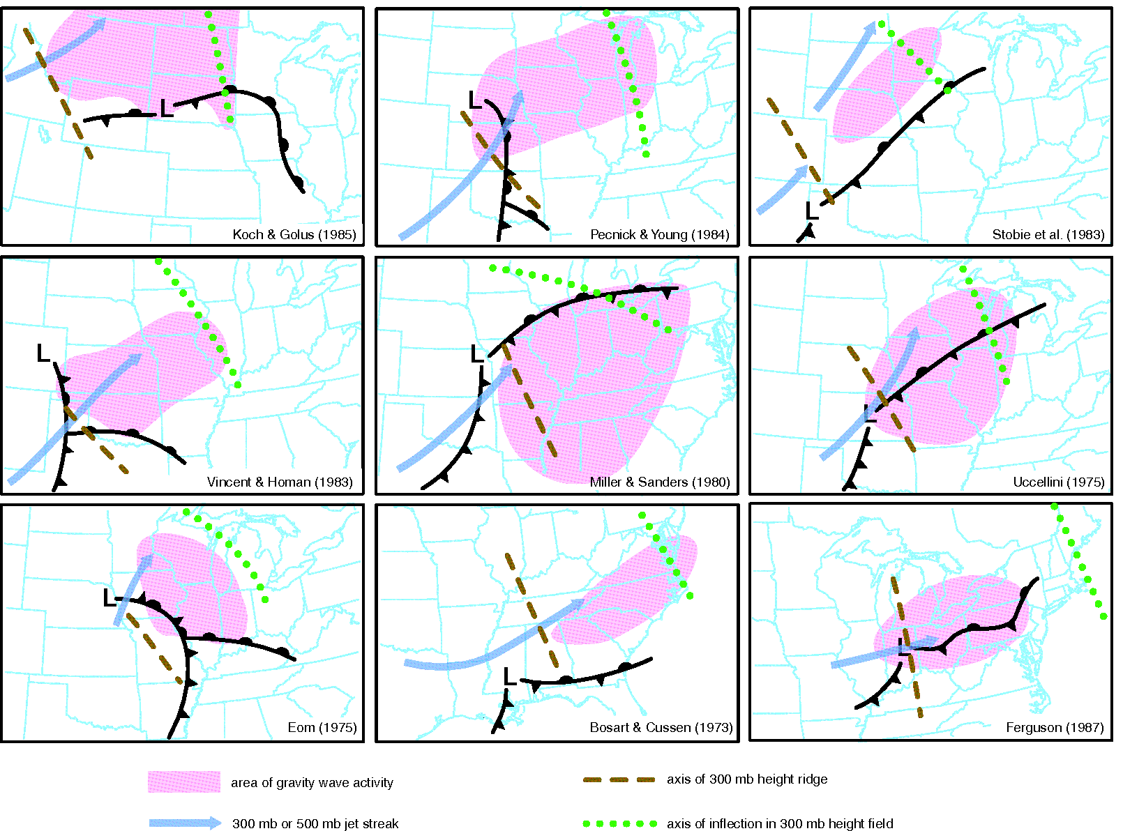
ATMS 316- Mesoscale Gravity Waves
Synoptic-scale conditions favorable for ducted mesoscale gravity waves (Fig 6.11)

Slide 71
ATMS 316- Mesoscale Gravity Waves
  Structure and environments of ducted mesoscale gravity waves
  Common synoptic settings
    Low-level inversion associated with a front
    Upper-level jet streak propagating toward a ridge axis
    Upper-level conditions associated with flow imbalance
      Initiates inertia-gravity waves (effect of Coriolis force is not negligible)
Notes:
71

Slide 72
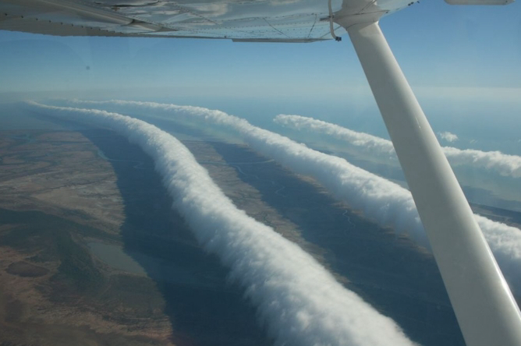
ATMS 316- Mesoscale Gravity Waves
Which scenario?
  Scenario#1; synoptic scale forcing alone
  Scenario#2; synoptic scale dominates mesoscale forcing
  Scenario#3; weak synoptic scale forcing
24 August 2009
Morning Glory
http://apod.nasa.gov/apod/ap090824.html

