Slide 1
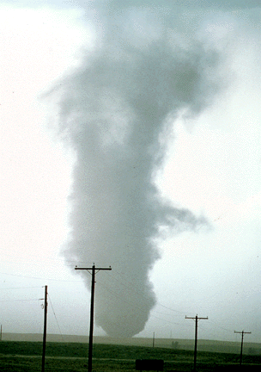
ATMS 316- Mesoscale Meteorology
Packet#3
Interesting things happen at the boundaries, or at the interface…
  Land, water (coastline)
http://www.ucar.edu/communications/factsheets/Tornadoes.html

Slide 2
ATMS 316- Mesoscale Meteorology
http://meted.ucar.edu/norlat/snow/lake_effect/
http://www.comet.ucar.edu/class/smfaculty/byrd/
Outline
  Background
  Lake-effect convection

Slide 3
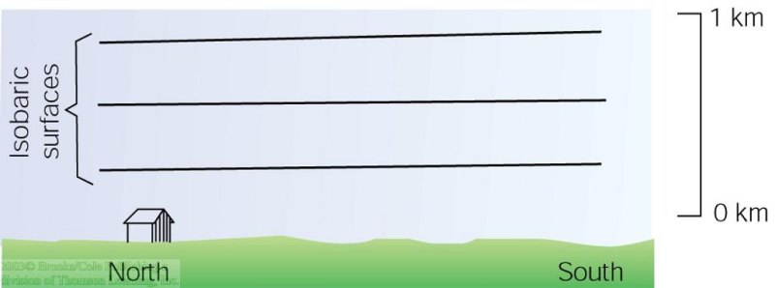
ATMS 316- Background
Thermal Circulations
  “cousin” to lake-effect snow events
A thermal circulation is produced by the heating and cooling of the atmosphere near the ground. The lines represent surfaces of constant pressure (isobaric surfaces). In this example, the isobars are parallel to the earth’s surface- there is no horizontal variation in pressure or temperature- no PGF and therefore no wind

Slide 4
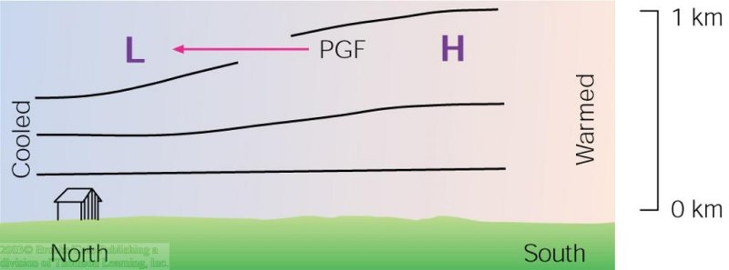
ATMS 316- Background
A thermal circulation produced by the heating and cooling of the atmosphere near the ground. The H's and L's refer to atmospheric pressure. The lines represent surfaces of constant pressure (isobaric surfaces). Suppose the air is cooled north and warmed south. PGF causes air to move from High to Low pressure

Slide 5
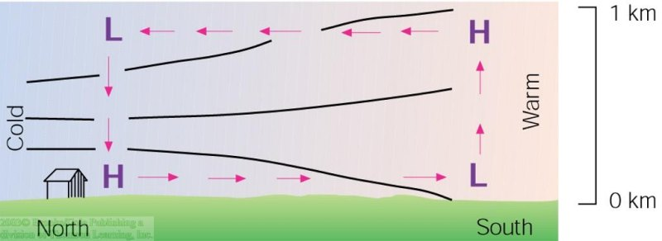
ATMS 316- Background
A thermal circulation produced by the heating and cooling of the atmosphere near the ground. The H's and L's refer to atmospheric pressure. The lines represent surfaces of constant pressure (isobaric surfaces). Air aloft moves from south to north, air leaves the southern area and “piles up” above northern area. PGF is established at surface and winds flow from north to south at the surface. We now have a thermal circulation- air flow resulting primarily from the uneven heating and cooling of air (a.k.a. “direct solenoidal circulation”)

Slide 6
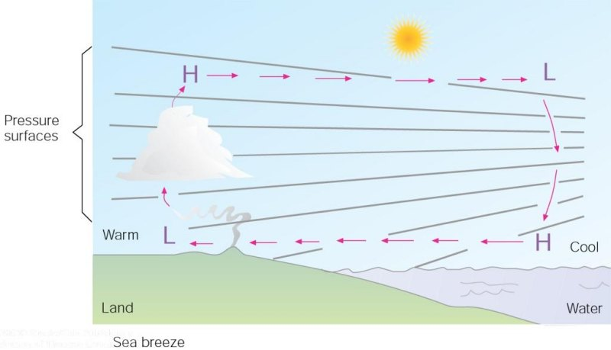
ATMS 316- Background
Sea breeze

Slide 7
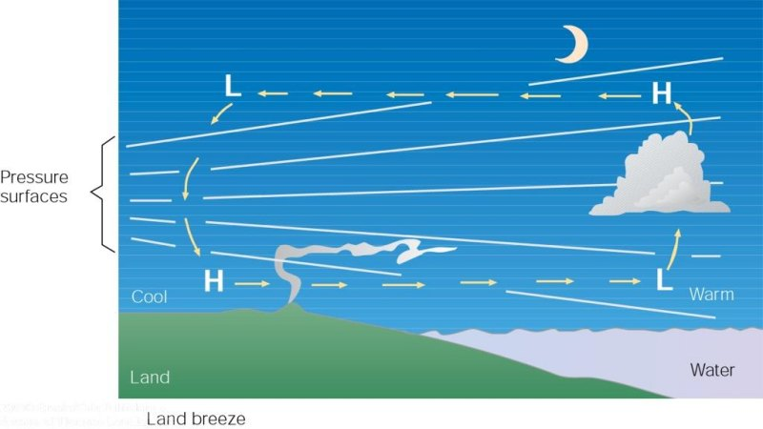
ATMS 316- Background
Land breeze

Slide 8
ATMS 316- Background
Which scenario for thermal circulations (e.g. sea breeze, land breeze)?
  Scenario#1; synoptic scale forcing alone
  Scenario#2; synoptic scale dominates mesoscale forcing
  Scenario#3; weak synoptic scale forcing

Slide 9
ATMS 316- Background
Which scenario for thermal circulations (e.g. sea breeze, land breeze)?
  Scenario#1; synoptic scale forcing alone
  Scenario#2; synoptic scale dominates mesoscale forcing
  Scenario#3; weak synoptic scale forcing

Slide 10
ATMS 316- Background
Turbulence and fluxes of heat, momentum, and moisture [material found in Section 4.1.2]
  The surface is quite often the most important source and sink of important atmospheric properties (heat, momentum, moisture)
  How do these properties get transported? Turbulence (a.k.a. friction)
    Scales
      200 m, BL turbulence
      20 m, surface-layer turbulence
      2 m, inertial subrange turbulence
      2 mm, fine-scale turbulence
Wallace & Hobbs, p. 381-389

Slide 11
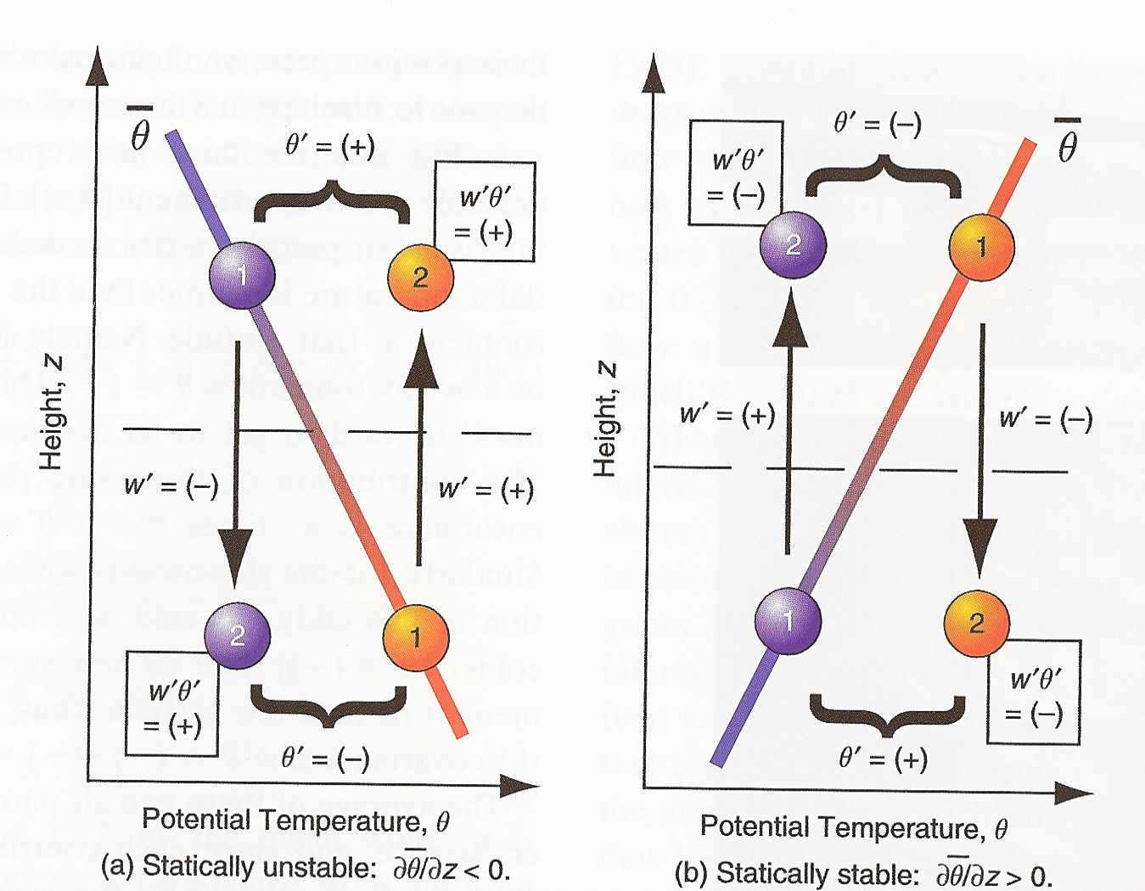
ATMS 316- Background
Turbulence and fluxes of heat, momentum, and moisture
  Example, heat flux (W m⁻²)…
  F_{H} is the kinematic heat flux [K m s⁻¹]
Wallace & Hobbs, p. 381-389

Slide 12
ATMS 316- Background
Turbulence and fluxes of heat, momentum, and moisture
  Turbulence closure problem
    Always more equations than unknowns
    Parameterize; approximate remaining unknowns as a function of the knowns
Wallace & Hobbs, p. 381-389

Slide 13
ATMS 316- Background
Turbulence and fluxes of heat, momentum, and moisture
  Turbulence closure problem
    Local, first-order closure
    K-theory
    Gradient-transfer theory
    Eddy-diffusivity theory
    Mixing length theory
Wallace & Hobbs, p. 381-389

Slide 14
ATMS 316- Background
Turbulence and fluxes of heat, momentum, and moisture
  Turbulence closure problem
    zeroth-order closure
    Similarity theory
    Mean flow state is parameterized directly
    turbulent fluxes are related to simple scaling parameters (friction velocity)
Wallace & Hobbs, p. 381-389

Slide 15
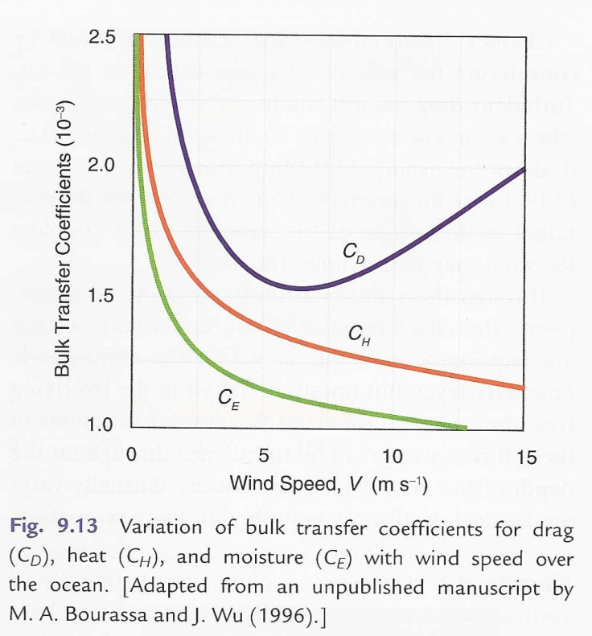
ATMS 316- Background
Turbulence and fluxes of heat, momentum, and moisture
  Bulk aerodynamic formulae, surface fluxes
Wallace & Hobbs, p. 381-389

Slide 16
ATMS 316- Background
Read Section 4.4 of the textbook
  Boundary layer convection

Slide 17
ATMS 316- Lake-effect Convection
Chapter 4, p. 93 - 102
  Climatology
  Production and release of CAPE as primary driver
  Evolution
  Other mesoscale dynamical processes
  Morphology of lake-effect snowstorms

Slide 18
ATMS 316- Lake-effect Convection
Climatology
  Definition: boundary layer convection that is enhanced by the advection of cold air over relatively warm water.

Slide 19
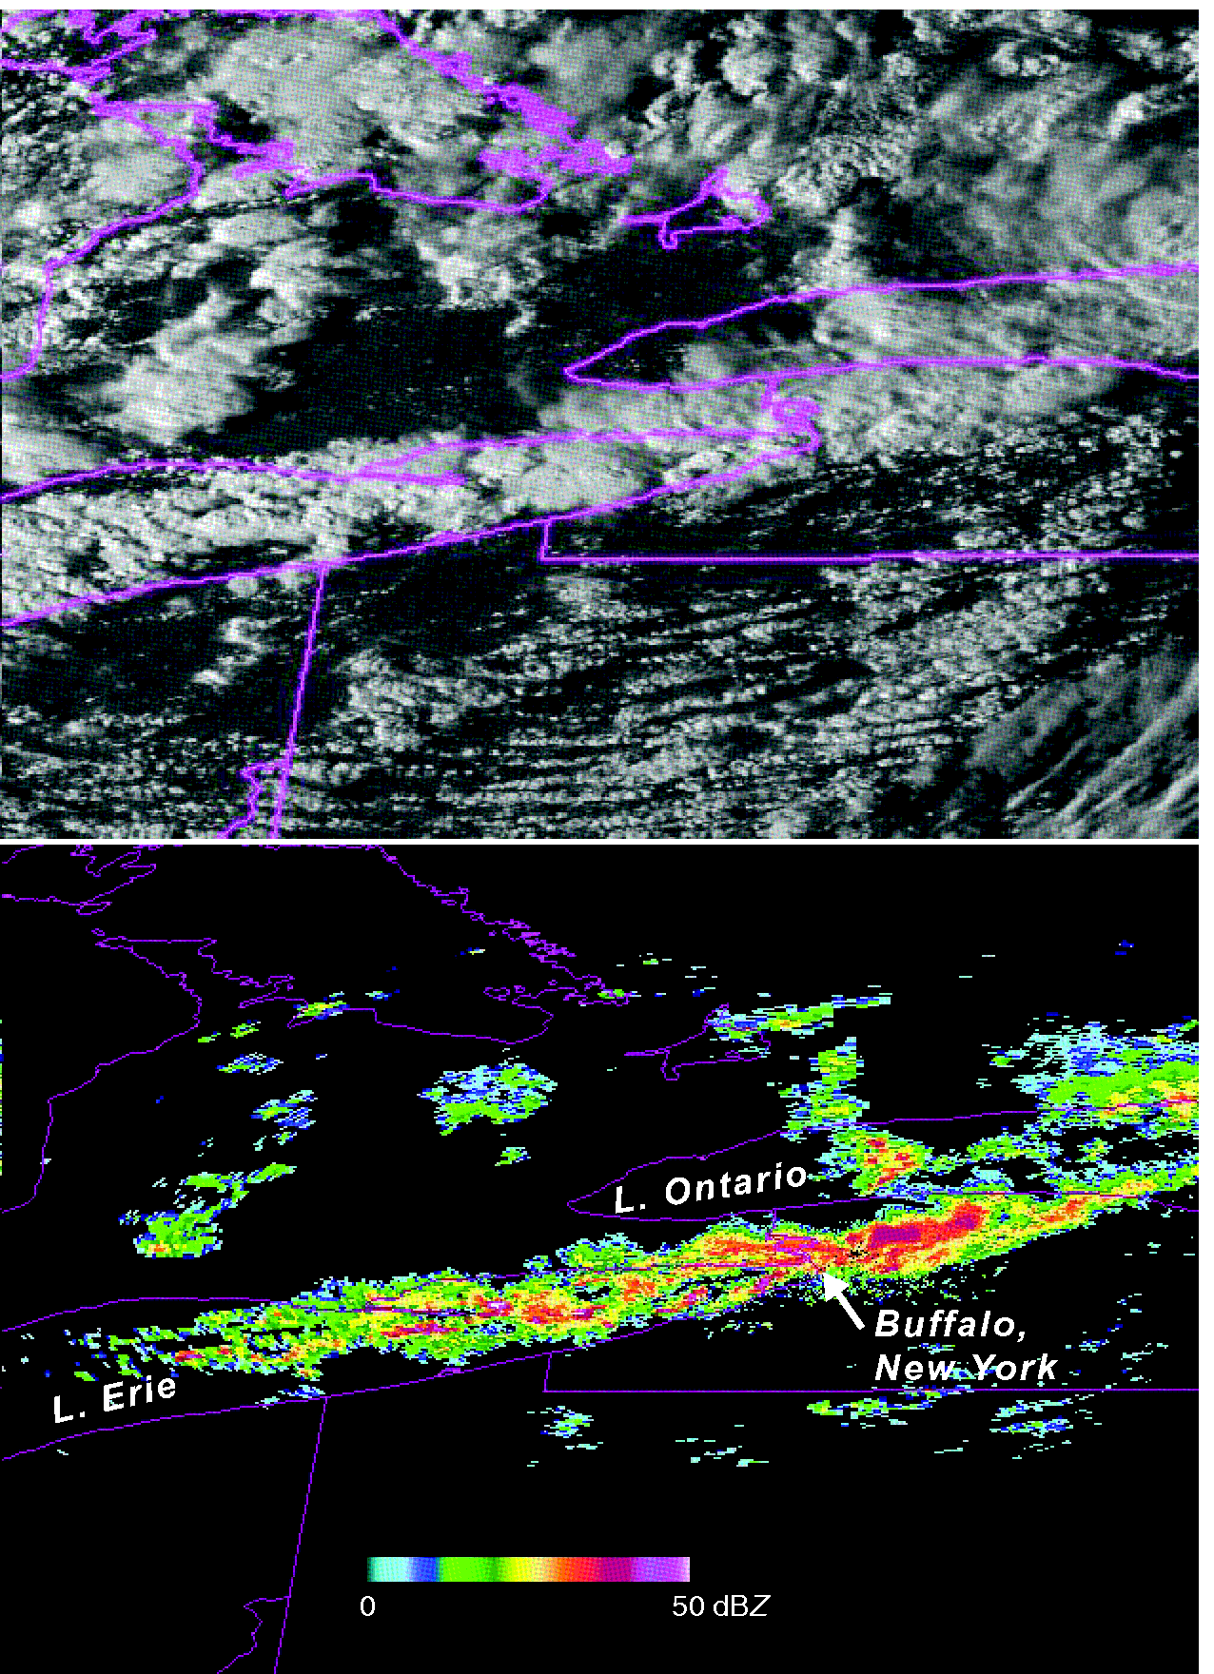
ATMS 316- Lake-effect Convection
Visible satellite and radar reflectivity imagery of an intense lake-effect snow band at 2115 UTC 12 October 2006. As much as 60 cm of snow fell near Buffalo, NY. SSTs ~ 17ºC and 850 hPa level T ~ −7ºC (Fig 4.18)

Slide 20
ATMS 316- Lake-effect Convection
Climatology
  Lake-effect, a.k.a.
    Ocean-effect
    Bay-effect
    examine p. 93-94 to find geographic regions around the globe impacted by lake-effect (and related) precipitation

Slide 21
ATMS 316- Lake-effect Convection
Climatology
  Great Lakes, North America
    Lake-effect ‘season’ extends from late fall to early winter;
    water temperatures are warmest relative to the air masses advected over the lakes
    By late winter, lake surface temperatures have cooled substantially or frozen over; putting an end to the season

Slide 22
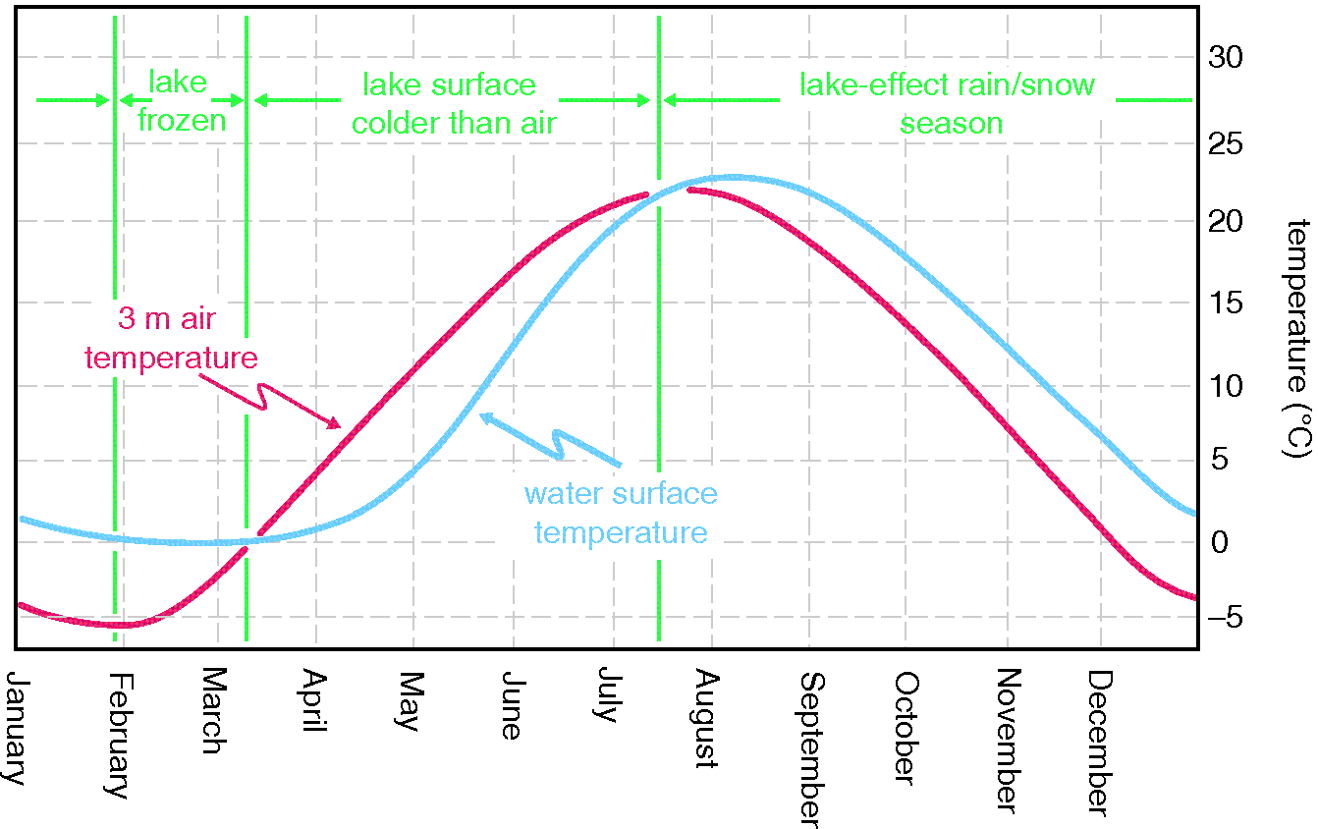
ATMS 316- Lake-effect Convection
Annual cycle of 3 m air temperature and Lake Erie surface temperature (Fig 4.19)

Slide 23
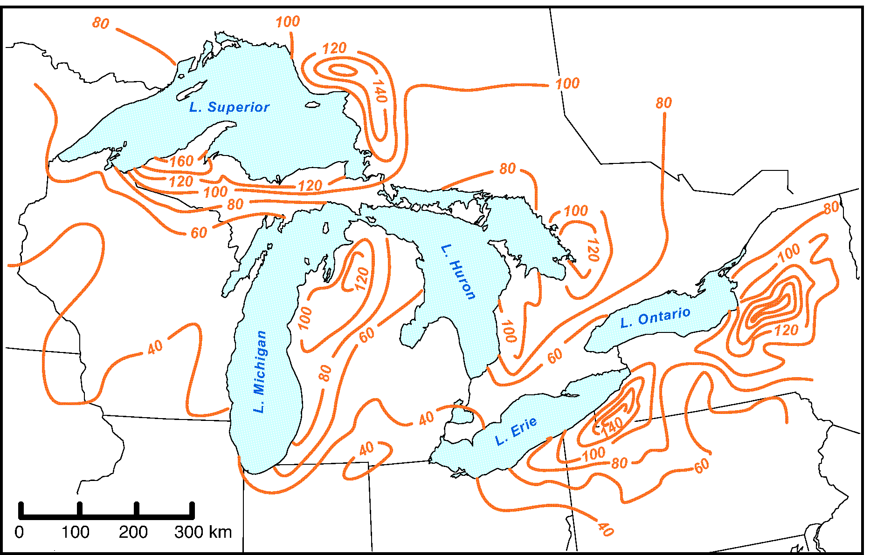
ATMS 316- Lake-effect Convection
Mean annual snowfall (inches) near the Great Lakes (Fig 4.17)

Slide 24
ATMS 316- Lake-effect Convection
Climatology
  One-fourth to one-half of the yearly snowfall on the shores of Lake Michigan could be attributed to lake effects (Braham and Dungey 1984)

Slide 25
ATMS 316- Lake-effect Convection
Production and release of CAPE as primary driver
  The deeper the cloud, the greater the amount of precipitation generated
    Destablize environment
    Moisten environment
    at low levels

Slide 26
ATMS 316- Lake-effect Convection
Production and release of CAPE as primary driver
  Destablization is much more dramatic over “warm” water
    Greater thermal inertia of water
    Greater moisture flux from a water surface
    Most intense events tend to occur behind strong cold fronts

Slide 27
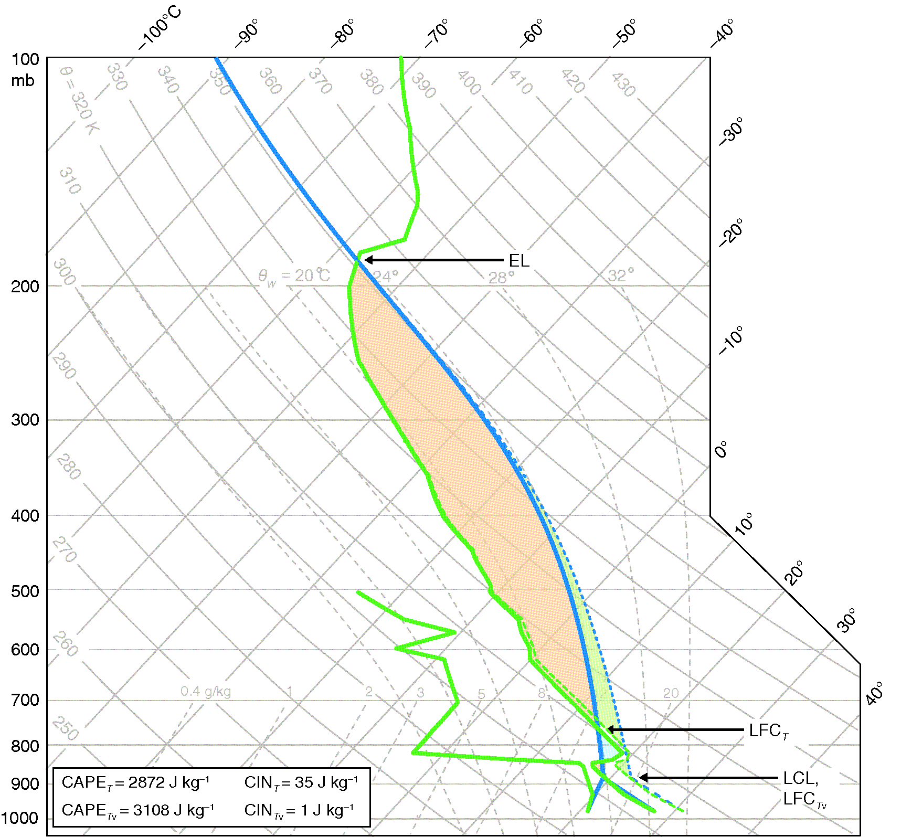
ATMS 316- Lake-effect Convection
Skew T – log p diagram obtained from the Del Rio, Texas, sounding at 1800 UTC 14 May 2008 (Fig 2.9)

Slide 28
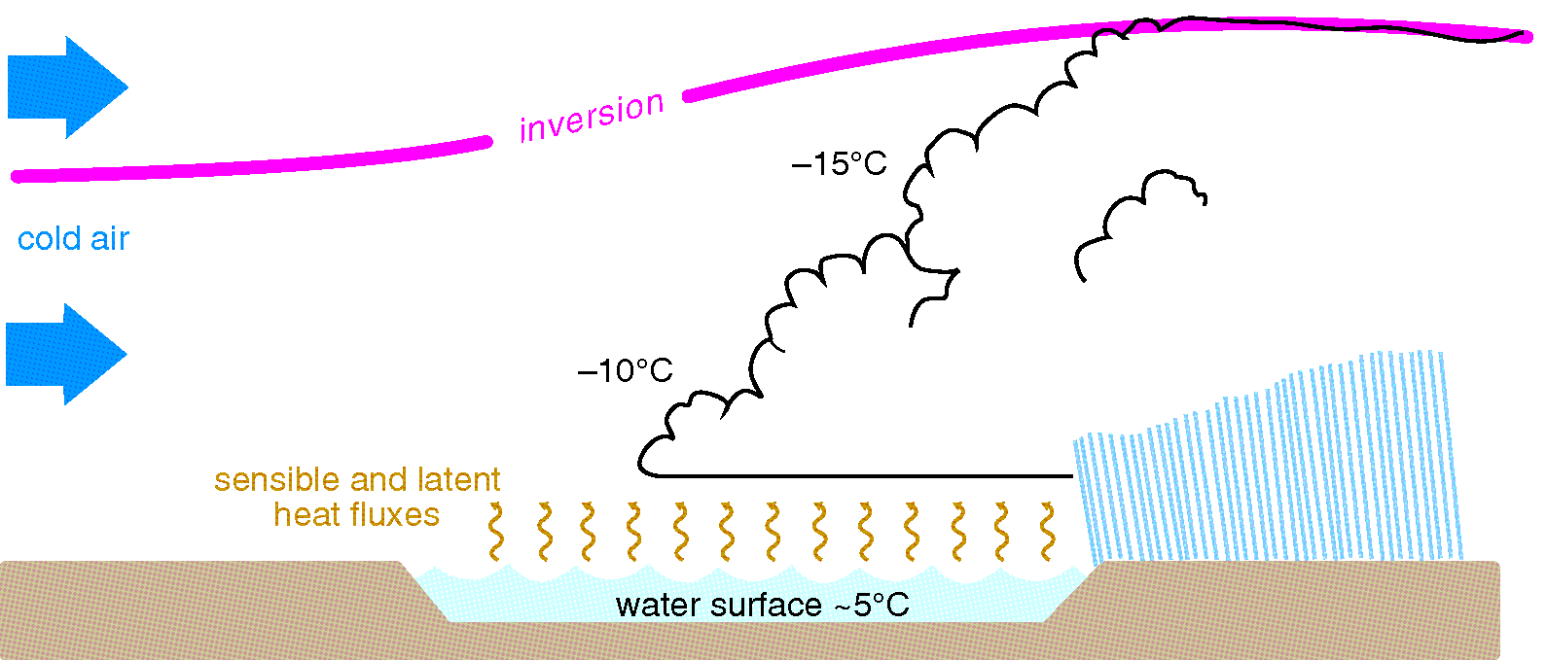
ATMS 316- Lake-effect Convection
Schematic illustrating the polar or arctic air mass modification that leads to the development of lake-effect convection (Fig 4.20)

Slide 29
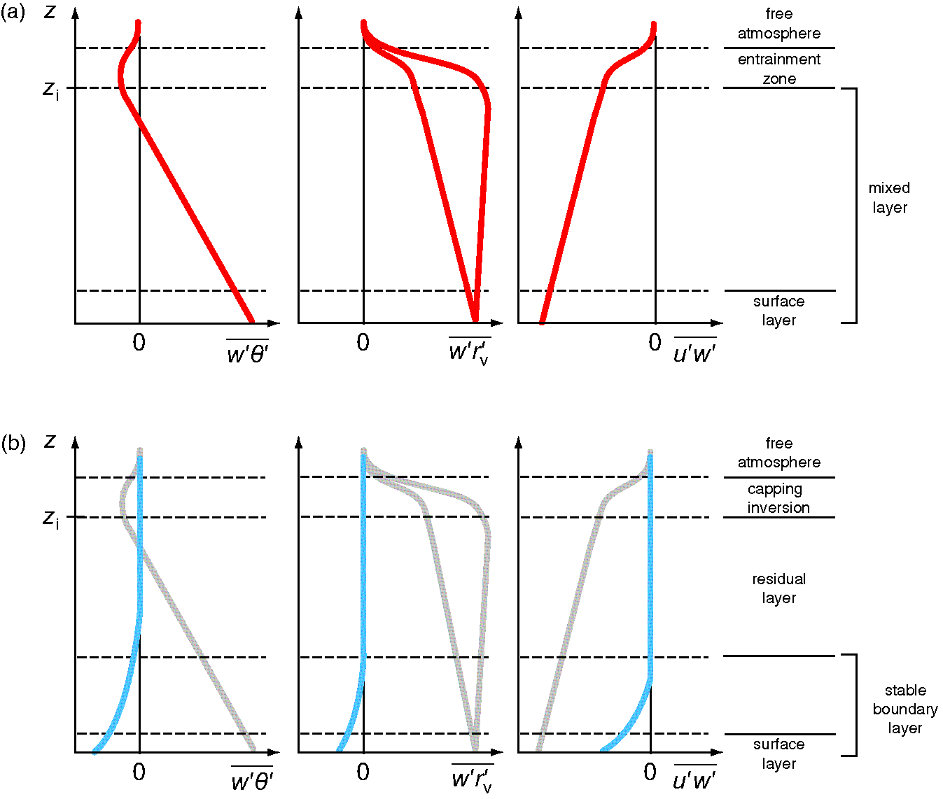
ATMS 316- Lake-effect Convection
Typical vertical profiles of vertical kinematic heat flux, moisture flux, and momentum flux during (a) daytime and (b) nighttime. Positive denotes upward flux, away from the surface. (Fig 4.2)

Slide 30
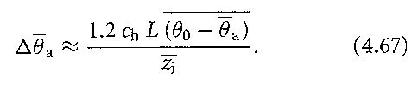


ATMS 316- Lake-effect Convection
Production and release of CAPE as primary driver
  Parameterized surface sensible heat flux
  (Eqtn 4.67 here)
where BB is the amount of warming for an air parcel at anemometer level averaged over the fetch, B is the bulk transfer coefficient for heat, L is the fetch, BB is the average lake-air mass temperature difference, and is the mean mixed layer depth.

Slide 31
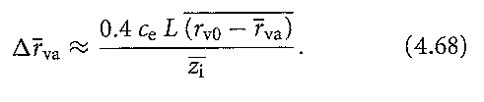


ATMS 316- Lake-effect Convection
Production and release of CAPE as primary driver
  Parameterized surface latent heat flux
  (Eqtn 4.68 here)
where BB is the amount of humidifying for an air parcel at anemometer level averaged over the fetch, is the bulk transfer coefficient for moisture, L is the fetch, is the average lake-air vapor mixing ratio difference, and B is the mean mixed layer depth.

Slide 32
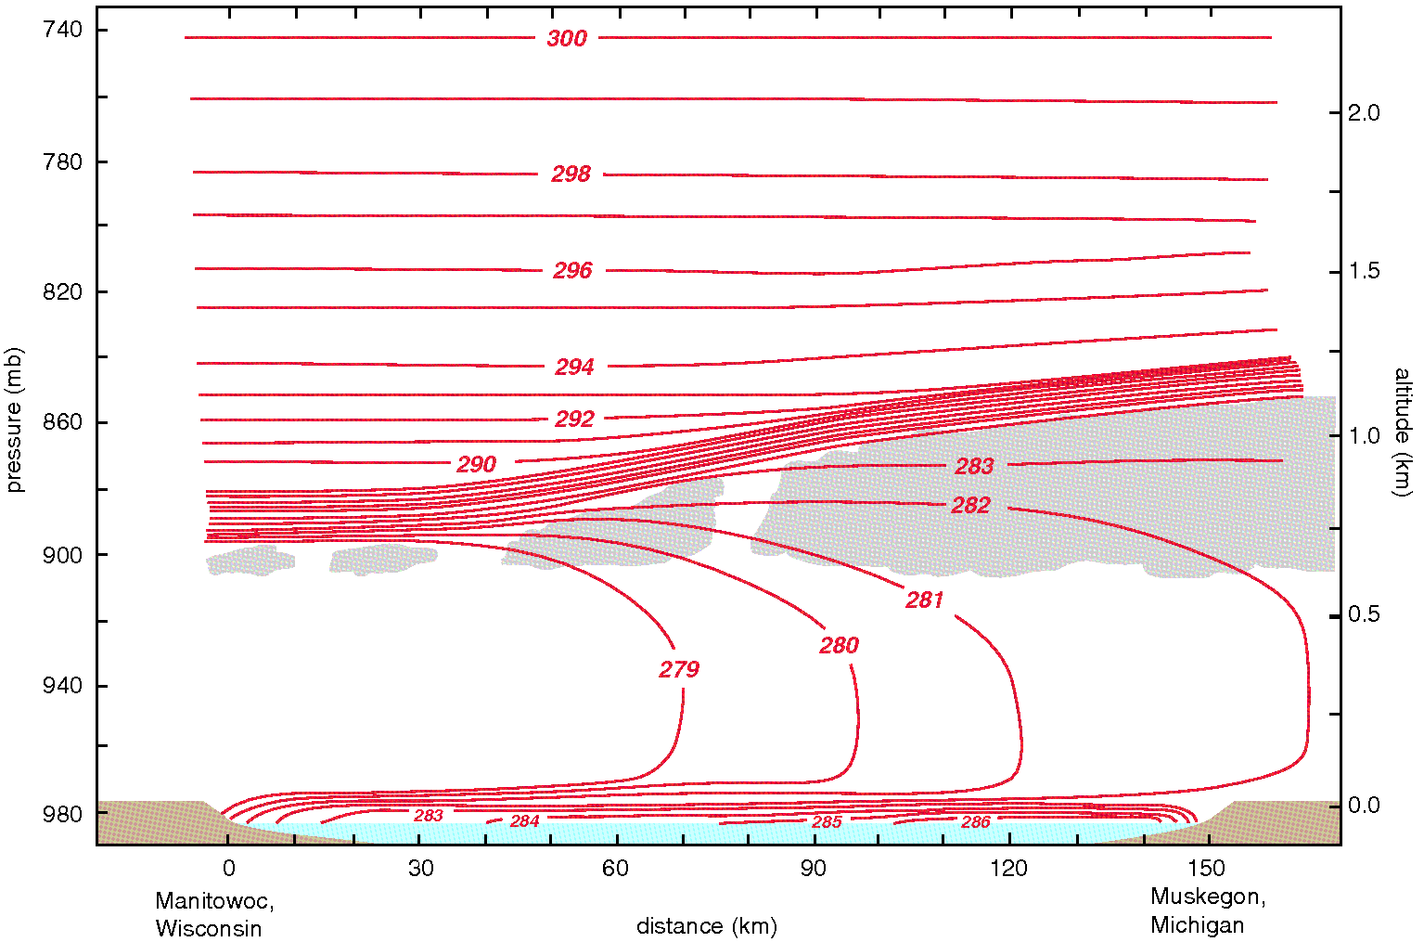
ATMS 316- Lake-effect Convection
Vertical cross section of potential temperature over Lake Michigan (Fig 4.21)

Slide 33
ATMS 316- Lake-effect Convection
Approximately 3 K of warming (west-to-east)
Superadiabatic temperature lapse rates just above the water surface
Deepening of the mixed layer (west-to-east) as a direct result of the BL modification

Slide 34
ATMS 316- Lake-effect Convection
Production and release of CAPE as primary driver
  Necessary condition; surface-to-850 hPa lapse rate becomes at least dry adiabatic
    850 hPa temperature should be at least 13 K lower than the water surface temperature (minimum threshold)

Slide 35
ATMS 316- Lake-effect Convection
Production and release of CAPE as primary driver
  Necessary condition; surface-to-850 hPa lapse rate becomes at least dry adiabatic
    The longer the fetch (distance cold air travels over the warm water surface), the greater the amount of time for surface fluxes to modify the cold air and sufficiently destabilize the lower atmosphere
fetch must be at least 75 km in length

Slide 36
ATMS 316- Lake-effect Convection
Evolution

Slide 37
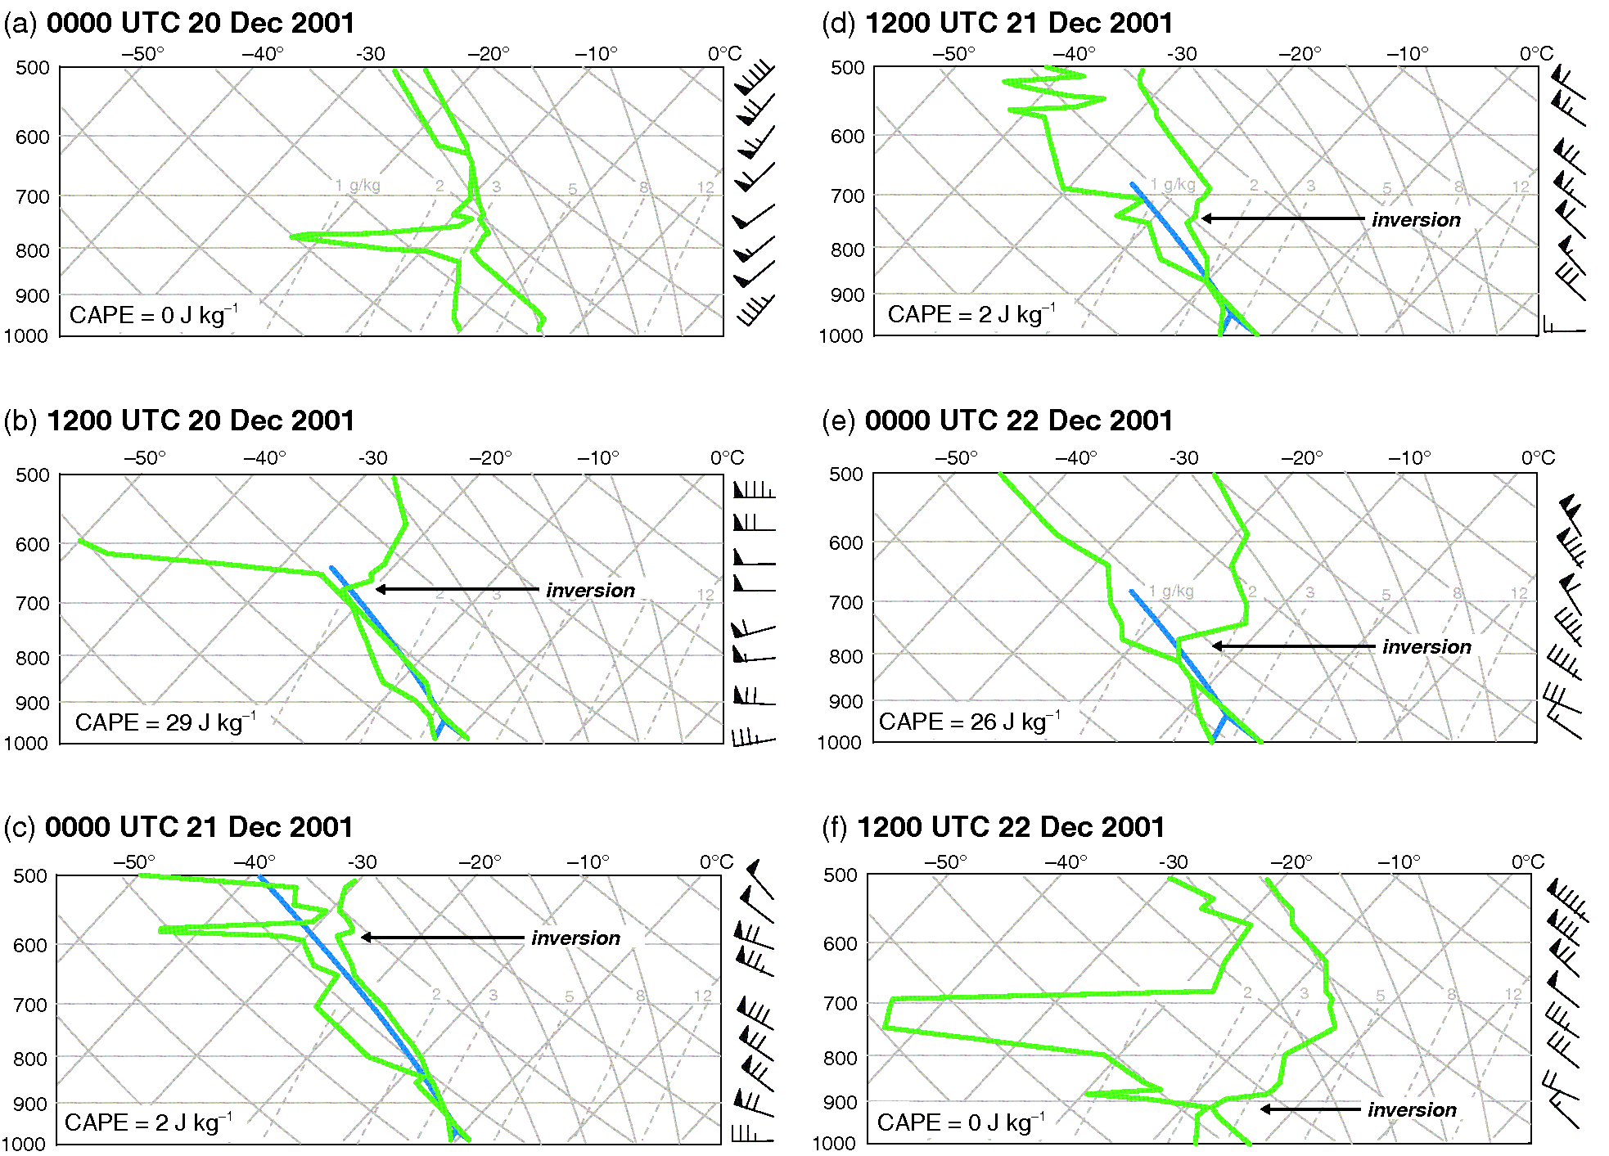
ATMS 316- Lake-effect Convection
Soundings from Buffalo, NY, obtained (a) before, (b) – (e) during, and (f) after a lake-effect snow event downwind of Lake Erie (Fig 4.22)

Slide 38
ATMS 316- Lake-effect Convection
EL no higher than 4-5 km (@ inversion)
destabilization of 1000-700 hPa layer (0000-1200 UTC 20 Dec)
rapid lowering of inversion (0000-1200 UTC 22 Dec) associated with the demise of the lake-effect convection [mid-level subsidence behind departing cold front]
Sounding location over land; superadiabatic lapse rates are likely evident over the lake, contributing to greater CAPE amounts (~ 200 J kg⁻¹)

Slide 39
ATMS 316- Lake-effect Convection
Other mesoscale dynamical processes

Slide 40
ATMS 316- Lake-effect Convection
Other mesoscale dynamical processes
  Thermally direct solenoid (see land breeze example)
    Magnitude of the horizontal air temperature gradient (baroclinity) determines the strength of the solenoid; a function of the degree of air mass modification→strength increases with increasing fetch

Slide 41
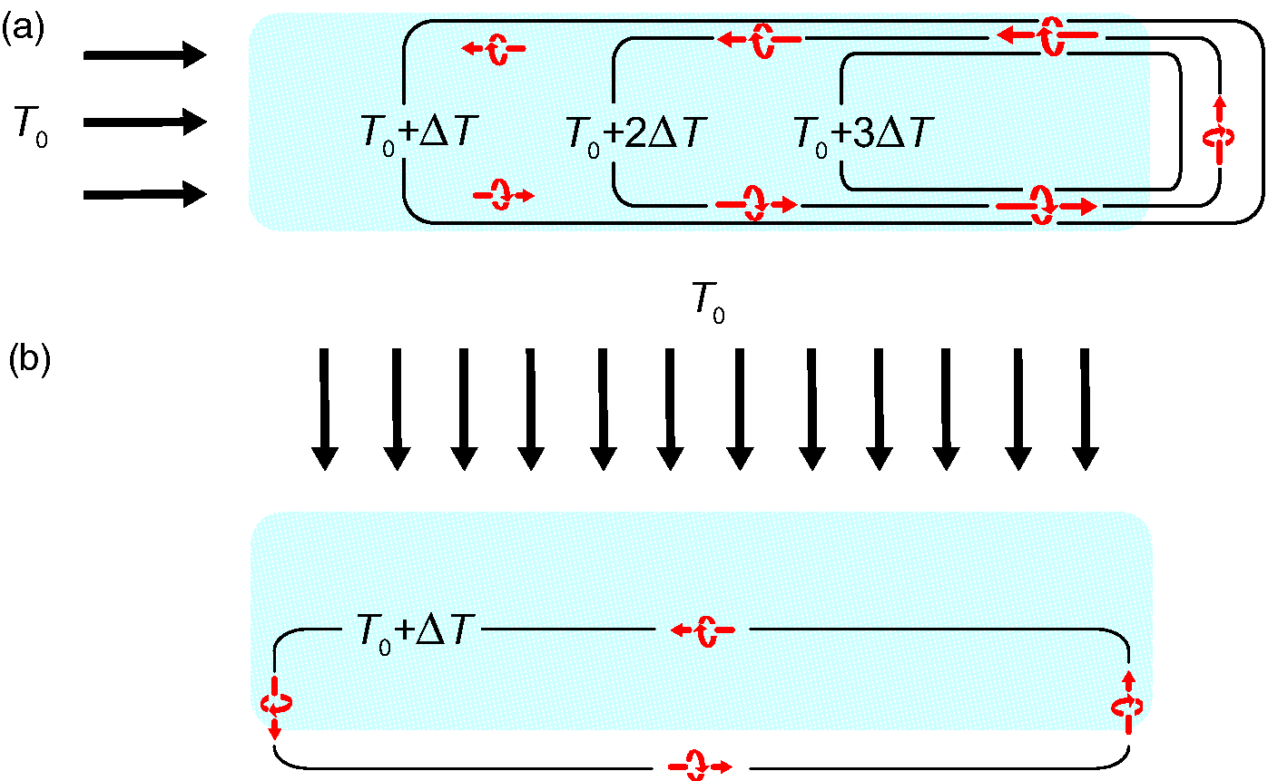
ATMS 316- Lake-effect Convection
Solenoidal circulations forced by the local horizontal temperature gradient for mean wind blowing along the (a) major or (b) minor lake axis (Fig 4.23)

Slide 42
ATMS 316- Lake-effect Convection
Other mesoscale dynamical processes
  Differential surface drag
    Larger cross-isobaric wind component over the rougher land surface

Slide 43
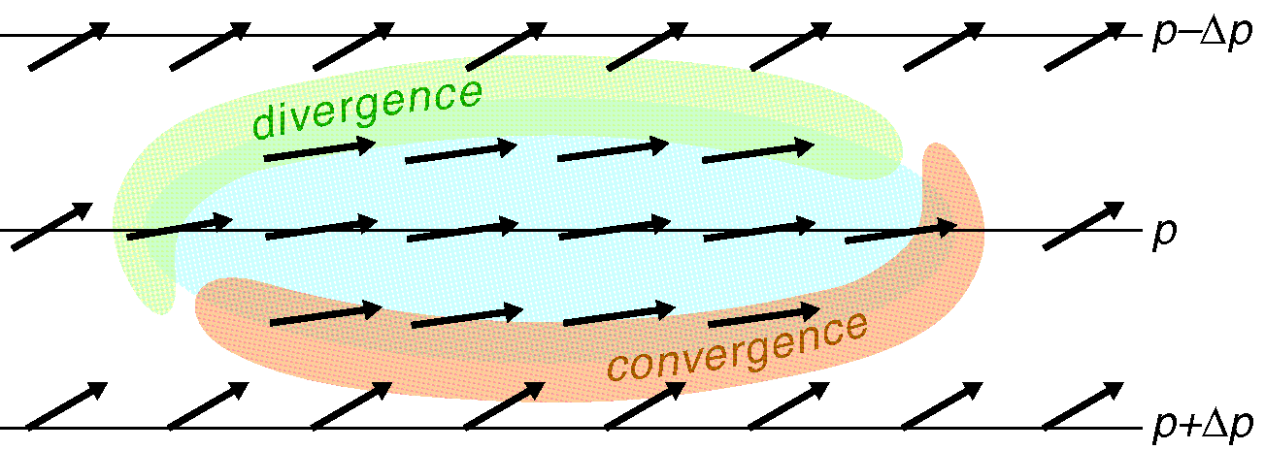
ATMS 316- Lake-effect Convection
Differential surface drag promotes mesoscale convergence and divergence (Fig 4.24)

Slide 44
ATMS 316- Lake-effect Convection
Other mesoscale dynamical processes
  Orographically forced ascent
  Large-scale cyclonic, geostrophic relative vorticity in the BL (Ekman pumping)
  Vigorous latent heat release (LHR) in convective clouds

Slide 45
ATMS 316- Lake-effect Convection
Morphology of lake-effect snowstorms

Slide 46
ATMS 316- Lake-effect Convection
Morphology of lake-effect snowstorms
  Four general types of lake effect snowstorms
    Broad area coverage
    Shoreline bands
    Midlake bands (shown at right)
    Mesoscale vortex

Slide 47
ATMS 316- Lake-effect Convection
Morphology of lake-effect snowstorms
  Organization of convection is strongly influenced by
    Wind speed
    Wind direction
    Vertical wind shear

Slide 48
ATMS 316- Lake-effect Convection
Morphology of lake-effect snowstorms
  Organization of convection is strongly influenced by
    Wind speed
      Strong; banding (most common)
      Weak; vortex
    Vertical wind speed shear
      Strong; banding (most common)
      Weak; cellular convection

Slide 49
ATMS 316- Lake-effect Convection
Morphology of lake-effect snowstorms
  Strong wind speed (7 - 15 m s⁻¹) and vertical speed shear
    Winds blow parallel to the major lake axis
      Single, intense band
      Heaviest precipitation events
      Maximize fetch, positive effect of the land-breeze circulation
Lake Ontario example →

Slide 50
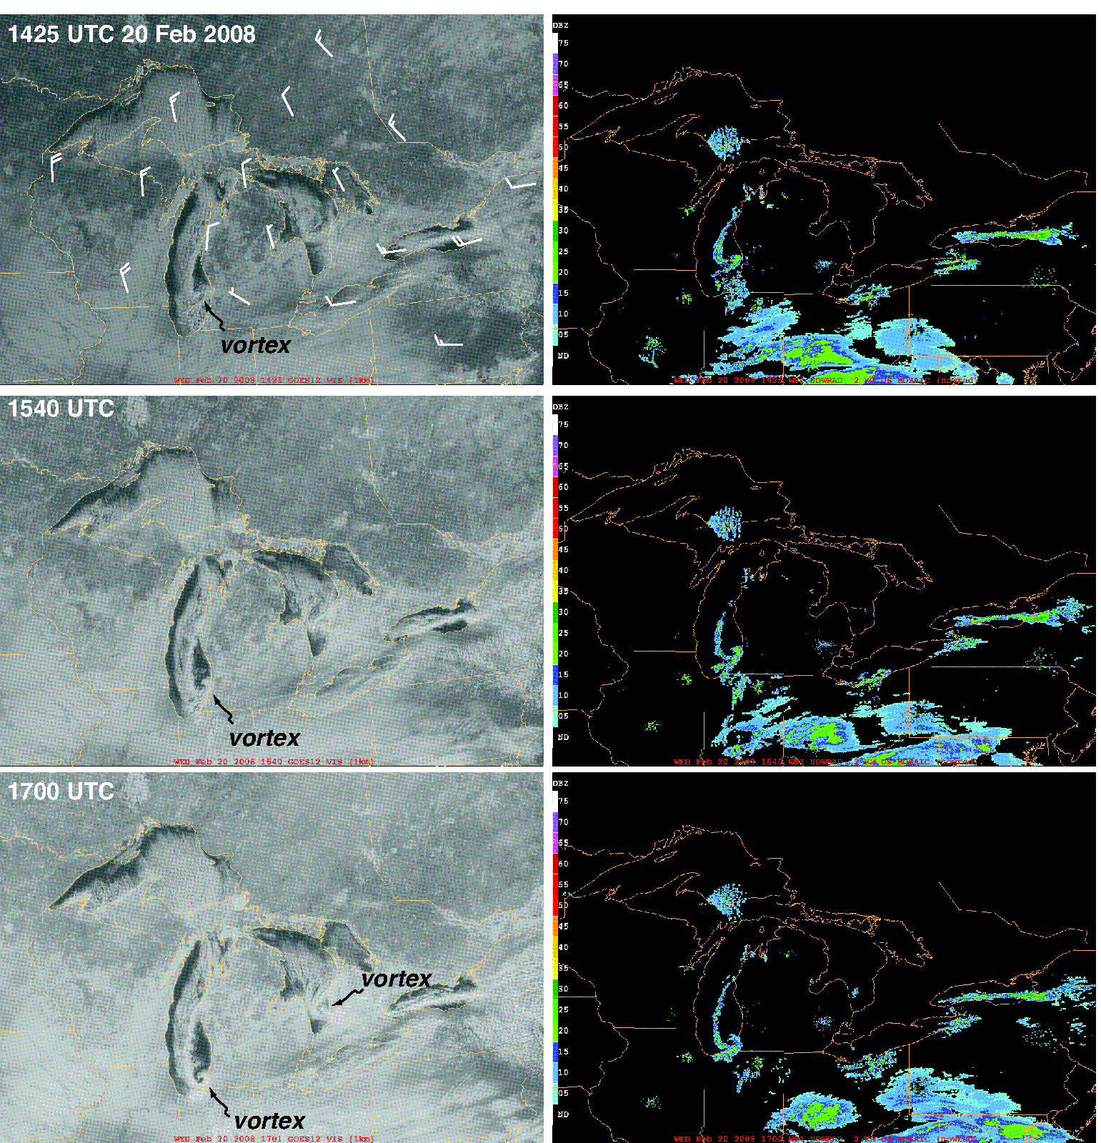
ATMS 316- Lake-effect Convection
Visible satellite and composite radar reflectivity imagery from a cold air outbreak over the Great Lakes region on 20 February 2008. Wind barbs (knots) at 925 hPa level from the 1200 UTC 20 February 2008 NAM analysis are overlaid on the 1425 UTC visible satellite image (Fig 4.25)

Slide 51
ATMS 316- Lake-effect Convection
Morphology of lake-effect snowstorms
  Strong wind speed (7 - 15 m s⁻¹) and vertical speed shear
    Winds blow parallel to the minor lake axis
      Multiple (HCR) banding
      Less intense precipitation events
      Minimal fetch, weaker solenoidal effects
      Broader areal coverage
Lake Superior example →

Slide 52
ATMS 316- Lake-effect Convection
Visible satellite and composite radar reflectivity imagery from a cold air outbreak over the Great Lakes region on 20 February 2008. Wind barbs (knots) at 925 hPa level from the 1200 UTC 20 February 2008 NAM analysis are overlaid on the 1425 UTC visible satellite image (Fig 4.25)

Slide 53
ATMS 316- Lake-effect Convection
Morphology of lake-effect snowstorms
  Weak wind speed (5 - 7 m s⁻¹) and vertical speed shear
    Winds blow parallel to the minor lake axis
      Shore-parallel banding near downwind shoreline
      Solenoidal circulation plays primary role in convection organization
      Precipitation remains fairly close to the shoreline
Lake Erie example →

Slide 54
ATMS 316- Lake-effect Convection
Visible satellite and composite radar reflectivity imagery from a cold air outbreak over the Great Lakes region on 20 February 2008. Wind barbs (knots) at 925 hPa level from the 1200 UTC 20 February 2008 NAM analysis are overlaid on the 1425 UTC visible satellite image (Fig 4.25)

Slide 55
ATMS 316- Lake-effect Convection
Morphology of lake-effect snowstorms
  Very weak wind speed ( < 5 m s⁻¹) and vertical speed shear
    Unlikely precipitation inland
    Mesoscale vortices
      Low-level convergence over lake
      Vortex stretching → cloud swirls
      Favored near curved shoreline
    Cellular convection
Lake Michigan example →

Slide 56
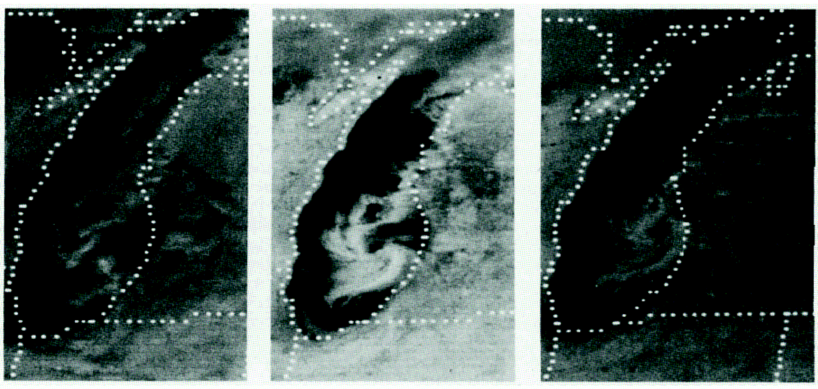
ATMS 316- Lake-effect Convection
Evolution of a lake vortex on 8 January 1981 over Lake Michigan at 1600 UTC (left), 1800 UTC (center), and 2000 UTC (right, Fig 4.26)

Slide 57
ATMS 316- Lake-effect Convection
  Examples from paper by Mark R. Hjelmfelt found in Monthly Weather Review, January 1990
Examples

Slide 58
ATMS 316- Lake-effect Convection
Morphology of lake-effect snowstorms
  Substantial vertical wind direction shear (> 30º over depth of BL)
    Adversely affects convection organization
      Banding less discernible
      Light precipitation accumulations over a broad region

Slide 59
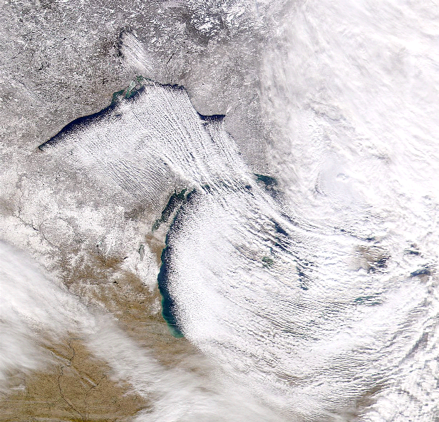
ATMS 316- Lake-effect Convection
Which scenario?
  Scenario#1; synoptic scale forcing alone
  Scenario#2; synoptic scale dominates mesoscale forcing
  Scenario#3; weak synoptic scale forcing
5 December 2000
Lake-effect snowstorm
http://antwrp.gsfc.nasa.gov/apod/image/0412/lakeeffect_seawifs_big.jpg

