Slide 1
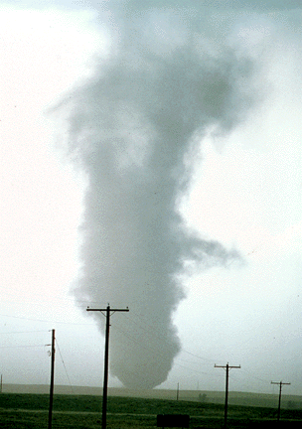
ATMS 316- Mesoscale Meteorology
Packet#11
Interesting things happen at the boundaries, or at the interface…
  Warm air, cold air
  Humid air, dry air
http://www.ucar.edu/communications/factsheets/Tornadoes.html

Slide 2
ATMS 316- Mesoscale Meteorology
http://www.meted.ucar.edu/mesoprim/shear/
Outline
  Background
  Isolated Convection

Slide 3

ATMS 316- Background
A starting point
  Convection organization; isolated (isolated updraft) or isolated updrafts merge to produce one large outflow
  Convective mode determines hazardous weather threat
  Mode is often easier to predict than whether, when, and where convective storms will be initiated
  Models quite useful for mode predictions
http://radarmet.atmos.colostate.edu/toga_coare/

Slide 4
ATMS 316- Isolated Convection
Chapter 8, p. 201 - 224
  Role of vertical wind shear
  Single-cell convection
  Multicellular convection
  Supercell convection
    Definition of a supercell and characteristics of supercell environments
    Structure of supercells
http://radarmet.atmos.colostate.edu/toga_coare/

Slide 5
ATMS 316- Isolated Convection
Role of vertical wind shear
  Organization affected by
    Vertical wind shear, CAPE, RH, and their vertical distribution
  Vertical wind shear exerts greatest influence on storm type
    Promotes storm organization and longevity
    Can be detrimental under certain conditions
  Quantifying vertical wind shear
    0-6 km vector wind difference; 0-6 km shear
http://radarmet.atmos.colostate.edu/toga_coare/
Notes:
5

Slide 6
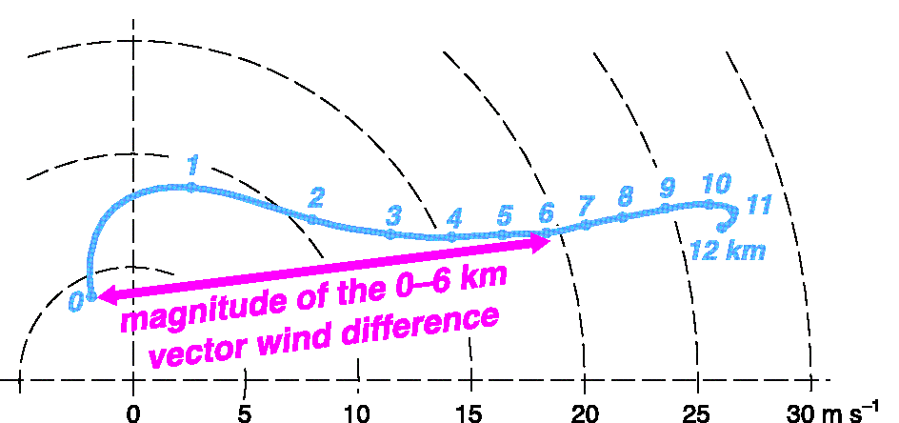
ATMS 316- Isolated Convection
Hodograph and 0-6 km shear. “0” is level of lowest wind measurement; typically a few meters above the ground* (Fig 8.1)
*small-scale hodograph details do not appear to be critical for anticipating storm type

Slide 7

ATMS 316- Isolated Convection
Role of vertical wind shear
  categorizing 0-6 km shear
    less than 10 m s⁻¹; weak shear
    between 10-20 m s⁻¹; moderate
    greater than 20 m s⁻¹ ; strong
  Bulk Richardson number (BRN) combines shear and CAPE
    Eq (8.1) here
    U is the magnitude of the vector difference between the 0-6 km mean wind and the 0-500 m mean wind
http://radarmet.atmos.colostate.edu/toga_coare/
Notes:
7

Slide 8
ATMS 316- Isolated Convection
Role of vertical wind shear
  CAPE
    measure of potential updraft strength*
    proxy for strength of outflow produced by evaporation, melting, and sublimation of hydrometeors within a storm (larger CAPE, stronger cold pools; to be discussed in Chapter 10)
  U a measure of 0-500 m storm-relative wind
    ½ U² storm-relative inflow KE
  BRN- balance between inflow & outflow
*updraft speed α CAPE ^{1/2}
http://radarmet.atmos.colostate.edu/toga_coare/
Notes:
8

Slide 9
ATMS 316- Isolated Convection
Role of vertical wind shear
  BRN
    Small (< 50); inflow and outflow well matched; longer-lived, more severe storms
      updrafts could develop significant rotation*
    Large (> 50); outflow might overwhelm inflow and undercut the updraft; short-lived cells
      *high inflow KE measures the ability of an updraft to acquire rotation via tilting of horizontal vorticity
http://radarmet.atmos.colostate.edu/toga_coare/
Notes:
9

Slide 10
ATMS 316- Isolated Convection
Role of vertical wind shear
  Why the influence of vertical wind shear?
    A measure of the degree to which precip and outflow interfere with the updraft
    Related to the lifting of environmental air at the gust front (dynamic vertical pressure gradients)
http://radarmet.atmos.colostate.edu/toga_coare/
Notes:
10

Slide 11
ATMS 316- Isolated Convection
Role of vertical wind shear
  A measure of the degree to which precip and outflow interfere with the updraft
    Tendency for the distance precipitation falls from its parent updraft to increase with increasing deep-layer shear and upper-level storm-relative winds
    Strong-shear environments have strong storm-relative winds (Fig. 8.2)…
http://radarmet.atmos.colostate.edu/toga_coare/
Notes:
11

Slide 12
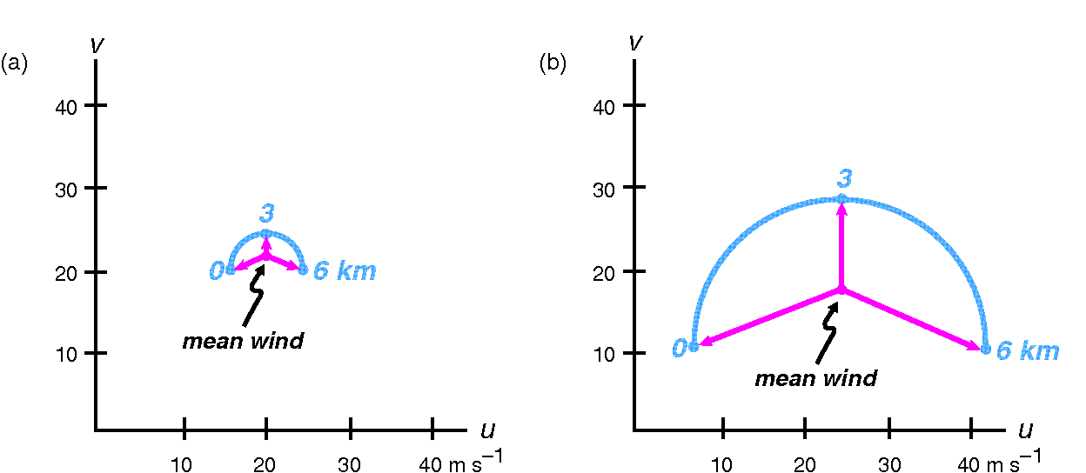
ATMS 316- Isolated Convection
V_{r}
Vertical wind shear and storm-relative winds (a) weak shear and (b) strong shear hodographs. Storm-relative winds plotted in magenta (Fig 8.2)
V
C
V = V_{r} + C
C
Notes:
12

Slide 13
ATMS 316- Isolated Convection
Role of vertical wind shear
  A measure of the degree to which precip and outflow interfere with the updraft
    Tendency for the distance precipitation falls from its parent updraft to increase with increasing deep-layer shear and upper-level storm-relative winds
    Strong-shear environments have strong storm-relative winds at low levels limit tendency for rain-cooled outflow to undercut the updraft
http://radarmet.atmos.colostate.edu/toga_coare/
Notes:
13

Slide 14
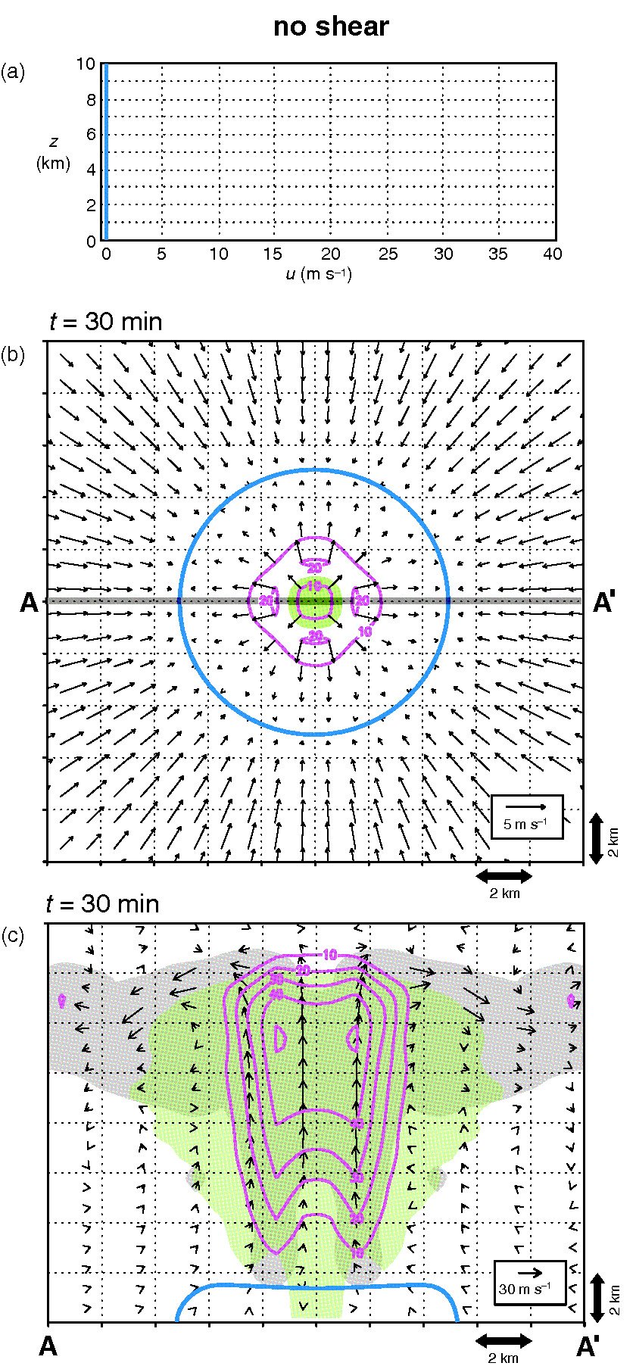
ATMS 316- Isolated Convection
Model simulations of convection (a) vertical u-component profile, (b) winds at 0.2 km, vertical velocity at 4.2 km, rainwater concentration {shaded}, and gust front {blue contour}, and (c) cloud water {grey}, large hydrometeors {green}, vertical velocity {magenta contours}, and storm-relative winds {arrows} (Fig 8.3)
Notes:
14

Slide 15
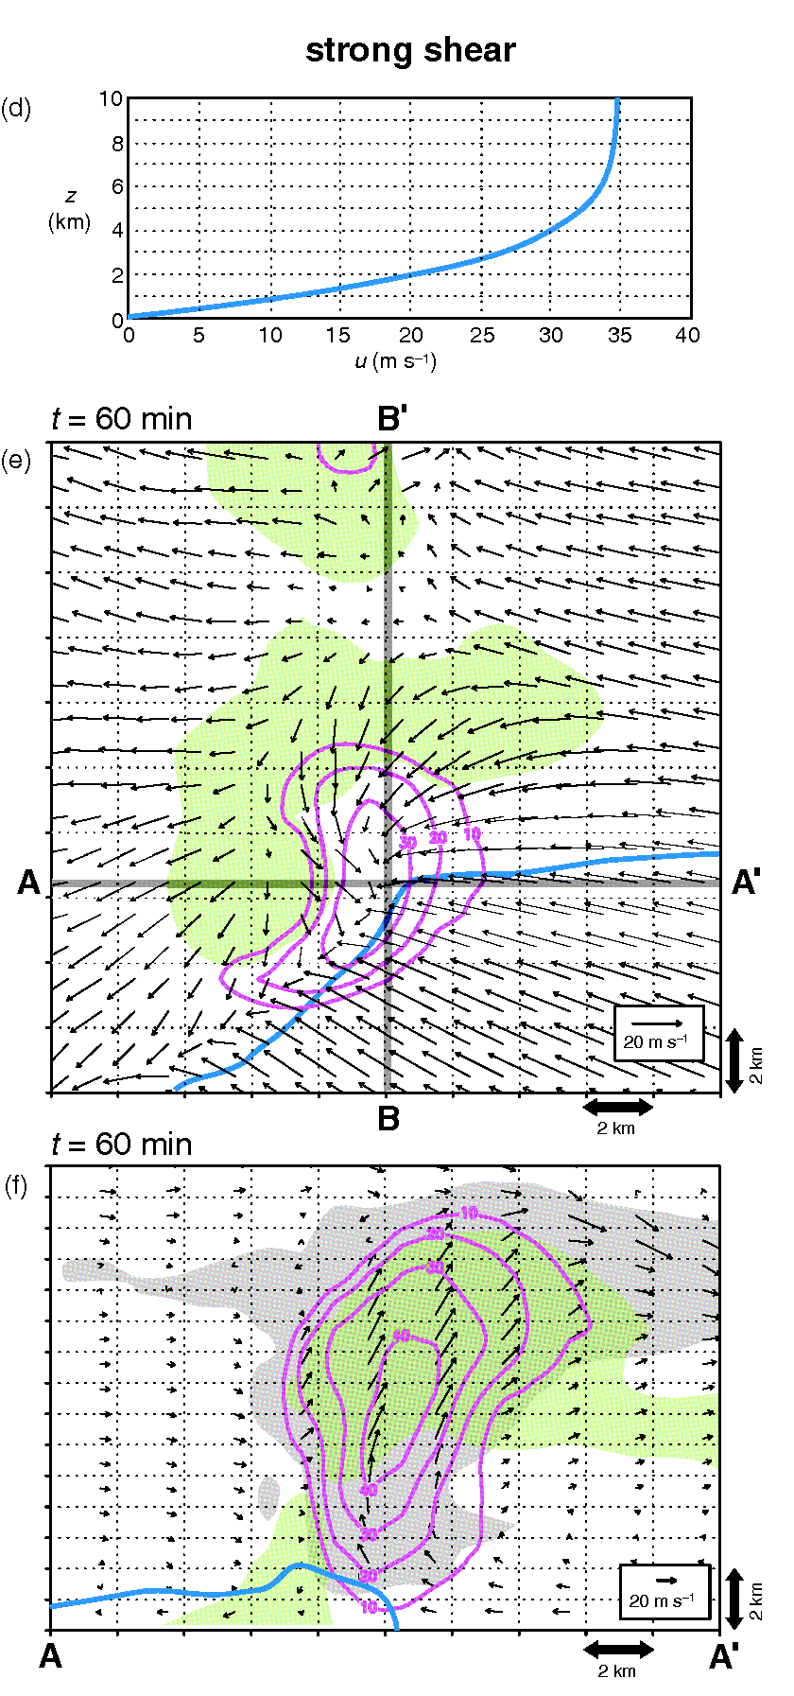
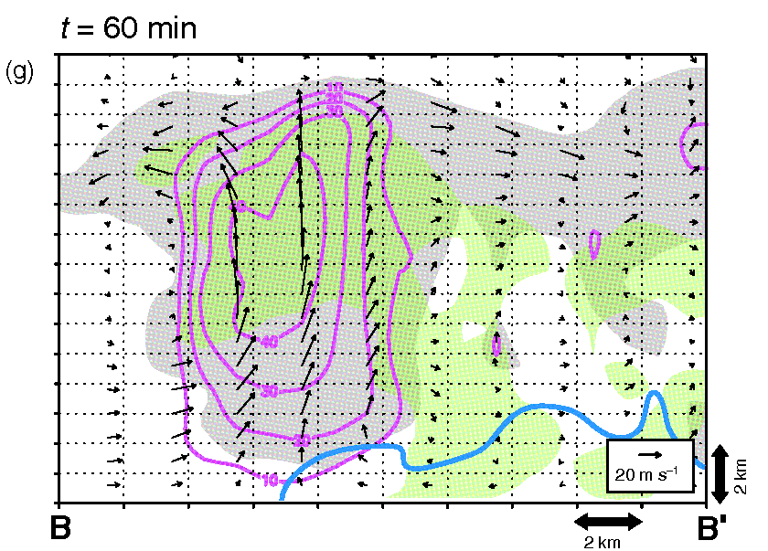
ATMS 316- Isolated Convection
Model simulations of convection (a) vertical u-component profile, (b) winds at 0.2 km, vertical velocity at 4.2 km, rainwater concentration {shaded}, and gust front {blue contour}, and (c) cloud water {grey}, large hydrometeors {green}, vertical velocity {magenta contours}, and storm-relative winds {arrows} (Fig 8.3)
Notes:
15

Slide 16
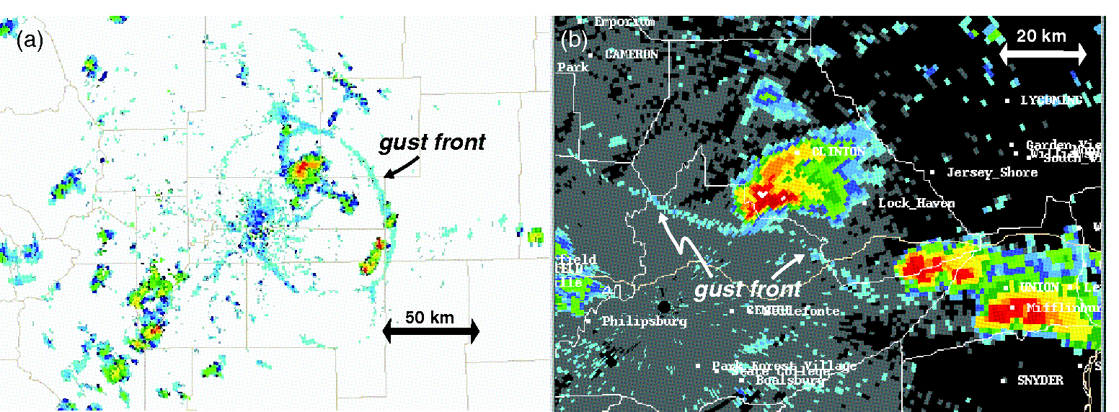
ATMS 316- Isolated Convection
Radar reflectivity comparison of gust fronts associated with convection in (a) weak and (b) strong shear environments. Gust front moves well beyond radar echo in weak shear (a), is closely attached to echo in strong shear (b) (Fig 8.4)
Notes:
16

Slide 17
ATMS 316- Isolated Convection
Role of vertical wind shear
  Related to the lifting of environmental air at the gust front (dynamic vertical pressure gradients)
    Weak vws; lifting by gust front weak, new cells generally fail to be initiated (single-cell convection)
    Moderate vws; lifting along gust front enhanced (downshear flank), repeated triggering of new cells (multicell convection)
http://radarmet.atmos.colostate.edu/toga_coare/
Notes:
17

Slide 18
ATMS 316- Isolated Convection
Role of vertical wind shear
  Related to the lifting of environmental air at the gust front (dynamic vertical pressure gradients)
    Strong vws; lifting enhanced at altitudes high above the gust front, propagation driven by deep-layer vertical pressure gradient forces independent of the gust front (supercell convection)
http://radarmet.atmos.colostate.edu/toga_coare/
Notes:
18

Slide 19
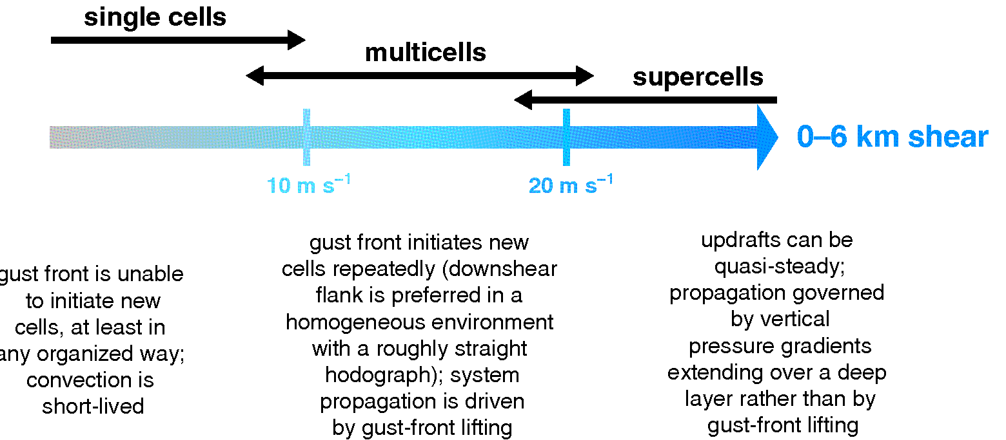
ATMS 316- Isolated Convection
Spectrum of storm types as a function of vertical wind shear (Fig 8.5)
Notes:
19

Slide 20
ATMS 316- Isolated Convection
Role of vertical wind shear
  Updraft tilt is sometimes promoted as important for storm organization and longevity (e.g., ATMS 103 textbook); greater tilt → greater longevity
    Strong vertical wind shear can promote more upright (zero tilt) updrafts in very vigorous convection
    Not a good predictor of storm longevity (or severity)
!!! Ability of the gust front or midlevel updraft to lift air to the LFC is what matters !!!
http://radarmet.atmos.colostate.edu/toga_coare/
Notes:
20

Slide 21
ATMS 316- Isolated Convection
Transition
  Much understanding comes from the idealized world of numerical simulations (e.g., horizontally homogeneous and time invariant environments)
  Reality;
    spatial inhomogeneities in the environment can lead to profound changes in convective storm morphology and behavior
    time variant; supercell to multicell mode changes observed
http://radarmet.atmos.colostate.edu/toga_coare/
Notes:
21

Slide 22
ATMS 316- Isolated Convection
Single-cell convection
  DMC consisting of a single updraft that does not initiate subsequent convection
    Lifting along gust front is weak
    Weak shear environment
    Difficult for the gust front to trigger new cells
  Often initiated by colliding outflows from individual single cells
http://radarmet.atmos.colostate.edu/toga_coare/
Notes:
22

Slide 23
ATMS 316- Isolated Convection
Single-cell convection
  Weak synoptic-scale forcings, dominated by diurnal cycle of the BL, tends to
    occur near and shortly after the time of maximum daytime heating
    dissipate quickly after sunset
  Severe weather (hail or wind gusts); pulse variety- short lived and marginal (difficult to issue warnings for)
    usually high CAPE (> 2000 J kg⁻¹) environments
http://radarmet.atmos.colostate.edu/toga_coare/
Notes:
23

Slide 24
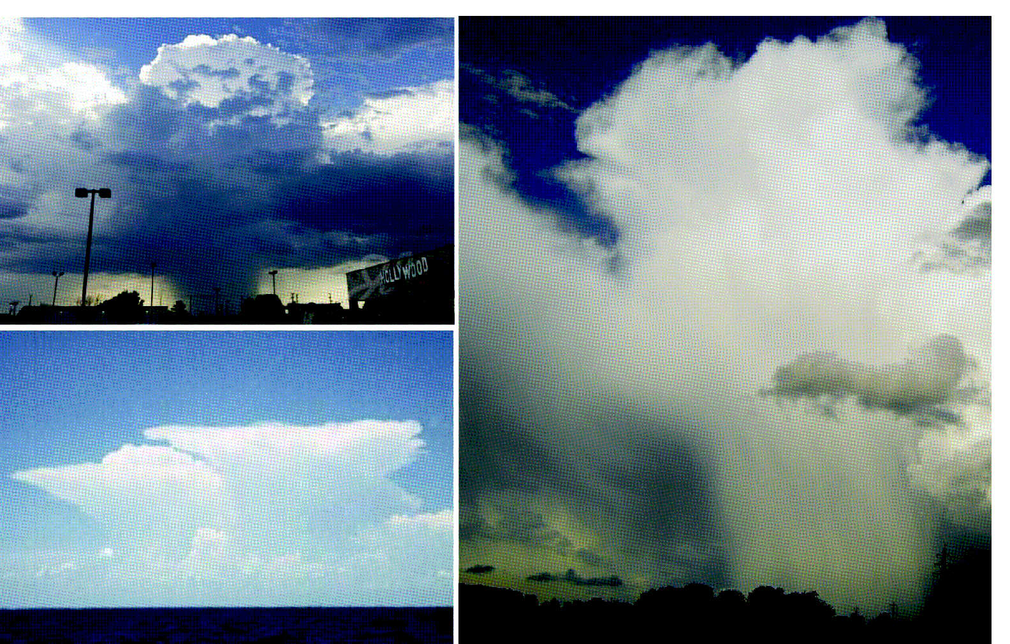
ATMS 316- Isolated Convection
Photographs of DMC in environments containing weak vertical wind shear (Fig 8.6)
Notes:
24

Slide 25
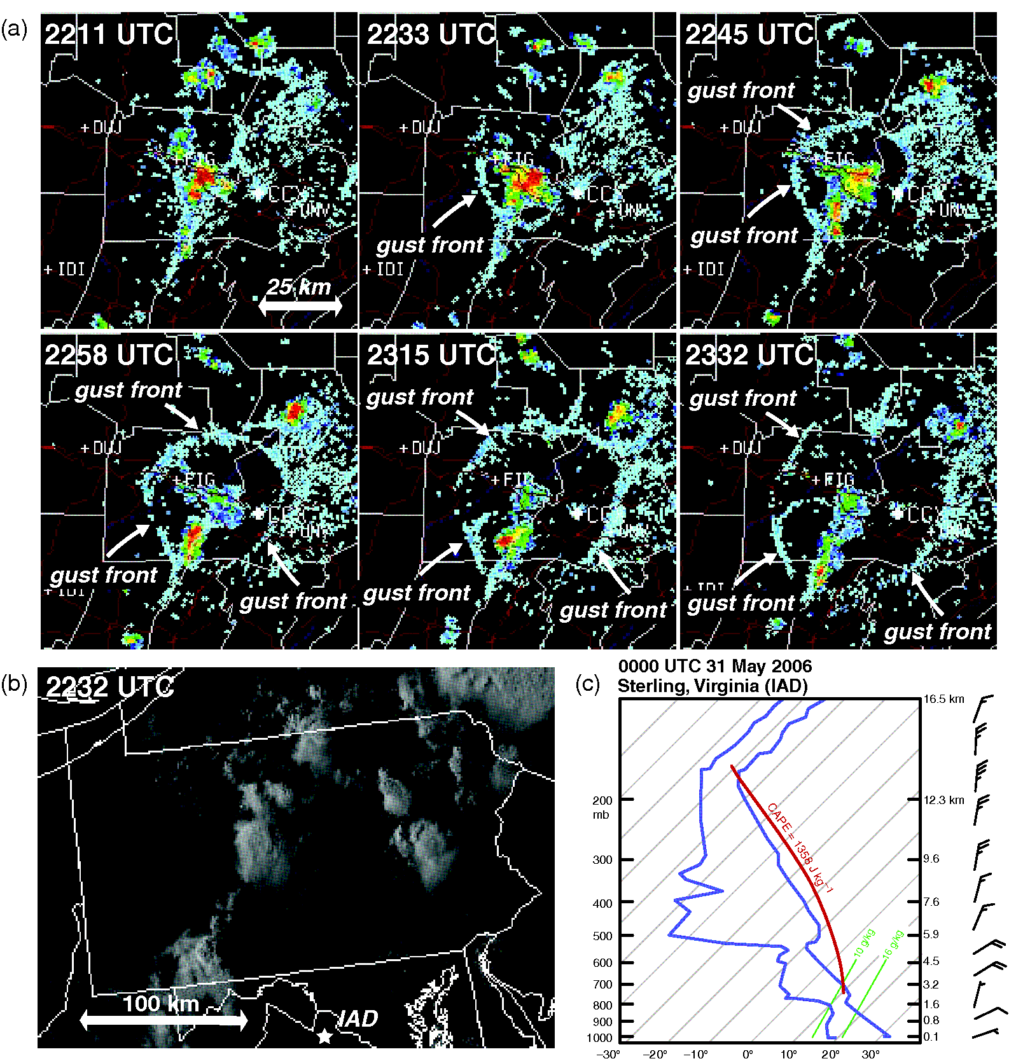
ATMS 316- Isolated Convection
Single-celled (disorganized) convection of 30 May 2006 (Fig 8.7)
Notes:
25

Slide 26
ATMS 316- Isolated Convection
Single-cell convection
  Updraft driven virtually solely by buoyancy (supercell updraft driven by both buoyancy + dynamic vertical pressure gradient forces)
  Lifetime a function of depth of convection, average updraft speed, time for precipitation to fall to the ground (see Eq. (8.2))
    ~ 30-60 minutes
http://radarmet.atmos.colostate.edu/toga_coare/
Notes:
26

Slide 27
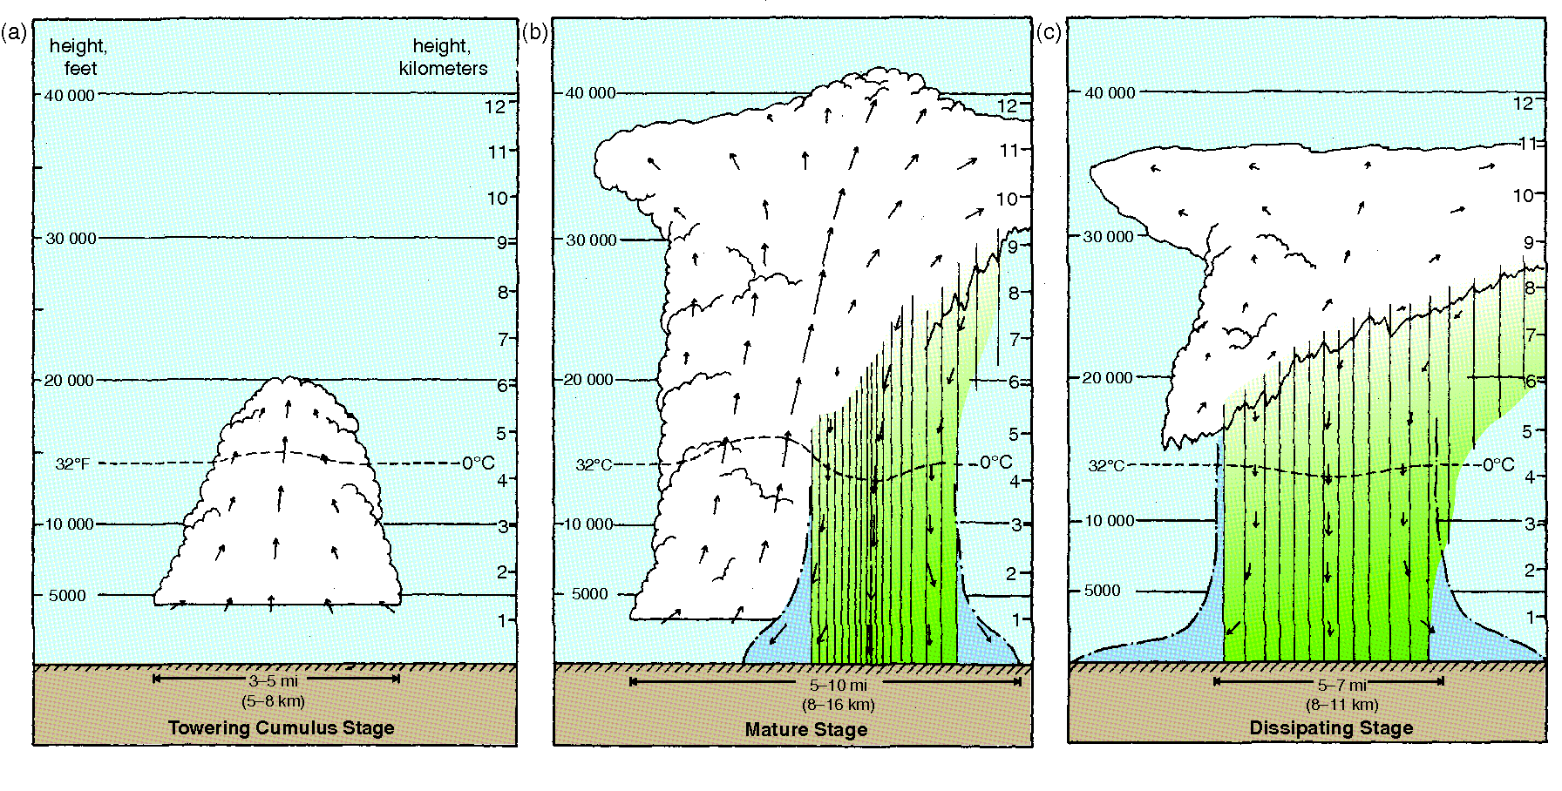
ATMS 316- Isolated Convection
Three stages of an ordinary (single) cell (Fig 8.8)
Notes:
27

Slide 28
ATMS 316- Isolated Convection
Single-cell convection
  Towering cumulus stage; only an updraft exists
  Mature stage; commences with production of precipitation
    Hydrometeor loading reduces updraft buoyancy
      Downdraft and gust front form
  Dissipating stage; downdraft completely dominates the cell
    Rain-cooled air spreads far from the updraft, which is cut off from potentially buoyant inflow and cannot be maintained
severe wx here (if at all)
→ “Orphan Anvil” (the musical)
Notes:
28

Slide 29
ATMS 316- Isolated Convection
Multicellular convection
  Most common form of convection in the midlatitudes
  Characterized by the repeated development of new cells along the gust front
    Sufficient lift to raise parcels to the LFC
    Individual cells persist for 30-60 min, multicellular convection can last for hours
http://radarmet.atmos.colostate.edu/toga_coare/
Notes:
29

Slide 30
ATMS 316- Isolated Convection
Multicellular convection
  Organization
    Meso-β-scale clusters of cells (Figs. 8.9 and 8.10)
    Meso-α-scale convective systems; nearly unbroken lines
http://radarmet.atmos.colostate.edu/toga_coare/
Notes:
30

Slide 31
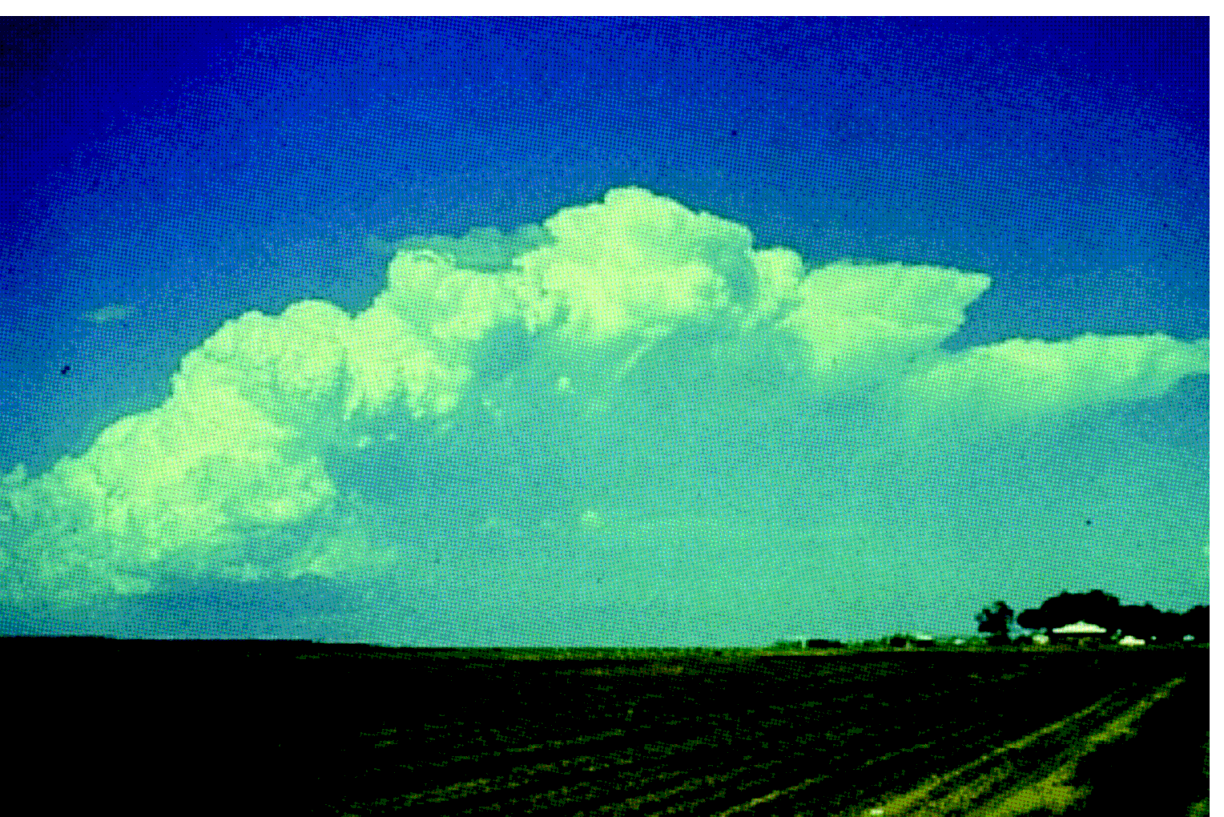
ATMS 316- Isolated Convection
Multicellular thunderstorm cluster. New updrafts being forced on the left, old dissipating updrafts shown on the right (Fig 8.9)
Notes:
31

Slide 32
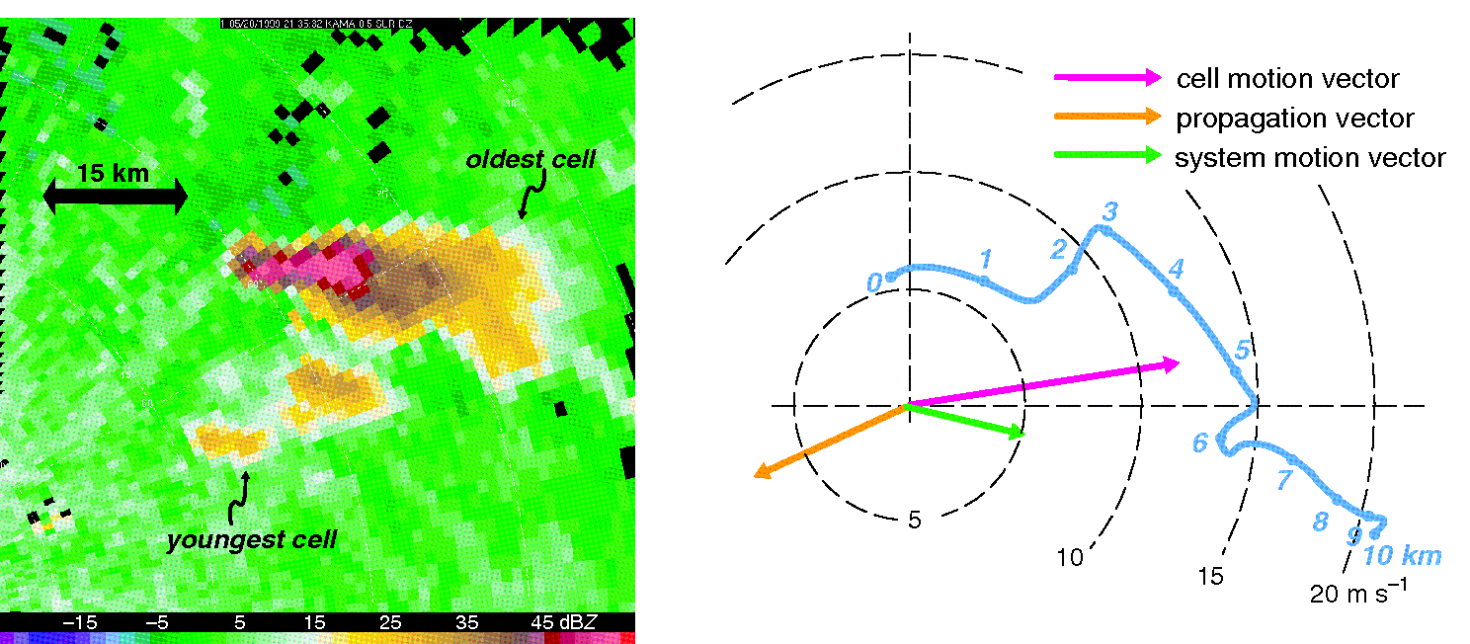
ATMS 316- Isolated Convection
Multicellular convection on 20 May 1999 as seen by the Amarillo, TX WSR-88D (a) and hodograph from a wind profiler located 100 km east of the convection. Southwestward propagation was not in the direction of the low-level shear (toward the east), the result of environmental inhomogeneity (Fig 8.10)
Notes:
32

Slide 33
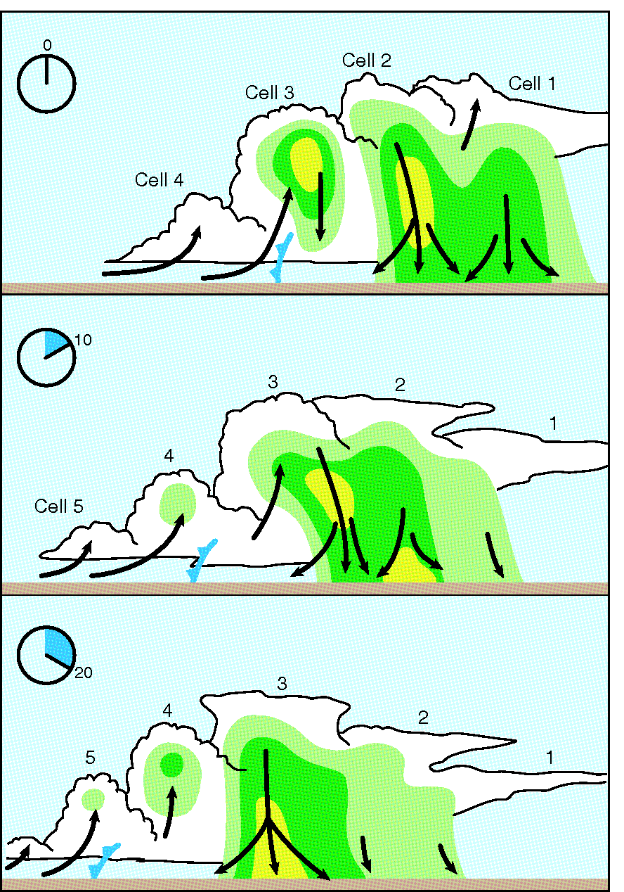
ATMS 316- Isolated Convection
Multicellular convection
  Environments
    Moderate vertical wind shear (10-20 m s⁻¹ range)
    CAPE small or large
Schematic of the evolution of multicellular convection (Fig 8.11)
Notes:
33

Slide 34
ATMS 316- Isolated Convection
Multicellular convection
  Top panel
    Cell 1; dissipating
    Cell 2; mature
    Cell 3; nearly mature
    Cell 4; not yet reached EL
Schematic of the evolution of multicellular convection (Fig 8.11)
updraft strength ~ altitude of first radar echo
Notes:
34

Slide 35
ATMS 316- Isolated Convection
Multicellular convection
  Middle panel (10 min. later)
    Cell 2; beginning to dissipate
    Cell 1; nearly completely dissipated
    Cell 3; passed through EL and is decelerating (forming an anvil)
    Cell 4; continuing to develop
    Cell 5; just initiated
Schematic of the evolution of multicellular convection (Fig 8.11)
updraft strength ~ altitude of first radar echo
Notes:
35

Slide 36
ATMS 316- Isolated Convection
Multicellular convection
  Bottom panel (20 min. later)
    Cell 1 & 2; nearly completely dissipated
    Cell 3; beginning to dissipate (dominated by downdrafts)
    Cell 4; nearing EL and maturity
    Cell 5; first echo, continues to grow
Schematic of the evolution of multicellular convection (Fig 8.11)
updraft strength ~ altitude of first radar echo
Notes:
36

Slide 37
ATMS 316- Isolated Convection
Multicellular convection
  (i) Individual ordinary cells tend to move with the velocity of the mean wind averaged over their depth
  (ii) Repeated cell development on preferred flank
  (i) and (ii); propagation of multicell system that can be slower or faster than mean wind and in a different direction (Fig. 8.10b)
Schematic of the evolution of multicellular convection (Fig 8.11)
Notes:
37

Slide 38
ATMS 316- Isolated Convection
Multicellular convection
  Movement of multicell system
    Sum of individual cell movement and propagation
  Individual cell movement
    Results from the advection of cells by the mean wind over the depth of the cell
cell motion
from Fig 8.10b…
movement of system
propagation
Notes:
38

Slide 39
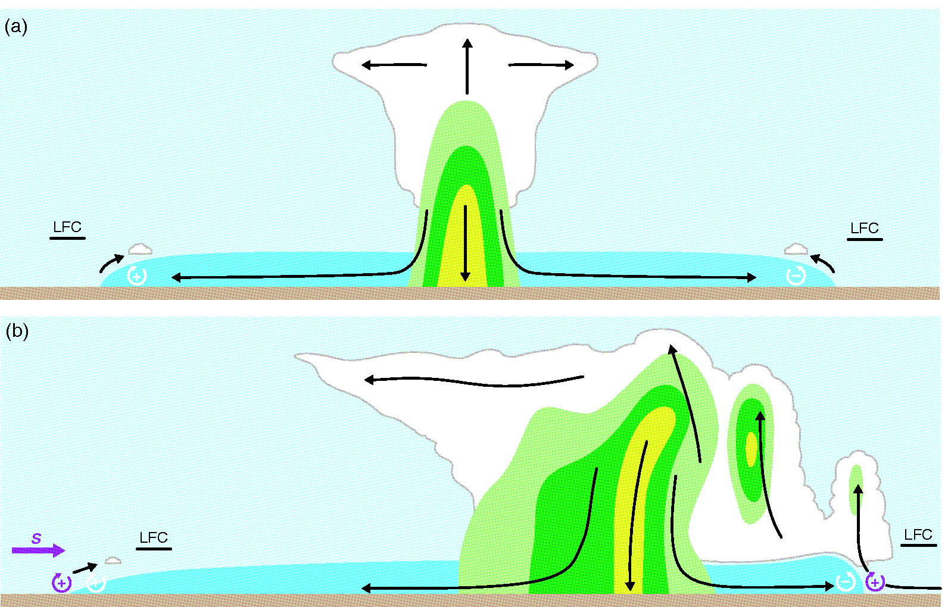
ATMS 316- Isolated Convection
Comparison of lifting by the gust front in (a) no-shear, single-cell environment and (b) a moderate-shear, multicell environment (shear is westerly) (Fig 8.12)
Notes:
39

Slide 40
ATMS 316- Isolated Convection
Multicellular convection
  Lifting tends to be deepest along the portion of the gust front where the environmental and outflow-induced horizontal vorticity cancel most
    enhanced (suppressed) on the downshear (upshear) flank of the outflow
Notes:
40

Slide 41
ATMS 316- Isolated Convection
Multicellular convection
  Initiation of new cells
    Vertical motion along a gust front is also influenced by the strength of the storm-relative headwind encountered by the gust front
      Straight hodograph → strongest headwinds at downshear flank
      Curved hodograph (Fig. 8.13)…
Notes:
41

Slide 42
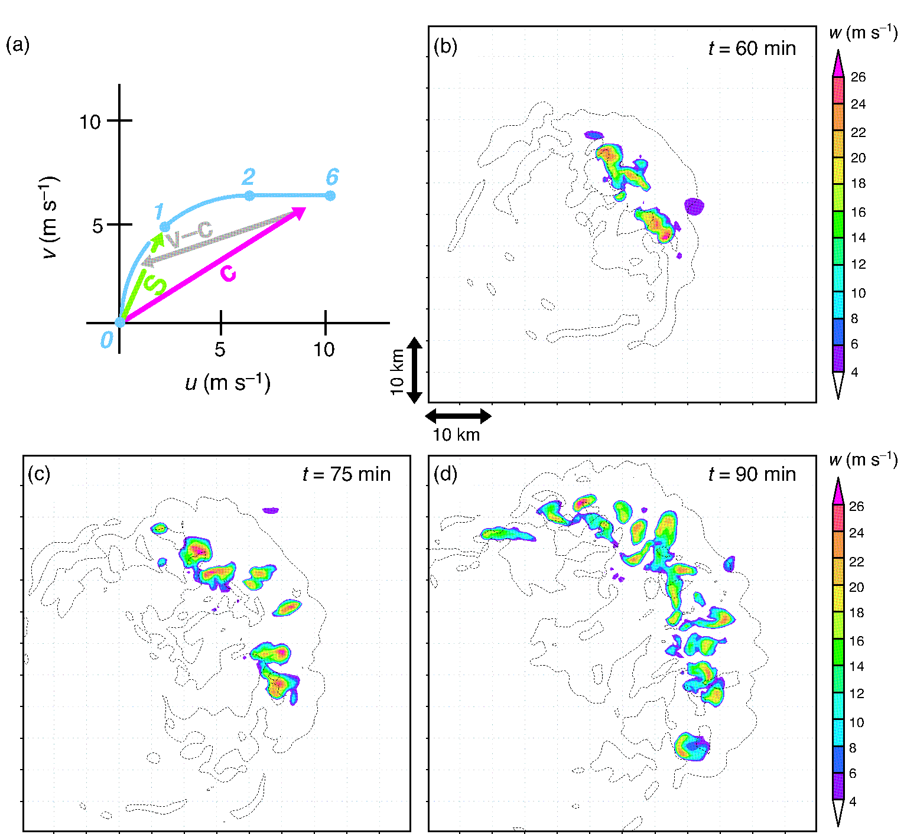
ATMS 316- Isolated Convection
Simulation of multicellular convection in which the hodograph is curved, cell motion (c), mean 0-1 km s-r wind (v-c), 0-1 km vector wind difference (S) (Fig 8.13)
Notes:
42

Slide 43
ATMS 316- Isolated Convection
Multicellular convection
  Initiation of new cells
    Vertical motion along a gust front is also influenced by the strength of the storm-relative headwind encountered by the gust front
      Straight hodograph → strongest headwinds at downshear flank
      Curved hodograph (Fig. 8.13) strongest headwind may not be on the downshear flank of the gust front
        shear (S) points toward NE, mean low-level env. storm-relative wind (v-c) points toward W/SW
        New cells develop along the gust front in an arc extending from the flank to the N and to the E, overall propagation toward the NE
Notes:
43

Slide 44
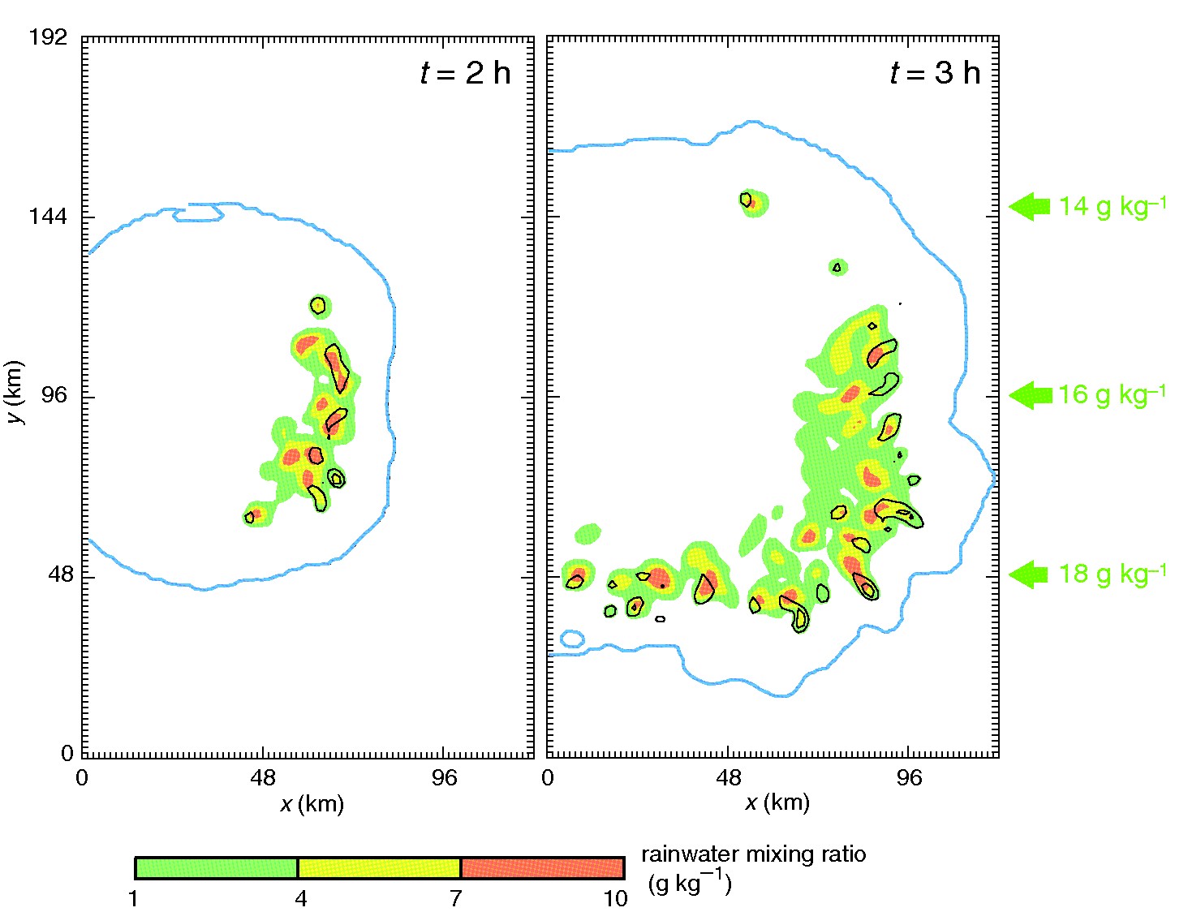
ATMS 316- Isolated Convection
Multicellular convection
  Environmental heterogeneities
    Mesoscale boundary (outflow, dryline)
    Synoptic front
    Terrain
    backbuilding – system propagation is in the opposite direction to individual cell motions
Notes:
44

Slide 45
ATMS 316- Isolated Convection
Multicellular convection
  Environmental heterogeneities
    Variability of CIN
      New cell generation (and system propagation) depend on where superposition of gust front lifting and weak CIN is optimal
Notes:
45

Slide 46
ATMS 316- Isolated Convection
(high CIN)
CIN gradient
(low CIN)
Simulation of multicellular convection in which the environment contains horizontally varying moisture and CIN (Fig 8.14)
Notes:
46

Slide 47
ATMS 316- Isolated Convection
Multicellular convection
  Environmental heterogeneities
    Variability of CIN
      Multicellular convection has a propagation component toward smaller CIN when CIN gradients exist in the environment
Notes:
47

Slide 48
ATMS 316- Isolated Convection
Supercellular convection
  Dynamic vertical pressure gradient forces act over large depths within supercells
    lifting forces are largely independent of the gust front
    propagate nearly continuously
http://radarmet.atmos.colostate.edu/toga_coare/
Notes:
48

Slide 49
ATMS 316- Isolated Convection
Supercellular convection
  Least common storm type
  Responsible for disproportionately large fraction of severe weather reports
    Almost all reports of large hail (d > 5 cm) and strong/ violent tornadoes (EF4 or EF5) are associated with supercell convection
    High lightning flash rates
    Long-lived (1-4 h lifetimes, as long as 8 h)
http://radarmet.atmos.colostate.edu/toga_coare/
Notes:
49

Slide 50
ATMS 316- Isolated Convection
Supercellular convection
  How to qualify?
    Dynamical criterion- presence of a persistent, deep mesocyclone within the updraft
    Mesocyclone
      3-8 km width
      Vertical vorticity ~ O(10⁻²) s⁻¹
      Persistent (~ 20 min)
      Extend over at least half the depth of the updraft
http://radarmet.atmos.colostate.edu/toga_coare/
Notes:
50

Slide 51
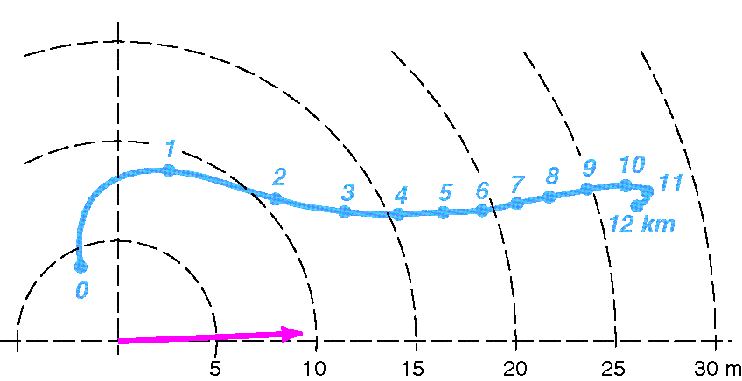
ATMS 316- Isolated Convection
Composite hodograph based on a nationwide sample of over 400 proximity soundings in the environments of cyclonically rotating supercell thunderstorms in the U.S. Mean storm motion indicated by magenta arrow (Fig 8.15)
Notes:
51

Slide 52
ATMS 316- Isolated Convection
Supercellular convection
  Large vertical wind shear
    Source of vertical vorticity
    Extends over a significant depth of the troposphere
  Motion of supercells deviates significantly from mean wind
    Cyclonic rotation; propagate to right of mean wind
    Anticyclonic rotation; propagate to left of mean wind
Notes:
52

Slide 53
ATMS 316- Isolated Convection
Supercellular convection
  Large vertical wind shear, extends over a significant depth of the troposphere
    Significant storm-relative winds at low and upper levels (see Section 8.1)
  Interaction of updraft with vertical wind shear
    Induce vertical pressure gradients that can enhance the updraft
    Extreme amount of CAPE are not necessary for supercells
Notes:
53

Slide 54
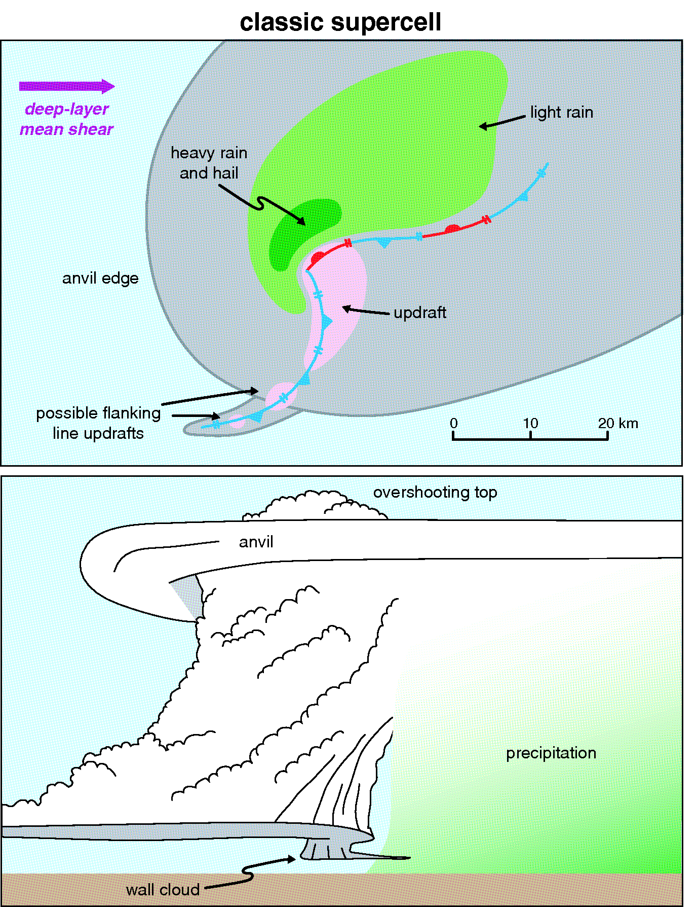
ATMS 316- Isolated Convection
Structure of supercells
  Single dominant updraft
  Flanking line of updrafts
  Large vertical velocities
    Can exceed 50 m s⁻¹
  Main updraft and associated mesocyclone “visually stunning”
Classic supercell structure (Fig 8.16)
Notes:
54

Slide 55
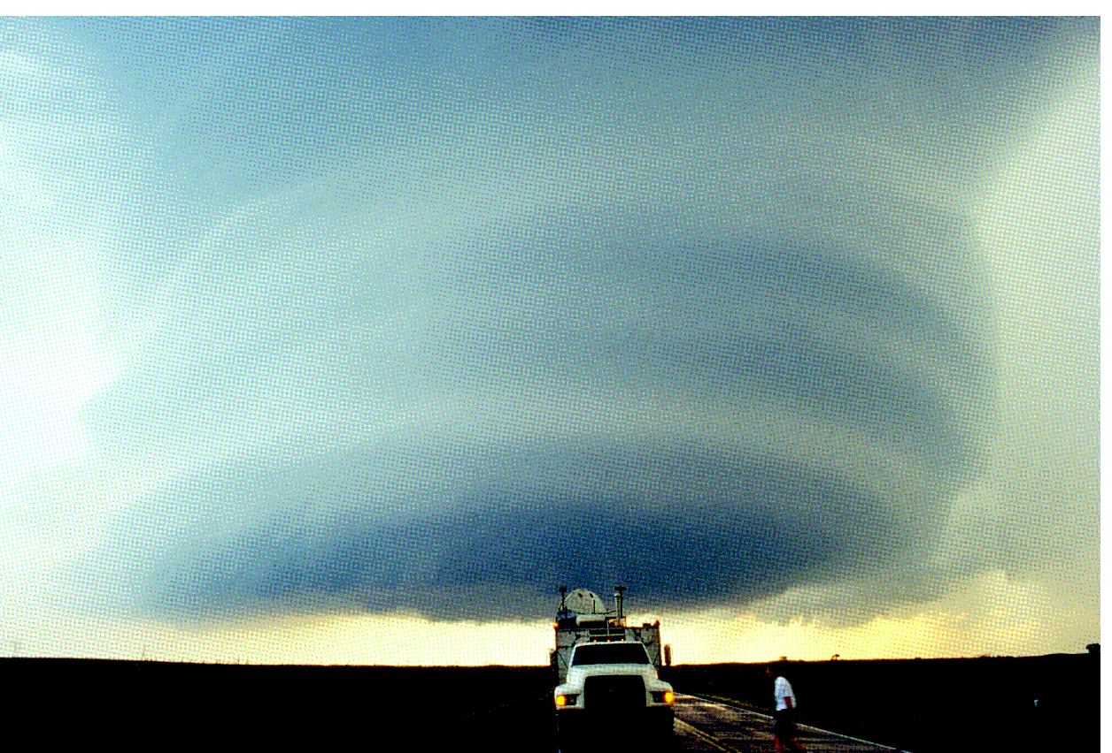
ATMS 316- Isolated Convection
A midlevel mesocyclone is the defining characteristic of a supercell storm (DOW in foreground) (Fig 8.17)
Notes:
55

Slide 56
ATMS 316- Isolated Convection
Structure of supercells
  Couplet of inbound/outbound radial velocities
  Wall cloud (rain cooled air from precip regions is drawn into the updraft)
  Airflow schematics shown in Figs. 8.19 and 8.20
Classic supercell structure (Fig 8.16)
Notes:
56

Slide 57
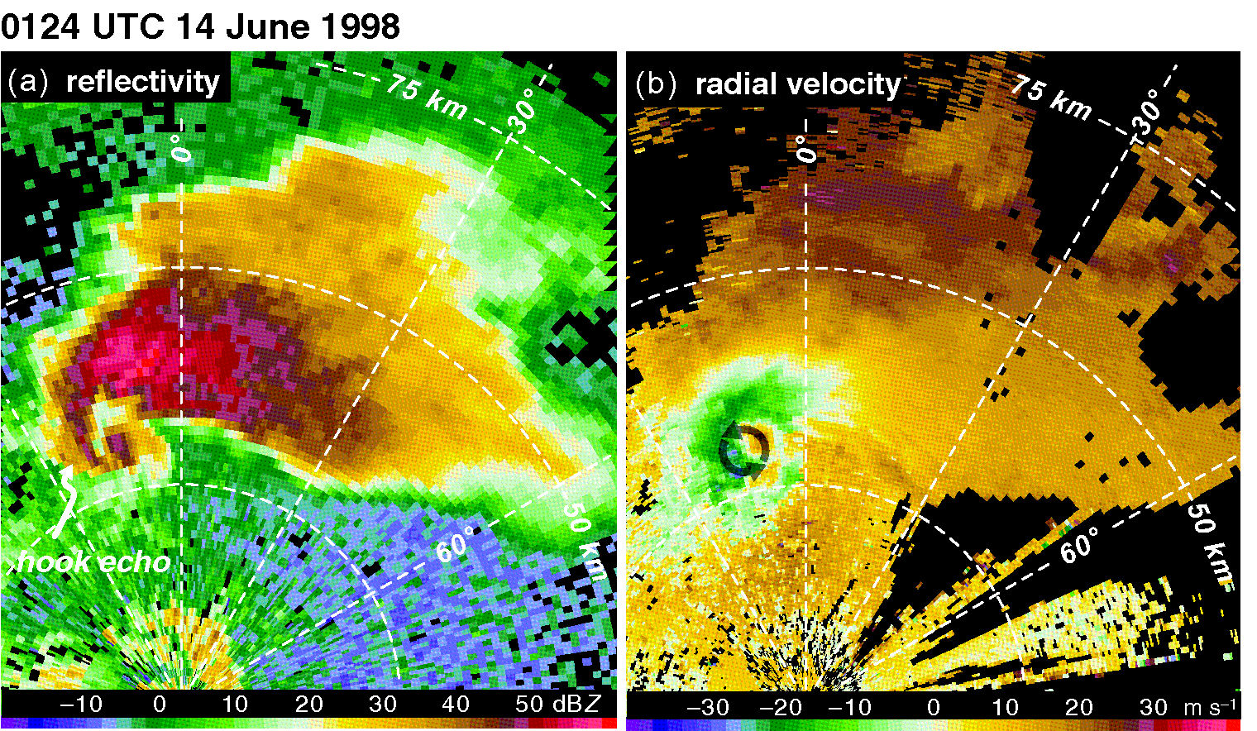
ATMS 316- Isolated Convection
Hook echo in (a) reflectivity data and an inbound/outbound couplet (highlighted by arrows) in (b) radial velocity data (Fig 8.18)
Notes:
57

Slide 58
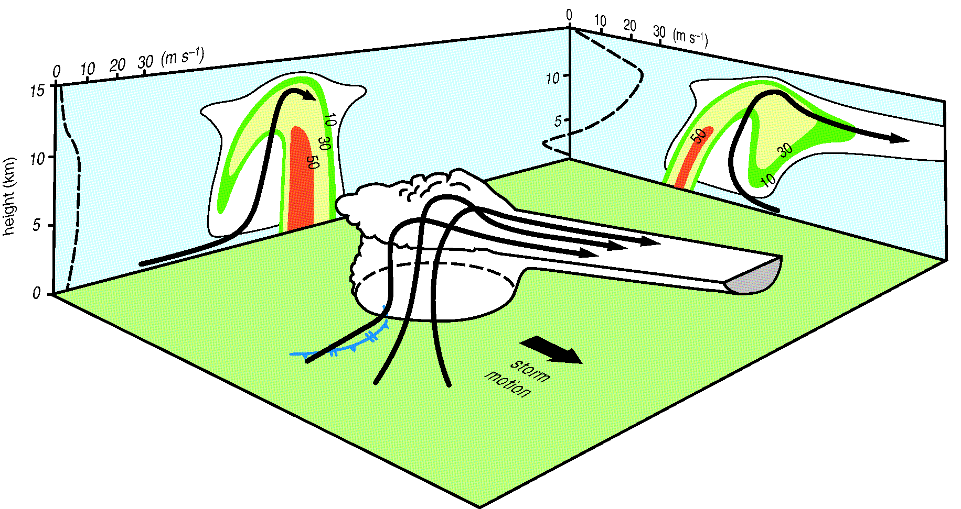
ATMS 316- Isolated Convection
Perspective view of a supercell depicting storm-relative airflow and reflectivity structure, rear-flank gust front shown {frontal symbol} (Fig 8.19)
Notes:
58

Slide 59
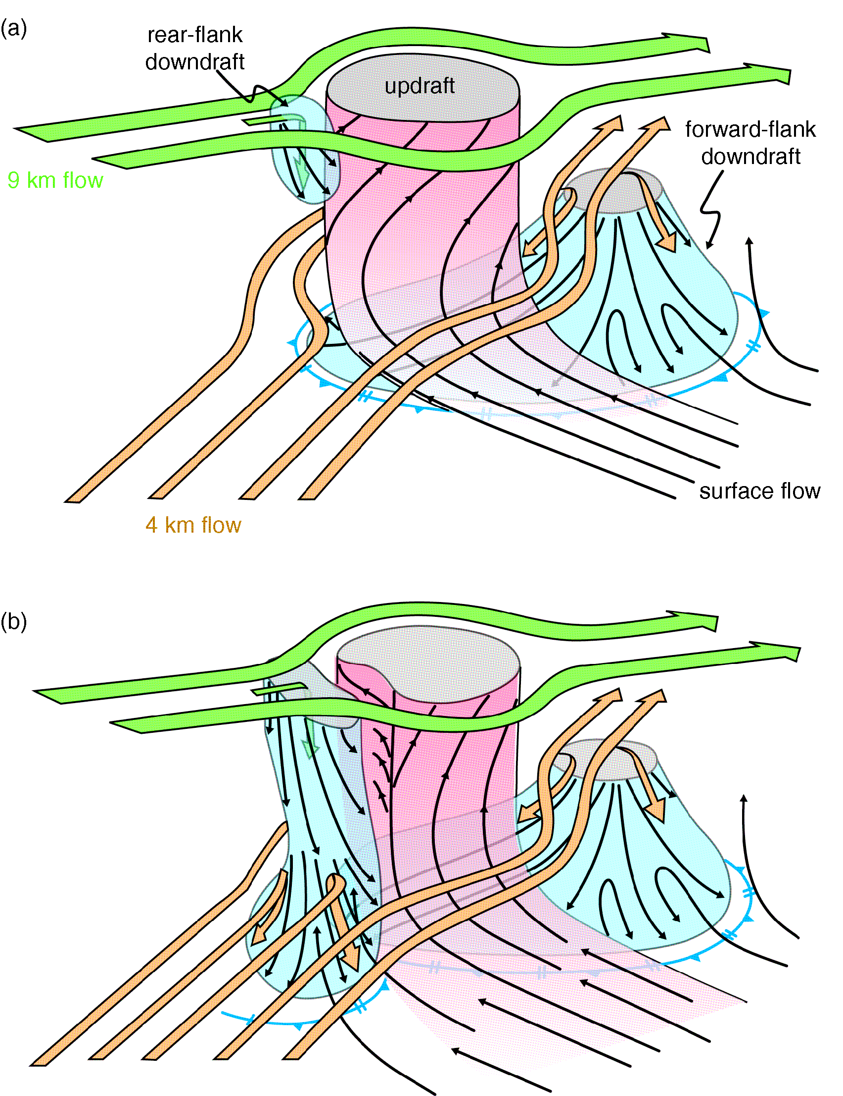
ATMS 316- Isolated Convection
Schematic 3D depiction of updraft and downdraft structure in a supercell storm during (a) early and (b) mature stages of the storm (8.20)
Notes:
59

Slide 60
ATMS 316- Isolated Convection
Structure of supercells
  Updraft is typically associated with reflectivity minimum (BWER, bounded weak echo region), insufficient hydrometeors to “paint” a significant reflectivity signal
    Updraft too strong for descent of hydrometeors
    Insufficient time for precip formation
Notes:
60

Slide 61
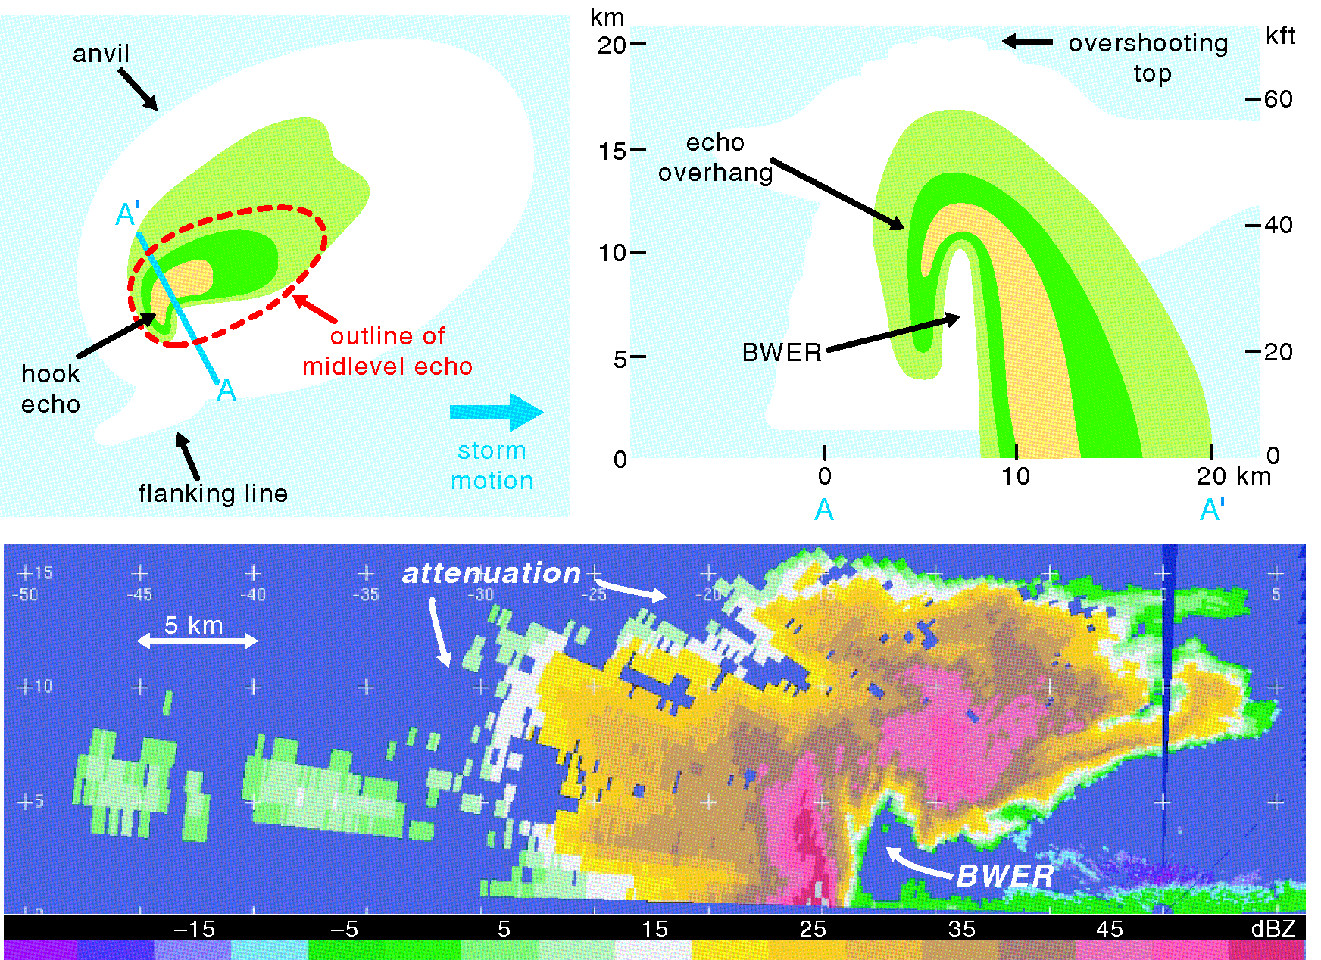
ATMS 316- Isolated Convection
Top, schematic of reflectivity structure of a supercell, bottom, actual quasi-vertical cross-section of radar reflectivity factor in a supercell thunderstorm at 2306 UTC 16 May 1995 (Fig 8.21)
Notes:
61

Slide 62
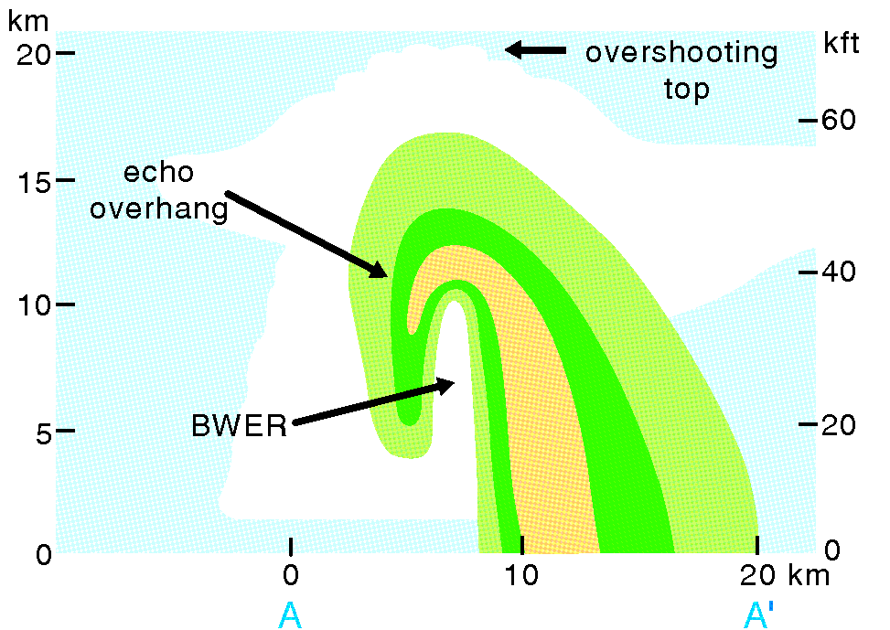
ATMS 316- Isolated Convection
Structure of supercells
  Hook echo
    Downward extension of the rear side of the echo overhang that caps the BWER
    Best-recognized reflectivity feature associated with a supercell storm
    Formation uncertain; hydrometeors are not good tracers of airflow because of their large fall speeds [don’t “go with the (air) flow”]
Notes:
62

Slide 63
ATMS 316- Isolated Convection
Structure of supercells
  Two main downdraft regions
    Hook echo region (rear-flank downdraft, RFD)
    Forward-flank downdraft (FFD)
Notes:
63

Slide 64
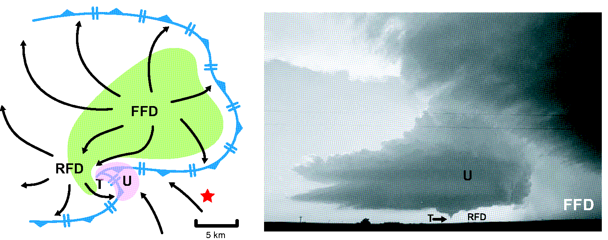
ATMS 316- Isolated Convection
(Left) schematic representation of a supercell thunderstorm (right) photograph of a tornadic supercell closely resembling schematic on left (Fig 8.22) {star = photographer position}
Notes:
64

Slide 65
ATMS 316- Isolated Convection
Structure of supercells
  RFD formation
    Dry winds impinge on backside of updraft (evaporative chilling and negative buoyancy) {thermodynamically forced}
    Downward-directed vertical pressure gradient forces on the storm upshear flank {dynamically forced}
Notes:
65

Slide 66
ATMS 316- Isolated Convection
Structure of supercells
  FFD formation
    Bulk of hydrometeors deposited on forward flank of the updraft (evaporative chilling and negative bouyancy)
  RFD and FFD collectively produce a surface gust front structure ~ midlatitude cyclone (Fig. 8.22)
Notes:
66

Slide 67
ATMS 316- Isolated Convection
Structure of supercells
  Occlusion downdraft
    Vertical vorticity amplifies near the ground and exceeds vertical vorticity aloft → vertical gradient of dynamic perturbation pressure develops, resulting in a downward acceleration of air (occurs in close proximity to the RFD)
Notes:
67

Slide 68
ATMS 316- Isolated Convection
Structure of supercells
  Inflow
    Commonly strong and occasionally damaging ( speeds > 20 m s⁻¹)
    Inflow low; dynamic pressure minimum of 1-3 mb (Fig. 8.23)
    Speeds explained using Bernoulli equation; flow is fast where pressure is low
    Inflow that accelerates from 5 to 20 m s⁻¹ generates an inflow low having a pressure deficit ~ 2 mb
Notes:
68

Slide 69
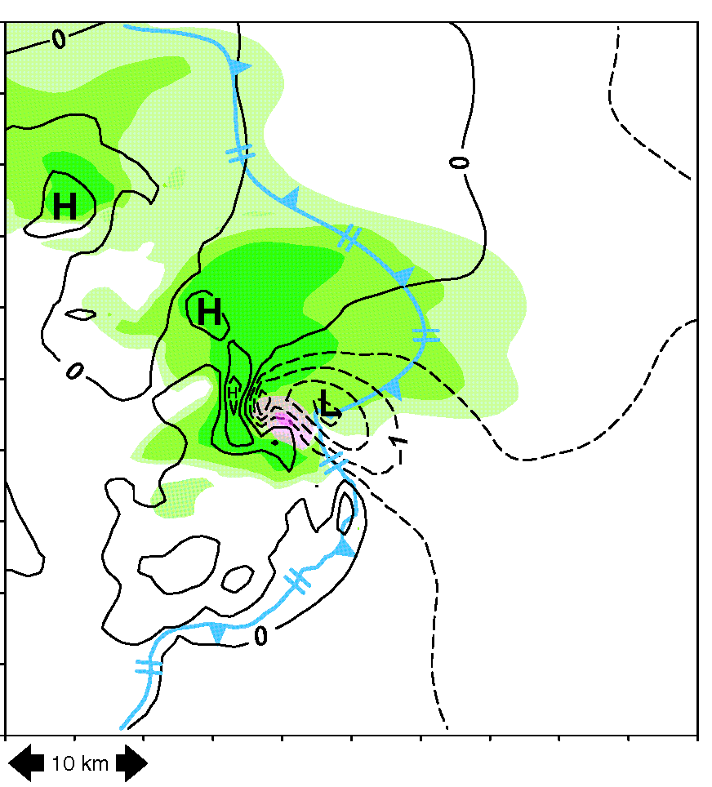
ATMS 316- Isolated Convection
Pressure perturbations at 125 m AGL in a numerical simulation of a supercell. Rainwater concentrations in green, updraft speeds (at 1.125 km) in pink (Fig 8.23)
Notes:
69

Slide 70
ATMS 316- Isolated Convection
Structure of supercells
  Supercell spectrum – spatial distribution of precipitation
    Classic (CL) supercells
    Low-precipitation (LP) supercells
    Heavy- or high-precipitation (HP) supercells
Notes:
70

Slide 71
ATMS 316- Isolated Convection
Structure of supercells
  Supercell spectrum – spatial distribution of precipitation
    Classic (CL) supercells – most precipitation falls on the forward flank, with only a small amount withing the hook echo at the rear of the updraft
Notes:
71

Slide 72
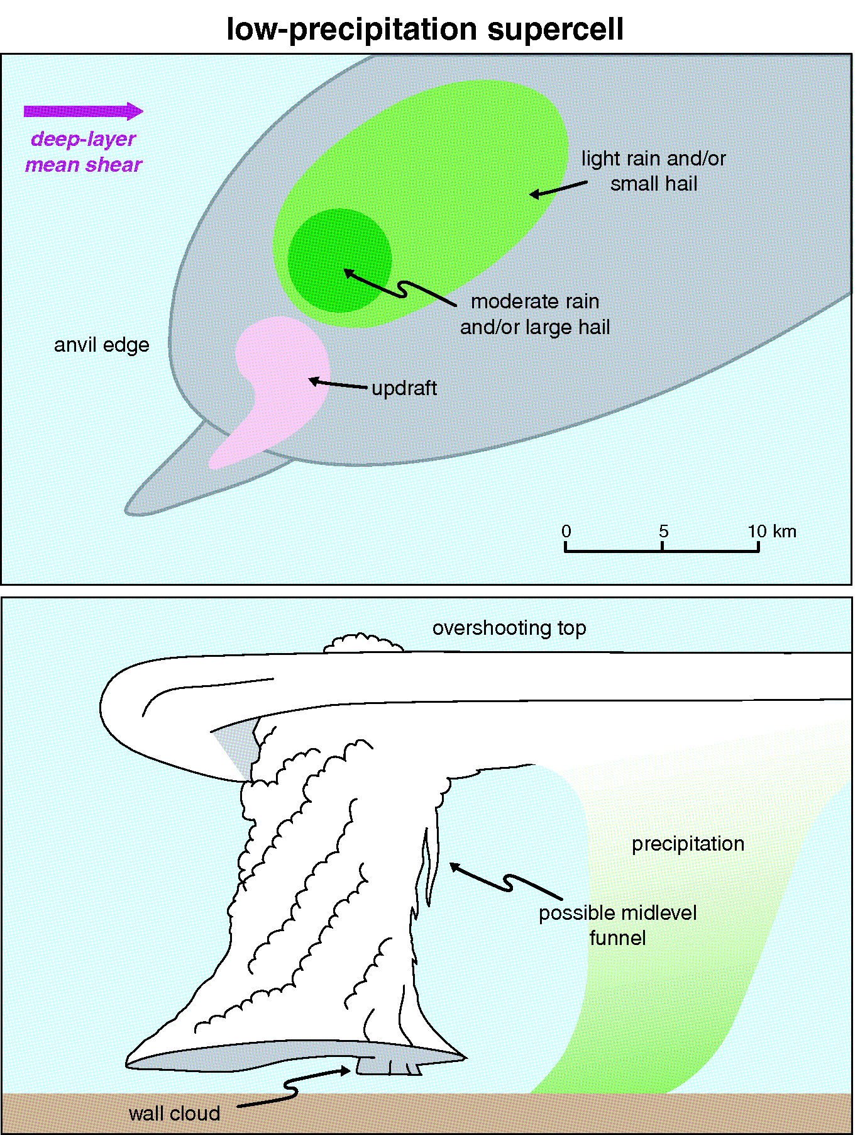
ATMS 316- Isolated Convection
LP supercell structure (Fig 8.24)
Notes:
72

Slide 73
ATMS 316- Isolated Convection
Structure of supercells
  Supercell spectrum – spatial distribution of precipitation
    Low-precipitation (LP) supercells- nearly all precipitation falls far from the updraft in the forward region of the storm, much of it evaporating before reaching the ground
      RFD absent?
      Tornadoes are rare in LP storms
Notes:
73

Slide 74
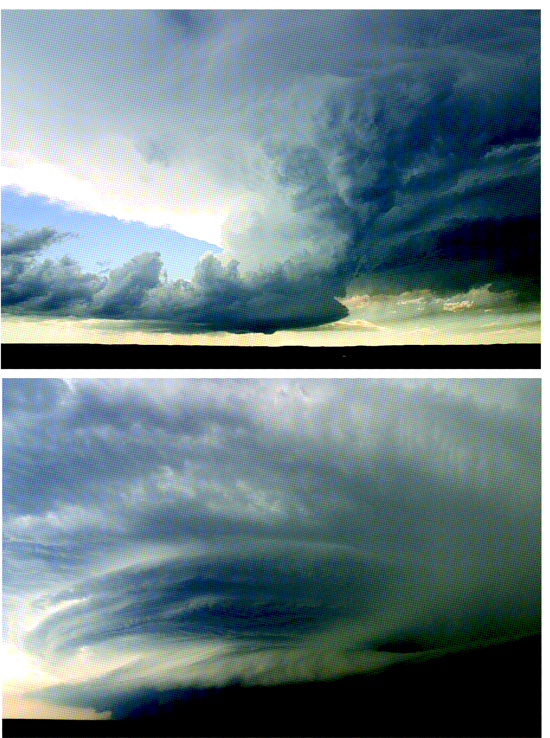
ATMS 316- Isolated Convection
Photographs of an LP (top) and HP (bottom) supercell (Fig 8.25)
Notes:
74

Slide 75
ATMS 316- Isolated Convection
Structure of supercells
  Supercell spectrum – spatial distribution of precipitation
    Heavy- or high-precipitation (HP) supercells- have a large amount of precipitation fall in the hook echo region and on the backside of the storm
    Kidney-bean reflectivity appearance
    Intense downdrafts → fewer tornadoes than CL (cause??)
Large hail and damaging downburst winds are common with HP supercells
Notes:
75

Slide 76
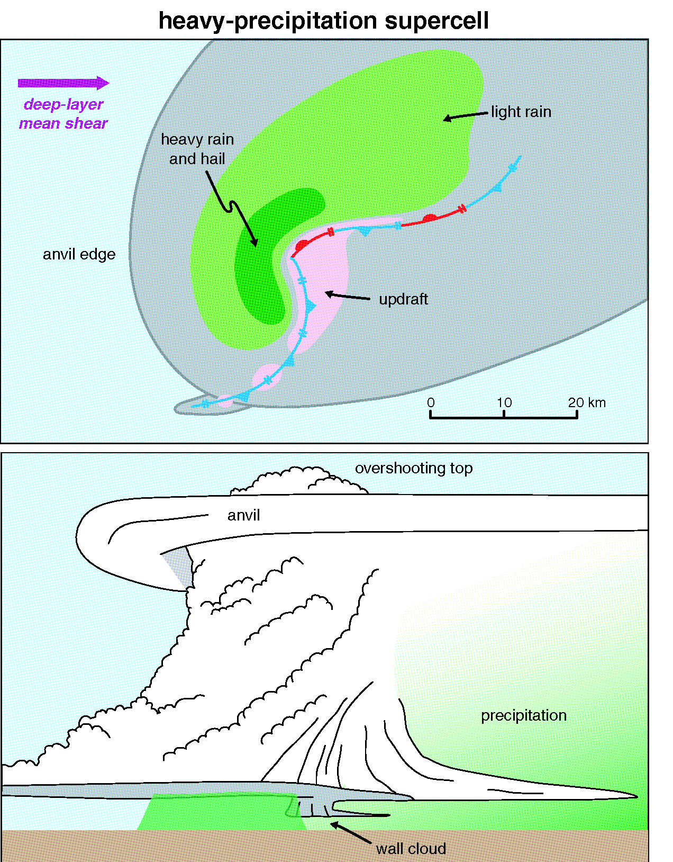
ATMS 316- Isolated Convection
HP supercell structure (Fig 8.26)
Notes:
76

Slide 77
ATMS 316- Isolated Convection
Structure of supercells
  Supercell spectrum – a continuum
    Most dangerous tornado threat; LP-CL transition region
    Supercell type - a strong function of upper-level storm-relative winds near the anvil level (9-12 km)
      Weak→ HP
      Strong → LP
      Moderate (18-28 m s⁻¹) → CL
Supercells can “seed” nearby storms, pushing them toward the HP end of the spectrum
Notes:
77

Slide 78
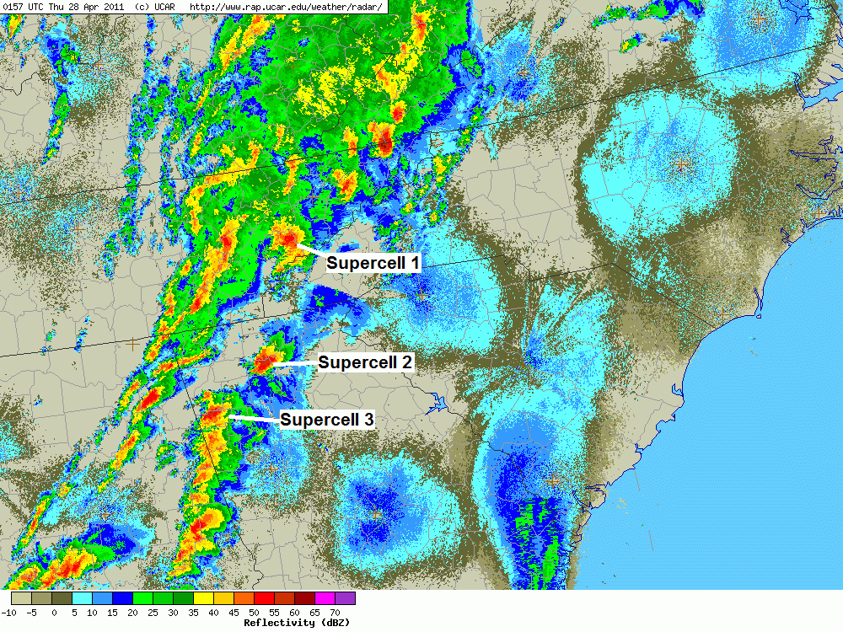
ATMS 316- Isolated Convection
Which scenario?
  Scenario#1; synoptic scale forcing alone
  Scenario#2; synoptic scale dominates mesoscale forcing
  Scenario#3; weak synoptic scale forcing
27 April 2011
Tornado outbreak
http://www.erh.noaa.gov/gsp/localdat/cases/2011/27April_EpicOutbreak/EpicOutbreak.html

