Slide 1
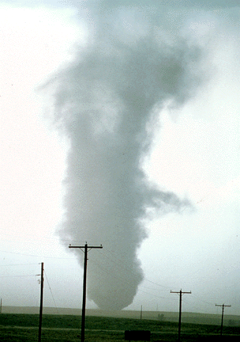
ATMS 316- Mesoscale Meteorology
Packet#10
Interesting things happen at the boundaries, or at the interface…
  Warm air, cold air
  Humid air, dry air
http://www.ucar.edu/communications/factsheets/Tornadoes.html

Slide 2
ATMS 316- Mesoscale Meteorology
http://rammb.cira.colostate.edu/training/visit/training_sessions/the_uw_convective_initiation_product/
Outline
  Background
  Convection Initiation

Slide 3

ATMS 316- Background
Convection Initiation
  Deep moist convection (DMC) arises when air is lifted to saturation and subsequently achieves positive buoyancy, such that it may rise to great heights
  Initiation of DMC = convection initiation; air parcels must reach their LFC
    CAPE is a necessary (not sufficient) condition for convection initiation
http://www.coolchaser.com/graphics/tag/Run%20dmc/3

Slide 4
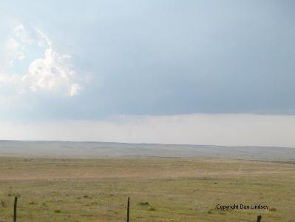
ATMS 316- Convection Initiation
Chapter 7, p. 184 - 199
  Requisites for convection initiation and the role of larger scales
      7.1.1 (lapse rate tendency eqtn)
      7.1.2 (mods of CAPE & CIN)
  Mesoscale complexities of convection initiation
      7.2.1 (CIN removal)
  Moisture convergence
  Elevated convection
http://www.ssec.wisc.edu/~rozoff/chasing/9Aug04/

Slide 5
ATMS 316- Convection Initiation
Requisites for convection initiation
  Why be concerned?
    Severe weather
    Effects on energy demand
    Impact on near-term NWP forecasts
    Possibility of subsequent severe weather development
http://www.ssec.wisc.edu/~rozoff/chasing/9Aug04/

Slide 6
ATMS 316- Convection Initiation
Requisites for convection initiation (CI)
  CI forecasting skill
    Advanced at a slow rate
    Much more than assessing parameters from skew T- log P diagrams
    Interaction of winds on multiple scales; micro-, meso-, and synoptic-scale
http://www.ssec.wisc.edu/~rozoff/chasing/9Aug04/

Slide 7
ATMS 316- Convection Initiation
Requisites for convection initiation
  Presence of an LFC and CAPE
    Relatively large low- to mid-tropospheric lapse rate
    Abundant moisture in low-troposphere
http://www.ssec.wisc.edu/~rozoff/chasing/9Aug04/

Slide 8
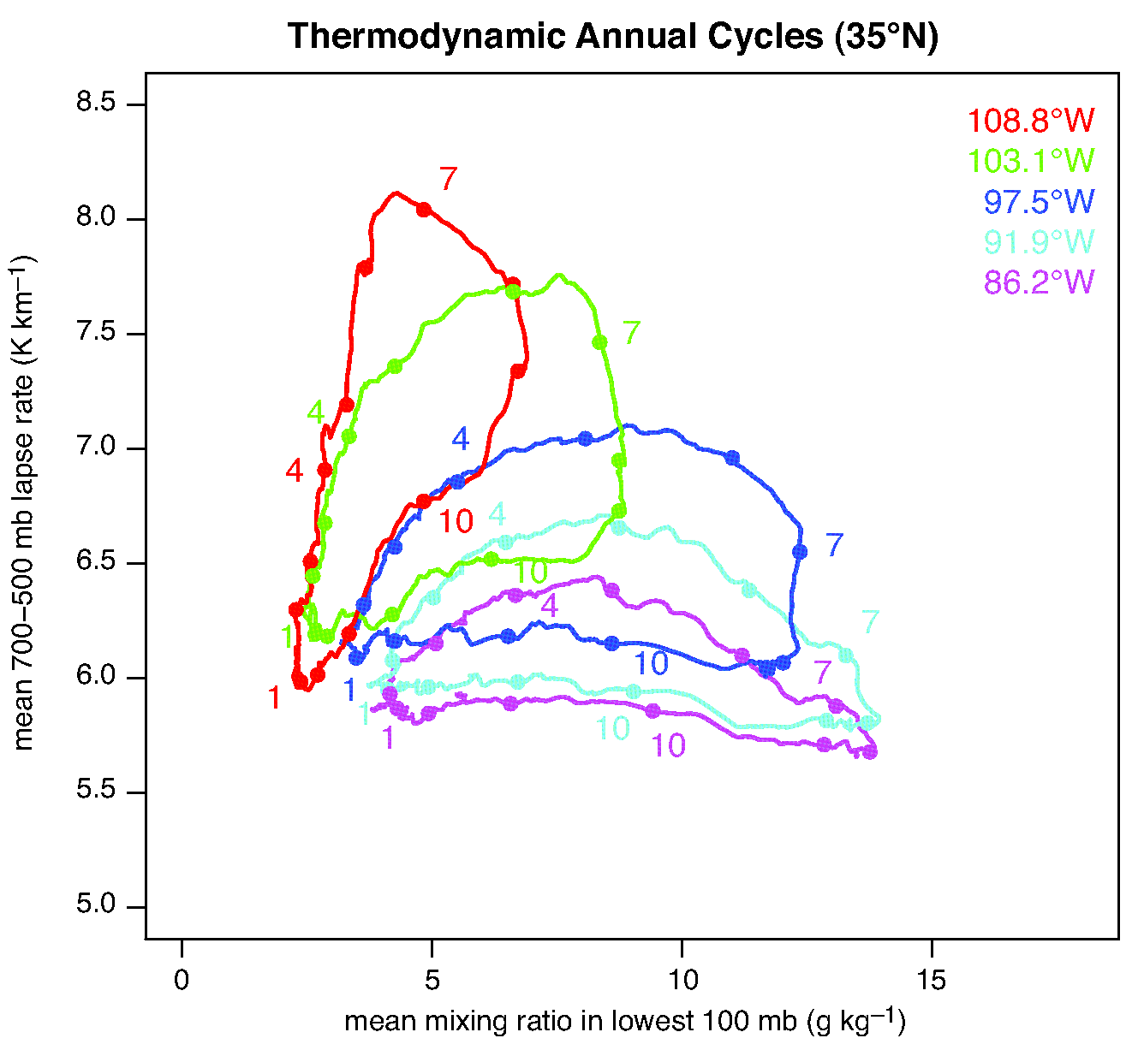
ATMS 316- Convection Initiation
Annual cycles of midlevel lapse rates versus the mean water vapor mixing ratio in the lowest 100 mb (NARR) at five locations in a west-east line located at 35ºN (Fig 7.1)

Slide 9
ATMS 316- Convection Initiation
Requisites for convection initiation
  CAPE not sufficient for CI
    Forced ascent – overcome convective inhibition (CIN)
      Synoptic fronts
      Drylines
      Outflow boundaries
      Sea breezes
      Orographic flow
      Ducted gravity waves
http://www.ssec.wisc.edu/~rozoff/chasing/9Aug04/

Slide 10
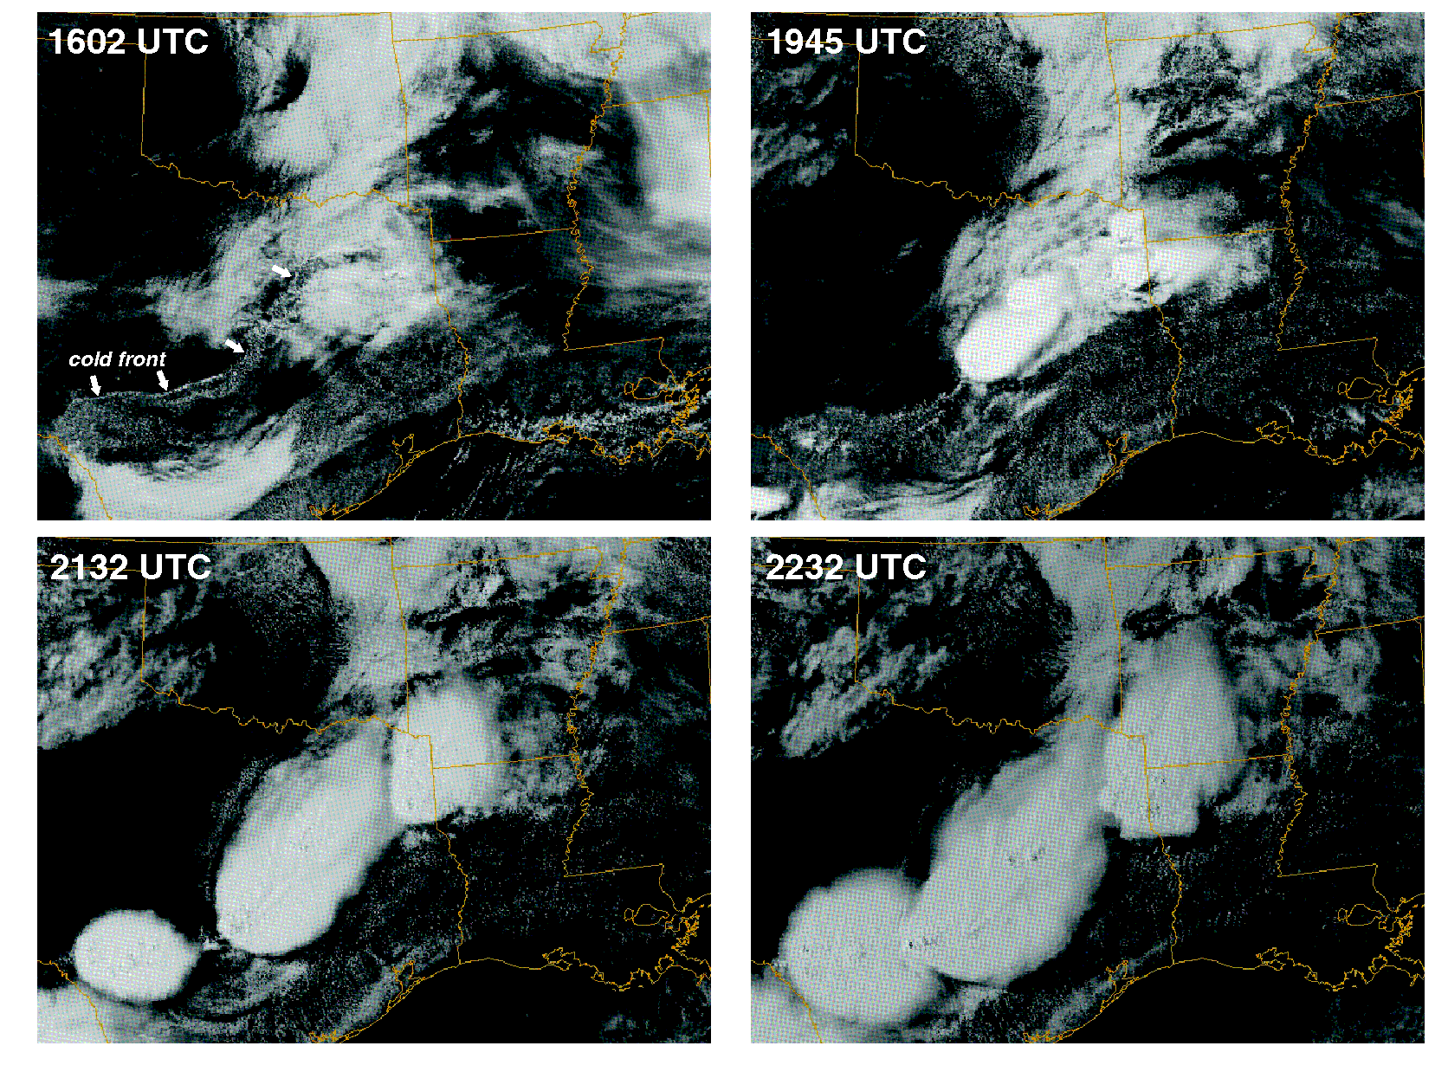
ATMS 316- Convection Initiation
In the absence of topography, DMC tends to be initiated along air mass boundaries, which are usually accompanied by a wind shift and convergence (Fig 7.2)

Slide 11
ATMS 316- Convection Initiation
Requisites for convection initiation
  Synoptic-scale dynamics
    Large-scale mean ascent
      Reduces CIN
      Deepens low-level moist layer
    Large-scale mean subsidence
      Strengthens cap (increases CIN)
      Compresses low-level moist layer
http://www.ssec.wisc.edu/~rozoff/chasing/9Aug04/

Slide 12
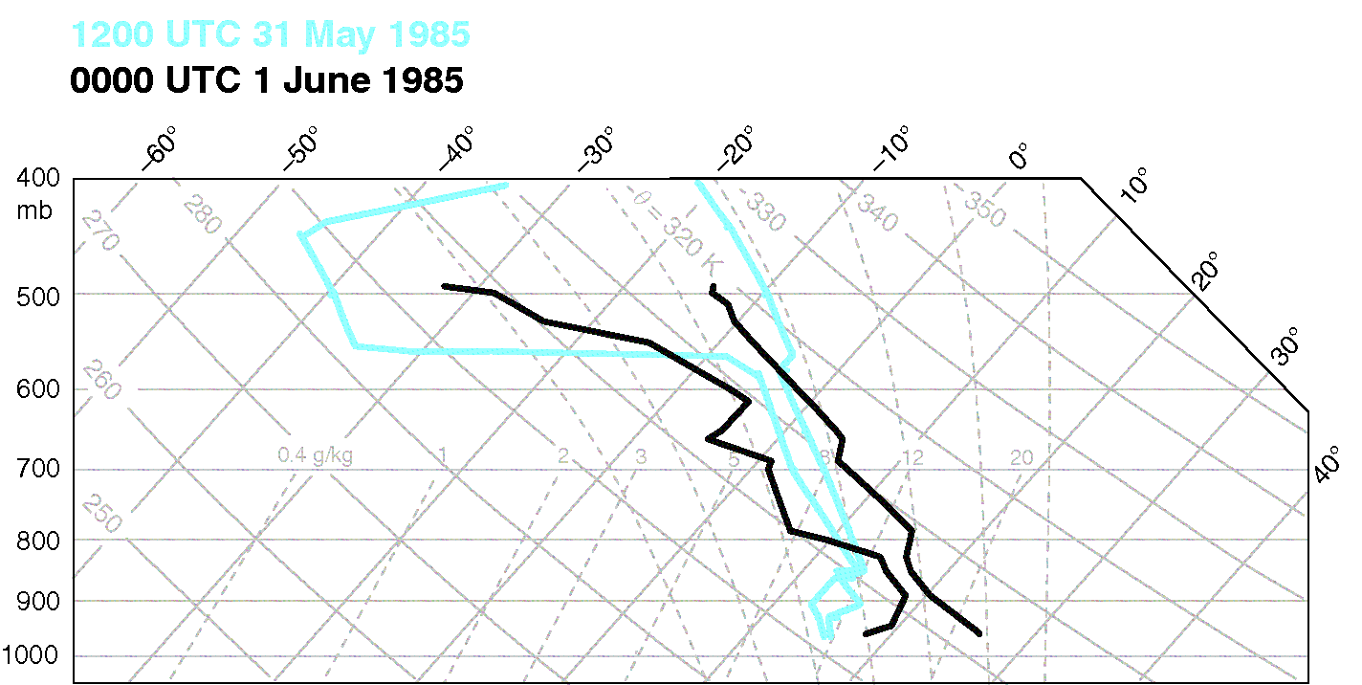
ATMS 316- Convection Initiation
Soundings from Pittsburgh, PA at 1200 UTC 31 May (blue) and 0000 UTC 1 June 1985 (black) (Fig 7.3)

Slide 13
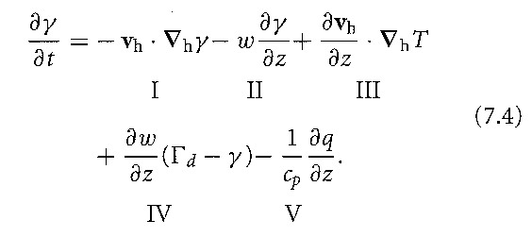
ATMS 316- Convection Initiation
Lapse rate tendency eqtn.
  Synoptic-scale dynamics
    Large-scale modulates CAPE and CIN by modifying the environmental lapse rate
    Eq. (7.4) here
Terms I and II; horizontal and vertical lapse rate advection, Term III combined with Term I; differential temperature advection, Term IV; stretching term, Term V; differential diabatic heating
http://www.ssec.wisc.edu/~rozoff/chasing/9Aug04/

Slide 14
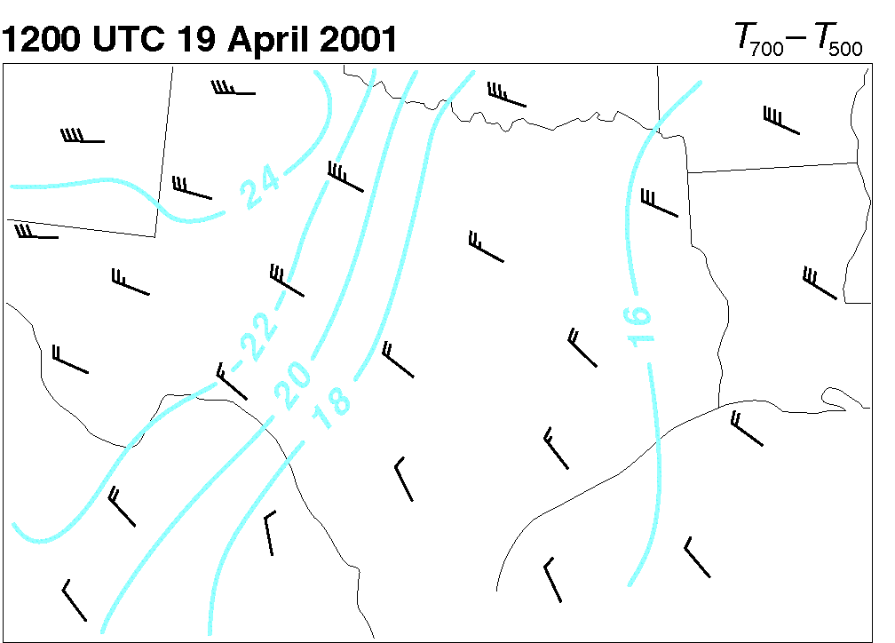
ATMS 316- Convection Initiation
Analysis of the envrionmental temperature difference between 500 and 700 mb (K), a bulk measure of the midlevel lapse rate. Wind barbs depict the mean wind in the 500-700 mb layer (Fig 7.4)

Slide 15
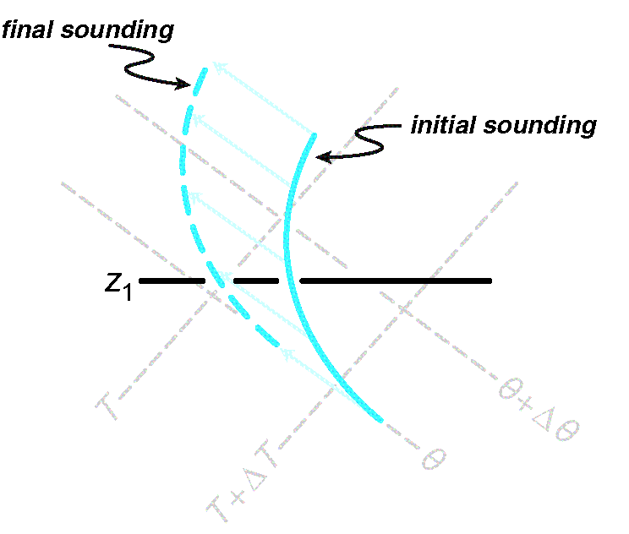
ATMS 316- Convection Initiation
Schematic thermodynamic diagram illustrating the effect of vertical lapse rate advection (Fig 7.5)

Slide 16
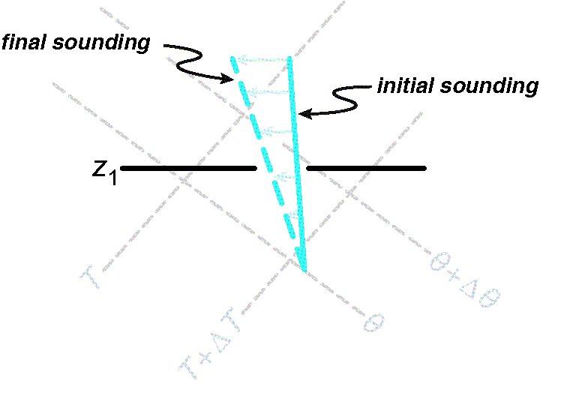
ATMS 316- Convection Initiation
Schematic thermodynamic diagram illustrating the effect of differential horizontal temperature advection {by the ageostrophic wind} (Fig 7.6)

Slide 17
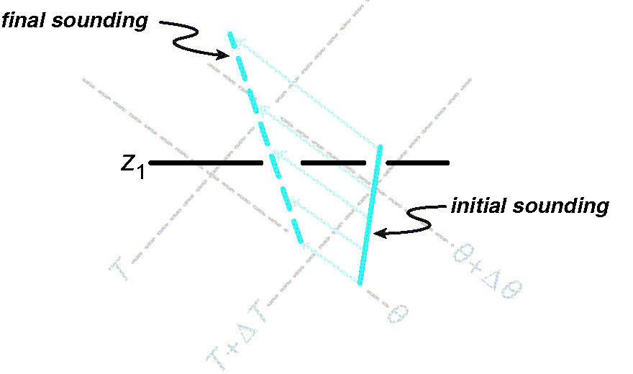
ATMS 316- Convection Initiation
Schematic thermodynamic diagram illustrating the stretching effect (Fig 7.7)

Slide 18
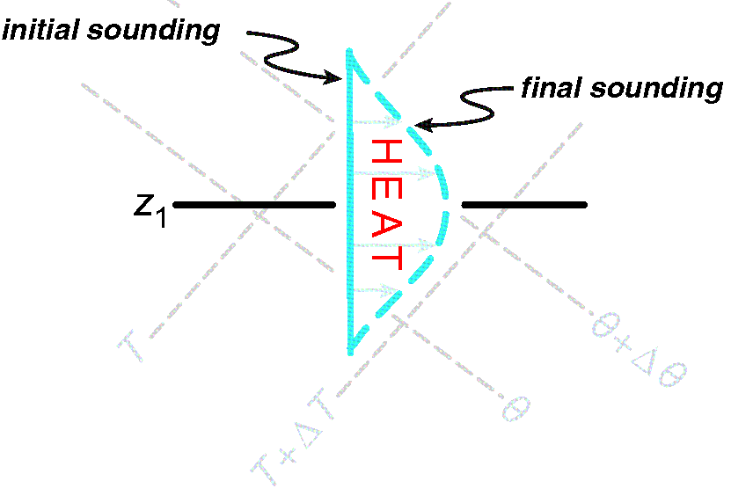
ATMS 316- Convection Initiation
Schematic thermodynamic diagram illustrating the effects of differential diabatic heating (Fig 7.6)

Slide 19
ATMS 316- Convection Initiation
Lapse rate tendency eqtn.
  Synoptic-scale dynamics
    Largest contribution tends to be from the horizontal advection of lapse rate (Term I)
    Eq. (7.4) here
On the mesoscale, Terms II-V easily can be an order of magnitude larger than their synoptic-scale magnitudes
http://www.ssec.wisc.edu/~rozoff/chasing/9Aug04/

Slide 20
ATMS 316- Convection Initiation
Other large-scale CAPE and CIN modifications
  Mean large-scale ascent always reduces CIN
  Dramatic increases in low-level moisture (Fig. 7.3)
  Diurnal reduction of CIN from morning to afternoon
  Potential instability need not be present for CIN reduction
http://www.ssec.wisc.edu/~rozoff/chasing/9Aug04/

Slide 21
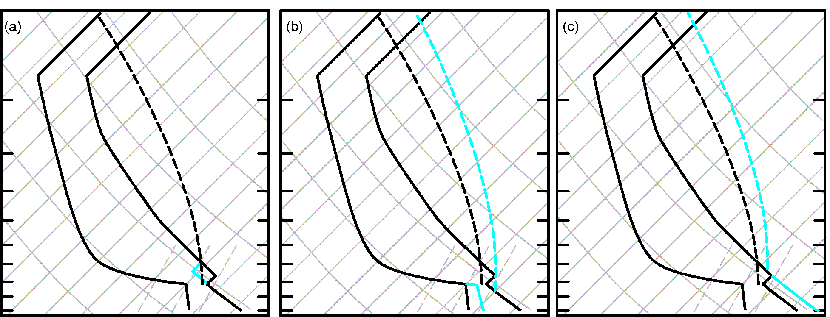
ATMS 316- Convection Initiation
CIN can be reduced by (a) large-scale rising motion, (b) low-level moistening, and (c) low-level warming (Fig 7.9)

Slide 22
ATMS 316- Convection Initiation
  Mesoscale complexities of convection initiation
  Convective storms are initiated along only limited segments of boundaries
http://www.ssec.wisc.edu/~rozoff/chasing/9Aug04/

Slide 23
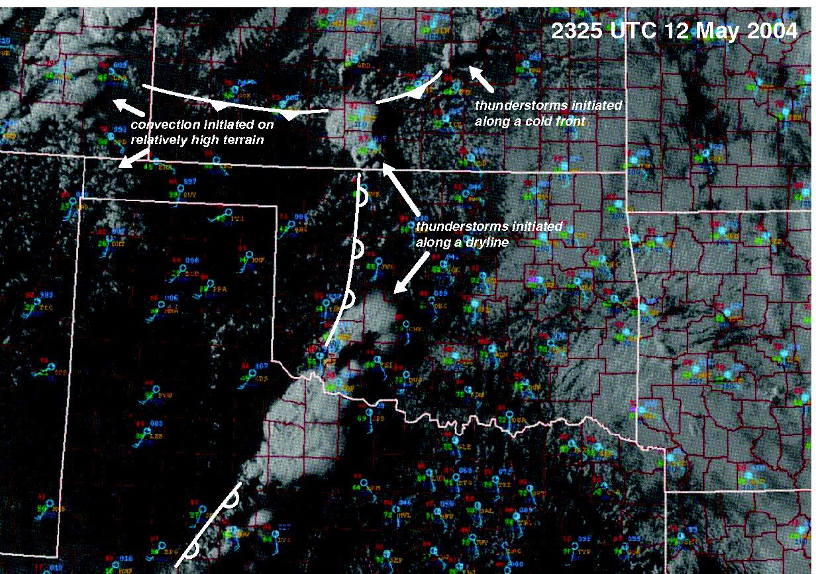
ATMS 316- Convection Initiation
Example of convection initiation along only short segments of air mass boundaries (Fig 7.10)

Slide 24
ATMS 316- Convection Initiation
  Mesoscale complexities of convection initiation
  Kinematic inhomogeneities along air mass boundaries
    HCRs intersect air mass boundaries (Fig. 7.11)
    Small-scale vertical vortices (misocyclones, Fig. 7.12)
http://www.ssec.wisc.edu/~rozoff/chasing/9Aug04/

Slide 25
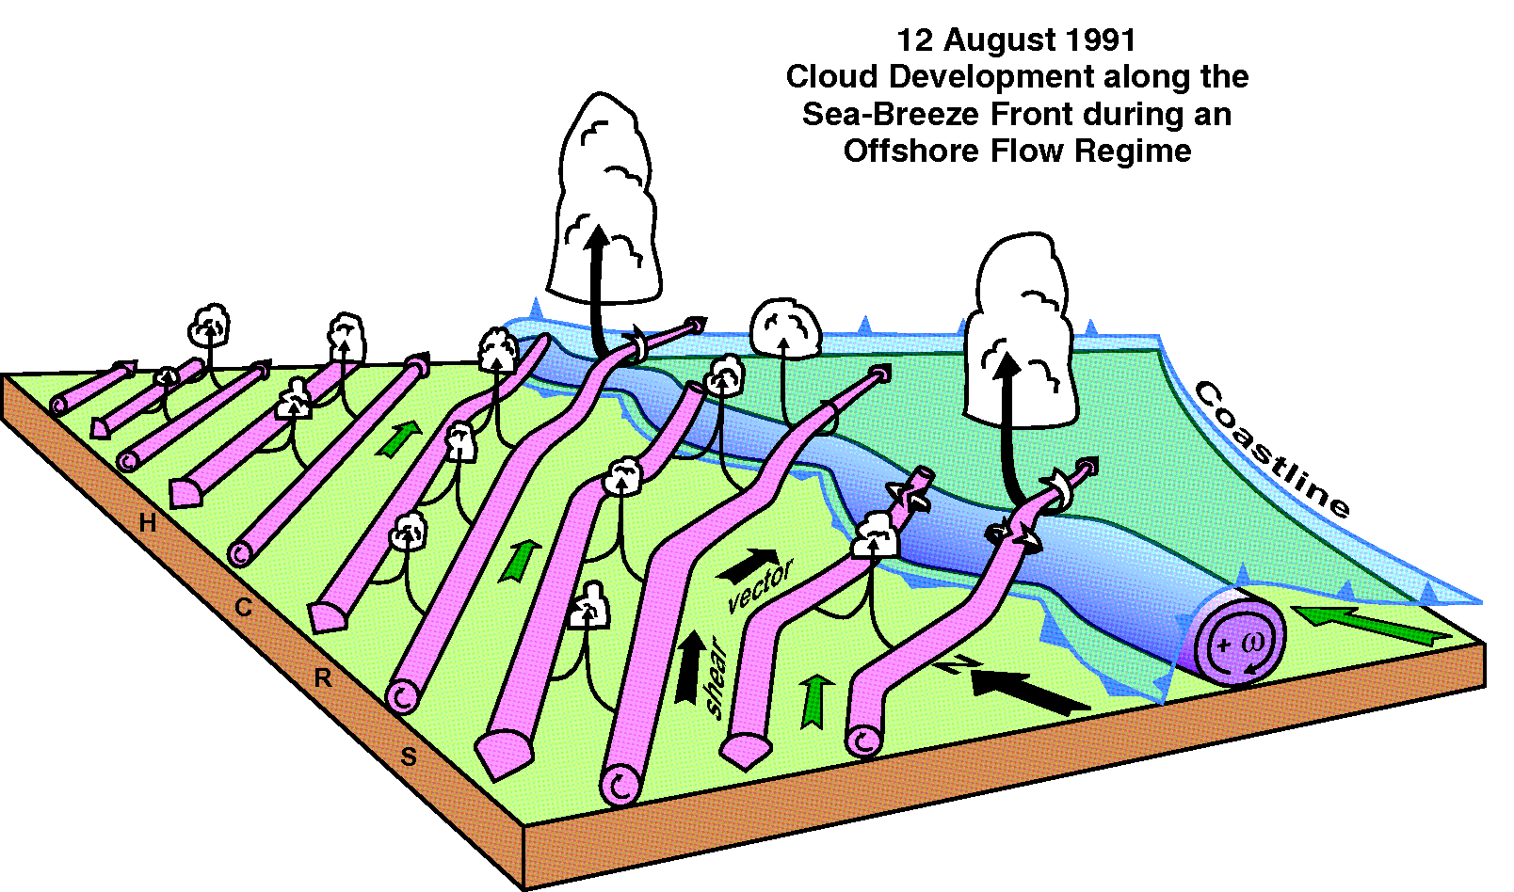
ATMS 316- Convection Initiation
Schematic diagram showing the interaction between the sea-breeze front and horizontal convective rolls and how it related to cloud development on 12 August 1991 during CaPE (Fig 7.11)

Slide 26
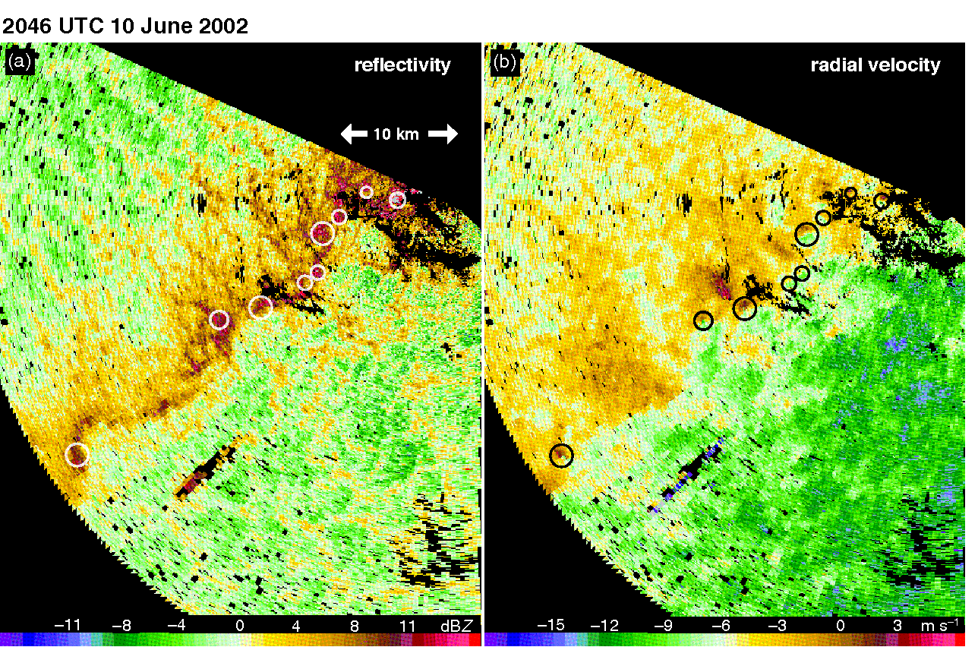
ATMS 316- Convection Initiation
Misocyclone (circled) along a non-precipitating cold front evident in (a) reflectivity (dBZ; uncalibrated) and (b) radial velocity (m s⁻¹) data obtained by the DOW radar in western Kansas (Fig 7.12)

Slide 27
ATMS 316- Convection Initiation
  Mesoscale complexities of convection initiation
  Kinematic inhomogeneities along air mass boundaries
    Core and gap structures (Fig. 7.13) and narrow cold-frontal rainbands (Sec. 5.1)
http://www.ssec.wisc.edu/~rozoff/chasing/9Aug04/

Slide 28
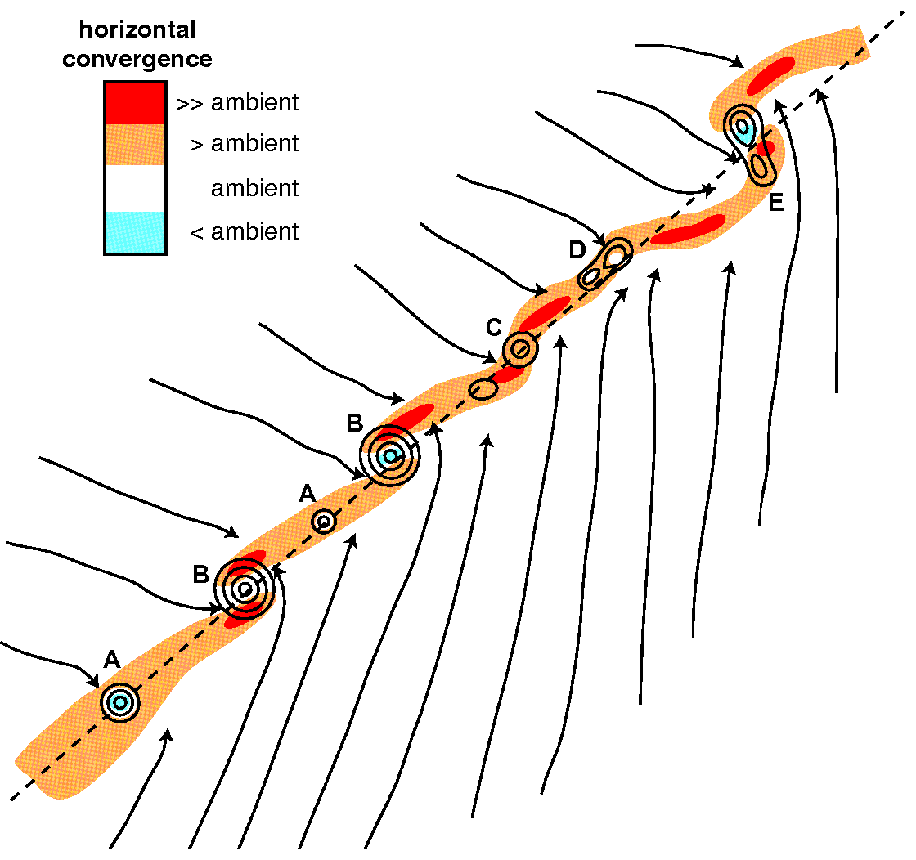
ATMS 316- Convection Initiation
Conceptual model of misocyclone (vertical vorticity greater than the ambient value is contoured), horizontal convergence (shaded), and streamlines observed during IHOP (Fig 7.13)

Slide 29
ATMS 316- Convection Initiation
  Mesoscale complexities of convection initiation
  Thermodynamic inhomogeneities
  CI ‘failures’
    Air parcels reach LFC, yet fail to develop into DMC (Fig. 7.14)
http://www.ssec.wisc.edu/~rozoff/chasing/9Aug04/

Slide 30
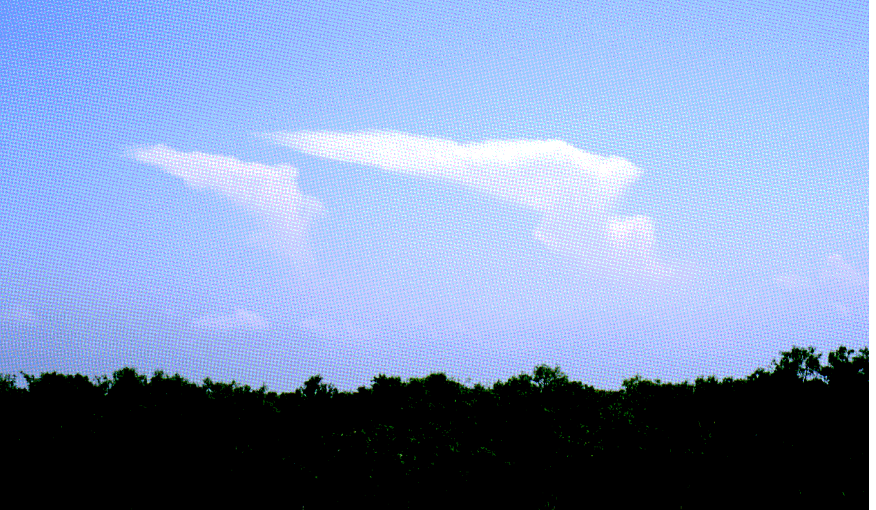
ATMS 316- Convection Initiation
A photograph of turkey towers, which develop when air parcels surpass their LFC, rise to high altitudes, and produce anvils, yet the DMC fails to sustain itself and reach maturity (Fig 7.14)

Slide 31
ATMS 316- Convection Initiation
  Insufficiency of CIN removal for CI
  CIN absent, yet DMC fails to develop (Fig. 7.15)
  DMC initiates despite significant CIN remaining
  Inhomogeneities in temperature and moisture fields are not observed or resolved in real time
http://www.ssec.wisc.edu/~rozoff/chasing/9Aug04/

Slide 32
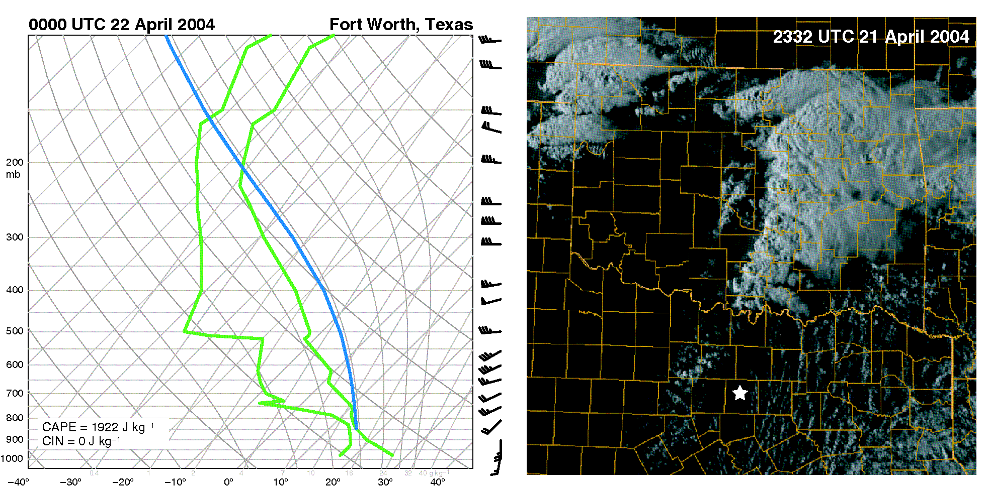
ATMS 316- Convection Initiation
Example of convection initiation ‘failure’ in the absence of CIN on 21 April 2004 (Fig 7.15)

Slide 33
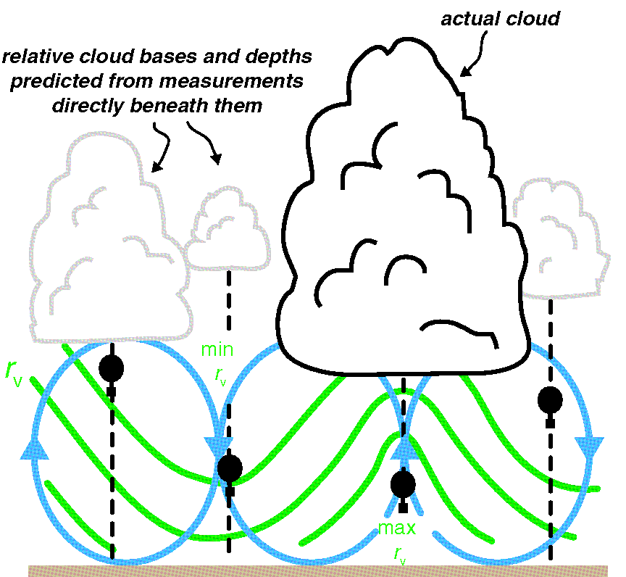
ATMS 316- Convection Initiation
Schematic showing the effect of boundary layer roll circulations on the moisture profiles measured by soundings (Fig 7.16)

Slide 34
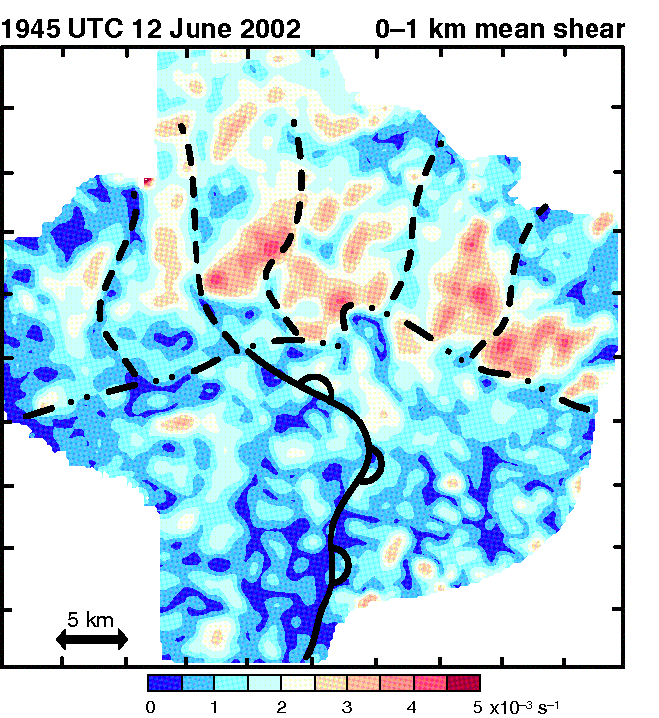
ATMS 316- Convection Initiation
Horizontal cross-section of the mean vertical wind shear in the 0-1 km AGL layer (Fig 7.17)

Slide 35
ATMS 316- Convection Initiation
  Insufficiency of CIN removal for CI
  CIN absent, yet DMC fails to develop (Fig. 7.15)
  DMC initiates despite significant CIN remaining
Thus, convection initation (CI) is not as simple as reaching the convective temperature or eliminating CIN.
http://www.ssec.wisc.edu/~rozoff/chasing/9Aug04/

Slide 36
ATMS 316- Convection Initiation
  Insufficiency of CIN removal for CI
  CIN absent, yet DMC fails to develop (Fig. 7.15)…
    Mixing (entrainment) of dry environmental air into ascending parcel dilutes its buoyancy and θe, raising the LCL and LFC
    Lift a parcel using the mean water vapor mixing ratio and θe of the lowest 50-100 mb
Accounts for mixing effects
http://www.ssec.wisc.edu/~rozoff/chasing/9Aug04/

Slide 37
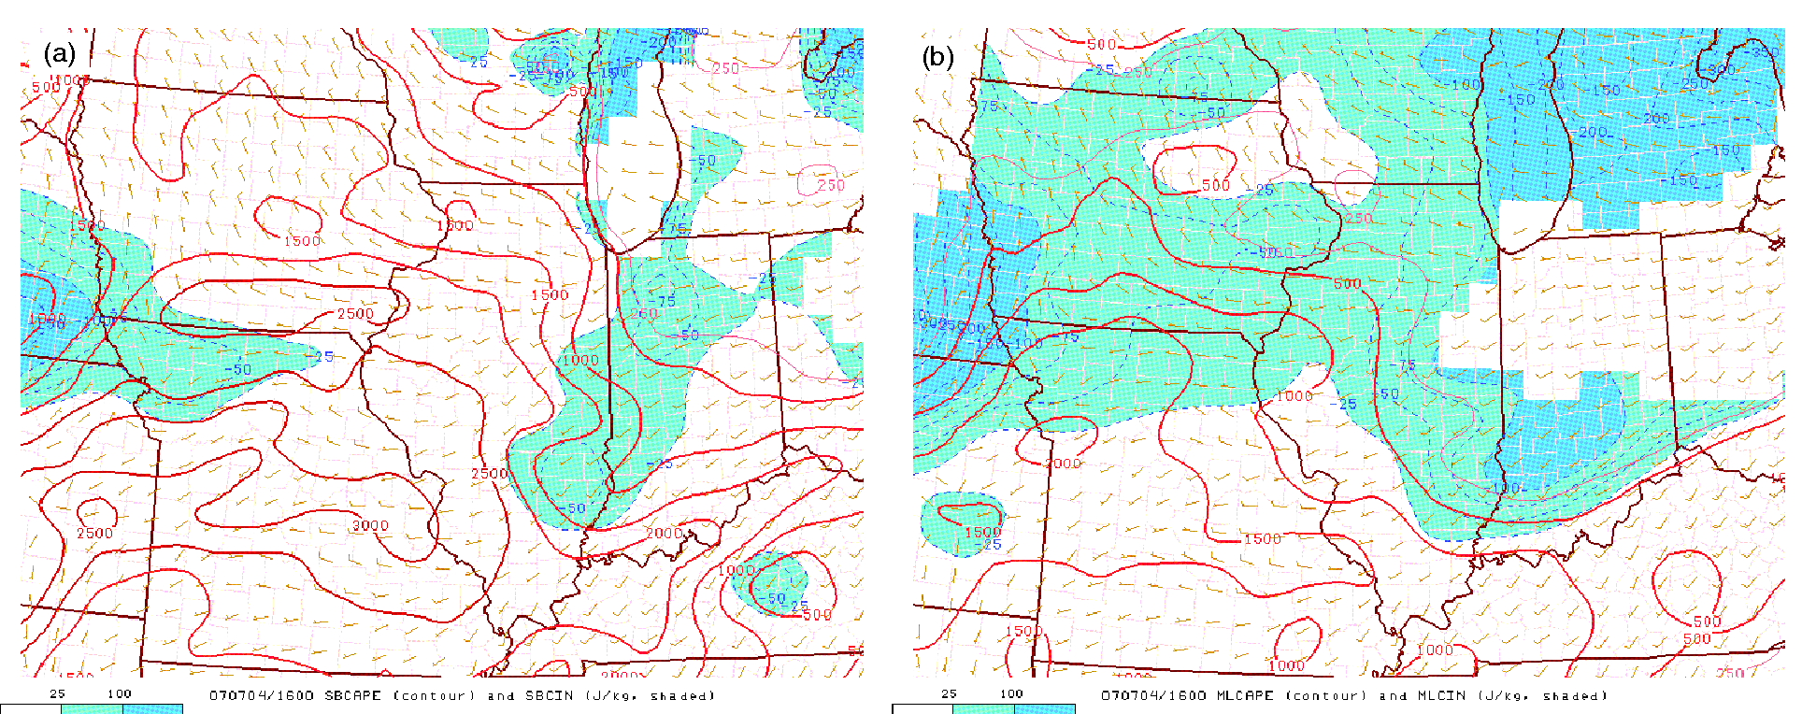
ATMS 316- Convection Initiation
Comparison of CAPE (red contours; J kg⁻¹) and CIN values (blue shading; J kg⁻¹) computed by lifting (a) a parcel from the surface, assuming no mixing, and (b) a parcel having the mean potential temperature and water vapor mixing ratio of the lowest 100 mb (Fig 7.18)

Slide 38
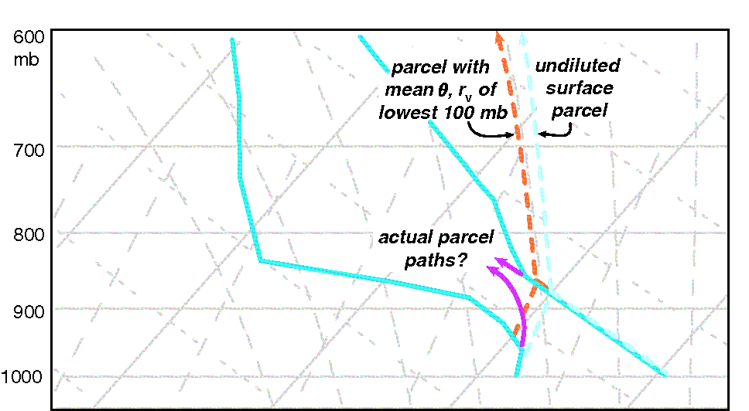
ATMS 316- Convection Initiation
In this sounding, convective temperature has been reached and no CIN is present, either for an undiluted surface parcel (light blue dashed path), or for a parcel having the mean potential temperature and water vapor mixing ratio of the lowest 100 mb (orange dashed path) (Fig 7.19)

Slide 39
ATMS 316- Convection Initiation
  Insufficiency of CIN removal for CI
  CIN absent, yet DMC fails to develop (Fig. 7.15)…
    Mixing increases with the ambient vertical wind shear and the tilt (away from the vertical) of the updraft
    Strong environmental wind shear has an inhibiting effect on CI
http://www.ssec.wisc.edu/~rozoff/chasing/9Aug04/

Slide 40
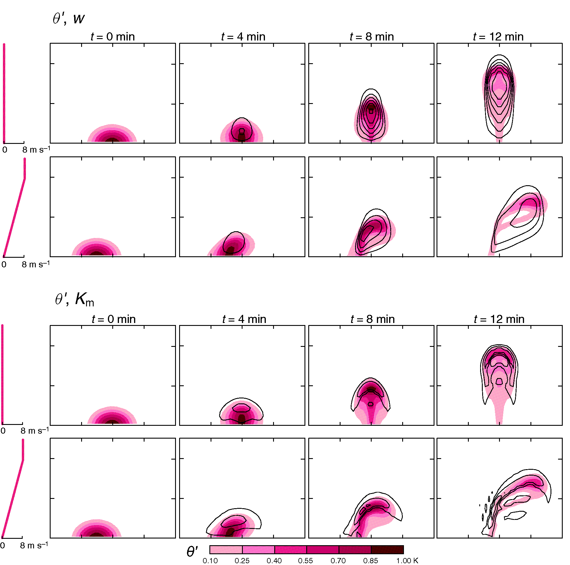
ATMS 316- Convection Initiation
Output from a pair of simulations of a thermal rising through a neutrally stratified boundary layer with and without vertical wind shear. Top two rows; θ perturbation (shaded) and w (contoured). Bottom two rows; eddy viscosity (contoured) (Fig 7.20)

Slide 41
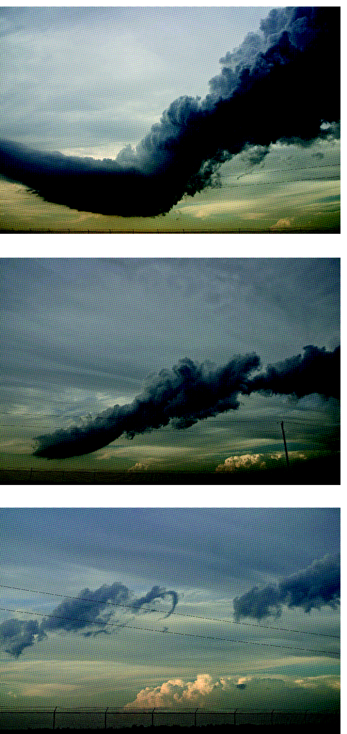
ATMS 316- Convection Initiation
In general, the detrimental effects of entrainment increase as the tilt of the updraft increases (Fig 7.21)

Slide 42
ATMS 316- Convection Initiation
  Insufficiency of CIN removal for CI
  CIN absent, yet DMC fails to develop (Fig. 7.15)…
    T and RH reduction due to mixing also a function of the env. air entrained into the lifted parcel
      Dry env → the greater the loss of positive buoyancy
Air mass bdries favored for CI due to deep moist layers (reducing hostility of env.)
http://www.ssec.wisc.edu/~rozoff/chasing/9Aug04/

Slide 43

ATMS 316- Convection Initiation
  Insufficiency of CIN removal for CI
  Parcel theory,
    Eq. (7.6) here
    Minimum vertical velocity needed by a parcel to pass through the layer of CIN en route to its LFC
http://www.ssec.wisc.edu/~rozoff/chasing/9Aug04/

Slide 44
ATMS 316- Convection Initiation
  Insufficiency of CIN removal for CI
  Soundings used for CIN assessment are typically ~ 10s to 100s km away from an area of BL convergence
    unrepresentative
  BL updrafts for CI are often associated with mesoscale convergence zones [limits usefulness of Eq. (7.6)]
http://www.ssec.wisc.edu/~rozoff/chasing/9Aug04/

Slide 45
ATMS 316- Convection Initiation
  Insufficiency of CIN removal for CI
  Summary
    CI a function of circulations at all scales, many that are unresolvable
    CIN and its removal is only part of the story
    Watch (vis sat imagery) for regions of low-level convergence where CIN is small
http://www.ssec.wisc.edu/~rozoff/chasing/9Aug04/

Slide 46
ATMS 316- Convection Initiation
  Moisture convergence
  Often used as a forecasting tool for convection initiation
    Occasionally invoked as an explanation for generation of local maxima in water vapor (moisture pooling)
    Cannot by itself produce a moisture pool
http://www.ssec.wisc.edu/~rozoff/chasing/9Aug04/

Slide 47
ATMS 316- Convection Initiation
  Moisture convergence
  What produces local moisture maxima?
    Associated with a deepening of boundary layer moisture
      Reduces dilution of rising parcels
      Vertical mixing results in a smaller drop (or no drop) in moisture concentration at the surface
http://www.ssec.wisc.edu/~rozoff/chasing/9Aug04/

Slide 48
ATMS 316- Convection Initiation
  Moisture convergence
  What produces a local moisture maximum?
    Occurs at the surface in regions where BL moisture is deeper than adjacent regions
      Produced by horizontal differences in the vertical advection of water vapor
http://www.ssec.wisc.edu/~rozoff/chasing/9Aug04/

Slide 49
ATMS 316- Convection Initiation
  Elevated convection
  Have focused up to now on surface-based DMC
    DMC drawing its inflow from air parcels in contact with the surface in close proximity to the updraft

Slide 50
ATMS 316- Convection Initiation
  Elevated convection
  Air parcels lifted from above a low-level stable layer, with little CIN and large CAPE, might initiate convection
    elevated DMC
http://www.ssec.wisc.edu/~rozoff/chasing/9Aug04/

Slide 51
ATMS 316- Convection Initiation
  Elevated convection
  Most often occurs at night
    Above nocturnal BLs
    Poleward of warm fronts (low-level jet??, Fig. 7.22)
    Occasionally initiated by a CFA (Section 5.1) ~300 km ahead of a sfc front or dryline
  Can become surface-based once outflow is produced
http://www.ssec.wisc.edu/~rozoff/chasing/9Aug04/

Slide 52
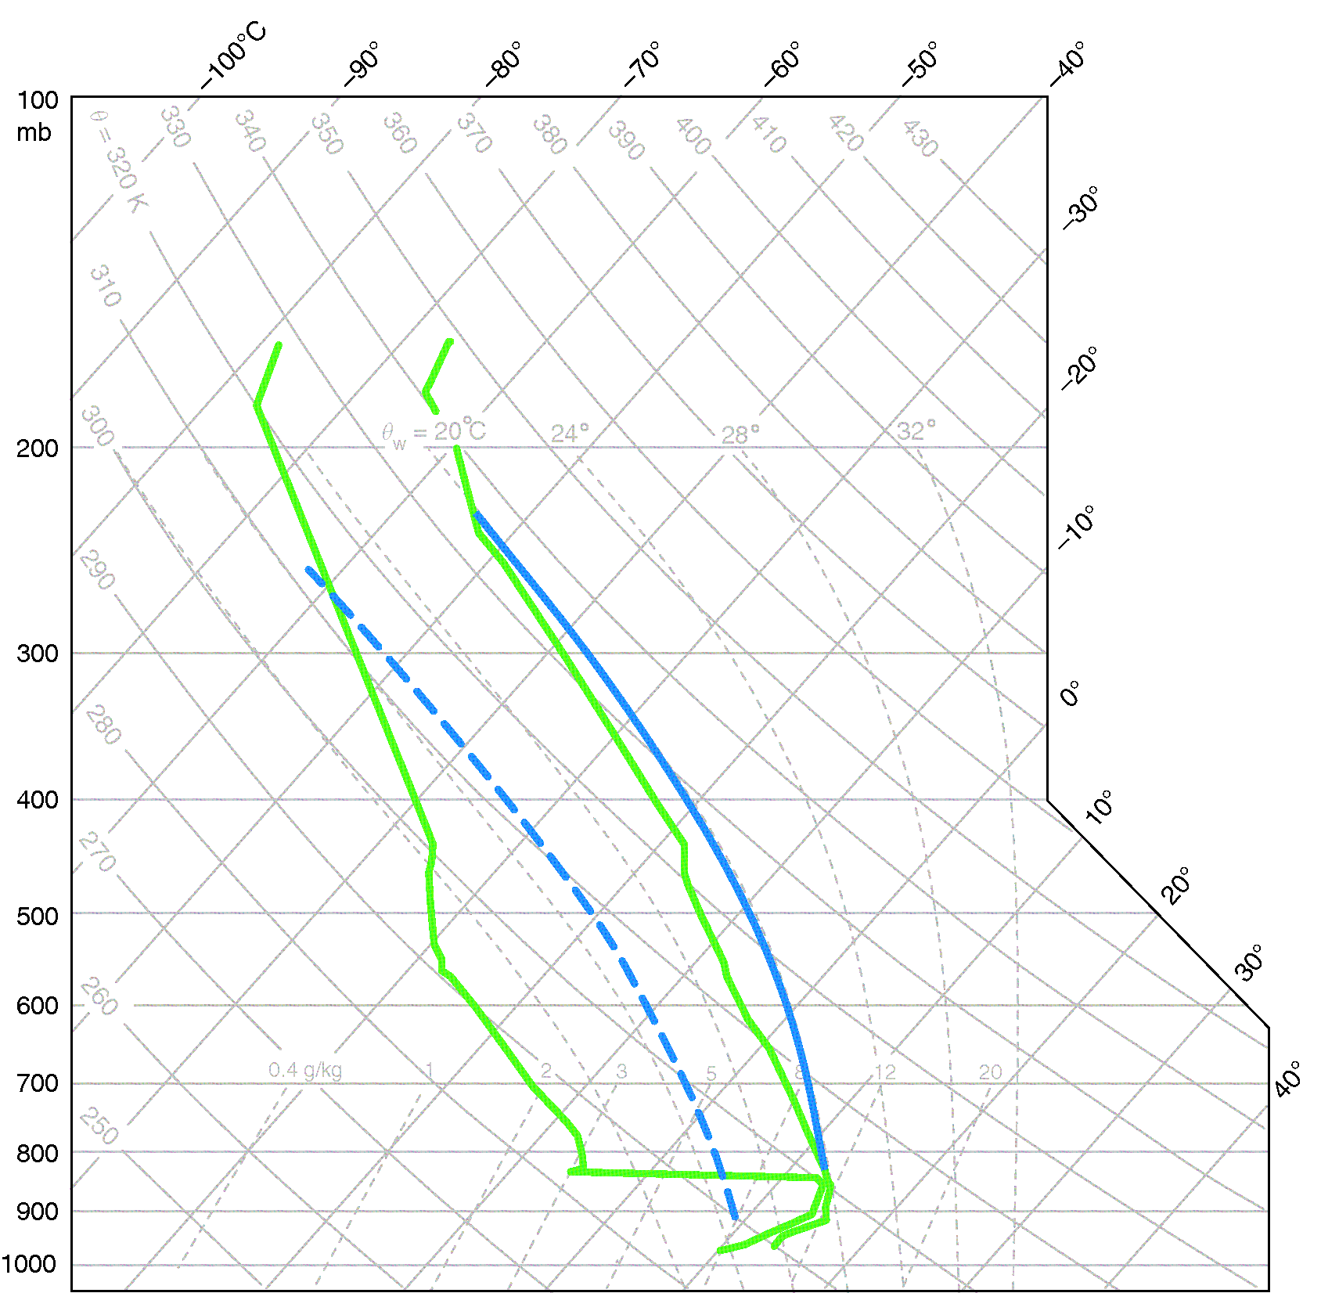
ATMS 316- Convection Initiation
Example of a sounding containing elevated CAPE but no sfc-based CAPE. Parcel lifted from the sfc follows the dashed blue trajectory, parcel lifted from the top of the stable boundary layer follows the solid blue trajectory (Fig 7.22)

Slide 53
ATMS 316- Convection Initiation
  Elevated convection
  Parcel lifted from sfc has no CAPE
  Parcel lifted from top of stable BL
    Little CIN
    CAPE ~ 1000 J kg⁻¹

Slide 54
ATMS 316- Convection Initiation
  Elevated convection
  Cloud base of elevated DMC not necessarily high
  Sfc-based convection can have high cloud bases
    Often observed with convection in southwestern U.S. (base above 3 km)
http://www.ssec.wisc.edu/~rozoff/chasing/9Aug04/

Slide 55
ATMS 316- Convection Initiation
  Elevated convection
  Primary threats
    Large hail
    Flooding
    Damaging winds less likely because downdrafts are less able to penetrate a stable low-level air mass
    Tornado production also inhibited for related reasons
http://www.ssec.wisc.edu/~rozoff/chasing/9Aug04/

Slide 56
ATMS 316- Convection Initiation
  Surface-based convection
  Most intense and severe
    Highest buoyancy when near-surface air is lifted
    Air has highest θe, (footnote#2, p. 194; θe is a measure of the potential warming from latent heat release)
    Greatest wind shear is located close to the ground (surface drag)
http://www.ssec.wisc.edu/~rozoff/chasing/9Aug04/

Slide 57
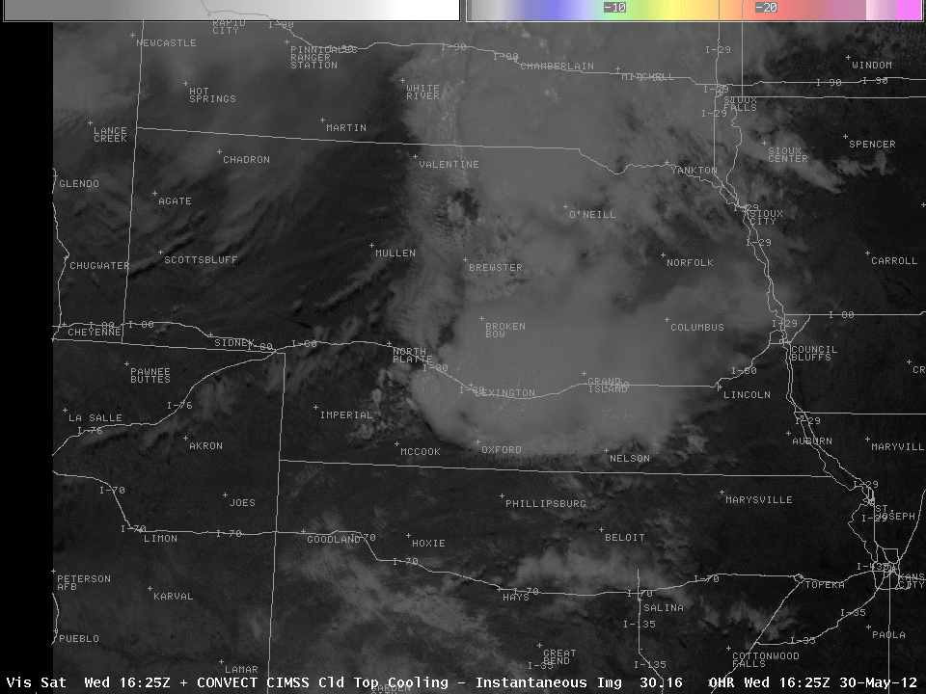
ATMS 316- Convection Initiation
Which scenario?
  Scenario#1; synoptic scale forcing alone
  Scenario#2; synoptic scale dominates mesoscale forcing
  Scenario#3; weak synoptic scale forcing
30 May 2012
convection initiation
http://cimss.ssec.wisc.edu/goes/blog/archives/category/convective-initiation

