Slide 1
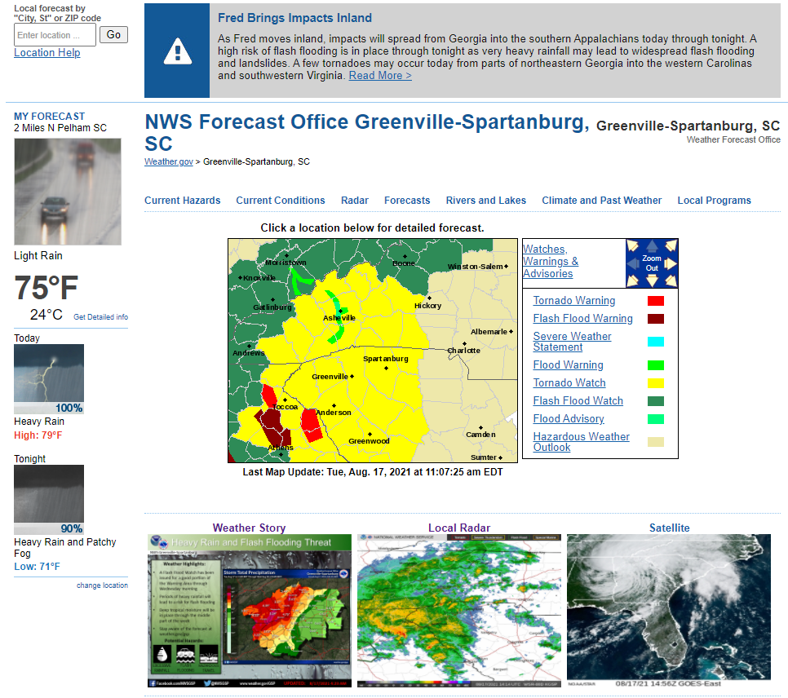
Fred – 16-18 Aug 2021

Slide 2
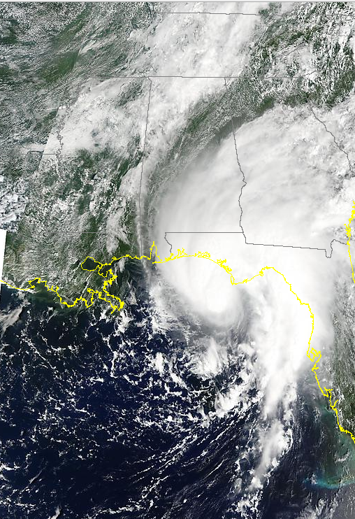
WPC summary – 20 Jan 2019
http://ge.ssec.wisc.edu/modis-today/

Slide 3
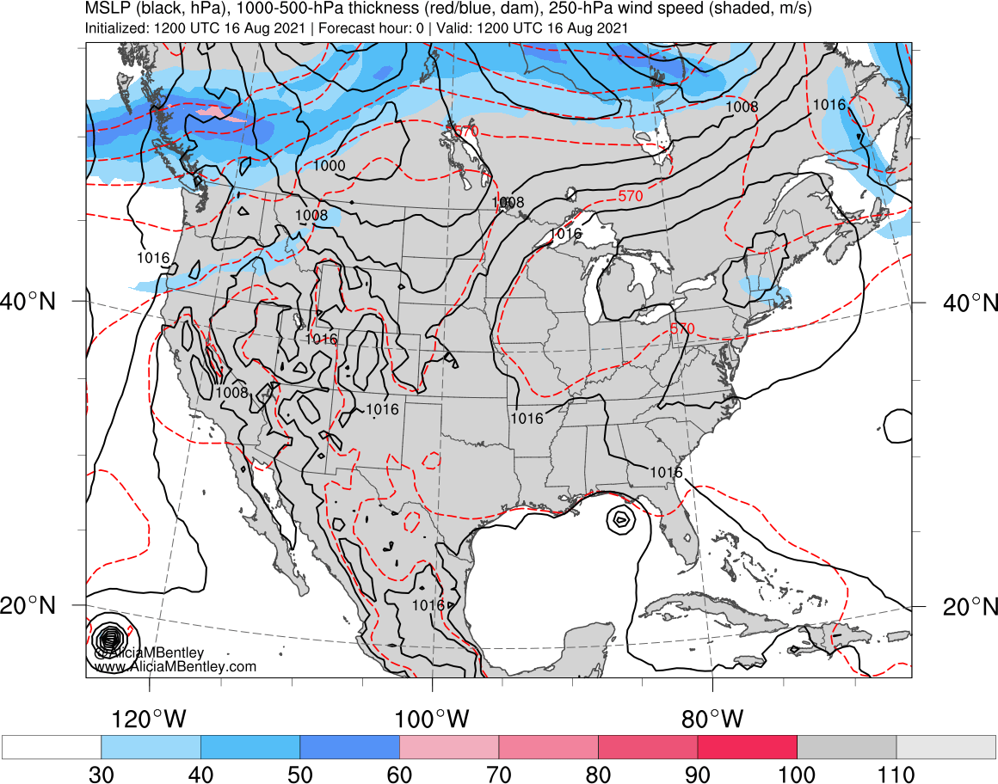
http://www.atmos.albany.edu/student/abentley/realtime.html

Slide 4
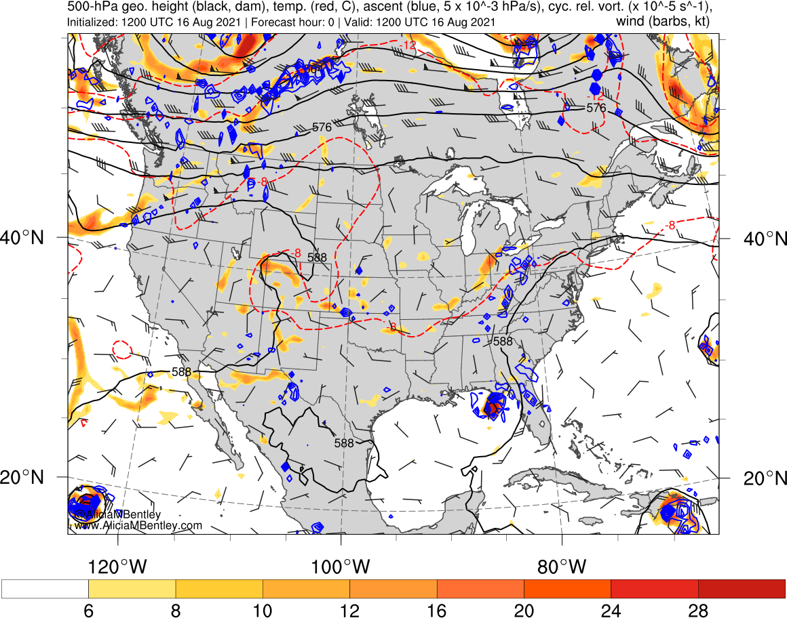
http://www.atmos.albany.edu/student/abentley/realtime.html

Slide 5
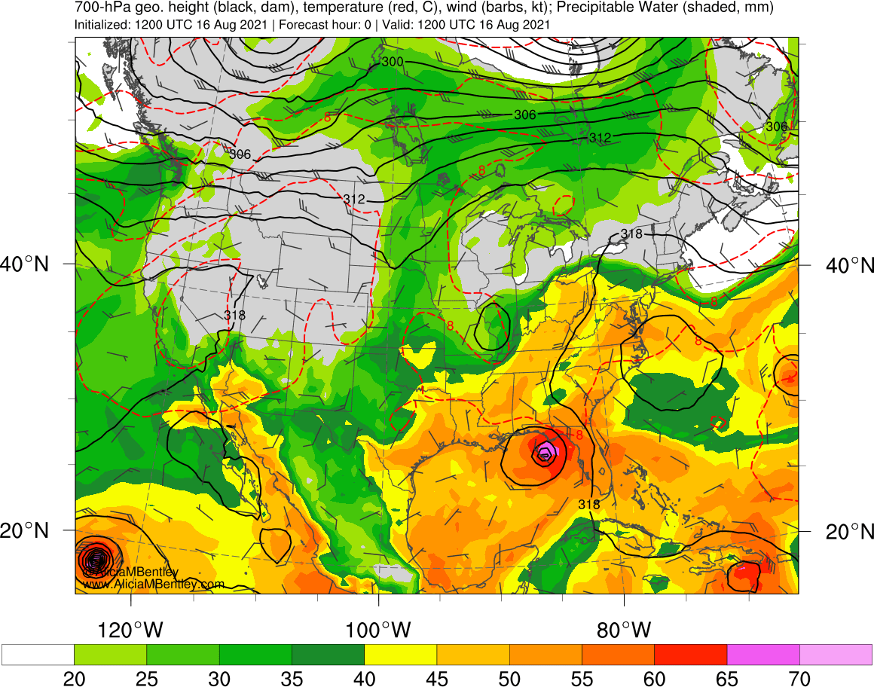
http://www.atmos.albany.edu/student/abentley/realtime.html

Slide 6
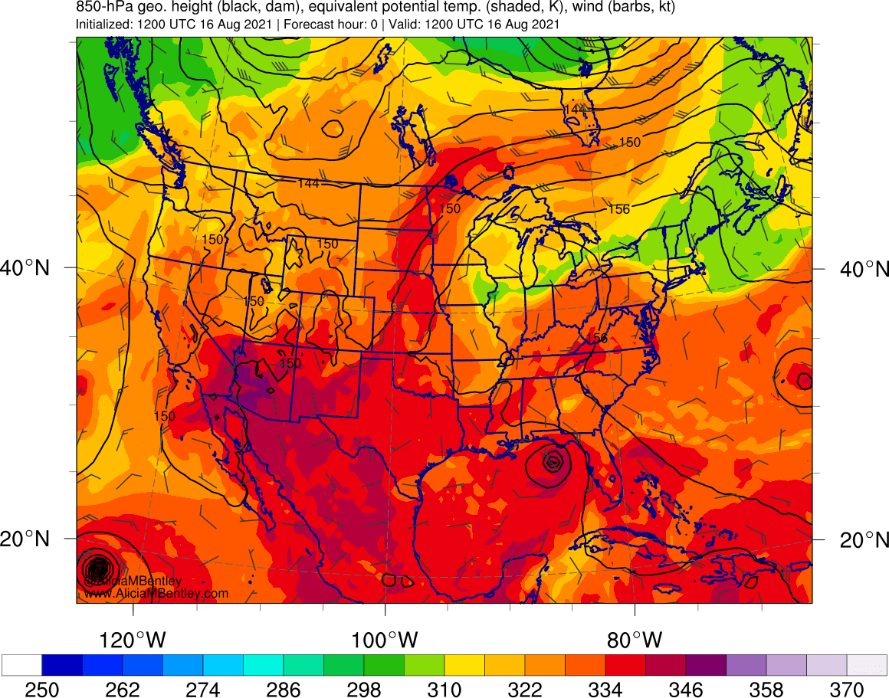
http://www.atmos.albany.edu/student/abentley/realtime.html

Slide 7
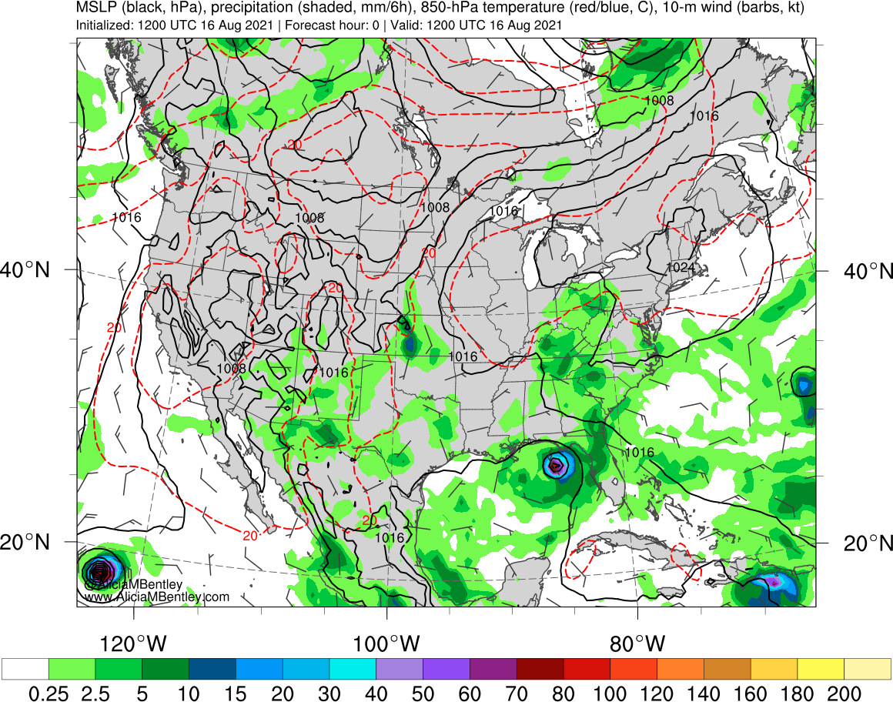
http://www.atmos.albany.edu/student/abentley/realtime.html

Slide 8
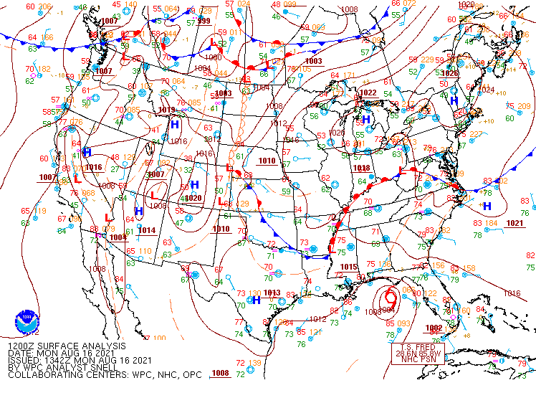
SLP – 1200 UTC 16 Aug 2021
https://www.wpc.ncep.noaa.gov/archives/web_pages/sfc/sfc_archive.php

Slide 9
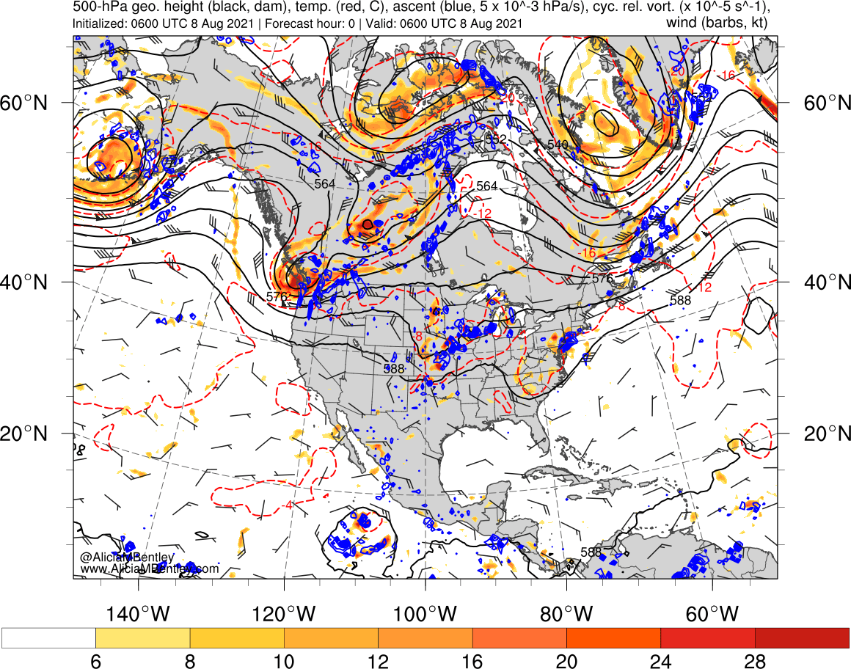
SSTs – 1500 UTC 20 Jan 2019

Slide 10
GOES-16
https://www.star.nesdis.noaa.gov/goes/conus.php?sat=G16
GARP

Slide 11
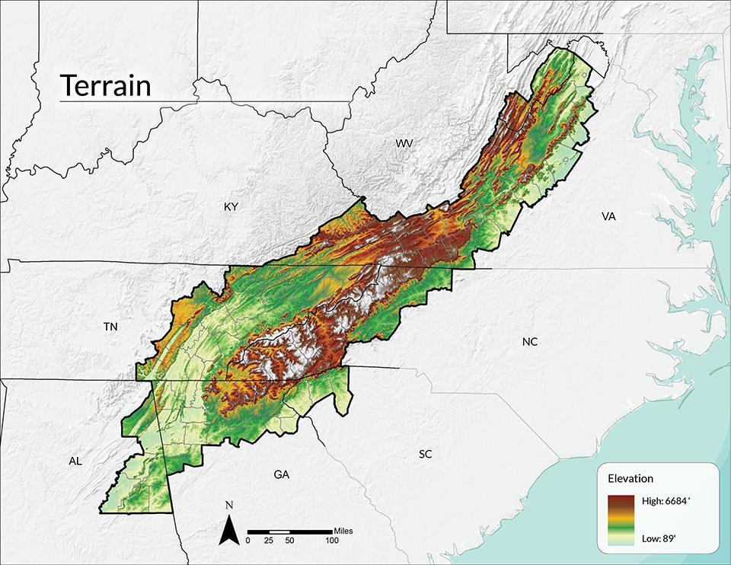
Southern Appalachians Terrain
http://southernappalachianvitalityindex.org/land/terrain-and-elevation

Slide 12
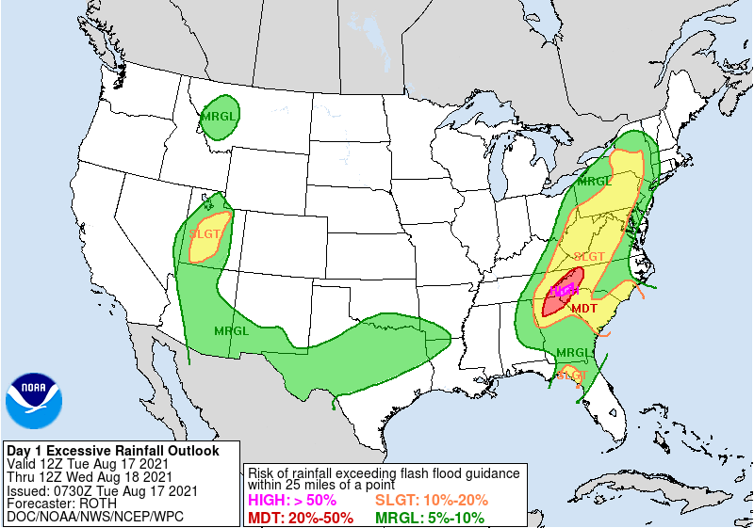
17 August 2021
https://www.wpc.ncep.noaa.gov/index.php#page=ovw

Slide 13
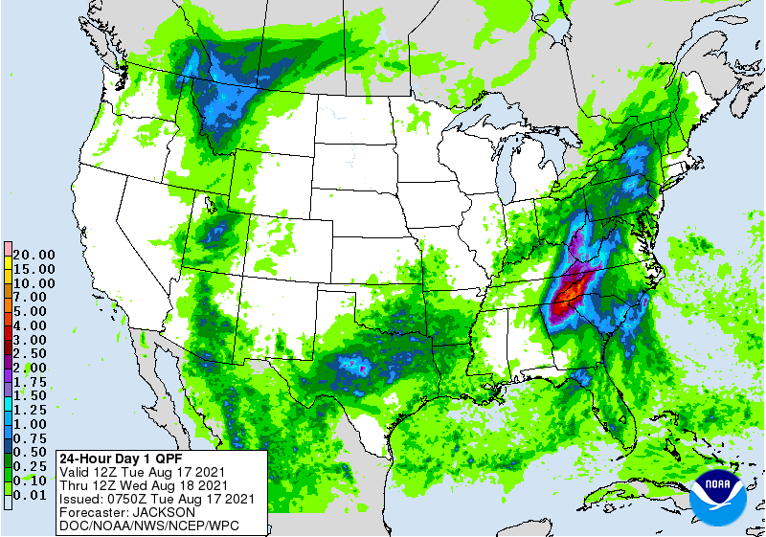
17 August 2021
https://www.wpc.ncep.noaa.gov/index.php#page=ovw

Slide 14
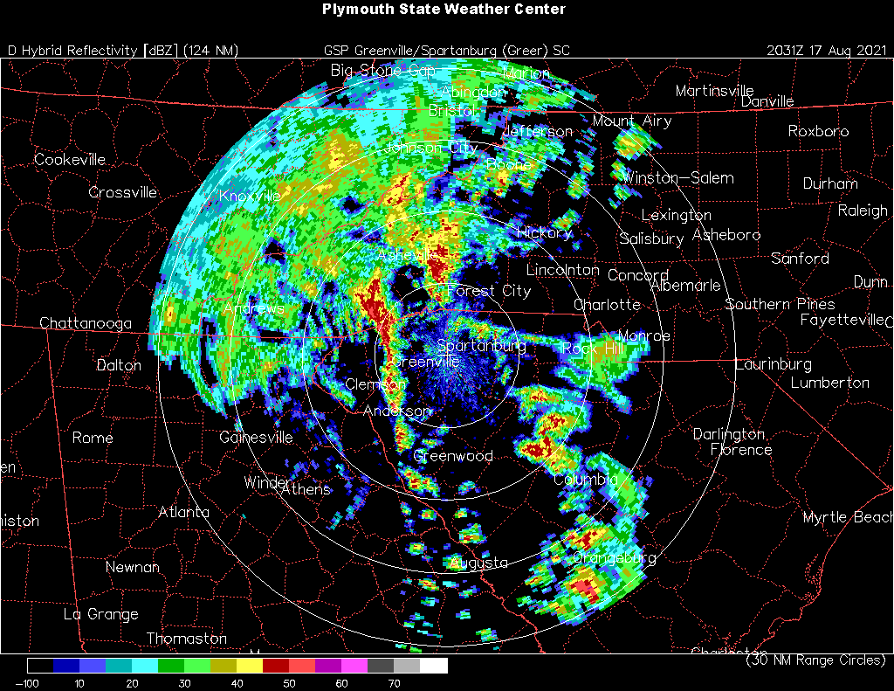
Western NC
CoCoRaHS rainfall accumulation…TBD
https://www.cocorahs.org/

Slide 15
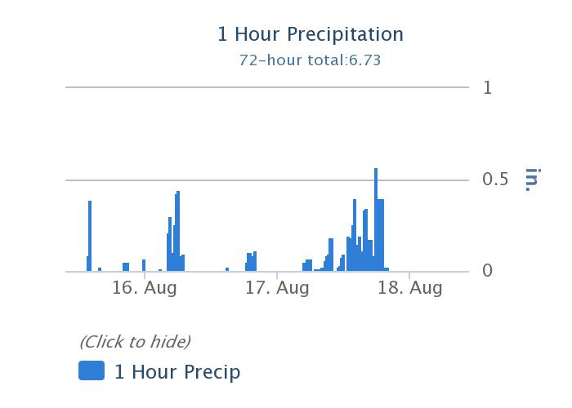
KAVL observations
https://www.wrh.noaa.gov/mesowest/getobext.php?wfo=sew&sid=KAVL&num=72&raw=0

Slide 16
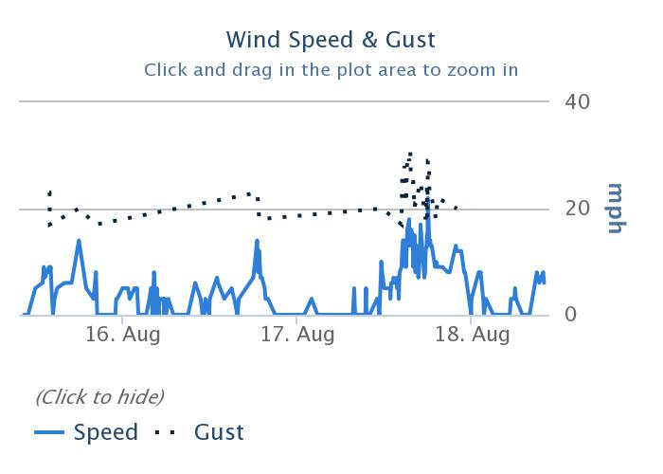
KAVL observations
https://www.wrh.noaa.gov/mesowest/getobext.php?wfo=sew&sid=KAVL&num=72&raw=0

Slide 17
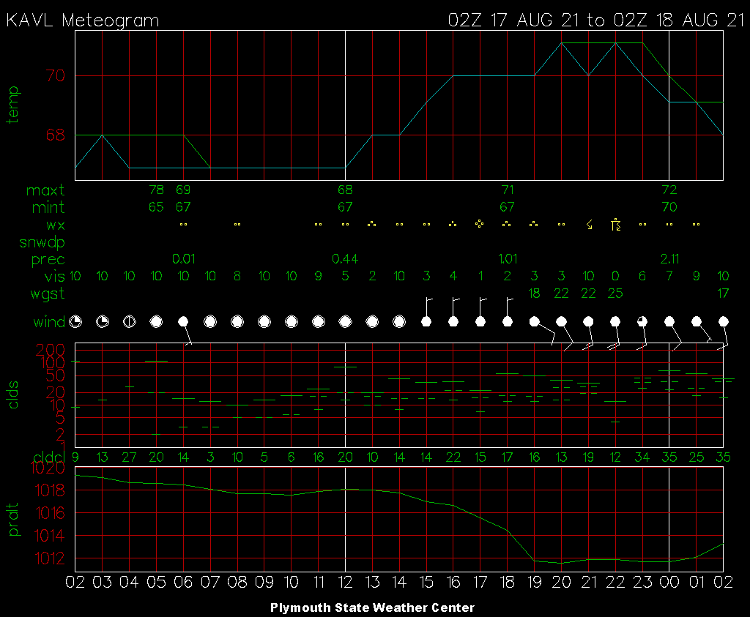
Asheville, NC
https://vortex.plymouth.edu/myo/sfc/statlog-a.html

Slide 18
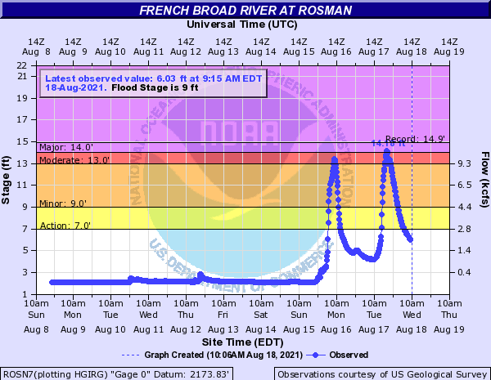
Rosman, NC
https://water.weather.gov/ahps2/index.php?wfo=gsp

Slide 19
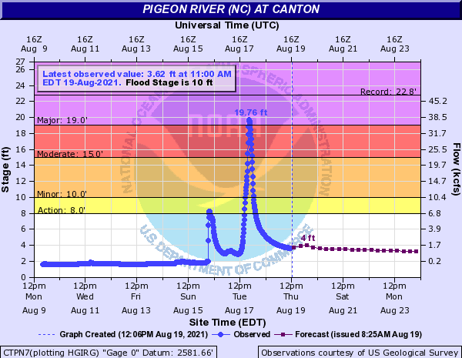
Canton, NC
https://water.weather.gov/ahps2/hydrograph.php?wfo=gsp&gage=ctpn7&hydro_type=0

Slide 20
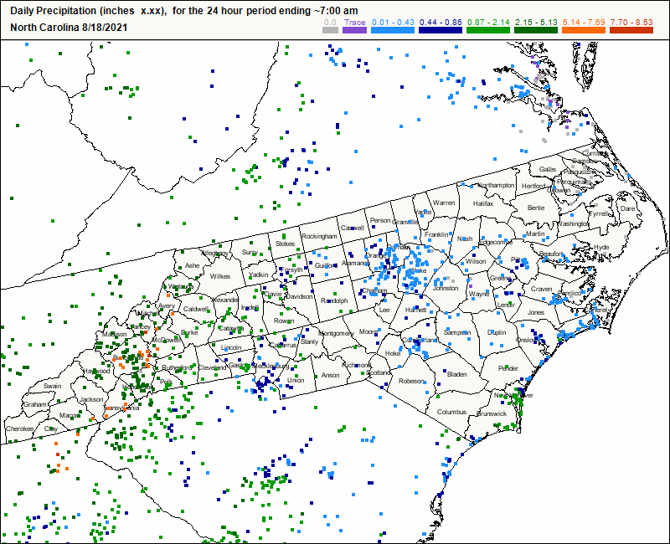
Western NC
CoCoRaHS rainfall accumulation…TBD
https://www.cocorahs.org/

Slide 21
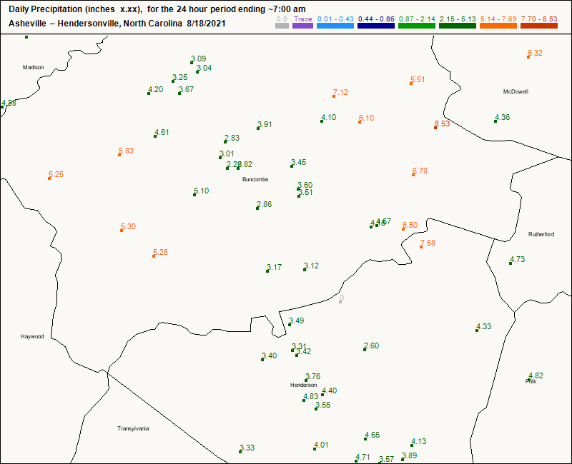
Western NC
https://www.cocorahs.org/

Slide 22
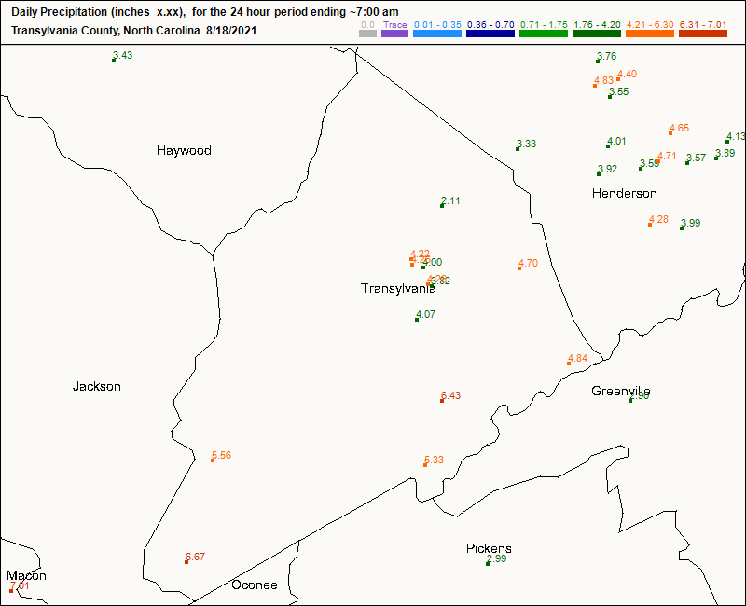
Western NC
https://www.cocorahs.org/

Slide 23
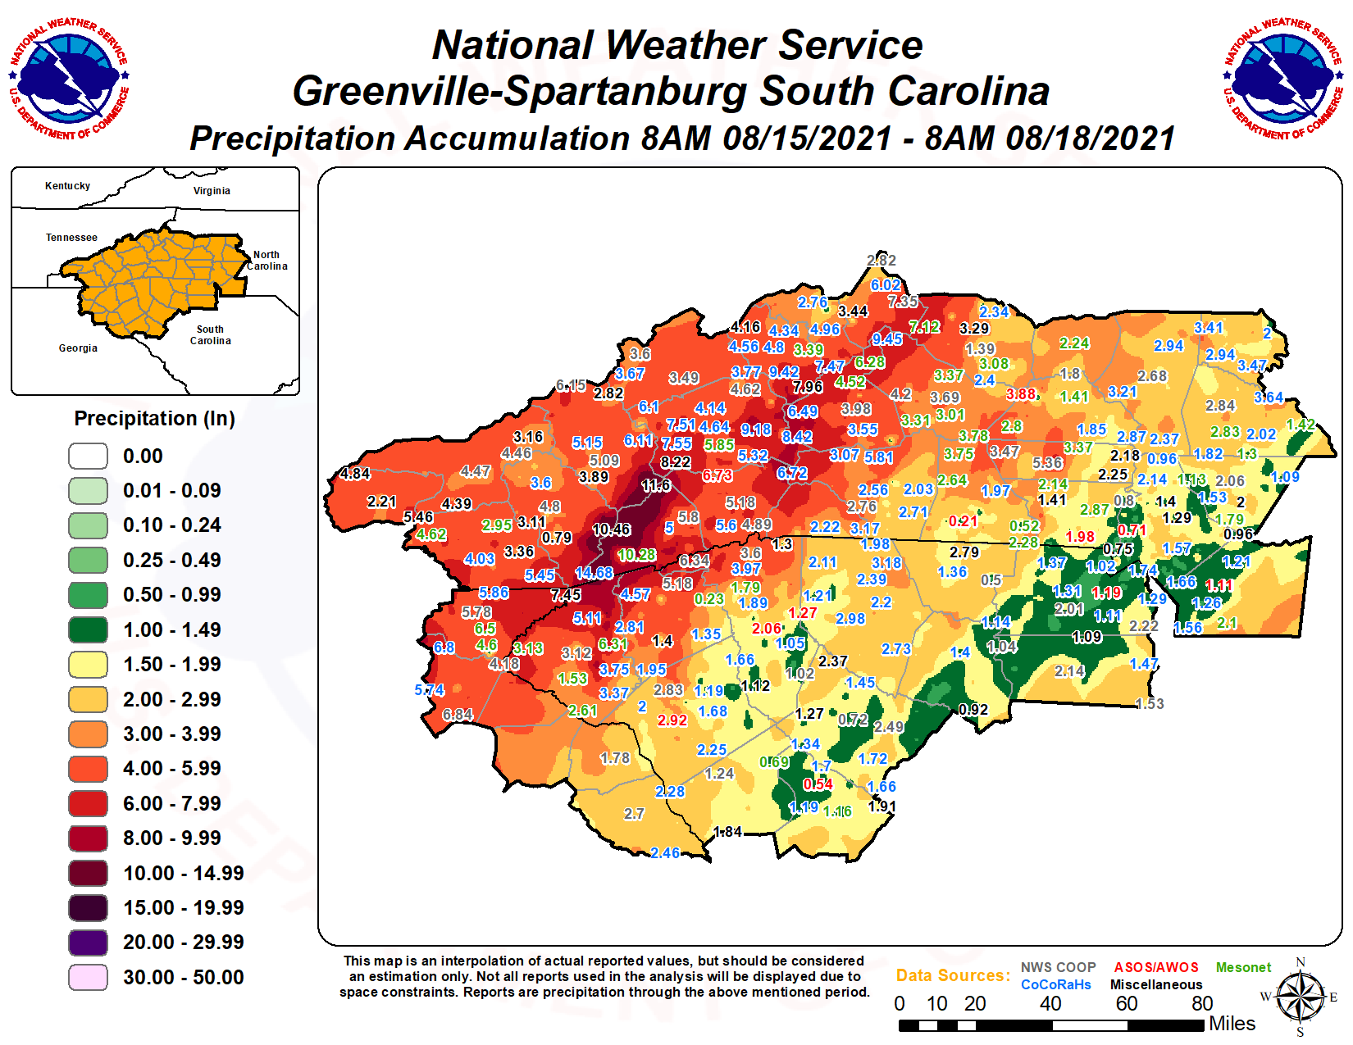
https://twitter.com/NWSGSP/status/1428055068042047496/photo/1

