Slide 1
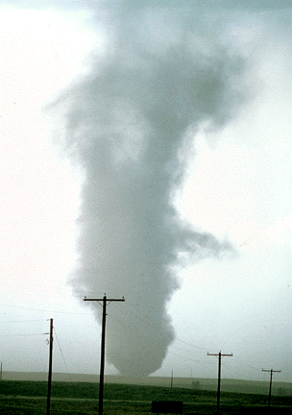
ATMS 316- Mesoscale Meteorology
Packet#9
Interesting things happen at the boundaries, or at the interface…
Dry air, humid air
Cold air, warm air
http://www.ucar.edu/communications/factsheets/Tornadoes.html

Slide 2
ATMS 316- Mesoscale Meteorology
https://www.meted.ucar.edu/mesoprim/shear/
Outline
Background
Drylines
Outflow boundaries

Slide 3
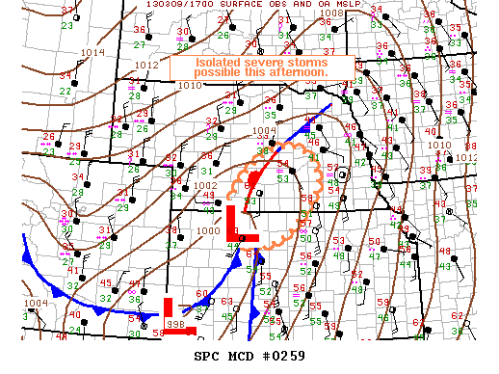
ATMS 316- Background
Drylines and outflow boundaries
Huge forecast challenge; where will convection be triggered?
Drylines and outflow boundaries can act as the trigger
Help to narrow focus to a smaller area, however
Challenge still remains; where precisely along a dryline or outflow boundary will the most dangerous convection be triggered?
http://www.spc.noaa.gov/exper/archive/event.php?date=20130309

Slide 4
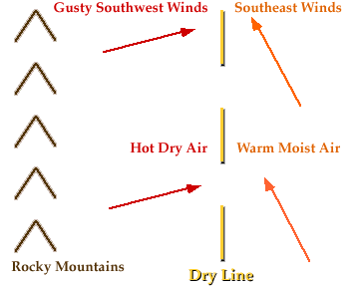
ATMS 316- Drylines & Outflow Boundaries
Chapter 5, p. 132 – 149
Drylines
General description
Dryline formation
Dryline motion
Capping inversions and convection initiation
Other aspects of drylines
Outflow boundaries
General description
Density current dynamics General characteristics
http://ww2010.atmos.uiuc.edu/(Gh)/guides/mtr/af/frnts/dfdef.rxml

Slide 5
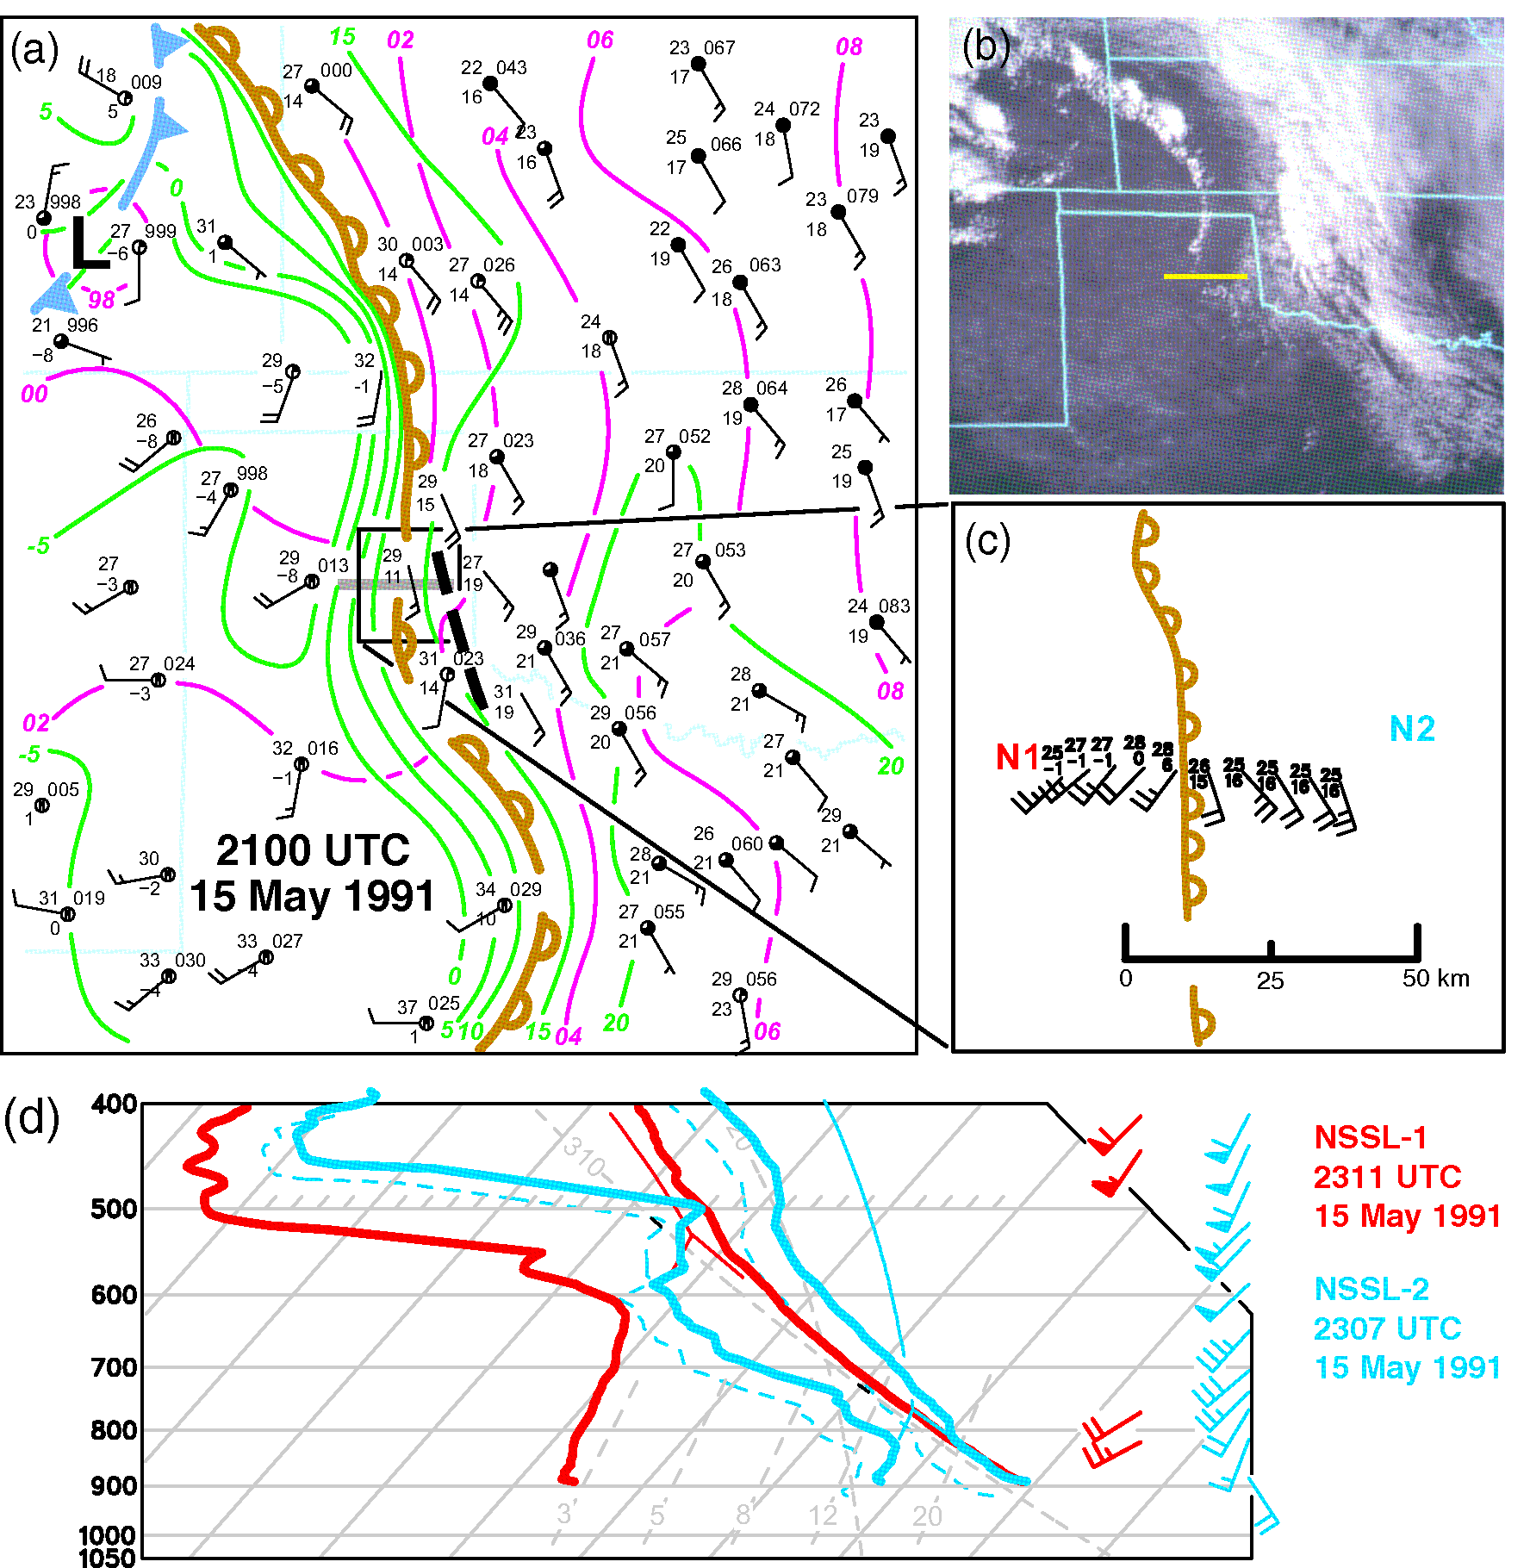
ATMS 316- Drylines & Outflow Boundaries
General description
Dryline
Boundary
Moist, maritime tropical
Dry, continental tropical
common in western Great Plains of U.S.

Slide 6
ATMS 316- Drylines & Outflow Boundaries
General description
Dryline
Geostrophic deformation (as in synoptic fronts) plays important role in its formation
Also found in n. India, e. China, and Spain; focus on those found in the U.S.

Slide 7
ATMS 316- Drylines & Outflow Boundaries
General description
Moist, maritime tropical air mass
Gulf of Mexico
Dry, continental tropical air mass
Southwestern U.S.
High plateau of Mexico
http://ww2010.atmos.uiuc.edu/(Gh)/guides/mtr/af/frnts/dfdef.rxml

Slide 8
ATMS 316- Drylines & Outflow Boundaries
General description
Vegetation, soil moisture, and associated surface latent heat flux, tends to decrease as one travels from east to west
Dewpoint temperature gradients
dryline; 10 K ( 1 km)⁻¹
ordinary; 10 K (100 km)⁻¹
http://ww2010.atmos.uiuc.edu/(Gh)/guides/mtr/af/frnts/dfdef.rxml

Slide 9
ATMS 316- Drylines & Outflow Boundaries
General description
Drylines generally oriented meridionally in the Great plains
Dry air west; humid air east
Dry air mass west of a dryline has a larger diurnal temperature cycle
warmer by day, cooler by night

Slide 10
ATMS 316- Drylines & Outflow Boundaries
Dryline formation
Strength of dryline is highly correlated with the strength of large-scale confluence
Strength of lee troughing downstream of Rocky Mtns
Result of adiabatic compression and warming of sinking air on the lee slope
Vortex stretching (spin-up of cyclonic relative vorticity)
http://ww2010.atmos.uiuc.edu/(Gh)/guides/mtr/af/frnts/dfdef.rxml

Slide 11
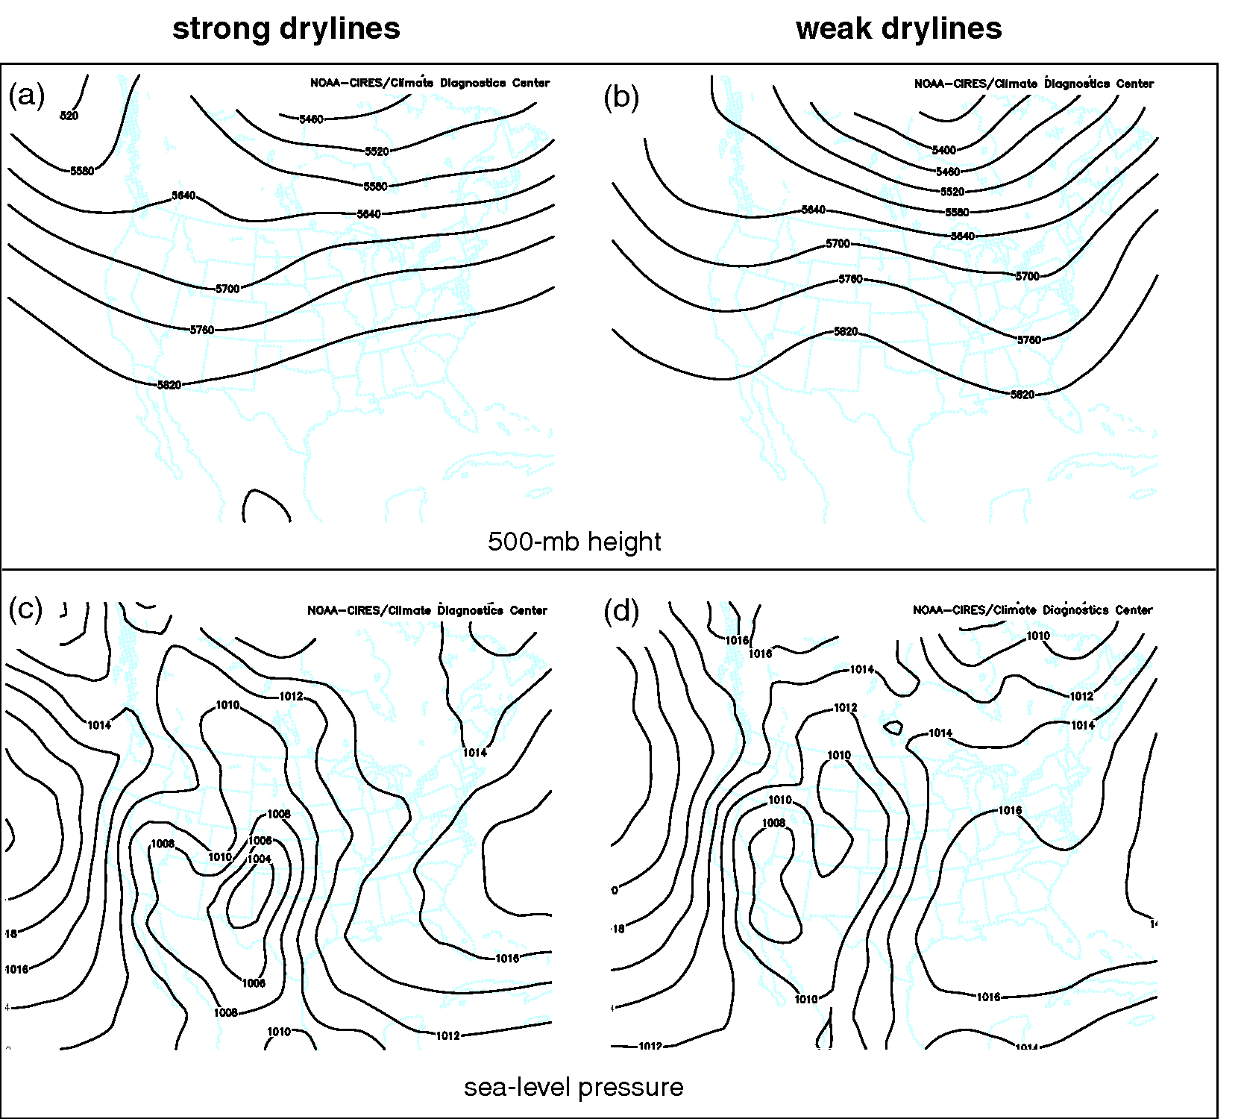
ATMS 316- Drylines & Outflow Boundaries
Dryline formation
Strength of dryline is highly correlated with the strength of large-scale confluence
Strength of lee troughing downstream of Rocky Mtns
Result of adiabatic compression and warming of sinking air on the lee slope
Vortex stretching (spin-up of cyclonic relative vorticity)

Slide 12
ATMS 316- Drylines & Outflow Boundaries
Dryline formation
Lee troughs downstream of Rockies draw
moist air nw’ward from GoM
dry air ne’ward from southwestern U.S. or northern Mexico

Slide 13
ATMS 316- Drylines & Outflow Boundaries
Dryline formation
Strong lee troughs
observed downstream of short-wave troughs in the mid- to upper-level westerlies
Weak lee troughs
Ridging in the mid- to upper-level westerlies

Slide 14
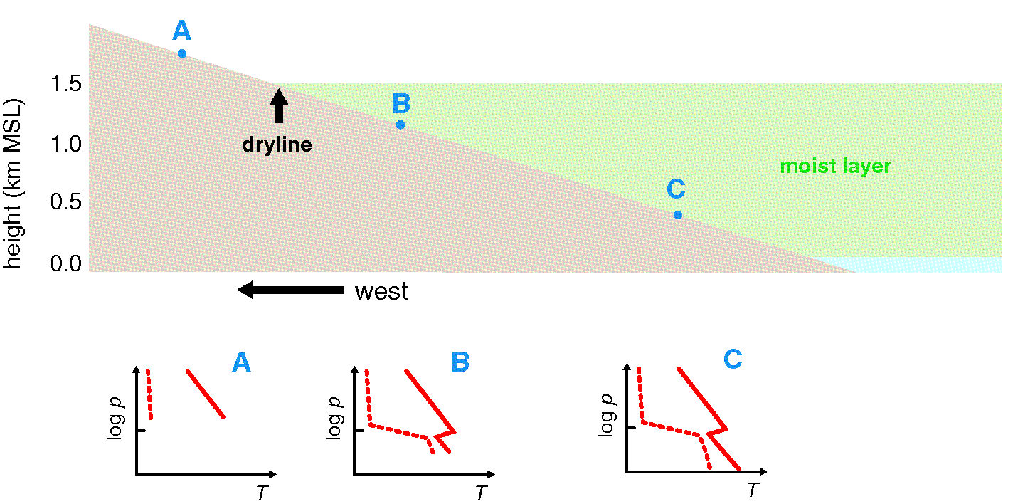
ATMS 316- Drylines & Outflow Boundaries
Dryline formation
Other contribution of sloping terrain (beside formation of lee troughs)
Drylines; intersection of the top of the maritime tropical boundary layer with the ground

Slide 15
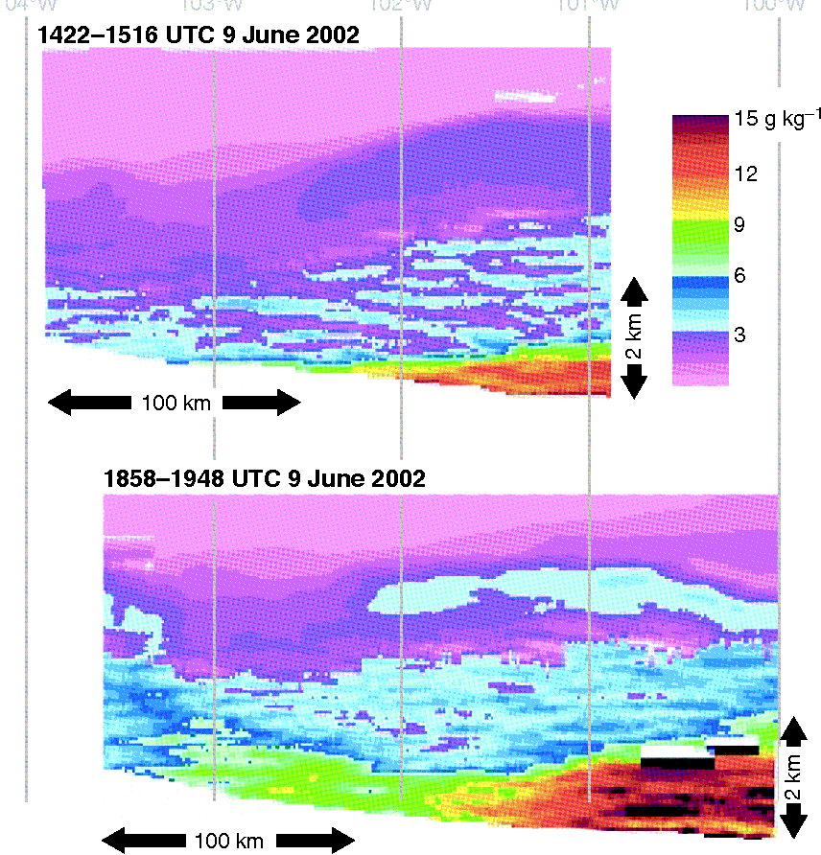
ATMS 316- Drylines & Outflow Boundaries
Dryline formation
Other contribution of sloping terrain (beside formation of lee troughs)
Moist layer is relatively deep in the east, relatively shallow in the west
Dryline is the intersection between the top of the moist layer and the ground
Mixing ratio from west-east traverses of a downward-pointing airborne water vapor lidar

Slide 16
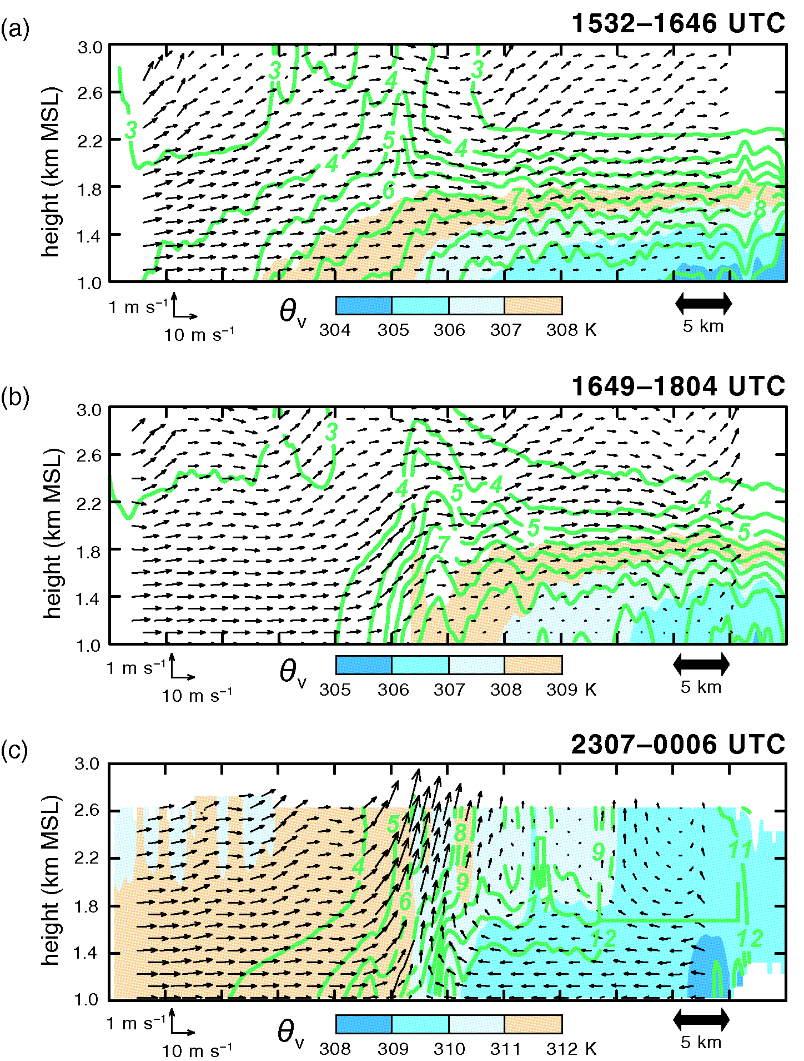
ATMS 316- Drylines & Outflow Boundaries
Dryline formation
boundary
Nearly upright from the ground to 1-1.5 km due to vertical mixing
Capped east of the dryline by a layer of large static stability at the BL top
Elevated mixed layer overlies inversion to the east
water vapor mixing ratio (contours)

Slide 17
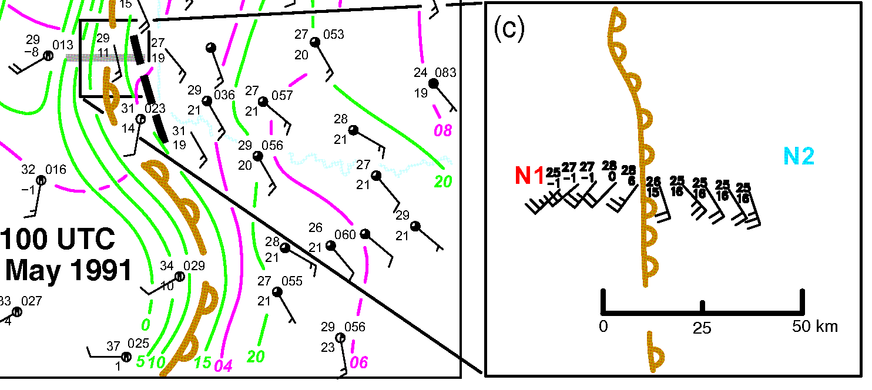
ATMS 316- Drylines & Outflow Boundaries
Dryline formation
Extreme moisture gradients;
dryline >10 K ( 1 km)⁻¹
positive feedback between frontogenesis and increase in horizontal moisture gradient leads to the convergence of moisture and temperature beneath the ascending branch of solenoidal vertical circulation

Slide 18
ATMS 316- Drylines & Outflow Boundaries
Dryline formation
Extreme moisture gradients;
dryline >10 K ( 1 km)⁻¹
Differential vertical mixing (vm)
Deeper vm on dry side increases westerly momentum transported to the ground
Increases low-level convergence
Increases moisture gradient

Slide 19
ATMS 316- Drylines & Outflow Boundaries
Dryline motion
Influence of strong synoptic-scale motion; dryline translates with no diurnal component to its motion
Diurnal influence is strong in the absence of strong synoptic-scale forcing
Eastward motion during the day
Westward retreat at night
http://ww2010.atmos.uiuc.edu/(Gh)/guides/mtr/af/frnts/dfdef.rxml

Slide 20
ATMS 316- Drylines & Outflow Boundaries
Dryline motion
Daytime; mixing east of dryline (“thin” layer of moist air) brings down westerlies to the surface and dryline propagates eastward
distinct from dryline jumping
http://ww2010.atmos.uiuc.edu/(Gh)/guides/mtr/af/frnts/dfdef.rxml

Slide 21
ATMS 316- Drylines & Outflow Boundaries
Dryline motion
Evening; air west of dryline cools faster than air east of it, radiation inversion forms
Vertical mixing ends, winds slow and back toward (lee trough), moisture and dryline is advected westward
http://ww2010.atmos.uiuc.edu/(Gh)/guides/mtr/af/frnts/dfdef.rxml

Slide 22
ATMS 316- Drylines & Outflow Boundaries
Capping inversions and convection initiation
Convective storms often form in the dry air mass just west of the dryline, where the ascending branch of the thermally direct circulation is situated
move east after formation, tapping into low-level moisture (if cap is weak)
http://ww2010.atmos.uiuc.edu/(Gh)/guides/mtr/af/frnts/dfdef.rxml

Slide 23
ATMS 316- Drylines & Outflow Boundaries
Capping inversions and convection initiation
Convection triggers east of a dryline
CFA
Gravity waves excited by dryline updrafts impinging on the stable layer atop the BL
http://ww2010.atmos.uiuc.edu/(Gh)/guides/mtr/af/frnts/dfdef.rxml

Slide 24
ATMS 316- Drylines & Outflow Boundaries
Capping inversions and convection initiation
Drylines
often precede cold fronts in the Great Plains and get “first crack” at encroaching upon the conditionally unstable mT air masses
more prone to initiate isolated T-storms
prolific tornado producers
http://ww2010.atmos.uiuc.edu/(Gh)/guides/mtr/af/frnts/dfdef.rxml

Slide 25
ATMS 316- Drylines & Outflow Boundaries
Capping inversions and convection initiation
Drylines are closely related to capping inversions (caps or lids)
prevent the release of CAPE until CIN of BL air can be overcome
allow for generation of large CAPE values
absence of cap → CAPE is released shortly after it is generated (as in tropics)
http://ww2010.atmos.uiuc.edu/(Gh)/guides/mtr/af/frnts/dfdef.rxml

Slide 26
ATMS 316- Drylines & Outflow Boundaries
Capping inversions and convection initiation
greatest potential for failed forecasts; days having strong capping inversions
large potential for severe weather (large CAPE)
large CIN

Slide 27
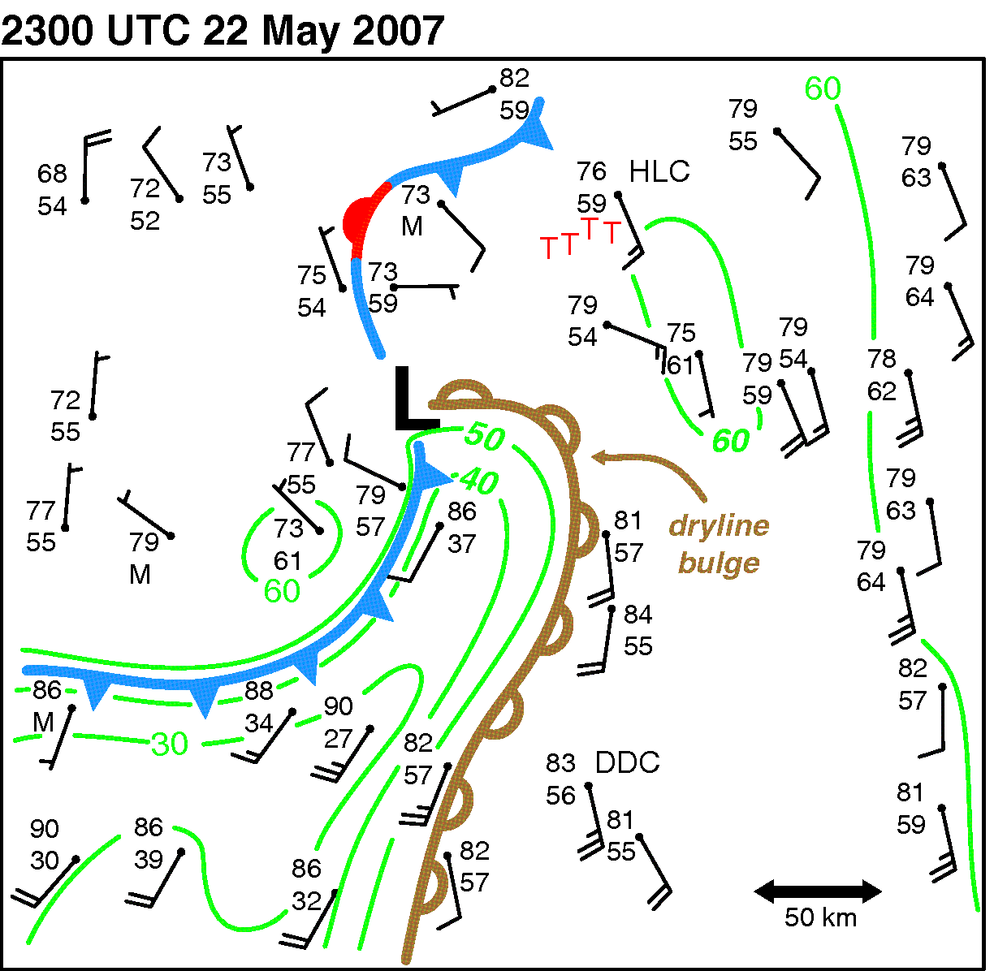
ATMS 316- Drylines & Outflow Boundaries
Other aspects of drylines
Multiple drylines
not well understood
Meso-β-scale bulges or waves in drylines
enhanced vertical mixing?
often in the left exit region of a jet streak
relative maximum in surface sensible heat fluxes

Slide 28
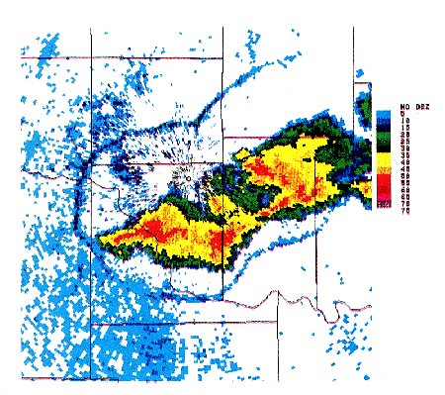
ATMS 316- Drylines & Outflow Boundaries
Outflow boundaries – general description
Produced by showers or T-storms as rain falls into subsaturated air and evaporates
Air tends to sink and spread outward, away from its source, upon reaching the surface
Associated with mesohigh or bubble high
http://apollo.lsc.vsc.edu/classes/met455/notes/section8/3.html

Slide 29
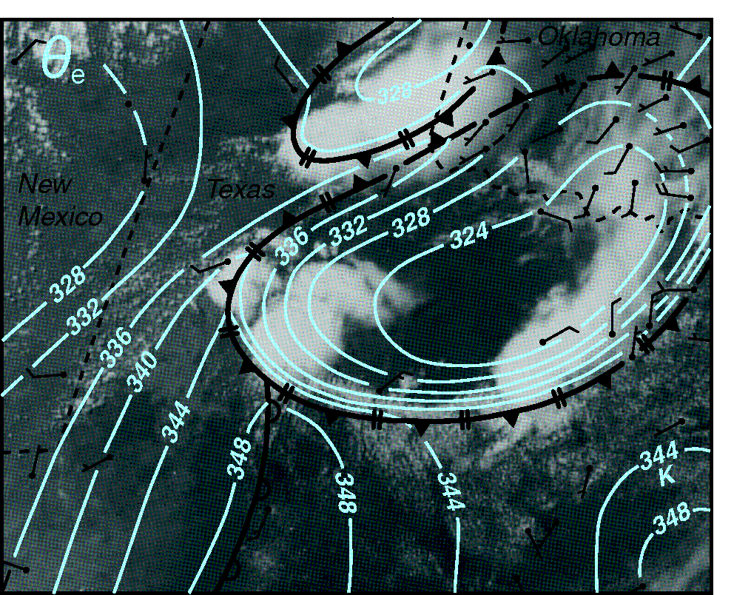
ATMS 316- Drylines & Outflow Boundaries
Outflow boundaries – general description
Dry air impinging on a T-storm updraft aloft
Melting and sublimation of snow, graupel, and/or hail can contribute to negative buoyancy, as well
θ_{e} of downdrafts and outflows tend to be lower than ambient values

Slide 30
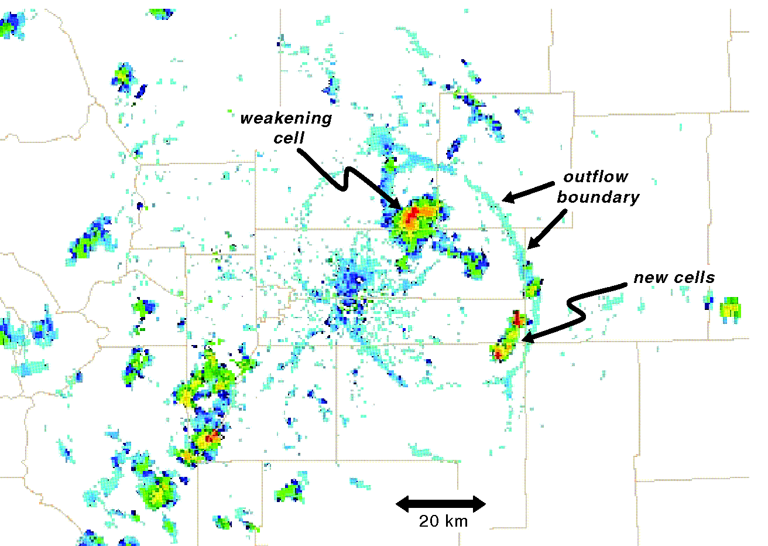
ATMS 316- Drylines & Outflow Boundaries
Outflow boundaries – general description
Outflow boundary, a.k.a.
Gust front (if close to originating convection)
Fine-line (detectable in radar reflectivity data; insects or air density differences)

Slide 31
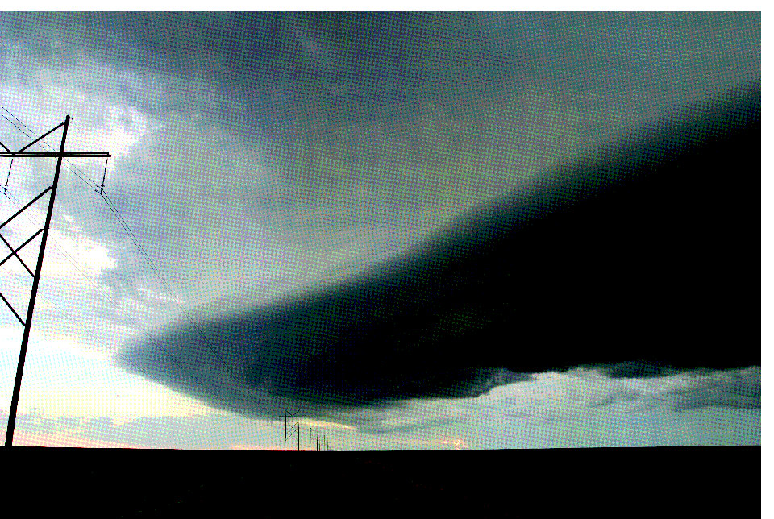
ATMS 316- Drylines & Outflow Boundaries
Outflow boundaries – general description
~1 km deep (100s m – 4 km)
persistent long-living convection yields greatest depths
arcus or shelf cloud
air forced to ascend along the leading edge of the outflow

Slide 32
ATMS 316- Drylines & Outflow Boundaries
Outflow boundaries – general description
θ_{e} deficit dependent on
Height from which air descends to the surface
Environmental temperature and moisture profile
difficult to generalize, depends on types and number of hydrometeors
hydrometeors are also dependent on the environmental RH

Slide 33
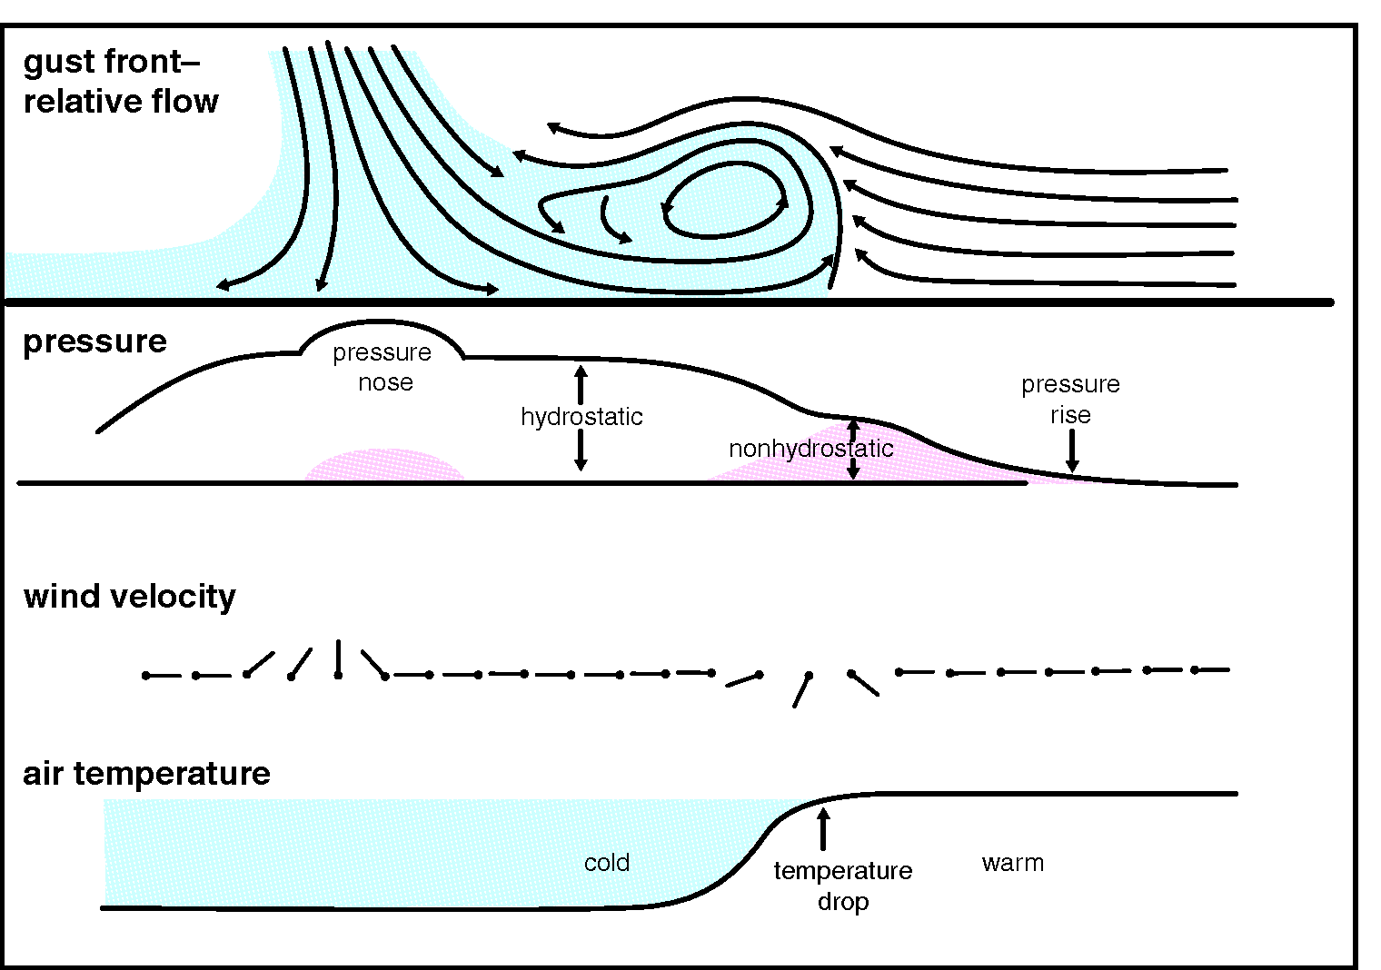
ATMS 316- Drylines & Outflow Boundaries
Outflow boundaries – general description
Pressure changes
Hydrostatic
Nonhydrostatic

Slide 34
ATMS 316- Drylines & Outflow Boundaries
Outflow boundaries – general description
Pressure changes
Hydrostatic
Pressure a function of depth of cold air
Nonhydrostatic
1) required with the deflection of ambient air up and over the outflow
2) deceleration of downdraft air as it approaches the ground
2)
1)

Slide 35
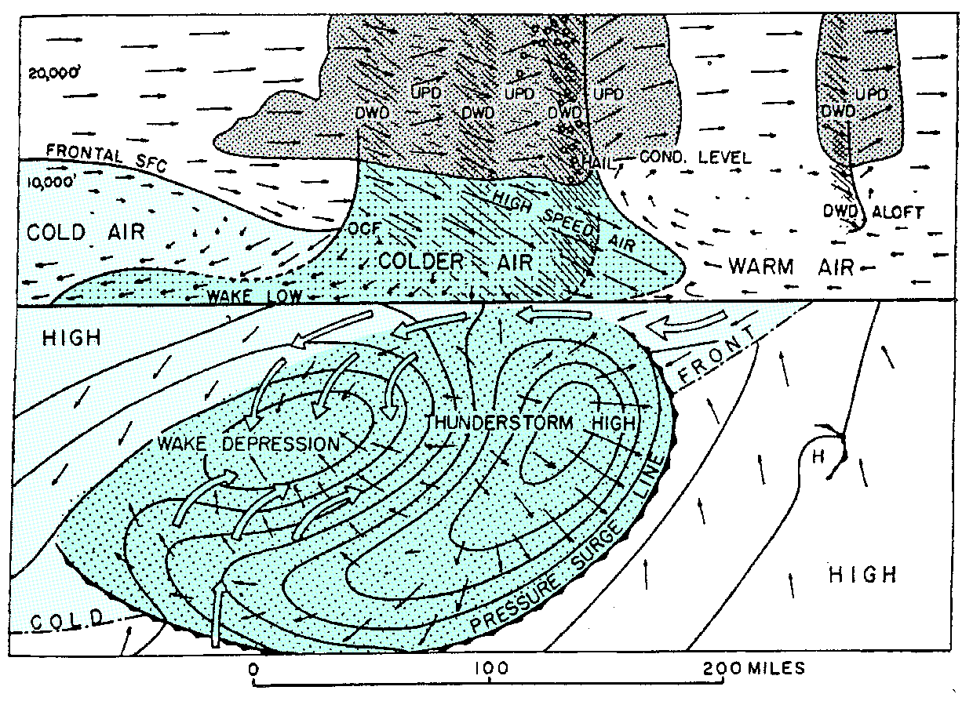
ATMS 316- Drylines & Outflow Boundaries
Outflow boundaries – general description
Wake low or wake depression
Region of low pressure typically developing in the trailing portion of the outflow
Net columnar warming due to subsidence and warming occurring at midlevels (hydrostatic effects)

Slide 36
ATMS 316- Drylines & Outflow Boundaries
Outflow boundaries – general description
Wake low or wake depression
Region of low pressure typically developing in the trailing portion of the outflow
Net columnar warming due to subsidence and warming occurring at midlevels (hydrostatic effects)

Slide 37
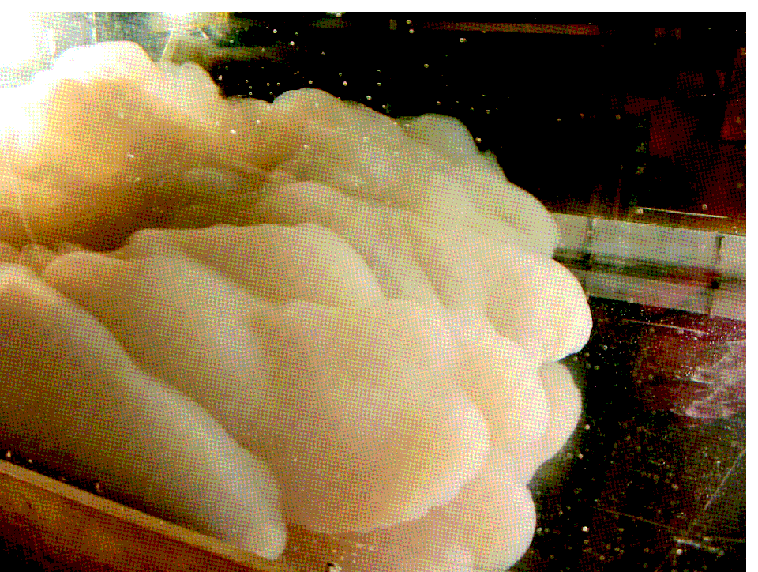
ATMS 316- Drylines & Outflow Boundaries
Density current dynamics
Outflow boundaries behave often like density currents
Flow of a relatively dense fluid embedded within a lighter fluid
Motion is dictated by horizontal pressure gradient force across the density interface
Behave as material surfaces (air parcels do not pass through the density interface)
A density current in a laboratory tank.

Slide 38
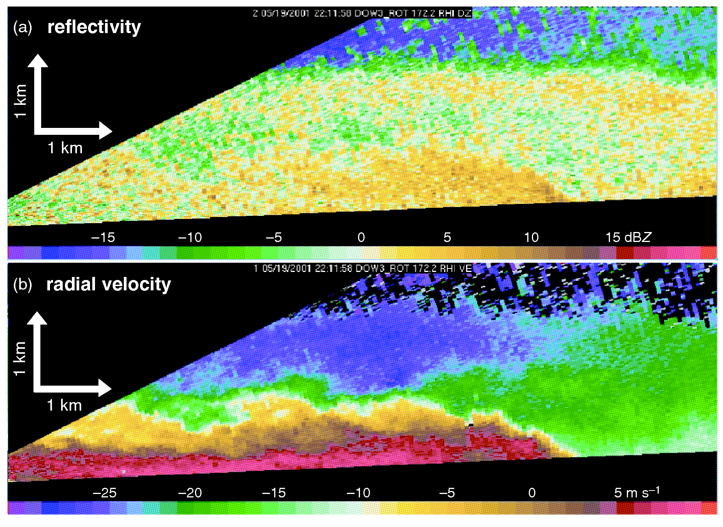
ATMS 316- Drylines & Outflow Boundaries
Density current dynamics
Density currents
Leading edge (head) depth depends on
Density differential
Ambient wind shear
Existence of a relative headwind or tailwind
Kelvin-Helmholtz instability can exist along the top interface
Flow breaks down into billows
Radar observations of a gust front (moving from L to R) having density current characteristics. (a) Reflectivity and (b) radial velocity.

Slide 39
ATMS 316- Drylines & Outflow Boundaries
Density current dynamics
Density currents
Leading edge (head) depth depends on
Density differential
Ambient wind shear
Existence of a relative headwind or tailwind
Kelvin-Helmholtz instability can exist along the top interface
Flow breaks down into billows

Slide 40
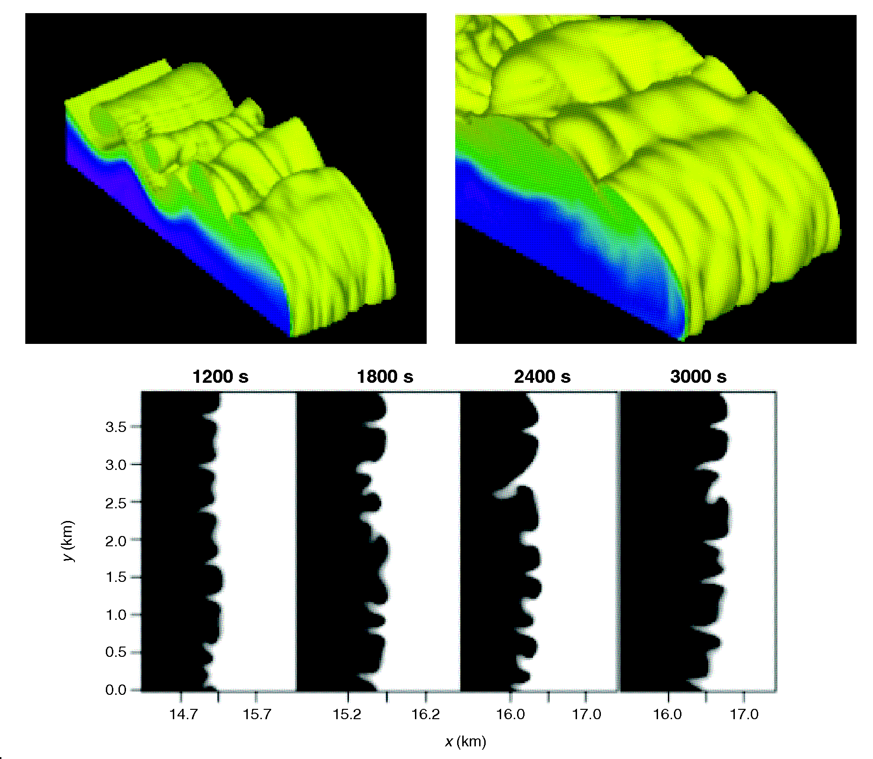
ATMS 316- Drylines & Outflow Boundaries
Density current dynamics
Density current, leading edge; lobe and cleft instability
Results when static instability arises as the leading edge of the density current tilts forward with height in a shallow layer near the ground

Slide 41
ATMS 316- Drylines & Outflow Boundaries
Density current dynamics
lobe and cleft instability
Frictional drag at the surface slows the speed of the dense fluid near the ground → tilts forward with height

Slide 42
ATMS 316- Drylines & Outflow Boundaries
Density current dynamics
H = density current depth
ρ₁ = ambient (lesser) density
ρ₂ = density current (higher) density
frame fixed relative to density current (-c), flat surface, no friction

Slide 43
ATMS 316- Drylines & Outflow Boundaries
Density current dynamics
Forward speed of the density current
Eq. (5.32) here
where c is the forward speed of the density current

Slide 44
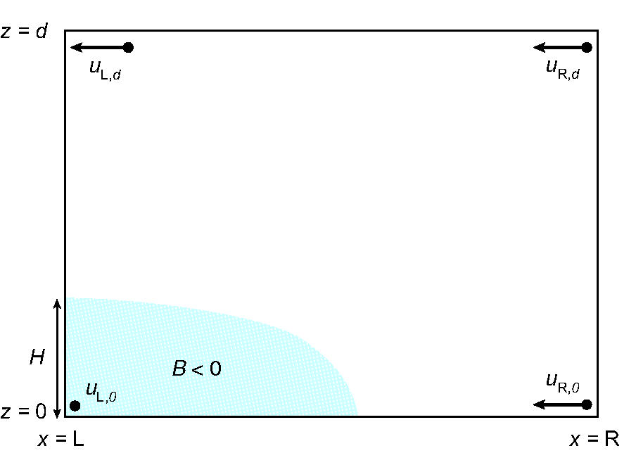
ATMS 316- Drylines & Outflow Boundaries
Density current dynamics
Alternate ‘control volume’ approach (relevant for items to be discussed in Chapter 9)
Integrate Eq (5.34) over the volume →

Slide 45
ATMS 316- Drylines & Outflow Boundaries
Density current dynamics
Forward speed of the density current
Eqs. (5.45) and (5.47) here
surface friction and vertical wind shear have been neglected

Slide 46
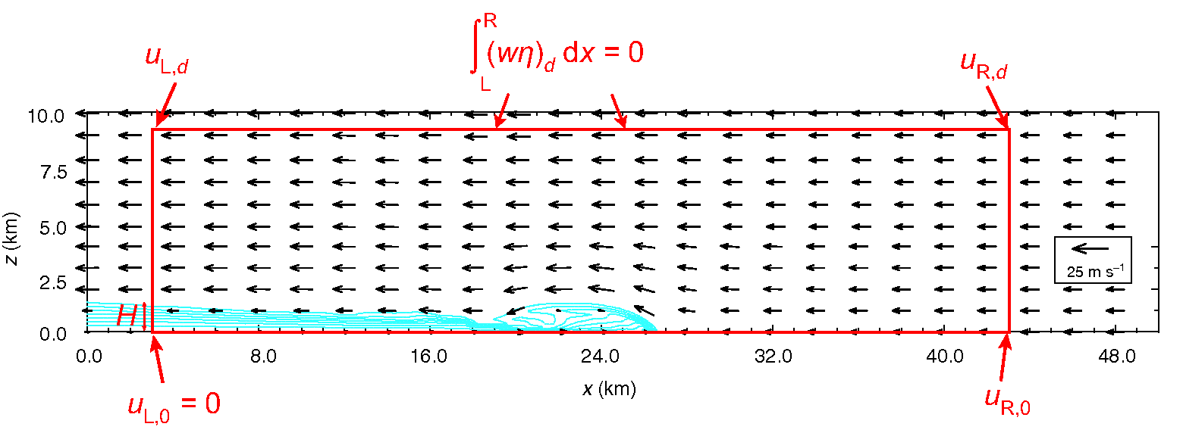
ATMS 316- Drylines & Outflow Boundaries
Density current dynamics
Application of Eq. (5.45)

Slide 47
ATMS 316- Drylines & Outflow Boundaries
Density current dynamics
Forward speed of the density current
Eqs. (5.45) and (5.47) here
surface friction and vertical wind shear have been neglected
How does non-zero vertical wind shear complicate the outflow boundary behavior?

Slide 48
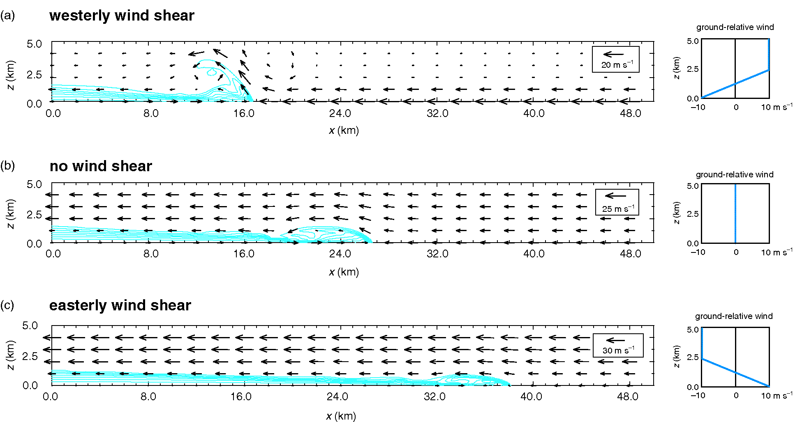
ATMS 316- Drylines & Outflow Boundaries
Density current dynamics
Vertical wind shear affects
Structure of the density current head
strength of lifting
depth of lifting
that occurs at the head

Slide 49
ATMS 316- Drylines & Outflow Boundaries
Density current dynamics
Vertical wind shear affects
Structure of the density current head
strength of lifting
depth of lifting
that occurs at the head

Slide 50
ATMS 316- Drylines & Outflow Boundaries
Density current dynamics
Vertical wind shear in the direction of the density current motion
Density current is slowed (relative to env. air) and develops a deeper head
Intense lifting of env. air at head (vertical jet)

Slide 51
ATMS 316- Drylines & Outflow Boundaries
Density current dynamics
Vertical wind shear opposite to the direction of the density current motion
Density current is fast (relative to env. air) and develops a shallow head
Weak/zero lifting of env. air at head

Slide 52
ATMS 316- Drylines & Outflow Boundaries
Density current dynamics
No vertical wind shear (identical to Fig. 5.30)
Density current is moderate (relative to env. air) and develops a moderate head
Moderate lifting of env. air at head

Slide 53
ATMS 316- Drylines & Outflow Boundaries
Density current dynamics
Implications for
initiation
propagation
maintenance
of convective storms*
*dynamics intimately tied to how the gust front interacts with the conditionally unstable environment

Slide 54
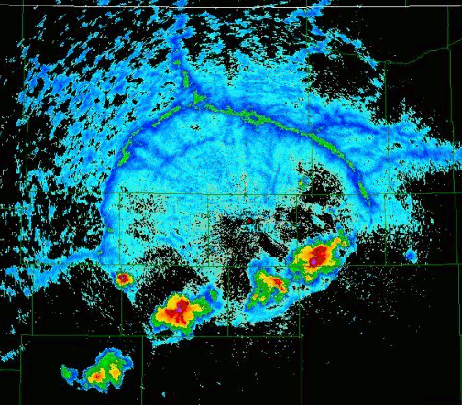
ATMS 316- Drylines & Outflow Boundaries
Which scenario?
Scenario#1; synoptic scale forcing alone
Scenario#2; synoptic scale dominates mesoscale forcing
Scenario#3; weak synoptic scale forcing
11 August 2009 outflow observed at KLNX
http://www.meteor.iastate.edu/~jdduda/perfectOFB.html

