Slide 1
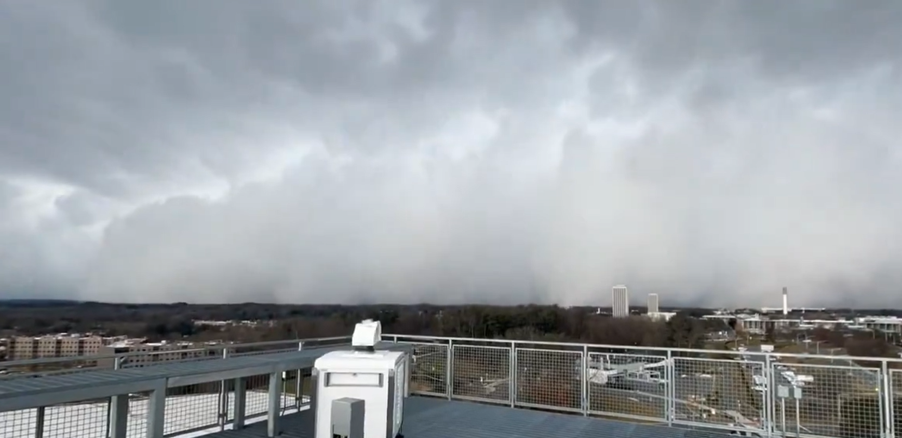
Snow squalls of 14 Jan 2024
https://twitter.com/patrickmillwx/status/1746594496282791991

Slide 2
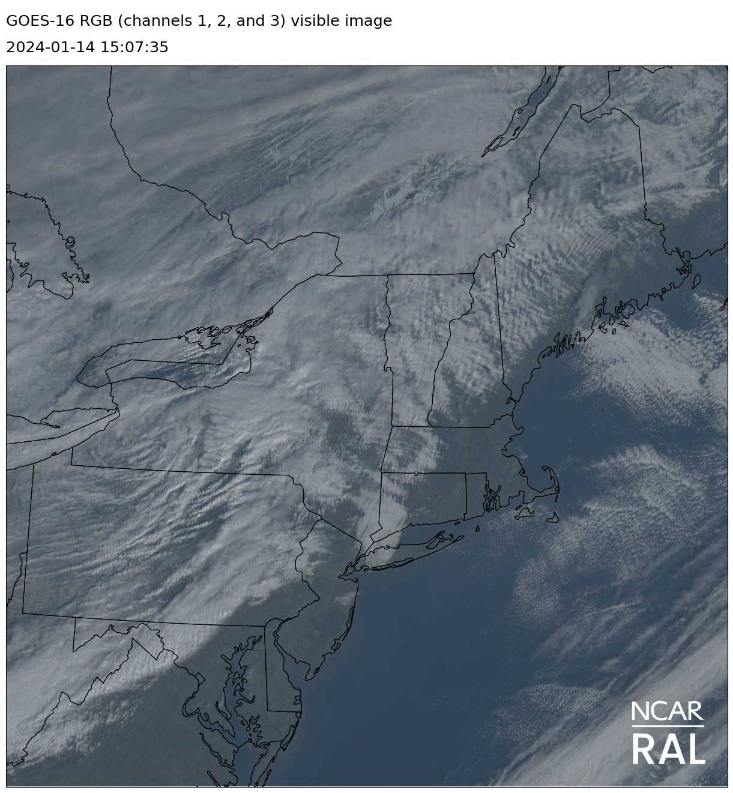
GARP
https://weather.ral.ucar.edu/satellite/

Slide 3
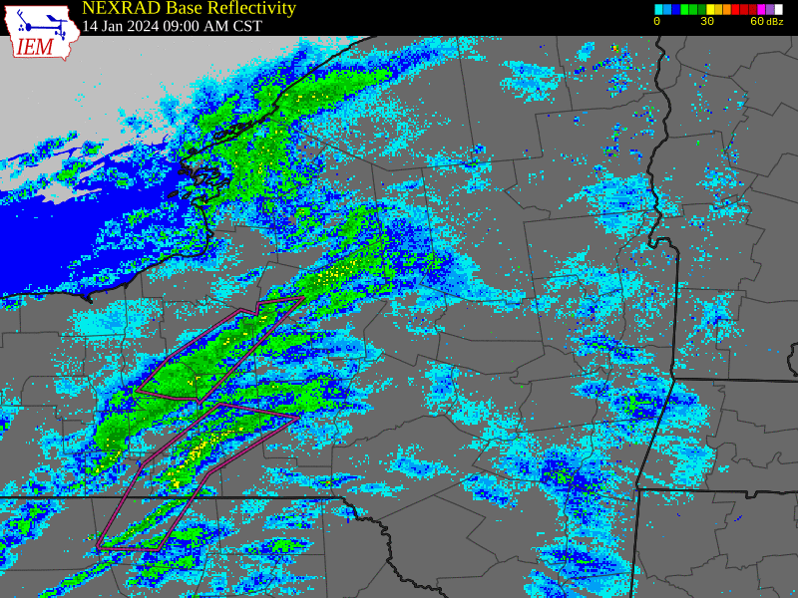
Albany, NY region

Slide 4
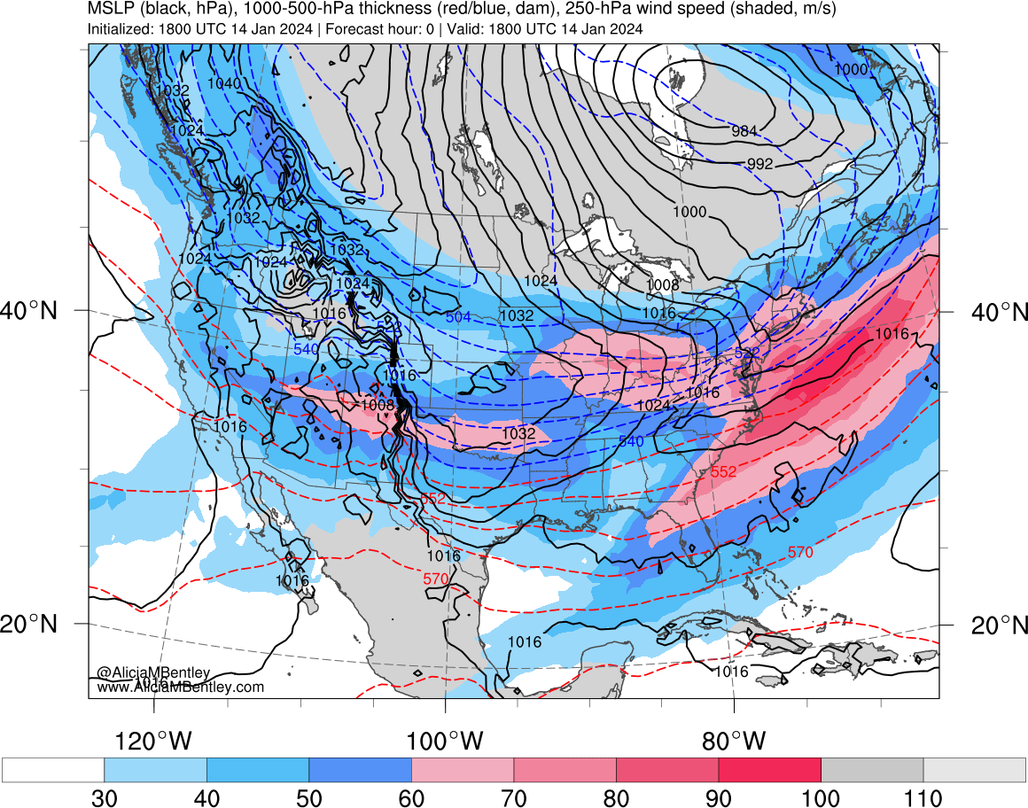
http://www.atmos.albany.edu/student/abentley/realtime.html

Slide 5
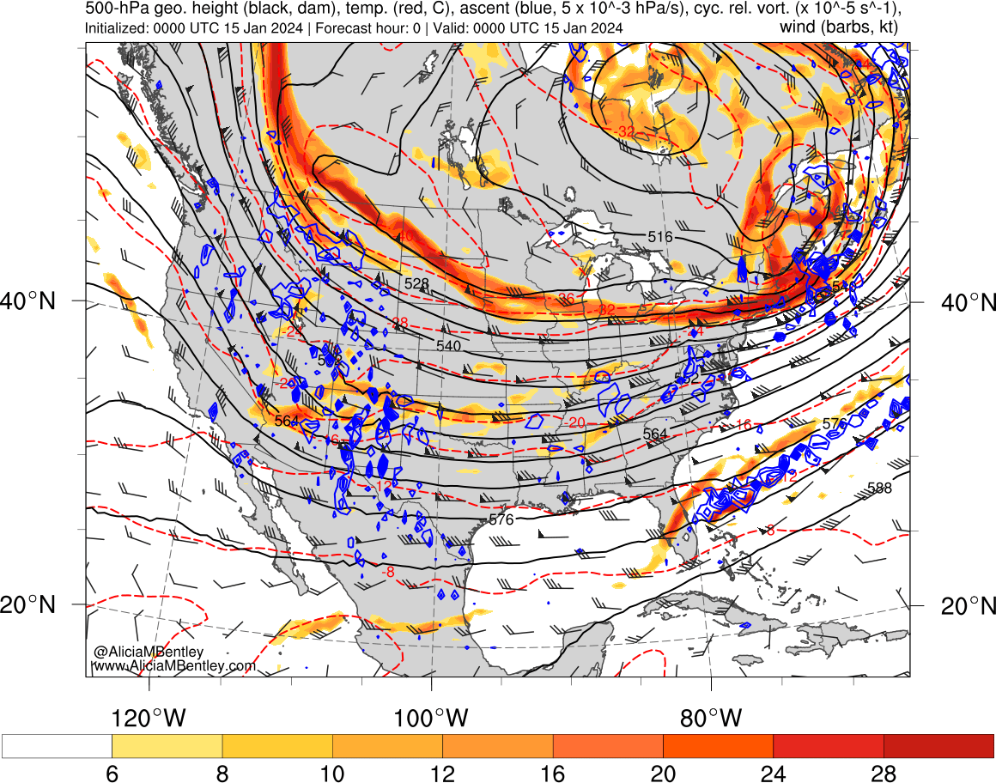
500 hPa
http://www.atmos.albany.edu/student/abentley/realtime.html

Slide 6
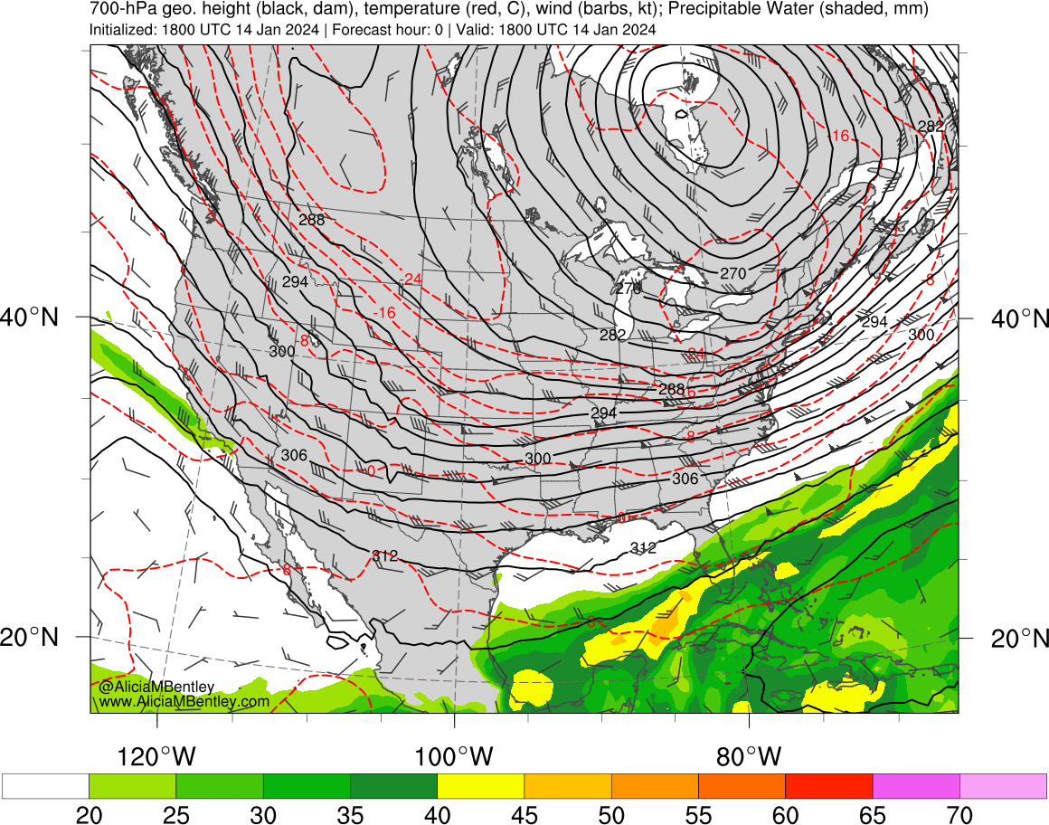
http://www.atmos.albany.edu/student/abentley/realtime.html

Slide 7
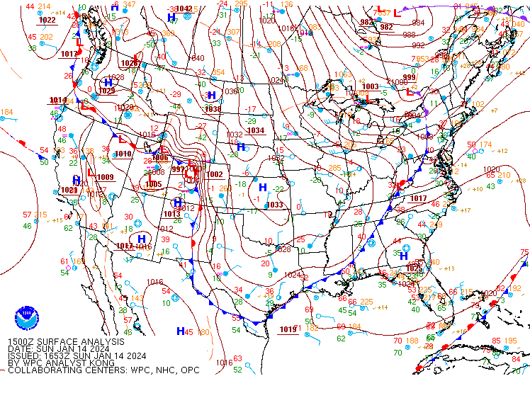
SLP – 1500 UTC 14 Jan 2024
https://www.wpc.ncep.noaa.gov/archives/web_pages/sfc/sfc_archive.php

Slide 8
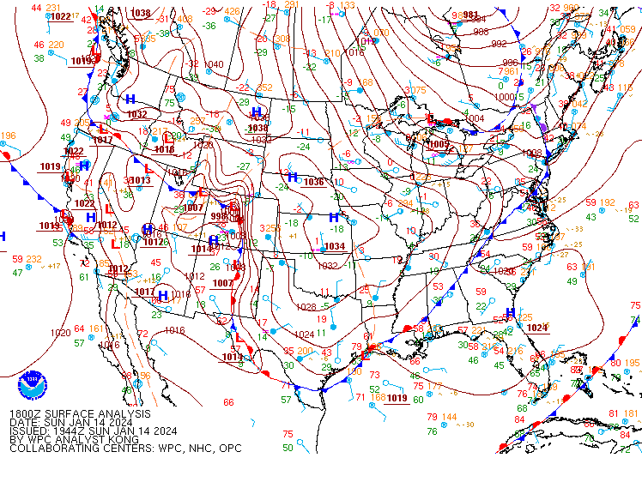
SLP – 1800 UTC 14 Jan 2024
https://www.wpc.ncep.noaa.gov/archives/web_pages/sfc/sfc_archive.php

Slide 9
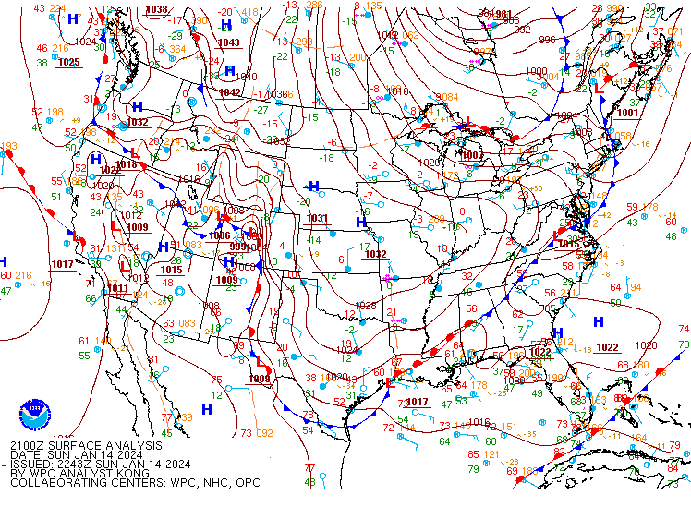
SLP – 2100 UTC 14 Jan 2024
https://www.wpc.ncep.noaa.gov/archives/web_pages/sfc/sfc_archive.php

Slide 10
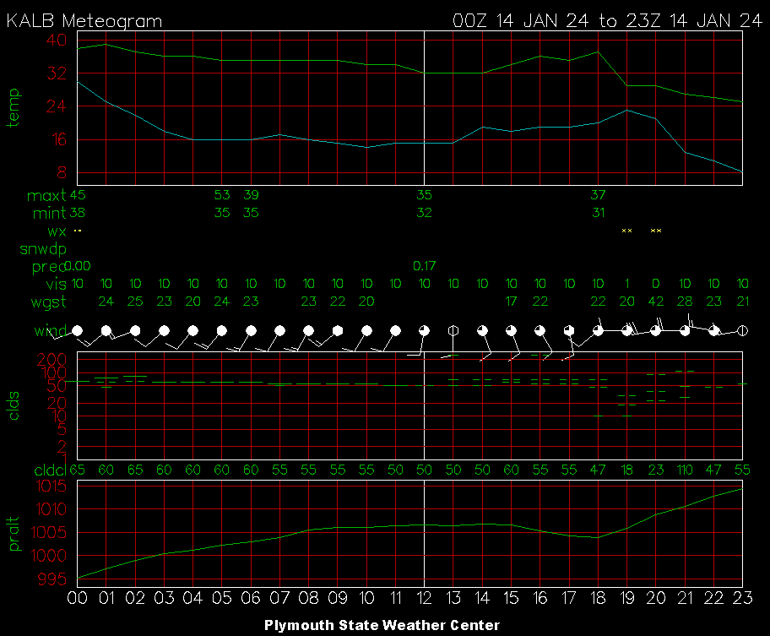
Albany, NY region
https://weather.uwyo.edu/upperair/sounding.html
https://vortex.plymouth.edu/myowxp/sfc/statlog-a.html

Slide 11
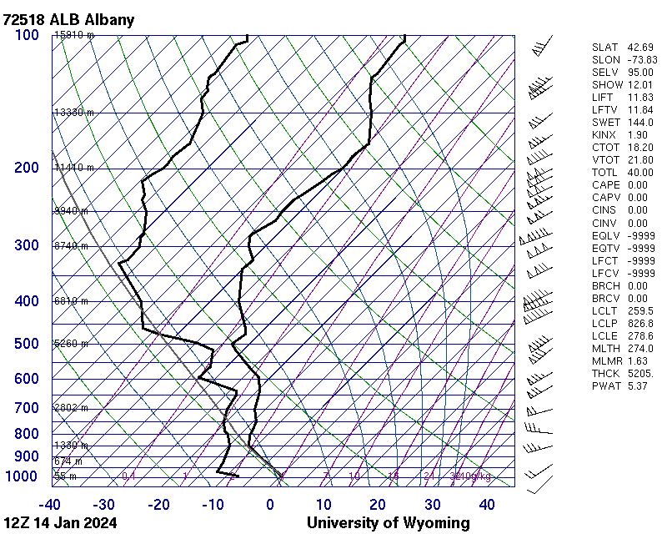
Albany, NY region
https://weather.uwyo.edu/upperair/sounding.html

Slide 12
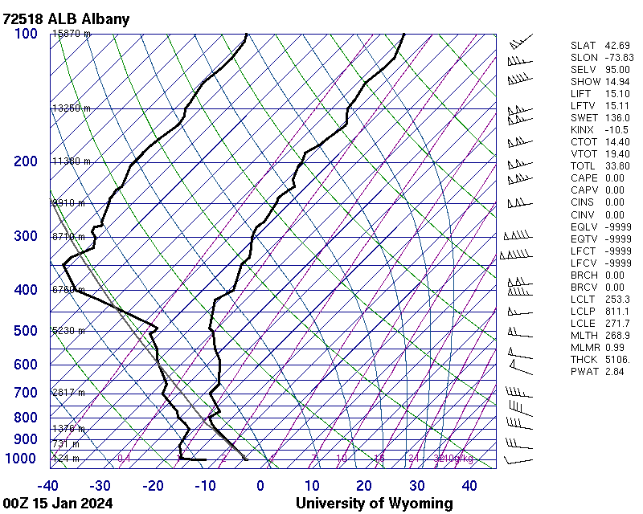
Albany, NY region
https://weather.uwyo.edu/upperair/sounding.html

Slide 13
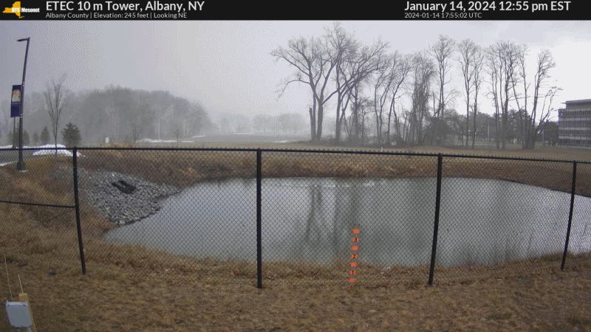
Albany, NY region

