Slide 1
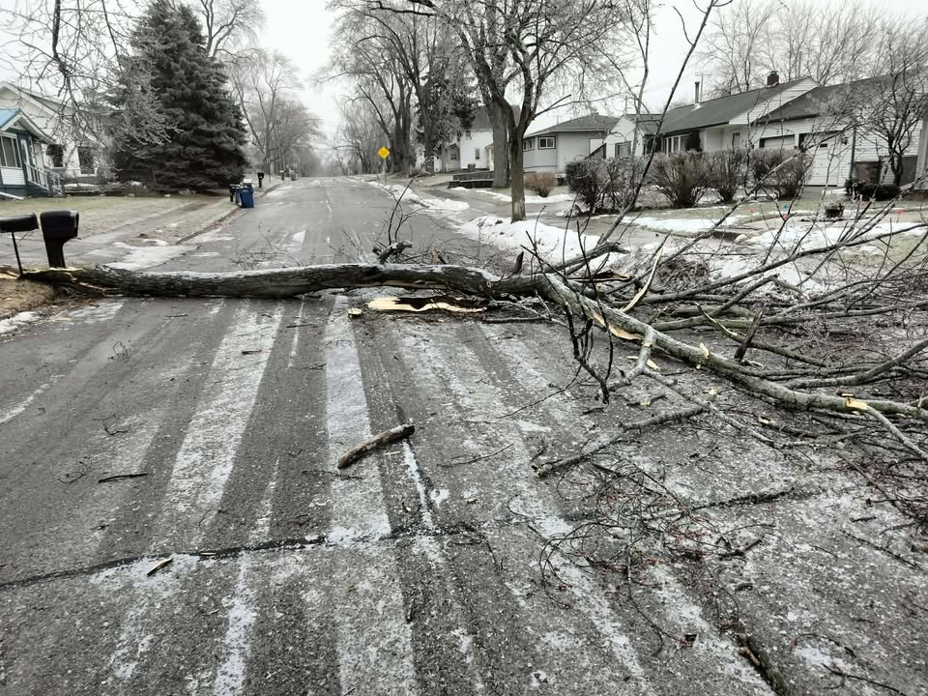
Freezing rain event of 26 Dec 2025
Credit: Robert Wittliff
https://www.weather.gov/dtx/freezingrain-12262025

Slide 2
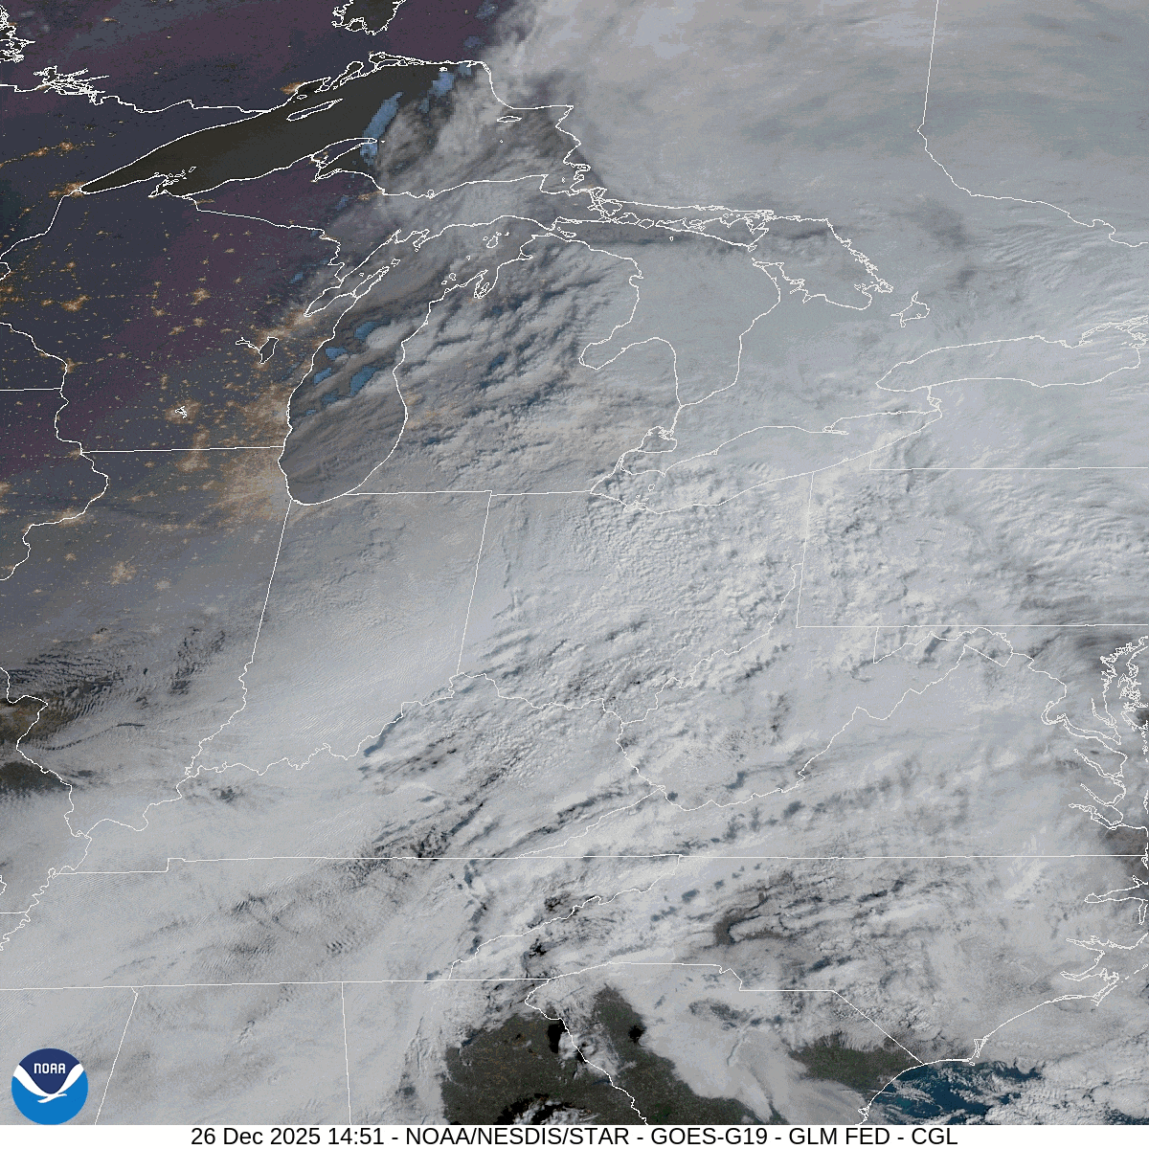
GARP
https://www.weather.gov/dtx/freezingrain-12262025

Slide 3
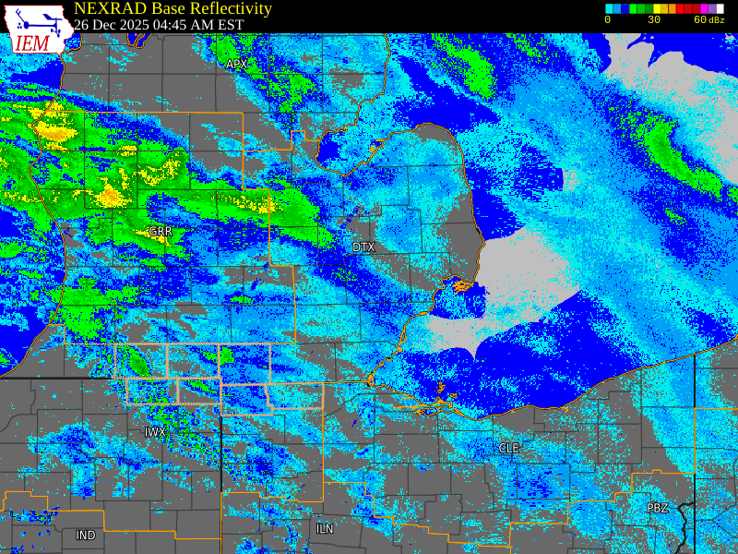
Central Michigan region
https://www.weather.gov/dtx/freezingrain-12262025

Slide 4
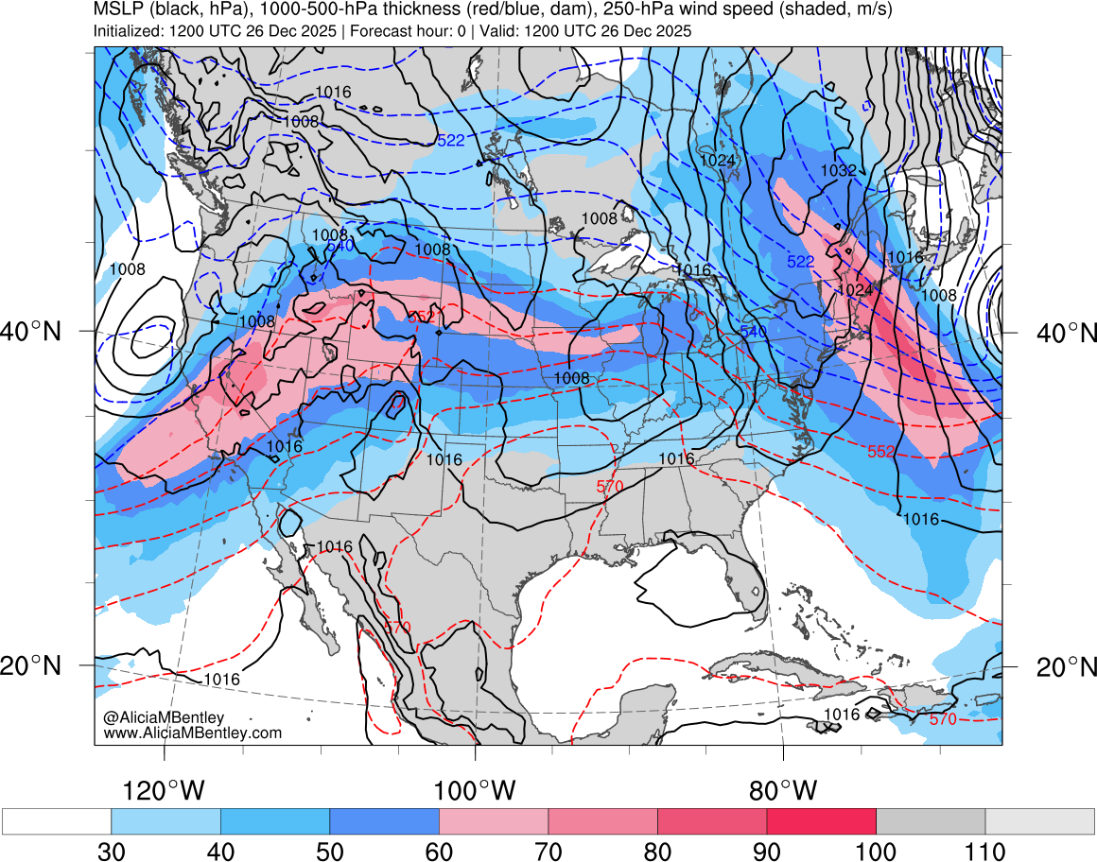
http://www.atmos.albany.edu/student/abentley/realtime.html

Slide 5
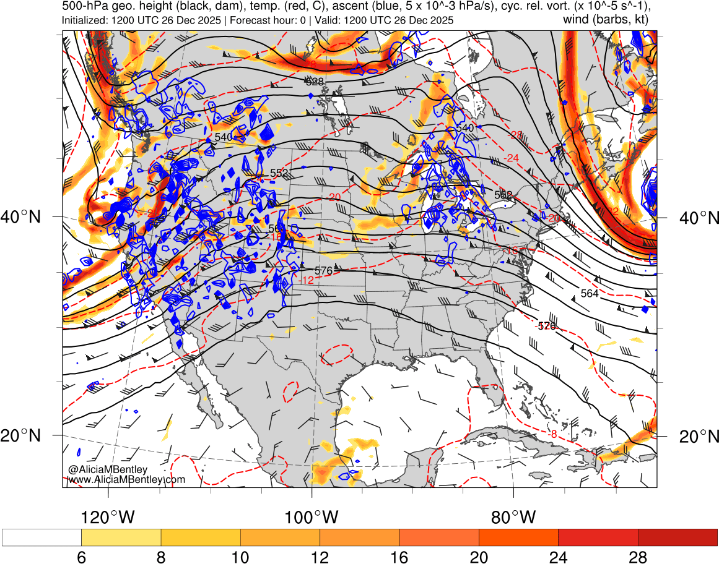
500 hPa
http://www.atmos.albany.edu/student/abentley/realtime.html

Slide 6
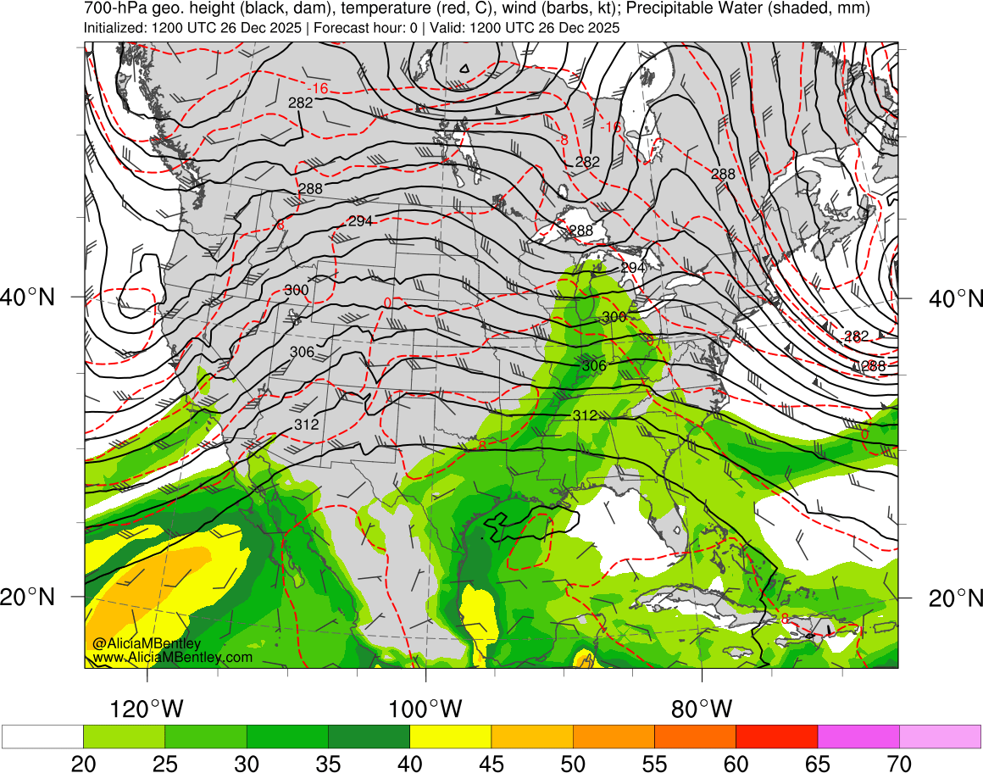
http://www.atmos.albany.edu/student/abentley/realtime.html

Slide 7
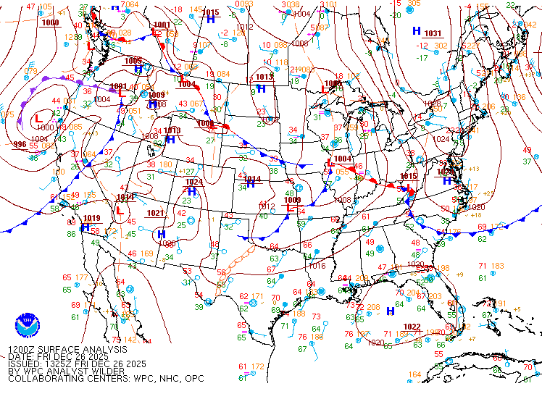
SLP – 1200 UTC 26 Dec 2025
https://www.wpc.ncep.noaa.gov/archives/web_pages/sfc/sfc_archive.php

Slide 8
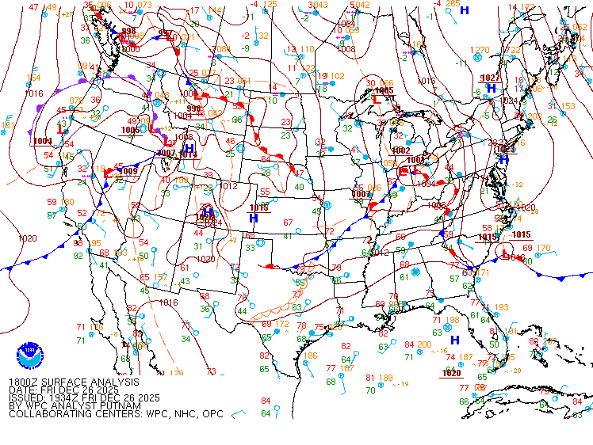
SLP – 1800 UTC 26 Dec 2025
https://www.wpc.ncep.noaa.gov/archives/web_pages/sfc/sfc_archive.php

Slide 9
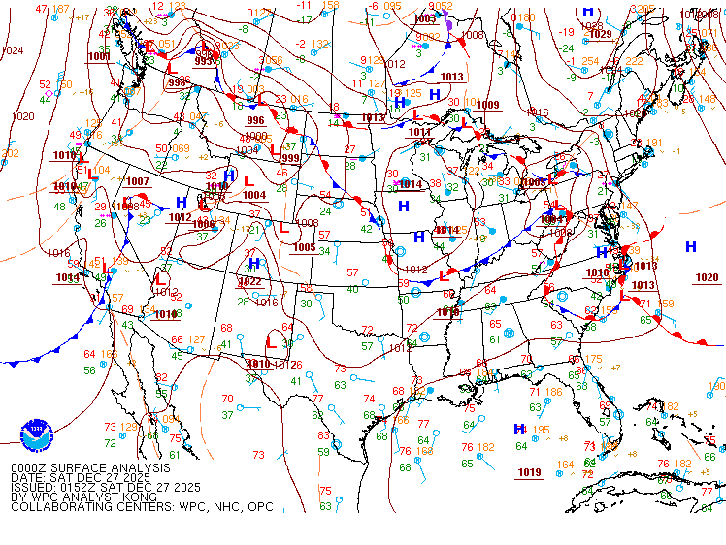
SLP – 0000 UTC 27 Dec 2025
https://www.wpc.ncep.noaa.gov/archives/web_pages/sfc/sfc_archive.php

Slide 10
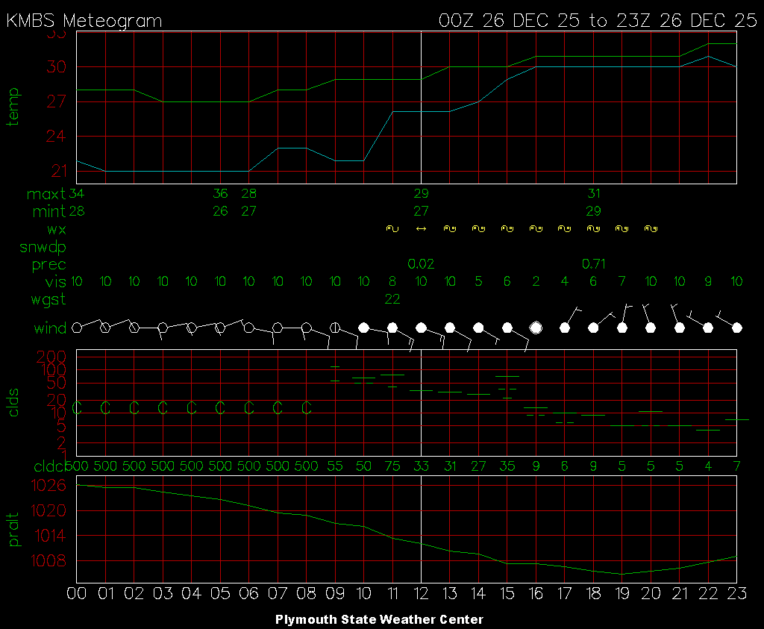
Central Michigan region
https://weather.uwyo.edu/upperair/sounding.html
https://vortex.plymouth.edu/myowxp/sfc/statlog-a.html

Slide 11
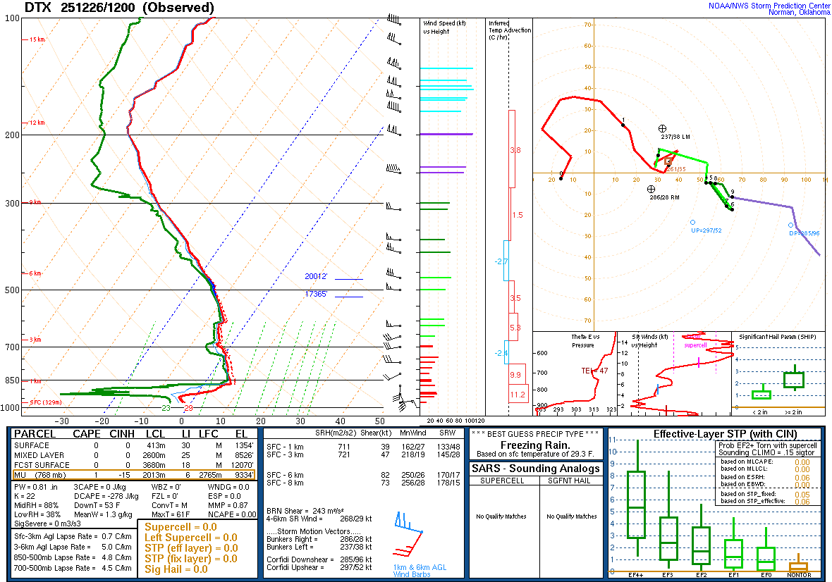
Central Michigan region
https://www.weather.gov/dtx/freezingrain-12262025

Slide 12
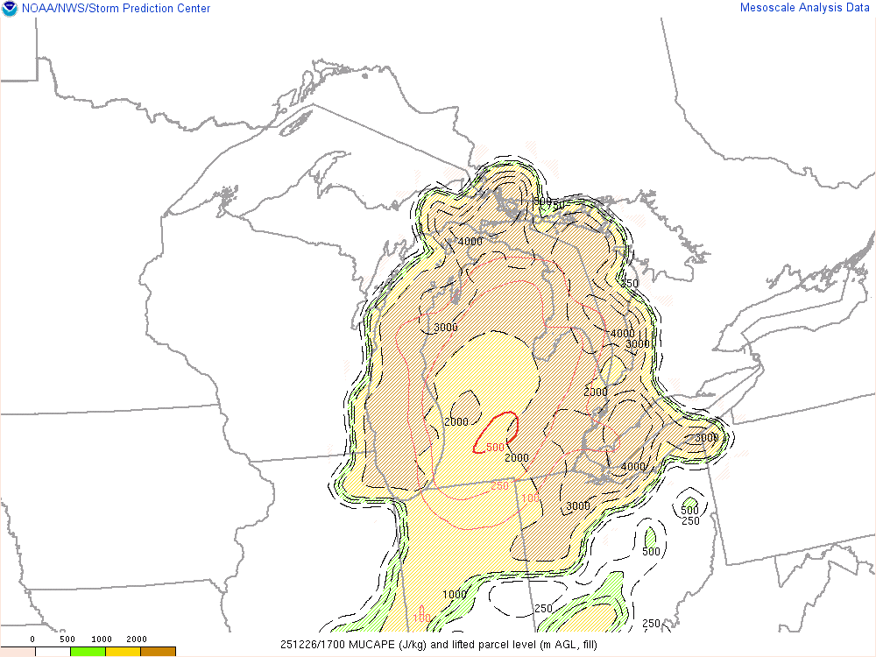
Central Michigan region
https://www.weather.gov/dtx/freezingrain-12262025

Slide 13
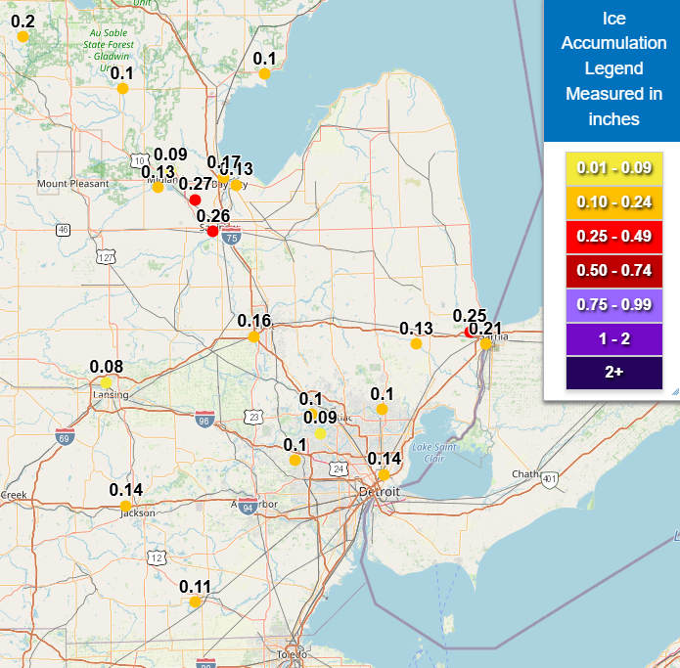
Central Michigan region

