Slide 1
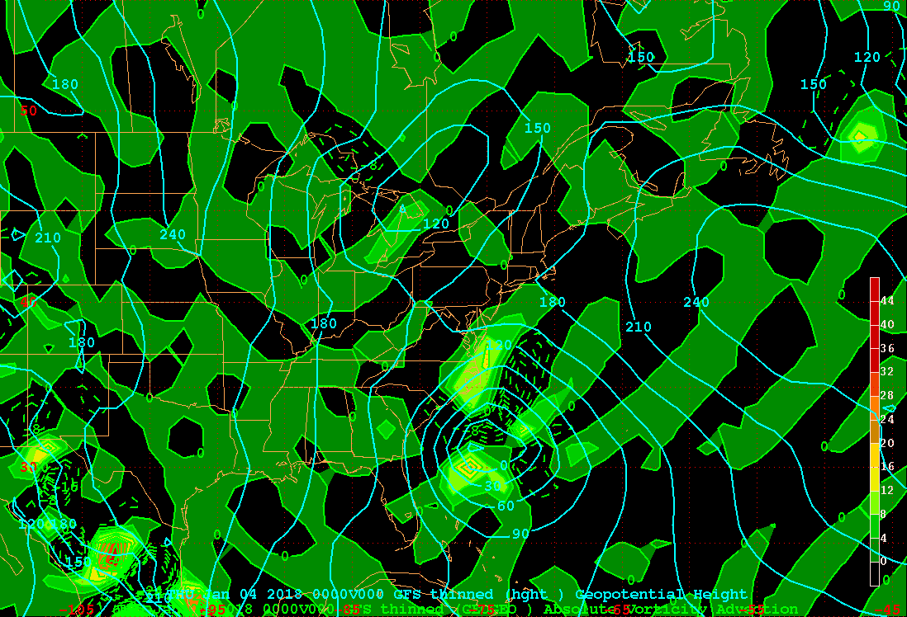
Z1000_GAVA
X

Slide 2
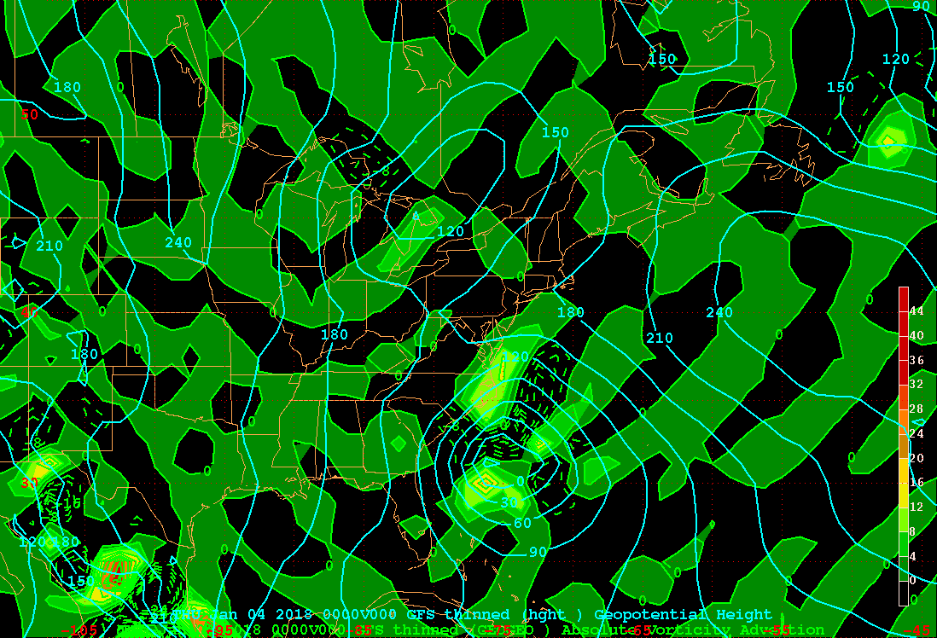
Z1000_GRVA
X

Slide 3
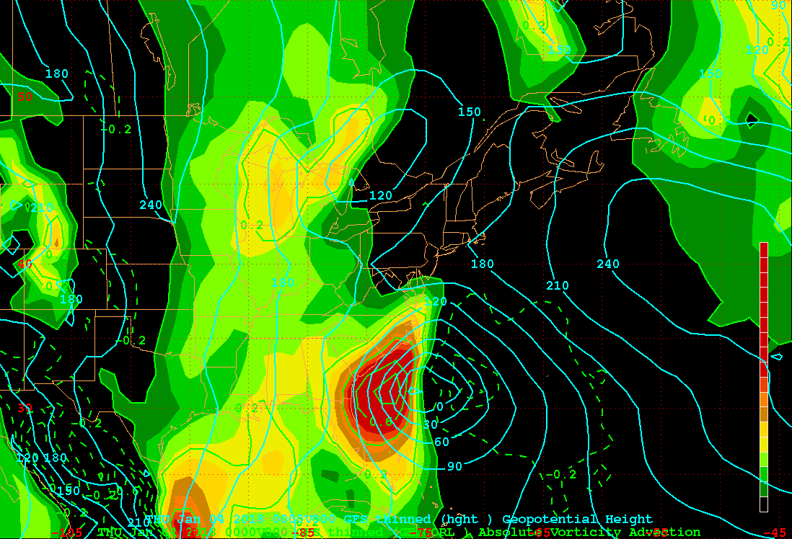
Z1000_CORA
X

Slide 4
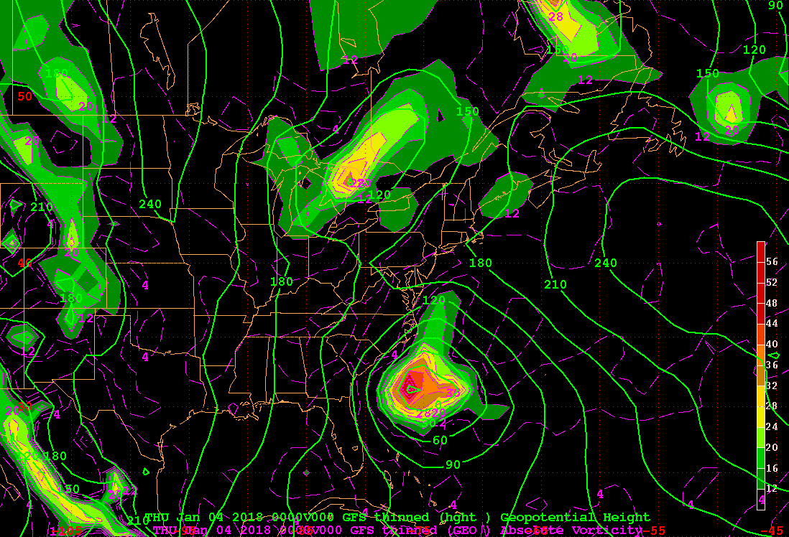
Z1000_GAV
X

Slide 5
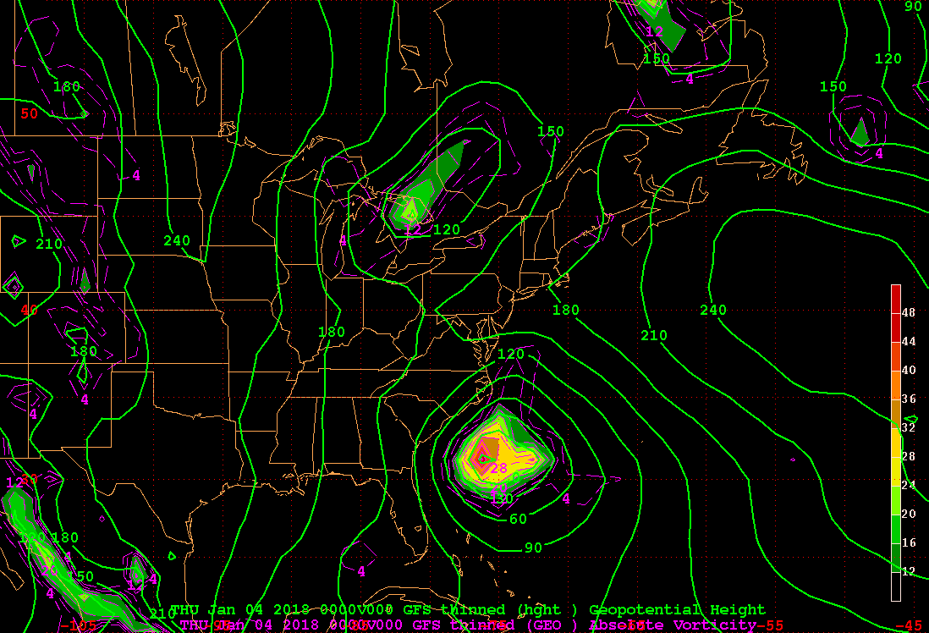
Z1000_GRV
X

Slide 6
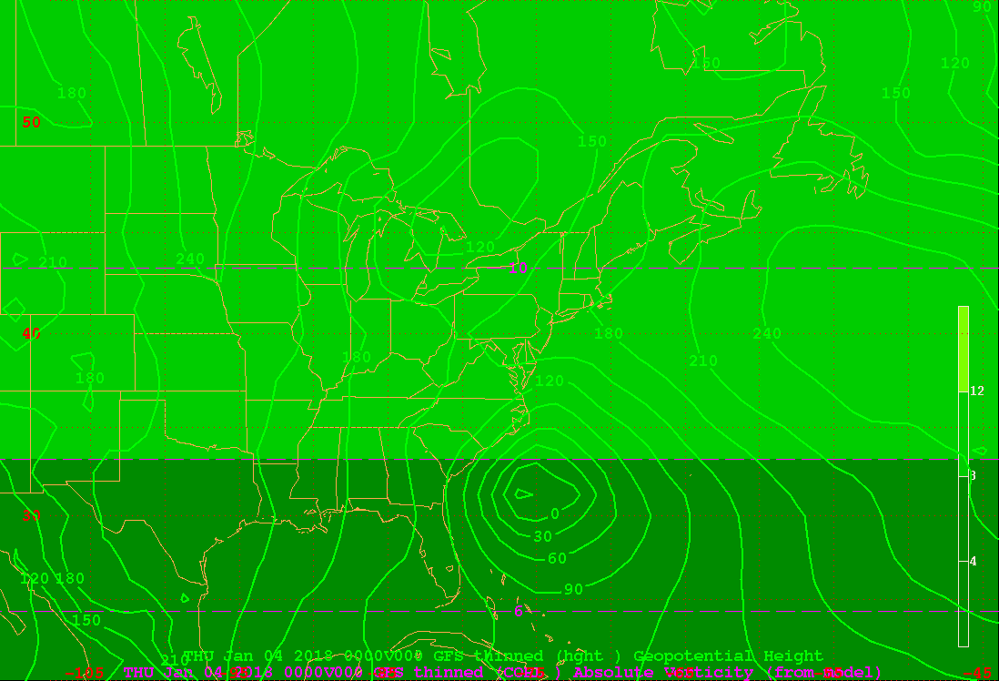
Z1000_COR
X

Slide 7
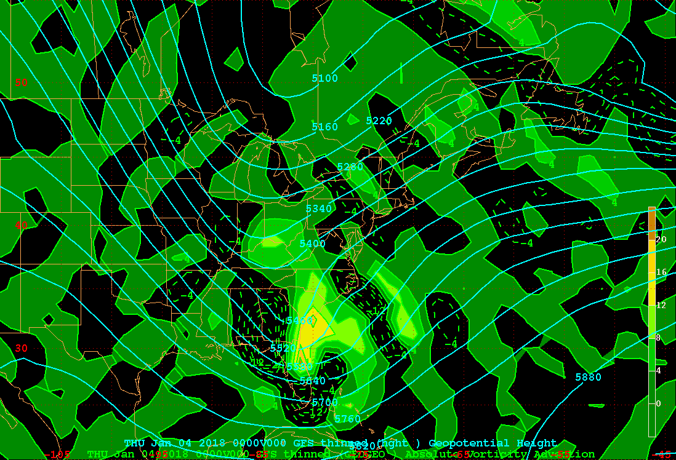
Z500_GAVA
X

Slide 8
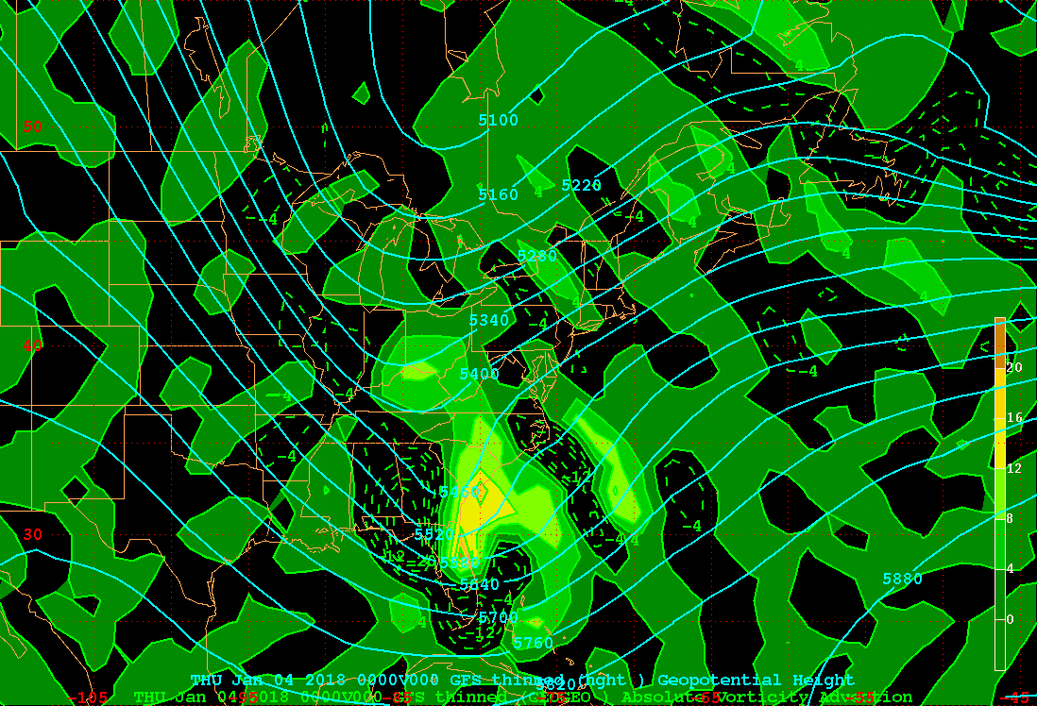
Z500_GRVA
X

Slide 9
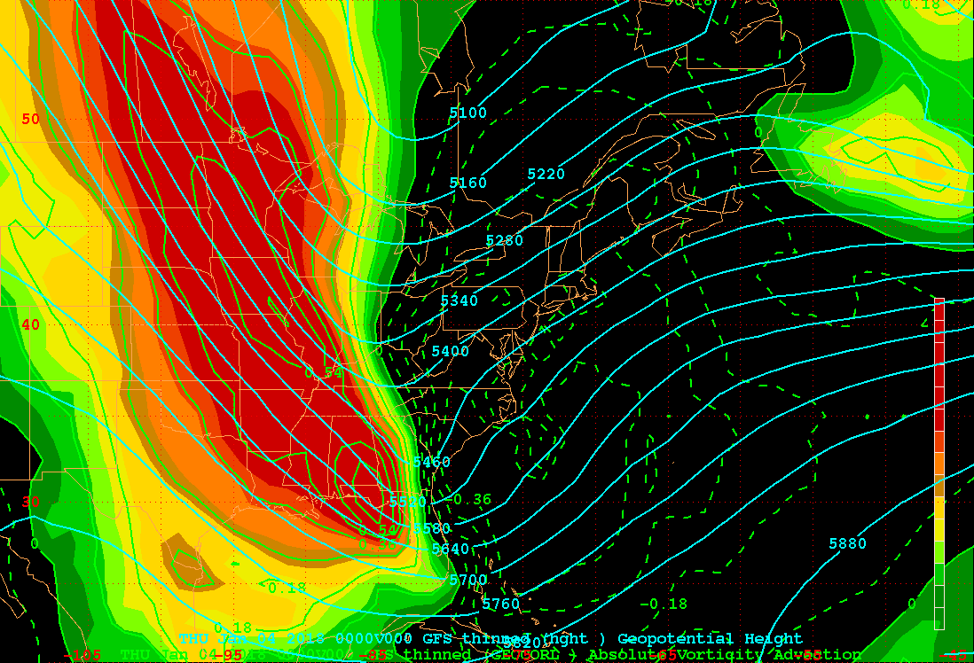
Z500_CORA
X

Slide 10
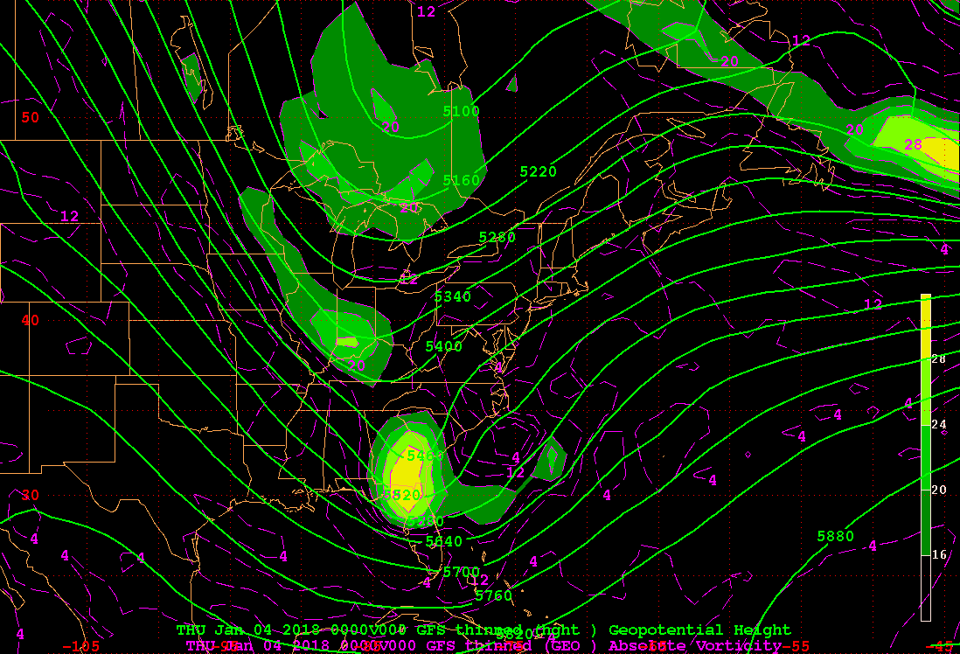
Z500_GAV
X

Slide 11
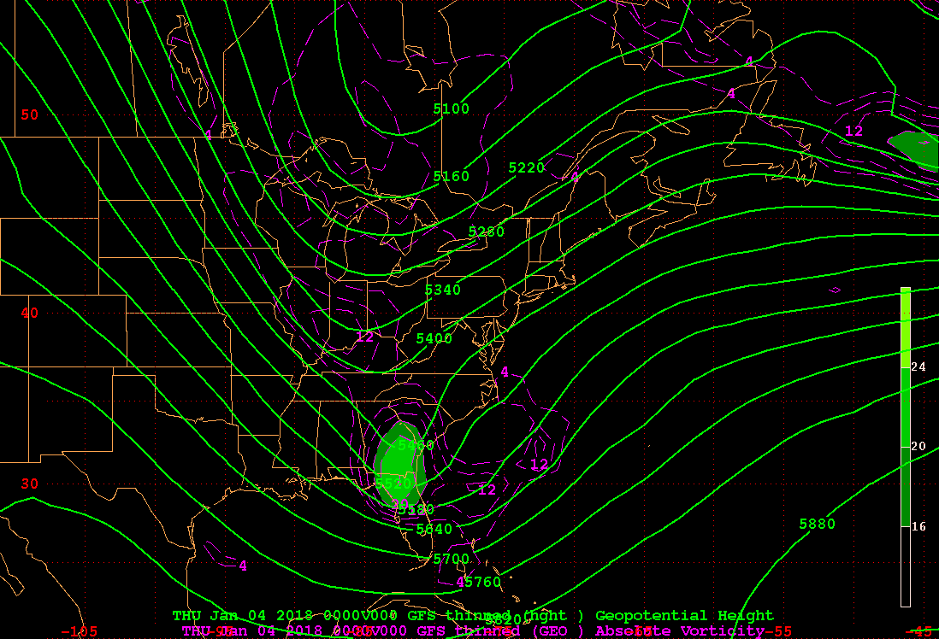
Z500_GRV
X

Slide 12
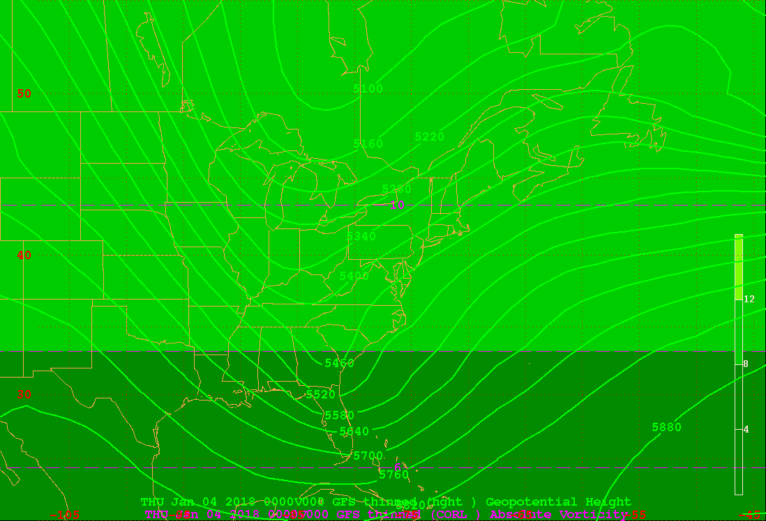
Z500_COR
X

Slide 13
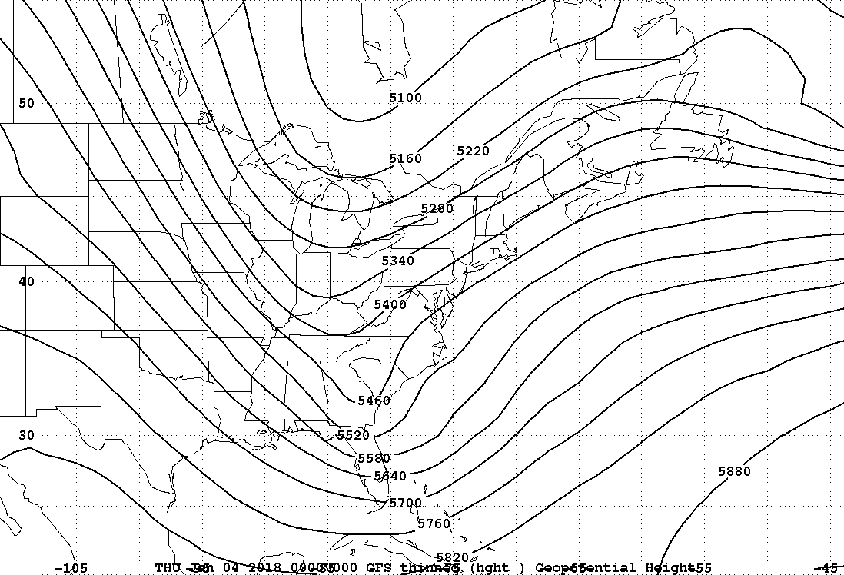
Z500
X

Slide 14
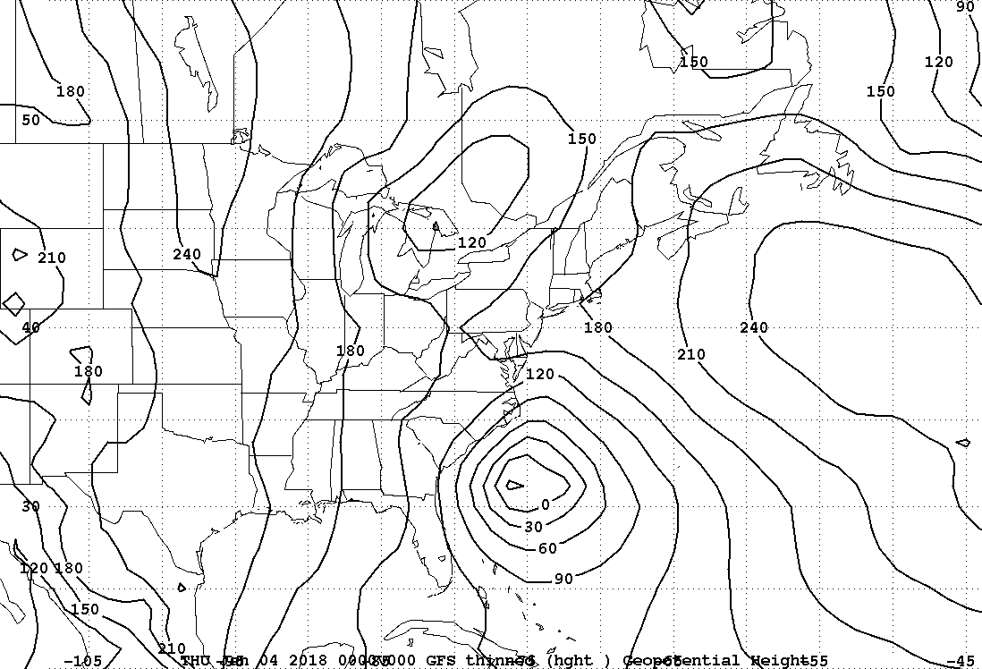
Z1000
X

Slide 15
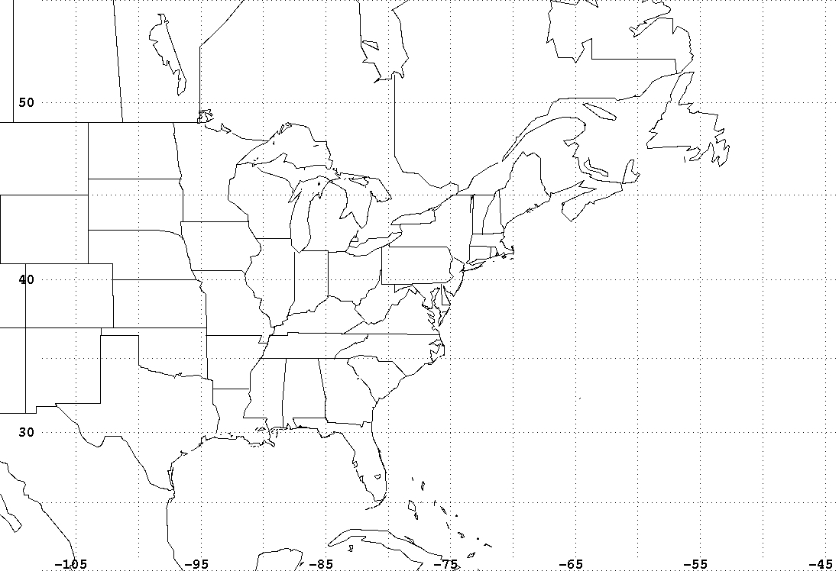
base map
X

Slide 16
1000 hPa geopotential height contour interval = 30 meters
500 hPa geopotential height contour interval = 60 meters
Geostrophic Absolute Vorticity (GAV) x 10⁻⁵ s⁻¹
Geostrophic Relative Vorticity (GRV) x 10⁻⁵ s⁻¹
1000 hPa level
contour and color interval = 4 x 10⁻⁵ s⁻¹
minimum contour (color) = 4 (12) x 10⁻⁵ s⁻¹
500 hPa level
contour and color interval = 4 x 10⁻⁵ s⁻¹
minimum contour (color) = 2 (16) x 10⁻⁵ s⁻¹
Geostrophic Earth’s Vorticity (COR) x 10⁻⁵ s⁻¹
contour (color) interval = 2 (4) x 10⁻⁵ s⁻¹
minimum contour (color) = 0 (4) x 10⁻⁵ s⁻¹

Slide 17
1000 hPa geopotential height contour interval = 30 meters
500 hPa geopotential height contour interval = 60 meters
Geostrophic Absolute Vorticity Advection (GAVA) x 10⁻⁹ s⁻²
Geostrophic Relative Vorticity Advection (GRVA) x 10⁻⁹ s⁻²
1000 hPa level
contour (color) interval = 4 (4) x 10⁻⁹ s⁻²
minimum contour (color) = -20 (0) x 10⁻⁹ s⁻²
500 hPa level
contour (color) interval = 4 (4) x 10⁻⁹ s⁻²
minimum contour (color) = -20 (0) x 10⁻⁹ s⁻²

Slide 18
1000 hPa geopotential height contour interval = 30 meters
500 hPa geopotential height contour interval = 60 meters
Geostrophic Earth’s Vorticity Advection (CORA) x 10⁻⁹ s⁻²
1000 hPa level
contour (color) interval = 0.2 (0.06) x 10⁻⁹ s⁻²
minimum contour (color) = -0.6 (0) x 10⁻⁹ s⁻²
500 hPa level
contour (color) interval = 0.09 (0.05) x 10⁻⁹ s⁻²
minimum contour (color) = -0.36 (0) x 10⁻⁹ s⁻²

