Slide 1
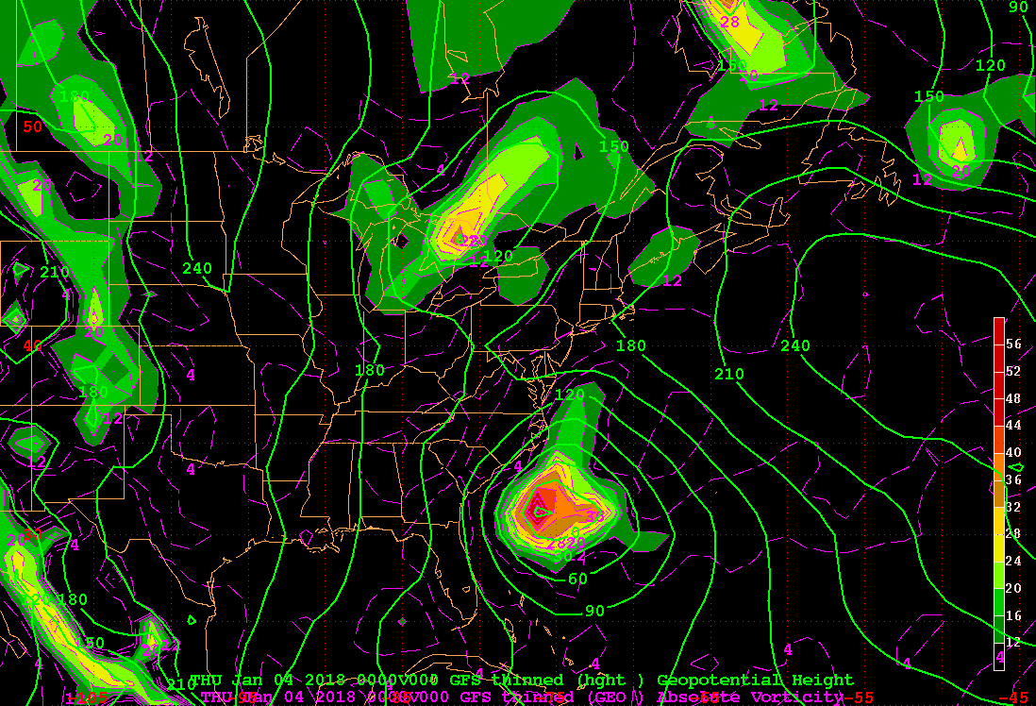
Z1000_GAV
X

Slide 2
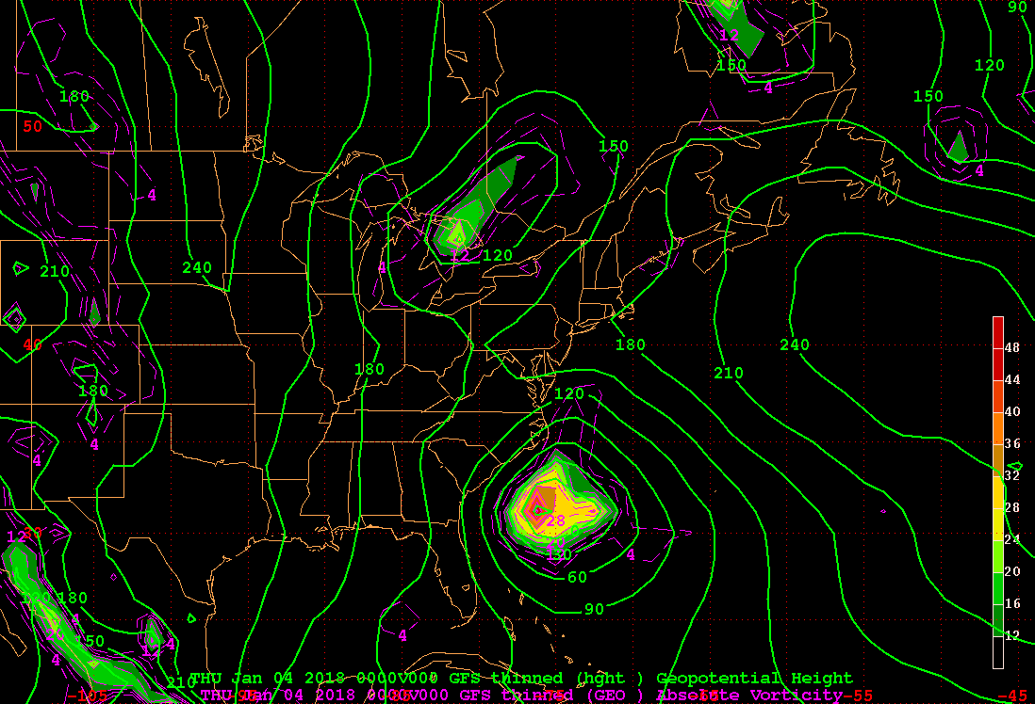
Z1000_GRV
X

Slide 3
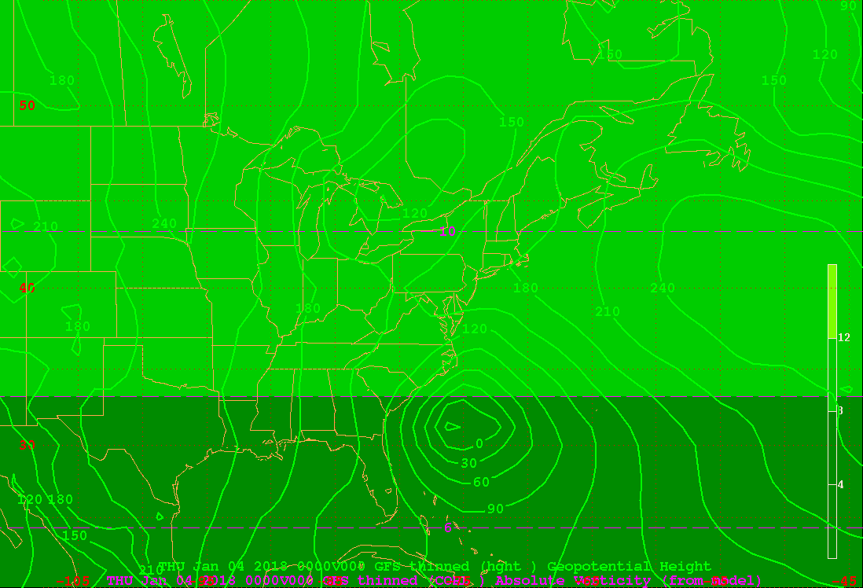
Z1000_COR
X

Slide 4
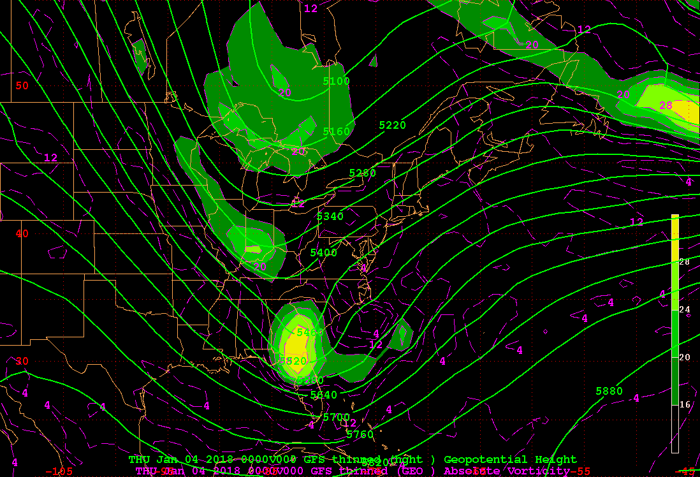
Z500_GAV
X

Slide 5
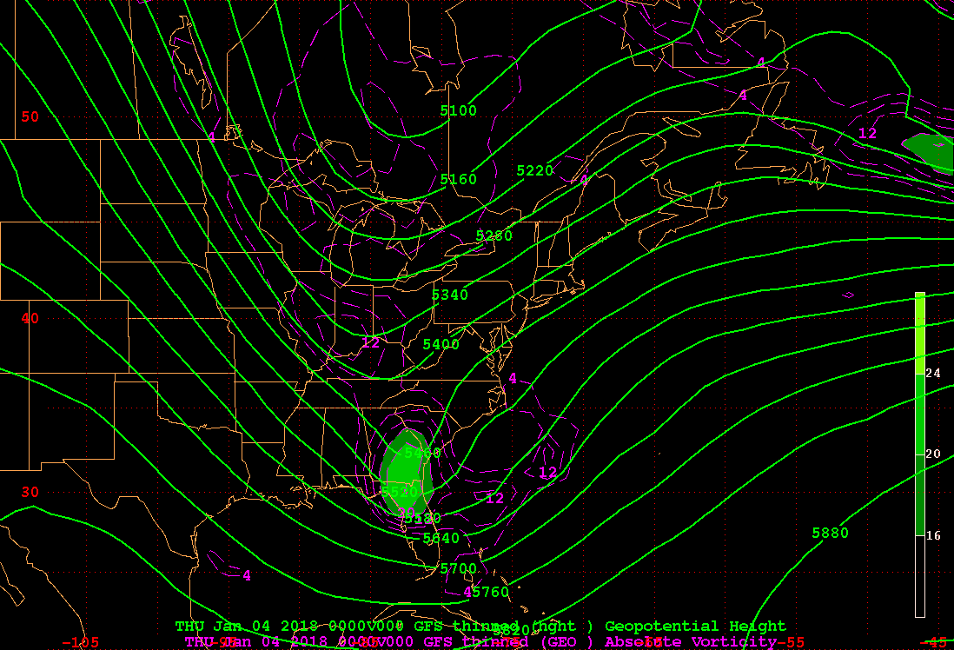
Z500_GRV
X

Slide 6
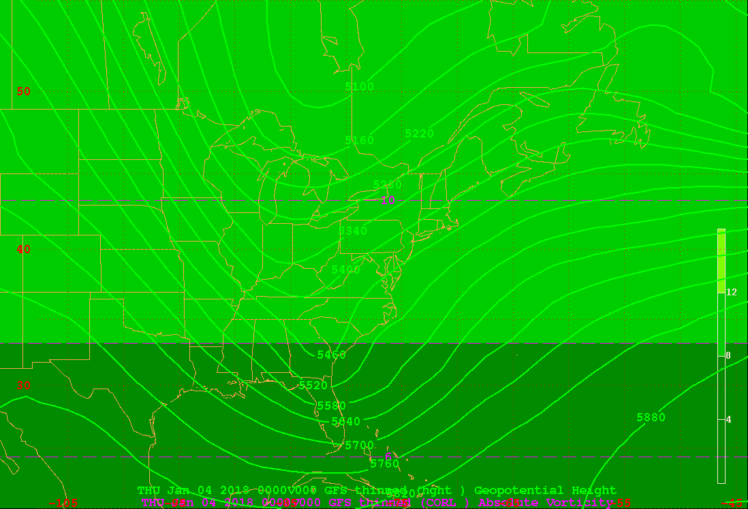
Z500_COR
X

Slide 7
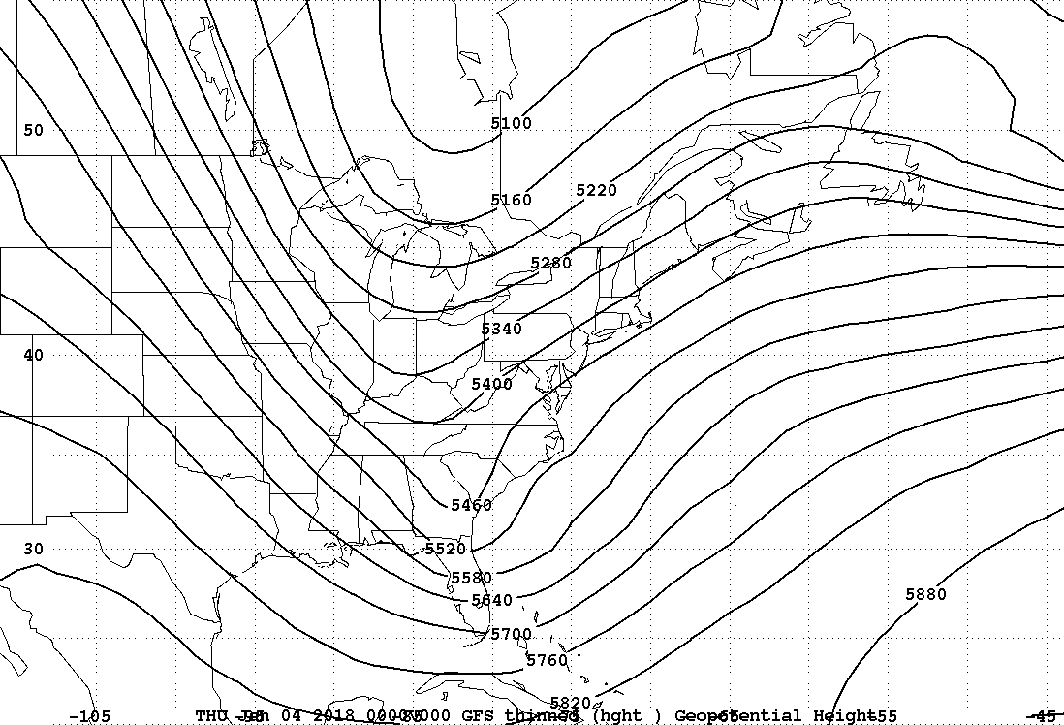
Z500
X

Slide 8
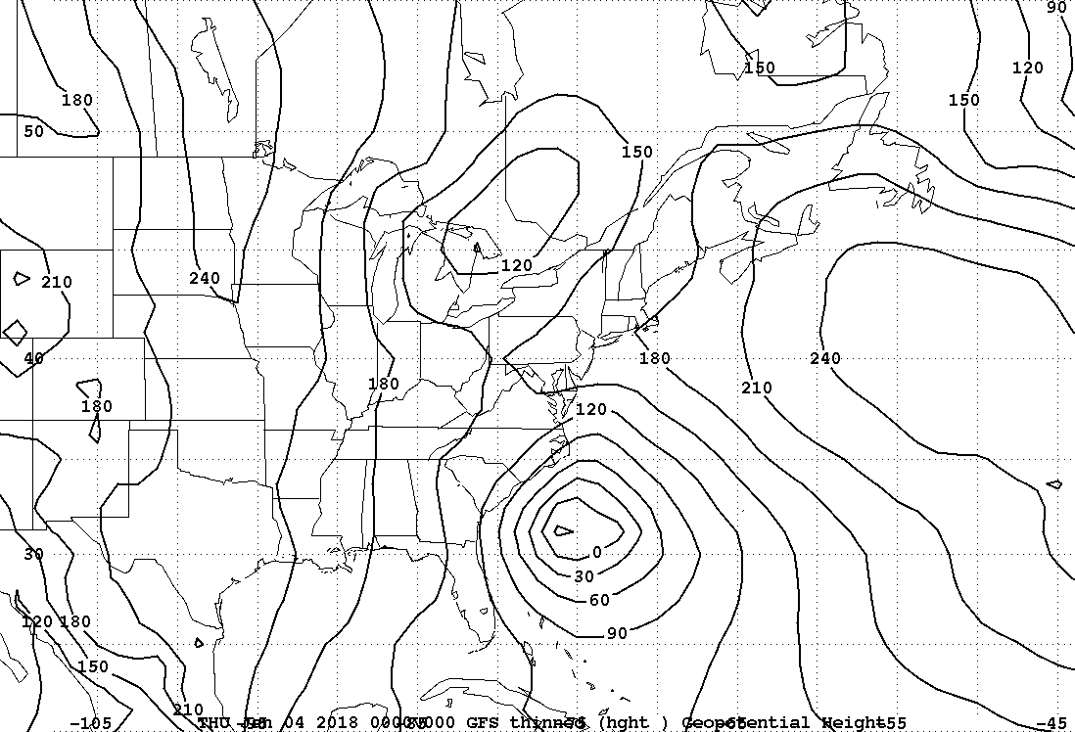
Z1000
X

Slide 9
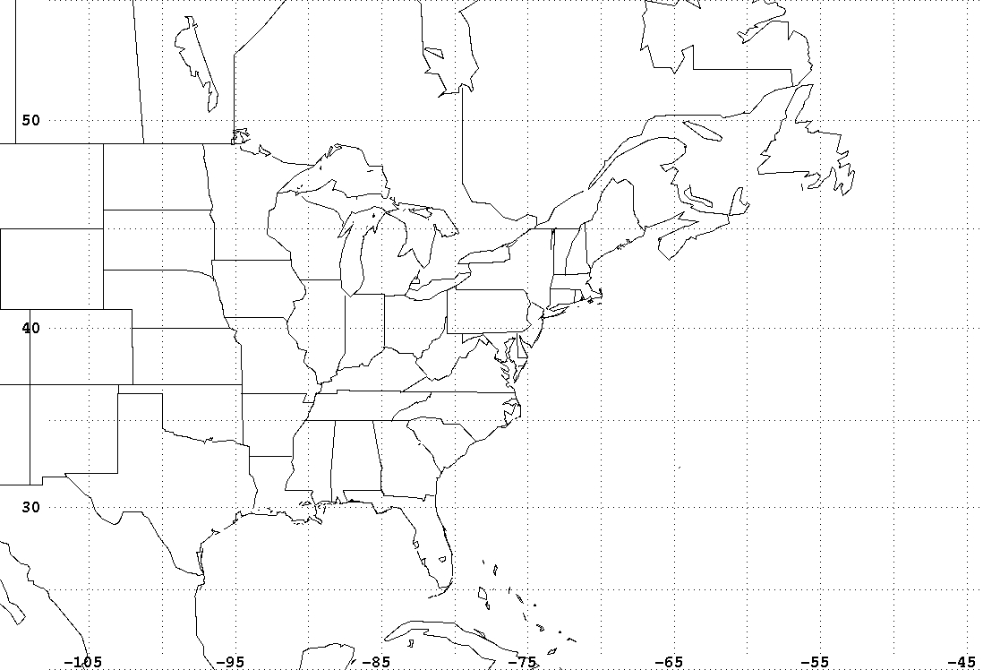
base map
X

Slide 10
1000 hPa geopotential height contour interval = 30 meters
500 hPa geopotential height contour interval = 60 meters
Geostrophic Absolute Vorticity (GAV) x 10⁻⁵ s⁻¹
Geostrophic Relative Vorticity (GRV) x 10⁻⁵ s⁻¹
1000 hPa level
contour and color interval = 4 x 10⁻⁵ s⁻¹
minimum contour (color) = 4 (12) x 10⁻⁵ s⁻¹
500 hPa level
contour and color interval = 4 x 10⁻⁵ s⁻¹
minimum contour (color) = 2 (16) x 10⁻⁵ s⁻¹
Geostrophic Earth’s Vorticity (COR) x 10⁻⁵ s⁻¹
contour (color) interval = 2 (4) x 10⁻⁵ s⁻¹
minimum contour (color) = 0 (4) x 10⁻⁵ s⁻¹

