Slide 1
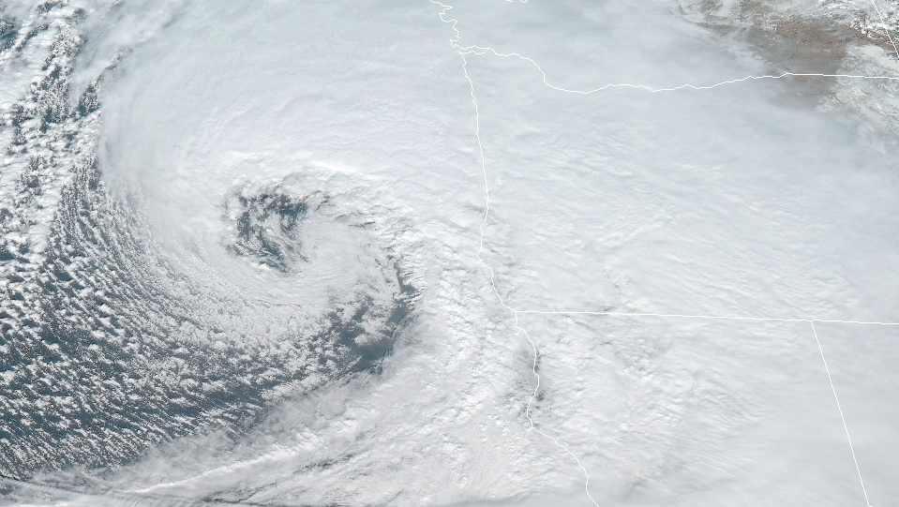
Synoptic-Scale Motions I:
Quasi-Geostrophic Analysis
Kinematics and Dynamics

Slide 2

Synoptic-Scale Motions I:
Quasi-Geostrophic Analysis
Outline of this lecture packet…
  The observed structure of extratropical circulations
  The quasi-geostrophic approximation
  Quasi-geostrophic prediction
  The diagnosis of vertical motion
  Idealized model of a baroclinic disturbance

Slide 3
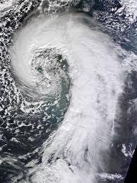
Synoptic-Scale Motions I:
Quasi-Geostrophic Analysis
The observed structure of extratropical circulations
  Weather disturbances on the synoptic scale have flow that tends toward nearly geostrophic (quasi-geostrophic) and hydrostatic balance => thermal wind balance (LP #3)
Introduction
https%3A%2F%2Fearthobservatory.nasa.gov%2Fimages%2F83127%2Fextratropical-cyclone-over-the-united-kingdom&psig=AOvVaw3Bfgj_8TNQvd5cZhUgAf10&ust=1577905129265004

Slide 4
Synoptic-Scale Motions I:
Quasi-Geostrophic Analysis
The observed structure of extratropical circulations
  The governing equations (LP #2), which express the conservation of momentum, mass, and energy, completely determine the relationships among the pressure, temperature, and velocity fields.
  For extratropical synoptic-scale systems, the twin requirements of hydrostatic and geostrophic balance constrain the baroclinic motions so that to a good approximation the structure and evolution of the three-dimensional velocity field are determined by the distribution of geopotential height on isobaric surfaces (quasi-geostrophic system).
Thermal wind balance

Slide 5
Synoptic-Scale Motions I:
Quasi-Geostrophic Analysis
The observed structure of extratropical circulations
  are generally highly asymmetric in form
  have the strongest winds and largest temperature gradients concentrated along narrow bands called fronts
  are highly baroclinic; amplitudes and phases of the geopotential and velocity perturbations both change substantially with height
  embedded in a slowly varying planetary scale flow that is itself highly baroclinic
  planetary scale flow is influenced by orography (i.e., by large-scale terrain variations) and continent-ocean heating contrasts so that it is highly longitude dependent
Mid-latitude synoptic-scale disturbances

Slide 6
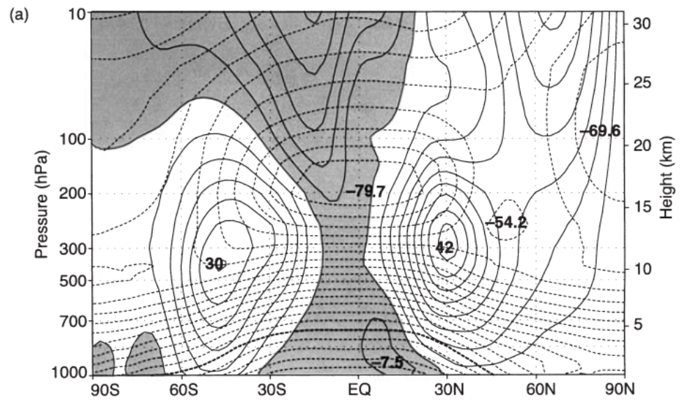
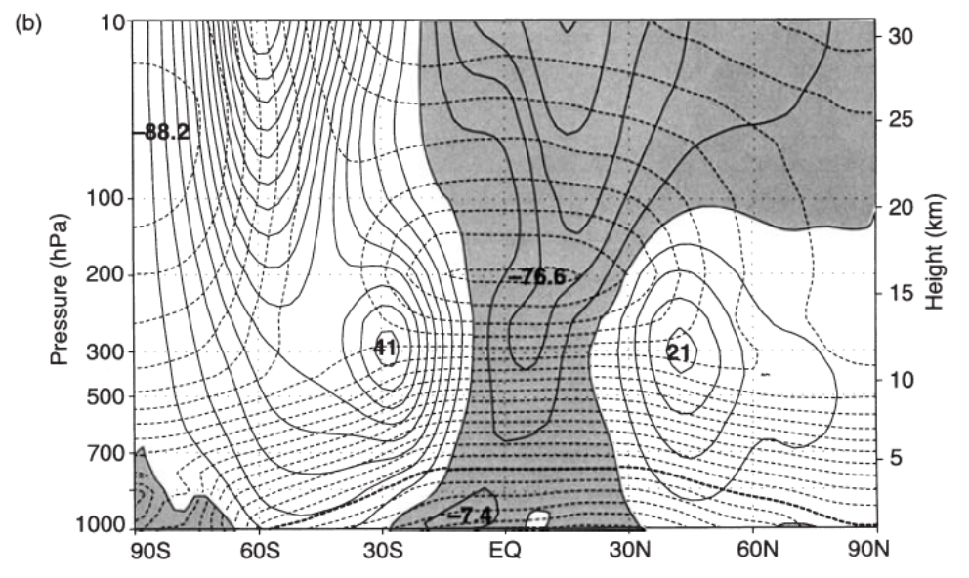
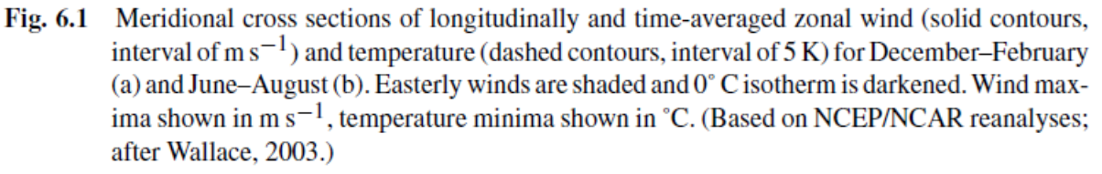
Synoptic-Scale Motions I:
Quasi-Geostrophic Analysis
The observed structure of extratropical circulations
  Zonally averaged cross sections do provide some useful information on the gross structure of the planetary scale circulation in which synoptic-scale eddies are embedded
Mid-latitude synoptic-scale disturbances

Slide 7
Synoptic-Scale Motions I:
Quasi-Geostrophic Analysis
The observed structure of extratropical circulations
Zonally averaged cross sections (DJF)

Slide 8
Synoptic-Scale Motions I:
Quasi-Geostrophic Analysis
The observed structure of extratropical circulations
  large pole to equator temperature gradient in Northern Hemisphere troposphere (winter)
  seasonal cycle in zonal wind speeds is similar to that of the meridional temperature gradient (thermal wind relationship)
  the core of maximum zonal wind speed (called the mean jet stream axis) is located
  [1] just below the tropopause
  [2] at the latitude where the thermal wind integrated through the troposphere is a maximum.
  In both hemispheres, this is about 30° during winter, but moves poleward to 40°– 45° during summer
Zonally averaged cross sections (DJF)

Slide 9
Synoptic-Scale Motions I:
Quasi-Geostrophic Analysis
The observed structure of extratropical circulations
Zonally averaged cross sections (JJA)

Slide 10
Synoptic-Scale Motions I:
Quasi-Geostrophic Analysis
The observed structure of extratropical circulations
  weak pole to equator temperature gradient in Northern Hemisphere troposphere (summer)
  seasonal tropospheric temperature gradient difference in Southern Hemisphere is less noteworthy
  [1] thermal inertia of oceans
  [2] greater fraction of surface in Southern Hemisphere is covered by oceans
Zonally averaged cross sections (JJA)

Slide 11
Synoptic-Scale Motions I:
Quasi-Geostrophic Analysis
The observed structure of extratropical circulations
  in the Northern Hemisphere the maximum zonal wind speed in the winter is twice as large as in the summer
  in the Southern Hemisphere the difference between winter and summer zonal wind maxima is much smaller
Zonally averaged cross sections (JJA)

Slide 12
Synoptic-Scale Motions I:
Quasi-Geostrophic Analysis
The observed structure of extratropical circulations
Mean zonal wind at the 200-hPa level (DJF)

Slide 13
Synoptic-Scale Motions I:
Quasi-Geostrophic Analysis
The observed structure of extratropical circulations
  very large deviations of the time-mean zonal flow from its longitudinally averaged distribution
  [1] strong zonal wind maxima (jets) near 30°N just east of the Asian and North American continents and north of the Arabian peninsula
  [2] distinct minima occur in the eastern Pacific and
  eastern Atlantic
Mean zonal wind at the 200-hPa level (DJF)

Slide 14
Synoptic-Scale Motions I:
Quasi-Geostrophic Analysis
The observed structure of extratropical circulations
  Synoptic-scale disturbances tend to
  [1] develop preferentially in the regions of maximum time-mean zonal winds associated with the western Pacific and western Atlantic jets
  [2] propagate downstream along storm tracks that approximately follow the jet axes
Mean zonal wind at the 200-hPa level (DJF)

Slide 15
Synoptic-Scale Motions I:
Quasi-Geostrophic Analysis
The observed structure of extratropical circulations
Mean 500-hPa contours in January (N.H.)

Slide 16
Synoptic-Scale Motions I:
Quasi-Geostrophic Analysis
The observed structure of extratropical circulations
  The most prominent asymmetries are the troughs to the east of the American and Asian continents.
  the intense jet at 35°N and 140°E is a result of the semi-permanent trough in that region
  the mean flow in which synoptic systems are embedded should be regarded as a longitude-dependent time-averaged flow
Mean 500-hPa contours in January (N.H.)

Slide 17
Synoptic-Scale Motions I:
Quasi-Geostrophic Analysis
The observed structure of extratropical circulations
Latitude–height cross sections through a cold front
zonal wind and potential temperature
potential temperature and Ertel potential vorticity

Slide 18
Synoptic-Scale Motions I:
Quasi-Geostrophic Analysis
The observed structure of extratropical circulations
  at any time the planetary scale flow in the region of the jet stream has much greater baroclinicity than indicated on time-averaged charts
  axis of the jet stream tends to be located above a narrow sloping zone of strong potential temperature gradients called the polar frontal zone (thermal wind balance)
Latitude–height cross sections through a cold front

Slide 19
Synoptic-Scale Motions I:
Quasi-Geostrophic Analysis
The observed structure of extratropical circulations
  strong static stability in the stratosphere
  isentropes (constant θ surfaces) cross the tropopause in the vicinity of the jet so that air can move between the troposphere and the stratosphere without diabatic heating or cooling
  strong gradient of Ertel potential vorticity at the tropopause; provides a strong resistance to cross-tropopause flow along the isentropes
Latitude–height cross sections through a cold front

Slide 20
Synoptic-Scale Motions I:
Quasi-Geostrophic Analysis
The observed structure of extratropical circulations
  the frontal zone is characterized by a strong positive anomaly in potential vorticity associated with the strong relative vorticity on the poleward side of the jet and the strong static stability on the cold air side of the frontal zone
  any small disturbance introduced into the jet will tend to amplify, drawing energy from the jet as it grows
  most synoptic-scale systems in mid-latitudes appear to develop as the result of an instability of the jet stream flow (baroclinic instability)
Latitude–height cross sections through a cold front

Slide 21
Synoptic-Scale Motions I:
Quasi-Geostrophic Analysis
The observed structure of extratropical circulations
  baroclinic instability- depends on the meridional temperature gradient, particularly at the surface.
  hence, through the thermal wind relationship, baroclinic instability depends on vertical shear and tends to occur in the region of the polar frontal zone
Latitude–height cross sections through a cold front

Slide 22
Synoptic-Scale Motions I:
Quasi-Geostrophic Analysis
The observed structure of extratropical circulations
A developing baroclinic wave at three stages of development

Slide 23
Synoptic-Scale Motions I:
Quasi-Geostrophic Analysis
The observed structure of extratropical circulations
  In the stage of rapid development there is a cooperative interaction between the upper level and surface flows; strong cold advection is seen to occur west of the trough at the surface, with weaker warm advection to the east
  a direct consequence of the fact that the trough at 500 hPa lags (lies to the west of ) the surface trough
  the mean geostrophic wind in the 1000-500-hPa layer is directed across the 1000-500-hPa thickness lines toward larger thickness west of the surface trough and toward smaller thickness east of the surface trough
A developing baroclinic wave at three stages of development

Slide 24
Synoptic-Scale Motions I:
Quasi-Geostrophic Analysis
The observed structure of extratropical circulations
West–east cross section through a developing baroclinic wave

Slide 25
Synoptic-Scale Motions I:
Quasi-Geostrophic Analysis
The observed structure of extratropical circulations
  throughout the troposphere the trough and ridge axes tilt westward (or upstream) with height
  axes of warmest and coldest air are observed to have the opposite tilt
  the westward tilt of the troughs and ridges is necessary in order that the mean flow transfers potential energy to the developing wave
  in the mature stage (not shown in Fig. 6.5) the troughs at 500 and 1000 hPa are nearly in phase => the thermal advection and energy conversion are quite weak
West–east cross section through a developing baroclinic wave

Slide 26
Synoptic-Scale Motions I:
Quasi-Geostrophic Analysis
The quasi-geostrophic approximation
  for motions that are hydrostatic and nearly geostrophic, the three-dimensional flow field is determined approximately by the isobaric distribution of geopotential [ Φ(x, y, p, t) ]
  => use of the isobaric coordinate system simplifies the development of approximate prognostic and diagnostic equations
Introduction

Slide 27
Synoptic-Scale Motions I:
Quasi-Geostrophic Analysis
The quasi-geostrophic approximation
Scale Analysis in Isobaric Coordinates

Slide 28
Synoptic-Scale Motions I:
Quasi-Geostrophic Analysis
The quasi-geostrophic approximation
  these equations still contain several terms that are of secondary significance for mid-latitude synoptic-scale systems
Scale Analysis in Isobaric Coordinates

Slide 29
Synoptic-Scale Motions I:
Quasi-Geostrophic Analysis
The quasi-geostrophic approximation
  recall from Section 2.4 that the horizontal flow is nearly geostrophic and that the magnitude of the ratio of vertical velocity to horizontal velocity is of order 10⁻³
Scale Analysis in Isobaric Coordinates

Slide 30
Synoptic-Scale Motions I:
Quasi-Geostrophic Analysis
The quasi-geostrophic approximation
Scale Analysis in Isobaric Coordinates

Slide 31
Synoptic-Scale Motions I:
Quasi-Geostrophic Analysis
The quasi-geostrophic approximation
  V can be replaced by V_{g} and the vertical advection, which arises only from the ageostrophic flow, can be neglected
Scale Analysis in Isobaric Coordinates

Slide 32
Synoptic-Scale Motions I:
Quasi-Geostrophic Analysis
The quasi-geostrophic approximation
  it is still necessary to retain the dynamical effect of the variation of the Coriolis parameter with latitude in the Coriolis force term in the momentum equation
Scale Analysis in Isobaric Coordinates

Slide 33
Synoptic-Scale Motions I:
Quasi-Geostrophic Analysis
The quasi-geostrophic approximation
Scale Analysis in Isobaric Coordinates

Slide 34
Synoptic-Scale Motions I:
Quasi-Geostrophic Analysis
The quasi-geostrophic approximation
Scale Analysis in Isobaric Coordinates

Slide 35
Synoptic-Scale Motions I:
Quasi-Geostrophic Analysis
The quasi-geostrophic approximation
Scale Analysis in Isobaric Coordinates

Slide 36
Synoptic-Scale Motions I:
Quasi-Geostrophic Analysis
The quasi-geostrophic approximation
  Equations (6.7), (6.11), (6.12), and (6.13b) constitute the quasi-geostrophic equations
  a complete set in the dependent variables Φ, V_{g}, V_{a}, and ω (provided that the diabatic heating rate is known)
  the quasi-geostrophic momentum equation (6.11) can be used diagnostically to determine the non-divergent part of V_{a}, for a known distribution of V_{g} (Section 6.4.3)
Scale Analysis in Isobaric Coordinates

Slide 37
Synoptic-Scale Motions I:
Quasi-Geostrophic Analysis
The quasi-geostrophic approximation
The Quasi-Geostrophic Vorticity Equation

Slide 38
Synoptic-Scale Motions I:
Quasi-Geostrophic Analysis
The quasi-geostrophic approximation
  Invertibility
  Equation (6.15) can be used to determine ζg(x, y) from a known field Φ(x, y). Alternatively, (6.15) can be solved by inverting the Laplacian operator to determine Φ from a known distribution of ζgg, provided that suitable conditions on Φ are specified on the boundaries of the region in question
  if evolution of the vorticity can be predicted, then inversion of (6.15) yields the evolution of the geopotential field, from which it is possible to determine the geostrophic wind and temperature distributions
The Quasi-Geostrophic Vorticity Equation

Slide 39
Synoptic-Scale Motions I:
Quasi-Geostrophic Analysis
The quasi-geostrophic approximation
The Quasi-Geostrophic Vorticity Equation

Slide 40
Synoptic-Scale Motions I:
Quasi-Geostrophic Analysis
The quasi-geostrophic approximation
The Quasi-Geostrophic Vorticity Equation

Slide 41
Synoptic-Scale Motions I:
Quasi-Geostrophic Analysis
The quasi-geostrophic approximation
The Quasi-Geostrophic Vorticity Equation

Slide 42
Synoptic-Scale Motions I:
Quasi-Geostrophic Analysis
The quasi-geostrophic approximation
  region I (upstream of the 500-hPa trough)
  –V_{g} ・∇ζ_{g} < 0, – βv_{g} > 0
  advection of relative vorticity tends to decrease the local vorticity, whereas the advection of planetary vorticity tends to increase the local vorticity
The Quasi-Geostrophic Vorticity Equation

Slide 43
Synoptic-Scale Motions I:
Quasi-Geostrophic Analysis
The quasi-geostrophic approximation
  region II (downstream of the 500-hPa trough)
  –V_{g} ・∇ζ_{g} > 0, – βv_{g} < 0
  advection of relative vorticity tends to increase the local vorticity, whereas the advection of planetary vorticity tends to decrease the local vorticity
The Quasi-Geostrophic Vorticity Equation

Slide 44
Synoptic-Scale Motions I:
Quasi-Geostrophic Analysis
The quasi-geostrophic approximation
  advection of relative vorticity tends to move the vorticity pattern and hence the troughs and ridges eastward (downstream)
  advection of planetary vorticity tends to move the troughs and ridges westward against the advecting wind field (retrograde motion or retrogression)
  net effect of advection on the evolution of the vorticity pattern depends on which type of vorticity advection dominates
The Quasi-Geostrophic Vorticity Equation

Slide 45
Synoptic-Scale Motions I:
Quasi-Geostrophic Analysis
The quasi-geostrophic approximation
The Quasi-Geostrophic Vorticity Equation

Slide 46
Synoptic-Scale Motions I:
Quasi-Geostrophic Analysis
The quasi-geostrophic approximation
  for a disturbance with a fixed amplitude of geopotential disturbance, the amplitude of the vorticity increases as the square of the wave number or, inversely, as the square of the horizontal scale
  advection of relative vorticity dominates over planetary vorticity advection for short waves (Lx < 3,000 km)
  for long waves (Lx >10,000 km) the planetary vorticity advection tends to dominate
The Quasi-Geostrophic Vorticity Equation

Slide 47
Synoptic-Scale Motions I:
Quasi-Geostrophic Analysis
The quasi-geostrophic approximation
  Since positive maxima in relative vorticity are associated with cyclonic disturbances, regions of positive cyclonic vorticity advection, which can be estimated easily from upper level maps, are commonly used as aids in forecasting synoptic-scale weather disturbances.
The Quasi-Geostrophic Vorticity Equation

Slide 48
Synoptic-Scale Motions I:
Quasi-Geostrophic Analysis
The quasi-geostrophic approximation
  A change in the vertical shear of the horizontal wind associated with differential (i.e., height dependent) vorticity advection will drive an ageostrophic vertical circulation, which adiabatically adjusts the horizontal temperature gradient to maintain thermal wind balance.
  The convergence and divergence fields associated with this vertical circulation will not only modify the effects of vorticity advection at upper levels, but will force changes in the vorticity distribution in the lower troposphere where advection may be very weak.
The Quasi-Geostrophic Vorticity Equation – other factors

Slide 49
Synoptic-Scale Motions I:
Quasi-Geostrophic Analysis
The quasi-geostrophic approximation
  thermal advection, which is often strong near the surface, does not merely force changes in the temperature in the lower troposphere. Rather, it will induce a vertical circulation, which through its associated divergence and convergence patterns will alter the vorticity fields both near the surface and aloft so that thermal wind balance is maintained.
The Quasi-Geostrophic Vorticity Equation – other factors

Slide 50
Synoptic-Scale Motions I:
Quasi-Geostrophic Analysis
Quasi-geostrophic prediction
  the ageostrophic vertical motion plays an essential role in the maintenance of thermal wind balance as the flow evolves, the evolution of the geostrophic circulation can actually be determined without explicitly determining the distribution of ω
Introduction

Slide 51
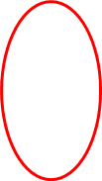
Synoptic-Scale Motions I:
Quasi-Geostrophic Analysis
Quasi-geostrophic prediction
Introduction

Slide 52
Synoptic-Scale Motions I:
Quasi-Geostrophic Analysis
Quasi-geostrophic prediction
  vertical stretching [∂ω/∂p > 0] forces
  [1] a positive tendency in the geostrophic vorticity (6.21)
  [2] a negative tendency of equal magnitude in the term on the left side in (6.22) {the local rate of change of a normalized static stability anomaly} => left side of (6.22) is negative when the lapse rate tendency is positive
  (i.e., when the static stability tendency is negative)
Ageostrophic vertical motion

Slide 53
Synoptic-Scale Motions I:
Quasi-Geostrophic Analysis
Quasi-geostrophic prediction
  vertical stretching [∂ω/∂p > 0], see Fig. 4.7
Ageostrophic vertical motion

Slide 54
Synoptic-Scale Motions I:
Quasi-Geostrophic Analysis
Quasi-geostrophic prediction
  vertical stretching [∂ω/∂p > 0], see Fig. 4.7
  an air column that moves adiabatically from a region of high static stability to a region of low static stability is stretched vertically (Fig. 4.7) so that the upper portion of the column cools adiabatically relative to the lower portion
  the relative vorticity in (6.21) and the normalized static stability anomaly in (6.22) are changed by equal and opposite amounts
  the normalized static stability anomaly is referred to as the stretching vorticity
Ageostrophic vertical motion

Slide 55
Synoptic-Scale Motions I:
Quasi-Geostrophic Analysis
Quasi-geostrophic prediction
  vertical stretching [∂ω/∂p > 0], see Fig. 4.7
  the role of the vertical motion distribution must be to maintain consistency between the geopotential tendencies required by vorticity advection in (6.21) and thermal advection in (6.22)
Ageostrophic vertical motion

Slide 56
Synoptic-Scale Motions I:
Quasi-Geostrophic Analysis
Quasi-geostrophic prediction
Geopotential Tendency

Slide 57
Synoptic-Scale Motions I:
Quasi-Geostrophic Analysis
Quasi-geostrophic prediction
  provides a relationship between the local geopotential tendency (term A) and the distributions of vorticity advection (term B) and thickness advection (term C)
  If the distribution of Φ is known at a given time, then terms B and C may be regarded as known forcing functions, and (6.23) is a linear partial differential equation in the unknown χ.
Geopotential Tendency Equation

Slide 58
Synoptic-Scale Motions I:
Quasi-Geostrophic Analysis
Quasi-geostrophic prediction
  distribution of vorticity advection (term B)
  usually the dominant forcing term in the upper troposphere
  for shortwaves term B is negative in region I of Fig. 6.7 (upstream of the upper level trough)
  because the sign of the geopotential tendency is opposite to that of term B in this case, χ will be positive and a ridge will tend to develop {necessary for the development of a negative anticyclonic geostrophic vorticity}
Geopotential Tendency Equation

Slide 59
Synoptic-Scale Motions I:
Quasi-Geostrophic Analysis
Quasi-geostrophic prediction
  distribution of vorticity advection (term B)
  important to note that the vorticity advection term is zero along both the trough and ridge axes, as both ∇ ζ_{g} and v_{g} are zero at the axes
  vorticity advection cannot change the strength of this type of disturbance at the levels where the advection is occurring, but only acts to propagate the disturbance horizontally and (as shown in the next section) to spread it vertically
Geopotential Tendency Equation

Slide 60
Synoptic-Scale Motions I:
Quasi-Geostrophic Analysis
Quasi-geostrophic prediction
  distribution of thickness advection (term C)
  major mechanism for amplification or decay of mid-latitude synoptic systems
  thickness advection tends to be largest in magnitude in the lower troposphere beneath the 500-hPa trough and ridge lines in a developing baroclinic wave
  because −∂Φ/∂p is proportional to temperature, the thickness advection is proportional to the temperature advection
Geopotential Tendency Equation

Slide 61
Synoptic-Scale Motions I:
Quasi-Geostrophic Analysis
Quasi-geostrophic prediction
  distribution of thickness advection (term C)
  proportional to minus the rate of change of temperature advection with respect to pressure
  term is sometimes referred to as differential temperature advection
  below the 500-hPa ridge there is strong warm advection associated with the warm front => increases thickness, thus builds the upper level ridge
  below the 500-hPa trough there is strong cold advection associated with the cold front => decreases thickness, thus deepens the upper level trough
Geopotential Tendency Equation

Slide 62
Synoptic-Scale Motions I:
Quasi-Geostrophic Analysis
Quasi-geostrophic prediction
  distribution of thickness advection (term C)
  above the 500-hPa level the temperature gradient is usually weaker, and the isotherms often become nearly parallel to the height lines so that thermal advection tends to be small
  forcing term C is concentrated in the lower troposphere
  => the geopotential tendency response will not be limited to the levels of forcing, but is spread in the vertical so that, as noted above, in developing waves differential temperature advection will deepen upper level troughs and build upper level ridges
Geopotential Tendency Equation

Slide 63
Synoptic-Scale Motions I:
Quasi-Geostrophic Analysis
Quasi-geostrophic prediction
  distribution of thickness advection (term C)
Geopotential Tendency Equation

Slide 64
Synoptic-Scale Motions I:
Quasi-Geostrophic Analysis
Quasi-geostrophic prediction
  distribution of thickness advection (term C)
Geopotential Tendency Equation

Slide 65
Synoptic-Scale Motions I:
Quasi-Geostrophic Analysis
Quasi-geostrophic prediction
  distribution of thickness advection (term C)
  advection of cold air into the air column below the 500-hPa trough reduces the thickness of that column, and hence lowers the height of the 500-hPa surface unless there is a compensating rise in the surface pressure
  warm advection into the air column below the ridge has the opposite effect
  in the absence of diabatic heating the horizontal temperature advection must be nonzero in order that a mid-latitude synoptic system intensifies through baroclinic processes
Geopotential Tendency Equation

Slide 66
Synoptic-Scale Motions I:
Quasi-Geostrophic Analysis
Quasi-geostrophic prediction
  Transform Eq. (6.23) to a conservation form of quasi-geostrophic potential vorticity
  from left to right, are the geostrophic relative vorticity, the planetary vorticity, and the stretching vorticity
The Quasi-Geostrophic Potential Vorticity Equation

Slide 67
Synoptic-Scale Motions I:
Quasi-Geostrophic Analysis
Quasi-geostrophic prediction
As a parcel moves about in the atmosphere, the geostrophic relative vorticity, the planetary vorticity, and the stretching vorticity terms may each change.
However, according to (6.24) their sum is conserved following the geostrophic motion
The Quasi-Geostrophic Potential Vorticity Equation

Slide 68
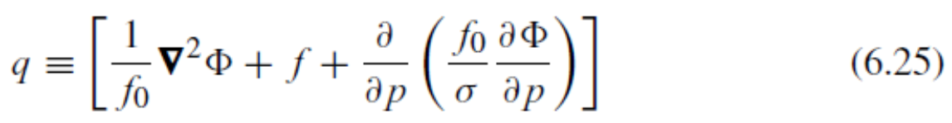
Synoptic-Scale Motions I:
Quasi-Geostrophic Analysis
Quasi-geostrophic prediction
  scalar q is proportional to a linearized form of the Ertel potential vorticity
  q has units of vorticity and is determined solely by the isobaric geopotential distribution
  q is conserved under adiabatic conditions following the geostrophic motion on an isobaric surface
  quasi-geostrophic potential vorticity tends to be proportional to minus the geopotential. A local increase in q is associated with trough development, whereas a decrease in q is associated with ridge development
The Quasi-Geostrophic Potential Vorticity Equation

Slide 69
Synoptic-Scale Motions I:
Quasi-Geostrophic Analysis
Quasi-geostrophic prediction
The Quasi-Geostrophic Potential Vorticity Equation

Slide 70
Synoptic-Scale Motions I:
Quasi-Geostrophic Analysis
Quasi-geostrophic prediction
  The process of recovering the geopotential field from the potential vorticity field is referred to as potential vorticity inversion.
  Because Φ is related to q by a second-order differential operator, the geopotential disturbance associated with a localized anomaly in q will extend horizontally and vertically beyond the region of anomalous q
  An example…
Potential Vorticity Inversion

Slide 71
Synoptic-Scale Motions I:
Quasi-Geostrophic Analysis
Quasi-geostrophic prediction
Potential Vorticity Inversion

Slide 72
Synoptic-Scale Motions I:
Quasi-Geostrophic Analysis
Quasi-geostrophic prediction
  pattern of potential temperature induced by this compact positive potential vorticity anomaly
  static stability is enhanced in the ball of positive potential vorticity and is reduced both above and below the ball
  because potential vorticity is conserved (and has zero anomaly outside the ball), positive vorticity anomalies are induced above and below the ball of potential vorticity to compensate for the reduced stability
Potential Vorticity Inversion - example

Slide 73
Synoptic-Scale Motions I:
Quasi-Geostrophic Analysis
Quasi-geostrophic prediction
  pattern of geostrophic wind induced by this compact positive potential vorticity anomaly
  geostrophic flow induced by the potential vorticity anomaly extends well beyond the boundary of the anomaly
Potential Vorticity Inversion - example

Slide 74
Synoptic-Scale Motions I:
Quasi-Geostrophic Analysis
Quasi-geostrophic prediction
  a potential vorticity anomaly at one level yields a nonzero geopotential anomaly (and hence nonzero geostrophic winds) at other levels
  has important consequences for the influence of upper level disturbances on the lower troposphere. The induction of geopotential changes in the lower troposphere by an upper level potential vorticity change can be demonstrated in a simple
  Another example…
Vertical Coupling Through Potential Vorticity

Slide 75
Synoptic-Scale Motions I:
Quasi-Geostrophic Analysis
Quasi-geostrophic prediction
  Upper-tropospheric flow induced by geopotential pattern of Eq. (6.20)
Vertical Coupling Through Potential Vorticity - example

Slide 76
Synoptic-Scale Motions I:
Quasi-Geostrophic Analysis
Quasi-geostrophic prediction
  Equation (6.31) shows that potential vorticity advection at a given altitude will generate a response in the geopotential tendency whose vertical scale (measured in pressure units) is λ⁻¹
Vertical Coupling Through Potential Vorticity - example

Slide 77
Synoptic-Scale Motions I:
Quasi-Geostrophic Analysis
Quasi-geostrophic prediction
  upper-level vorticity advection associated with disturbances of large horizontal scale (small k) will produce geopotential tendencies that extend down to the surface with little loss of amplitude
  for disturbances of small horizontal scale the response is confined close to the levels of forcing
Vertical Coupling Through Potential Vorticity - example

Slide 78
Synoptic-Scale Motions I:
Quasi-Geostrophic Analysis
Quasi-geostrophic prediction
Vertical Coupling Through Potential Vorticity - example

Slide 79
Synoptic-Scale Motions I:
Quasi-Geostrophic Analysis
Quasi-geostrophic prediction
  In mathematical terms, the differential operator in (6.31) spreads the response in the vertical so that forcing at one altitude influences other altitudes.
Vertical Coupling Through Potential Vorticity - example

Slide 80
Synoptic-Scale Motions I:
Quasi-Geostrophic Analysis
The diagnosis of vertical motion
  associated with divergence and convergence of ageostrophic flow
  important as vertical motion is directly linked with sensible weather having a dramatic societal impact
Introduction

Slide 81
Synoptic-Scale Motions I:
Quasi-Geostrophic Analysis
The diagnosis of vertical motion
  the vorticity equation method of estimating ω is usually more accurate than the continuity equation method discussed in Section 3.5.1 of Holton
  alternative method of estimating the vertical motion, called the omega equation, which utilizes both the vorticity equation and the thermodynamic equation, is developed here
The Traditional Omega Equation

Slide 82
Synoptic-Scale Motions I:
Quasi-Geostrophic Analysis
The diagnosis of vertical motion
  using a variation of Eqs. (6.13b) and (6.21), and eliminating χ, the traditional omega equation is derived
The Traditional Omega Equation

Slide 83
Synoptic-Scale Motions I:
Quasi-Geostrophic Analysis
The diagnosis of vertical motion
  approximate form
  a diagnostic equation for the field of ω in terms of the instantaneous Φ field
  a method of estimating ω that does not depend on observations of the ageostrophic wind (fraught with error)
The Traditional Omega Equation

Slide 84
Synoptic-Scale Motions I:
Quasi-Geostrophic Analysis
The diagnosis of vertical motion
  approximate form
  only observations of Φ at a single time are needed to determine the ω field using (6.36)
  The terms in (6.36), however, do employ higher order derivatives than are involved in the other methods of estimating ω. Accurately estimating such terms from noisy observational data can be difficult.
The Traditional Omega Equation

Slide 85
Synoptic-Scale Motions I:
Quasi-Geostrophic Analysis
The diagnosis of vertical motion
  assume that ω has sinusoidal behavior not only in the horizontal, but also in the vertical
  left side of (6.36) is proportional to −ω upward motion is forced where the right-hand side of (6.36) is positive and downward motion is forced where it is negative
The Traditional Omega Equation - interpretation

Slide 86
Synoptic-Scale Motions I:
Quasi-Geostrophic Analysis
The diagnosis of vertical motion
  right side of (6.36) represents the advection of absolute vorticity by the thermal wind
The Traditional Omega Equation - interpretation

Slide 87
Synoptic-Scale Motions I:
Quasi-Geostrophic Analysis
The diagnosis of vertical motion
  right side of (6.36) represents the advection of absolute vorticity by the thermal wind
The Traditional Omega Equation - interpretation
Let’s plot some vectors!!

Slide 88
Synoptic-Scale Motions I:
Quasi-Geostrophic Analysis
The diagnosis of vertical motion
  due to the westward tilt of the system with height, the 500-hPa geopotential field leads the isotherm pattern.
The Traditional Omega Equation - interpretation
Note: w = dz/dt, (not omega)

Slide 89
Synoptic-Scale Motions I:
Quasi-Geostrophic Analysis
The diagnosis of vertical motion
  rising motion above the surface low and subsidence above the surface high
  For example, above the surface low there is positive vorticity associated with negative geopotential deviations, as vorticity is proportional to the Laplacianof geopotential. Increasing vorticity thus implies a falling geopotential (χ < 0). Hence the 500- to 1000-hPa thickness is decreasing in that region.
The Traditional Omega Equation - interpretation

Slide 90
Synoptic-Scale Motions I:
Quasi-Geostrophic Analysis
The diagnosis of vertical motion
  Because horizontal temperature advection is small above the center of the surface low, the only way to cool the atmosphere as required by the thickness tendency is by adiabatic cooling through the vertical motion field.
  Without this compensating vertical motion, either the vorticity changes at 500 hPa could not remain geostrophic or the temperature changes in the 500- to 1000-hPa layer could not remain hydrostatic.
The Traditional Omega Equation - interpretation

Slide 91
Synoptic-Scale Motions I:
Quasi-Geostrophic Analysis
The diagnosis of vertical motion
  for synoptic-scale motions where vorticity is constrained to be geostrophic and temperature is constrained to be hydrostatic, vertical motion field is just that required to ensure that
  [1] changes in vorticity will be geostrophic
  [2] changes in temperature will be hydrostatic
The Traditional Omega Equation – a summary

Slide 92
Synoptic-Scale Motions I:
Quasi-Geostrophic Analysis
The diagnosis of vertical motion
  the left-hand side in (6.53) is proportional to the vertical velocity**. Hence, a convergent Q forces ascent, and a divergent Q forces descent.
The Q Vector form of the Q-G omega equation
**clarification is in order

Slide 93
Synoptic-Scale Motions I:
Quasi-Geostrophic Analysis
The diagnosis of vertical motion
  by rotation of the horizontal coordinate axes…
  The Q vector, and hence the forcing of vertical motion, can be estimated with the aid of (6.55) from observations of Φ and T on a single isobaric surface
The Q Vector form of the Q-G omega equation

Slide 94
Synoptic-Scale Motions I:
Quasi-Geostrophic Analysis
The diagnosis of vertical motion
  The Q vector, and hence the forcing of vertical motion, can be estimated with the aid of (6.55) from observations of Φ and T on a single isobaric surface
  Examples!!
The Q Vector form of the Q-G omega equation
x axis is parallel to the local isotherm with cold air on the left

Slide 95
Synoptic-Scale Motions I:
Quasi-Geostrophic Analysis
The diagnosis of vertical motion
  Examples (cont.)!!
The Q Vector form of the Q-G omega equation
x axis is parallel to the local isotherm with cold air on the left
(+y axis points toward cold air, normal to local isotherm)

Slide 96
Synoptic-Scale Motions I:
Quasi-Geostrophic Analysis
The diagnosis of vertical motion
  in some synoptic situations, advection by the ageostrophic wind may be important in the evolution of the temperature and vorticity fields (to be examined in detail in Synoptic II)
The Ageostrophic Circulation

Slide 97
Synoptic-Scale Motions I:
Quasi-Geostrophic Analysis
The diagnosis of vertical motion
The Ageostrophic Circulation

Slide 98
Synoptic-Scale Motions I:
Quasi-Geostrophic Analysis
The diagnosis of vertical motion
  1st term (RHS); directed down the gradient of the tendency field
  2nd term (RHS); dominated by zonal advection
The Ageostrophic Circulation
isallobaric wind
advective part of the ageostrophic wind

Slide 99
Synoptic-Scale Motions I:
Quasi-Geostrophic Analysis
The diagnosis of vertical motion
The Ageostrophic Circulation
Examples!!
1st term; solid arrows
2nd term; open arrows

Slide 100
Synoptic-Scale Motions I:
Quasi-Geostrophic Analysis
The diagnosis of vertical motion
The Ageostrophic Circulation

Slide 101
Synoptic-Scale Motions I:
Quasi-Geostrophic Analysis
The diagnosis of vertical motion
The Ageostrophic Circulation

Slide 102
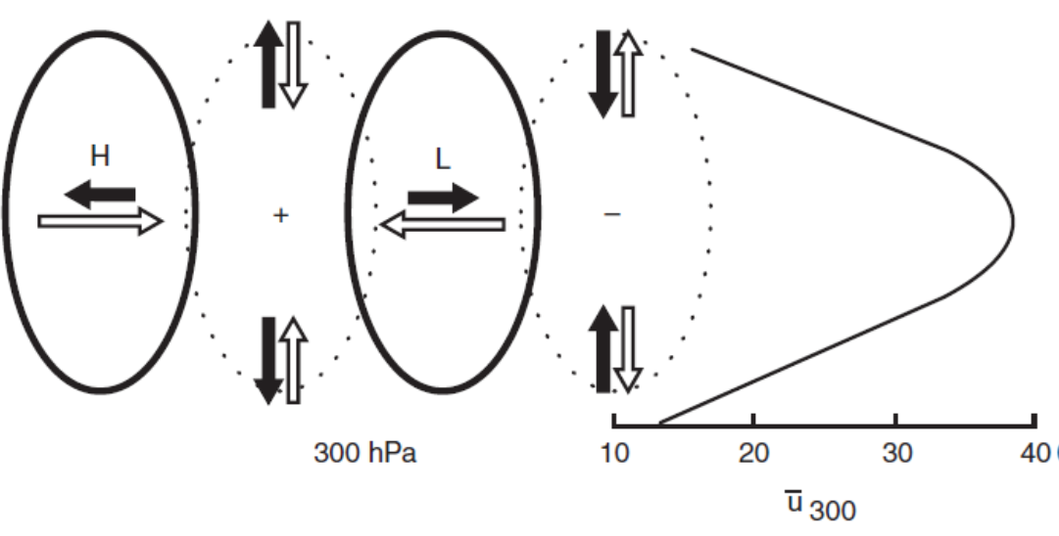
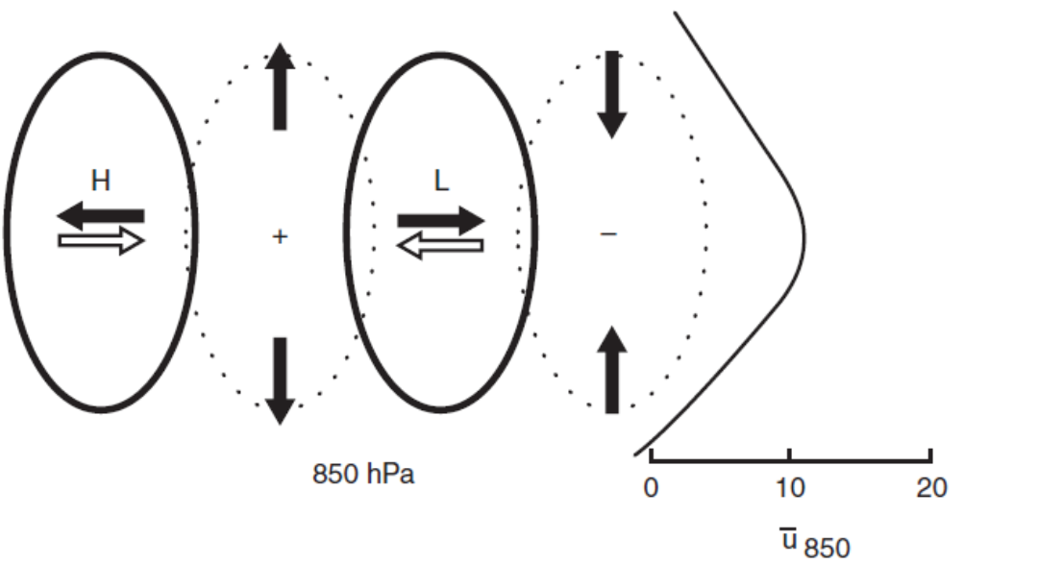
Synoptic-Scale Motions I:
Quasi-Geostrophic Analysis
The diagnosis of vertical motion
  note that due to the strong jetstream at 300 hPa at the center of the waves the advective contribution dominates over the isallobaric contribution. On the flanks of the waves at 300 hPa the two contributions are of comparable amplitude so that the net ageostrophic wind is small
  at the 850-hPa level, however, the two contributions nearly cancel at the center of the perturbations, whereas the advective contribution is nearly zero on the flanks
The Ageostrophic Circulation

Slide 103
Synoptic-Scale Motions I:
Quasi-Geostrophic Analysis
The diagnosis of vertical motion
  net result
  ageostrophic motion for baroclinic waves is primarily zonal in the upper troposphere and primarily meridional in the lower troposphere
The Ageostrophic Circulation

Slide 104
Synoptic-Scale Motions I:
Quasi-Geostrophic Analysis
Idealized model of a baroclinic disturbance
essential structural characteristics of a developing baroclinic wave

Slide 105
Synoptic-Scale Motions I:
Quasi-Geostrophic Analysis
Idealized model of a baroclinic disturbance
Introduction

Slide 106
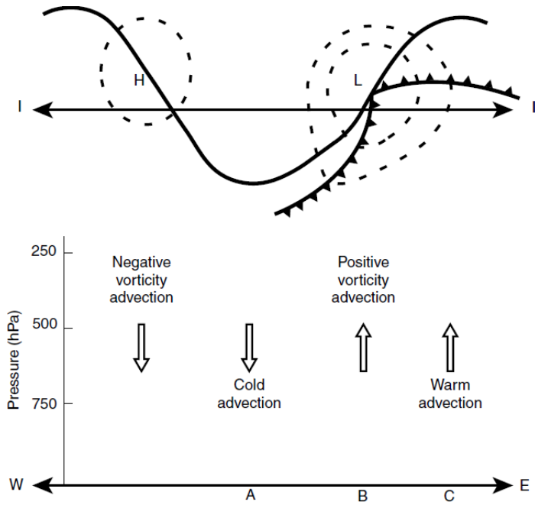
Synoptic-Scale Motions I:
Quasi-Geostrophic Analysis
Idealized model of a baroclinic disturbance
characteristics of a developing baroclinic wave

Slide 107
Synoptic-Scale Motions I:
Quasi-Geostrophic Analysis
Idealized model of a baroclinic disturbance
  in all cases the vertical motion and divergence fields act to keep the temperature changes hydrostatic and vorticity changes geostrophic in order to preserve thermal wind balance
  we may regard the vertical and divergent ageostrophic motions as constituting a secondary circulation imposed by the simultaneous constraints of geostrophic and hydrostatic balance
characteristics of a developing baroclinic wave

Slide 108
Synoptic-Scale Motions I:
Quasi-Geostrophic Analysis
Idealized model of a baroclinic disturbance
  note that the secondary circulation in a developing baroclinic system always acts to oppose the horizontal advection fields
  Thus, the divergent motions tend partly to cancel the vorticity advection, and the adiabatic temperature changes due to vertical motion tend to cancel partly the thermal advection.
characteristics of a developing baroclinic wave

Slide 109
Synoptic-Scale Motions I:
Quasi-Geostrophic Analysis
Idealized model of a baroclinic disturbance
  It should now be clear that a secondary divergent circulation is necessary to satisfy the twin constraints of geostrophic and hydrostatic balance for a baroclinic system.
  The secondary circulation is itself forced, however, by slight departures from geostrophy.
characteristics of a developing baroclinic wave

Slide 110
Synoptic-Scale Motions I:
Quasi-Geostrophic Analysis
ageostrophic flow toward lower pressure is associated
with conversion of energy from potential energy to kinetic energy
Idealized model of a baroclinic disturbance
  cold advection causes the geopotential height to fall and thus intensifies the horizontal pressure gradient
  the wind becomes slightly subgeostrophic and experiences an acceleration across the isobars toward lower pressure
  cross isobaric ageostrophic wind component is responsible for the convergence spins up the vorticity in the upper troposphere so that it adjusts geostrophically to the new geopotential distribution
  cross isobaric flow is accelerated by the pressure gradient force so that the wind speed adjusts back toward geostrophic balance
characteristics of a developing baroclinic wave – column A

