Slide 1
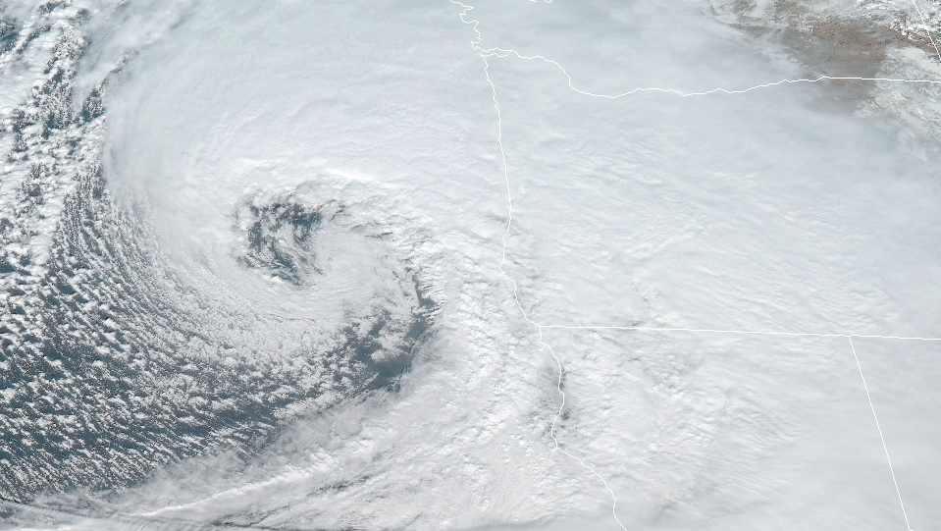
Synoptic-Scale Motions II:
Baroclinic Instability
Kinematics and Dynamics

Slide 2

Synoptic-Scale Motions II:
Baroclinic Instability
Outline of this lecture packet…
  Hydrodynamic instability
  Normal mode baroclinic instability: a two-layer model
  The energetics of baroclinic waves
  Baroclinic instability of a continuously stratified atmosphere
  Growth and propagation of neutral modes

Slide 3
Synoptic-Scale Motions II:
Baroclinic Instability
Review
  Developed diagnostic relationships between geopotential, vorticity, temperature, and vertical velocity in midlatitude synoptic-scale systems via the quasi-geostrophic framework
  No information on origins, growth rates, propagation speeds of atmospheric disturbances
    Found in this chapter via the techniques of Chapter 7
Chapter 6

Slide 4
Synoptic-Scale Motions II:
Baroclinic Instability
Background
  the development of synoptic-scale weather disturbances is often referred to as cyclogenesis, a term that emphasizes the role of relative vorticity in developing synoptic-scale systems
  role of dynamical instability of the mean flow in accounting for the growth of synoptic-scale disturbances
  quasi-geostrophic equations provide a reasonable theoretical basis for understanding the development of synoptic-scale storms
Cyclogenesis

Slide 5
Synoptic-Scale Motions II:
Baroclinic Instability
Hydrodynamic instability
  A zonal mean flow field is said to be hydrodynamically unstable if a small disturbance introduced into the flow grows spontaneously, drawing energy from the mean flow.
    Parcel instability (convective or inertial instability)
    Wave instability (important for synoptic-scale meteorology)
Introduction

Slide 6
Synoptic-Scale Motions II:
Baroclinic Instability
Hydrodynamic instability
  Wave instability (important for synoptic-scale meteorology)
    Barotropic instability - a wave instability associated with the horizontal shear in a jet-like current
    Baroclinic instability - a wave instability associated with the vertical shear in a jet-like current
Introduction

Slide 7
Synoptic-Scale Motions II:
Baroclinic Instability
Hydrodynamic instability
  Baroclinic instability - a wave instability associated with the vertical shear in a jet-like current
    grows by converting potential energy associated with the mean horizontal temperature gradient that must exist to provide thermal wind balance for the vertical shear in the basic state flow
Introduction

Slide 8
Synoptic-Scale Motions II:
Baroclinic Instability
Hydrodynamic instability
  Wave-like disturbances (arising from wave instability)
    linearized version of the governing equations is analyzed to determine the structure and amplification rate for the various wave modes supported by the system
    normal modes method - assume that a small perturbation consisting of a single Fourier wave mode of form exp[ik(x – ct)] is introduced into the flow and to determine the conditions for which the phase velocity c has an imaginary part (exponential growth)
    initial value approach
Introduction

Slide 9
Synoptic-Scale Motions II:
Baroclinic Instability
Hydrodynamic instability
Introduction

Slide 10
Synoptic-Scale Motions II:
Baroclinic Instability
Hydrodynamic instability
  a large amplitude upper-level potential vorticity anomaly is advected into a region where there is a preexisting meridional temperature gradient at the surface
Introduction

Slide 11
Synoptic-Scale Motions II:
Baroclinic Instability
Hydrodynamic instability
  the circulation induced by the upper-level anomaly (which extends downward, as discussed in Section 6.3) leads to temperature advection at the surface; this induces a potential vorticity anomaly near the surface, which in turn reinforces the upper-level anomaly
    If they become phase-locked; induced circulations produce a very rapid amplification of the anomaly pattern
Introduction

Slide 12
Synoptic-Scale Motions II:
Baroclinic Instability
Normal mode baroclinic instability: a 2-layer model
  The atmosphere is represented by two discrete layers bounded by surfaces numbered 0, 2, and 4 (generally taken to be the 0-, 500-, and 1000-hPa surfaces, respectively) as shown in Fig. 8.2
Introduction

Slide 13
Synoptic-Scale Motions II:
Baroclinic Instability
Normal mode baroclinic instability: a 2-layer model
  Q-G vorticity equation for the midlatitude β plane is applied at the 250- and 750-hPa levels, designated by 1 and 3
  Q-G thermodynamic energy equation is applied at the 500-hPa level, designated by 2
  define a geostrophic streamfunction,ψ ≡ Φ/f₀ and
Introduction

Slide 14
Synoptic-Scale Motions II:
Baroclinic Instability
Normal mode baroclinic instability: a 2-layer model
Governing equations

Slide 15
Synoptic-Scale Motions II:
Baroclinic Instability
Normal mode baroclinic instability: a 2-layer model
  …at the middle of the two layers
Governing equations

Slide 16
Synoptic-Scale Motions II:
Baroclinic Instability
Normal mode baroclinic instability: a 2-layer model
Governing equations

Slide 17
Synoptic-Scale Motions II:
Baroclinic Instability
Normal mode baroclinic instability: a 2-layer model
Linear Perturbation Analysis

Slide 18
Synoptic-Scale Motions II:
Baroclinic Instability
Normal mode baroclinic instability: a 2-layer model
Linear Perturbation Analysis

Slide 19
Synoptic-Scale Motions II:
Baroclinic Instability
Normal mode baroclinic instability: a 2-layer model
Linear Perturbation Analysis

Slide 20
Synoptic-Scale Motions II:
Baroclinic Instability
Normal mode baroclinic instability: a 2-layer model
Linear Perturbation Analysis

Slide 21
Synoptic-Scale Motions II:
Baroclinic Instability
Normal mode baroclinic instability: a 2-layer model
  Exponential growth if c has an imaginary part…
  ➔ occurs if δ < 0
Linear Perturbation Analysis

Slide 22
Synoptic-Scale Motions II:
Baroclinic Instability
Normal mode baroclinic instability: a 2-layer model
  Consider two special cases; [1] barotropic mean flow (U_{T} = 0) and [2] f-plane approximation ( β = 0 )
Linear Perturbation Analysis

Slide 23
Synoptic-Scale Motions II:
Baroclinic Instability
Normal mode baroclinic instability: a 2-layer model
  The phase speed c₁ is simply the dispersion relationship for a barotropic Rossby wave with no y dependence (see Section 7.7); B = 0 [Eq. (8.17)] so that the perturbation is barotropic in structure
barotropic mean flow (U_{T} = 0)

Slide 24
Synoptic-Scale Motions II:
Baroclinic Instability
Normal mode baroclinic instability: a 2-layer model
  The phase speed c₂ is a dispersion relationship analogous to the Rossby wave speed for a homogeneous ocean with a free surface; the perturbation is baroclinic, although the basic state is barotropic
  rising motion west of the 250-hPa trough produces the thickness changes required by the westward motion of the system [c₂ – U_{m} < 0]
barotropic mean flow (U_{T} = 0)

Slide 25
Synoptic-Scale Motions II:
Baroclinic Instability
Normal mode baroclinic instability: a 2-layer model
  all waves longer than the critical wavelength L_{c} will amplify (for typical tropospheric conditions we find that L_{c} ≈ 3000 km)
f-plane approximation ( β = 0 )

Slide 26
Synoptic-Scale Motions II:
Baroclinic Instability
Normal mode baroclinic instability: a 2-layer model
  critical wavelength for baroclinic instability increases with increasing static stability
  increased static stability resists vertical displacements (strong rising motion) => static stability stabilizes shorter waves [no growth as APE -> KE conversion through vertical motions is damped by strong static stability]
f-plane approximation ( β = 0 )

Slide 27
Synoptic-Scale Motions II:
Baroclinic Instability
Normal mode baroclinic instability: a 2-layer model
  General disturbance solution; exp(–ikct), exponential growth rate is α = kc_{i} , where c_{i} designates the imaginary part of the phase speed
f-plane approximation ( β = 0 ), growth rate

Slide 28
Synoptic-Scale Motions II:
Baroclinic Instability
Normal mode baroclinic instability: a 2-layer model
  neutral curve, which connects all values of U_{T} and k for which δ = 0 so that the flow is marginally stable.
General case; disturbance growth [Eq. (8.21)]

Slide 29
Synoptic-Scale Motions II:
Baroclinic Instability
thermal wind
Normal mode baroclinic instability: a 2-layer model
  neutral curve, which connects all values of U_{T} and k for which δ = 0 so that the flow is marginally stable.
General case; disturbance growth [Eq. (8.21)]
zonal wave number

Slide 30
Synoptic-Scale Motions II:
Baroclinic Instability
Normal mode baroclinic instability: a 2-layer model
  β effect stabilizes flow
  Minimum value of U_{T} required for unstable growth depends strongly on k. Thus, the β effect strongly stabilizes the long wave end of the wave spectrum (k → 0)
General case; disturbance growth [Eq. (8.21)]

Slide 31
Synoptic-Scale Motions II:
Baroclinic Instability
Normal mode baroclinic instability: a 2-layer model
  Baroclinically unstable waves always propagate at a speed that lies between maximum and minimum mean zonal wind speeds U₁ > U₃ > 0; the real part of the phase speed satisfies the inequality U₃ < c_{r} < U₁ for unstable waves.
  For long waves and weak basic state wind shear, the solution given by (8.21) will have c_{r} < U₃, there is no steering level, and unstable growth cannot occur.
General case; disturbance growth [Eq. (8.21)]

Slide 32
Synoptic-Scale Motions II:
Baroclinic Instability
Normal mode baroclinic instability: a 2-layer model
  Minimum in wind shear at (wave of maximum instability)
    If U_{T} were gradually raised from zero the flow would first become unstable for perturbations of wave number k = 2^{1/4}λ. Those perturbations would then amplify and in the process remove energy from the mean thermal wind, thereby decreasing U_{T} and stabilizing the flow.
General case; disturbance growth

Slide 33
Synoptic-Scale Motions II:
Baroclinic Instability
Normal mode baroclinic instability: a 2-layer model
  under normal conditions of static stability the wavelength of maximum instability is about 4000 km, close to the average wavelength for midlatitude synoptic systems
  observed behavior of midlatitude synoptic systems is consistent with the hypothesis that such systems can originate from infinitesimal perturbations of a baroclinically unstable basic current
General case; disturbance growth

Slide 34
Synoptic-Scale Motions II:
Baroclinic Instability
Normal mode baroclinic instability: a 2-layer model
  Other factors may influence the development of synoptic systems
    instabilities due to lateral shear in the jetstream,
    Nonlinear interactions of finite amplitude perturbations, and
    the release of latent heat in precipitating systems
General case; disturbance growth

Slide 35
Synoptic-Scale Motions II:
Baroclinic Instability
Normal mode baroclinic instability: a 2-layer model
  Forcing of vertical motion; by [1] thermal advection (evaluated at level 2) and [2] differential vorticity advection (evaluated as the difference between the vorticity advection at level 1 and that at level 3)
Vertical Motion in Baroclinic Waves

Slide 36
Synoptic-Scale Motions II:
Baroclinic Instability
Normal mode baroclinic instability: a 2-layer model
  Q-vector expression in two-layer model…
Vertical Motion in Baroclinic Waves

Slide 37
Synoptic-Scale Motions II:
Baroclinic Instability
Normal mode baroclinic instability: a 2-layer model
  Q-vector expression in two-layer model…
Vertical Motion in Baroclinic Waves

Slide 38
Synoptic-Scale Motions II:
Baroclinic Instability
Normal mode baroclinic instability: a 2-layer model
  Q-vector expression in two-layer model…
  sinking motion is forced by negative anticyclonic advection of disturbance vorticity [AVA] by the basic state thermal wind (or alternatively, cold advection of the basic state thermal field by the perturbation meridional wind)
Vertical Motion in Baroclinic Waves

Slide 39
Synoptic-Scale Motions II:
Baroclinic Instability
Normal mode baroclinic instability: a 2-layer model
  diagram the structure of a baroclinically unstable disturbance in the two-level model
Vertical Motion in Baroclinic Waves

Slide 40
Synoptic-Scale Motions II:
Baroclinic Instability
Normal mode baroclinic instability: a 2-layer model
  diagram the structure of a baroclinically unstable disturbance in the two-level model
    Linear interpolation has been used between levels so that the trough and ridge axes are straight lines tilted back toward the west with height
    In this example the ψ₁ field lags the ψ₃ field by about 65◦ in phase so that the trough at 250 hPa lies 65◦ in phase west of the 750-hPa trough
Vertical Motion in Baroclinic Waves

Slide 41
Synoptic-Scale Motions II:
Baroclinic Instability
Normal mode baroclinic instability: a 2-layer model
  at 500 hPa the perturbation thickness field lags the geopotential field by one-quarter wavelength
  temperature advection by the perturbation meridional wind is in phase with the 500-hPa thickness field so that the advection of the basic state temperature by the perturbation wind acts to intensify the perturbation thickness field
    also illustrated by the zonally oriented Q vectors shown at the 500 hPa-level
Vertical Motion in Baroclinic Waves; diagram

Slide 42
Synoptic-Scale Motions II:
Baroclinic Instability
Normal mode baroclinic instability: a 2-layer model
  divergence–convergence pattern that contributes
    a positive vorticity tendency near the 250-hPa trough
    a negative vorticity tendency near the 750-hPa ridge
    opposite tendencies at the 250-hPa ridge and 750-hPa trough
  in all cases these vorticity tendencies tend to increase the extreme values of vorticity at the troughs and ridges, this secondary circulation system will act to increase the strength of the disturbance
Vertical Motion in Baroclinic Waves; diagram

Slide 43
Synoptic-Scale Motions II:
Baroclinic Instability
Normal mode baroclinic instability: a 2-layer model
Vertical Motion in Baroclinic Waves
advection

Slide 44
Synoptic-Scale Motions II:
Baroclinic Instability
Normal mode baroclinic instability: a 2-layer model
Vertical Motion in Baroclinic Waves
div/conv

Slide 45
Synoptic-Scale Motions II:
Baroclinic Instability
Normal mode baroclinic instability: a 2-layer model
  vorticity advection leads the vorticity field by one-quarter wavelength
  since in this case the basic state wind increases with height, the vorticity advection at 250 hPa is larger than that at 750 hPa
  effect of this differential vorticity advection would be to move the upper-level trough and ridge pattern eastward more rapidly than the lower-level pattern (westward tilt of the trough–ridge pattern would quickly be destroyed)
Vertical Motion in Baroclinic Waves

Slide 46
Synoptic-Scale Motions II:
Baroclinic Instability
Normal mode baroclinic instability: a 2-layer model
  maintenance of this tilt in the presence of differential vorticity advection is due to the concentration of vorticity by vortex stretching associated with the divergent secondary circulation
  concentration of vorticity by the divergence effect lags the vorticity field by about 65◦ at 250 hPa and leads the vorticity field by about 65◦ at 750 hPa
  net vorticity tendencies ahead of the vorticity maxima and minima are less than the advective tendencies at the upper level and greater than the advective tendencies at the lower level
Vertical Motion in Baroclinic Waves

Slide 47
Synoptic-Scale Motions II:
Baroclinic Instability
Normal mode baroclinic instability: a 2-layer model
  vorticity concentration by the divergence effect will tend to amplify the vorticity perturbations in the troughs and ridges at both the 250- and 750-hPa levels as required for a growing disturbance
Vertical Motion in Baroclinic Waves

Slide 48
Synoptic-Scale Motions II:
Baroclinic Instability
The energetics of baroclinic waves
  baroclinically unstable perturbations will amplify exponentially by drawing energy from the mean flow.
  this section considers the energetics of linearized baroclinic disturbances and shows that the potential energy of the mean flow is the energy source for baroclinically unstable perturbations
Introduction

Slide 49
Synoptic-Scale Motions II:
Baroclinic Instability
The energetics of baroclinic waves
  total energy of the atmosphere is the sum of internal energy, gravitational potential energy, and kinetic energy
  internal and gravitational potential energy are proportional in a hydrostatic atmosphere and the two forms of energy may be combined into a single term called the total potential energy
Available Potential Energy

Slide 50
Synoptic-Scale Motions II:
Baroclinic Instability
The energetics of baroclinic waves
Available Potential Energy

Slide 51
Synoptic-Scale Motions II:
Baroclinic Instability
The energetics of baroclinic waves
  to demonstrate qualitatively why most of the total potential energy is unavailable
Example

Slide 52
Synoptic-Scale Motions II:
Baroclinic Instability
The energetics of baroclinic waves
  to demonstrate qualitatively why most of the total potential energy is unavailable
Example

Slide 53
Synoptic-Scale Motions II:
Baroclinic Instability
The energetics of baroclinic waves
  initially consists of two equal masses of dry air separated by a vertical partition
  the two air masses are at uniform potential temperatures θ₁ and θ₂, respectively, with θ₁ < θ₂
  the ground level pressure on each side of the partition is taken to be 1000 hPa
  the maximum kinetic energy that can be realized by an adiabatic rearrangement of mass within the same volume when the partition is removed
Example

Slide 54
Synoptic-Scale Motions II:
Baroclinic Instability
The energetics of baroclinic waves
  Because θ is conserved for an adiabatic process, the two air masses cannot mix.
Example

Slide 55
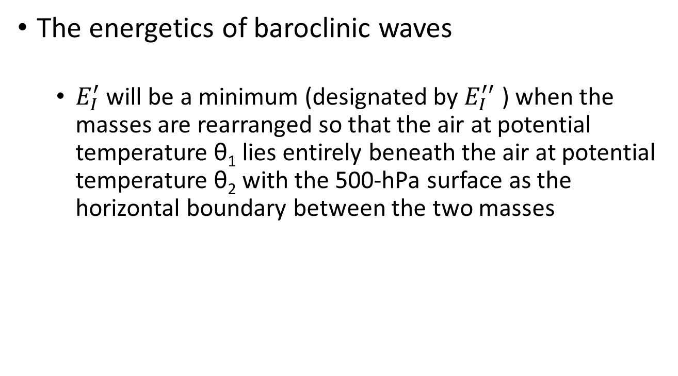
Synoptic-Scale Motions II:
Baroclinic Instability
The energetics of baroclinic waves
  $E_{I}^{′}$will be a minimum (designated by $E_{I}^{′′}$ ) when the masses are rearranged so that the air at potential temperature θ₁ lies entirely beneath the air at potential temperature θ₂ with the 500-hPa surface as the horizontal boundary between the two masses
Example

Slide 56
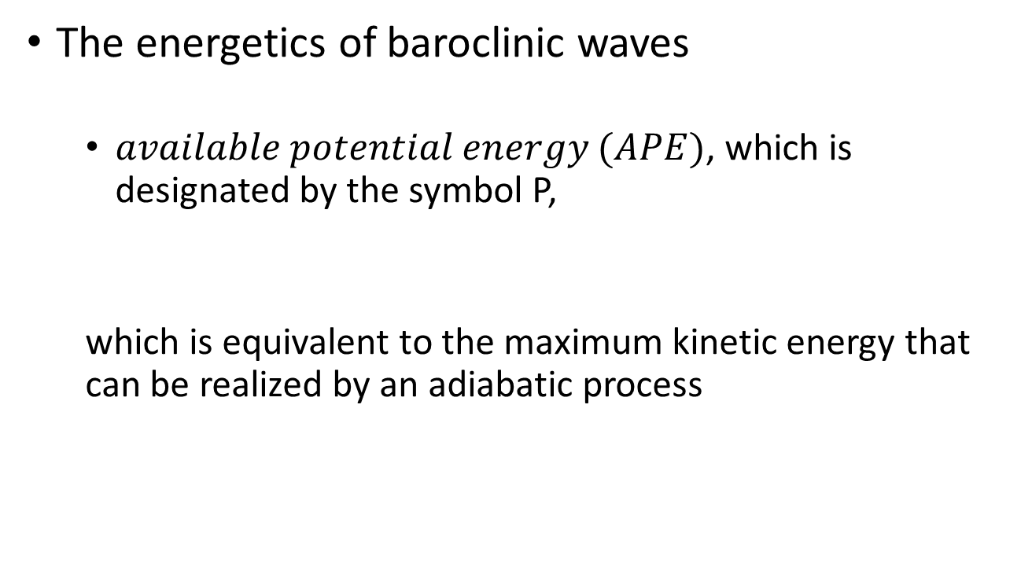
Synoptic-Scale Motions II:
Baroclinic Instability
The energetics of baroclinic waves
  $available potential energy (APE)$, which is designated by the symbol P,
  which is equivalent to the maximum kinetic energy that can be realized by an adiabatic process
Example

Slide 57
Synoptic-Scale Motions II:
Baroclinic Instability
The energetics of baroclinic waves
  Lorenz (1960)
Example

Slide 58
Synoptic-Scale Motions II:
Baroclinic Instability
The energetics of baroclinic waves
  Lorenz (1960)
Example

Slide 59
Synoptic-Scale Motions II:
Baroclinic Instability
The energetics of baroclinic waves
Energy Equations for the Two-Layer Model

Slide 60
Synoptic-Scale Motions II:
Baroclinic Instability
The energetics of baroclinic waves
Energy Equations for the Two-Layer Model

Slide 61

Synoptic-Scale Motions II:
Baroclinic Instability
The energetics of baroclinic waves
Energy Equations for the Two-Layer Model

Slide 62
Synoptic-Scale Motions II:
Baroclinic Instability
The energetics of baroclinic waves
  Final term in Eqs. (8.37) and (8.38) are equal and opposite {represent conversion term between potential and kinetic energy}
  Warm air rising and cold air sinking; APE => KE
    a situation that clearly tends to lower the center of mass and hence the potential energy of the perturbation
  Both forms of energy can increase if APE can be generated [first term of Eq. (8.38)] at a greater rate than its conversion to KE
Energy Equations for the Two-Layer Model

Slide 63
Synoptic-Scale Motions II:
Baroclinic Instability
The energetics of baroclinic waves
  Generation of APE; depends on the correlation between the perturbation thickness and the meridional velocity at 500 hPa
  where x₀ designates the phase difference between the barotropic and baroclinic parts of the disturbance
Energy Equations for the Two-Layer Model

Slide 64
Synoptic-Scale Motions II:
Baroclinic Instability
The energetics of baroclinic waves
  Generation of APE; depends on the correlation between the perturbation thickness and the meridional velocity at 500 hPa
  must be positive if the perturbation potential energy is to increase
Energy Equations for the Two-Layer Model

Slide 65
Synoptic-Scale Motions II:
Baroclinic Instability
The energetics of baroclinic waves
  Generation of APE; [ >0 ]
  kx₀ must satisfy the inequality 0 < kx₀ < π.
  Furthermore, the correlation will be a positive maximum for kx₀ = π/2, that is, when the temperature wave lags the geopotential wave by 90° in phase at 500 hPa (one quarter wavelength)
  poleward advection of warm air, equatorward advection of cold air => generation of APE
    amplifies upper-level wave {CAA [WAA] under upper trough [ridge]}, maintains westward tilt with height
Energy Equations for the Two-Layer Model

Slide 66
Synoptic-Scale Motions II:
Baroclinic Instability
The energetics of baroclinic waves
  Thus, for quasi-geostrophic perturbations, a westward tilt of the perturbation with height implies both
    that the horizontal temperature advection will increase the available potential energy of the perturbation and
    that the vertical circulation will convert perturbation available potential energy to perturbation kinetic energy.
Energy Equations for the Two-Layer Model

Slide 67
Synoptic-Scale Motions II:
Baroclinic Instability
The energetics of baroclinic waves
  it is only the potential energy generation rate that determines the growth of the total energy P’ + K’ of the disturbance
  the rate of increase of the total energy of the perturbation depends on the magnitude of the basic state thermal wind U_{T}
Energy Equations for the Two-Layer Model

Slide 68
Synoptic-Scale Motions II:
Baroclinic Instability
The energetics of baroclinic waves
  Because the generation of perturbation energy requires systematic poleward transport of warm air and equatorward transport of cold air, it is clear that baroclinically unstable disturbances tend to reduce the meridional temperature gradient and hence the available potential energy of the mean flow
Energy Equations for the Two-Layer Model

Slide 69
Synoptic-Scale Motions II:
Baroclinic Instability
The energetics of baroclinic waves
  Because the generation of perturbation energy requires systematic poleward transport of warm air and equatorward transport of cold air, it is clear that baroclinically unstable disturbances tend to reduce the meridional temperature gradient and hence the available potential energy of the mean flow
Energy Equations for the Two-Layer Model

Slide 70
Synoptic-Scale Motions II:
Baroclinic Instability
The energetics of baroclinic waves
  parcels that move poleward and upward with slopes less than the slope of the zonal mean potential temperature surface will become warmer than their surroundings, and vice versa for parcels moving downward and equatorward
    the correlations between disturbance meridional velocity and temperature and between disturbance vertical velocity and temperature will both be positive as required for baroclinically unstable disturbances
Energy Equations for the Two-Layer Model

Slide 71
Synoptic-Scale Motions II:
Baroclinic Instability
The energetics of baroclinic waves
  parcels that move poleward and upward with slopes greater than the slope of the zonal mean potential temperature surface will become colder than their surroundings, and vice versa for parcels moving downward and equatorward
    the correlations between disturbance meridional velocity and temperature and between disturbance vertical velocity and temperature will both be negative as required for baroclinically stable disturbances
Energy Equations for the Two-Layer Model

Slide 72
Synoptic-Scale Motions II:
Baroclinic Instability
The energetics of baroclinic waves
  the rate of energy generation can be greater for an atmosphere in which the meridional slope of the potential temperature surfaces is large
  why baroclinic instability has a short-wave cutoff
    Intensity of the vertical circulation must increase as the wavelength decreases.
    Thus, the slopes of the parcel trajectories must increase with decreasing wavelength, and for some critical wavelength the trajectory slopes will become greater than the slopes of the potential temperature surfaces.
Energy Equations for the Two-Layer Model

Slide 73
Synoptic-Scale Motions II:
Baroclinic Instability
The energetics of baroclinic waves
Energy Equations for the Two-Layer Model
Warm air poleward
Cold air equatorward
Warm air rising
Cold air sinking

Slide 74
Synoptic-Scale Motions II:
Baroclinic Instability
Baroclinic instability – cont. stratified atmosphere
  Severe constraint of two-layer model; assumes that the altitude dependence of large-scale systems can be adequately represented with only two degrees of freedom in the vertical (250- and 750-hPa levels)
    disturbances that are concentrated near the ground or near the tropopause can hardly be represented accurately in the two-layer model
Introduction

Slide 75
Synoptic-Scale Motions II:
Baroclinic Instability
Baroclinic instability – cont. stratified atmosphere
  Obtain necessary conditions for baroclinic or barotropic instability from an integral theorem first developed by Rayleigh (8.4.2)
    baroclinic instability is intimately related to the mean meridional gradient of potential vorticity and the mean meridional temperature gradient at the surface
Introduction

Slide 76
Synoptic-Scale Motions II:
Baroclinic Instability
Baroclinic instability – cont. stratified atmosphere
  pose the stability problem for a continuously stratified atmosphere in a fashion that leads to a second-order differential equation for the vertical structure that can be solved by standard methods (Eady, 8.4.3)
Introduction

Slide 77
Synoptic-Scale Motions II:
Baroclinic Instability
Baroclinic instability – cont. stratified atmosphere
  Derivation of the Rayleigh theorem and the Eady stability model is facilitated if we transform from the standard isobaric coordinates to a vertical coordinate based on the logarithm of pressure. In the log-pressure coordinates, the vertical coordinate is defined as
Log-pressure coordinates

Slide 78
Synoptic-Scale Motions II:
Baroclinic Instability
Baroclinic instability – cont. stratified atmosphere
  Hydrostatic equation
  Continuity equation
Log-pressure coordinates

Slide 79
Synoptic-Scale Motions II:
Baroclinic Instability
Baroclinic instability – cont. stratified atmosphere
  First law of thermodynamics
  Potential vorticity
Log-pressure coordinates
{Rel. vort. + Earth’s vort. + Stretching vort.}

Slide 80
Synoptic-Scale Motions II:
Baroclinic Instability
Baroclinic instability – cont. stratified atmosphere
The Rayleigh Theorem

Slide 81
Synoptic-Scale Motions II:
Baroclinic Instability
Baroclinic instability – cont. stratified atmosphere
  Equation (8.53), together with its boundary conditions, constitutes a linear boundary value problem for Ψ(y, z∗)
The Rayleigh Theorem

Slide 82
Synoptic-Scale Motions II:
Baroclinic Instability
Baroclinic instability – cont. stratified atmosphere
  for unstable modes, c_{i} is non-zero
  quantity is non-negative
The Rayleigh Theorem – necessary condition for instability

Slide 83
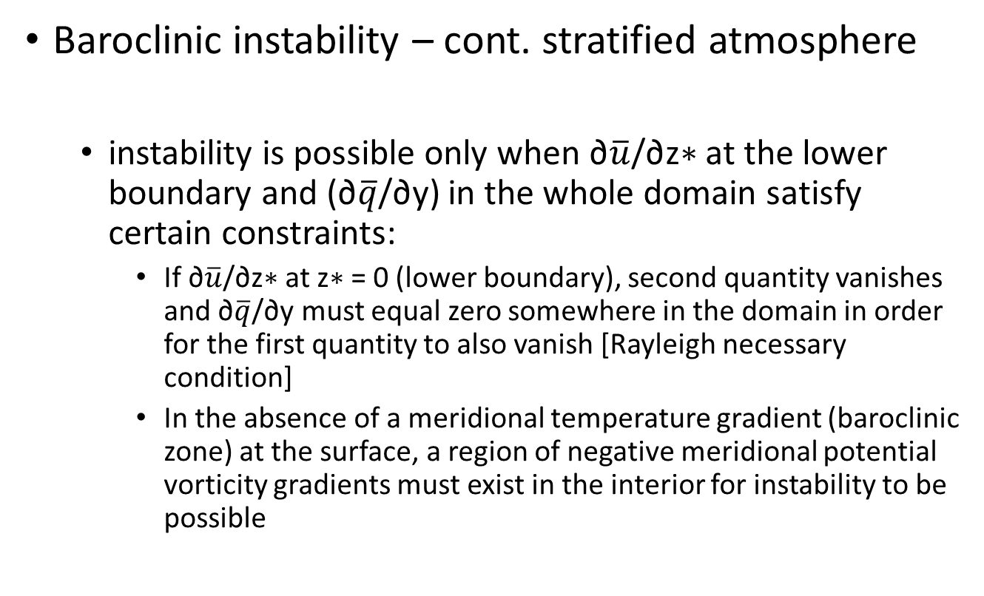
Synoptic-Scale Motions II:
Baroclinic Instability
Baroclinic instability – cont. stratified atmosphere
  instability is possible only when ∂$\overline{u}$/∂z∗ at the lower boundary and (∂$\overline{q}$/∂y) in the whole domain satisfy certain constraints:
    If ∂$\overline{u}$/∂z∗ at z∗ = 0 (lower boundary), second quantity vanishes and ∂$\overline{q}$/∂y must equal zero somewhere in the domain in order for the first quantity to also vanish [Rayleigh necessary condition]
    In the absence of a meridional temperature gradient (baroclinic zone) at the surface, a region of negative meridional potential vorticity gradients must exist in the interior for instability to be possible
The Rayleigh Theorem – necessary condition for instability

Slide 84
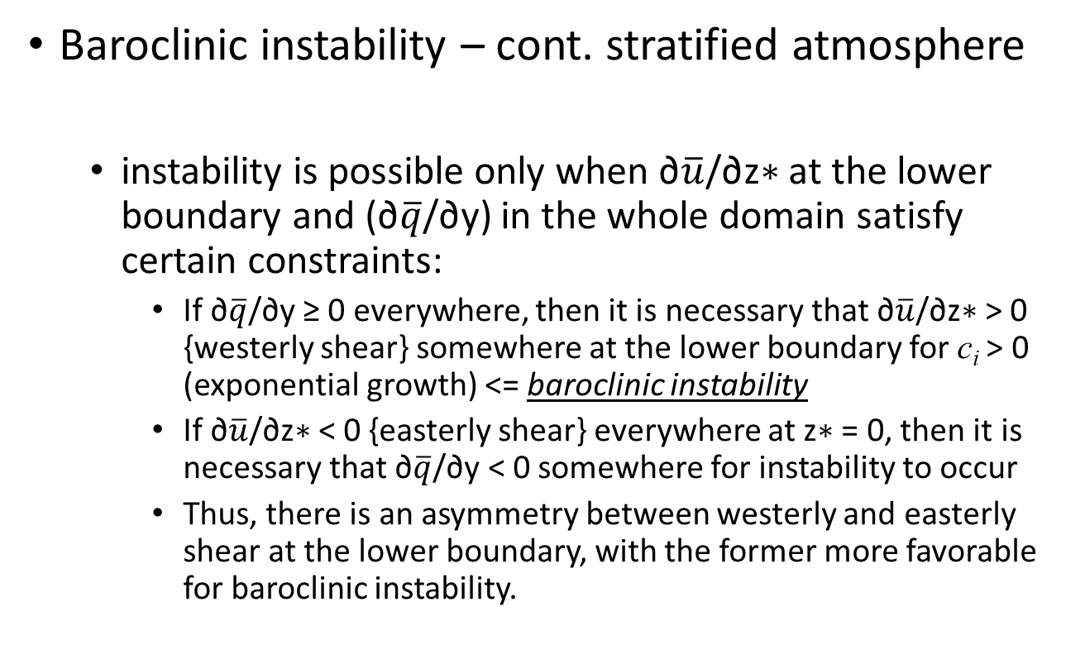
Synoptic-Scale Motions II:
Baroclinic Instability
Baroclinic instability – cont. stratified atmosphere
  instability is possible only when ∂$\overline{u}$/∂z∗ at the lower boundary and (∂$\overline{q}$/∂y) in the whole domain satisfy certain constraints:
    If ∂$\overline{q}$/∂y ≥ 0 everywhere, then it is necessary that ∂$\overline{u}$/∂z∗ > 0 {westerly shear} somewhere at the lower boundary for c_{i} > 0 (exponential growth) <= baroclinic instability
    If ∂$\overline{u}$/∂z∗ < 0 {easterly shear} everywhere at z∗ = 0, then it is necessary that ∂$\overline{q}$/∂y < 0 somewhere for instability to occur
    Thus, there is an asymmetry between westerly and easterly shear at the lower boundary, with the former more favorable for baroclinic instability.
The Rayleigh Theorem – necessary condition for instability

Slide 85
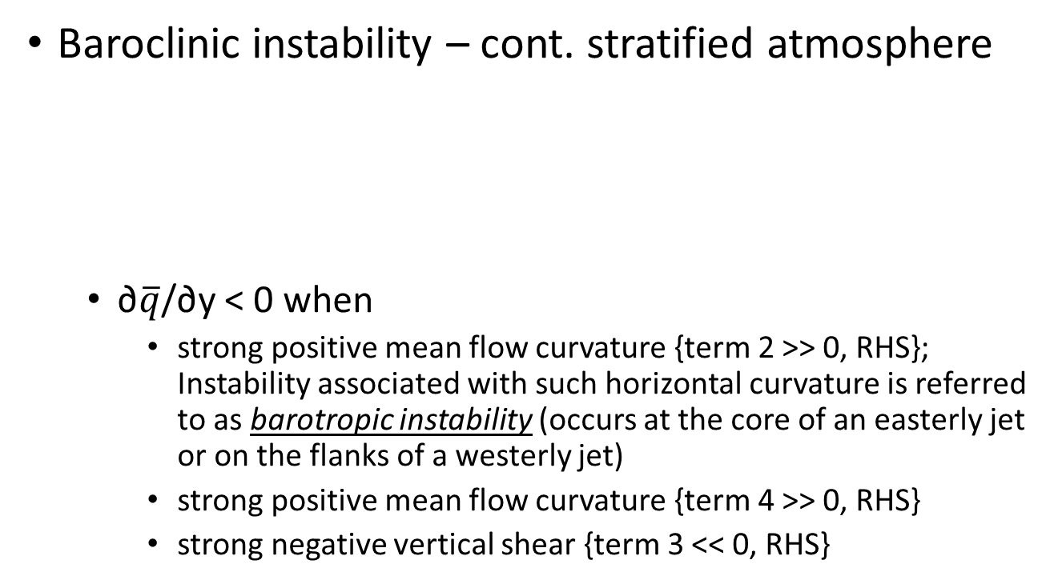
Synoptic-Scale Motions II:
Baroclinic Instability
Baroclinic instability – cont. stratified atmosphere
  ∂$\overline{q}$/∂y < 0 when
    strong positive mean flow curvature {term 2 >> 0, RHS}; Instability associated with such horizontal curvature is referred to as barotropic instability (occurs at the core of an easterly jet or on the flanks of a westerly jet)
    strong positive mean flow curvature {term 4 >> 0, RHS}
    strong negative vertical shear {term 3 << 0, RHS}
The Rayleigh Theorem – necessary condition for instability

Slide 86
Synoptic-Scale Motions II:
Baroclinic Instability
Baroclinic instability – cont. stratified atmosphere
  Baroclinic instability
    a mean meridional temperature gradient at the ground is essential for its existence
    can also be excited at the tropopause due to the rapid decrease of ε with height if there is a sufficiently strong easterly mean wind shear to cause a local reversal in the mean potential vorticity gradient
The Rayleigh Theorem – necessary condition for instability

Slide 87
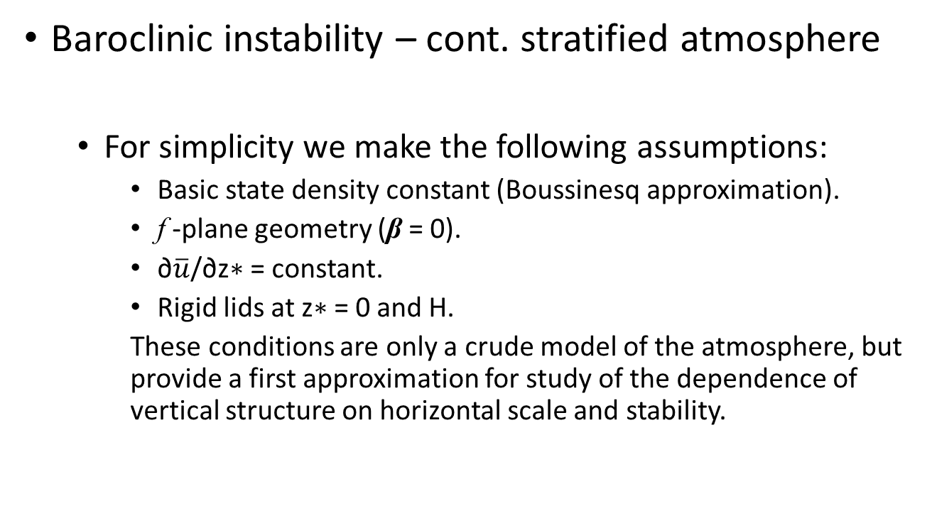
Synoptic-Scale Motions II:
Baroclinic Instability
Baroclinic instability – cont. stratified atmosphere
  For simplicity we make the following assumptions:
    Basic state density constant (Boussinesq approximation).
    f -plane geometry (β = 0).
    ∂$\overline{u}$/∂z∗ = constant.
    Rigid lids at z∗ = 0 and H.
    These conditions are only a crude model of the atmosphere, but provide a first approximation for study of the dependence of vertical structure on horizontal scale and stability.
Eady Stability Problem

Slide 88
Synoptic-Scale Motions II:
Baroclinic Instability
Baroclinic instability – cont. stratified atmosphere
Eady Stability Problem - necessary condition for instability

Slide 89
Synoptic-Scale Motions II:
Baroclinic Instability
Baroclinic instability – cont. stratified atmosphere
  For waves with equal zonal and meridional wave numbers (k = l), the wavelength of maximum growth rate turns out to be
    Substituting this value of α into the solution for the vertical structure of the streamfunction (8.67) and using the lower boundary condition to express the coefficient B in terms of A, we can determine the vertical structure of the most unstable mode
Eady Stability Problem - necessary condition for instability

Slide 90
Synoptic-Scale Motions II:
Baroclinic Instability
Baroclinic instability – cont. stratified atmosphere
  For waves with equal zonal and meridional wave numbers (k = l), the wavelength of maximum growth rate turns out to be
Eady Stability Problem - necessary condition for instability

Slide 91
Synoptic-Scale Motions II:
Baroclinic Instability
Baroclinic instability – cont. stratified atmosphere
  trough and ridge axes slope westward with height, in agreement with the requirements for extraction of available potential energy from the mean flow
  axes of the warmest and coldest air, however, tilt eastward with height, a result that could not be determined from the two-layer model where temperature was given at a single level
Eady Stability Problem - necessary condition for instability

Slide 92
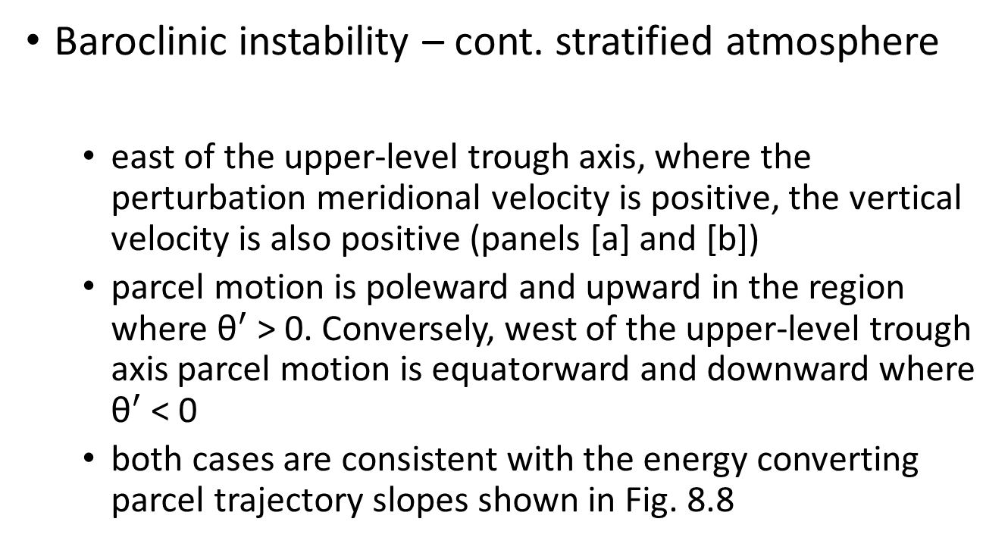
Synoptic-Scale Motions II:
Baroclinic Instability
Baroclinic instability – cont. stratified atmosphere
  east of the upper-level trough axis, where the perturbation meridional velocity is positive, the vertical velocity is also positive (panels [a] and [b])
  parcel motion is poleward and upward in the region where ${\text{θ}}^{′}$> 0. Conversely, west of the upper-level trough axis parcel motion is equatorward and downward where ${\text{θ}}^{′}$< 0
  both cases are consistent with the energy converting parcel trajectory slopes shown in Fig. 8.8
Eady Stability Problem - necessary condition for instability

Slide 93
Synoptic-Scale Motions II:
Baroclinic Instability
Growth and propagation of neutral modes
  baroclinic wave disturbances with certain favorable initial configurations may amplify rapidly even in the absence of baroclinic instability
  basic idea of transient growth of neutral modes can be used to
    consider disturbances that consist of waves in the two-layer model with zonal wave numbers slightly higher than the short-wave cutoff for baroclinic instability
    demonstrate the important phenomenon of downstream development of disturbances due to the group velocity effect
Introduction

Slide 94
Synoptic-Scale Motions II:
Baroclinic Instability
Growth and propagation of neutral modes
Transient growth of neutral waves

Slide 95
Synoptic-Scale Motions II:
Baroclinic Instability
Growth and propagation of neutral modes
Transient growth of neutral waves
<= whoa!

Slide 96
Synoptic-Scale Motions II:
Baroclinic Instability
Growth and propagation of neutral modes
  for small μ the barotropic mode initially consists of two waves of nearly equal amplitude that are 180◦ out of phase so that they nearly cancel, whereas the baroclinic mode initially consists of two very weak waves that are in phase
  as time advances the two oppositely propagating barotropic modes begin to reinforce each other, leading to a maximum amplitude trough 90◦ to the east of the initial trough at time t_{m} = π / (2kμU_{T} )
Transient growth of neutral waves

Slide 97
Synoptic-Scale Motions II:
Baroclinic Instability
Growth and propagation of neutral modes
  at time t_{m} = π / (2kμU_{T} )
Transient growth of neutral waves

Slide 98
Synoptic-Scale Motions II:
Baroclinic Instability
Growth and propagation of neutral modes
  at time t_{m} = π / (2kμU_{T} )
Transient growth of neutral waves

Slide 99
Synoptic-Scale Motions II:
Baroclinic Instability
Growth and propagation of neutral modes
  the amplitude of the barotropic disturbance increases by a factor of 8 in about 48 h
  energy source for the transient amplification of the neutral modes is conversion of the available potential energy of the mean flow into disturbance potential energy by meridional temperature advection, followed immediately by conversion to disturbance kinetic energy by the secondary vertical circulation
Transient growth of neutral waves

Slide 100
Synoptic-Scale Motions II:
Baroclinic Instability
Growth and propagation of neutral modes
  maximum upward motion and lower level convergence occur to the west of the initial upper level ridge, and maximum downward motion and lower level divergence occur west of the initial upper level trough
  the result is that a pattern of nearly barotropic troughs and ridges develops 90◦ to the east of the initial trough and ridge pattern
  unlike normal mode instability the growth in this case does not continue indefinitely
Transient growth of neutral waves

Slide 101
Synoptic-Scale Motions II:
Baroclinic Instability
Growth and propagation of neutral modes
  It was noted in Section 7.2.2 that under some circumstances the zonal group velocity may exceed the zonal phase speed so that the energy of a wave group propagates faster than the individual wave disturbances.
  The two-layer channel model with constant Coriolis parameter can be used to demonstrate the process of dispersion and downstream development of neutral waves in a simple context.
Downstream development

Slide 102
Synoptic-Scale Motions II:
Baroclinic Instability
Growth and propagation of neutral modes
Downstream development

Slide 103
Synoptic-Scale Motions II:
Baroclinic Instability
Growth and propagation of neutral modes
  Comparison of (8.77 ) with (8.71) shows that relative to the mean zonal flow the group velocity exceeds the phase velocity by the factor in parentheses on the right side of (8.77 ) for both eastward and westward directed neutral modes.
  For example, if ,
  the group velocity equals twice the phase speed, which is the situation shown schematically in Fig. 7.4.
Downstream development

Slide 104
Synoptic-Scale Motions II:
Baroclinic Instability
Growth and propagation of neutral modes
  the situation shown schematically in Fig. 7.4.
Downstream development
group velocity
phase speed

