Slide 1
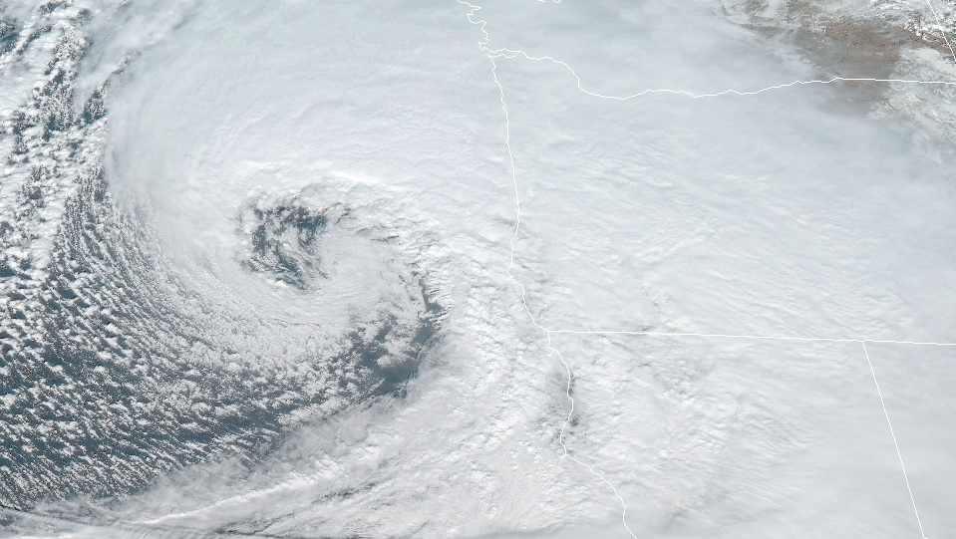
Introduction
Kinematics and Dynamics

Slide 2


Introduction
Outline of this lecture packet…
  Overview of ATMS courses
  Dimensions, units, scales of motion
  Fundamental forces
  Newton and your sick stomach
  Vertical aspects of the atmosphere

Slide 3
Introduction
Overview of courses
  ATMS 305 and ATMS 455 address processes acting as sources or sinks of available ‘fuel’ for atmospheric disturbances at different scales
Thermodynamic Energy Equation

Slide 4

Introduction
Overview of courses
  This course (ATMS 310) addresses processes, through the movement of mass, momentum, energy, and moisture, creating the right conditions (‘ingredients’) to produce an atmospheric disturbance, if a ‘trigger’ is present
Momentum Equations

Slide 5

Introduction
Overview of this course (ATMS 310)
  On occasion, we will apply principles and concepts learned in this course to considerations of computer weather models (numerical weather prediction, NWP)
https://www.nbcnews.com/mach/science/5-ways-world-s-fastest-supercomputer-could-change-world-ncna883766

Slide 6
Introduction
Overview of this course (ATMS 310)
  A set of equations (governing equations) will be developed and examined that form the basis of NWP
    Partial differential equations (PDEs)
    No general solutions exist
    NWP uses simplified forms of the governing equations
    How to simplify the PDEs depends on the scale of atmospheric disturbances you want to address

Slide 7
Introduction
Dimensions, units, scales of motion
  Also known as MKS Units (International System, SI)
  Four dimensionally independent properties
  Why metric (a history lesson; Vilhelm Bjerknes)?

Slide 8
Introduction
Dimensions, units, scales of motion
  Units having special names and symbols
  Unit analysis is useful as a check for the accuracy of your algebraic steps taken in reaching a solution [Example]
You will be expected ALWAYS to indicate units in your work

Slide 9
Introduction
Dimensions, units, scales of motion
  Common non-SI units…
    Minutes (min), hour (h), day (d)
    Hectopascal (hPa) as pressure
    Celsius temperature
one Kelvin unit equals one degree Celsius

Slide 10
Introduction
Dimensions, units, scales of motion
  Common prefixes in science

Slide 11
Introduction
Dimensions, units, scales of motion
  Scaling depends on the expected…
    magnitude, perturbation (fluctuation), and length/ depth/ time scale on which the fluctuation occurs

Slide 12
Introduction
Dimensions, units, scales of motion
  Scaling allows the simplification of the complicated governing equations to forcings relevant to the atmospheric ‘animal of interest’ (phenomenon) in our computer weather model
    Dominant terms in the governing equations depends on the horizontal scale of motions
For purposes of operational forecasting, there’s not much practical justification for simulating atmospheric phenomena smaller than the mesoscale, however,…
for purposes of research, there’s always justification for simulating smaller atmospheric phenomena (e.g., large eddy simulations).

Slide 13
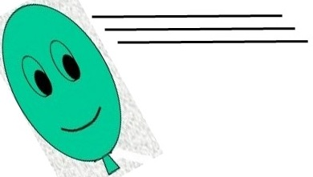
Introduction
Fundamental forces
  The movement of Polly Parcel is determined by laws prescribing the conservation of mass, momentum, and energy
  Conservation of momentum depends on the nature of forces influencing atmospheric motions
    Body forces- act on the center of mass of an air parcel; magnitude is proportional to the mass of the parcel (e.g., gravity)
    Surface forces- act across the boundary surface separating the air parcel from its surroundings; magnitude is independent of the air parcel mass (e.g., PGF)

Slide 14
Introduction
Fundamental forces
  Newton’s 2nd law of motion…
    rate of change of momentum (a.k.a. acceleration) of an object, as measured in a fixed coordinate system, is the sum of all forces acting on the object
  Fundamental forces
    pressure gradient force, gravitational force, friction
  Apparent forces (coordinate system that rotates with earth)
    centrifugal force, Coriolis force

Slide 15
Introduction
Fundamental forces
Pressure Gradient Force

Slide 16
Introduction
Fundamental forces
  Momentum transfer per unit time per unit area is the pressure exerted on the walls of the air parcel by the surrounding air
Pressure Gradient Force

Slide 17
Introduction
Fundamental forces
  Note!!!: negative sign indicates PGF is directed from high to low pressure (counter to the usual gradient vector direction; from low to high)
  Units of PGF (and other forces)? [let’s work it out!]
Pressure Gradient Force (PGF)

Slide 18
Introduction
Fundamental forces
Gravitational Force

Slide 19
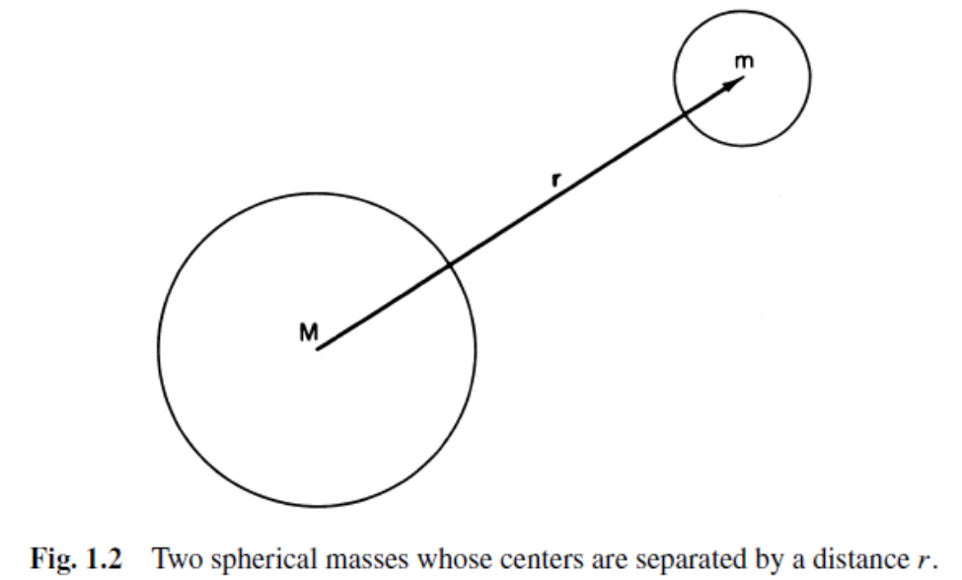
Introduction
Fundamental forces
Gravitational Force
‘a’ is the mean radius of the earth and ‘z’ is distance above mean sea level, z << a, so we can effectively treat gravitational force as a constant

Slide 20
Introduction
Fundamental forces
Viscous Force (a.k.a. force of friction)

Slide 21
Introduction
Fundamental forces
Viscous Force (a.k.a. force of friction)

Slide 22
Introduction
Fundamental forces
  For the troposphere and stratosphere (below 100 km), molecular viscosity is negligible outside the lowest 3 cm of the atmosphere
  Turbulent eddies are the primary source of momentum transfer (Synoptic II; macro-scopic ‘friction’)
Viscous Force (a.k.a. force of friction)

Slide 23
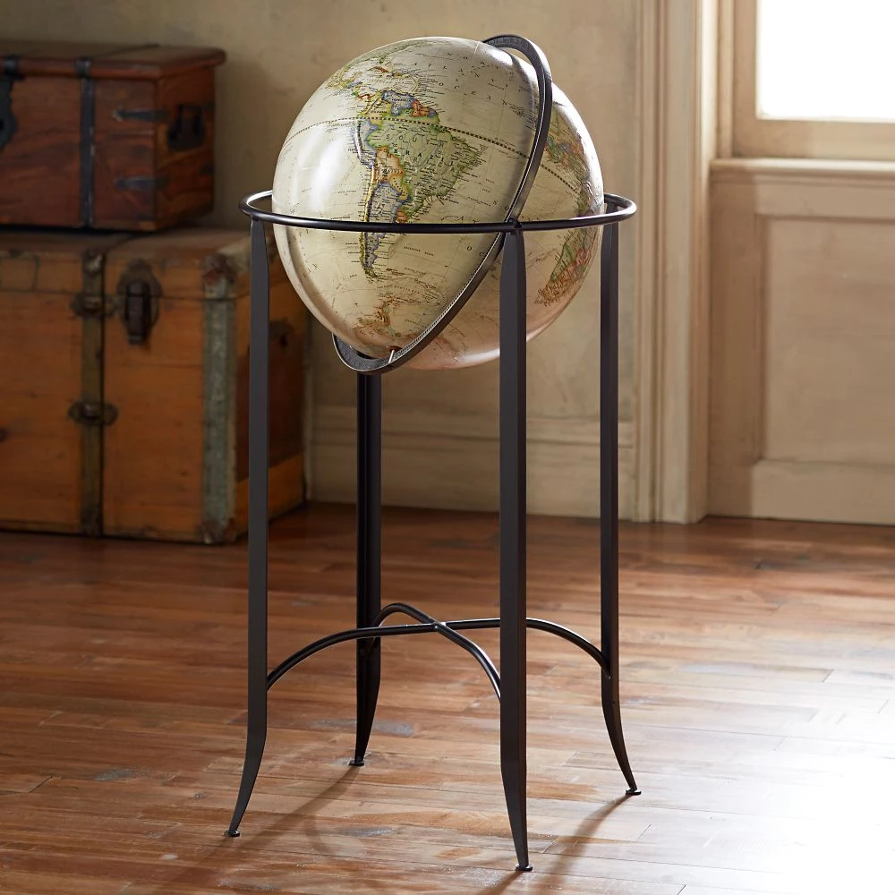
Introduction
Newton and your sick stomach
  Newton’s 2nd Law applies to a fixed coordinate frame
  Because you and I and our observing systems ‘spin,’ a geocentric (non-intertial) reference frame is natural
  Must take into account the ‘spin’ of our geocentric reference frame to apply Newton’s 2nd Law
    Apparent forces; centrifugal force and Coriolis force
As you and I ‘rest’ in RRO 238, the world (and ASOS and sounding stations) spin at ~800 mph at our latitude
https://shop.nationalgeographic.com/products/national-geographic-hillary-globe?gclid=EAIaIQobChMIhvvEkq_M5gIVAoiGCh13zwwLEAQYCCABEgLw9PD_BwE

Slide 24
Introduction
Newton and your sick stomach
  Although the angular velocity of the object is constant, its direction is not; hence there’s a net acceleration
  For a frame o’ reference spinning with the object, the string force must be balanced by an apparent force (since it’s not accelerating); Centrifugal force
Centripetal acceleration

Slide 25
Introduction
Newton and your sick stomach
  For a frame o’ reference spinning with the object, the string force must be balanced by an apparent force (since it’s not accelerating); Centrifugal force
Centripetal acceleration

Slide 26
Introduction
Newton and your sick stomach
  Where Ω is the earth’s rotation rate [=7.292 x 10⁻⁵ rad s⁻¹]. Note gravity is the vector sum between the true force of gravity (g*) and centripetal acceleration.
Centripetal acceleration

Slide 27
Introduction
Newton and your sick stomach
  Also note that g is NOT directed toward the center of the earth, but is perpendicular to geopotential (Φ). Horizontal surfaces on the earth (oblate spheroid) are surfaces of constant geopotential.
Centripetal acceleration

Slide 28
Introduction
Newton and your sick stomach
  …required to apply Newton’s 2nd Law if an object is changing its position on the earth’s surface.
Coriolis force…

Slide 29

Introduction
Newton and your sick stomach
  where the first column on the right-hand-side (rhs) is related to the Coriolis force and the second column on the rhs is related to curvature effects
Coriolis force

Slide 30
Introduction
Newton and your sick stomach
Coriolis force for synoptic scale motions [ ]

Slide 31
Introduction
Newton and your sick stomach
Coriolis force for synoptic scale motions [ ]
Recall the right-hand-rule and cross products
Co can only change the direction of Polly’s motion, not her speed

Slide 32
Introduction
Newton and your sick stomach
  deflection is to the right (left) in the Northern (Southern) Hemisphere
  ‘strength’ of Co depends on
  [1] speed of horizontal wind (u=dx/dt, v=dy/dt)
  [2] latitude of object
  [3] rotation rate of earth
  is negligible for motions with time scales that are very short compared to the period of earth’s rotation (such as draining toilets after having been flushed)
Coriolis force

Slide 33
Introduction
Vertical aspects of the atmosphere
  ATMS 305 and ATMS 455 address processes responsible for changing the available ‘fuel’ for atmospheric disturbances at different scales
A static (unmoving and unchanging) atmosphere…

Slide 34
Introduction
Vertical aspects of the atmosphere
  Balance between gravity force and vertical pressure gradient force
  An excellent approximation for synoptic scale (and larger) atmospheric disturbances
Hydrostatic balance

Slide 35
Introduction
Vertical aspects of the atmosphere
  Pressure decreases more rapidly with height in a cold layer than in a warm layer
  In an isothermal atmosphere, pressure decreases exponentially with geopotential height by a factor of e⁻¹ per scale height
Hydrostatic balance + ideal gas law = hypsometric equation

Slide 36
Introduction
Vertical aspects of the atmosphere
hypsometric equation
ΔZ =

Slide 37
Introduction
Vertical aspects of the atmosphere
  Thickness of the layer between two isobaric surfaces is proportional to the layer mean temperature
hypsometric equation

Slide 38
Introduction
Vertical aspects of the atmosphere
Isobaric vertical coordinates

Slide 39
Introduction
Vertical aspects of the atmosphere
  transform from height to pressure (isobaric) vertical coordinates
Isobaric vertical coordinates

Slide 40
Introduction
Vertical aspects of the atmosphere
Isobaric vertical coordinates

Slide 41
Introduction
Vertical aspects of the atmosphere
What is ‘missing’ in the horizontal PGF expressions of the isobaric vertical coordinate system (rhs)?
Isobaric vertical coordinates
density ---> cannot be accurately observed, a great advantage of using isobaric vertical coordinates

Slide 42
Introduction
Vertical aspects of the atmosphere
Other vertical coordinates…

Slide 43
Introduction
Vertical aspects of the atmosphere
  where ‘s’ is an atmospheric variable changing in the vertical such that it either continually increases or decreases with height
Other vertical coordinates

Slide 44
Introduction
Vertical aspects of the atmosphere
  Examples in NWP…
  [1] sigma (normalized pressure, σ =1 at the ground), useful in regions of strong topographic variations
  [2] isentropic [θ ]…to be seen later in this course and in ATMS 410 and 411
Other vertical coordinates

