Slide 1
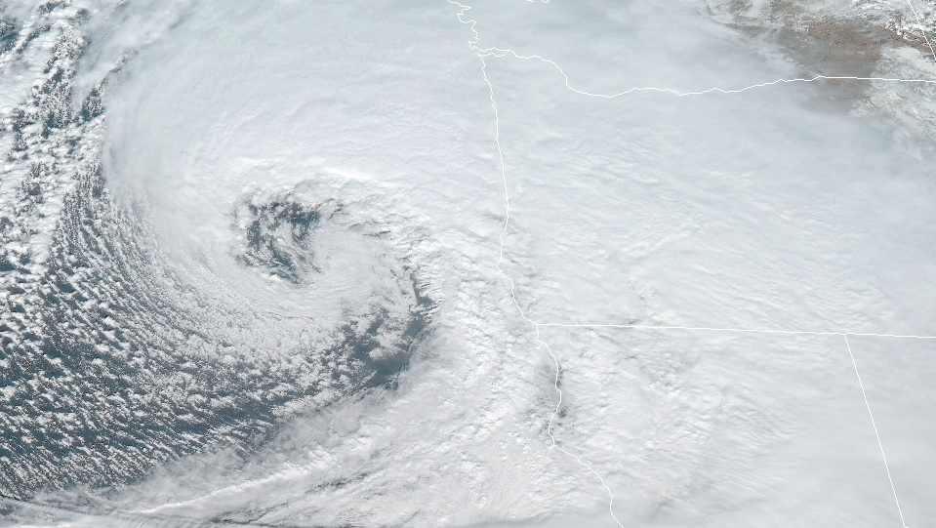
Circulation and Vorticity
Kinematics and Dynamics

Slide 2

Circulation and Vorticity
Outline of this lecture packet…
  The circulation theorem
  Vorticity
  Potential vorticity
  The vorticity equation
  Vorticity in barotropic fluids
  The baroclinic (Ertel) potential vorticity equation

Slide 3

Circulation and Vorticity
The circulation theorem
  Conserved properties provide constraints on motions of the atmosphere that can be exploited for diagnostic and prognostic (forecast) purposes
  Conservation of angular momentum is used typically when solid body rotation is involved (e.g., planets)
Introduction
https%3A%2F%2Fthewoodenwagon.com%2Fwoodentoy%2FGM2434B.html&psig=AOvVaw3q-quZYoPcWb6SsJ_n-HKR&ust=1577806876986264

Slide 4
Circulation and Vorticity
The circulation theorem
  …used typically when solid body rotation is involved (e.g., planets)
  …analog is used for rotation of a fluid, two primary measures;
  [1] circulation – a scalar integral quantity, a macroscopic measure of rotation for a finite area of the fluid
  [2] vorticity – a vector field that gives a microscopic measure of the rotation at any point in the fluid
Conservation of angular momentum

Slide 5
Circulation and Vorticity
The circulation theorem
  The circulation, C, about a closed contour in a fluid is defined as the line integral
evaluated along the contour of the component of the velocity vector that is locally
tangent to the contour
Definition

Slide 6
Circulation and Vorticity
The circulation theorem
  The circulation, C, about a closed contour in a fluid is defined as the line integral
Definition

Slide 7
Circulation and Vorticity
The circulation theorem
circular ring of fluid of radius R in solid-body rotation at angular velocity about the z axis
  U = Ω × R, where R is the distance from the axis of rotation to the ring of fluid
  Unlike angular momentum or angular velocity, circulation can be computed without reference to an axis of rotation; it can thus be used to characterize fluid rotation in situations where “angular velocity” is not defined easily.
A solid-body-like rotation example

Slide 8
Circulation and Vorticity
The circulation theorem
line integral of Newton’s 2nd Law about a closed loop
  For a barotropic fluid (density a function of pressure alone), the solenoidal term is zero. Absolute circulation is conserved following motion [Kelvin’s circulation theorem].
Where does it come from?

Slide 9
Circulation and Vorticity
The circulation theorem
Earth’s circulation…
Relative circulation is useful for meteorological applications

Slide 10
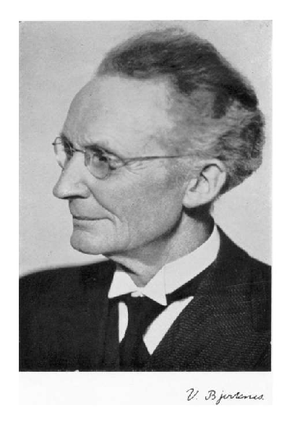
Circulation and Vorticity
The circulation theorem
Relative circulation…
Relative circulation is useful for meteorological applications
Zero for a barotropic fluid
a.k.a., Vilhelm’s ticket out of theoretical physics

Slide 11
Circulation and Vorticity
The circulation theorem
  Equation (4.6) indicates that in a barotropic fluid the relative circulation for a closed chain of fluid particles will be changed if either
  [1] horizontal area enclosed by the loop changes or
  [2] the latitude changes
Relative circulation change in a barotropic fluid

Slide 12
Circulation and Vorticity
The circulation theorem
  From Eq. (4.3) it is apparent that circulation can develop in a baroclinic fluid (solenoidal term is non-zero)
  Sea-breeze example…
Relative circulation change in a baroclinic fluid

Slide 13
Circulation and Vorticity
The circulation theorem
Relative circulation change in a baroclinic fluid
cold
warm
constant pressure at surface

Slide 14
Circulation and Vorticity
The circulation theorem
  From Eq. (4.3) it is apparent that circulation can develop in a baroclinic fluid (solenoidal term is non-zero)
  Sea-breeze example…
Relative circulation change in a baroclinic fluid
mean tangential velocity × circuit path length = circulation

Slide 15
Circulation and Vorticity
Vorticity
  Curl of the velocity
Mathematical definition

Slide 16
Circulation and Vorticity
Vorticity
  Regions of positive ζ are associated with cyclonic storms in the Northern Hemisphere; regions of negative ζ are associated with cyclonic storms in the Southern Hemisphere. Thus, the distribution of relative vorticity is an excellent diagnostic for weather analysis.
Vertical components of absolute and relative vorticity

Slide 17
Circulation and Vorticity
Vorticity
relative, absolute, and planetary vorticity
,

Slide 18
Circulation and Vorticity
Vorticity
  the vertical component of vorticity is defined as the circulation about a closed contour in the horizontal plane divided by the area enclosed, in the limit where the area approaches zero
relative vorticity and circulation

Slide 19
Circulation and Vorticity
Vorticity
  circulation divided by area gives the average normal component of vorticity in the region
  vorticity may thus be regarded as a measure of the local angular velocity of the fluid
relative vorticity and circulation

Slide 20
Circulation and Vorticity
Vorticity
Natural coordinates

Slide 21
Circulation and Vorticity
Vorticity
  net vertical vorticity component is the result of the sum of two parts:
  [1] the rate of change of wind speed normal to the direction of flow –∂V/∂n, called the shear vorticity; and
  [2] the turning of the wind along a streamline V/Rs , called the curvature vorticity
Natural coordinates

Slide 22
Circulation and Vorticity
Vorticity
  [1] the rate of change of wind speed normal to the direction of flow –∂V/∂n, called the shear vorticity; and
  [2] the turning of the wind along a streamline V/Rs , called the curvature vorticity
Natural coordinates

Slide 23
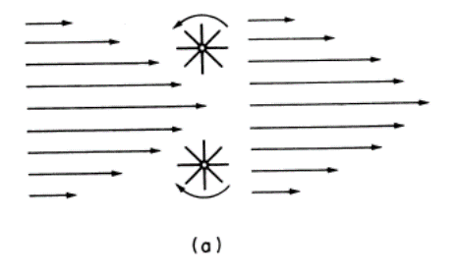
Circulation and Vorticity
Vorticity
  The lower of the two paddle wheels in Fig. 4.6a will turn in a clockwise direction (anticyclonically) because the wind force on the blades north of its axis of rotation is stronger than the force on the blades to the south of the axis.
  The upper wheel will, of course, experience a counterclockwise (cyclonic) turning.
  Thus, the poleward and equatorward sides of a westerly jetstream are referred to as the cyclonic and anticyclonic shear sides, respectively.
Natural coordinates

Slide 24
Circulation and Vorticity
Vorticity
  Conversely, curved flow may have zero vorticity provided that the shear vorticity is equal and opposite to the curvature vorticity.
  The fluid along the inner boundary on the curve flows faster in just the right proportion so that the paddle wheel does not turn.
Natural coordinates

Slide 25
Circulation and Vorticity
Potential vorticity
Adiabatic (isentropic) flow

Slide 26
Circulation and Vorticity
Potential vorticity
  potential vorticity is conserved following motion in frictionless and adiabatic flow
Ertel’s potential vorticity

Slide 27
Circulation and Vorticity
Potential vorticity
Adiabatic (isentropic) flow
initial
final
What must happen to the vortex, if we assume it is moving along at constant latitude?

Slide 28
Circulation and Vorticity
Potential vorticity
In a homogeneous incompressible (constant density) fluid

Slide 29
Circulation and Vorticity
Potential vorticity
Westerly flow
  Westerly zonal flow must remain purely zonal if absolute vorticity (η) is to be conserved following the motion.
Easterly flow
  An easterly current can curve either to the north or to the south and still conserve absolute vorticity.
In a homogeneous incompressible (constant density) fluid with constant depth (h)

Slide 30
Circulation and Vorticity
Potential vorticity
In a homogeneous incompressible (constant density) fluid with variable depth (h) as westerly flow crosses an infinite mtn
1 2 3 4 5

Slide 31
Circulation and Vorticity
Potential vorticity
Start with uniform zonal flow upstream of mountain
  vertical displacement of θ surface at upper levels is spread horizontally; it extends upstream and downstream of the barrier and has smaller amplitude in the vertical than the displacement near the ground
In a homogeneous incompressible (constant density) fluid with variable depth (h) as westerly flow crosses an infinite mtn

Slide 32
Circulation and Vorticity
Potential vorticity
  [1] depth increases just upstream of mountain (ζ must become positive in order to conserve potential vorticity)
  [2] cyclonic curvature causes poleward drift that increases earth’s vorticity (increase in f )
  [3] depth decreases as column crosses mountain (ζ must decrease in order to conserve potential vorticity)
In a homogeneous incompressible (constant density) fluid with variable depth (h) as westerly flow crosses an infinite mtn

Slide 33
Circulation and Vorticity
Potential vorticity
  [3] anti-cyclonic curvature causes equatorward drift that decreases earth’s vorticity
  [4] after passing over mountain (increase in depth [h]), ζ must increase to offset the decrease in earth’s vorticity and conserve potential vorticity
  [5] depth decreases as column moves away from mtn (ζ must decrease in order to conserve potential vorticity)
In a homogeneous incompressible (constant density) fluid with variable depth (h) as westerly flow crosses an infinite mtn

Slide 34
Circulation and Vorticity
Potential vorticity
  as column continues to move away from mtn and maintains a constant depth, its inertia will cause a continuous series of equatorward and poleward oscillations of the column about its original latitude [not shown]
In a homogeneous incompressible (constant density) fluid with variable depth (h) as westerly flow crosses an infinite mtn

Slide 35
Circulation and Vorticity
Potential vorticity
In a homogeneous incompressible (constant density) fluid with variable depth (h) as easterly flow crosses an infinite mtn
3 2 1

Slide 36
Circulation and Vorticity
Potential vorticity
  Let’s predict what will happen as…
  [1] depth increases (h) as column approaches mountain
  [2] depth decreases (h) as column surmounts mountain
  [3] depth increases (h) as column moves away from mtn
In a homogeneous incompressible (constant density) fluid with variable depth (h) as easterly flow crosses an infinite mtn

Slide 37
Circulation and Vorticity
Potential vorticity
  Why the difference between westerly and easterly flow over the mountain?
  => the dependence of the Coriolis parameter on latitude
In a homogeneous incompressible (constant density) fluid with variable depth (h) as flow crosses an infinite mtn

Slide 38
Circulation and Vorticity
Potential vorticity
In a barotropic fluid (density a function of pressure only)
Rossby potential vorticity conservation law

Slide 39
Circulation and Vorticity
Potential vorticity
  as a column moves inward in a rotating vessel (solid body rotation), its absolute vorticity decreases as it moves toward the axis of rotation
  to conserve potential vorticity, its depth must also decrease
  The same result would apply if a column of fluid on a rotating sphere were moved equatorward without a change in depth. In this case, ζ would have to increase to offset the decrease of f .
  Therefore, in a barotropic fluid, a decrease of depth with increasing latitude has the same effect on the relative vorticity as the increase of the Coriolis force with latitude.
In a barotropic fluid (density a function of pressure only)

Slide 40
Circulation and Vorticity
The vorticity equation
  derive an equation for the time rate of change of vorticity without limiting the validity to adiabatic motion
Cartesian coordinate form
vertical coordinate?

Slide 41
Circulation and Vorticity
The vorticity equation
  Divergence term
  If the horizontal flow is divergent, the area enclosed by a chain of fluid parcels will increase with time and if circulation is to be conserved, the average absolute vorticity of the enclosed fluid must decrease (i.e., the vorticity will be diluted).
Cartesian coordinate form

Slide 42
Circulation and Vorticity
The vorticity equation
  Tilting or twisting term
  represents vertical vorticity generated by the tilting of horizontally oriented components of vorticity into the vertical by a nonuniform vertical motion field.
Cartesian coordinate form

Slide 43
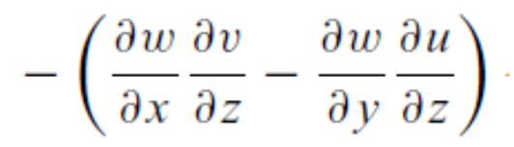
Circulation and Vorticity
The vorticity equation
  Tilting or twisting term
Cartesian coordinate form
Example; generation of positive vertical vorticity

Slide 44
Circulation and Vorticity
The vorticity equation
  Solenoidal term
  is just the limit of the solenoidal term in the circulation theorem [Eq. (4.5)] divided by the area when the area goes to zero
Cartesian coordinate form

Slide 45
Circulation and Vorticity
The vorticity equation
  derive an equation for the time rate of change of vorticity without limiting the validity to adiabatic motion
  No solenoidal term (horizontal derivatives are taken with respect to constant pressure surfaces rather than on constant height surfaces)
Isobaric vertical coordinates

Slide 46
Circulation and Vorticity
The vorticity equation
Scale analysis

Slide 47
Circulation and Vorticity
The vorticity equation
Scale analysis

Slide 48
Circulation and Vorticity
The vorticity equation
Scale analysis
+

Slide 49
Circulation and Vorticity
The vorticity equation
  Therefore, scale analysis of the vorticity equation indicates that synoptic-scale motions must be quasi-non-divergent.
Scale analysis

Slide 50
Circulation and Vorticity
The vorticity equation
  the concentration or dilution of absolute vorticity leads to changes in absolute vorticity following the motion
Scale analysis

Slide 51
Circulation and Vorticity
The vorticity equation
  demonstrates why cyclonic disturbances can be much more intense than anticyclones (ζ → −f )
Scale analysis

Slide 52
Circulation and Vorticity
The vorticity equation
  scaling used to derive Eq. (4.22b) is invalid in the vicinity of fronts [TBD in Synoptic II]
Scale analysis

Slide 53
Circulation and Vorticity
Vorticity in barotropic fluids
  a homogeneous incompressible fluid of variable depth, h(x, y, t) = z2 − z1, where z2 and z1 are the heights of the upper and lower boundaries, respectively.
Barotropic model

Slide 54
Circulation and Vorticity
Vorticity in barotropic fluids
The Barotropic (Rossby) Potential Vorticity Equation

Slide 55
Circulation and Vorticity
Vorticity in barotropic fluids
The Barotropic Vorticity Equation

Slide 56
Circulation and Vorticity
Vorticity in barotropic fluids
The Barotropic Vorticity Equation, nondivergent flow

Slide 57
Circulation and Vorticity
The baroclinic (Ertel) potential vorticity equation
Horizontal momentum equation in isentropic coordinates

Slide 58
Circulation and Vorticity
The baroclinic (Ertel) potential vorticity equation
Isentropic vertical coordinates

Slide 59
Circulation and Vorticity
The baroclinic (Ertel) potential vorticity equation
  When the diabatic and frictional terms are small, potential vorticity is approximately conserved following the motion on isentropic surfaces.
Potential vorticity equation

Slide 60
Circulation and Vorticity
The baroclinic (Ertel) potential vorticity equation
  weather disturbances having sharp gradients in dynamical fields, such as jets and fronts, are associated with large anomalies in the Ertel potential vorticity
  potential vorticity anomalies are particularly useful in identifying and tracing the evolution of meteorological disturbances
Potential vorticity equation

Slide 61
Circulation and Vorticity
The baroclinic (Ertel) potential vorticity equation
Constraints on isentropic vorticity
horizontal divergence
friction and diabatic forcing
horizontal flux vector

Slide 62
Circulation and Vorticity
The baroclinic (Ertel) potential vorticity equation
  Vorticity cannot be changed by vertical transfer across the isentropes.
  For an isentrope that does not intersect the surface of the earth the global average of ζ_{θ} is constant.
  Integration of ζ_{θ} over the sphere shows that the global average ζ_{θ} is exactly zero.
  Vorticity on such an isentrope is neither created nor destroyed; it is merely concentrated or diluted by horizontal fluxes along the isentropes.
Constraints on isentropic vorticity

