Slide 1
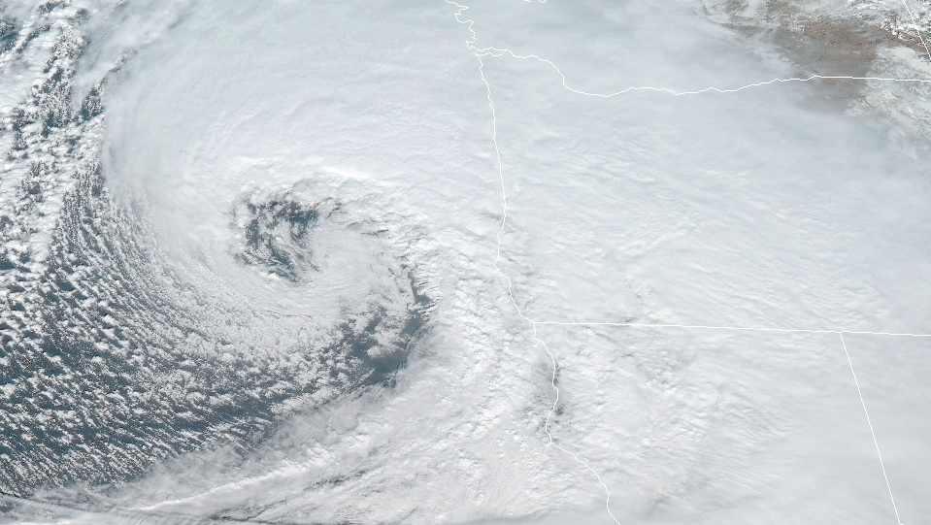
Applications of the Basic Equations
Kinematics and Dynamics

Slide 2

Applications of the Basic Equations
Outline of this lecture packet…
  Basic equations in isobaric coordinates
  Balanced flow
  Trajectories and streamlines
  The thermal wind
  Vertical motion
  Computer weather model considerations
  Surface pressure tendency

Slide 3
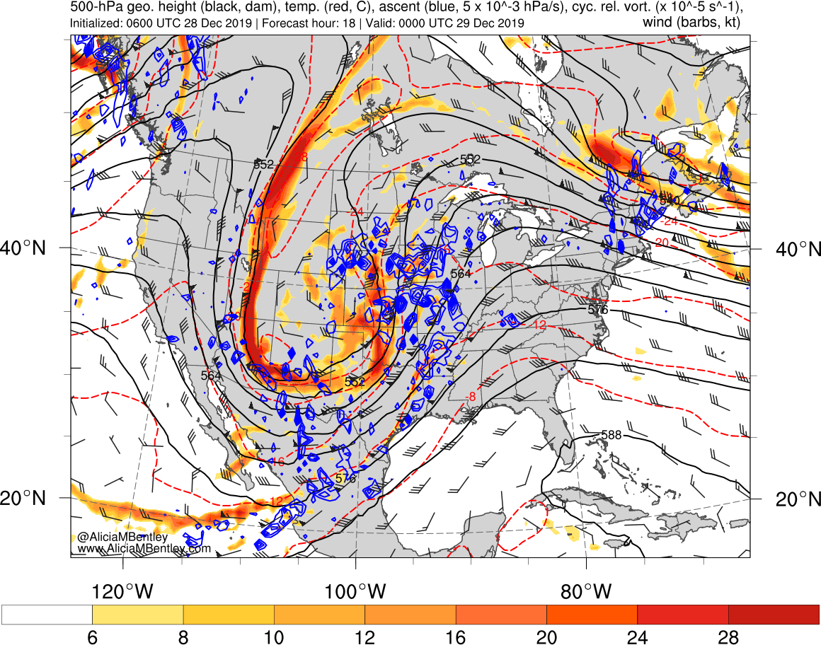
Applications of the Basic Equations
Basic equations in isobaric coordinates
  We learned in lecture packet (LP) #1 an advantage of using constant pressure (isobaric) vertical coordinates; elimination of the density term in the expression of the ____________ ____________ force
Horizontal momentum equation
http://www.atmos.albany.edu/student/abentley/realtime/standard.php?domain=conus&variable=rel_vort

Slide 4
Applications of the Basic Equations
Basic equations in isobaric coordinates
  Vertical coordinate?
Horizontal momentum equation
p

Slide 5
Applications of the Basic Equations
Basic equations in isobaric coordinates
Horizontal momentum equation

Slide 6
Applications of the Basic Equations
Basic equations in isobaric coordinates
  a given geopotential gradient implies the same geostrophic wind at any height (____________ coordinates)
  a given horizontal pressure gradient implies different values of the geostrophic wind depending on the density (height coordinates)
Horizontal momentum equation

Slide 7
Applications of the Basic Equations
Basic equations in isobaric coordinates
  a given geopotential gradient implies the same geostrophic wind at any height (isobaric coordinates)
  a given horizontal pressure gradient implies different values of the geostrophic wind depending on the density ( height coordinates, see Eq. (2.23) )
Horizontal momentum equation
Is the geostrophic wind ____________ (assuming constant f )?

Slide 8
Applications of the Basic Equations
Basic equations in isobaric coordinates
Continuity equation

Slide 9
Applications of the Basic Equations
Basic equations in isobaric coordinates
Thermodynamic energy equation

Slide 10
Applications of the Basic Equations
Basic equations in isobaric coordinates
  Thus, S_{p} is positive provided that the lapse rate is less than dry adiabatic. However, because density decreases approximately ____________ with height, S_{p} increases rapidly with height. This strong height dependence of the stability measure S_{p} is a minor disadvantage of isobaric coordinates.
Thermodynamic energy equation

Slide 11
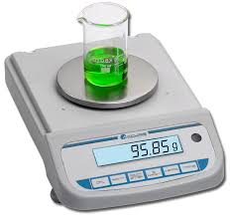
Applications of the Basic Equations
Balanced flow
  To better visualize approximate atmospheric balances observed on the synoptic scale, we assume
  [1] steady state (time independent) flow
  [2] no vertical ____________
Introduction
https%3A%2F%2Fwww.amizonasci.com%2Fproduct%2Fcompact-balance-series-readability-0-1-to-0-01g%2F&psig=AOvVaw0JYfQfb4n4hCCRcxKj2xWw&ust=1577629846547641

Slide 12
Applications of the Basic Equations
Balanced flow
  More straightforward system for visualizing some properties of atmospheric ____________
Natural horizontal coordinates

Slide 13
Applications of the Basic Equations
Balanced flow
Natural horizontal coordinates

Slide 14
Applications of the Basic Equations
Balanced flow
acceleration following Polly Parcel’s motion is the sum of
  the rate of change of speed of the air parcel
  its centripetal acceleration due to the ____________ of the trajectory
Natural horizontal coordinates

Slide 15
Applications of the Basic Equations
Balanced flow
  Coriolis force
  ____________ ____________force
Natural horizontal coordinates

Slide 16
Applications of the Basic Equations
Balanced flow
Natural horizontal coordinates

Slide 17
Applications of the Basic Equations
Balanced flow
  special flow scenarios…
____________ horizontal coordinates
[1]
= 0
[2]
= constant

Slide 18
Applications of the Basic Equations
Balanced flow
Natural horizontal coordinates – geostrophic flow

Slide 19
Applications of the Basic Equations
Balanced flow
  “inertial flow” governed by (3.12) is not the same as inertial motion in an absolute reference frame
  The flow governed by (3.12) is just the constant angular ____________ oscillation referred to in Section 1.5.4
Natural horizontal coordinates – inertial flow

Slide 20
Applications of the Basic Equations
Balanced flow
  In the atmosphere, motions are nearly always generated and maintained by pressure gradient forces; the conditions of ____________ pressure required for pure inertial flow rarely exist.
Natural horizontal coordinates – inertial flow

Slide 21
Applications of the Basic Equations
Balanced flow
Natural horizontal coordinates – ____________ flow

Slide 22
Applications of the Basic Equations
Balanced flow
Natural horizontal coordinates – cyclostrophic flow

Slide 23
Applications of the Basic Equations
Balanced flow
  Valid when the Rossby number is large
  => Coriolis force is negligible
  Cyclonic or anticyclonic flow; PGF is always directed toward the center of curvature
  Typical of tornadic flow
Natural horizontal coordinates – cyclostrophic flow

Slide 24
Applications of the Basic Equations
Balanced flow
Natural horizontal coordinates – ____________ wind flow

Slide 25
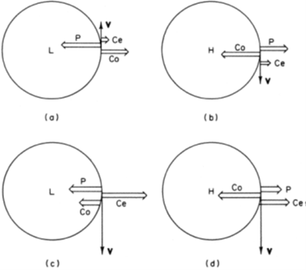
Applications of the Basic Equations
Balanced flow
  a three-way balance among the Coriolis force, the centrifugal force, and the horizontal pressure gradient force
  can exist only under very special circumstances
  it is always possible, however, to define a gradient wind, which at any point is just the wind component parallel to the height contours that satisfies (3.10)
  because (3.10) takes into account the centrifugal force due to the curvature of parcel trajectories, the gradient wind is often a better approximation to the actual wind than the ____________ wind
Natural horizontal coordinates – gradient wind flow

Slide 26
Applications of the Basic Equations
Balanced flow
Natural horizontal coordinates – gradient wind flow

Slide 27
Applications of the Basic Equations
Balanced flow
Natural horizontal coordinates – gradient wind flow

Slide 28
Applications of the Basic Equations
Balanced flow
  Absolute angular momentum =
  Anomalous cases have negative absolute angular momentum. Because the only source of negative absolute angular momentum is the Southern Hemisphere, the anomalous cases are unlikely to occur except perhaps close to the ____________.
Natural horizontal coordinates – gradient wind flow

Slide 29
Applications of the Basic Equations
Balanced flow
Subgeostrophic flow; normal cyclonic flow ( f R > 0), Vg is larger than V
Supergeostrophic flow; ____________ flow ( f R < 0), Vg is smaller than V
Natural horizontal coordinates – gradient wind flow

Slide 30
Applications of the Basic Equations
Trajectories and streamlines
  path followed by a particular air parcel over a finite ____________ of time is called the trajectory of the parcel
Definitions

Slide 31
Applications of the Basic Equations
Trajectories and streamlines
  height contours are actually streamlines of the ____________ wind (i.e., lines that are everywhere parallel to the instantaneous wind velocity)
Definitions

Slide 32
Applications of the Basic Equations
Trajectories and streamlines
  trajectories trace the motion of individual fluid parcels over a finite ____________ interval
  streamlines give a “snapshot” of the velocity field at any ____________
Definitions**
**trajectories and streamlines only coincide under steady state motion fields (when local rate of change of velocity vanishes)

Slide 33
Applications of the Basic Equations
Trajectories and streamlines
  Trajectories; determined by the integration of
  over a finite time span for each parcel to be followed
  Streamlines; determined by the integration of
  with respect to x at time t₀0
Definitions

Slide 34
Applications of the Basic Equations
Trajectories and streamlines
Relationship between R_{t} and R_{s}

Slide 35
Applications of the Basic Equations
Trajectories and streamlines
  Local turning of the wind
Relationship between R_{t} and R_{s} in a moving cyclone

Slide 36
Applications of the Basic Equations
Trajectories and streamlines
  ‘frozen’ (steady state) cyclone moving with ____________ velocity C
Relationship between R_{t} and R_{s} in a moving cyclone

Slide 37
Applications of the Basic Equations
|R_{t}|< > = |R_{s}|?
Trajectories and streamlines
  Local turning of the wind
Relationship between R_{t} and R_{s} in a moving cyclone
Application of Eq. (3.17)

Slide 38
Applications of the Basic Equations
The thermal wind
  Geostrophic wind must have vertical shear in the presence of a horizontal ____________ gradient
Vertical shear of the geostrophic wind

Slide 39
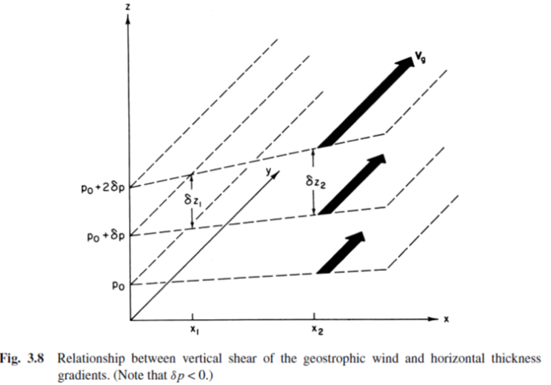
Applications of the Basic Equations
The thermal wind
Vertical shear of the geostrophic wind
∇_{p}T direction?
cold
warm

Slide 40
Applications of the Basic Equations
The thermal wind
Vertical ____________ of the geostrophic wind

Slide 41
Applications of the Basic Equations
The thermal wind
  Equation (3.30) is often referred to as the thermal wind equation. However, it is actually a relationship for the vertical wind shear (i.e., the rate of change of the geostrophic wind with respect to ln p). Strictly speaking, the term thermal wind refers to the vector ____________ between geostrophic winds at two levels.
Vertical shear of the geostrophic wind

Slide 42
Applications of the Basic Equations
The thermal wind
Vertical shear of the geostrophic wind

Slide 43
Applications of the Basic Equations
The thermal wind
Vertical shear of the geostrophic wind

Slide 44
Applications of the Basic Equations
The thermal wind
Vertical shear of the geostrophic wind

Slide 45
Applications of the Basic Equations
The thermal wind
  a geostrophic wind that turns counterclockwise with height (backs) is associated with cold-air ____________
  clockwise turning (veering) of the geostrophic wind with height implies warm advection by the geostrophic wind in the layer
  “Back in time it was cold.”
  => Analog between geostrophic wind, with low heights (pressure) to the left of the wind direction (N.H.); thermal wind, low temperatures (thickness) to the left of the ‘wind’ direction (N.H.)
Vertical shear of the geostrophic wind

Slide 46
Applications of the Basic Equations
The thermal wind
  A ____________ atmosphere is one in which the density depends only on the pressure, ρ = ρ(p), so that isobaric surfaces are also surfaces of constant density
  An atmosphere in which density depends on both the temperature and the pressure, ρ = ρ (p, T ), is referred to as a baroclinic atmosphere
Barotropic and baroclinic atmospheres

Slide 47
Applications of the Basic Equations
The thermal wind
  A very strong constraint on the motions in a rotating fluid; the large-scale motion can depend only on ____________ position and time, not on height.
Barotropic atmosphere

Slide 48
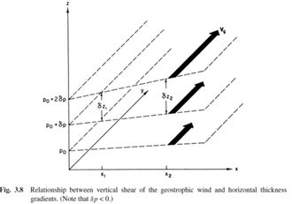
Applications of the Basic Equations
The thermal wind
  In a baroclinic atmosphere the geostrophic wind generally has vertical shear, and this shear is related to the horizontal temperature gradient by the thermal wind equation (3.30). Obviously, the baroclinic atmosphere is of ____________ importance in dynamic meteorology.
Baroclinic atmosphere

Slide 49
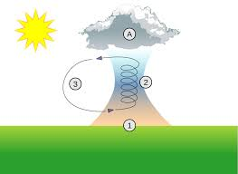
Applications of the Basic Equations
Vertical motion
  vertical velocity is not measured directly but must be inferred from the fields that are measured directly
  [1] kinematic method – continuity equation
  [2] adiabatic method – ____________ ____________equation
Its estimation
https%3A%2F%2Fen.wikipedia.org%2Fwiki%2FThermal&psig=AOvVaw2JHIbng-3_kmxXbe0t4Lof&ust=1577652401134540

Slide 50

Applications of the Basic Equations
Vertical motion
  where
  actual wind = geostrophic + ageostrophic wind
Conversion between omega and w

Slide 51
Applications of the Basic Equations
Vertical motion
Kinematic method – integration of the ____________ equation

Slide 52
Applications of the Basic Equations
Vertical motion
Kinematic method – integration of the continuity equation

Slide 53
Applications of the Basic Equations
Vertical motion
  In order to determine the ____________ divergence, the partial derivatives ∂u/∂x and ∂v/∂y are generally estimated from the fields of u and v by using finite difference approximations
Kinematic method – integration of the continuity equation

Slide 54
Applications of the Basic Equations
Vertical motion
  horizontal divergence is due primarily to the small departures of the wind from geostrophic balance (i.e., the ageostrophic wind)
  a 10% error in evaluating one of the wind components in (3.41) can easily cause the estimated divergence to be in error by ____________%
  for this reason, the continuity equation method is not recommended for estimating the vertical motion field from observed horizontal winds
Kinematic method – integration of the continuity equation

Slide 55
Applications of the Basic Equations
Vertical motion
  advantage; temperature advection can usually be estimated quite accurately in ____________ by using geostrophic winds
  disadvantage; the local rate of change of temperature is required => difficult to accurately estimate ∂T /∂t over a wide area, especially in instances of heavy rainfall (strong diabatic heating)
Adiabatic method – thermodynamic energy equation

Slide 56

Applications of the Basic Equations
Computer weather model considerations
  objective of a computer weather forecast model is to predict the future state of the atmospheric circulation from knowledge of its present state by use of numerical approximations to the ____________ equations
Introduction [Chapter 13]
https%3A%2F%2Fwww.top500.org%2Fnews%2Fjuwels-becomes-germanys-most-powerful-supercomputer%2F&psig=AOvVaw0dzV_mAzimZYdYsxJS5Nqe&ust=1577656927490960

Slide 57
Applications of the Basic Equations
Computer weather model considerations
  involve points at equal distances on either side of x₀, they are called ____________ differences
Approximations of horizontal derivatives

Slide 58
Applications of the Basic Equations
Computer weather model considerations
Approximation of time tendency

Slide 59
Applications of the Basic Equations
Computer weather model considerations
  it (time difference scheme) has disadvantages in that it introduces a spurious “computational” mode and has stringent requirements on the maximum value permitted for the ____________ number.
Approximation of time tendency

Slide 60
Applications of the Basic Equations
Computer weather model considerations
  if the difference equations are not stable, numerical solutions will exhibit ____________ growth even when, as in the case of the linear advection equation, the original differential equation system has solutions whose amplitudes remain constant in time
Computational stability

Slide 61
Applications of the Basic Equations
Computer weather model considerations
Computational stability

Slide 62
Applications of the Basic Equations
Computer weather model considerations
Approximation of time tendency

Slide 63
Applications of the Basic Equations
Computer weather model considerations
  In the situation shown in Fig. 13.1, σ = 1.5. Examination of the centered difference system (13.8) shows that the numerical solution at point A in Fig. 13.1 depends only on grid points within the shaded region of the figure.
Approximation of time tendency

Slide 64
Applications of the Basic Equations
Computer weather model considerations
  because A lies on the characteristic line x−ct = 0, the true solution at point A depends only on the initial condition at x = 0 (i. e., a parcel which is initially at the origin will be advected to the point 3δx in time 2δt)
  the numerical solution cannot possibly faithfully reproduce the solution to the original differential equation since, as shown in Fig. 13.1, the value at point A in the numerical solution has no ____________ on the conditions at x = 0
Approximation of time tendency

Slide 65
Applications of the Basic Equations
Computer weather model considerations
  Although the CFL condition (13.18) guarantees stability of the centered difference approximation to the one-dimensional advection equation, in general the CFL criterion is only a necessary and not sufficient condition for computational ____________.
Approximation of time tendency

Slide 66
Applications of the Basic Equations
Computer weather model considerations
  Use of simplified basic equations (assume nearly geostrophic and hydrostatic balance) to filter out unwanted phenomena (e.g., sound and gravity waves)
  => c < 100 m s⁻¹−1 (maximum wind speed w/o sound and gravity waves), for a grid interval of 200 km a time increment of over 30 min is ____________.
Another means to insure computational stability

Slide 67
Applications of the Basic Equations
Computer weather model considerations
  Required for limited area models (e.g., NAM, HRRR)
  An outer ‘zone’ of blended fields from the forecast model and its ‘mother’ gridded fields (e.g., GFS)
  Allows the computation of horizontal ____________ along the outer edge of the model
Lateral boundary conditions

Slide 68
Applications of the Basic Equations
Computer weather model considerations
  Required for ALL computer weather models
  Needed to start the time tendency portion of the governing equations
  Data assimilation – process of creating initial ____________ that are a blend of
  [1] observations at locations of observing platforms (e.g., ASOS, satellites, radars)
  [2] a gridded ‘first guess’ field, typically an old forecast from a previous computer weather model simulation, at locations lacking observations
Initial conditions

Slide 69
Applications of the Basic Equations
Surface pressure tendency
  the surface pressure tendency at a given point is determined by the total convergence of mass into the vertical column of atmosphere above that point
  => a direct consequence of the hydrostatic assumption, which implies that the pressure at a point is determined solely by the ____________ of the column of air above that point
Falling pressure on Aunt Matilda’s barometer -> stormy

Slide 70
Applications of the Basic Equations
Surface pressure tendency
  ∇・V is difficult to compute accurately from observations because it depends on the ageostrophic wind field
  there is a strong tendency for vertical compensation (when there is convergence in the lower troposphere there is divergence aloft, and vice versa)
  net integrated convergence or divergence is a small residual in the vertical integral of a ____________ determined quantity
Falling pressure on Aunt Matilda’s barometer -> stormy

Slide 71
Applications of the Basic Equations
Surface pressure tendency
Application of Eq. (3.44) to a thermal cyclone

Slide 72
Applications of the Basic Equations
Surface pressure tendency
  heat source generates a local warm anomaly in the mid-troposphere
  heights of the upper level pressure surfaces are raised above the warm anomaly
  horizontal pressure gradient force at the upper levels drives a ____________ upper level wind
Application of Eq. (3.44) to a thermal cyclone

Slide 73
Applications of the Basic Equations
Surface pressure tendency
  By (3.44) this upper level divergence will initially cause the surface pressure to decrease, thus generating a surface low below the warm anomaly (Fig. 3.11b)
  The horizontal pressure gradient associated with the surface low then drives a low-level _____________ and vertical circulation, which tends to compensate the upper level divergence
  The degree of compensation between upper divergence and lower convergence will determine whether the surface pressure continues to fall, remains steady, or rises
Application of Eq. (3.44) to a thermal cyclone

Slide 74
Applications of the Basic Equations
Surface pressure tendency
Isobaric vertical coordinates

