Slide 1
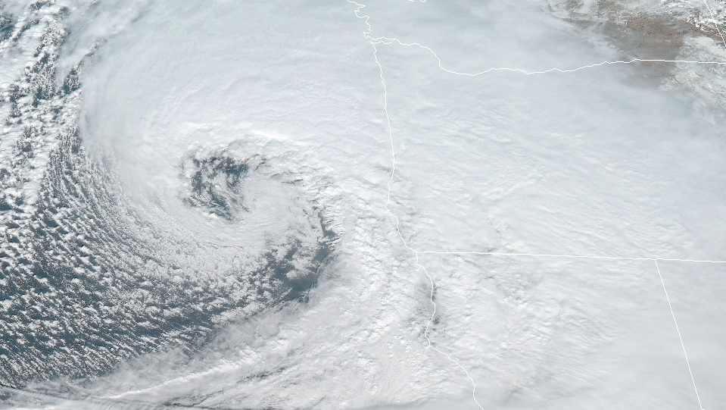
Basic Conservation Laws
Kinematics and Dynamics

Slide 2

Basic Conservation Laws
Outline of this lecture packet…
  Introduction
  Eulerian and Lagrangian frameworks
  Momentum equations on a rotating planet
  Momentum equations in spherical coordinates
  Scale analysis of equations of motion
  Continuity equation (conservation of mass)
  Thermodynamic energy eqtn (conservation of energy)
  Thermodynamics Review

Slide 3

Basic Conservation Laws
Introduction
  Our computer weather models are successful because they are guided by equations that represent the conservation of mass, momentum, energy, and moisture
  The first three quantities are the current focus; assume a ‘dry’ (unsaturated) atmosphere [we can make life simpler by neglecting phase changes of water]
Conservation principles
https%3A%2F%2Fwww.discogs.com%2FZZ-Top-La-Grange%2Frelease%2F8972626&psig=AOvVaw3KRosJ4UAxBAGTUkB6l7g8&ust=1577542891012579

Slide 4
Basic Conservation Laws
Introduction
  Eulerian – control volume whose position is fixed relative to the coordinate system
  Lagrangian – control volume moves about following the motion of the fluid; always contains the same fluid particles
Frames of reference

Slide 5

Basic Conservation Laws
Eulerian and Lagrangian frameworks
  Eulerian – local derivative; rate of change of a field variable (e.g., u, v, w, T, ρ,) at a fixed point
  Lagrangian – total derivative; rate of change of a field variable following fluid motion
Relationship between the two frameworks

Slide 6
Basic Conservation Laws
Eulerian and Lagrangian frameworks
  Lagrangian – total derivative; rate of change of a field variable following fluid motion. Example: change in temperature following Polly, Taylor series expansion…
Relationship between the two frameworks

Slide 7

Basic Conservation Laws
Eulerian and Lagrangian frameworks
Relationship between the two frameworks

Slide 8

Basic Conservation Laws
Eulerian and Lagrangian frameworks
Relationship between the two frameworks
total
local
advection

Slide 9
Basic Conservation Laws
Eulerian and Lagrangian frameworks
The local (Eulerian) rate of change of a property is the total (Lagrangian) rate of change plus advection (moving stuff around)
Relationship between the two frameworks
> 0, winds blow from warm air; warm air advection
< 0, winds blow from cold air; cold air advection

Slide 10
Basic Conservation Laws
Eulerian and Lagrangian frameworks
  A property is conserved following an air parcel if the total derivative of a property is zero
    Local change in the property is due entirely to advection
Relationship between the two frameworks

Slide 11

Basic Conservation Laws
Momentum equations on a rotating planet
How to make Newton’s 2nd Law applicable…
Consequence of a rotating frame of reference
A is an arbitrary vector
https%3A%2F%2Fwww.dailyfx.com%2Fforex%2Feducation%2Ftrading_tips%2Fdaily_trading_lesson%2F2019%2F06%2F13%2Fspinning-top-candlestick.html&psig=AOvVaw3oBw7EyWm-EKfV_eEVnd8c&ust=1577546734238985

Slide 12
Basic Conservation Laws
Ω
Momentum equations on a rotating planet
How to make Newton’s 2nd Law applicable…

Slide 13

Basic Conservation Laws
Momentum equations in rotating coordinates
Newton’s 2nd Law…
https%3A%2F%2Fwww.justwatch.com%2Fus%2Ftv-show%2Fplanet-earth%2Fseason-1&psig=AOvVaw0EoqYX2YhdVqHwzxNwaixg&ust=1577553659999214

Slide 14
Basic Conservation Laws
Momentum equations in rotating coordinates
Newton’s 2nd Law…

Slide 15
Basic Conservation Laws
Momentum equations in rotating coordinates
Newton’s 2nd Law…
Centripetal acceleration
Coriolis acceleration
Fundamental forces acceleration

Slide 16
Basic Conservation Laws
Momentum equations in rotating coordinates
Newton’s 2nd Law…

Slide 17
Basic Conservation Laws
Momentum equations in rotating coordinates
  Equation (2.8) states that the acceleration following the relative motion in the rotating frame equals the sum of the Coriolis force, the pressure gradient force, effective gravity, and friction.
  This form of the momentum equation is basic to most work in dynamic meteorology.
What vertical coordinate system?...

Slide 18
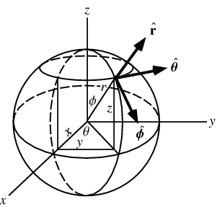
Basic Conservation Laws
Momentum equations in spherical coordinates
coordinate axes are (λ, φ, z), where λ is longitude, φ is latitude, and z is the vertical distance above the surface of the earth
unit vectors i, j, and k are now taken to be directed eastward, northward, and upward
Useful form for NWP and other applications
http%3A%2F%2Fmathworld.wolfram.com%2FSphericalCoordinates.html&psig=AOvVaw2jutw5oW2xoAWSx0Ob61Xe&ust=1577555707053107

Slide 19
Basic Conservation Laws
Momentum equations in spherical coordinates
unit vectors i, j, and k are directed eastward, northward, and upward
Useful form for NWP and other applications

Slide 20
Basic Conservation Laws
Momentum equations in spherical coordinates
  Dx = a cosφ Dλ and Dy = a Dφ.
  u ≡ Dx/Dt and v ≡ Dy/Dt, horizontal components in the eastward and northward directions, respectively
Useful form for NWP and other applications

Slide 21
Basic Conservation Laws
Momentum equations in spherical coordinates
Useful form for NWP and other applications
rotating frame of reference

Slide 22
Basic Conservation Laws
Momentum equations in spherical coordinates
  Expansion of force components in Eq. (2.8)
Useful form for NWP and other applications

Slide 23
Basic Conservation Laws
Momentum equations in spherical coordinates
Coriolis force

Slide 24
Basic Conservation Laws
Momentum equations in spherical coordinates
Pressure gradient force

Slide 25
Basic Conservation Laws
Momentum equations in spherical coordinates
Gravitational force

Slide 26
Basic Conservation Laws
Momentum equations in spherical coordinates
Frictional force

Slide 27
Basic Conservation Laws
Momentum equations in spherical coordinates
Terms proportional to 1/a on the left-hand sides in (2.19)–(2.21) are called curvature terms; they arise due to the curvature of the earth.
Component form of momentum equations

Slide 28
Basic Conservation Laws
Momentum equations in spherical coordinates
  Eqs. (2.19)–(2.21) are nonlinear partial differential equations. The presence of nonlinear advection processes is one reason that dynamic meteorology is an interesting and challenging subject.
Component form of momentum equations

Slide 29
Basic Conservation Laws
Momentum equations in spherical coordinates
  The presence of nonlinear advection processes is one reason that dynamic meteorology is an interesting and challenging subject.
Component form of momentum equations

Slide 30
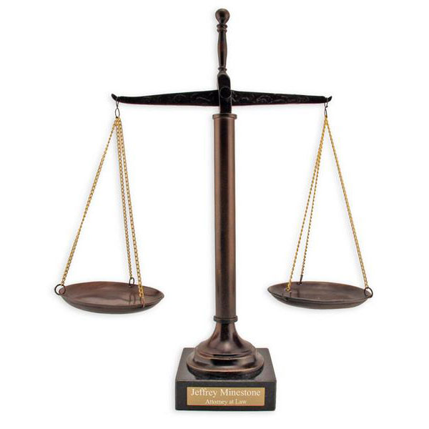
Basic Conservation Laws
Scale analysis of equations of motion
  The complete equations of motion [(2.19)–(2.21)] describe all types and scales of atmospheric motions. Sound waves, for example, are a perfectly valid class of solutions to these equations.
Component form of momentum equations

Slide 31
Basic Conservation Laws
Scale analysis of equations of motion
  Elimination of terms on scaling considerations not only has the advantage of
  [1] simplifying the mathematics,
  [2] the elimination of small terms in some cases has the very important property of completely eliminating or filtering an unwanted type of motion (e.g., sound waves).
  Focus on weather ‘animals’ (phenomena) relevant to the synoptic scale
NWP applications
https://www.memorablegifts.com/gifts/pc/Scales-of-Justice-Sculpture-p2452.htm

Slide 32
Basic Conservation Laws
Scale analysis of equations of motion
NWP applications – synoptic scale
Note!!

Slide 33
Basic Conservation Laws
Scale analysis of equations of motion
Synoptic scale

Slide 34
Basic Conservation Laws
Scale analysis of equations of motion
Synoptic scale
Important near the ground; where atmospheric motions have substantial vertical shear

Slide 35
Basic Conservation Laws
Scale analysis of equations of motion
Synoptic scale - geostrophic approximation and geostrophic wind
approximate balance

Slide 36
Basic Conservation Laws
Scale analysis of equations of motion
Synoptic scale - geostrophic approximation and geostrophic wind

Slide 37
Basic Conservation Laws
Scale analysis of equations of motion
geostrophic wind

Slide 38
Basic Conservation Laws
Scale analysis of equations of motion
Approximate Prognostic Equations; the Rossby Number

Slide 39
Basic Conservation Laws
Scale analysis of equations of motion
Approximate Prognostic Equations; the Rossby Number

Slide 40
Basic Conservation Laws
Scale analysis of equations of motion
  Applications of these equations in weather prognosis is difficult because acceleration (which must be measured accurately) is given by the small difference between two large terms. Thus, a small error in measurement of either velocity or pressure gradient will lead to very large errors in estimating the acceleration.
Approximate Prognostic Equations; the Rossby Number

Slide 41
Basic Conservation Laws
Scale analysis of equations of motion
  A convenient measure of the magnitude of the acceleration compared to the Coriolis force may be obtained by forming the ratio of the characteristic scales for the acceleration and the Coriolis force terms: (U²/L)/(f₀U). This ratio is a nondimensional number called the Rossby number after the Swedish meteorologist C. G. Rossby (1898–1957) and is designated by
  Thus, the smallness of the Rossby number is a measure of the validity of the geostrophic approximation.
the Rossby Number

Slide 42
Basic Conservation Laws
Scale analysis of equations of motion
The Hydrostatic Approximation
approximate balance
hydrostatic equilibrium - the pressure at any point is equal to the weight of a unit cross-section column of air above that point

Slide 43
Basic Conservation Laws
Scale analysis of equations of motion
The Hydrostatic Approximation

Slide 44
Basic Conservation Laws
Continuity equation
  Eulerian – control volume whose position is fixed relative to the coordinate system
  Lagrangian – control volume moves about following the motion of the fluid; always contains the same fluid particles
Conservation of mass – two methods of derivation…

Slide 45
Basic Conservation Laws
Continuity equation
Eulerian derivation…

Slide 46
Basic Conservation Laws
Continuity equation
Eulerian derivation…

Slide 47
Basic Conservation Laws
Continuity equation
Lagrangian derivation…

Slide 48
Basic Conservation Laws
Continuity equation
Lagrangian derivation…

Slide 49
Basic Conservation Laws
Continuity equation
Lagrangian derivation…

Slide 50
Basic Conservation Laws
Continuity equation
Scale analysis
Term A

Slide 51
Basic Conservation Laws
Continuity equation
Scale analysis
Term B

Slide 52
Basic Conservation Laws
Continuity equation
Scale analysis
Term C

Slide 53
Basic Conservation Laws
Continuity equation
  Approximation (2.34) shows that for purely horizontal flow the atmosphere behaves as though it were an incompressible fluid. However, when there is vertical motion the compressibility associated with the height dependence of ρ₀ must be taken into account.
Scale analysis

Slide 54
Basic Conservation Laws
Thermodynamic energy eqtn (conservation of energy)
First Law of Thermodynamics – dry atmosphere

Slide 55
Basic Conservation Laws
Thermodynamic energy eqtn (conservation of energy)
  the change in internal energy of the system is equal to the difference between the heat added to the system and the work done by the system.
First Law of Thermodynamics

Slide 56
Basic Conservation Laws
Thermodynamic energy eqtn (conservation of energy)
First Law of Thermodynamics
body forces work
Total thermodynamic energy
pressure forces work
heat added

Slide 57
Basic Conservation Laws
Thermodynamic energy eqtn (conservation of energy)
First Law of Thermodynamics

Slide 58
Basic Conservation Laws
Thermodynamic energy eqtn (conservation of energy)
subtract Eq. (2.40) from Eq. (2.35)…
First Law of Thermodynamics

Slide 59
Basic Conservation Laws
Thermodynamics Review
Alternate form of the first law of thermodynamics

Slide 60

Basic Conservation Laws
Thermodynamics Review
  Thus, every air parcel has a unique value of potential temperature, and this value is conserved for dry adiabatic motion. Because synoptic scale motions are approximately adiabatic outside regions of active precipitation, θ is a quasi-conserved quantity for such motions.
Potential temperature

Slide 61
Basic Conservation Laws
Thermodynamics Review
  Thus, for reversible processes, fractional potential temperature changes are indeed proportional to entropy changes. A parcel that conserves entropy following the motion must move along an isentropic (constant θ) surface.
Potential temperature

Slide 62
Basic Conservation Laws
Thermodynamics Review
Adiabatic lapse rate

Slide 63
Basic Conservation Laws
Thermodynamics Review
  If Γ< Γ_{d} d so that θ increases with height, an air parcel that undergoes an adiabatic displacement from its equilibrium level will be positively buoyant when displaced downward and negatively buoyant when displaced upward so that it will tend to return to its equilibrium level and the atmosphere is said to be statically stable or stably stratified.
Static stability

Slide 64
Basic Conservation Laws
Thermodynamics Review
Static stability – buoyancy oscillations

Slide 65
Basic Conservation Laws
Thermodynamics Review
  Therefore, if N² > 0, the parcel will oscillate about its initial level with a period τ = 2π/N. The corresponding frequency N is the buoyancy frequency. For average tropospheric conditions, N ≈ 1.2×10⁻¹ s⁻¹ so that the period of a buoyancy oscillation is about 8 min.
Static stability – buoyancy oscillations

Slide 66
Basic Conservation Laws
Thermodynamics Review
Static stability – buoyancy oscillations

Slide 67
Basic Conservation Laws
Thermodynamics Review
Thermodynamic energy equation – scale analysis

Slide 68
Basic Conservation Laws
Thermodynamics Review
Thermodynamic energy equation – scale analysis

